Slide 1
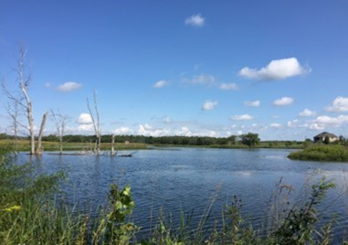
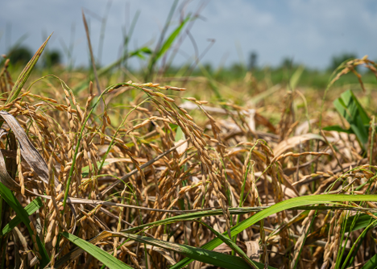

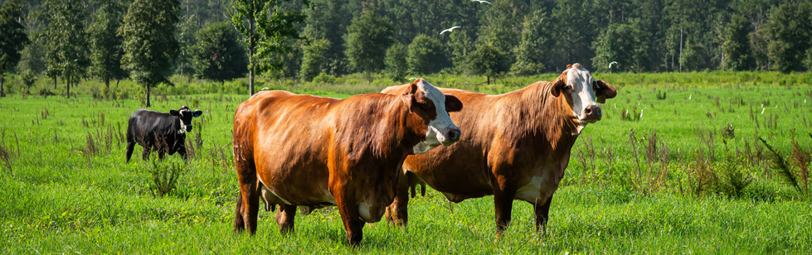
Regenerative Pilot Program

Slide 2
Regenerative Pilot Program
Regenerative agriculture is a conservation management approach that emphasizes natural resources through improved soil health, water management, and natural vitality for the productivity and prosperity of American agriculture and communities. The Regenerative Pilot Program (RPP) is a farmer-first, outcomes-based approach to conservation designed to return the agency to its core mission, helping people help the land, by addressing whole-farm resource concerns through support for voluntary regenerative agriculture Conservation Plans.
NRCS website
https://www.nrcs.usda.gov/programs-initiatives/regenerative-pilot-program

Slide 3
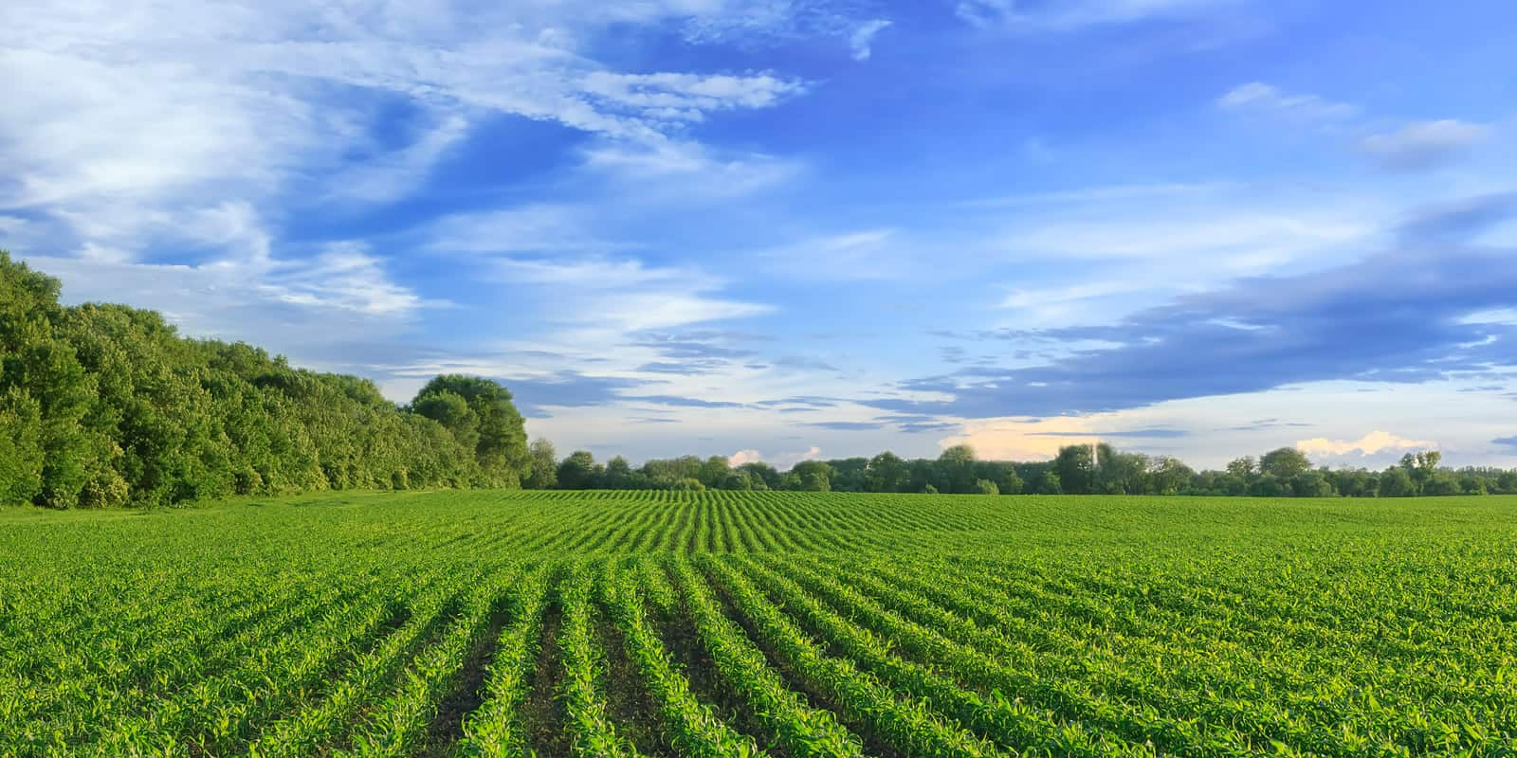
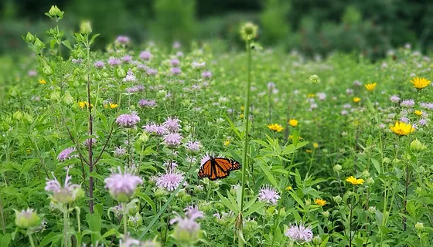
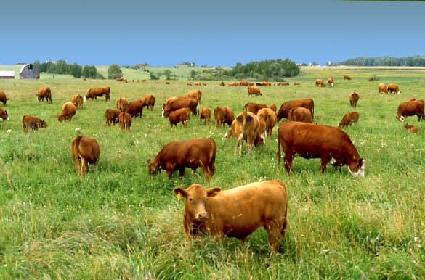
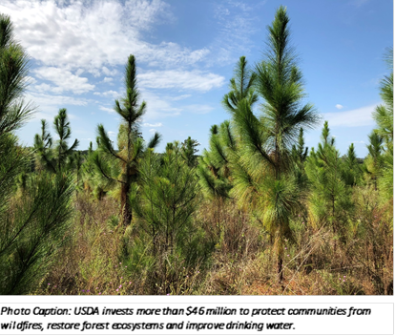
Regenerative Pilot Program Requirements
Whole Farm Assessment
One Primary Practices currently being implemented or plant to be implemented in the contract
Soil Health Testing
Minimum 5-year contract

Slide 4
State Technical Advisory Committees Role in FY 27 RPP
Identify the land use(s) that have the greatest need based on critical soil and water resource concerns for North Dakota
Current Land uses available in RPP
Cropland
Pastureland
Rangeland
Forest
Other Land use Types
Associated Ag Land
Farmstead

Slide 5
State Technical Advisory Committees Role in FY 27 RPP
Refine the list of soil and water resource concerns and the corresponding resource concern components to those that are of critical need for conservation planning and program delivery efforts for North Dakota.

Slide 6
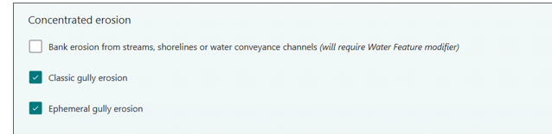
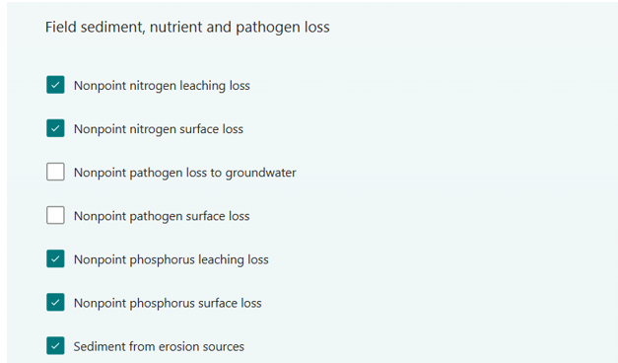
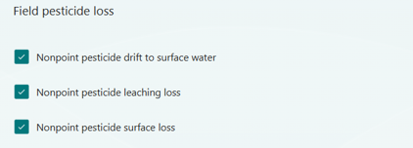
Cropland Resource Concerns

Slide 7
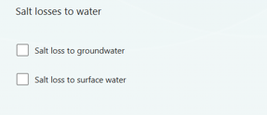
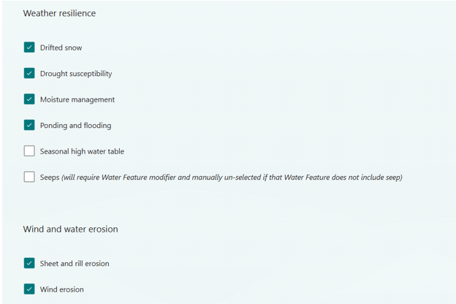
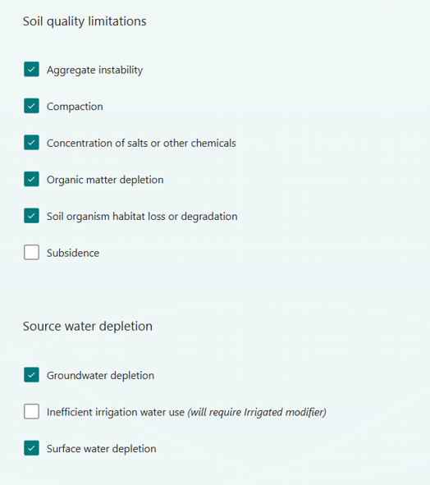
Cropland Resource Concerns

Slide 8
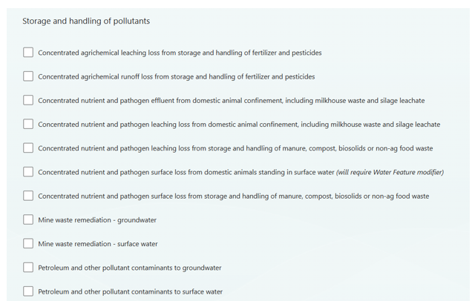
Cropland Resource Concerns

Slide 9
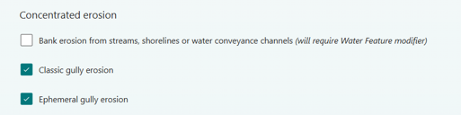
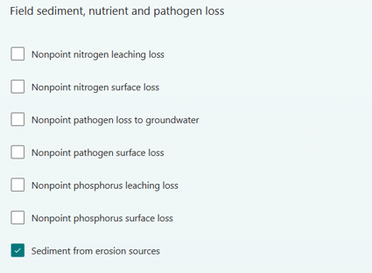
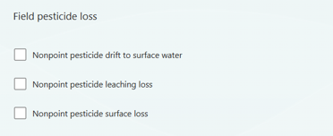
Pasture Resource Concerns

Slide 10
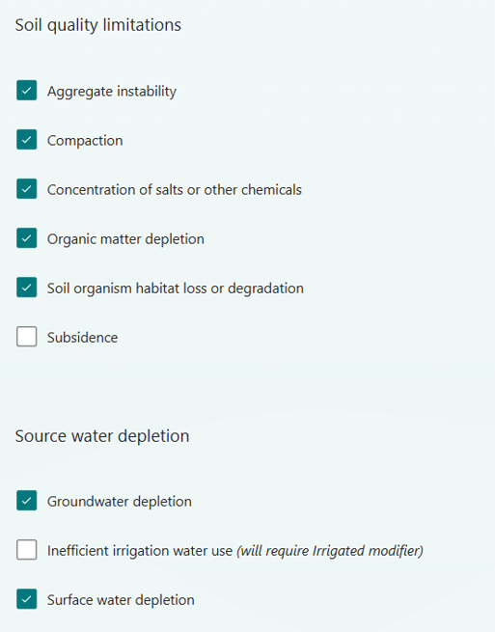
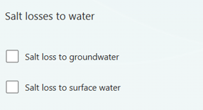
Pasture Resource Concerns

Slide 11
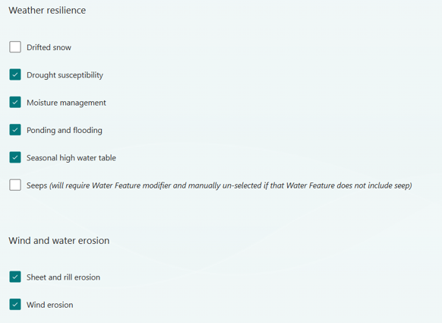
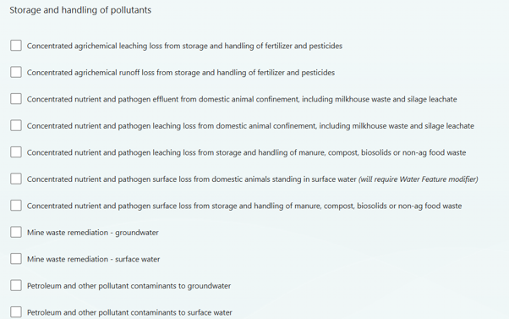
Pasture Resource Concerns

Slide 12
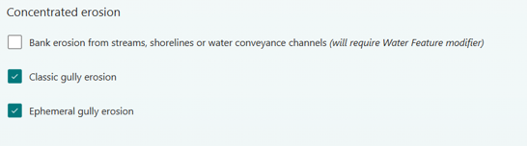
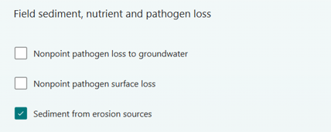
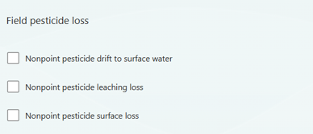
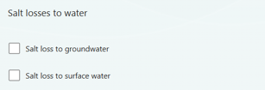
Rangeland Resource Concerns

Slide 13
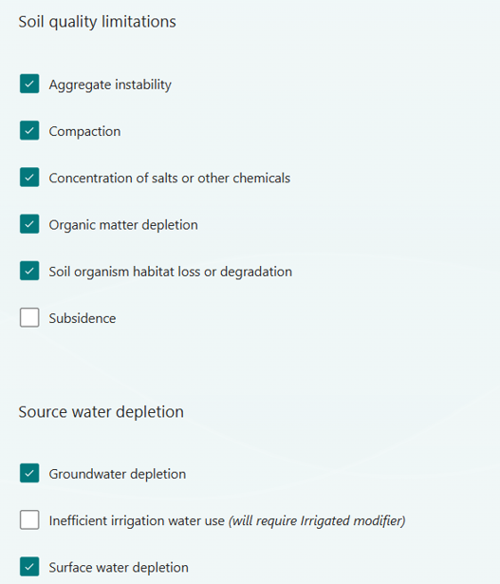
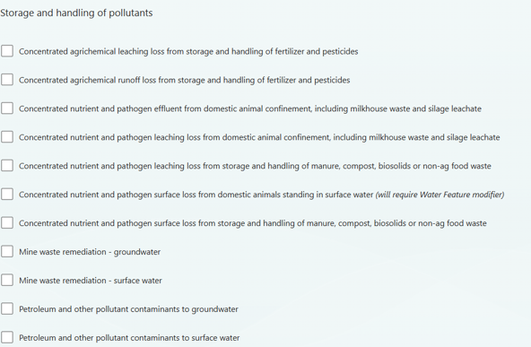
Rangeland Resource Concerns

Slide 14
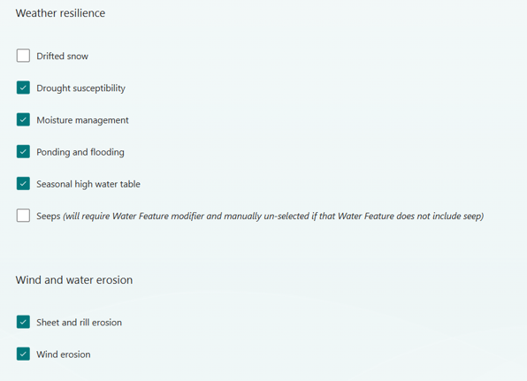
Rangeland Resource Concerns

Slide 15
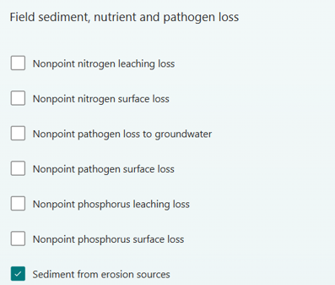
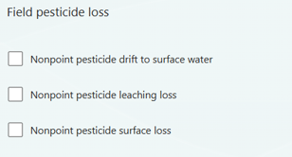
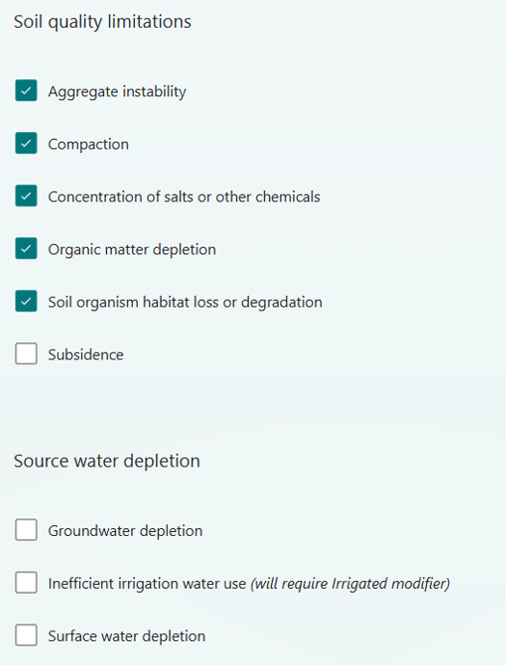
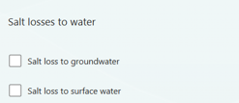
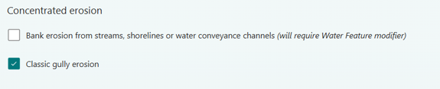
Forest Resource Concerns

Slide 16
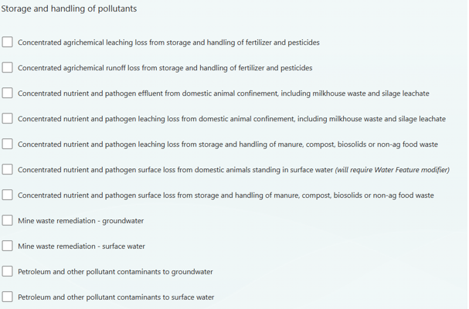
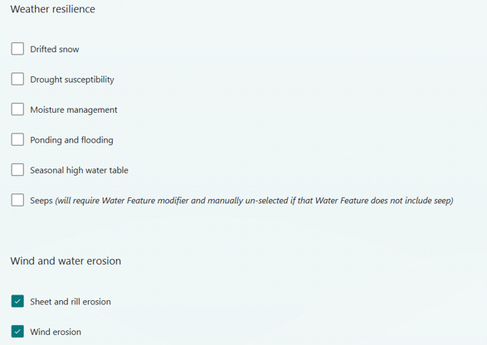
Forest Resource Concerns

Slide 17
State Technical Advisory Committees Role in FY 27 RPP
Identify additional conservation practices essential, based on a practice’s primary functions, to address a critical soil and water resource concern for North Dakota
  Primary regenerative practices should be those practices that when installed lead to the highest likelihood of soil or water resource condition improvement.
  Avoid adding conservation practices to the list that are supportive/facilitating to one of the existing 15 primary regenerative practices or your additional primary practice(s), as supportive practices are already eligible for RPP funding.

Slide 18
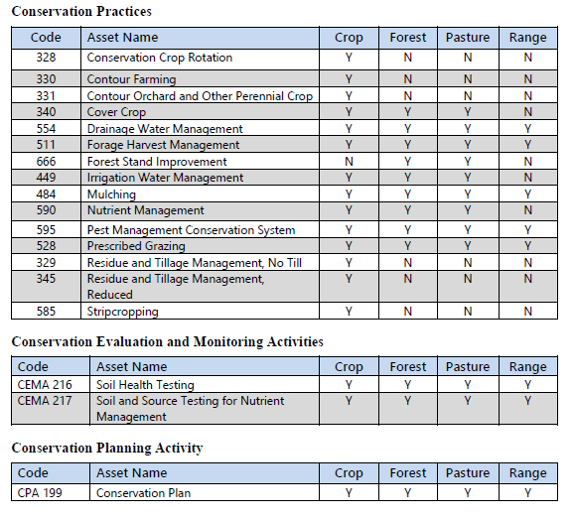
RPP Primary Practices
Excerpts from NI 440 307.14 Regenerative Dec. 2025

Slide 19
Practices ND should add to the RPP Primary Practices List
386 Field Border
390 Riparian Herbaceous Cover
393-Filter Strip
810 Annual Forages for Grazing Systems

Slide 20
Questions

