Slide 1
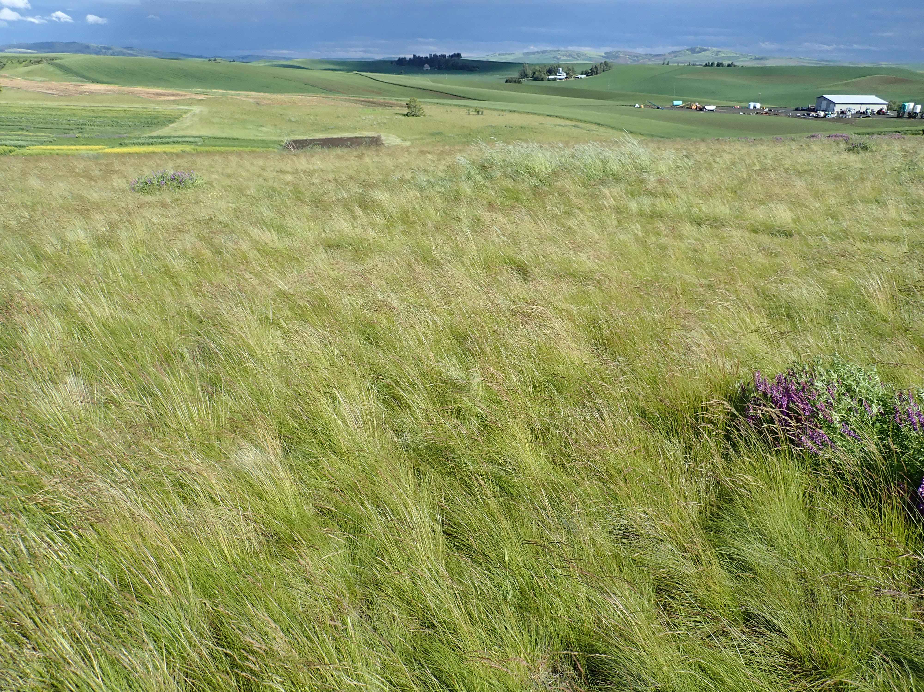
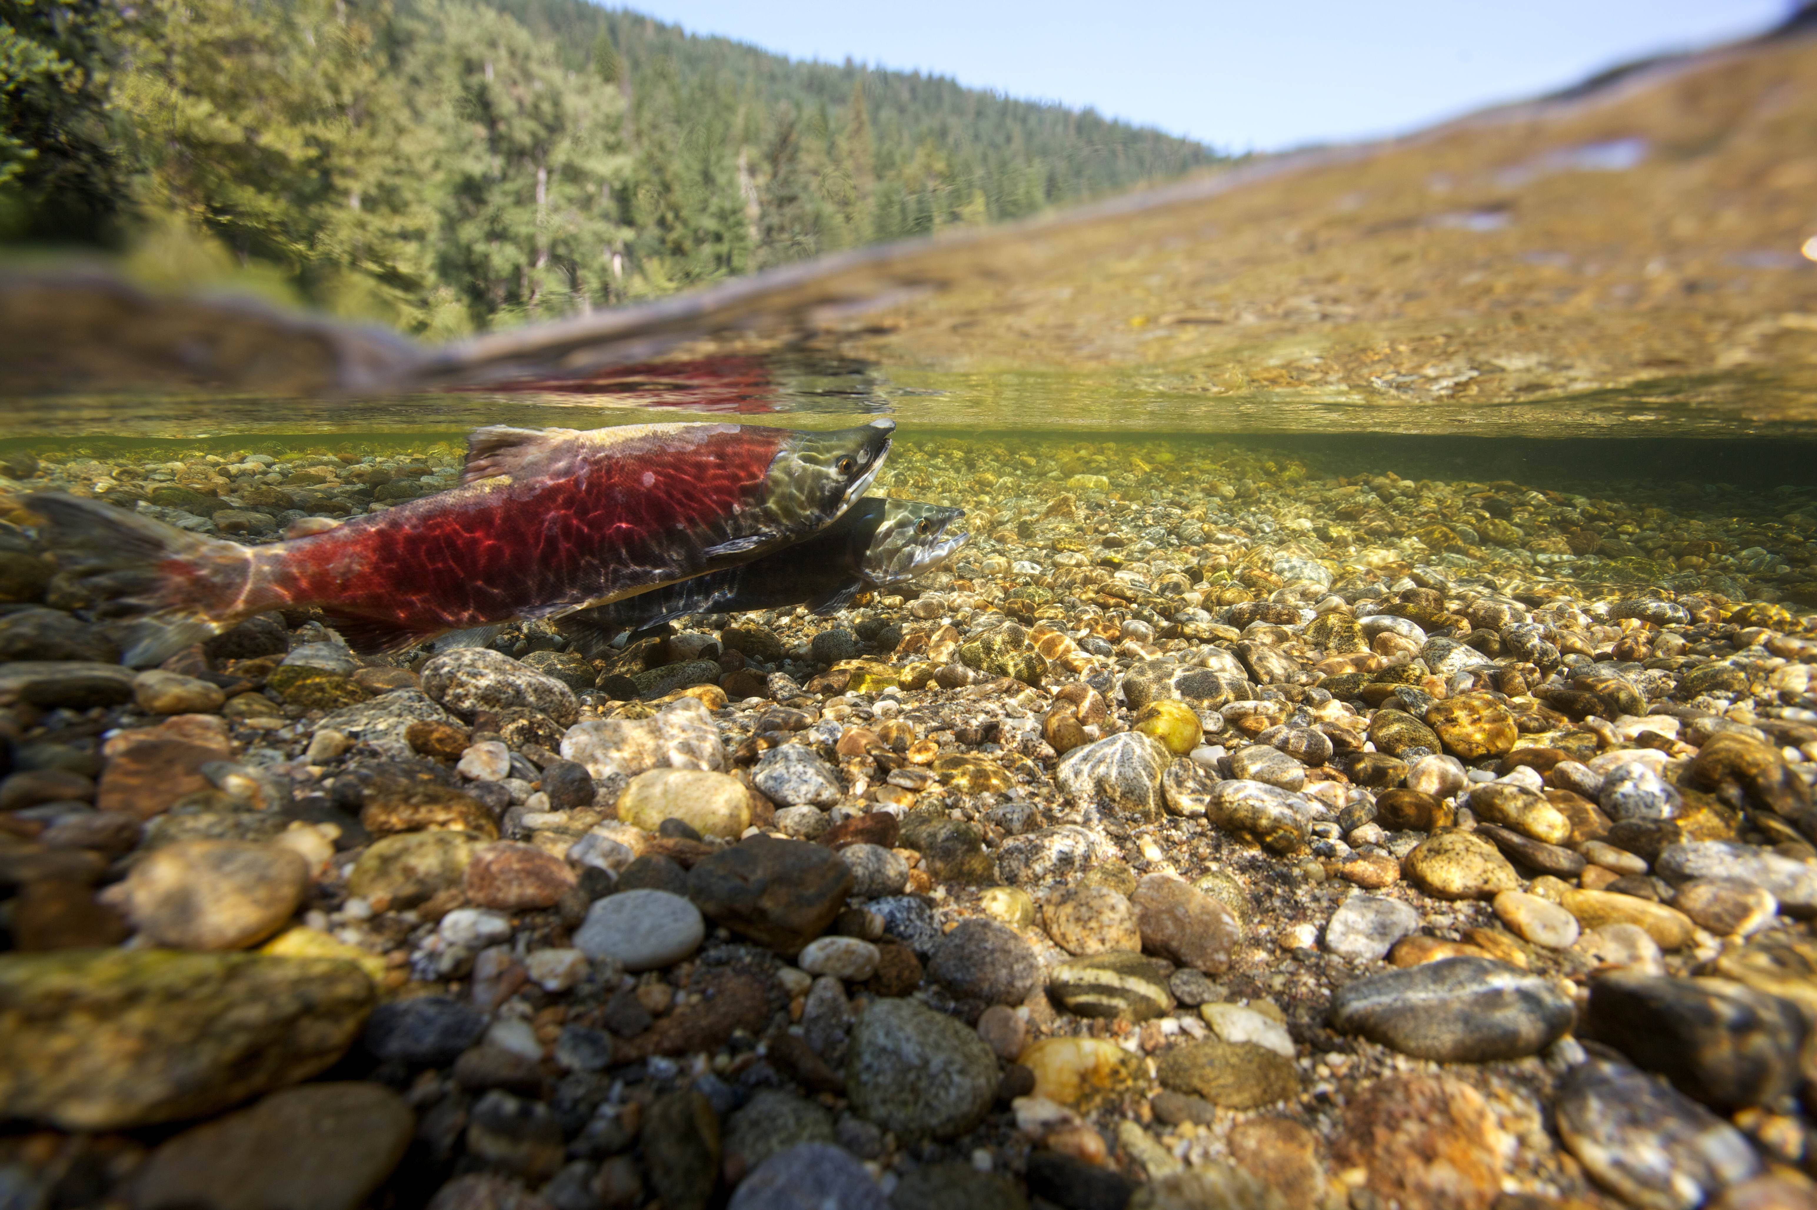
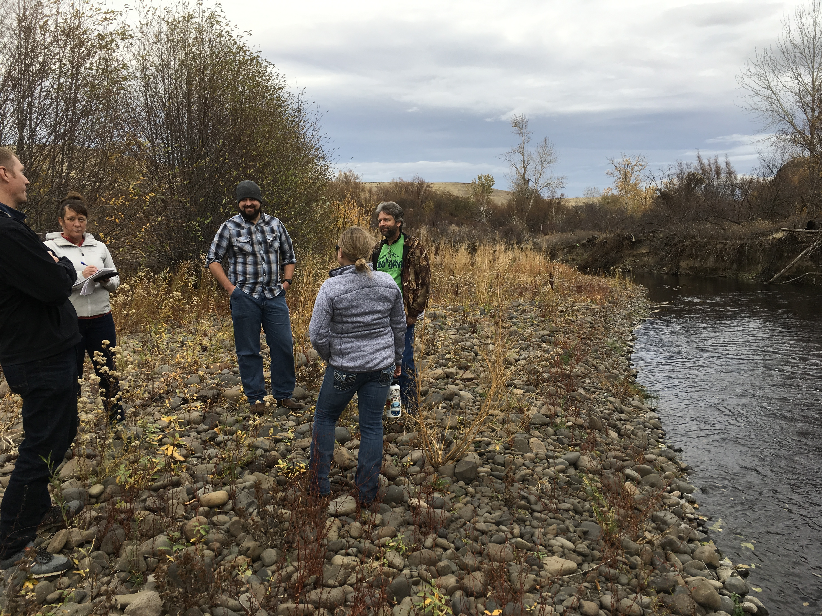

2025 State Wildlife Action Plan: new NRCS conservation opportunities?
Notes:
State wildlife action plans (SWAPs) and the priority species and habitats they identify are recognized by NRCS as foundational information for many of our wildlife practices. Washington’s 2025 SWAP provides us updated information on the state’s priority species (or species of greatest conservation need – SGCNs) and the conservation issues affecting them.

Slide 2
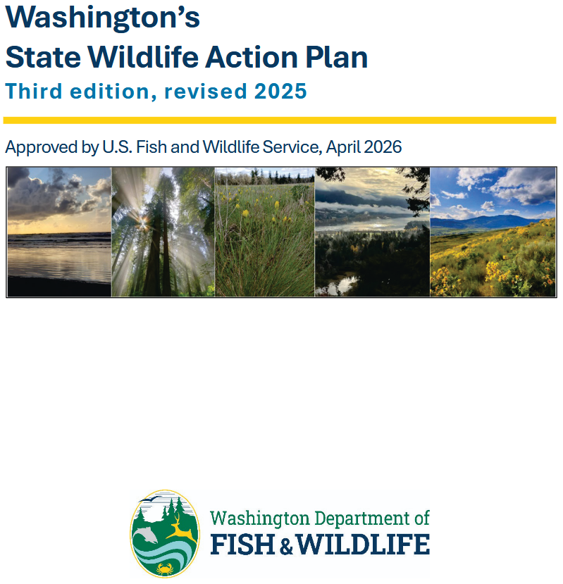
State Wildlife Action Plan (SWAP) for Washington
Provides updated information on species of greatest conservation need (SGCN)
  Includes information on their habitat needs, threats affecting them, and conservation actions (general) that may help them
  SGCN information is valuable for NRCS conservation planning, but available formats are complex for immediate local use
Notes:
While developing the 2025 SWAP, WDFW has assembled and organized a large amount of information on priority habitats and species, central among which are updated lists of Species of Greatest Conservation Need (SGCNs), which include 254 animal species and 127 plant species statewide. This information is available through WDFW’s SWAP webpage in several formats, including a lengthy pdf document as well as 21 associated tables. Much of this information is organized by individual species, or by groups of related species.

Slide 3
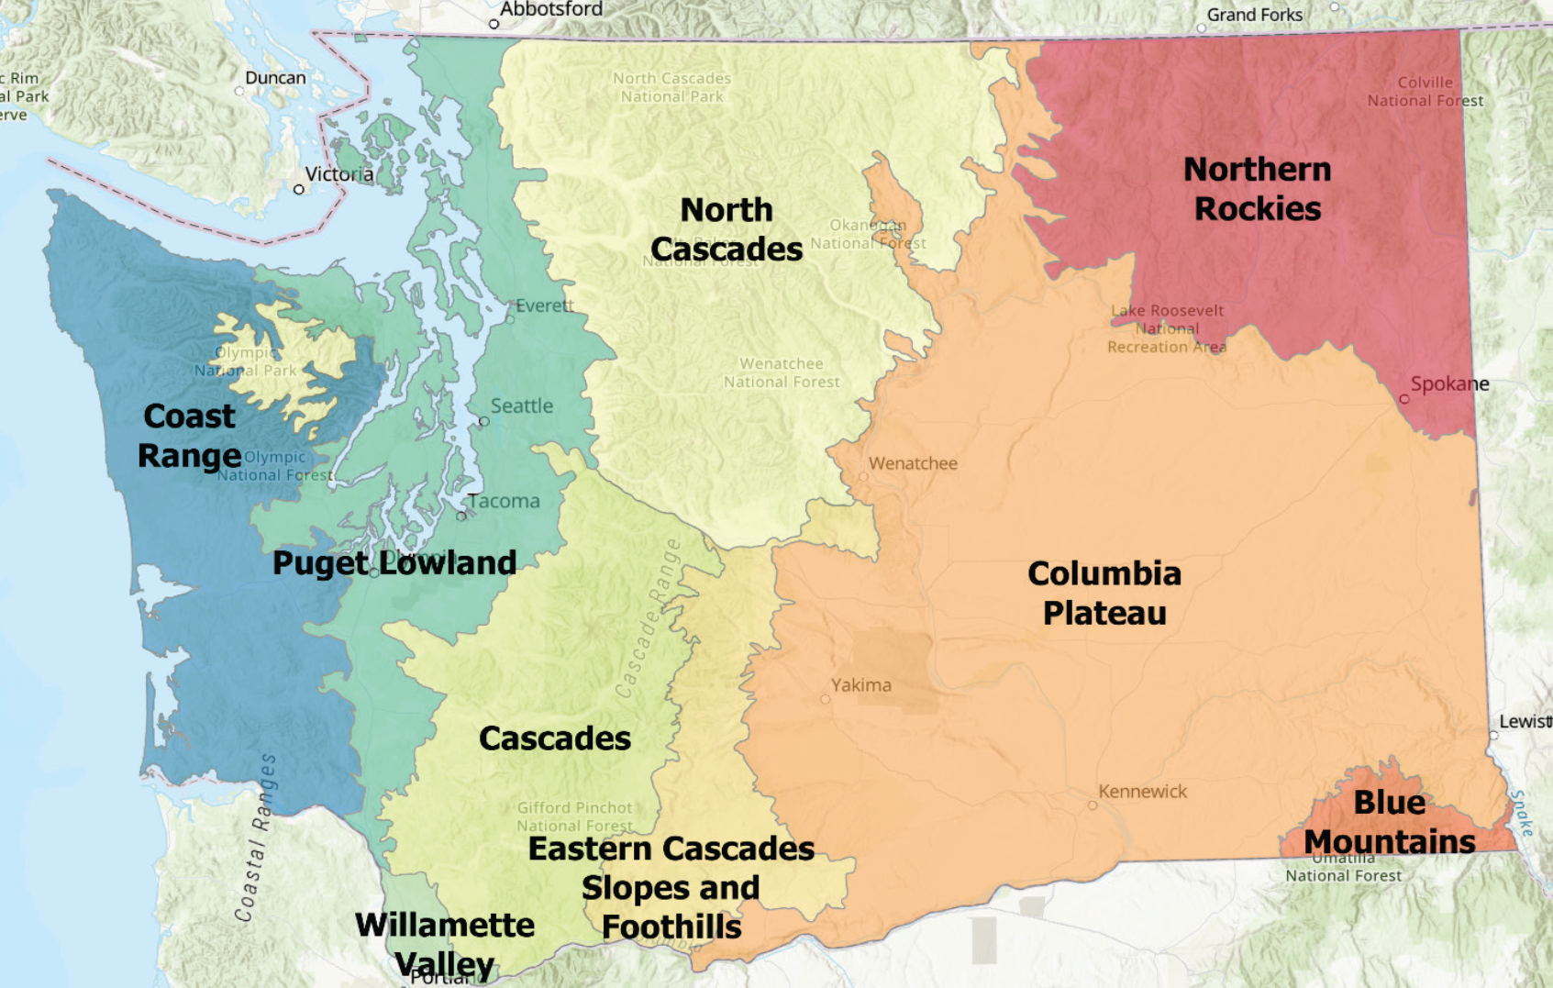
SWAP provides SGCN lists by ecoregions
NRCS field office areas (several counties each) differ from these ecoregions, so each field office work area includes parts of several ecoregions
Notes:
The SWAP does break out and provide lists of plant and animal SGCNs by ecoregions (9 across Washington State). While these lists are regionally and ecologically coherent sets, the ecoregion boundaries differ markedly from those of our field offices - each of which covers parts of several ecoregions. Use of the (full) SGCN lists for ecoregions at the field office scale will tend to include some extraneous species from outside that work area., so the available SGCN information is not particularly well-aligned for efficient use at the scale of our field offices. ,
so we are interested in working further with the SWAP data to make this valuable information easier for our field offices to use.

Slide 4
Reworking available SGCN data to align with and facilitate NRCS field use
Wildlife subcommittee workgroup reviewing and tailoring SGCN lists to field office area:
  Initial project: Palouse Team (Spokane and Whitman counties)
  Use statewide watershed-scale (HUC10) distribution data for SGCNs to develop SGCN list for a Team area.
  Review and synthesize SGCN information on habitat needs, threats, and general conservation actions needed
  Where appropriate identify specific practices or other NRCS conservation actions that are likely means to address SGCN’s needs
Notes:
With these limitations in mind, some reconfiguration and further working of the available SGCN information can make it more efficient and better-aligned for our field planners to utilize, which should support more use of our updated SWAP.
A workgroup comprised of several members of our STAC Wildlife subcommittee and Pheasants Forever biologists have initiated this work, starting with the Palouse Team area (Spokane and Whitman counites) as our pilot project. First, we developed an SGCN list for that two-county areas by compiling expected SGCN distributions by watersheds (HUC10 scale), which is available in the SWAP’s tabular data. Next, for that list of Palouse-area SGCNs we will be reviewing and summarizing the SWAP’s extensive information for each SGCN on habitat associations, conservation issues or threats, and general types of conservation actions recommended to address those threats. Where SWAP information identifies needed conservation actions that align well with NRCS conservation tools, our workgroup will try to identify and list specific practices or enhancement activities that may be likely options to address the SGCN’s particular conservation needs.
Some of the identified threats, such as those relating to siting of energy projects or regulation of major reservoir levels, may not be ones that NRCS can typically address. Conversely, when habitat loss or degradation are the principal factors impacting a particular SGCN, NRCS may be well-equipped to support a variety of potential solutions for producers interested in these conservation opportunities. Our goal is to do the background review and synthesis work to provide the field office with information facilitating identification and implementation of voluntary conservation activities that support SGCNs when there are opportunities to do so.
Finalize after discussion with Palouse team staff; report to Wildlife subcommittee in October and then STAC.

