Slide 1
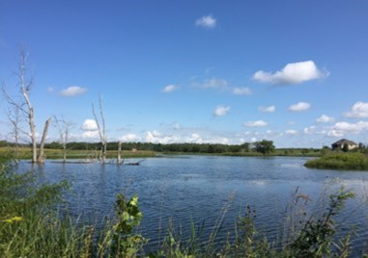
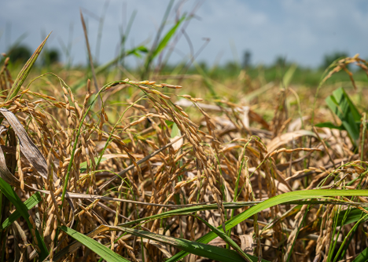


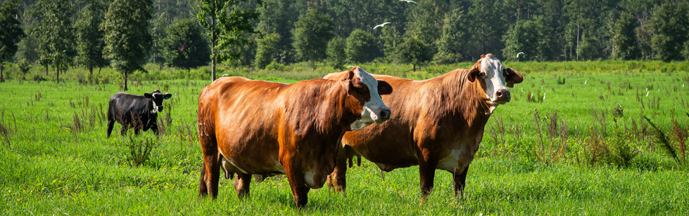
David F. Rose
NRCS-WA Acting State Resource Conservationist

Slide 2
Regenerative Pilot Program (RPP) Overview
Regenerative agriculture is a conservation management approach that emphasizes
Natural resources through improved soil health | Water Management | Natural vitality for the productivity and prosperity of agriculture and communities
The RPP addresses whole-farm resource concerns through support for voluntary regenerative agriculture Conservation Plans

Slide 3

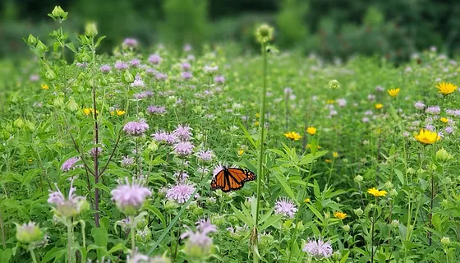
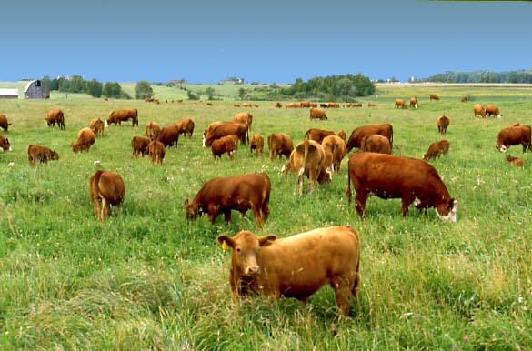
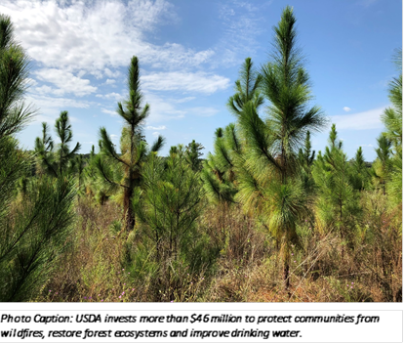
Regenerative Pilot Program Requirements
Whole Farm Assessment
Primary Practices
Soil Health Testing
Minimum 5-Year Contract

Slide 4


What is the “Whole Farm”
Policy allows producer to define a subset of land as a separate operation/farm Whole farm definition = largely up to the producer with input from the planner | CSP Regen must follow same policy requirements as regular CSP All land the operator controls for 5-year contract must be enrolled Separate AgLands and NIPF
Note: When working with tribes to complete a whole farm assessment, NRCS and the Tribe will follow NI 440 307.14 , in combination with program policies found in CPM 440 Part 530 to address the unique relationship between the Tribe and its members so as not to create an undue hardship.
Notes:
Assessment is key word, assess all land units and client determines where to implement new conservation practices.

Slide 5
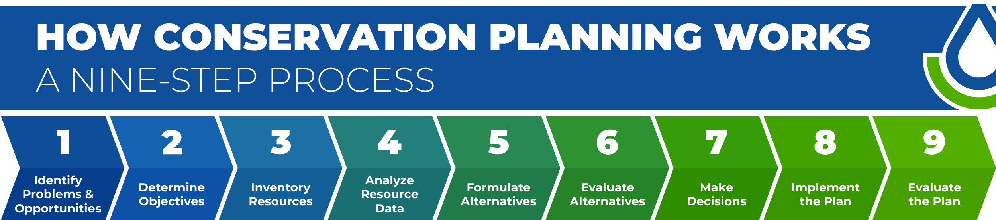
Land Uses
RPP focuses on Crop, Forest, Pasture, and Range

Slide 6
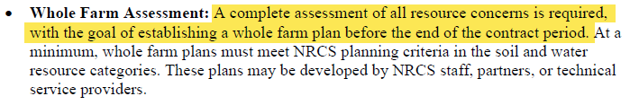
Assessment - Resource Concerns
Excerpt from NI 440 307.14 Regenerative Jan. 2026
Assessment Requirement: all applicable resource concerns/components assessed
  Goal: start conversation about whole farm planning and begin working towards creating a whole farm plan

Slide 7
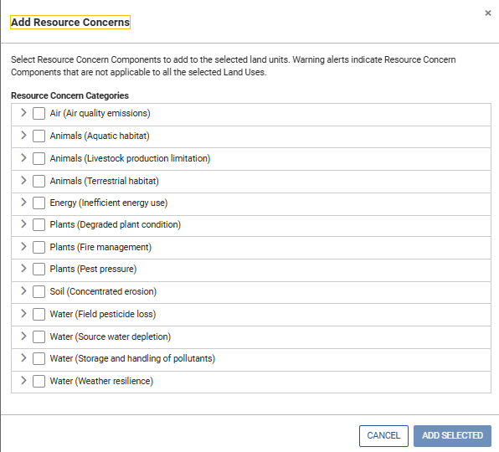
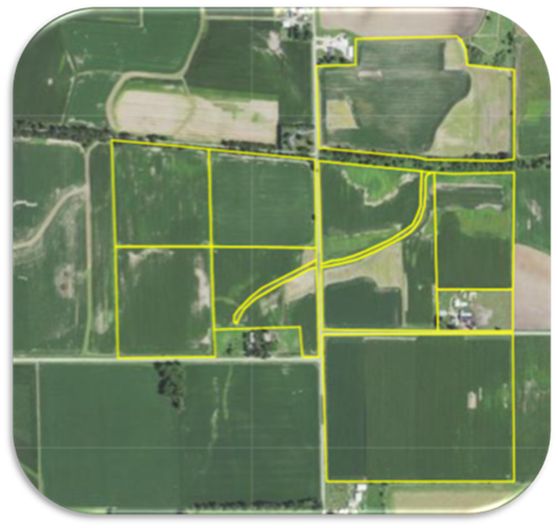
Assessment - Resource Concerns

Slide 8
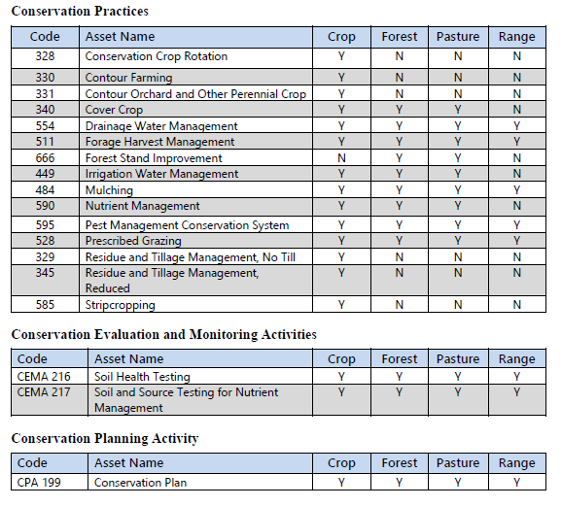
Primary RPP Practices
A minimum of one primary Regen Practice
  Existing: has been implemented (even without NRCS)
  Planned: future implementation
May also include:
  Supporting: needed to facilitate the primary
  Other: allows for a conservation plan to be written to meet all the client’s objectives (beyond RPP).

Slide 9
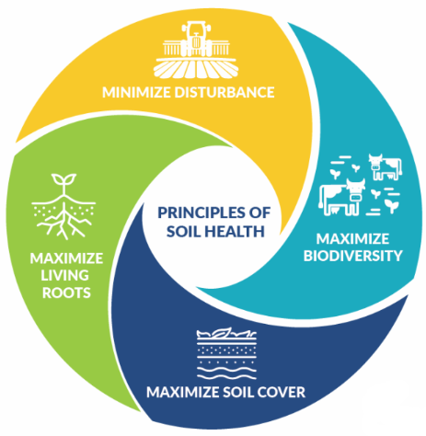
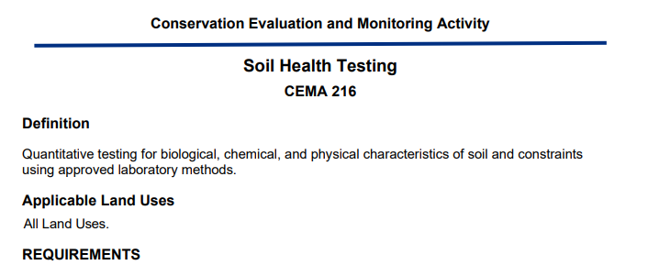
Soil Health Testing
Participants must agree to perform Soil Health Testing in the first and last year of the contract (at a minimum) to establish a starting baseline and to record the resulting changes.
Financial assistance for Soil Health Testing is available through CEMA 216.
Updated
CEMA 216 Soil Health Testing 01/2026

Slide 10
Regenerative Agriculture
Strategy Plan
1. Vision
NRCS-WA boosts Washington’s working lands by promoting regenerative agriculture to enhance soil, water quality, natural vitality, and lasting resilience.
2. Mission
Assist producers to enhance environmental results and increase farm profitability through comprehensive regenerative conservation plans for the entire farm.

Slide 11
Regenerative Agriculture Strategy Plan
3. Strategic Goals
Goal 1 — Expand Regenerative Agricultural Planning Throughout Washington
Increase the proportion of NRCS assessments that meet regenerative agriculture criteria: 25% in FY26, 50% in FY27, 75% in FY28, 100% by 2030.
Goal 2 — Strengthen Soil Health Outcomes
Use whole farm assessments and promote CEMA 216 soil health testing for producers to track changes in soil function over 5-year contracts.
Goal 3 — Increase Producer Access & Participation
Simplify program applications, reduce barriers to program participation, including connecting producers with Qualified Individuals (QI) and Technical Service Providers (TSP).
Goal 4 — Build Partnerships with Tribes & Local Organizations
Expand collaboration on regenerative agriculture with Tribes, Conservation Districts, Coalition for Organic & Regenerative Agriculture (CORA), and other partners across Washington.

Slide 12
Regenerative Agriculture Strategy Plan
4. Objectives & Supporting Activities
These objectives support the above goals.
Objective A — Build Staff & Partner Capacity
Provide training on regenerative practices and whole farm planning; update RPP guidance and tools. Continue efforts to build QI/TSP networks.
Objective B — Improve Communication & Outreach
Share success stories, newsletters, webinars, and promote QI/TSP availability with partners and the public.
Objective C — Enhance Program Delivery
Integrate soil health and regenerative agriculture fundamentals into conservation planning and practice implementation requirements (IR’s).
Objective D — Support Whole Farm Adoption
Conduct whole farm assessments for all regenerative agriculture focused EQIP/CSP applications and encourage adoption of primary regenerative practices.

Slide 13
Regenerative Agriculture Strategy Plan
5. Primary Regenerative Practices to Promote
Emphasize the primary conservation practices, which include:
Practices may be added or removed; this plan will be updated as needed.
Conservation Crop Rotation (328) | Mulching (484)
Contour Farming (330) | Nutrient Management (590)
Contour Orchard and Other Perennial Crop (331) | Pest Management Conservation System (595)
Cover Crop (340) | Grazing Management (528)
Drainage Water Management (554) | Residue and Tillage Management, No Till (329)
Forage Harvest Management (511) | Residue and Tillage Management, Reduced (345)
Forest Stand Improvement (666) | Stripcropping (585)
Irrigation Water Management (449)

Slide 14
Regenerative Agriculture Strategy Plan
6. Metrics & Tracking
Metrics include percentage of regenerative assessments, soil health indicators, whole farm plan totals, partner engagement, and outreach output. Target increased participation in regenerative agriculture of NRCS clients as laid out in Strategic Goal 1.
7. Implementation Timeline
FY26: Launch training and tools.
FY27–29: Expand staff capacity and partnerships.
2030: Full integration of regenerative planning.
8. Partnership Strategy
Coordinate with Tribes, Washington Soil Health Initiative (WaSHI), Coalition for Organic & Regenerative Agriculture (CORA), Washington State Department of Agriculture (WSDA) Regional Markets, Washington State University, Washington State Conservation Commission (WSCC) and local conservation districts.

Slide 15
Regenerative Agriculture Strategy Plan
Action Plan
To achieve the strategic goals, NRCS-WA will implement the following specific targets:
Goal 1. Expand Regenerative Planning Across Washington:
  Design and deliver annual workshops for NRCS staff to train them on the updated regenerative assessment criteria.
  Implement quarterly progress reviews to track the proportion of assessments meeting regenerative standards and report results to leadership; adjust strategies as needed to ensure 25% by FY26, 50% by FY27, 75% by FY28, and 100% by 2030.
  NRCS-WA will assess at least 100 new producers in regenerative planning by FY26, increasing to 250 by FY27, 400 by FY28, and reaching 600 total producers by 2030. Additionally, at least 50,000 acres will be transitioned to regenerative management practices by 2030.
  Establish or maintain partnerships with at least five local conservation districts per year to extend regenerative planning outreach into regions with historically low participation.

Slide 16
Regenerative Agriculture Strategy Plan
Action Plan
To achieve the strategic goals, NRCS-WA will implement the following specific targets:
Goal 2. Strengthen Soil Health Outcomes:
  NRCS-WA will ensure that at least 80% of participating farms demonstrate measurable improvements in soil organic matter, water infiltration rates, and soil structure within five years. This will be accomplished through direct follow-up with program participants. NRCS-WA will offer targeted technical assistance to producers whose soil health metrics fall below the regional average.
  Require all participating producers to undergo whole farm assessments using standardized protocols and conduct CEMA‑216 soil health tests at the start and end of each 5‑year contract period.
  Organize biannual knowledge-sharing forums where producers review soil health data, discuss best practices, and set goals for continued improvement.

Slide 17
Regenerative Agriculture Strategy Plan
Action Plan
To achieve the strategic goals, NRCS-WA will implement the following specific targets:
Goal 3. Increase Producer Access & Participation:
  Launch a targeted outreach campaign by FY27, including informational webinars, mailers, and farm visits, to increase awareness of regenerative conservation planning opportunities among underrepresented producer groups.
  Streamline enrollment procedures by developing an online application portal, and provide step-by-step guidance for new applicants, aiming to reduce processing time by 30% within two years.
  Secure and distribute financial incentives (such as grants or incentive programs) and technical assistance packages to help producers implement regenerative practices, with a goal of supporting 100 new producers each year.
  Build additional capacity in the QI and TSP program for producers to have access to additional technical assistance. Increase TSPs by 10% each year.

Slide 18
Regenerative Agriculture Strategy Plan
Action Plan
To achieve the strategic goals, NRCS-WA will implement the following specific targets:
Goal 4. Build Partnerships with Tribes & Local Organizations
  NRCS-WA will promote regenerative agriculture, technical assistance, and available financial assistance programs at 20 partner events statewide, on an annual basis.

Slide 19
STAC Recommendations
Critical soil and water resource concerns
Action
Refine the list of soil and water resource concerns and the corresponding resource concern components to those that are of critical need for conservation planning and program delivery efforts within a State.
Context
Planners will be required to assess all critical soil and water resource concerns.
Producers will be required to treat all critical soil and water resource concerns and components that are deficient to be eligible for RPP in your State.
STAC recommendation
What resource concerns and components should be added or deleted for WA?

Slide 20
STAC Recommendations
Eligible land uses
Action
Identify the land use(s) that have the greatest need based on critical soil and water resource concerns.
Context
Identified land use(s) will be those eligible for RPP in your State.
STAC recommendation
What land use(s) have the greatest need for RPP in WA?

Slide 21
STAC Recommendations
Additional primary regenerative conservation practices
Action
Identify additional conservation practices essential, based on a practice’s primary functions, to address a critical soil and water resource concern.
Primary regenerative practices should be those practices that when installed lead to the highest likelihood of soil or water resource condition improvement.
Practices should either have soil and water resource concerns as a primary purpose or have a value of 1 or greater in the CPPE.
Avoid adding conservation practices to the list that are supportive/facilitating to one of the existing 15 primary regenerative practices or your additional primary practice(s), as supportive practices are already eligible for RPP funding.
Context
To be eligible, producers will need at least one primary regenerative practice currently being implemented or planned to be implemented in the contract.
STAC recommendation
What land use(s) have the greatest need for RPP in WA?

Slide 22
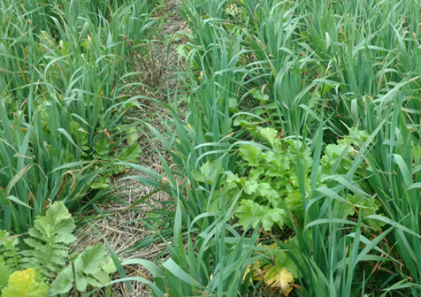

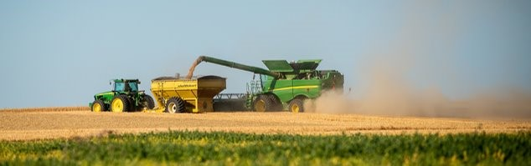
Questions &
Answers

