Slide 1



FY27 Geographic Area Rate Cap
Carlee Elliott
State Easement
Program Manager

Slide 2

GARC Background
In accordance with the ACEP-WRE statute, regulations, and policy, NRCS must determine whether eligible lands may be enrolled in ACEP-WRE based on the likelihood of successful restoration of wetland functions and values, taking into considering the cost of acquiring the easement and the cost of the restoration, protection, enhancement, maintenance, and management.

Slide 3
GARC Policy
The basis for the compensation offer for an easement or 30-year contract enrollment will be the lowest of the following:
(i) The fair market value (FMV) of the land using either of the following: a Uniform Standards for Professional Appraisal Practices (USPAP) individual appraisal or an area wide market analysis (AWMA) or survey,
(ii) The geographic area rate cap (GARC), or
(iii) An amount voluntarily offered by the landowner.

Slide 4
GARC Policy
440 CPM Part 528, Subpart M, Section 528.122:
Each fiscal year the State Conservationist, in consultation with the State Technical Advisory Committee (STAC), must establish a process to determine easement and 30-year land use contract compensation values.

Slide 5
FY27 NRCS-WA GARC Proposal
The FY2027 ACEP-WRE GARC value for permanent easement offers will be 85% of the individually appraised fair market value of the subject property, not to exceed $5,000/acre, unless there are federal or state threatened and endangered (T&E) species present or if the site is considered essential habitat for species recovery.
In those cases that T&E species are present, there will be a hold down of $10,000/acre. (The $5,000/acre figure is the maximum set forth in policy, unless the state establishes a justification for a higher amount).

Slide 6
FY27 NRCS-WA GARC Proposal
Compensation for FY2027
30‑year easements, 30‑year tribal land use contracts, and WRE reserved grazing rights compensated at 75% of appraised fair market value, capped at $5,000 per acre.
Reserved Grazing Rights Eligibility
Washington NRCS allows RGR on new ACEP‑WRE enrollments only when a Threatened & Endangered species is present and dependent on early‑successional wetland habitat.
Must have written concurrence from ASTC‑P, SRC, and STC.
Compensation for RGR on 30‑year Agreements
RGR compensation on 30‑year easements and 30‑year tribal land use contracts is 75% of the calculated 30‑year value, capped at $5,000 per acre.
Notes:
The FY2027 compensation for 30-yr easements, 30-yr tribal land use contracts and WRE-reserved grazing rights easements be set at 75% of the individually appraised fair market value of the subject property, not to exceed $5,000/acre, without any exceptions. Washington NRCS may allow the Reserved Grazing Right option on any new ACEP-WRE enrollments only if Threatened & Endangered (T&E) species are present, the T&E species identified is heavily dependent on early successional habitat wetland community and is concurred in writing for the official case file by the Washington NRCS Assistant State Conservationist for Programs (ASTC-P), State Resource Conservationist (SRC), and State Conservationist (STC). WRE-reserved grazing rights easement compensation on 30-year easements and 30-year tribal land use contracts will be 75% of the calculated 30-year compensation value, not to exceed $5,000/acre, without exceptions.

Slide 7

FY27 NRCS-WA GARC Example
Joe Farmer has 12 acres
USPAP Appraisal (Before CE value – After CE value = CE)
Before CE $300,000 – After CE $200,000 = $100,000
$100,000 /12ac = $8,333.3333/ac

Slide 8
FY27 NRCS-WA GARC Example
$100,000 /12ac = $8,333.3333/ac
GARC = 85% of $100,000, or $7,083.333/ac
  No T&E = capped at $5,000/ac
    $5,000 x 12ac = $60,000
  If T&E = capped at $10,000/ac or appraisal ac – whichever is less:
    $7,083.333/ac x 12ac = $85,000

Slide 9
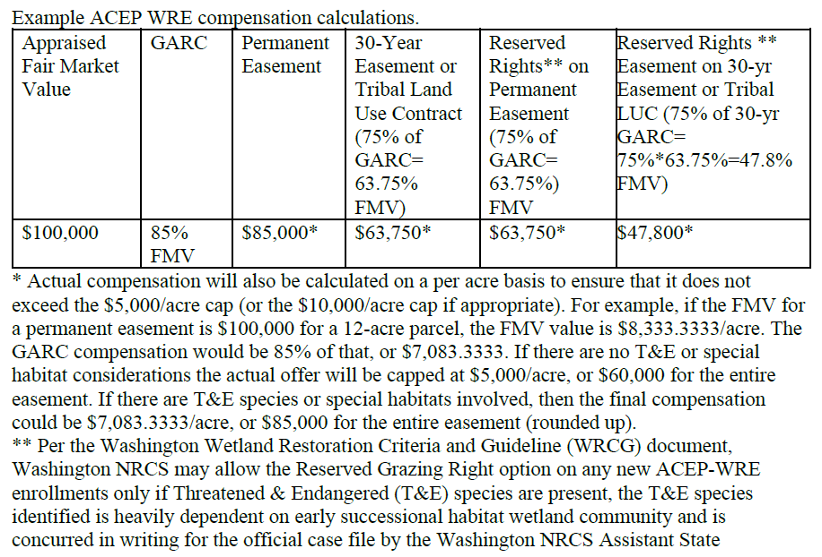
FY27 NRCS-WA GARC Example

Slide 10
FY27 NRCS-WA GARC Example

Slide 11
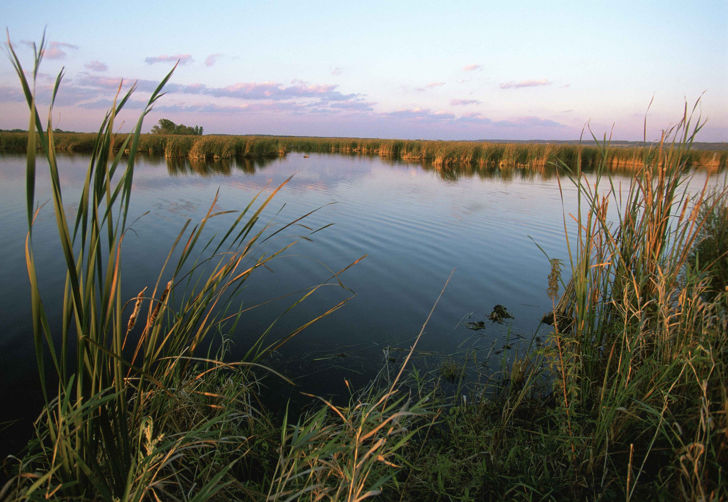
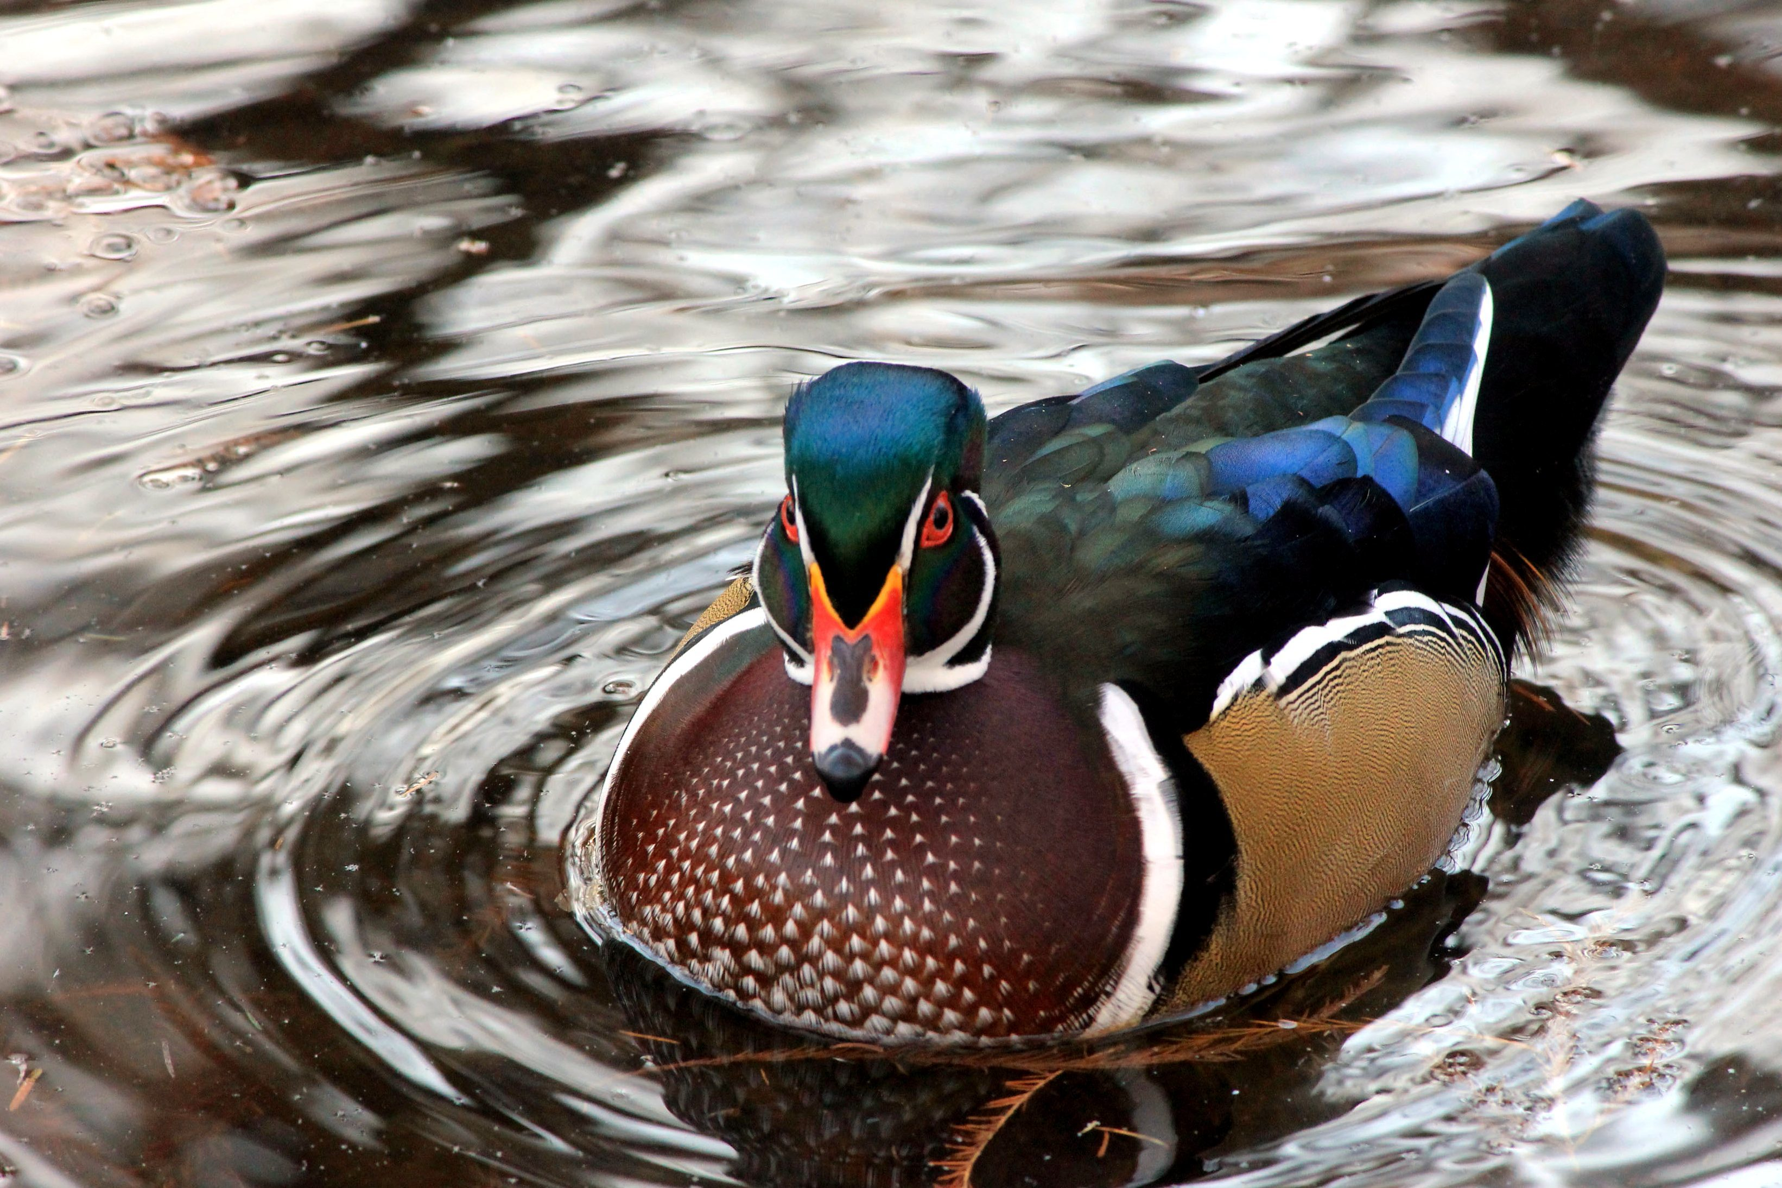
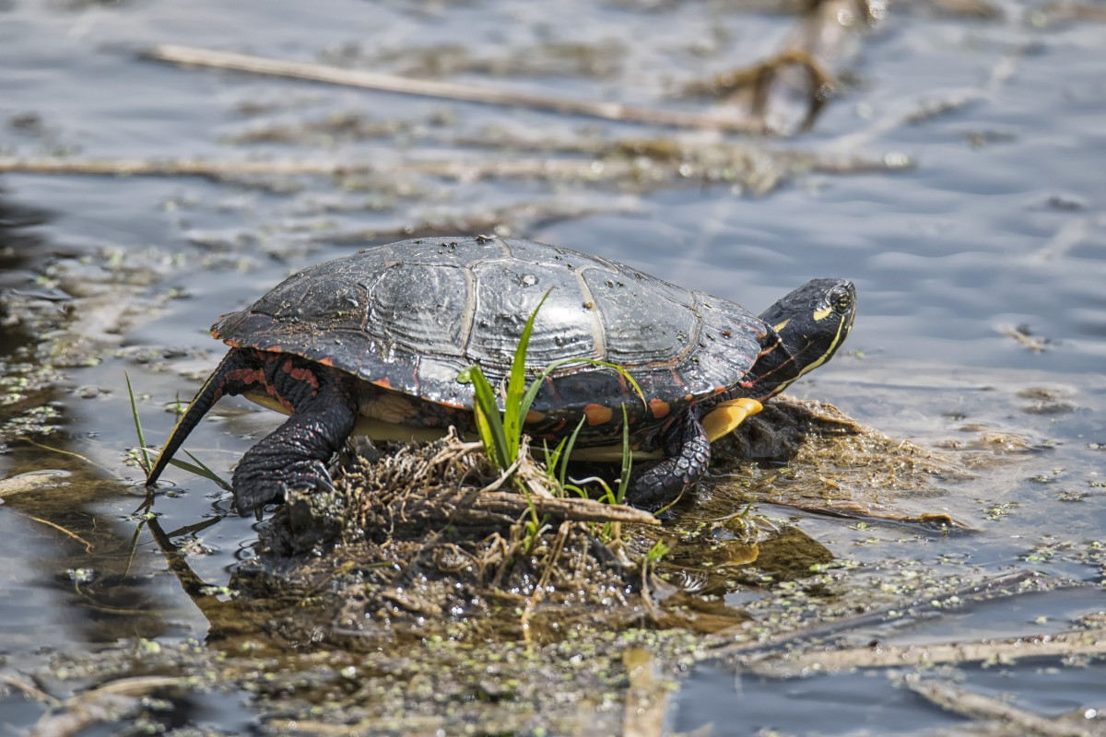
Questions?

