Slide 1
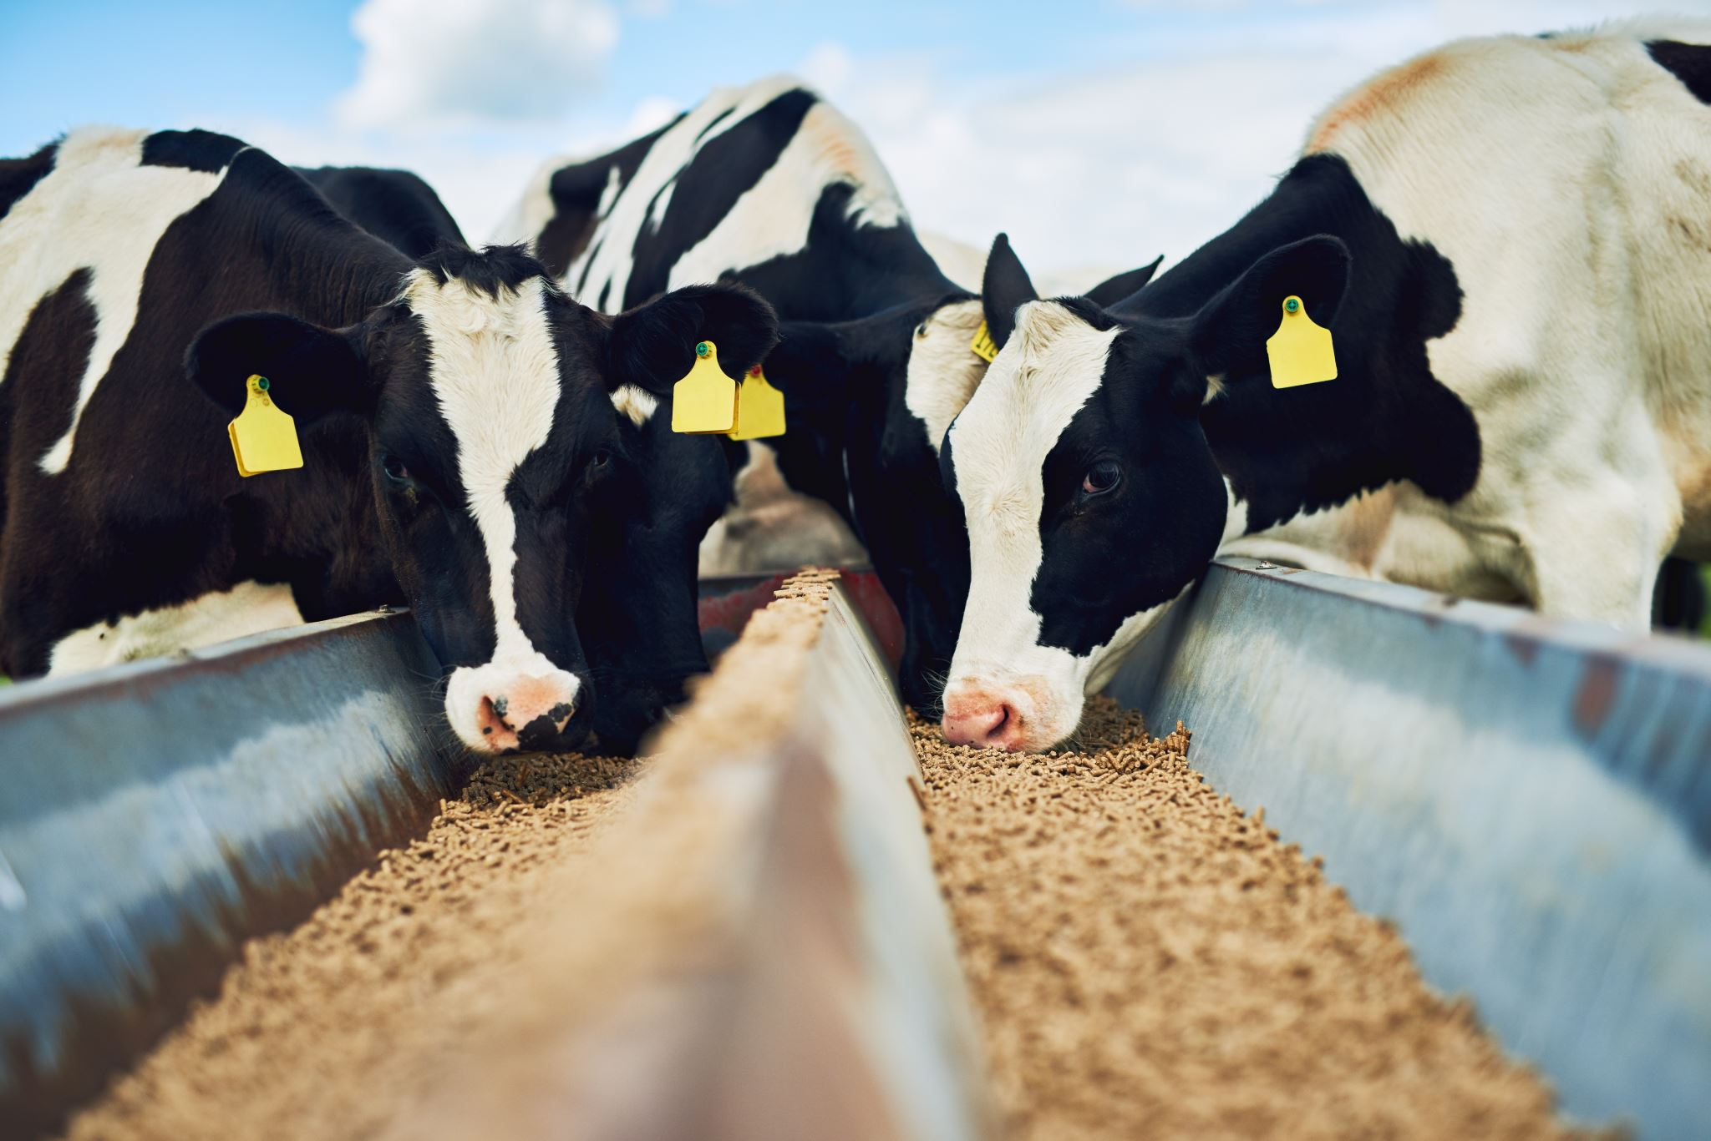


FY27 Agricultural Land Easement Ranking
Carlee Elliott
State Easement
Program Manager

Slide 2
Agricultural Land Easement (ALE)
Permanent conservation easement
Held by an eligible entity (such as a land trust, state/local government, or Indian tribe)
Protects the agricultural viability and related conservation values of eligible land by limiting nonagricultural uses
NRCS does not hold ALEs directly like WRE
NRCS provides matching funds to eligible entities for these easements as a third party with enforceable rights
Land trusts submit applications to NRCS; NRCS ranks and funds based on project merit

Slide 3
ALE Ranking Background
Prior to January 2026, ALE rankings were created with national guidance and released by states.
In January 2026, National announced a signup 2 to spend 200M in align with the Chief’s priority of “Keeping Working Lands in Working Hands”
  National released and managed the funds, not states.
Dec. 20, 2025 WA Signup (ALE & WRE)
Jan. 15, 2026 National Signup
Dec. 18, 2026 WA Signup (ALE & WRE)

Slide 4
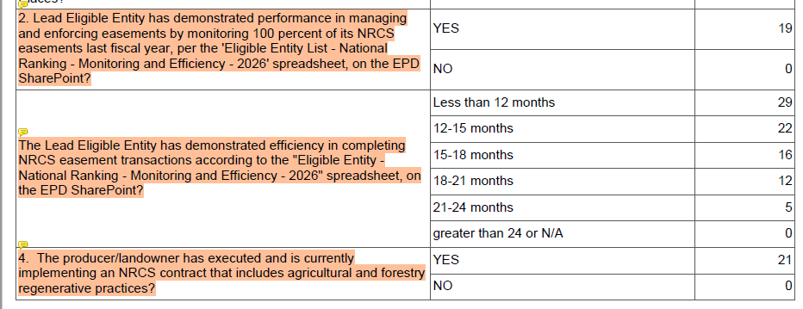
Proposed National ?s for WA to Adopt:

Slide 5
Pros and Cons
+ Highlight stewardship monitoring as priority
+ Entice eligible entities to increase response/appraisals
+ Become competitive nation wide in event of another
national signup
+ Align WA with national policy shifts and updates
+ Consistency in documentation
+ Strengthen oversight
+ WA scoring defensible at national reviews
- Be cognoscente & maintain state priorities

Slide 6
Questions?

