Slide 1
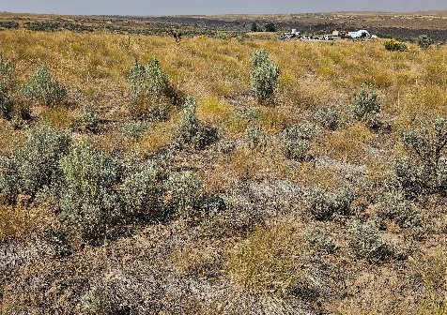
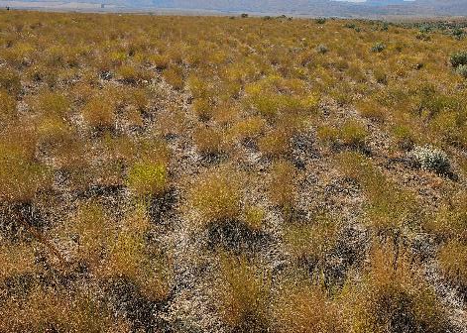

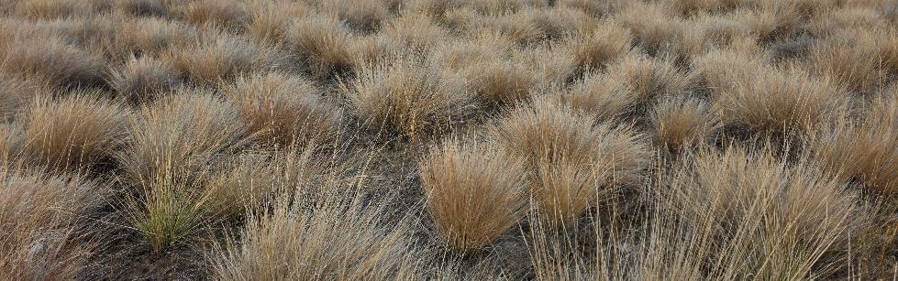
WA-CRP Technical Updates

Slide 2
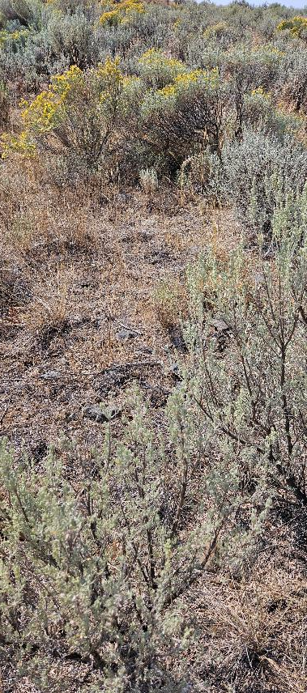
Hot Topics
Plant Density for dry areas (<12”)
Two-year fallow period
Two-year establishment period
Seeding rates, methods and trials
Grazing specific windows by County

Slide 3
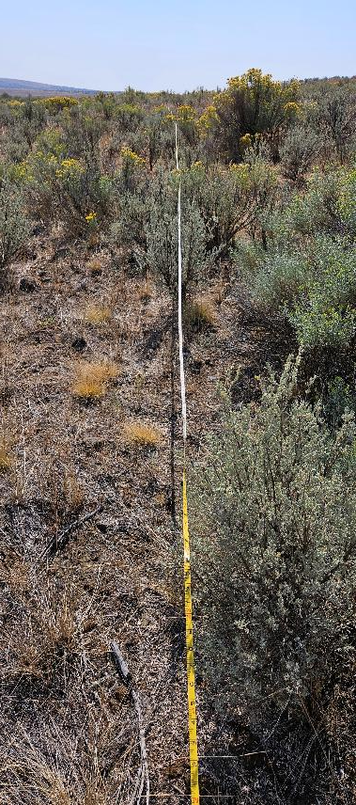
Plant Density Requirements
Discussions have been ongoing and formal requests are expected to reduce certification densities, in some areas to as low as 0.3 plants per square foot.
Current guidance for Central WA and drier sites is 0.8 plants per square foot.
Notes:
Concern with lower desirable herbaceous (bunchgrass) density is invasion and dominance of annual grasses, as well as other weeds.

Slide 4
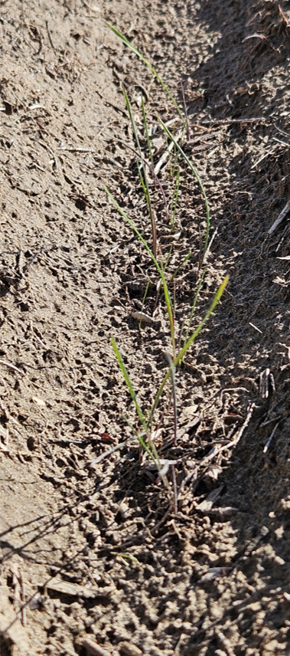
Two-Year Fallow Period
Par. 426 of 2-CRP states “Approved permanent cover is required to be seeded within 12 months after the CRP-1 effective date, according to Exhibit 11. However, NRCS or TSP, in consultation with COC or CED, may, in developing the conservation plan, permit up to an additional 12 months, not to exceed 24 continuous months, to seed or install the approved permanent cover”
Notes:
Concern with lower desirable herbaceous (bunchgrass) density is invasion and dominance of annual grasses, as well as other weeds.

Slide 5
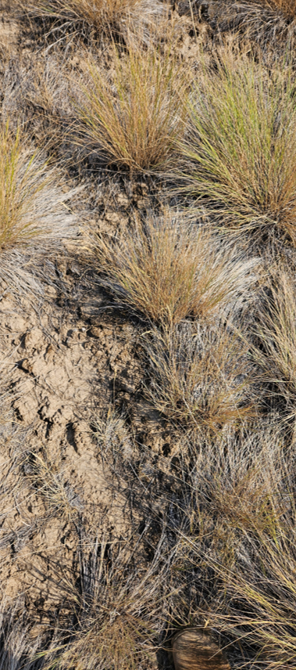
Two-Year Establishment Window
Par. 426 also states: “NRCS or TSP, within 2 years of certifying completion of the practice, will conduct a site visit to determine whether the approved permanent cover is fully established, as determined by NRCS”
NRCS technical note language: It is essential to watch and manage native seedings for two or more years before deciding whether they are successful.
Notes:
Again, more specific to our drier regions in Washington – we do not feel that 24 months is of adequate time to determine successful establishment of a new seeding. Transects are also not the best way to measure plant densities in these new seedings, where our grasses are very small and and in obvious furrows. Grid sampling or range hoops would be a better tell. Look for updated guidance to field offices reflecting this.

Slide 6
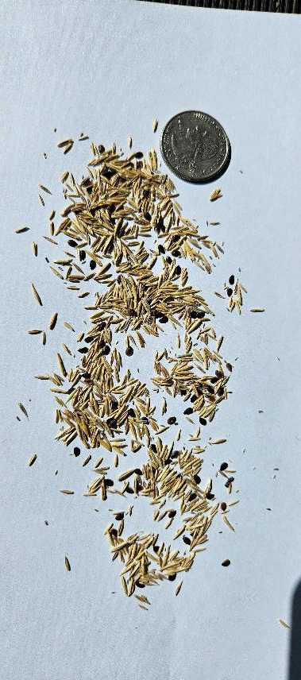
Seeding Rates
Guidance is old
Request to lower our seeding rates based on new technology
Notes:
We’ve seen rates go from 13 lbs per acre down to 6. Currently there is an ask for grass seeding rates to be reduced even farther due to the fact that our seed drills are more advanced, are producers are more experienced, as well as associated costs – which isn’t a valid reason for decreasing them. Stand failures seem to occur more commonly than successes as of late, but this is more due to drought and timing than anything

Slide 7
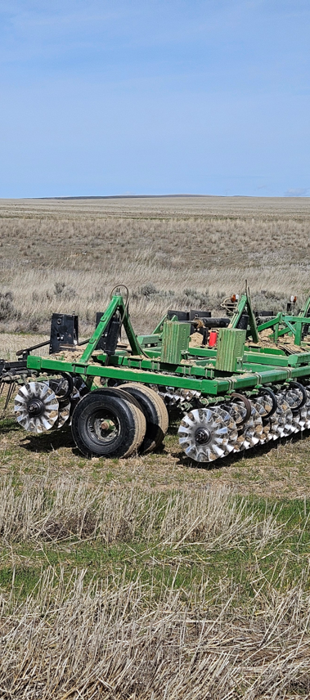
Seeding Methods
No-till drill
Conventional Drills
Broadcast seeding
Drone seeding
Notes:
Argument that newer seeding methods are more effective and exact at placing seed at proper depth and getting a good seedbed prep/pack. There have also been requests for broadcast seedings which are allowed under NRCS technical standards. Drones are now being equipped with dry rate spreaders, so in theory can do the same thing. Uncertain on the effectiveness of this method at this time.

Slide 8
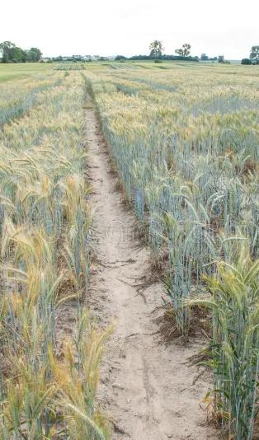
PMC Trials
Different drills types
Different seeding rates
Staged seedings
Notes:
The real way to update our standards and technical notes is with on the ground trials. Requests put forward for some seeding trials – need willing producers, land, equipment and seed ; as well as staff time – to make these meaningful.

Slide 9
Grazing Timelines
WA Exhibit 6, Par. 626
COC’s may authorize one of the following grazing periods. COC’s may approve different grazing periods for different areas of the county. Each area can only be approved for one grazing period. If different periods are authorized for different areas, the boundary must be such that it can be easily and clearly communicated to participants, and be approved in advance by the State Office. See page 4 for currently approved periods.
  July 2 – October 29
  October 1 – November 30 and January 1 – March 1
  November 1 – February 28
Notes:
Current WA Exhibits require that COC’s select a specific grazing period . We believe these WA exhibits are outdated and should be rescinded. Policy already restricts participants to 60, 90, or 120 days based on the type of grazing that is going to occur, adding these timelines just makes it more difficult for this practice to be put in place on the ground.

Slide 10
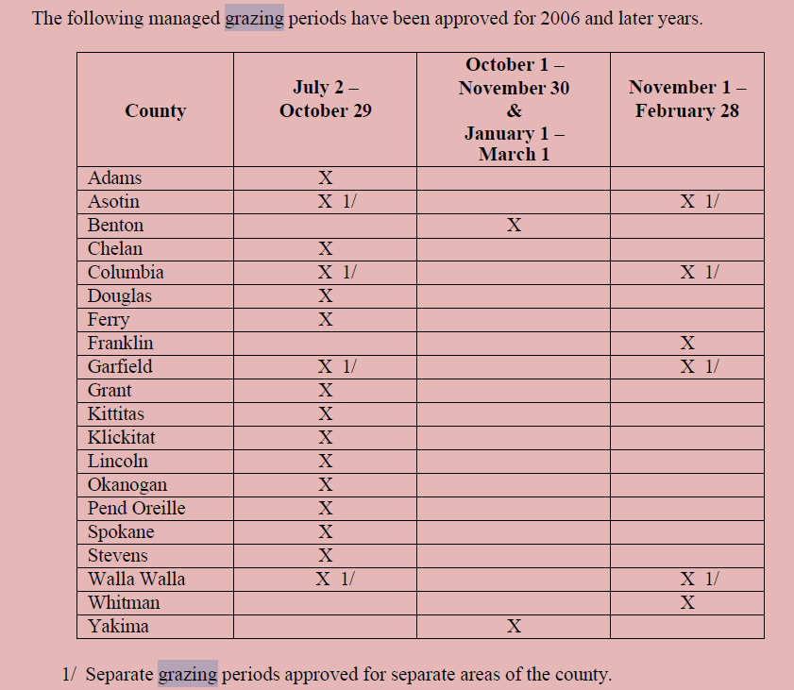

Haying and Grazing Periods
Notes:
Current WA grazing periods, by County. Several counties are further split and use different grazing periods (Asotin, Columbia, Garfield, Walla Walla)

Slide 11
Questions?

