Slide 1
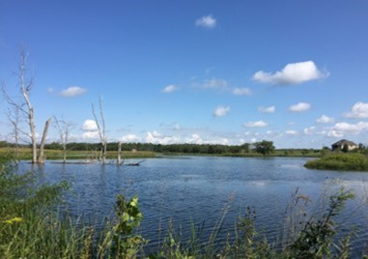
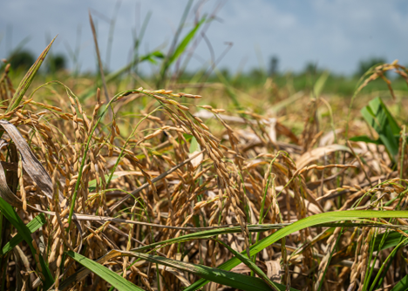


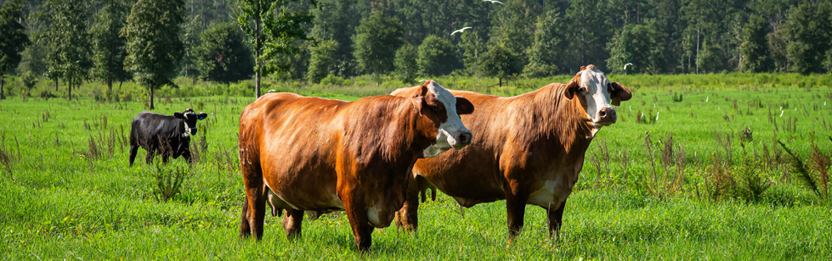
Robert D. Evans (Bobby)
NRCS-WA State Resource Conservationist

Slide 2

Regenerative agriculture is a conservation management approach that emphasizes natural resources through improved soil health, water management, and natural vitality for the productivity and prosperity of American agriculture and communities. The Regenerative Pilot Program (RPP) is a farmer-first, outcomes-based approach to conservation designed to return the agency to its core mission, helping people help the land, by addressing whole-farm resource concerns through support for voluntary regenerative agriculture Conservation Plans.
NRCS website
https://www.nrcs.usda.gov/programs-initiatives/regenerative-pilot-program

Slide 3

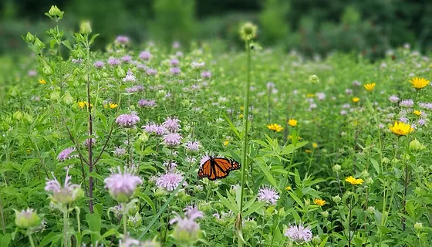
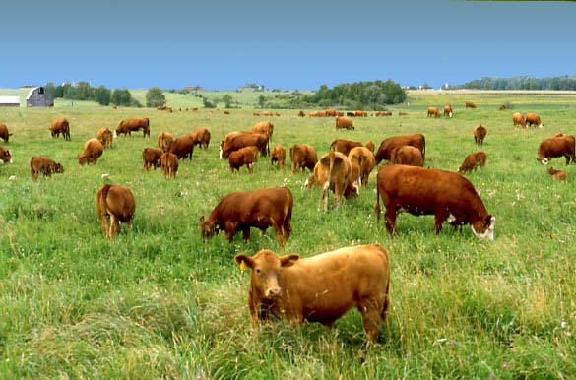
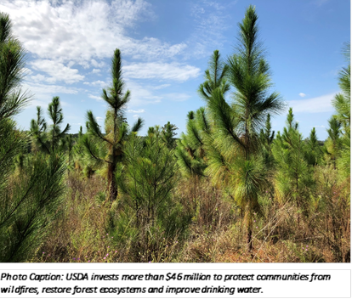
Regenerative Pilot Program Requirements
Whole Farm Assessment
Primary Practices
Soil Health Testing
Minimum 5-year contract

Slide 4
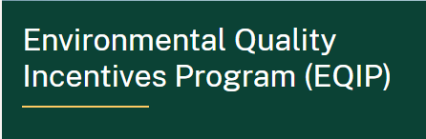

What is the “Whole Farm”
Environmental Quality Incentives Program (EQIP) | Conservation Stewardship Program (CSP)
Policy allows producer to define a subset of land as a separate operation/farm Whole farm definition = largely up to the producer with input from the planner | CSP Regen must follow same policy requirements as regular CSP All land the operator controls for 5-year contract must be enrolled Separate AgLands and NIPF
Note: When working with tribes to complete a whole farm assessment, NRCS and the Tribe will follow NI 440 307.14 , in combination with program policies found in CPM 440 Part 530 to address the unique relationship between the Tribe and its members so as not to create an undue hardship.
Notes:
Assessment is key word, assess all land units and client determines where to implement new conservation practices.

Slide 5
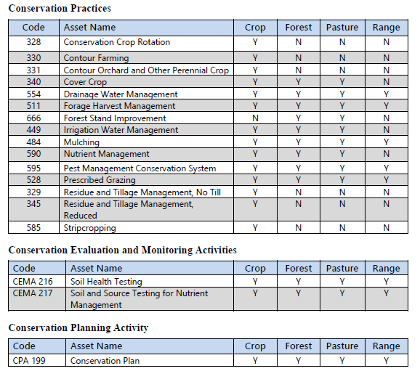
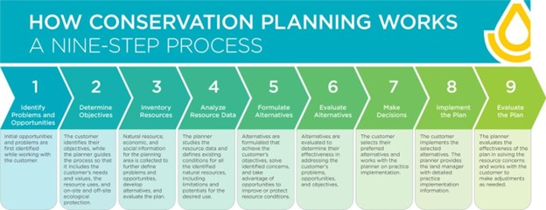
Land Uses
RPP focuses on Crop, Forest, Pasture, and Range

Slide 6
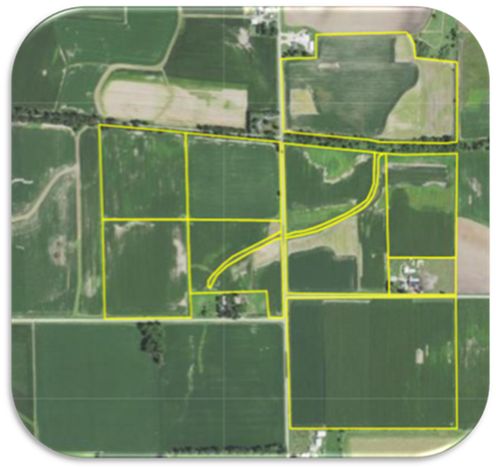
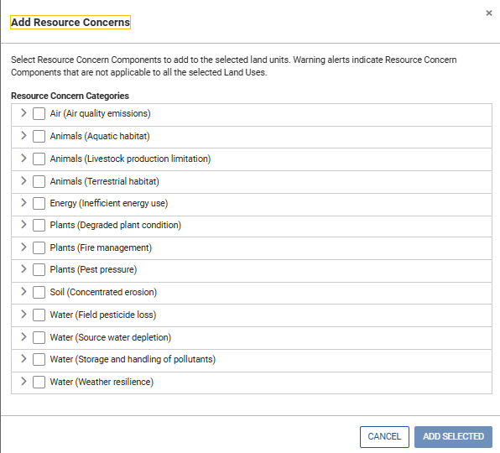
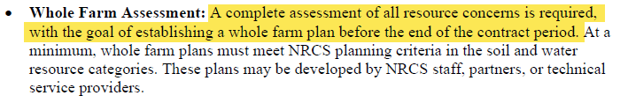
Assessment - Resource Concerns
Excerpt from NI 440 307.14 Regenerative Jan. 2026
Assessment Requirement: all applicable resource concerns/components assessed
  Goal: start conversation about whole farm planning and begin working towards creating a whole farm plan

Slide 7
Primary RPP Practices
A minimum of one primary Regen Practice
  Existing: has been implemented (even without NRCS)
  Planned: future implementation
May also include:
  Supporting: needed to facilitate the primary
  Other: allows for a conservation plan to be written to meet all the client’s objectives (beyond RPP).

Slide 8
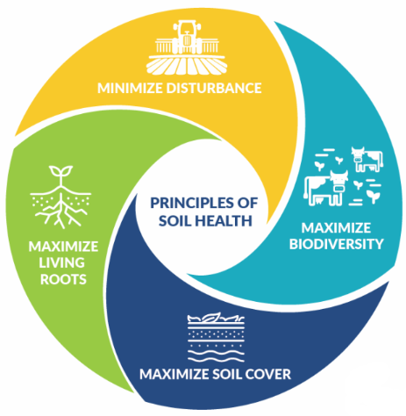
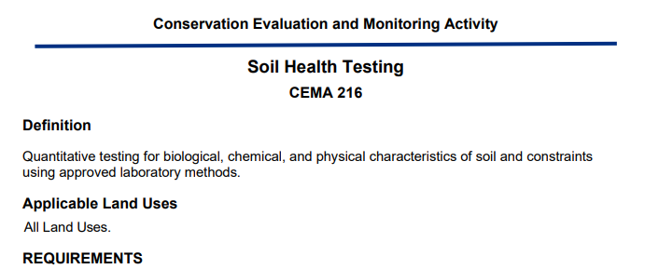
Soil Health Testing
Participants must agree to perform Soil Health Testing in the first and last year of the contract (at a minimum) to establish a starting baseline and to record the resulting changes.
Financial assistance for Soil Health Testing is available through CEMA 216.
Updated
CEMA 216 Soil Health Testing 01/2026

Slide 9
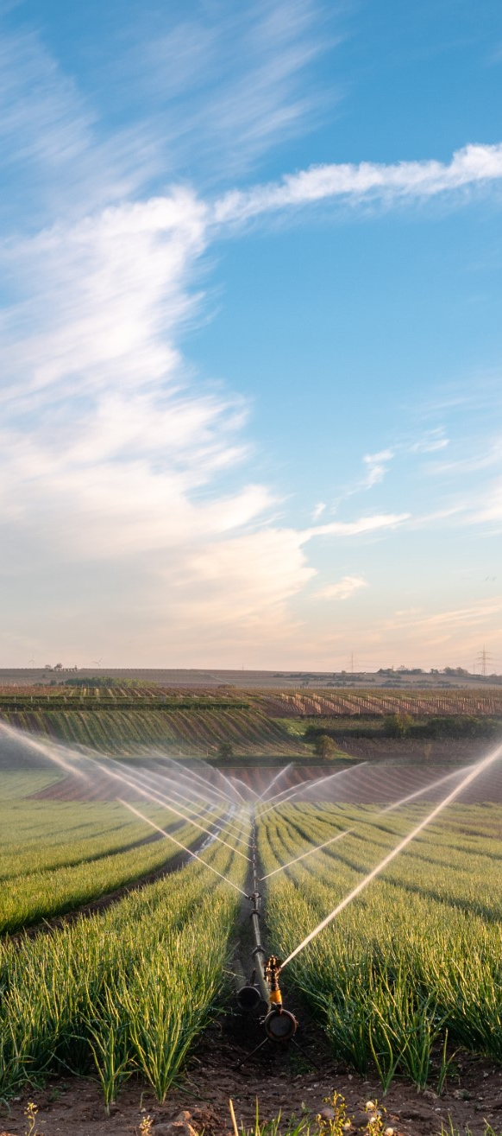
CEMA 216 changes: 30K’
Revision to CEMA 216 was needed to provide a product that:
  Allows for increased availability of commercial labs to be able to offer the services to producers
  Is simpler and easier to understand methods for producers, Technical Service Providers (TSPs), Qualified Individuals (QIs), and field office staff
  Streamlines the payment scenarios

Slide 10

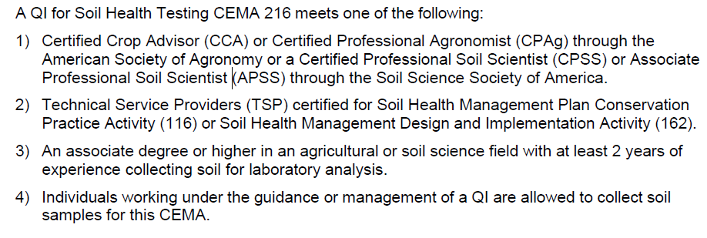

Qualified Individuals - CEMA 216

Slide 11
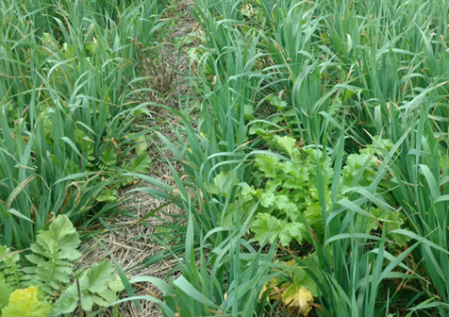

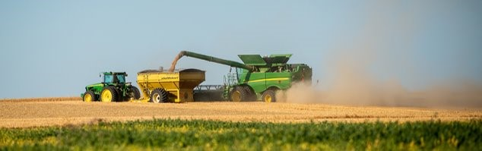
Questions &
Answers

