Slide 1
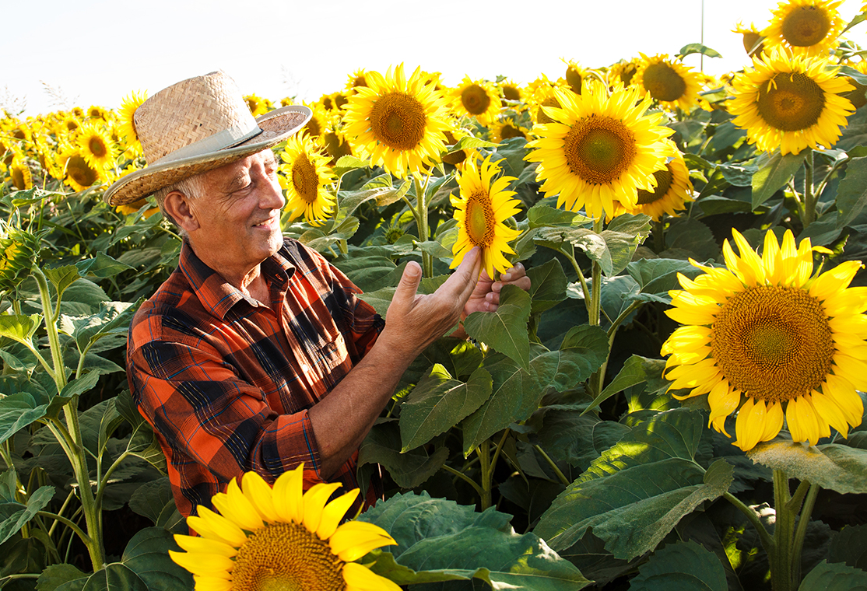
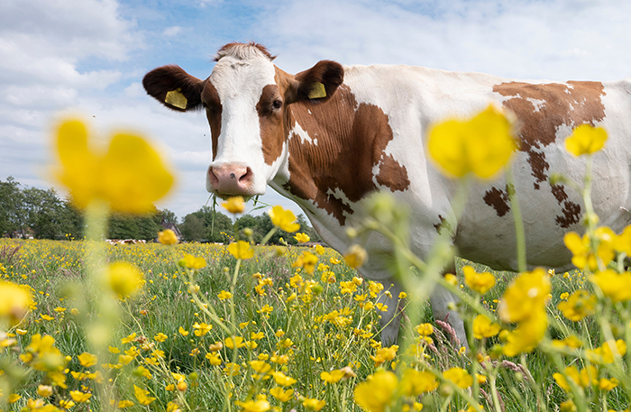
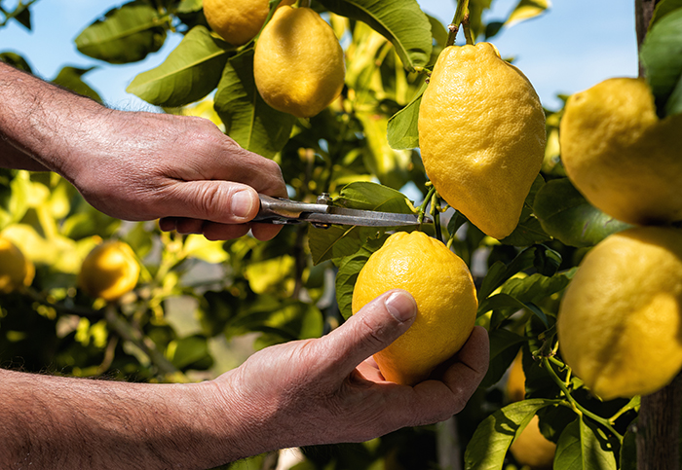

Conservation Practice Standards and FOTG Updates

Slide 2

Updated Timelines on Conservation Practice Standard Reviews
Chief has requested all Conservation Practices Standards (CPS) be reviewed this year.
The intent is to streamline reviews so that many comments are captured before the CPS is placed on the Federal Register.
Latest review time was shifted to 2 weeks.

Slide 3

WA Process for Initial Reviews of a CPS
The State Resource Conservationist (SRC), Bobby Evans, and the State Conservation Engineer (SCE), Lynelle Knehans, are responsible for collecting comments on CPSs
An email is sent to STAC and WATCAC with the draft CPS and a due date.
All comments should be sent to the SRC and the SCE by the due date.
Not all comments will be incorporated into the CPS.

Slide 4

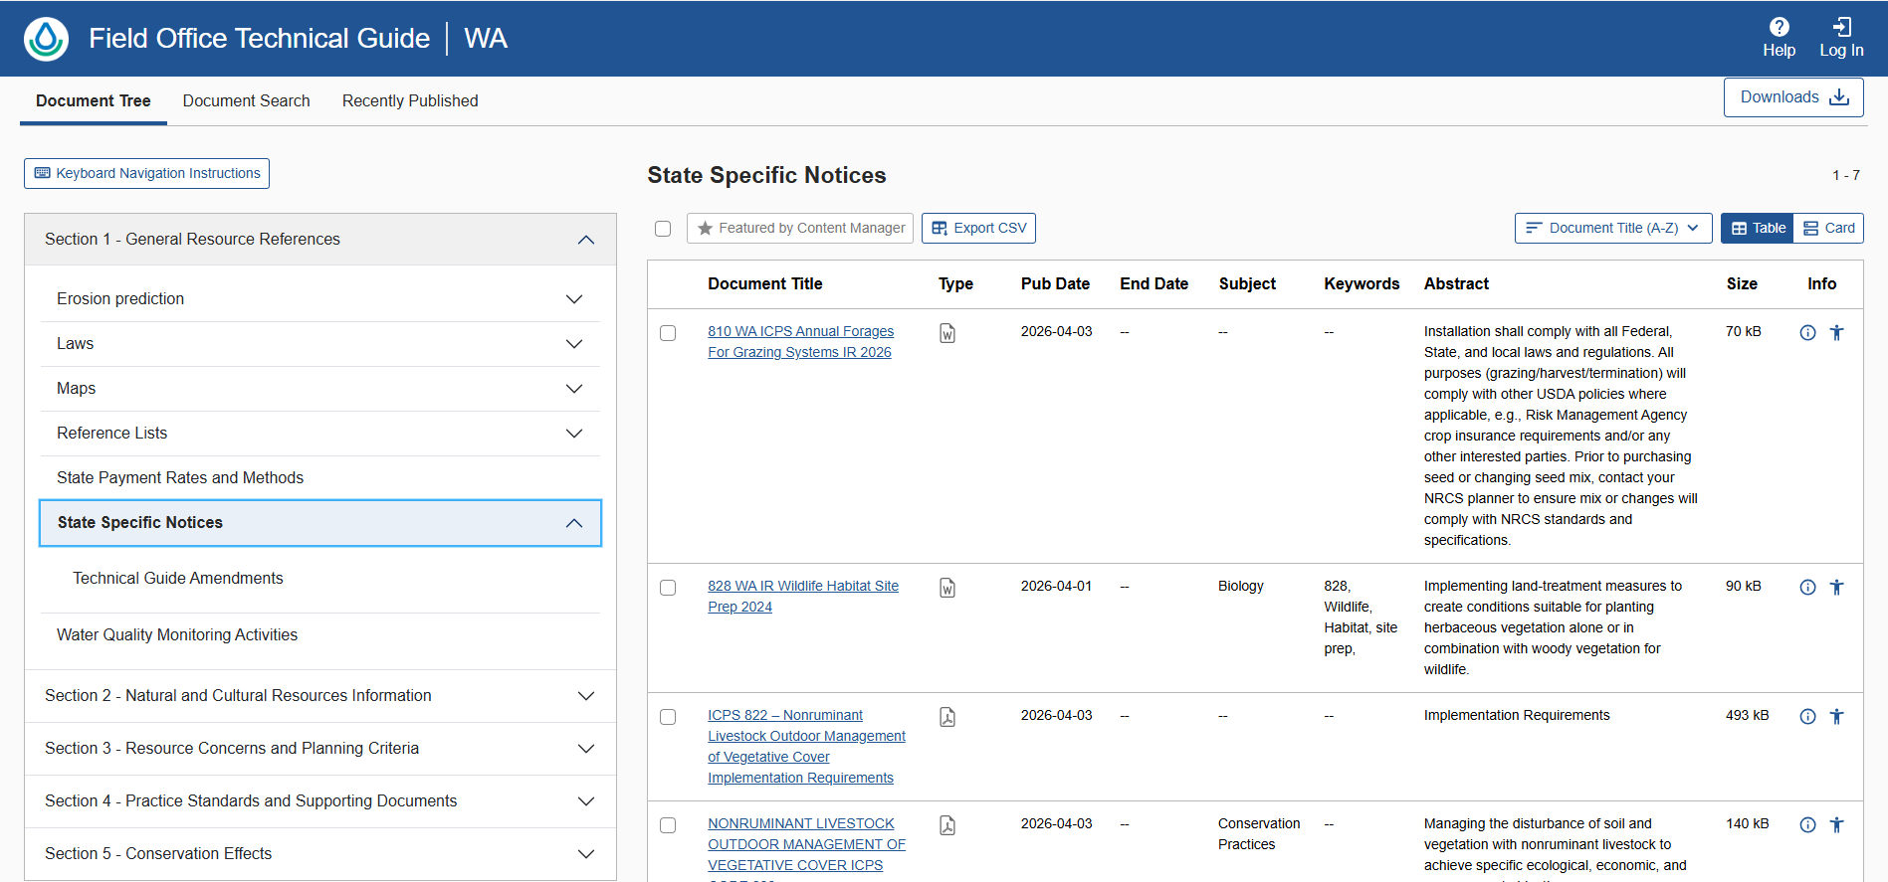
Interim Practices FOTG Update
Location of Interim Practices due to software issues is under Section 1: State Specific Notices

Slide 5
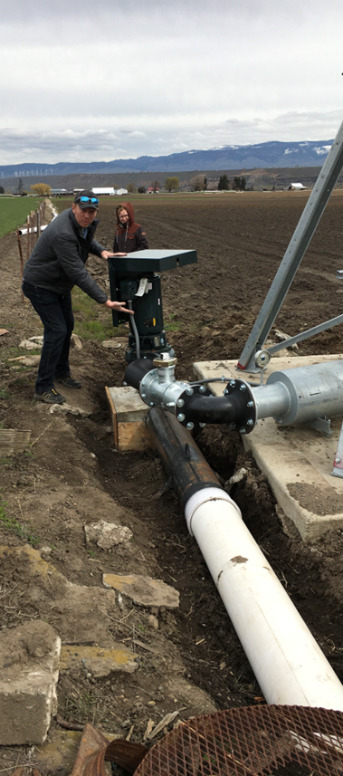
Irrigation FOTG Updates
Coming Soon:
  Updated “Irrigation System Design” Package
    This package can be used for the full system design package of an irrigation system
  Vendor Checklist
    Provided to vendors which describes the minimum requirements for meeting NRCS irrigation practices
  Planner Checklist
    Provided for planners to determine if all required documents are completed for planning, design and closeout.

Slide 6

Forestry FOTG Updates
All 2025 Practice Standard updates for Forestry Practices are on hold for further review from national.
  WA adoption will occur once final CPS is released
    Access Road
    Silvopasture
    Forest Trails & Landings,
    Tree/Shrub Site Preparation
    Woody Residue Treatment
State & Area Foresters are in the process of reviewing and revising Implementation Requirements
  Woody Residue Treatment
  Tree/Shrub Site Prep
  Tree/Shrub Establishment
  Forest Stand Improvement
All Guidance Documents and and Implementation Requirement updates are expected to be posted at start of FY27

Slide 7
FOTG Updates
Practice Name | Code | Document Type | Status | Notes?
Grazing Management | 528 | Implementation Requirement | Under Review | Intensive Monitoring
Structures for Wildlife | 649 | Implementation Requirement | Posted | More specifications to come
Wildlife Habitat Site Prep | 828 | Implementation Requirement | Posted | Section 1
Resource Conserving Cover Crops | n/a | Agronomy Technote 22 | Posted | Technote
Resource Conserving & Improved Resource Conserving Crop Rotation | 328 | Worksheet & Requirements | Posted | CSP: Under Conservation Crop Rotation (328) Section 4
Annual Forages for Grazing Systems | 810 |  | Posted | Section 1
Annual Forages for Grazing Systems | 810 | Implementation Requirement & Guidance Document | Posted | Section 1
Nonruminant Livestock Mgmt of Vegetative Cover | 822 | Implementation Requirement | Posted | Section 1
Prescribed Grazing | 528 | Adv Grazing Management | Posted | CSP document

