Slide 1
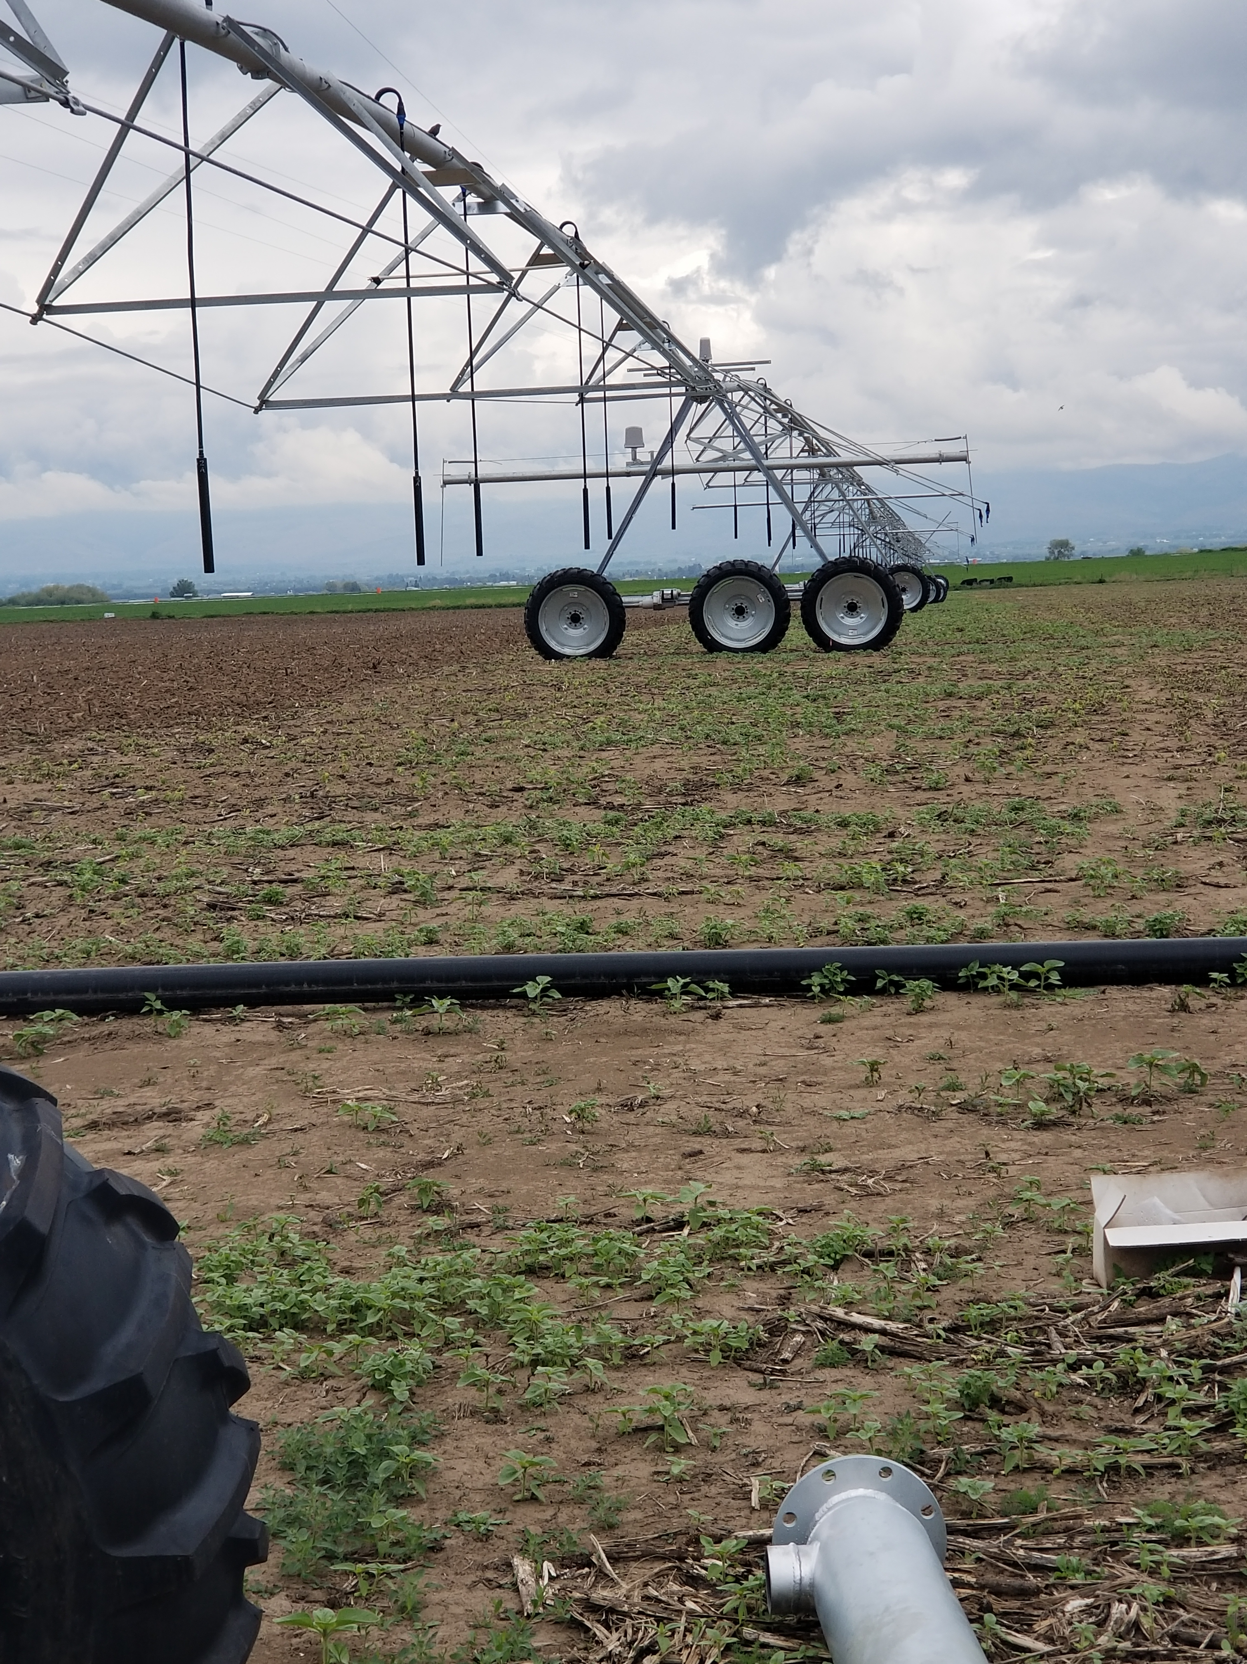
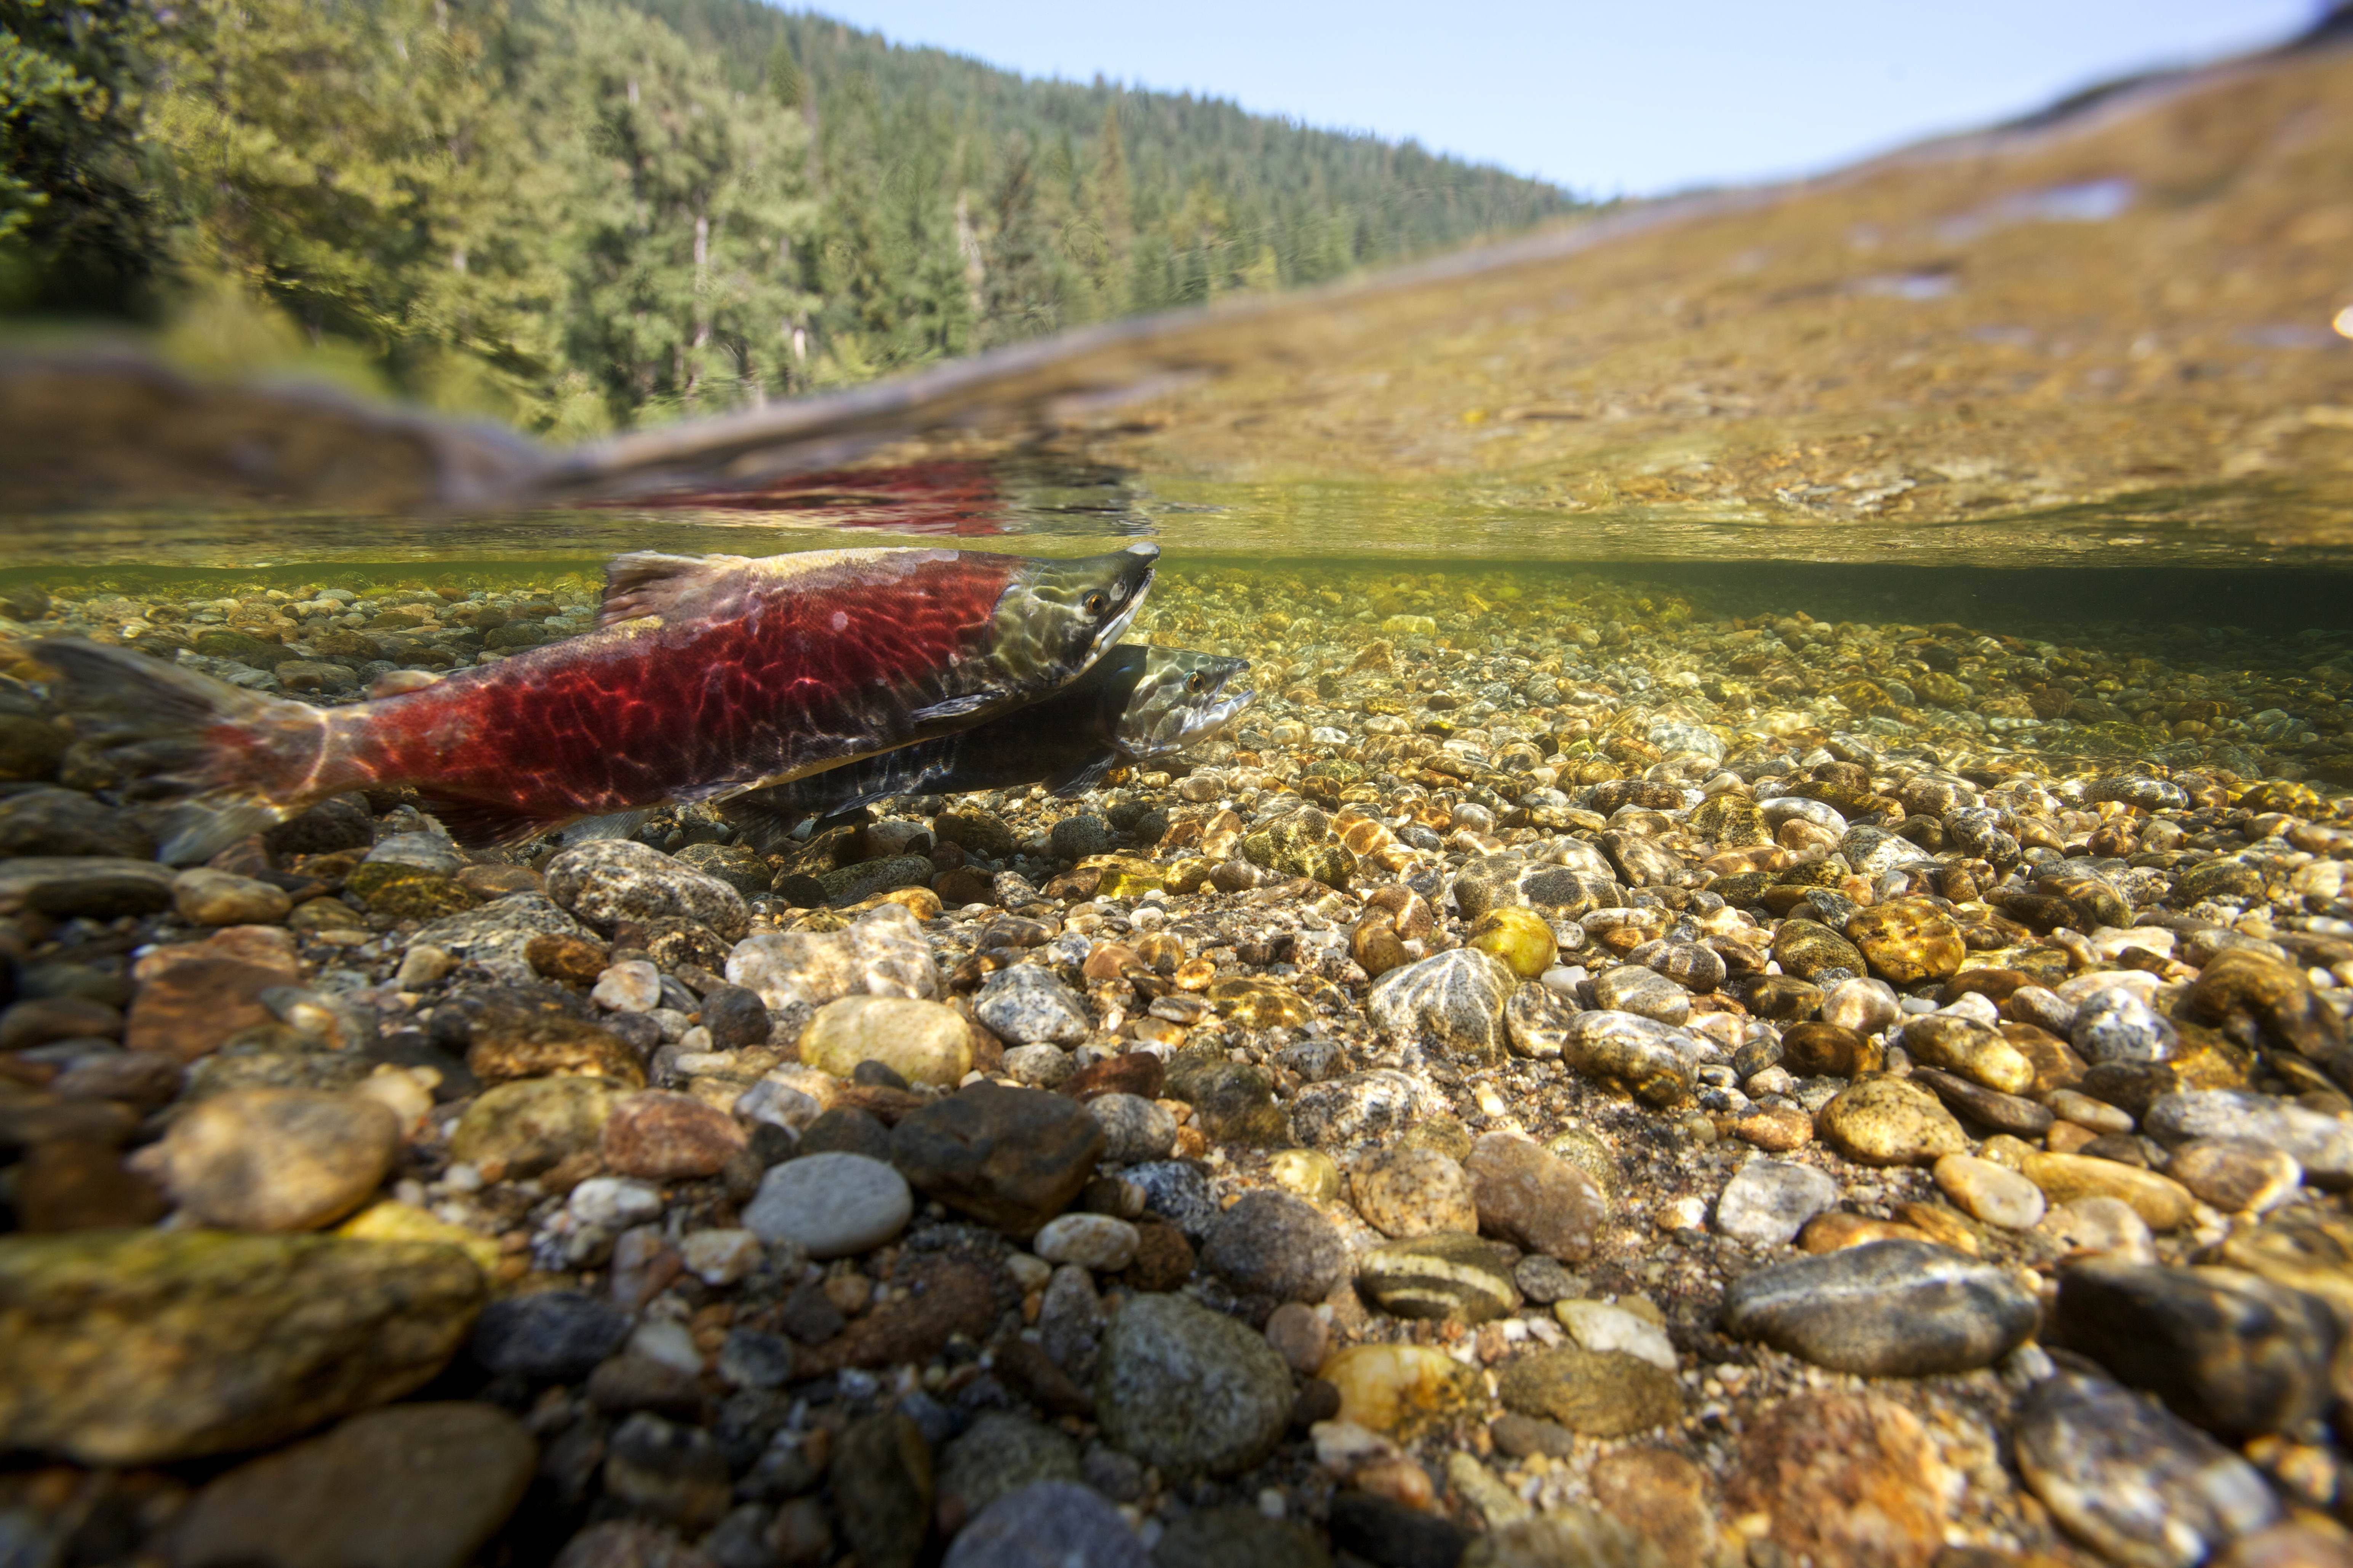
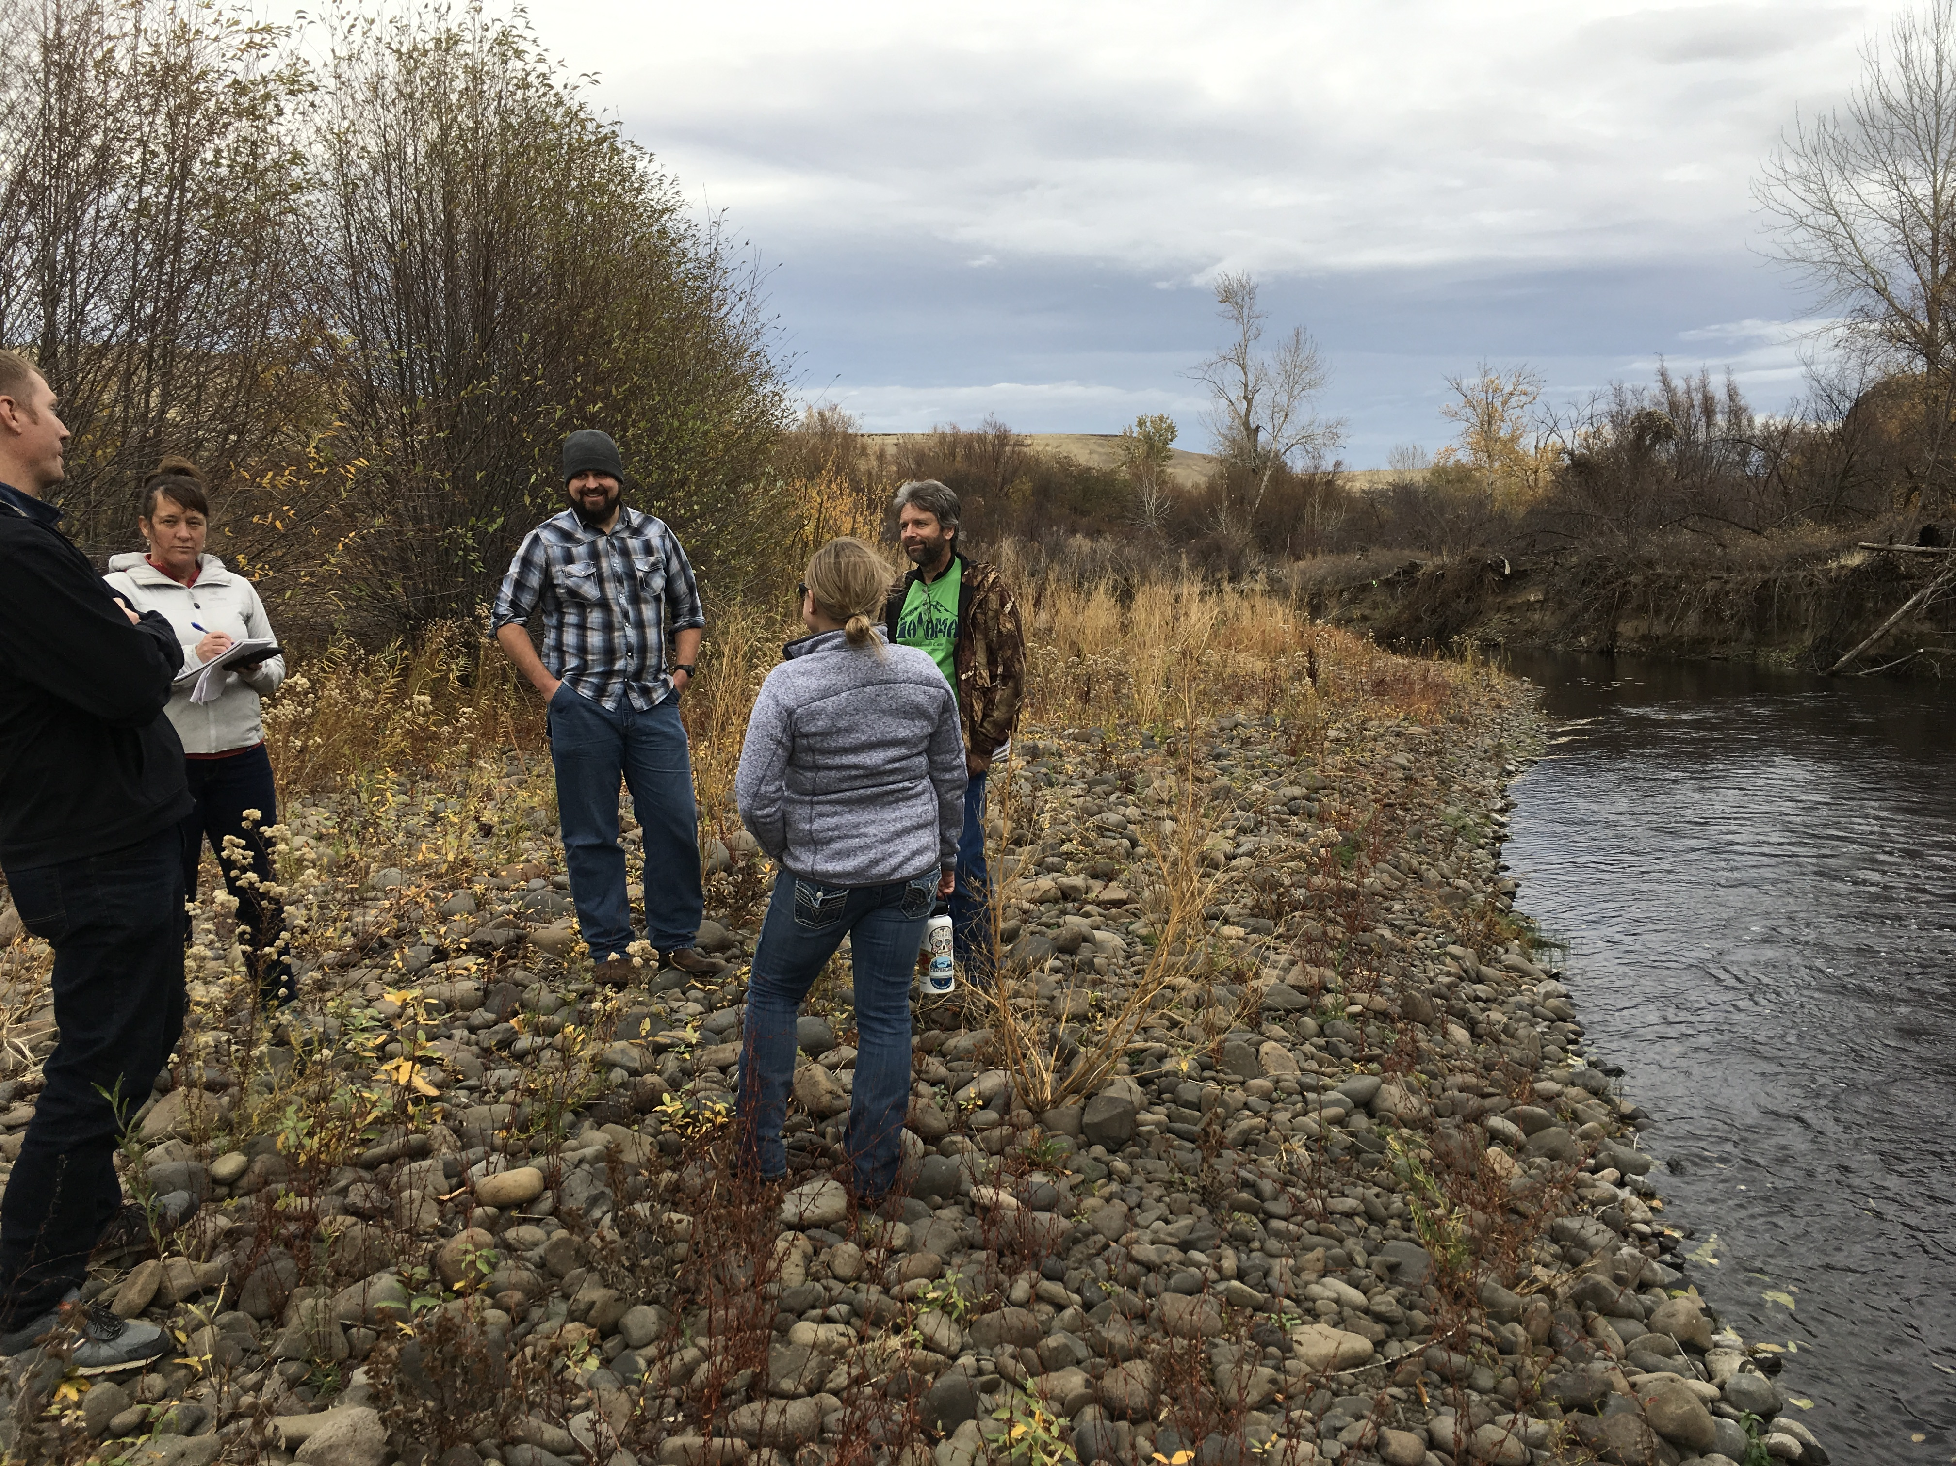
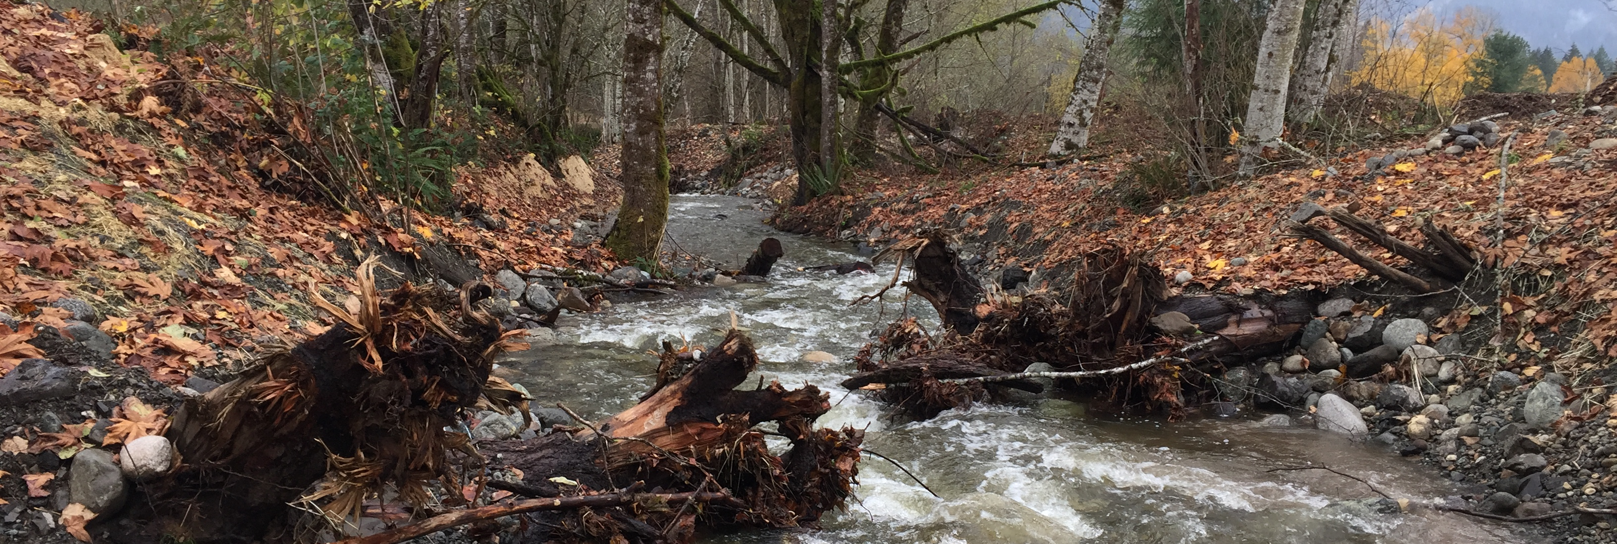
CRP Updates

Slide 2

Notice CRP-1073
Notice CRP-1073 was released 1/28/26 and removed our requirement for NRCS to do status reviews for the final 10% PIP Payments.
This reduced work on renewing CRP, a major benefit to NRCS field staff

Slide 3

CRP Transition Incentive Program (TIP) Authority (Notice CRP-1081)
  Enrollments effective March 16, 2026, through September 30, 2026
    CRP-1R must be submitted by Aug 14, 2026
    Limited to CRP contracts that expire Sept 30, 2026, or Sept 30, 2027
  $50M nationally
  Owner leasing (5+ years) or selling to Beginning Farmer or Veteran
  Voluntarily transfer expiring CRP 2 years prior to expiration
  Additional 2 years post expiration if not to family member

Slide 4
CRP 1081 Transition Incentive Program (TIP)
Potential Practices Covered
Preparing the land for certified organic food production
Installing filter strips
Installing fencing
Installing livestock watering facilities
  Note: Grazing is not allowed before CRP-1 expiration.
Installing pipelines
Installing water wells
Other appropriate practices as recommended by NRCS or TSP

Slide 5

FY26 CRP Updates
Notice CRP-1082: NRCS needs to submit Continuous CRP plans by Sept 18th, 2026
SAFE Seeding Updates in process
Grassland CRP will close our sign-up period for the year and will be announced later.
^{Factsheet updates:}
  Consideration of Native Seed Mixes & Producer CRP Offers
  CRP Tech Considerations Fact Sheet

