Slide 1

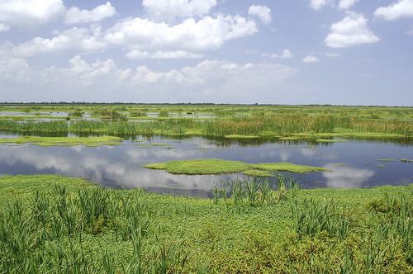
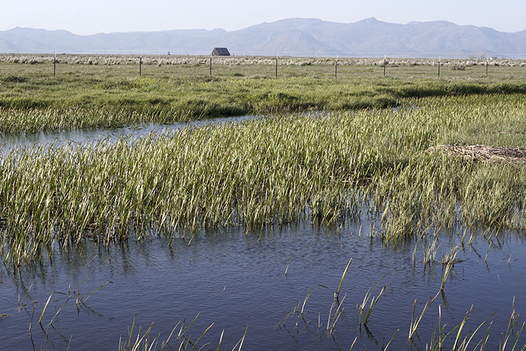
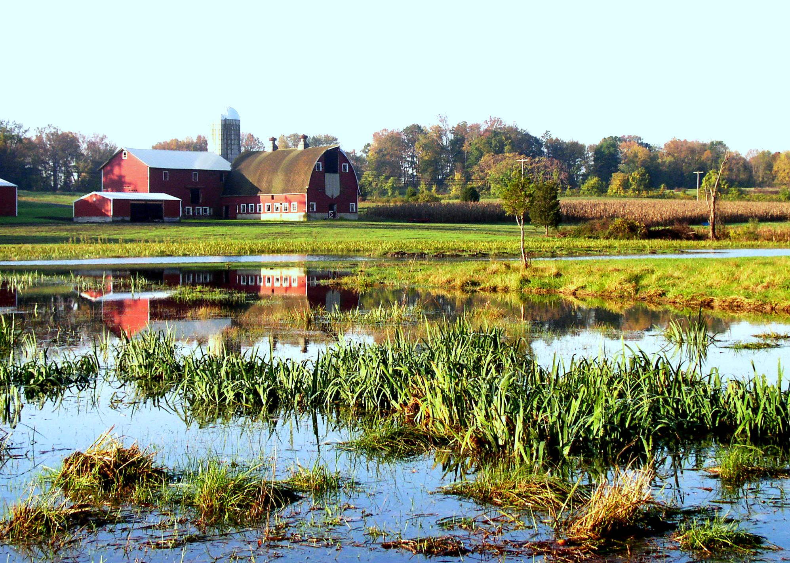
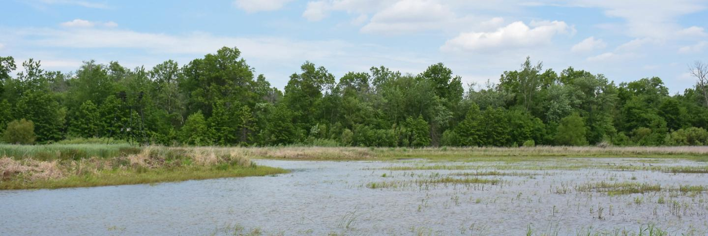
NRCS WA Wetland Conservations Compliance Updates
STAC Meeting; Feb 2026
Max Ross
State Resource Soil Scientist
NRCS Washington

Slide 2
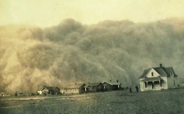
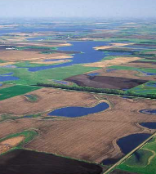
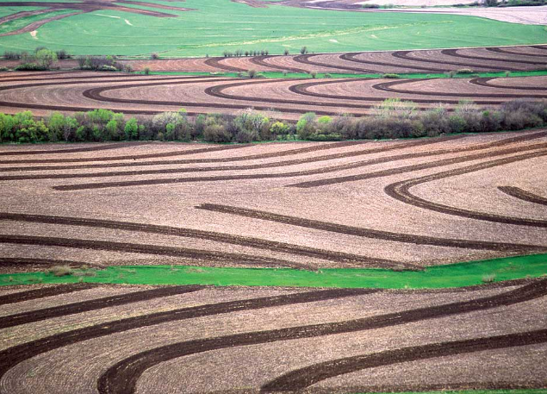
Wetland Conservation Compliance Background
1930’s: Dust Bowl
1935: Soil Conservation Act; established SCS, now NRCS in USDA
1955-1980: Loss of approximately 50% of wetlands in the US; primarily attributed to agricultural development
1985: Food Security Act (1985 Farm Bill) establishes the HELC and WC provisions
  “conservation compliance”
  “swampbuster” and “sodbuster” provisions
1990: Farm Bill expands wetland conservation provisions
2014: Farm Bill expands list of ineligible benefits for producers out of compliance

Slide 3
Overview of Wetland Compliance Provisions
Disincentivizes producers from converting wetlands to make production of agricultural commodities possible. Specifically, those who:
  Convert a wetland and plant a commodity crop after Dec 23, 1985 are ineligible for USDA programs
  Convert a wetland resulting in commodity crop production being made possible after Nov 28, 1990 are ineligible for USDA programs
  Converted a wetland prior to Dec 23, 1985 largely remain eligible for program benefits
    Sometimes with conditions
Exceptions and exemptions exist
  Non-commodity crops, development and infrastructure
Mitigation and restoration options exist for re-obtaining USDA program eligibility
FSA WC provisions only pertain to USDA program participants
  Clean Water Act, Critical Areas Ordinance, regulatory agencies are separate

Slide 4
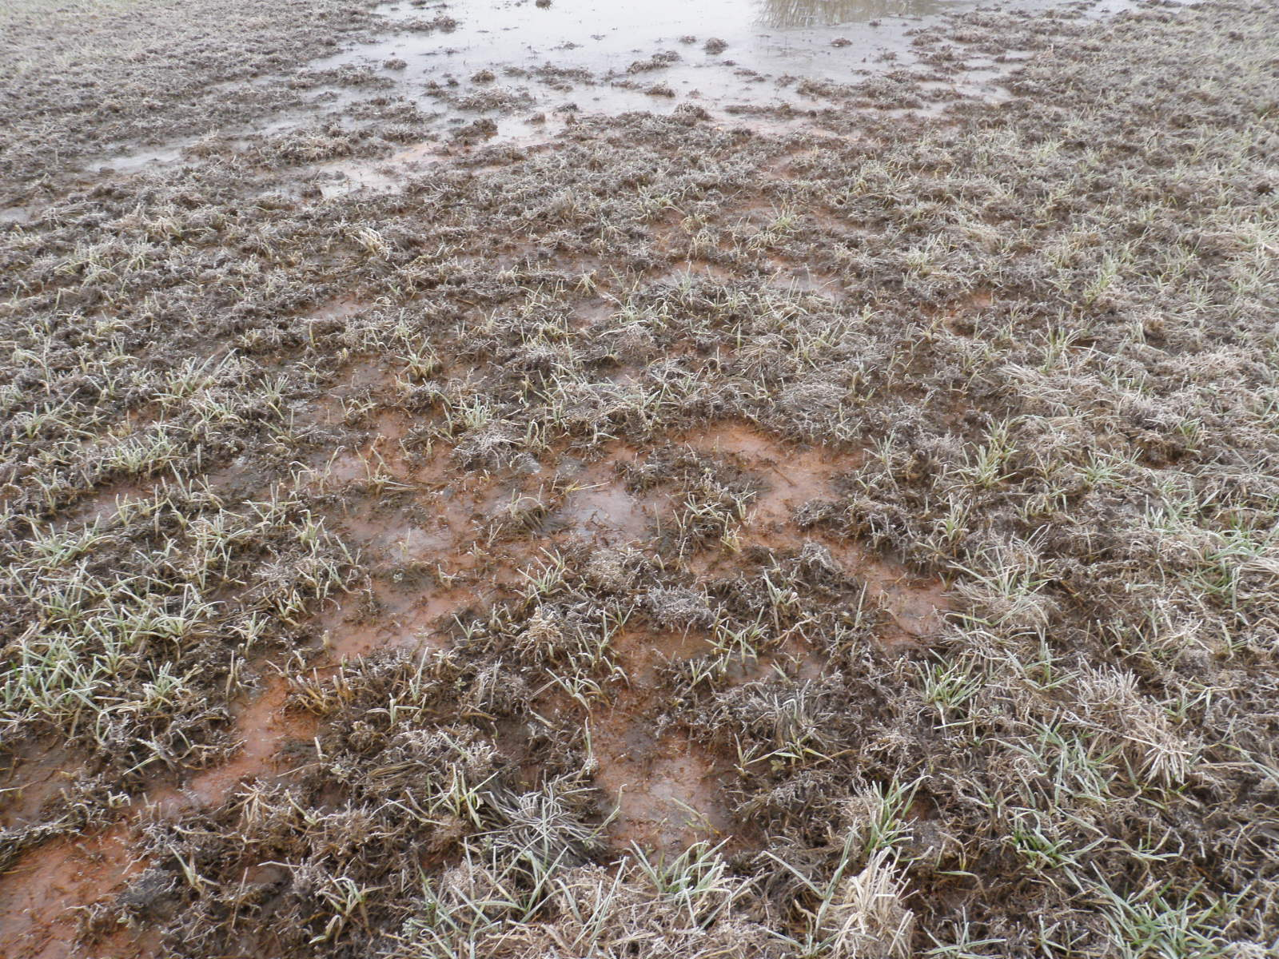
Wetland Compliance Roles and Responsibilities
Beginning in FY2024, the Farm Service Agency (FSA) will begin entering Highly Erodible Land Conservation (HELC) and Wetland Conservation (WC) requests into the HELC/WC Tracking Tool in Conservation Desktop (CD)
FSA
Enter all requests for Wetland determinations into CD.
Receive and process AD-1026
Issue FSA-569
Refer requests to the District Conservationist or field office.
Enter all appeals made directly to the COC into CD.
Enter all appeals made to NAD following a COC appeal into CD.
Photo: Jericho Winter
NRCS Field office
Enter all Wetland determination requests received via CPA-038.
Fill out the Wetland Request Workbook & gather documents.
Refer the request with completed Workbook & docs to the Wetland Specialist.
Have general awareness of FSA Conservation Compliance and be able to communicate with producers.
NRCS Wetland Specialist
Complete all Preliminary and Final Technical Determinations.
Complete evaluations and updated determinations for minimal effect exemption.
Update requests in CD as they are completed & upload docs to CD-DMS.
Enter all preliminary appeals for wetlands.
Enter final appeals made directly to NAD following the issuance of an FTD.

Slide 5
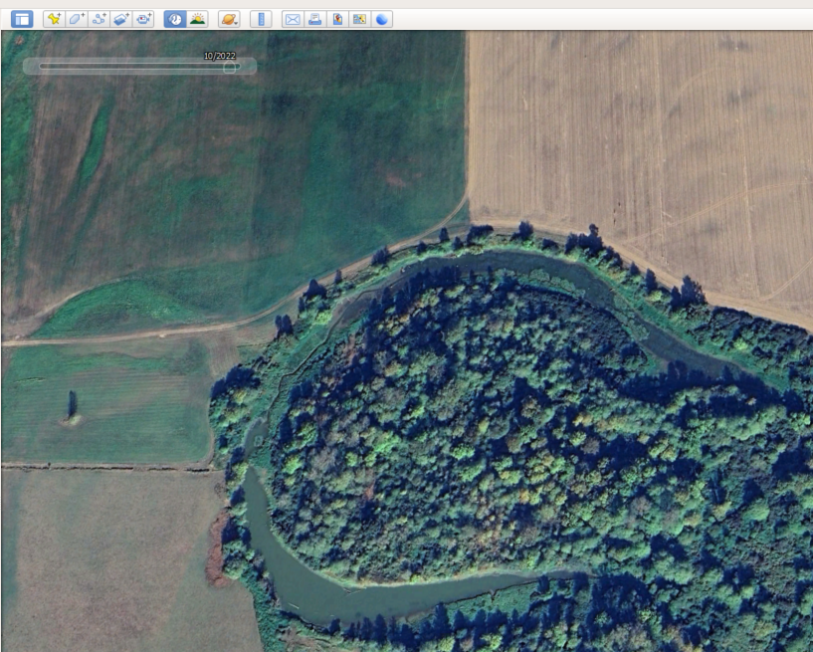
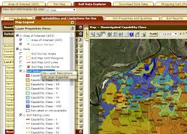
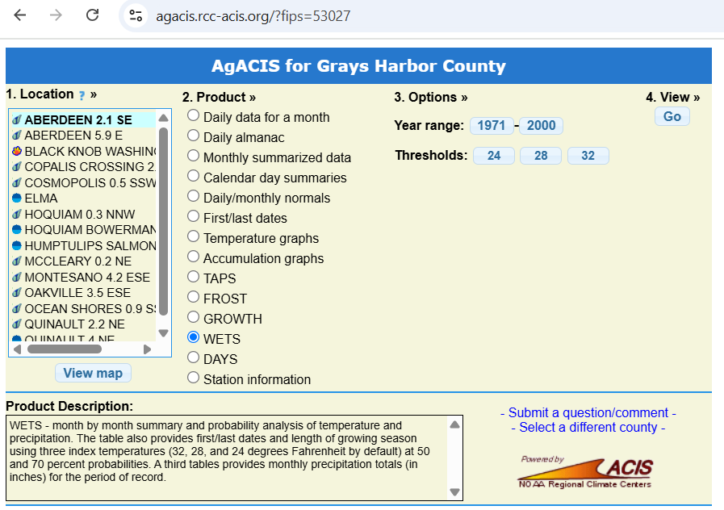
Certified Wetland Determination (CWD) Process
Wetland determination procedure requires both off-site and on-site investigations
Remote Sensing (off-site) Investigation:
  Obtain and review historical aerial imagery, LiDAR, NWI maps, Soil Survey, etc.
  Clarify scope and timeline of wetland conversion and relevant management activities
  Review WETS tables – precipitation and temperature data
  Confirm cropping and land-use history
  Identification of drainage features, if applicable
  Determine “best drained condition” prior to Dec 23, 1985, if applicable
  Preliminary mapping – identification of sample units

Slide 6

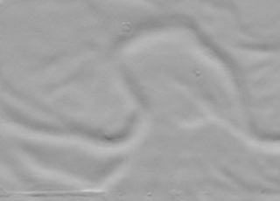
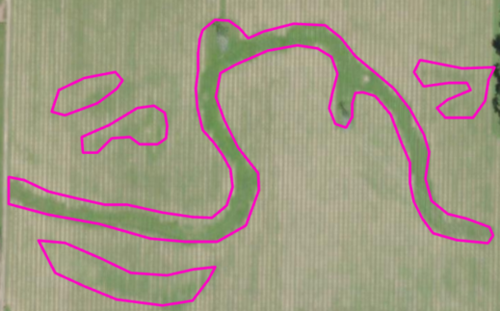
Wetland Determination Process – Sample Units
Smallest identifiable land unit within the area subject to wetland determination
Sample units are identified based on having unique: Plant community, soil properties, hydrology, landscape/landform, land-use, and/or management impact
Sample units may repeat throughout study area
Goal is to identify and delineate unique wetland units and non-wetlands
EXAMPLE:
Dec 1985 Aerial
2018 LiDAR
2023 Aerial with labeled sample units
1
2a
2b
2c
3
2d
Sample Unit 1: Depressional drainageway; likely wetland
Sample Unit 2: Slight depressions, changes in vegetation color; potential wetlands
Sample Unit 3: Upland; likely non-wetland

Slide 7
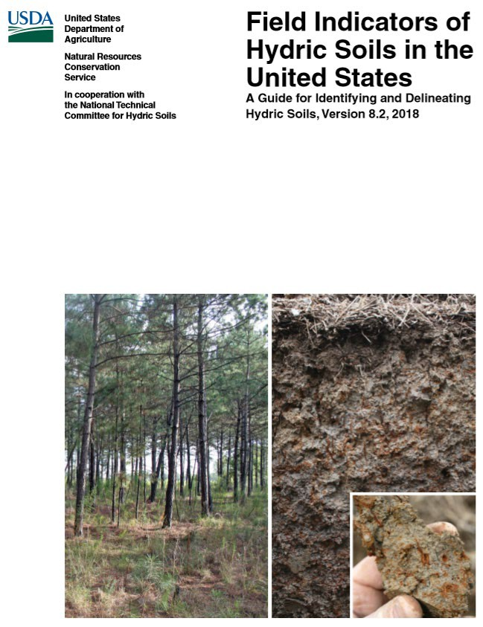
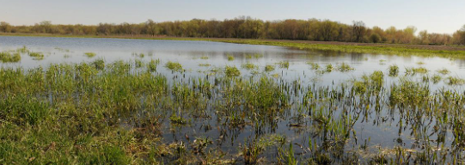
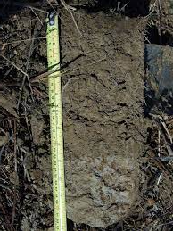
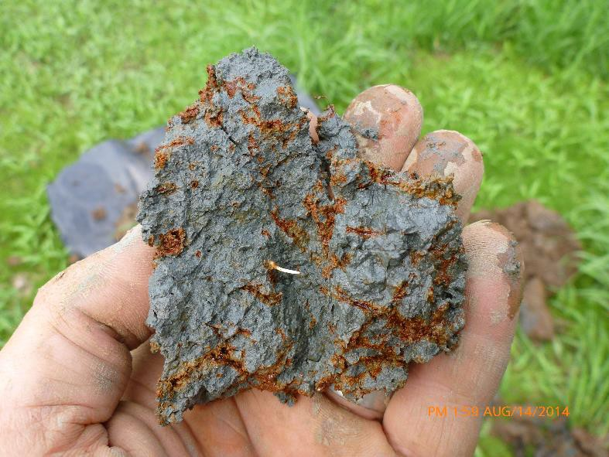
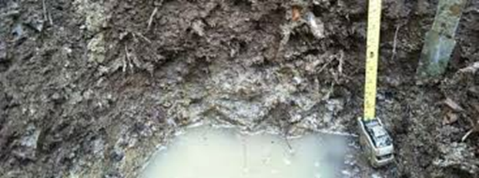
Wetland Determination Process – On-site Investigation
Field (on-site) Investigation:
  Travel often required
  Representative point within each sample unit to determine if it is a wetland
    Prevalence of hydrophytic vegetation
    Hydric soils
    Wetland hydrology

Slide 8
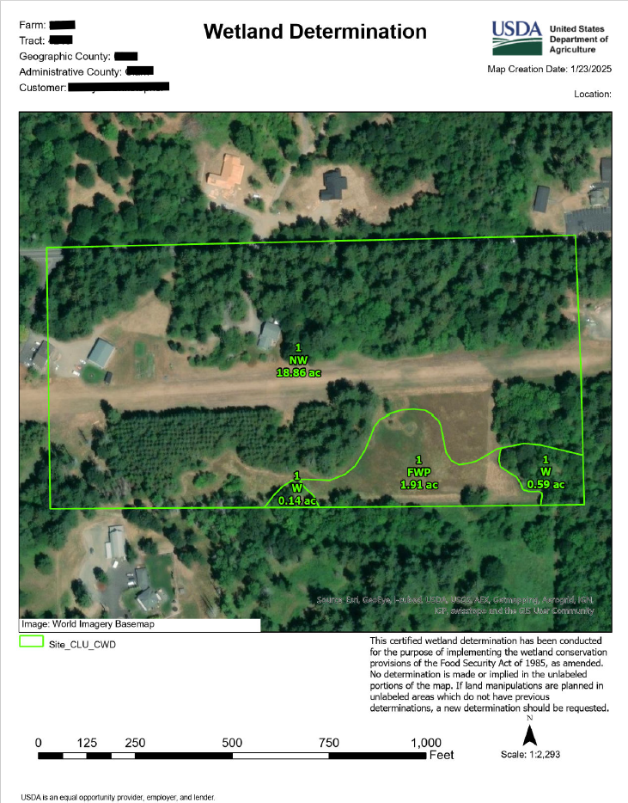
Wetland Determination Process – Issue CWD
Each sample unit will be identified as a wetland or non-wetland and assigned a Food Security Act wetland label
Common labels include:
  W (wetland): Area meeting wetland criteria, not converted after Dec 23, 1985
  NW (non-wetland): Area that does not contain a wetland
  PC (prior-converted): Wetland converted to cropland before Dec 23, 1985. These areas not subject to WC provisions of the FSA unless further drainage alters adjacent wetlands
  FW (farmed wetland): Wetland that was manipulated or planted before 1985 but still meets wetland hydrology criteria. These areas may be farmed and maintained as documented prior to Dec 23, 1985, if they are not abandoned
  FWP (farmed wetland pasture): Wetland used for pasture or hay, manipulated or planted before Dec 23, 1985. These areas may be farmed and maintained as documented prior to Dec 23, 1985, if they are not abandoned
  WX (manipulated wetlands): Wetlands manipulated after Dec 23, 1985, but not for the purpose of making production possible, and production was not made possible
  CW+yr (converted wetland): Wetland converted after Dec 23, 1985, making production possible; may result in ineligibility for USDA program benefits
    Indicates violation occurred; eligibility determined by FSA
The wetland determination map will identify wetland boundaries, wetland type (label), CLU field number, and acres

Slide 9
CWD Process and Workload
  CWD typically requires 40-80+ hours of work
    Travel and fieldwork typically account for ~half of total time
  Required to issue CWD within 6 months of receiving request
    If feasible; there are exceptions
  Very limited staff with JAA to complete CWD’s
    Currently only 2 in WA State
  Wetland fieldwork should be conducted during “wet part of growing season”
    March - June
  Often a backlog of CWD requests
  Producers often wait until they have their CWD to move forward with applications or contracting

Slide 10
State Off-Site Methods for CWD
  Comprehensive methods for completing CWD using exclusively off-site methods
  Co-authored with Jericho Winter (OR SSS), Heather Noel (WA Easement/Wetland Specialist), Jennifer Cavanaugh (West Region Wetland Compliance Specialist)
    Reviewed and edited by national wetland compliance staff
  Any CWD with adverse outcome will still require on-site determination
    Adverse to the producer
  SOSM document available to STAC for review and comment

Slide 11
State Off-Site Methods - Overview
  Procedure for identifying and delineating sample units
  Criteria, assessments, and acceptable resources for identifying wetland hydrology, soils, and vegetation
  Assessment for obvious non-wetland situations
  Procedure of assigning wetland labels and finalizing determination

Slide 12
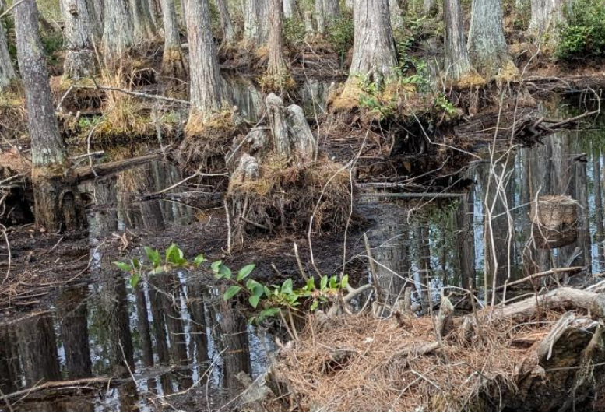
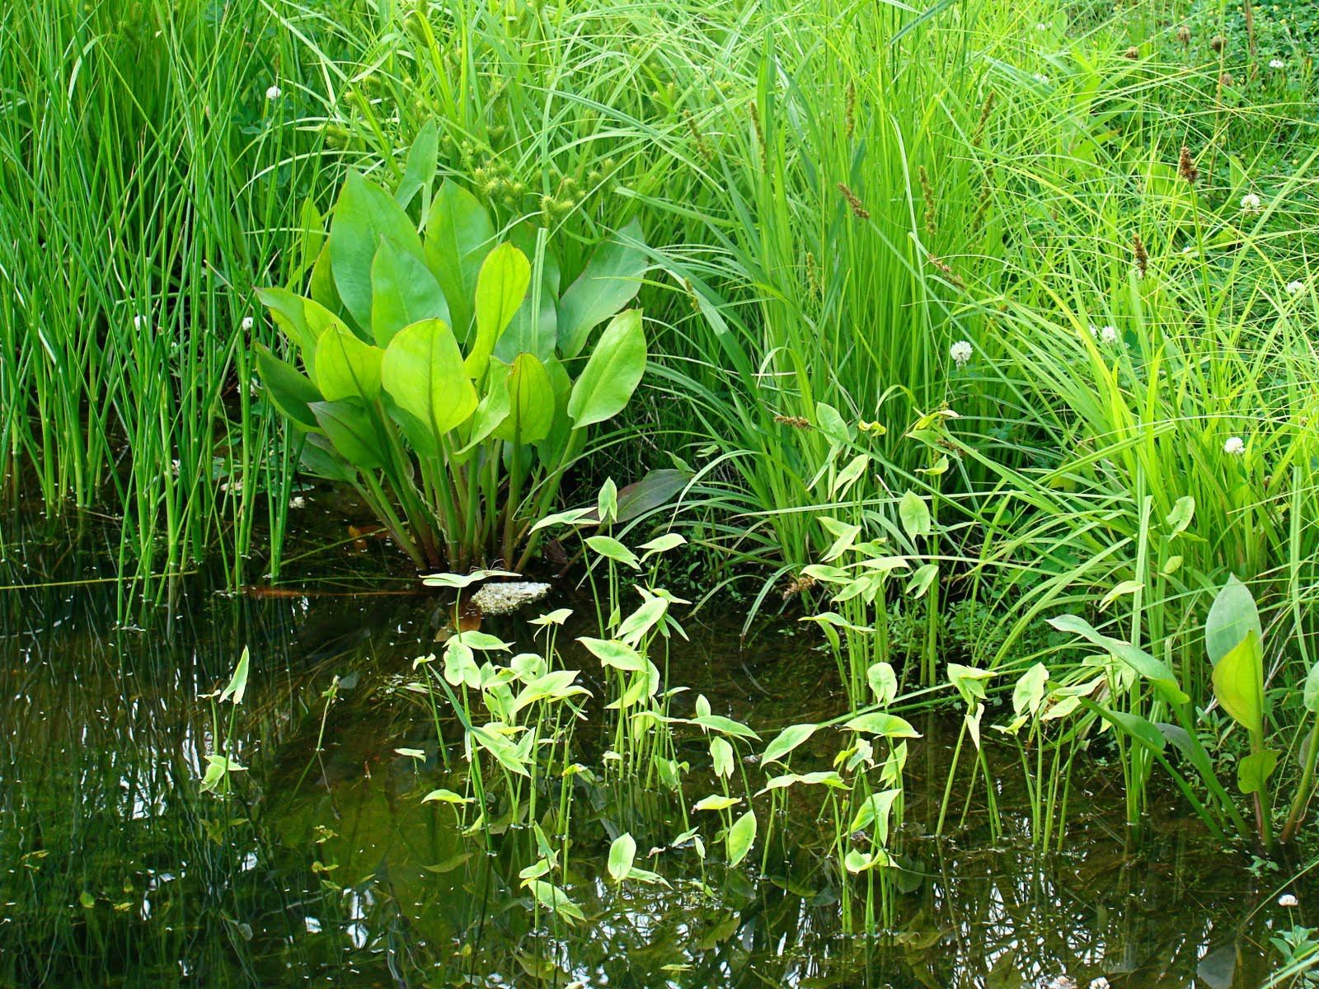
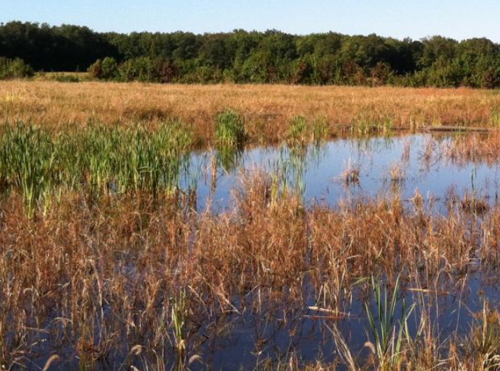
State Off-Site Methods - Vegetation
  Procedure for identifying vegetation in each sample unit
  Data References:
    Documented Reference Sites
    Ecological Site Descriptions
    Official Series Description
    Web Soil Survey Reports
    NWI Maps
    Aerial Imagery

Slide 13
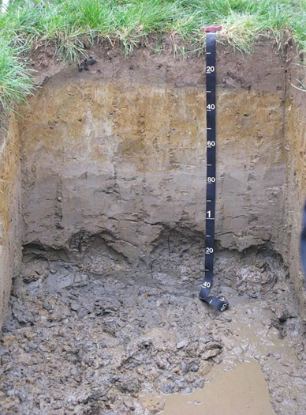
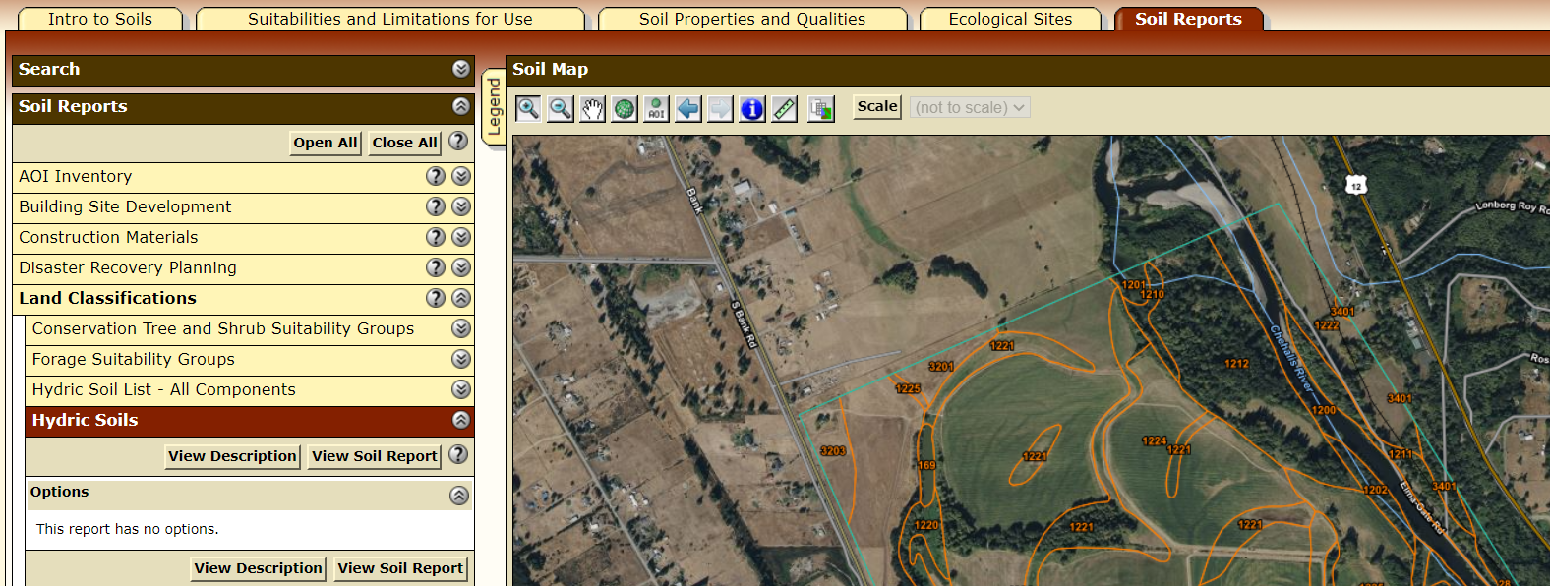
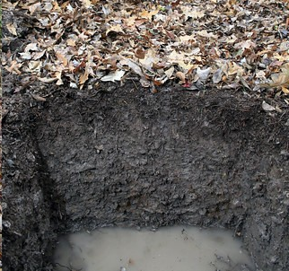
State Off-Site Methods – Hydric Soils
  Determined using Soil Survey data assessment:
    Landform of sample unit and soil survey map unit to be confirmed using LiDAR, aerial imagery, topographic maps, etc.
    If soil map unit is comprised entirely of hydric soil and/or miscellaneous areas meeting hydric criteria, the soil is determined to be hydric
    If soil map unit is comprised partially of a hydric soil the sample unit landform must be consistent with the hydric component landform for the soil to be determined as hydric

Slide 14
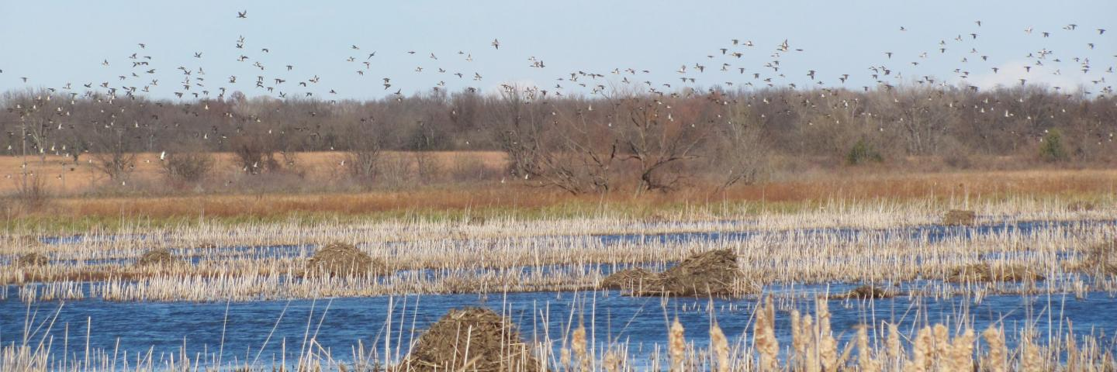
State Off-Site Methods - Hydrology
  Determine normal circumstances and growing season
    WETS Tables, imagery, land-use history
  Determine whether pre-1985 and/or post-1985 drainage is present
    If pre-1985, determine “best drained condition”
    Separate assessments for post-1985 drainage and no post-1985 drainage
  Assessments use following resources:
    Web Soil Survey Water Features Report
    NWI Maps
    USGS Topographic Maps and Map Symbols
    Aerial Imagery

Slide 15
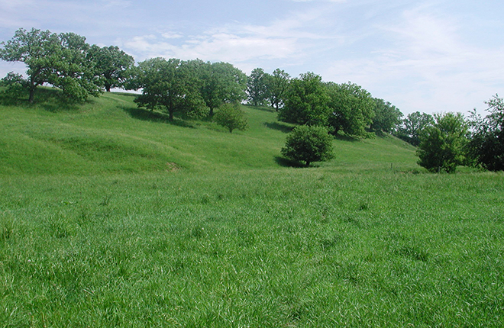
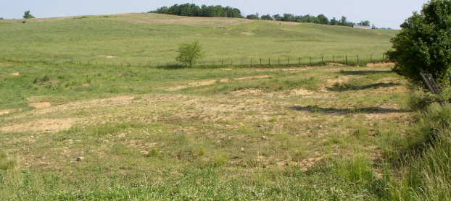
State Off-Site Methods – Obvious Non-Wetlands
  Assessment for obvious non-wetland situations:
    Sloping or convex landform
    Soil map unit contains <10% hydric soil and hydric soil indicator not met using SOSM
    Hydrophytic vegetation not present, as determined using SOSM
    No wetness signatures on aerial imagery
  Wetland specialist may label sample unit as non-wetland

Slide 16
State Off-Site Methods – WC Label
Each sample unit will be identified as a wetland or non-wetland
Sample units will be evaluated for land-use and manipulation history using available resources:
  Aerial Imagery
  NRCS and FSA Records
  Producer Records
  LiDAR
Sample units assigned Food Security Act WC label
Common label examples include:
  W (wetland): Area meeting wetland criteria, not converted after Dec 23, 1985
  NW (non-wetland): Area that does not contain a wetland
  PC (prior-converted): Wetland converted to cropland before Dec 23, 1985. These areas not subject to WC provisions of the FSA unless further drainage alters adjacent wetlands
Label definitions and restrictions are same for on-site and off-site CWD

Slide 17
SOSM Adoption Process
Draft State Off-site Methods
Peer Review
SLT Review
STAC Review
Submit final draft to federal register

Slide 18
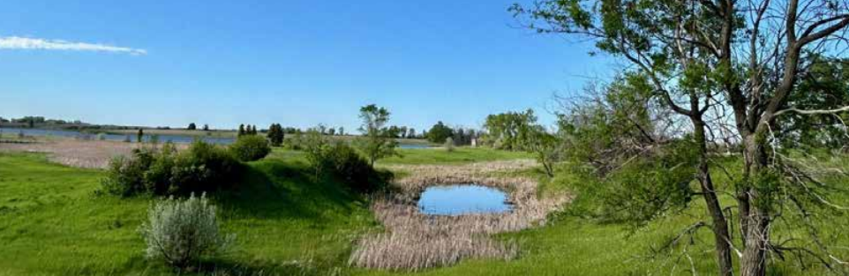
Minimal Effect Exemption (MEE) - Background
7 CFR Section 12.5(b)(1)(v)
  The NRCS may grant a USDA participant an exemption when he or she converts a wetland through an action that has a minimal effect on the functions and values of the wetlands in the area
A MEE allows a producer to engage in a wetland conversion action without losing eligibility for USDA programs
USDA participants granted MEE are not exempt from Clean Water Act Section 404 requirements nor other state or local regulations

Slide 19
Minimal Effect Exemption (MEE) - Procedure
NRCS WA MEE Procedure and Decision Matrix document
  Document is in draft status and available to STAC for review and comment
Procedure provides 2 methods for arriving at MEE decision
  Expedited Minimal Effect
  Comprehensive Functional Assessment

Slide 20
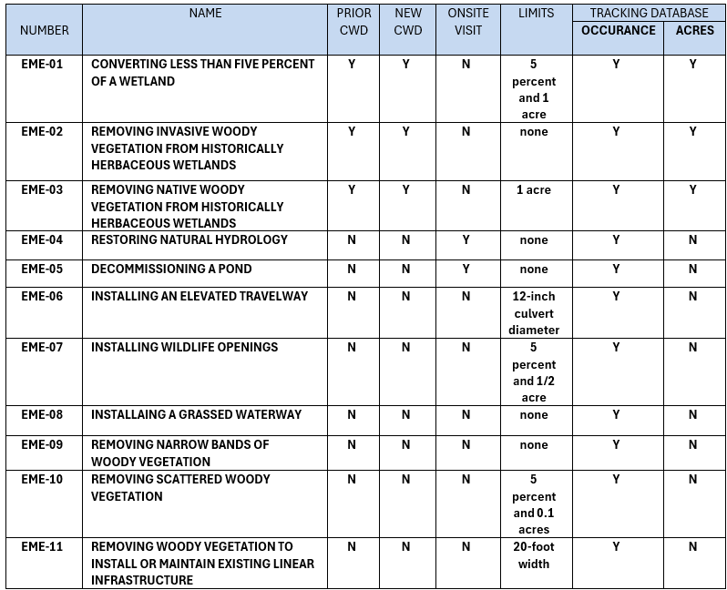
Expedited Minimal Effect
Rapid assessment for issuing MEE decisions
Specific practices and actions that could result in wetland conversion, with defined limits/conditions associated with those practices
Will apply to most requests for MEE

Slide 21
Minimal Effect Functional Assessment - Overview
For requests that don’t meet any expedited MEE
Functional assessment of the converted wetland and wetlands in the area (2 mile radius)
Quantifies impacts of conversion action on wildlife habitat, water quality, floodwater storage
Special consideration given to “rare and unique” wetlands as determined by State Conservationist

Slide 22
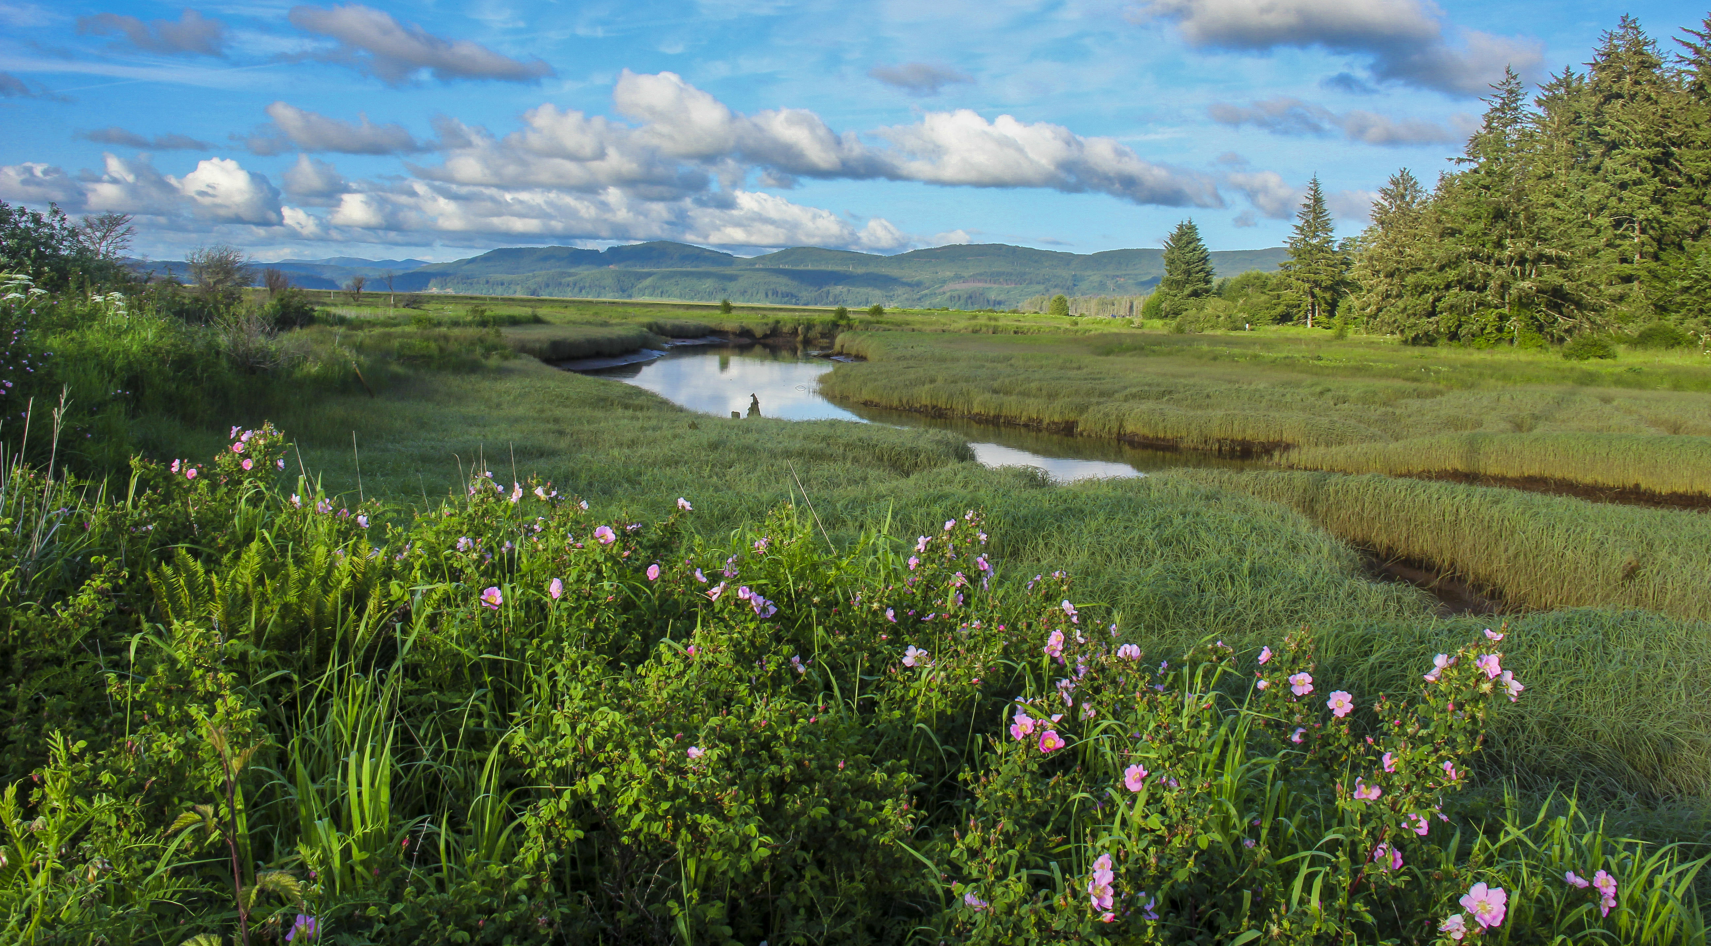
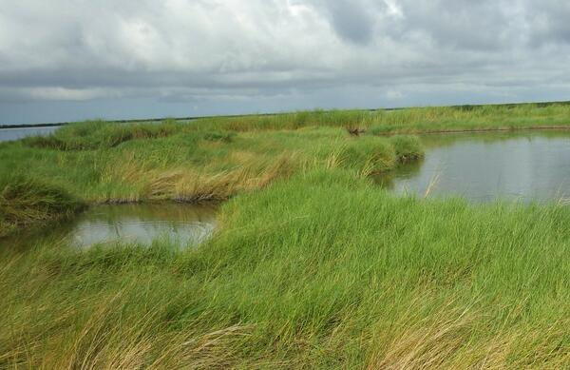
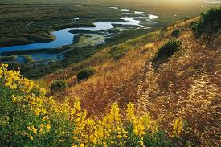
Rare and Unique Wetlands – Draft List
Special consideration given to “rare and unique” wetlands
  Wetlands that would not be granted MEE
  Need STAC review and comments
Crowberry Bogs
Calcareous Fens
Peat Bogs
Alkali Wetlands
Interdunal Wetlands
Estuarian Wetlands
Riverine Wetlands
Wetlands containing or habitat for federally listed endangered species

Slide 23
Functional Assessment Process
Step 1: Identify the Project Area on Three Maps
Step 2: Determine Size of Project Area
Step 3: Conduct an Offsite Review
Step 4: Conduct A Meandering Survey and Identify Sub-Areas as Appropriate
Step 5: Document Hydrologic, Vegetative, and Soil Conditions for the Project Area
Step 6: Consideration of Rare and Unique Wetland Value
Step 7: Rating the Ecological Variables of the Project Area
Step 8: Determine Impacts to Wildlife Habitat FC for the Project Area
Step 9: Determine Impacts to the Water Quality FC for the Project Area
Step 10: Determine Impacts to the Floodwater Storage FC for the Project Area
Step 11: Determine Cumulative Wetland FCU Loss for Project Area
Step 12: Determine the Final Cumulative Wetland FCU Loss for the Tract
Step 13: Identify Wetlands in the Area.
Step 14: Determine the FC of Each Wetland in the Area.
Step 15: Determine the total FCUs of Wetlands in the Area
Step 16: Determine Ratings for Wetlands in the Area (VWIA):
Step 17: Determine Ratings for Combined Effect of Similar Actions (VCSA)
Step 18: Determine the Resiliency of Wetlands in the Area to Sustain Ecological Services
Step 19: Determine if the Project Meets the Minimal Effect Threshold

Slide 24
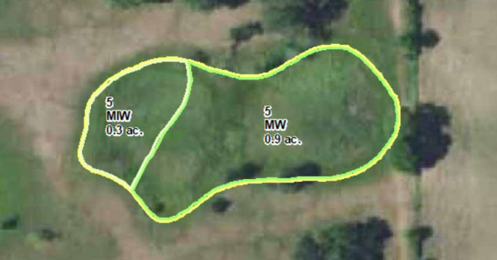
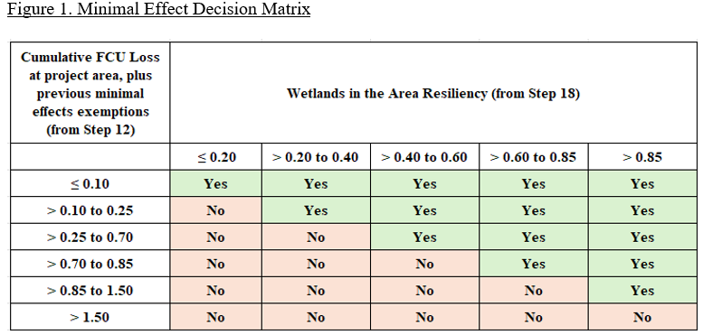
Granting MEE
Wetlands qualifying for exemption will be labeled “MW” on a new CWD issued by NRCS

Slide 25
MEE Adoption Process
Draft Procedure Document
Peer Review
SLT Review
STAC Review
Complete Final Draft
Minimal Effect Procedure can be adopted via state bulletin on 1-year trial basis

Slide 26
Questions?
Max Ross
State Resource Soil Scientist
Washington State NRCS
360.480.6578
Max.ross@usda.gov

