Slide 1
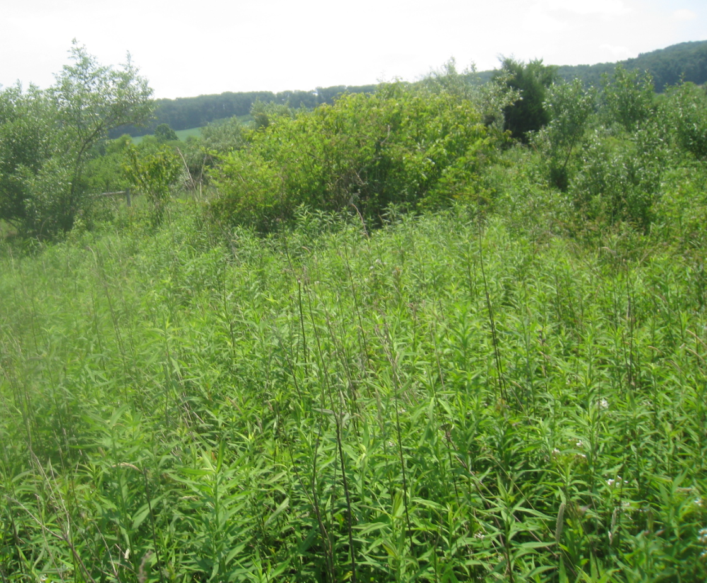
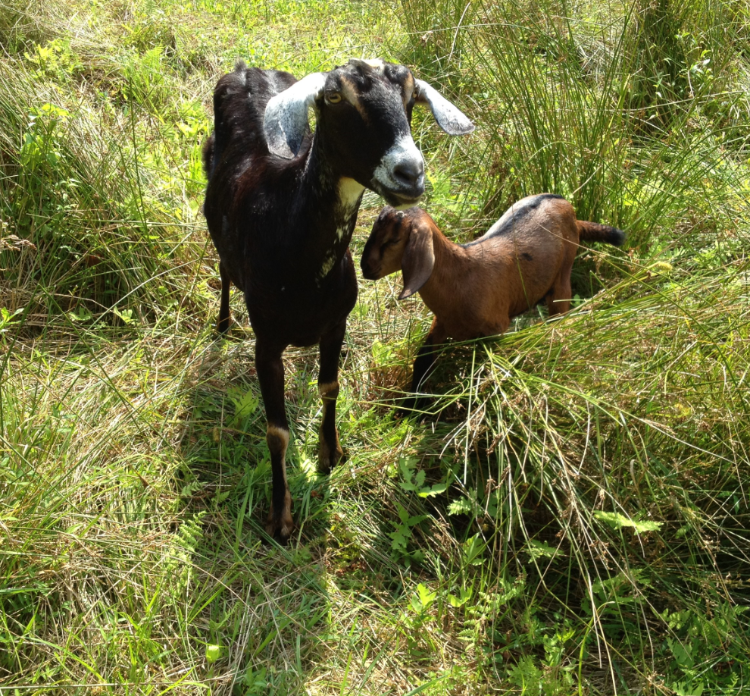
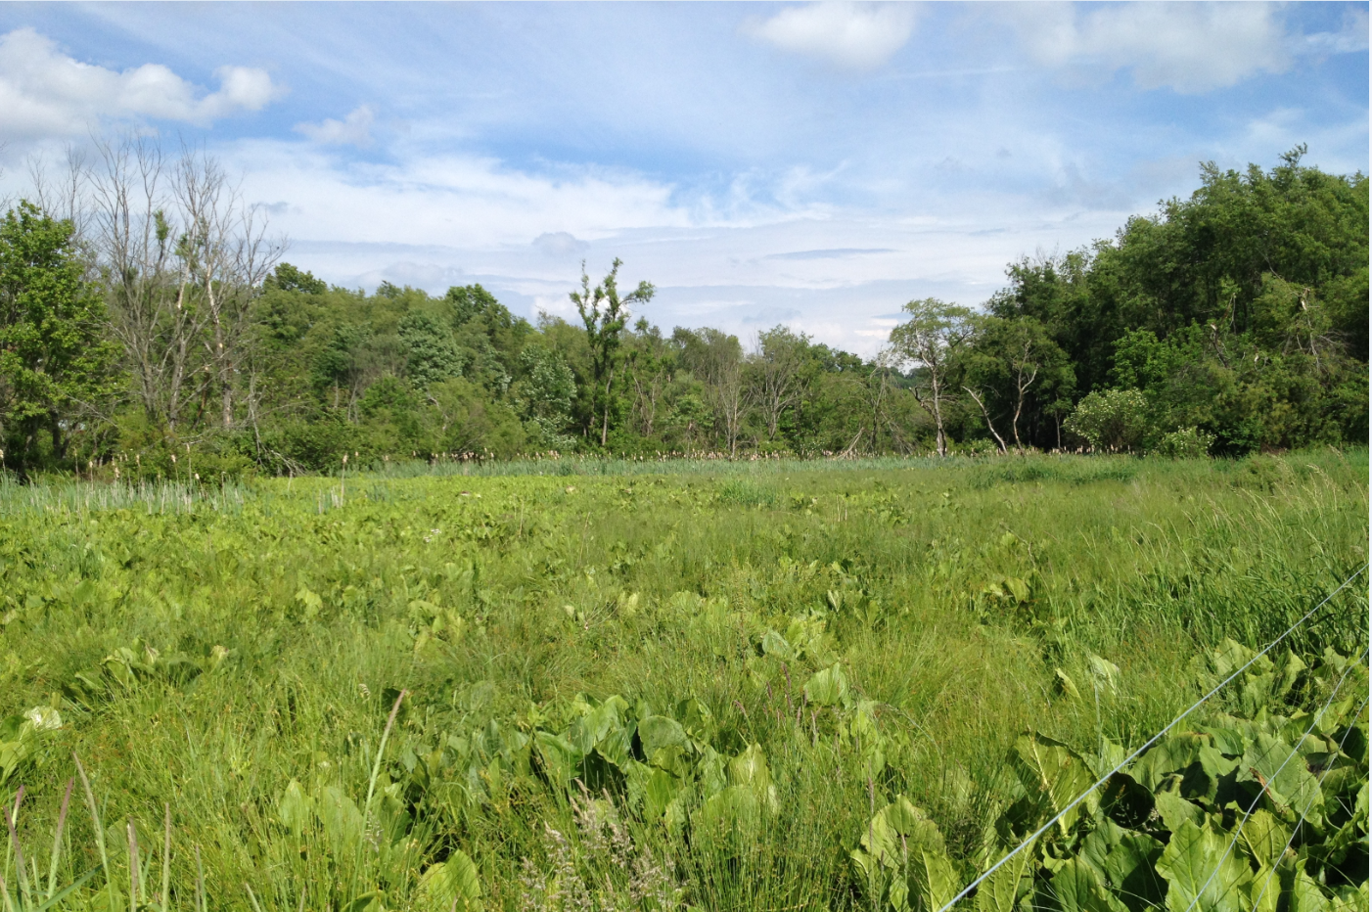
FY24 ACEP Allocations &
Obligations
Carroll County Wetland Easement Restoration
Wetlands Reserve Easements
ACEP WRE General/Stewardship
  $1.6 Million Obligated $ 2.7 Million Allocation
ACEP WRE Bog Turtle
  $0 Obligated $110,000 Allocation
  *No Applications
ACEP WRE IRA
  $0 Obligated $0 Allocation
  *Nationally run and selected. Funds kept at NHQ.
Agricultural Easements
  $0 Obligated $255,000 Allocation
  *No Applications
Before
During
After

Slide 2
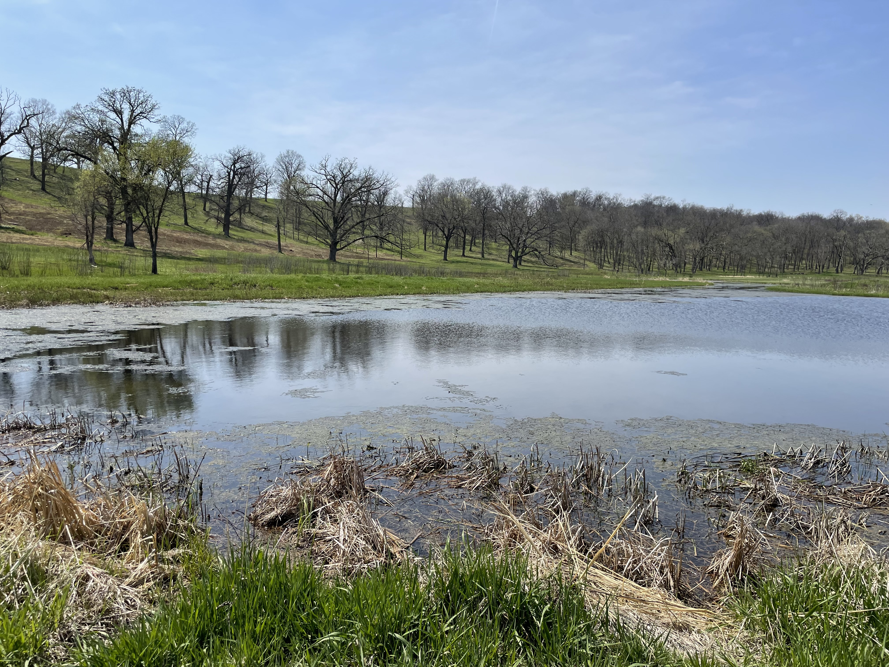
FY25 ACEP Allocations and Applications
Wetlands Reserve Easements
ACEP WRE General/Stewardship
  $ 3 Million Allocation
  - 11 Applications. 9 Eligible in 5 Counties* for 480 acres totaling ~$3 Million
  *Dorchester, Caroline, Queen Anne’s Wicomico, Worcester
ACEP WRE Bog Turtle
  $110,000 Allocation
  - No Applications
ACEP WRE IRA
  $1.1 Million Allocation
  - On Pause
Agricultural Easements
  $500,000 Allocation
  -1 Application for 5 Projects in Dorchester County for ~1,000 acres totaling ~$3.4 Million* Fed * Approximately Half the Easement Value

