Slide 1
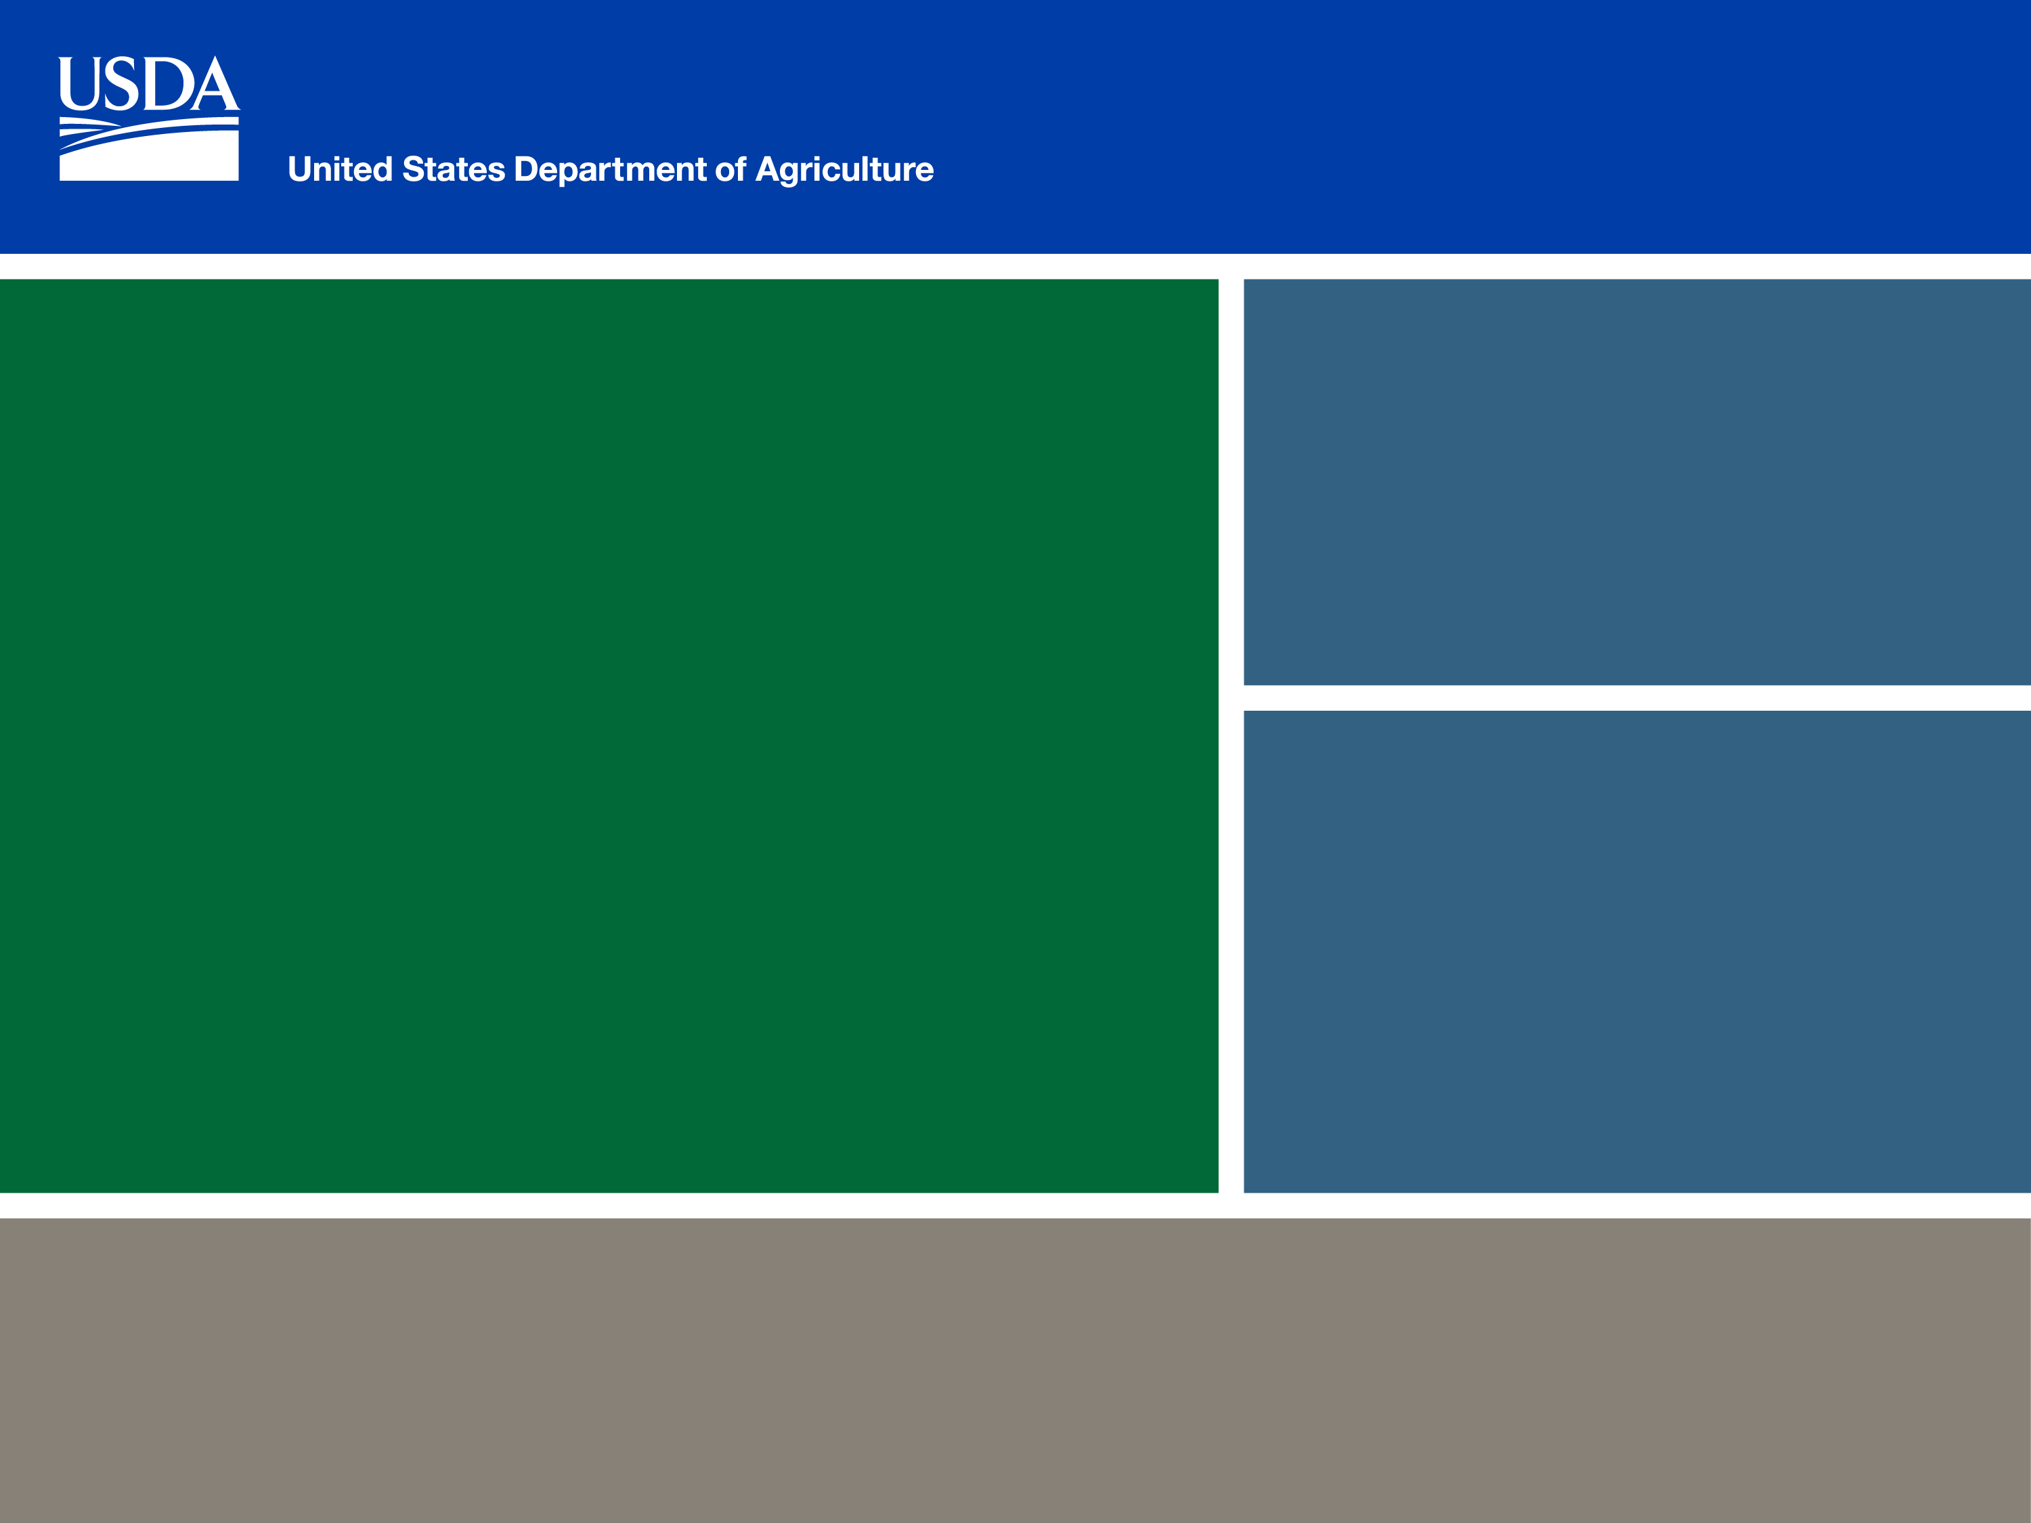
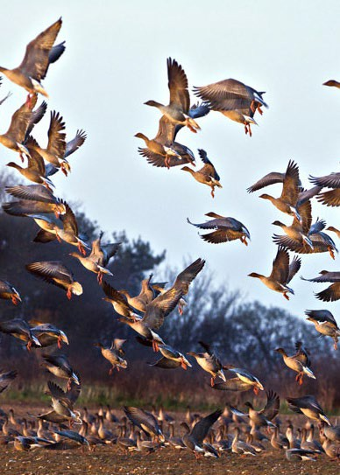
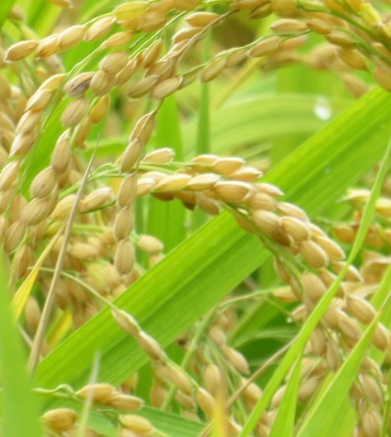
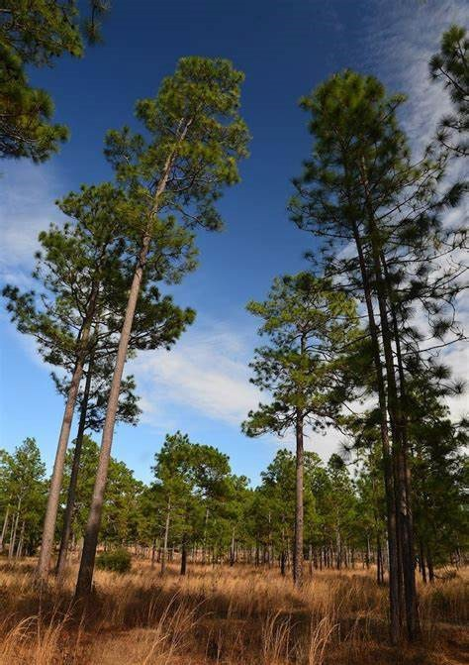


MD RCPP
FY 2024 & FY 2025
Bianca Soto- RCPP Program Manager

Slide 2
Project Types
Alternative Funding Arrangements (AFA)
RCPP Classic​
Partner defined project​
NRCS responsible for FA execution through producer contracts, easements, and watershed agreements​
Partner may deliver FA in support of NRCS producer contracts​
NRCS involved in technical assistance, may delegate some to partner​
Partner led project​
Partner contracts directly with eligible producers/landowners or performs work on their behalf​
Partner expected to deliver all technical assistance​

Slide 3
FY 2024-2025 Active RCPP Project
  RCPP Classic (Total 6 PPA Active)
  Achieving WIP Goals & NM Compliance in Maryland
  2445 Million Acre Challenge RCPP
  Engaging Small AFOs in the NM Planning Process
  2589 RCPP-ESLC Land Protection Initiatives
  New!--3119 Connecting Small and Urban Farms in the Baltimore and Washington D.C. Urban Corridor with Conservation Resources
  New!--3150 Mid-Atlantic Dairy Farmers Producing Tangible Results Through Climate Smart Solutions

Slide 4
FY 2024-2025 Active RCPP Project
  RCPP AFA (Total 3 PPA Active)
  2659-Maryland Clean Water Commerce Outcomes Project
  New!-- 3083 Scaling the adoption of adaptive nitrogen management using low-cost cover crop imaging and nitrogen crediting technology
  New!--3269 Nature’s Climate Solution: Planting Forests and Building Resiliency in Maryland

Slide 5
FY 2024 RCPP
Project ID & Project Name | Lead Partner | Financial Assistance Available | Obligate Funds | RCPP Applications | RCPP Obligated Contracts
AFA
2659- Maryland Clear Water Commerce Outcomes Project | Sand County Foundation & EPIC | $2,129,050.00 | 0 | 15 | 3
Classic
2019-Achieving WIP Goals & NM Compliance in MD | MD Dept. of Agriculture | $1,782,120 | $1,307,573 | 5 | 4
2697-Engaging Small Animal Feeding Operation (AFOs) in the Nutrient Management Planning Process | Sustainable Chesapeake | $1,609,252.00 | $453,308 | 1 | 1
1860-Grazing for Water Quality & Soil Health (Final FY Funding 2023) | Chesapeake Bay Foundation | $26,143.04 | $1,488.96 | 0 | 0
2589-ESLC Land Protection Initiative | Eastern Shore Land Conservancy | $4,042,000.00 | 0 | 0 | 0

Slide 6
FY 2025 RCPP
Project ID & Project Name | Lead Partner | Financial Assistance Available | Obligate Funds | RCPP Applications | RCPP Obligated Contracts
AFA
2659- Maryland Clear Water Commerce Outcomes Project | Sand County Foundation & EPIC | $2,129,050.00 | $10,802.80 ( FY 2024 Applications)
3083-Scaling the adoption of adaptive nitrogen management using low-cost cover crop imaging and nitrogen crediting technology- IRA Funds | The Nature Conservancy | $7,925,000.00 | N/A | N/A | N/A
3269-Nature’s Climate Solution: Planting Forests and Building Resiliency in Maryland-IRA Funds | Maryland Department of Natural Resources | $7,675,000.00 | N/A | N/A | N/A

Slide 7
FY 2025 RCPP
Project ID & Project Name | Lead Partner | Financial Assistance Available | Obligate Funds | RCPP Applications | RCPP Obligated Contracts
Classic
2019-Achieving WIP Goals & NM Compliance in MD ( Final FY FA funding 25) | MD Dept. of Agriculture | $129,836 | $367,164 | 1 | 1
2445-Million Acre Challenge (Final FY FA funding 26) | Future Harvest | $497,000
2697-Engaging Small Animal Feeding Operation (AFOs) in the Nutrient Management Planning Process( Final FY FA funding 27) | Sustainable Chesapeake | $1,155,944.00 |  | 2- Cancelled
2589-ESLC Land Protection Initiative ( Final FY FA funding 26) | Eastern Shore Land Conservancy | $ 4,042,000 $1,000,000.00 ( FY 2025) |  | 1
3119-Connecting Small and Urban Farms in the Baltimore and Washington D.C. Urban Corridor with Conservation Resources ( Final FY FA funding 29) | Sustainable Chesapeake | $900,000 ( FY 2025- $300,000)
1860-Grazing for Water Quality & Soil Health (Final FY Funding 2026) | Chesapeake Bay Foundation | $27,509.82
3150-Mid Atlantic Dairy Farmers Producing Tangible Results Through Climate Smart Solutions.- IRA Funds | Maryland & Virginia Milk Producers Cooperative Association | $1,500,000.00

Slide 8



Slide 9
Non-Discrimination Statement
  In accordance with Federal civil rights law and U.S. Department of Agriculture (USDA) civil rights regulations and policies, the USDA, its Agencies, offices, and employees, and institutions participating in or administering USDA programs are prohibited from discriminating based on race, color, national origin, religion, sex, gender identity (including gender expression), sexual orientation, disability, age, marital status, family/parental status, income derived from a public assistance program, political beliefs, or reprisal or retaliation for prior civil rights activity, in any program or activity conducted or funded by USDA (not all bases apply to all programs). Remedies and complaint filing deadlines vary by program or incident.
  Persons with disabilities who require alternative means of communication for program information (e.g., Braille, large print, audiotape, American Sign Language, etc.) should contact the responsible Agency or USDA's TARGET Center at (202) 720-2600 (voice and TTY) or contact USDA through the Federal Relay Service at (800) 877-8339. Additionally, program information may be made available in languages other than English.
  To file a program discrimination complaint, complete the USDA Program Discrimination Complaint Form, AD-3027, found online at How to File a Program Discrimination Complaint and at any USDA office or write a letter addressed to USDA and provide in the letter all of the information requested in the form. To request a copy of the complaint form, call (866) 632-9992. Submit your completed form or letter to USDA by: (1) mail: U.S. Department of Agriculture, Office of the Assistant Secretary for Civil Rights, 1400 Independence Avenue, SW, Washington, D.C. 20250-9410; (2) fax: (202) 690-7442; or (3) email: program.intake@usda.gov.
  USDA is an equal opportunity provider, employer, and lender.

