Slide 1

Western Water and Working Lands
Framework for Conservation Action
USDA is an equal opportunity provider, employer, and lender.

Slide 2
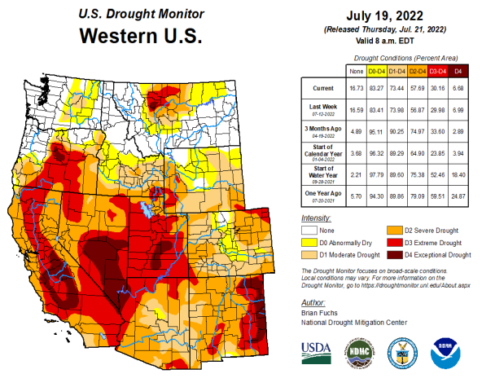
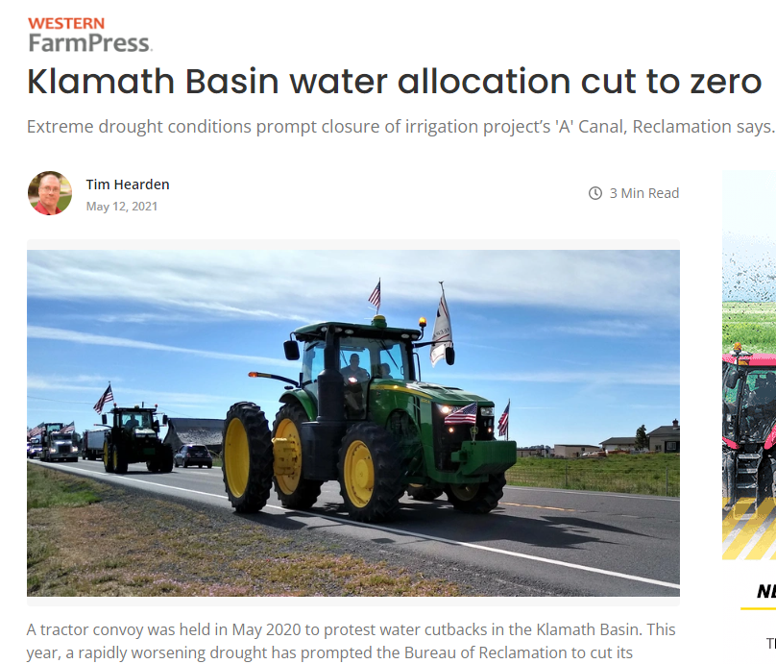
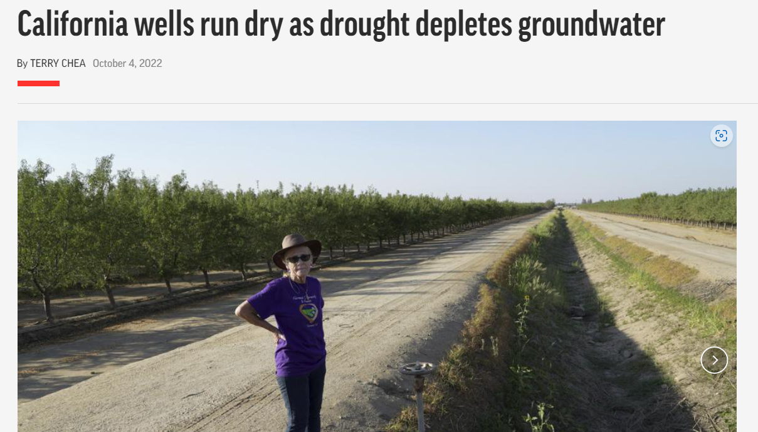
Notes:
Drought and aridification
Impacts to farming
Impacts to citizens- water users

Slide 3
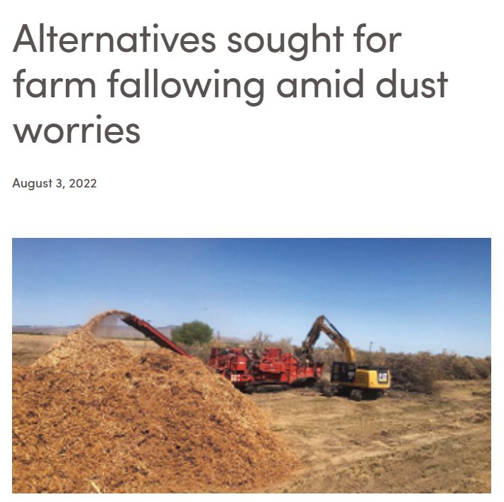
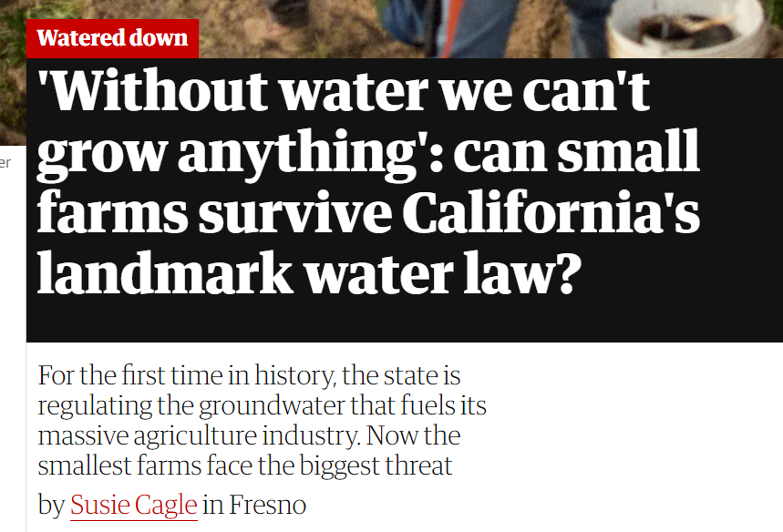
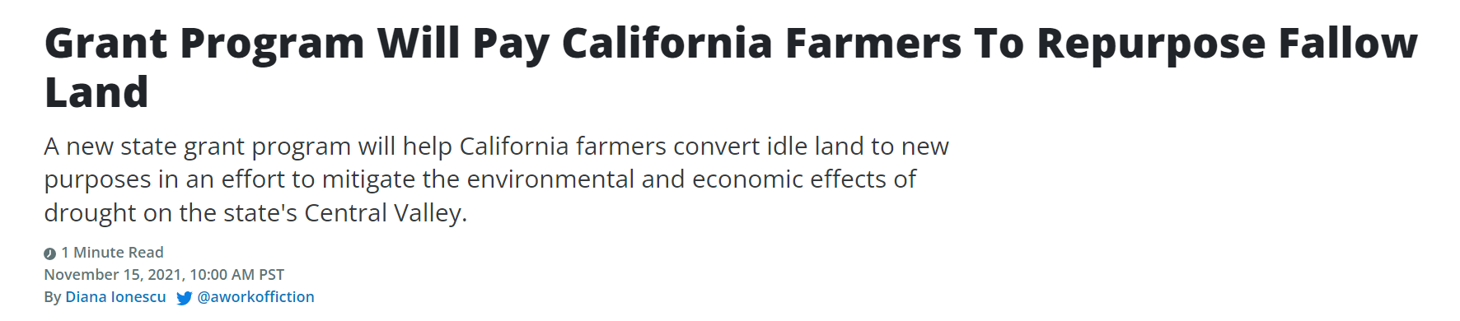
Notes:
Effects are unevenly felt
As we try to solve this problem we may be creating other, different problems.
Land and water management are closely intertwined.
There are innovative solutions out there where NRCS can engage

Slide 4
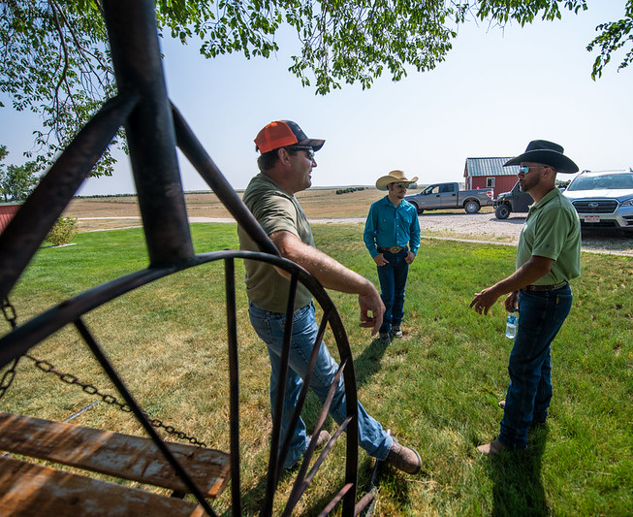
Role of NRCS
Private working lands
Science-based conservation
Practice implementation
Financial assistance
Align with state and local agency efforts
Notes:
How can NRCS plug into state efforts and other Federal efforts? How can we harness our strengths to advance towards shared goals?
Private lands- a piece of the landscape we can work on, where other agencies can’t
We have the ability to combine cutting-edge science with practical project design, and provide funding that catalyzes projects
We can align our efforts with state and local programs to magnify the effects.

Slide 5
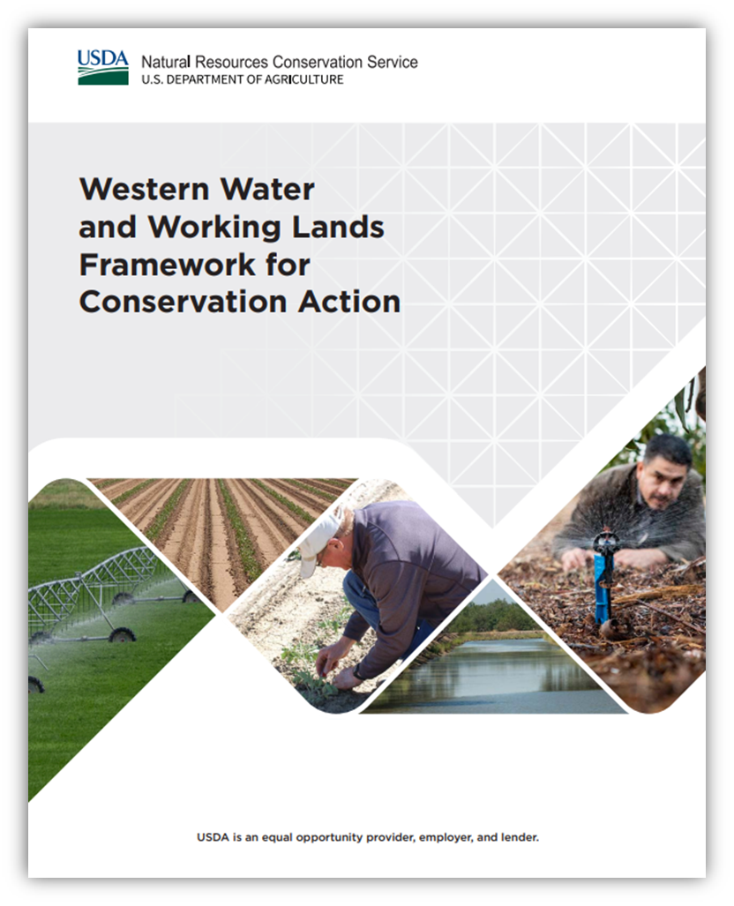
Management Challenges
Forecasting water supply
Sustaining agricultural productivity
Protecting groundwater availability
Protecting surface water availability
Managing and restoring rangelands and forestlands
Responding to catastrophic events
Notes:
These management challenges were identified and laid out in the WW Framework
The management systems that I’ll propose here are focused on these in bold:

Slide 6
Strategies
Improve reliability of water supply forecasts
Improve soil moisture and irrigation water management
Improve water and nutrient management in crop fields and pastures
Modernize water infrastructure
Improve community water supply by completing watershed projects
Increase reuse of wastewater for agriculture and conservation
Prolong aquifer life
Complete managed aquifer recharge projects
Reduce surface water withdrawals
Install conservation systems that protect water quality
Restore and protect streams and wetlands
Manage and restore rangelands and forestlands
Increase resilience during disaster recovery
Notes:
These are the strategies for addressing the management challenges that are clearly in our wheelhouse.
There are a couple more that we can do with a bit of a stretch
And a few that are really out of our scope

Slide 7
Water Scarcity Management Systems:
A Portfolio of Conservation Scenarios
Water supply
Irrigation Efficiency
On-Farm Recharge
Ag system change
High to low irrigation demand
Irrigated to grazed
Land re-purposing
Habitat
Flood control
Ecosystem services
Source water protection
Fallow land protection
Notes:
We have a lot to offer already in our catalog. These scenarios configure NRCS proven practices into innovative systems designed to address water scarcity and aligned with public and private initiatives going forward in California now.
There are other approaches that I haven’t identified or fleshed out- things like mountain meadow or beaver-dam analogues that could be used for upper watershed groundwater recharge.
These are still very much a work in progress and could benefit from putting more of our heads together.

Slide 8
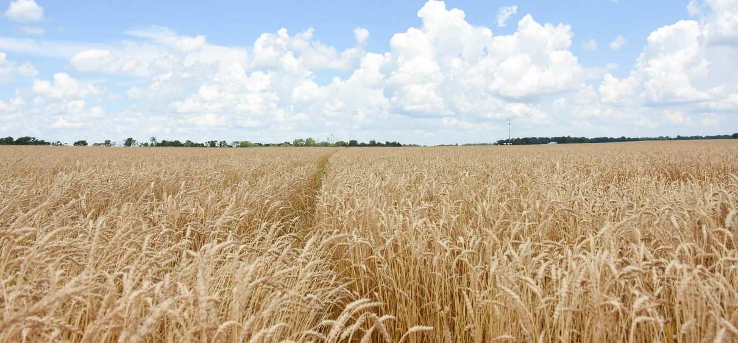
Conversion from intensive water use to lower water use agriculture system
A crop rotation designed to use less water, either through selection of low-water-use crops or periodic fallowing, is adopted
Practice Codes | Conservation Practice Standard Names | CSP Enhancement Codes | CSP Enhancement Activity Titles
328 384 329 345 | Conservation Crop Rotation Woody Residue Treatment Residue and Tillage Mgt, No-Till Residue and Tillage Mgt, Reduced Till | E328A E328B E329C E345C | Resource conserving crop rotation Improved resource conserving crop rotation No till to increase plant-available moisture Reduced tillage to increase plant-available moisture
Notes:
There has been recent research looking at the economic viability of dryland and reduced-irrigation crops in the San Joaquin valley. This system has the potential to keep agricultural land productive while reducing water use.
These are some activities that could be associated with this kind of land-use change.
Note some innovative uses of these practices: Crop rotation for moisture conservation; woody residue treatment to remove permanent crops

Slide 9
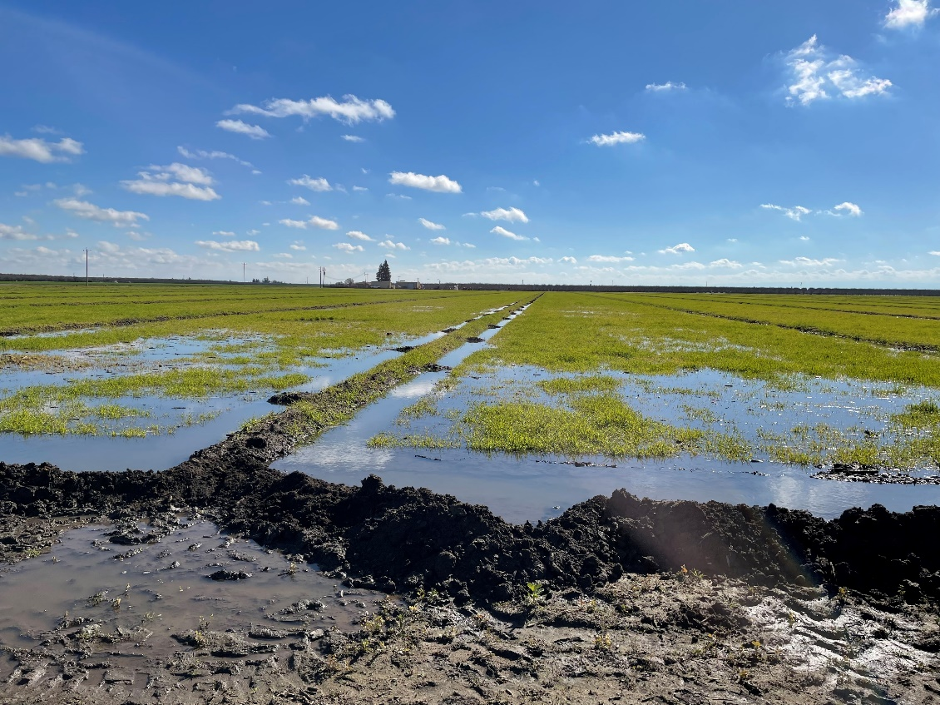
Groundwater recharge on active farmland, fallowed land, and “farm edges”
Excess surface water flows are applied to farmland, fallowed land, and farm edges for the purpose of recharging groundwater supplies in support of a groundwater management plan (GMP).
Practice Codes | Conservation Practice Standard Names | CSP Enhancement Codes | CSP Enhancement Activity Titles
815 817 590 595 327 340 | Groundwater recharge basin or trench On-Farm Recharge Nutrient Management Pest Management Conservation Cover Cover Crop | E340G | Cover crop to reduce water quality degradation by utilizing excess soil nutrients
Notes:
This is already innovative for NRCS since we only recently added groundwater depletion as a resource concern. This scenario focuses on groundwater recharge on farmlands and associated lands. It depends on getting our groundwater recharge practice standards approved.
Other practices are here to protect water quality and to promote infiltration

Slide 10
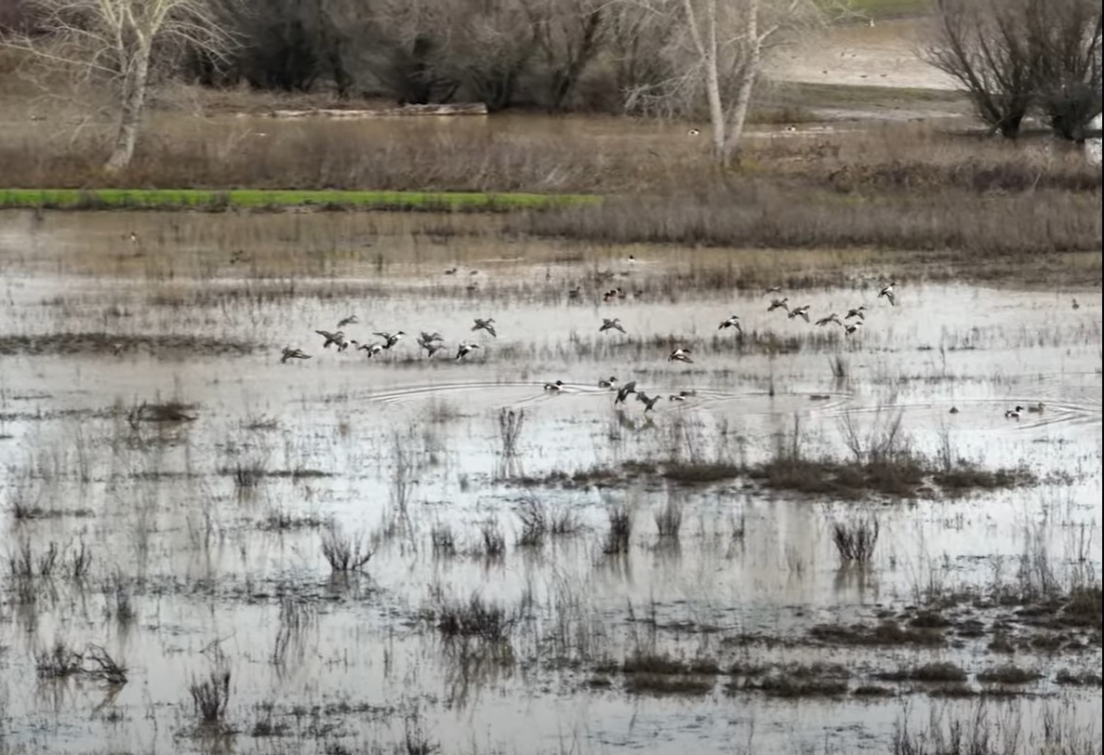
Multi-benefit systems (Wildlife habitat, flood protection, groundwater recharge) for land re-purposing
Land retired from irrigated agriculture is converted to one or more compatible uses such as wildlife habitat, flood protection, or groundwater recharge.
Practice Codes | Conservation Practice Standard Names | CSP Enhancement Codes | CSP Enhancement Activity Titles
643 644 645 646 658 659 580 | Restoration of Rare or Declining Natural Communities Wetland Wildlife Habitat Management Upland Wildlife Habitat Management Shallow Water Development and Management Wetland Creation Wetland Enhancement Streambank and Shoreline Protection | E643C E644A E646A, E646B, E646C E580A E580B | Restore glade habitat to benefit threatened and endangered species and state species of concern Managing Flood-Irrigated Landscapes for Wildlife (Manage water and vegetation for wading bird, shorebird, and waterbird habitat) Stream corridor bank stability improvement Stream corridor bank vegetation improvement
Photo: CA Department of Water Resources
Notes:
Some ideas that are being implemented by partners include floodplain connection projects to benefit fish and waterfowl, recharge basins inset into floodplains, wildlife-friendly recharge basins, two-stage ditches, constructed wetlands.
While we already have the capability to do a lot of these projects, they are being applied in innovative ways or in different places in the landscape, or to achieve different purposes.

Slide 11
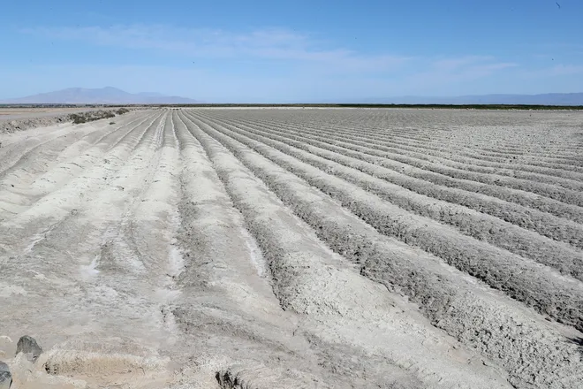
Protecting fallow fields in production rotations from wind and water erosion
Conservation practices are applied to address wind or water erosion during fallow periods.
Practice Codes | Conservation Practice Standard Names | CSP Enhancement Codes | CSP Enhancement Activity Titles
340 327 330 332 588 589 603 386 393 484 | Cover Crop Conservation Cover Contour Farming Contour Buffer Strips Cross Wind Ridges Cross Wind Trap Strips Herbaceous Wind Barriers Field Border Filter Strip Mulching | E340A E340G E340H E386A E386C | Cover crop to reduce soil erosion Cover crop to reduce water quality degradation by utilizing excess soil nutrients Cover crop to suppress excessive weed pressures and break pest cycles Enhanced field borders to reduce soil erosion along the edge(s) of a field Enhanced field borders to decrease particulate emissions along the edge(s) of the field
Photo by Jay Calderon for the Desert Sun.
Notes:
This scenario addresses resource concerns that are likely to occur from fallowing, such as wind and water erosion, water quality degradation from residual nutrients, or to prevent fallow land from becoming a source of weeds for neighboring properties.
Use of conservation practices as preventative measures to protect the land resource and prevent offsite impacts from fallowing.

Slide 12
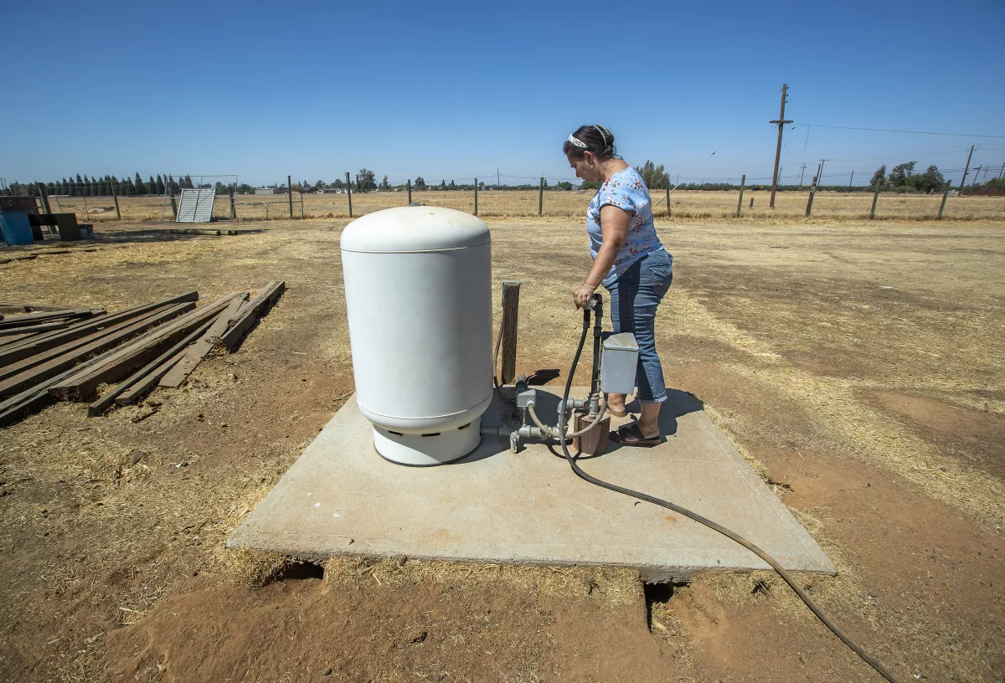
Source water protection for vulnerable communities
Practices are implemented to maintain or improve the quantity and protect the quality of drinking water supplied from groundwater or surface water sources.
Practice Codes | Conservation Practice Standard Names | CSP Enhancement Codes | CSP Enhancement Activity Titles
351 817 815 590 595 605 386 393 | Well Decommissioning On-Farm Recharge Recharge Basin or Trench Nutrient Management Pest Management Denitrifying Bioreactor Field Border Filter Strip
Photo by Mel Melcon for the Los Angeles Times.
Notes:
It’s not clear how we might prioritize groundwater depletion resource concern for underserved communities or wells most at risk of going dry.
Source water protection provision in 2018 Farm Bill
Tradeoff of agricultural production vs. drinking water supplies
Watershed scale planning, watershed scale resource concerns.
No enhancements for these practices- opportunities to develop enhancements?
Potentially develop an enhancement for Well Decommissioning or Recharge practices?

Slide 13
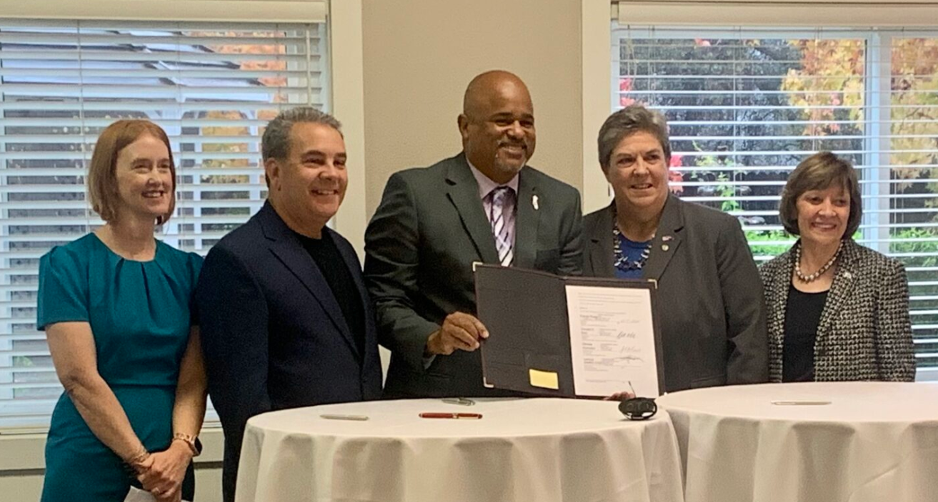
Partnerships
Partnerships for funding
Partnerships for mutual goals
Partnerships for science
Notes:
Identify partnerships outside our agency that can magnify impacts to the resources
Better understand how we might shape our activities to align with theirs, and vice versa

Slide 14
Outcomes
Metrics embedded into Western Waters Framework
  Rely on NRCS business tools
  Report acres, number of participants, or number of practices applied
Are there more meaningful measures?
  How might we leverage partner data?
  How might we relate outcomes to broader goals?
Notes:
Similar to having our AQ projects “count” toward reportable measures for the State of California’s air quality goals- can we design around measures and goals that are meaningful to our partners and to congress? IRA funding, climate smart,

Slide 15
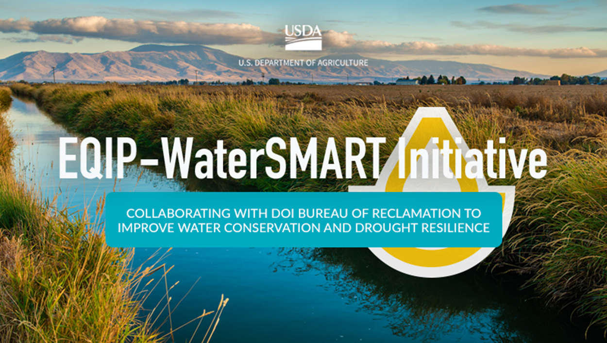

Slide 16
EQIP - WaterSMART Initiative
Priorities are:
  Improving irrigation water use efficiency
  Preventing groundwater depletion
  Preventing surface water depletion
  Optimal use of naturally available moisture and prevention of drought stress

Slide 17
EQIP - WaterSMART Initiative
10 ongoing projects
$5.76 Million
Fresno, Kern, Kings, Riverside, Tulare Counties
Practices:
  Efficient irrigation systems
  Irrigation management
  Nutrient management
  Cover crops

Slide 18
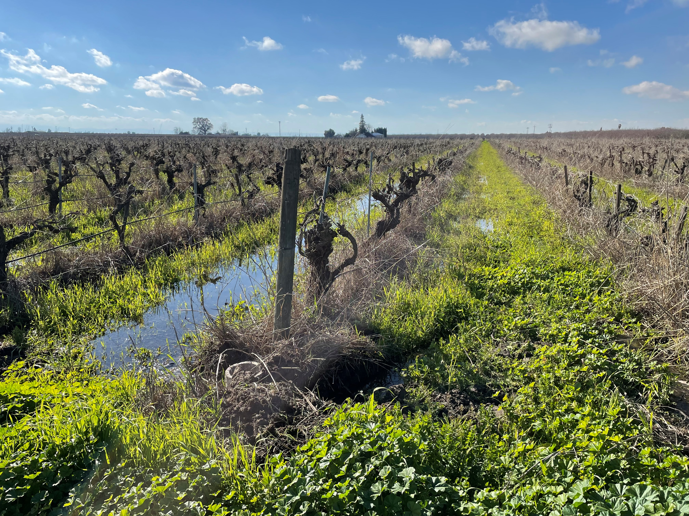
EQIP - WaterSMART Initiative- New FY 23
Madera Irrigation District
One of three awarded
$1.5 Million over 5 years
Practices:
  Micro-irrigation
  Pipelines
  Nutrient Management
  Groundwater Recharge
  Cover crops

Slide 19
Western Water and Working Lands
Framework for Conservation Action
USDA is an equal opportunity provider, employer, and lender.

