Slide 1
Soil Health Update
Laura Starr Ph.D., Regional Soil Health Specialist
May 1st, 2025

Slide 2
Changes to the Soil Health Division
5 out of 10 Regional Soil Health Specialist and our team leader Joe Williams took DRP.
Laura Starr - Western region
Marlon Winger – Central region
Nathan Lowder – Eastern region

Slide 3
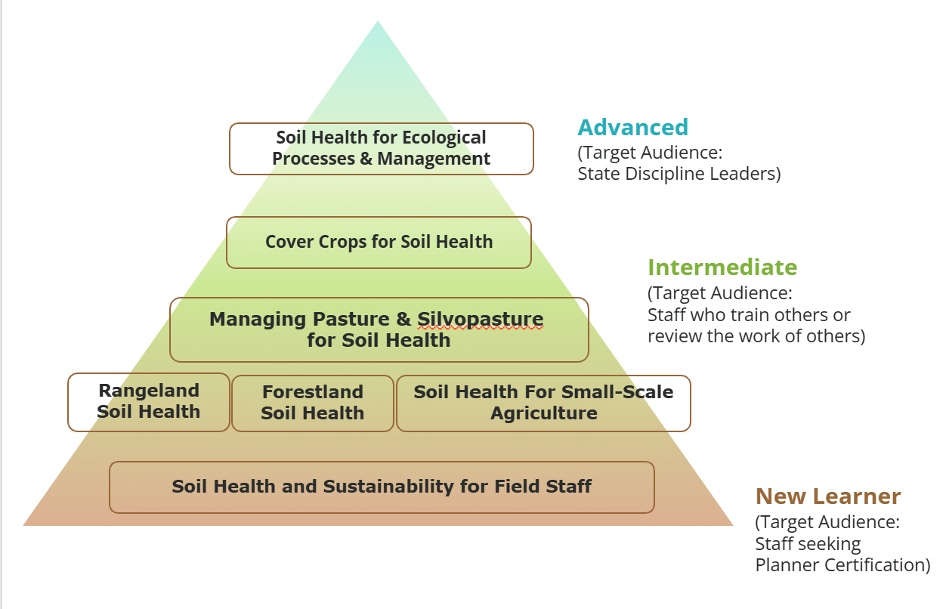
Training – Model for State Empowerment
360 NI Part 320 Instructor Certification for Soil Health and Sustainability for Field Staff Training Course
Notes:
while all national in-person training has been cancelled this year, we are making all of the materials and instructional guides available now on the Teams site and eventually the website once their is 508 compliance review. You can tell WA that they are free to use the materials and to get technical assistance from staff virtually on using the materials.
We are hoping that in the new structure in coming years there will be staff who are able to resume in-person technical training delivery

Slide 4
Conservation Practice Standards & Activities
Conservation Practice Standards (CPS)
  CPS 336 Soil Carbon Amendment
  Interim CPS (ICPS) 809 Conservation Harvest Management
    Montana, Idaho, Wyoming, Washington, Oregon
  ICPS 825 Culturally Significant Plantings for Soil Health
    Washington, Oregon, Pacific Islands Area, Maine, Connecticut, Rhode Island, Massachusetts
Conservation Activities
  CPA 116 Soil Health Management Plan
  DIA 162 Soil Health Management System Design
  CEMA 204 Adaptive Management for Soil Health
  CEMA 216 Soil Health Testing
  CEMA 221 Soil Carbon Stock Monitoring

Slide 5
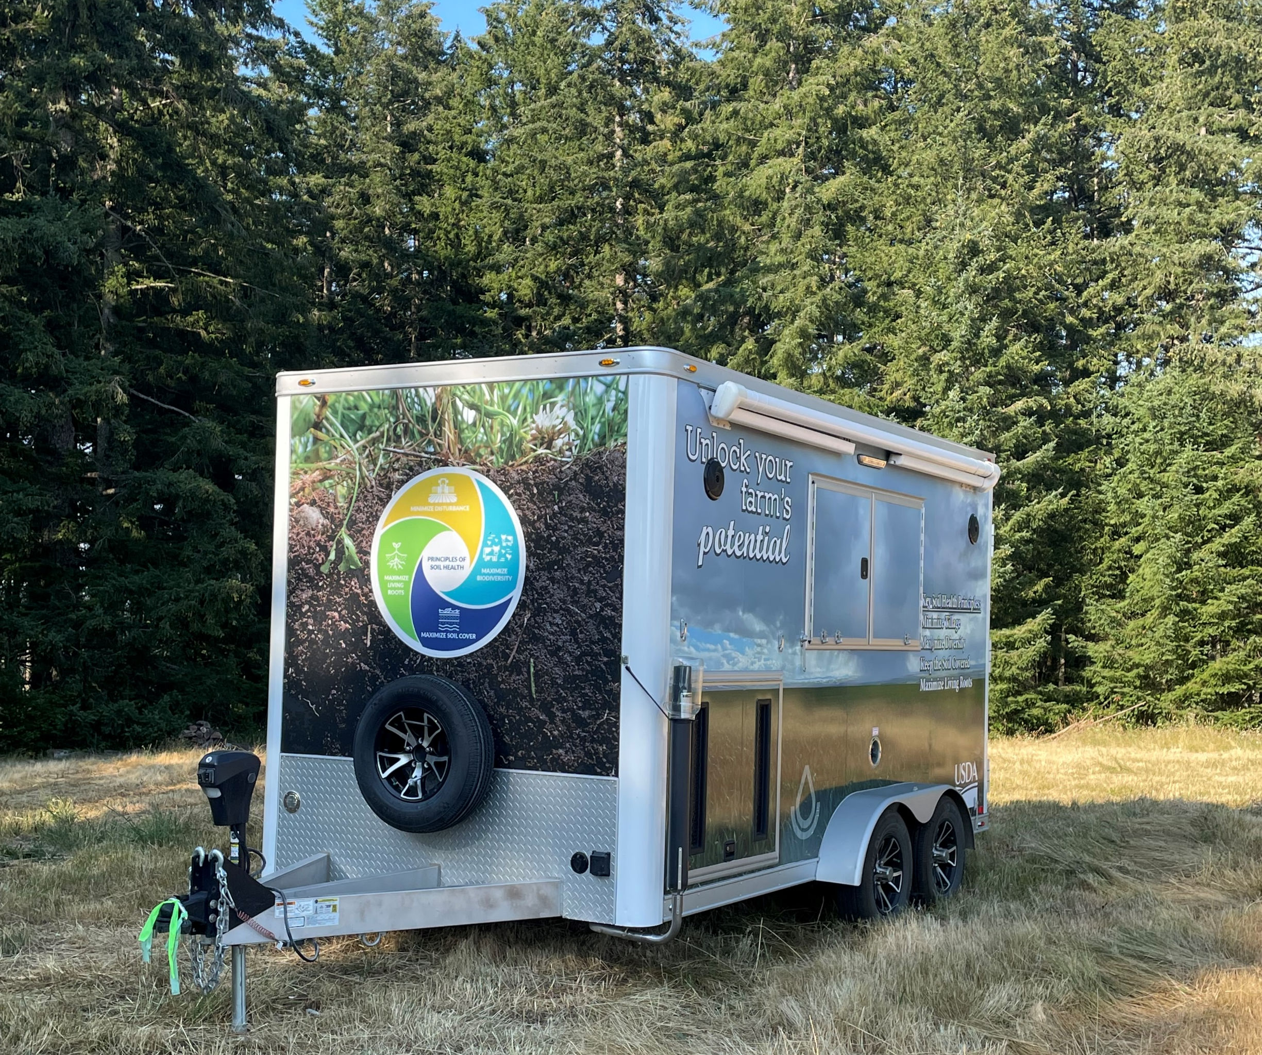
Demonstration Trailers
The Soil Health Division has purchased four demonstration trailers to aid its mission to provide support and education opportunities to the states for the purpose of increasing staff awareness of soil health and soil health conservation. These demonstration trailers will be made available to assist states in their education and outreach events to both internal staff and external stakeholders.
Location in West Region: Pendleton, Oregon
Establishing a new custodian in the coming weeks.
Notes:
Options for use may include:
NRCS hosted trainings
NRCS hosted conferences/meetings
SWCD hosted field days with NRCS collaboration
Washington State NRCS has requested the use at the State FFA convention to provide Soil Health Demonstrations to high school students from across the state.

Slide 6
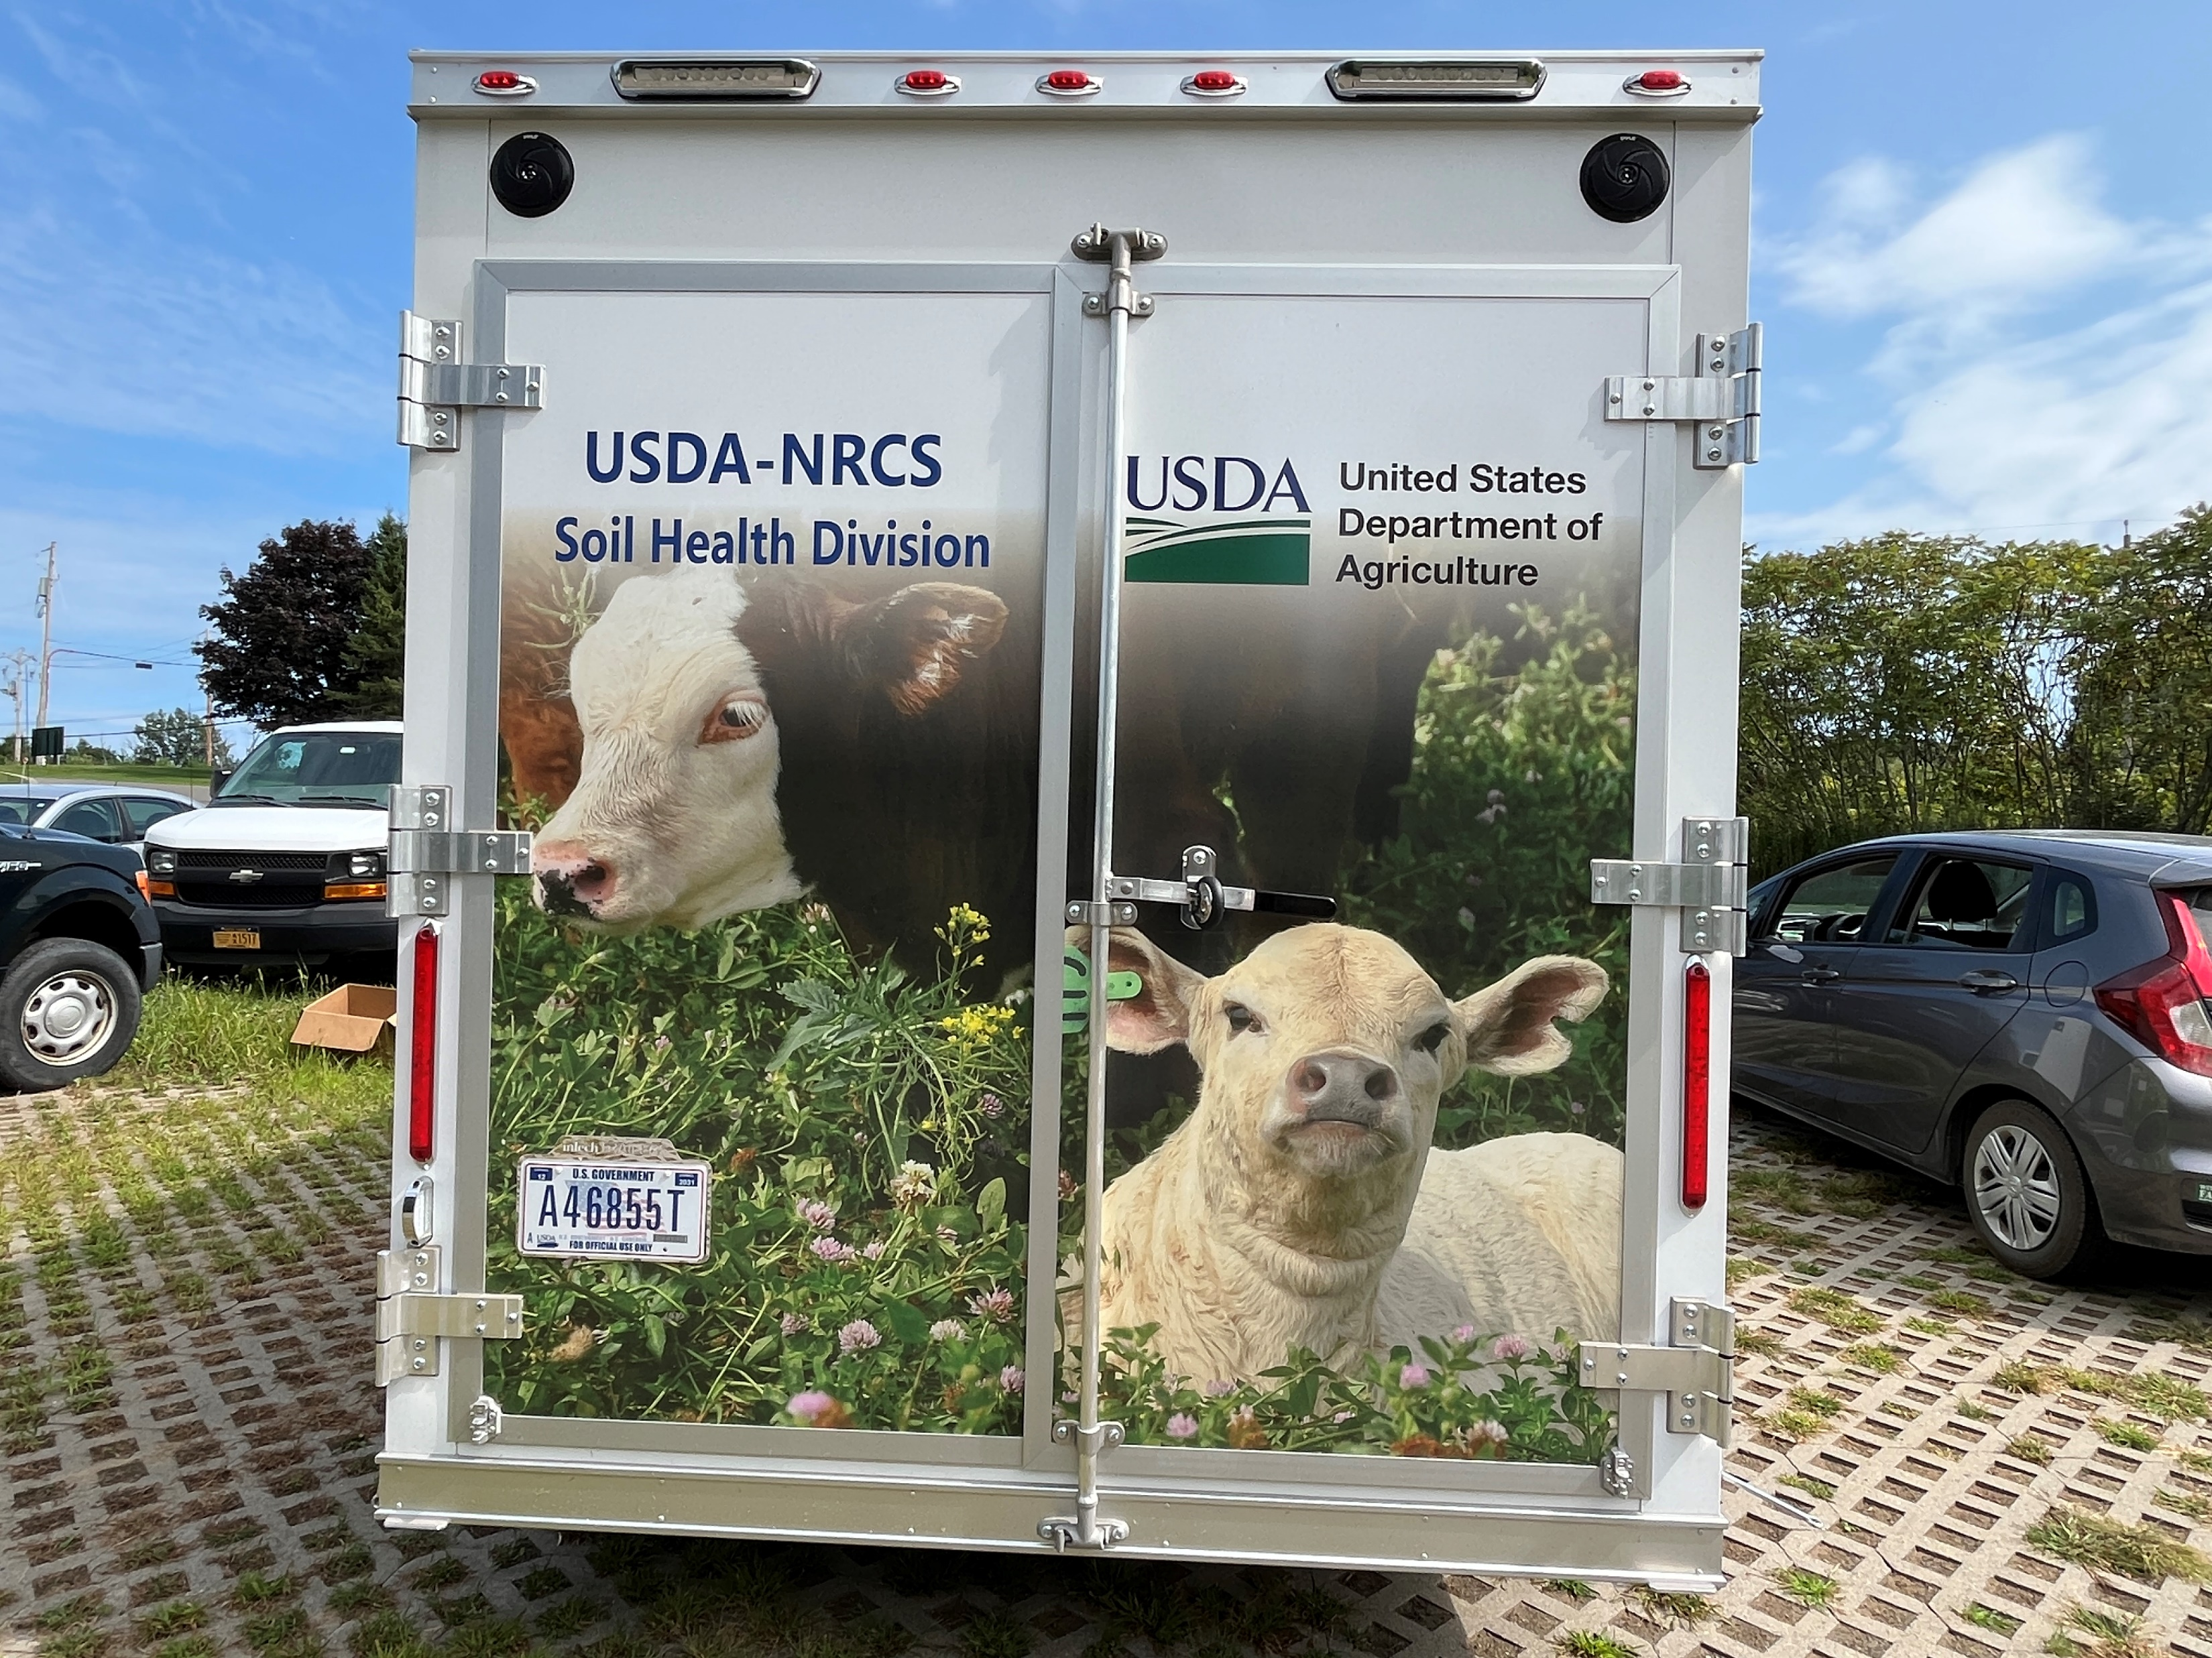
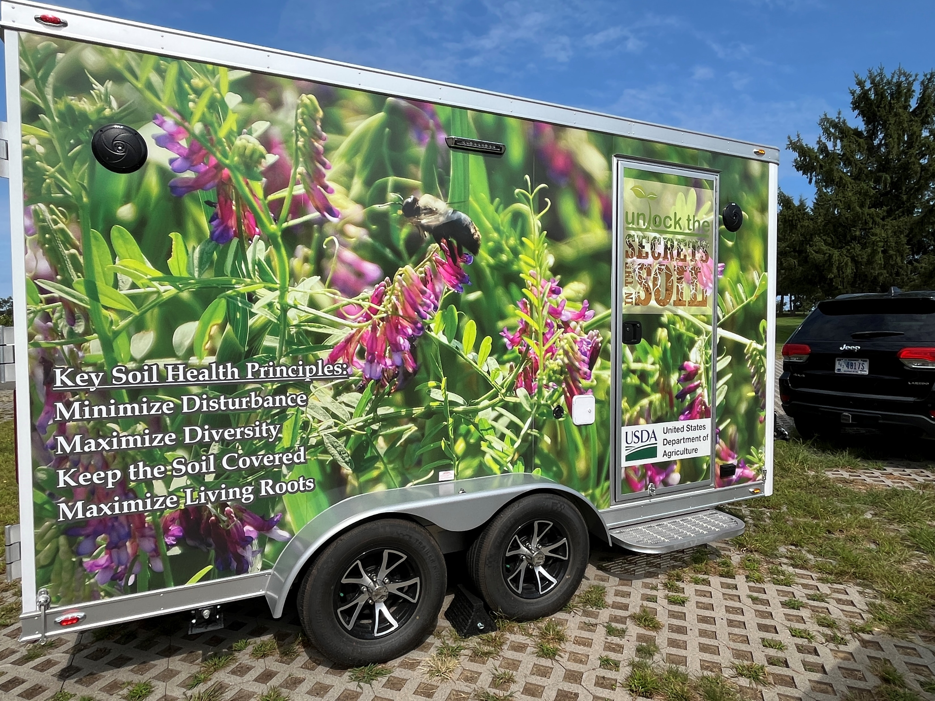
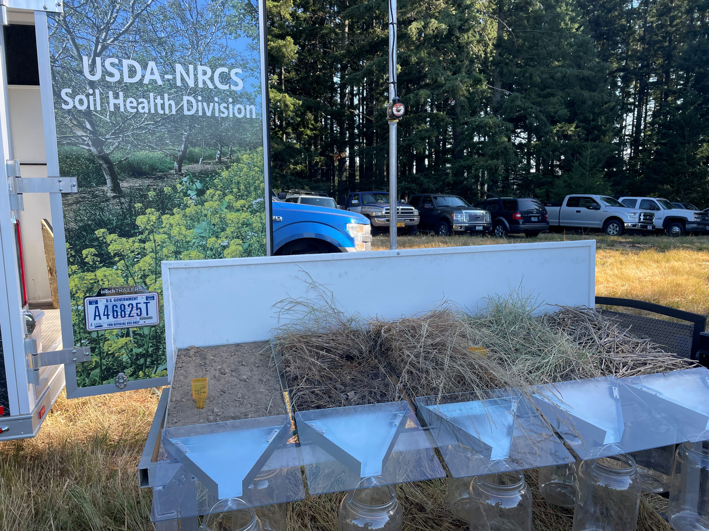
Trailer Systems
4 presenter audio system with trailer speakers and amplifier
Display screen with HDMI connection for external devices
GoPro Camera
On-Board water storage tank
On-Board Generator and battery system
Notes:
NATIONAL INSTRUCTION DOCUMENT IS IN REVIEW PROCESS AT THE MOMENT
The division has developed a use and troubleshoot guide that will be provided with the trailer delivery. Along with that, the regional soil health specialists acting as the custodians of the trailers will provide a walk-around instruction training when the trailer is being loaned out.
Beyond the permanent trailer systems identified on this slide there are also the following soil health demonstrations: wind erosion simulator, rainfall simulator, and slake tubes are provided with the trailer. Other demonstrations can be made available when working with the regional specialists.
Water tank storage is 63 gallons- 3 full demonstrations or 4 quick demonstrations with the rainfall simulator

Slide 7
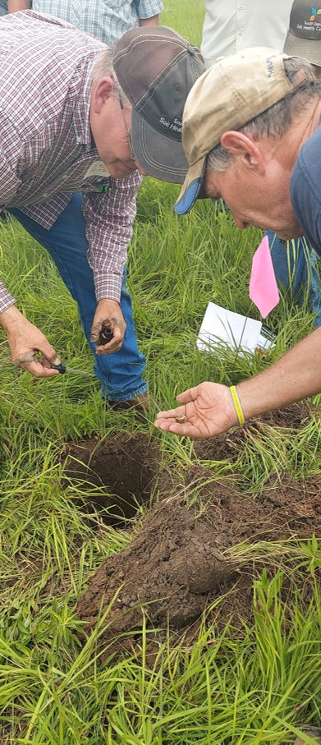
Models and Assessment Tools
Rangeland In Field Soil Health Assessment
Forestland In Field Soil Health Assessment
Revised Cropland In Field Soil Health Assessment
Soil Carbon Amendment Calculator and Conversion Tool
Soil Health Assessment Protocol and Evaluation (SHAPE)
Not an NRCS tool but an excellent resource similar to SHAPE – WaSHI State of the Soils
Notes:
Wanted to draw attention to the work done by The Washington Soil Health Initiative (WaSHI), a partnership between the Washington State Department of Agriculture, Washington State University, and the State Conservation Commission.

Slide 8
IT Projects
Soil Health Scorecard
AFT Predictive Soil Health Economics Calculator (PSHEC)
Vegetation Specifications Suite (Veg Spec)
Biochar Atlas Conservation Grants –
Conservation Practices Data and Innovations (2018 Farm Bill mandate)
  CIG site and search tool
  Producer Operations Data System (PODS) – collect point-level on-farm data from soil health demonstration trials
  Conservation Practices Data and Innovations site
Erosion Tools Suite
Conservation Management Benefits Navigator (CMBN)
Notes:
Soil Health Scorecard – Tableau-based data visualization tool allowing agency to capture soil health management results on all land uses for all programs going back to the 1985 Food Security Act
Predictive Soil Health Economics Calculator – allows producers to understand economic outcomes of implementing soil health management systems on various crops throughout the U.S.
Vegetation Specifications Suite – technical specifications for all vegetative Conservation Practice Standards
Biochar Atlas –tool to assist field planners with developing implementation requirements for CPS 336
Conservation Grants – Conservation Practices Data and Innovations (2018 Farm Bill mandate)
CIG site and search tool
Producer Operations Data System (PODS) – collect point-level on-farm data from soil health demonstration trials
Conservation Practices Data and Innovations site
Erosion Tools Suite – common interface to run erosion tools (RUSLE2 & WEPS) from Conservation Desktop application
Conservation Management Benefits Navigator (CMBN) - utilizes AI to harvest and sort peer-reviewed research articles and other research-based projects in order to update practices and technical handbooks & manuals

Slide 9
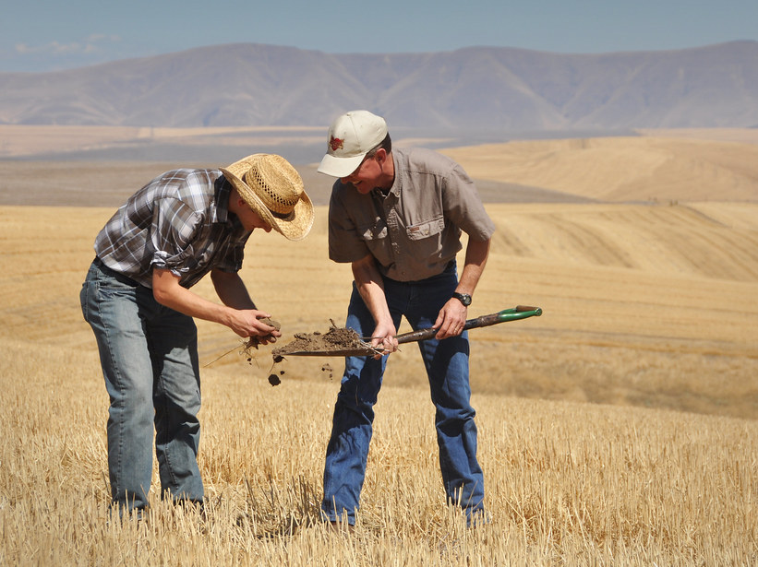
Partnership Work
Formalized Partnership Activities in West Region:
  Soil Health Institute & National Association of Conservation Districts Economic Case Studies
  Native American Rangeland Partnership
  Intertribal Agricultural Council
  Oregon State University
  University of California Cooperative Extension
  U.S. Bureau of Land Management
  U.S. Forest Service
  U.S.D.A. Agricultural Research Service

Slide 10

West Region Cover Crop Selection Tool
The SHD continues to support the development and data verification for the Western Cover Crop Council.
The council is currently working with Precision Sustainable Agriculture group from the ARS and the software development team to finalize the testing protocol to release the western selection tool data to the public and have industry partners and stakeholders provide feedback on the tool.
Anticipated full release of the tool for the Western states is Fall 2025
Notes:
SHD Regional Specialists including Marlon Winger, Laura Starr, Zahangir Kabir, and Nick Sirovatka have provided technical expertise to the data collection and primary verification to get the tool ready for a public release testing phase. Many other state Soil Health POC’s have also provided their time in this effort.
The Western Cover Crop Council supports: Alaska, Arizona, California, Colorado, Idaho, Montana, Nevada, New Mexico, Oregon, Pacific Island Area, Utah, Washington State, and Wyoming
Nick Sirovatka is the identified liaison for the SHD to the WCCC

Slide 11
Publications and Technical References
Starr, L., Douglas, J., Kirwan, B., Casey, A., Mirsky, S., Englert, J., Ackroyd, V., and Thapa, R. 2025. Multi-state, multi-seeding rate evaluations of three cool season cover crop mixes: Effects on cover crop performance, soil health indicators, and an analysis of costs. Journal of Soil and Water Conservation.
TN 450-TCH-4 The Basics of Addressing Resource Concerns with Conservation Practices within Integrated Soil Health Management Systems on Cropland
TN 450-TCH-5 Full-Scale Rainfall Simulator Instructor Guide
TN 470-SH-01 Choosing a Laboratory for Soil Health Testing
TN 470-SH-05 Rangeland Soil Health Technical Note
TN 470-SH-06 Soil Health in Temperate Silvopasture Systems Technical Note
TN 470-SH-02 Basics of Urban Soil Health
TN 470-SH-03 Site Evaluation for Urban Soil Health
TN 470-SH-04 Conservation Practices for Soil Health in Urban and Small Scale Agriculture
TN 470-SH-07 Guidance on Field Grab Sampling for Soil Health Testing Technical Note
TN 470-SH-08 Forestland In-Field Soil Health Assessment Guide and Spreadsheet
TN 470-SH-09 Cover Crop and Crop Aftermath Grazing Technical Note
Coming Soon!! TN 470-SH-XX Soil Health Testing

Slide 12

Questions

