Slide 1
FY2023
California NRCS
Program Summary
April 5, 2023
Brandon Steinberg
Acting Assistant State Conservationist for Programs

Slide 2
FY2023 Farm Bill Allocations

Slide 3
FY2023 CSP Allocations

Slide 4
FY2023 EQIP Allocations

Slide 5
FY2023 EQIP: National Initiatives

Slide 6
FY2023 EQIP General: Statewide

Slide 7
FY2023 EQIP General: Regional

Slide 8
EQIP General Allocation Percentages
Metric | Required
Livestock | 50%
Wildlife | 10%
Beginning Farmer/Rancher | 5%
Socially Disadvantaged Farmer/Rancher | 5%
EQIP-CIC | 5%

Slide 9
FY2023 Inflation Reduction Act

Slide 10
FY2023 IRA-EQIP

Slide 11
FY2023 Financial Assistance Program Deadlines
Program | Application Cutoff | Obligation Deadline
CSP | 12/9/22 | 6/7/23
 | 4/14/23 | 8/30/23
IRA-CSP | 4/28/23 | 8/15/23
EQIP | 12/9/22 | 6/23/23
 | 4/3/23 | 8/30/23
EQIP-CIC | 1/31/23 | 6/23/23
 | 4/3/23 | 8/30/23
IRA-EQIP | 3/17/23 | 8/15/23

Slide 12
RCPP 18 Projects
12 Projects
Addressing a wide variety of resource concerns but most notably
  Water Conservation
  Soil Health
  Forest Health
  Aquatic and Terrestrial Habitat
Utilizing Land Management Contracts (EQIP/ CSP like), Rentals (CRP like) and Easements (ALE like)

Slide 13
RCPP 18 in FY 2023
One new project was awarded
  Farmer to Farmer Collaboration; Increasing Pollinators Across Diverse California Farms and Ranches
    Goal: to increase capacity of California agricultural lands to provide habitat, forage, and other support to wild and managed pollinators, including bees, butterflies and other important invertebrate species.
    Alternative Funding Arrangement
    Covers 10 CA Counties
    Awarded a 5 year agreement for a total of $1,723,183.00

Slide 14
RCPP 18 in FY 23
One renewal project was awarded
  Crisis to Opportunity; Sierra Nevada Recovery and Resilience
  Goal: to address the forest health crisis by removing dead trees from high mortality areas, reduce fuels by thinning and removing fuel loads
  RCPP Classic Renewal
  Covers 11 CA Counties
  Awarded a 5 year agreement for a total of $10,000,000.00

Slide 15
Conservation Innovation Grants (CIG)
Tentative NFO Posting:
May 1, 2023
Proposal Submission Deadline:
June 15, 2023

Slide 16
Easements
Easement Component Program | Allocation | Sign-up Date | Applications
Wetland Reserve Easements | $5,503,460 | 12/16/2022 | 12
Agricultural Land Easements | $5,123,150 | 12/16/2022 | 7
Wetland Reserve Easements (IRA) | To be determined | 02/17/2023 | 3

Slide 17
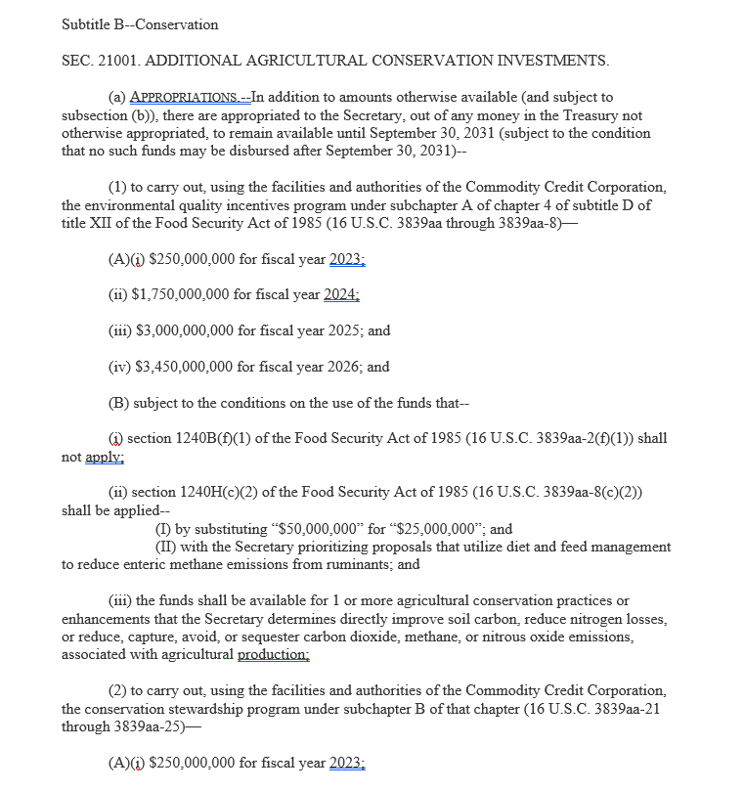
Inflation Reduction Act (IRA)
Notes:
The IRA was enacted under Subtitle B “Conservation” of Title II of the IRA Public Law 117-169, on August 16, 2022.

Slide 18
Inflation Reduction Act (IRA)
The Inflation Reduction Act of 2022 will provide assistance to agricultural and forestland producers to invest in climate and clean energy solutions and promote climate-related benefits through NRCS programs.
  Conservation Stewardship Program (IRA-CSP)
  Environmental Quality Incentives Program (IRA-EQIP)
  EQIP-Conservation Incentive Contracts (IRA-EQIP-CIC)
  Regional Conservation Partnership Program Land Management and Rental (IRA-RCPP-LMR)

Slide 19
IRA – CA Priorities
IRA – CSP
  Agricultural Lands
  Non-Industrial Private Forestland
  All Climate Smart Agriculture and Forestry Mitigation Activities and Resource Concern Categories
IRA – EQIP
  Air Quality
  Forestry
  Climate Smart Agriculture and Forestry Mitigation Activities and Resource Concerns will be tailored to each fund pool.

Slide 20
IRA Contract Requirements
EQIP and CSP contracts using IRA funds must include one or more core practices or activities listed on the Climate-Smart Agriculture and Forestry (CSAF) Mitigation Activities List for FY2023.
Facilitating practices or activities that directly support CSAF core practices or activities may be included in the contract.

Slide 21
Climate-Smart Agriculture and Forestry (CSAF) Mitigation Activities List
Climate Change Mitigation Practice Categories
  Soil Health
  Agroforestry, Forestry and Upland Wildlife Habitat
  Restoration of Disturbed Lands
  Energy, Combustion, and Electricity Efficiency
  Wetlands
  Nitrogen Management
  Livestock Partnership
  Grazing and Pasture

Slide 22
Non-Discrimination Statement​
​
In accordance with Federal civil rights law and U.S. Department of Agriculture (USDA) civil rights regulations and policies, the USDA, its Agencies, offices, and employees, and institutions participating in or administering USDA programs are prohibited from discriminating based on race, color, national origin, religion, sex, gender identity (including gender expression), sexual orientation, disability, age, marital status, family/parental status, income derived from a public assistance program, political beliefs, or reprisal or retaliation for prior civil rights activity, in any program or activity conducted or funded by USDA (not all bases apply to all programs). Remedies and complaint filing deadlines vary by program or incident. ​
​
Persons with disabilities who require alternative means of communication for program information (e.g., Braille, large print, audiotape, American Sign Language, etc.) should contact the responsible Agency or USDA’s TARGET Center at (202) 720-2600 (voice and TTY) or contact USDA through the Federal Relay Service at (800) 877-8339. Additionally, program information may be made available in languages other than English.​
​
To file a program discrimination complaint, complete the USDA Program Discrimination Complaint Form, AD-3027, found online at How to File a Program Discrimination Complaint and at any USDA office or write a letter addressed to USDA and provide in the letter all of the information requested in the form. To request a copy of the complaint form, call (866) 632-9992.​
​
Submit your completed form or letter to USDA by:​
(1) mail: U.S. Department of Agriculture​
Office of the Assistant Secretary for Civil Rights​
1400 Independence Avenue, SW​
Washington, D.C. 20250-9410; ​
(2) fax: (202) 690-7442; or ​
(3) email: program.intake@usda.gov. ​
​
USDA is an equal opportunity provider, employer, and lender.

