Slide 1
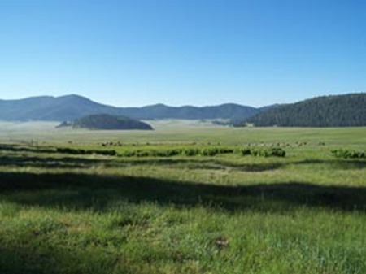
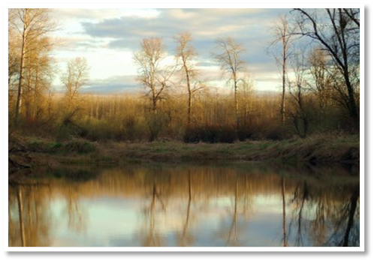
IRA
Agricultural Conservation Easement Program (ACEP)
Agricultural Land Easements
Wetland Reserve Easements
Dean Kwasny - Easement Program Manager, CA NRCS

Slide 2
IRA Easement Objectives & Funding
To carry out the agricultural conservation easement program and acquire easements or interests in land that will most reduce, capture, avoid, or sequester carbon dioxide, methane, or nitrous oxide emissions.

Slide 3
IRA ACEP National Authorization for FY 2023
Notes:
The FA/TA split is a 65/35 percentage split similar to the split used in ACEP under the Farm Bill

Slide 4
FY 2023 ACEP Implementation Strategy
Limited funds for ACEP in FY 2023
Nationally identified IRA target areas and ranking criteria will be used to acquire and restore easements on lands that:
  Will reduce, capture, avoid, or sequester carbon dioxide, methane, or nitrous oxide emissions
  Have already been identified as having significant Greenhouse Gas (GHG) mitigation potential if restored (USDA Report, 2013)
  Leverage and advance existing USDA and NRCS strategic planning efforts, including Climate Adaption Plans

Slide 5
Benefits of FY2023 IRA ACEP Strategy
  NRCS’s extensive soils data will be used to target lands with greatest potential to reduce greenhouse gases or sequester carbon.
    Lands that will restore or protect permanent and persistent vegetative cover types.
    Lands with a high risk of conversion that would result in a net contribution of greenhouse gases.
    Lands in close proximity to other similarly conserved lands that increase connectedness and related co-benefits within a watershed.
    Lands that that provide permanent protection in the most impactful landscapes in the US.

Slide 6
Benefits of FY2023 IRA ACEP Strategy
ACEP-WRE
  Targeting organic soils provides a per acre GHG net-benefit many times higher than the per-acre benefit from other soils.
  Wetland restoration on degraded organic soils is a priority for GHG mitigation and ecosystem restoration commitments under the UN Climate Convention.
ACEP-ALE
  Will focus on securing grasslands in areas of highest risk for conversion to non-grassland uses (e.g. cultivation, development, subdivision) to prevent the release of soil carbon stores.
  Within the IRA target area, prioritize organic soil carbon percentage to provide maximum benefit to grassland areas with high potential for carbon sequestration.

Slide 7
FY 2023 ACEP – IRA Target Areas
ACEP Enrollment Options | Deed Terms | IRA Target Areas
ACEP Wetland Reserve Easements (ACEP-WRE) | Standard ACEP-WRE Warranty Easement Deed | Soils high in Organic Carbon meeting designated thresholds. Including certain wet histosols, soils with histic epipedons, aquolls (wet mollisols), and soils with umbric epipedons.
 | ACEP-WRE with Reservation of Grazing Rights
ACEP Agricultural Land Easements – Grasslands (ACEP-ALE–Grasslands) | Grasslands of Special Environmental Significance | Grasslands located in the NRCS-WLFW Great Plains Grassland Biome
 | Grasslands with no agricultural intensification
Notes:
In future years, enrollment options and areas may be expanded as data becomes available to support inclusion for IRA funding.

Slide 8
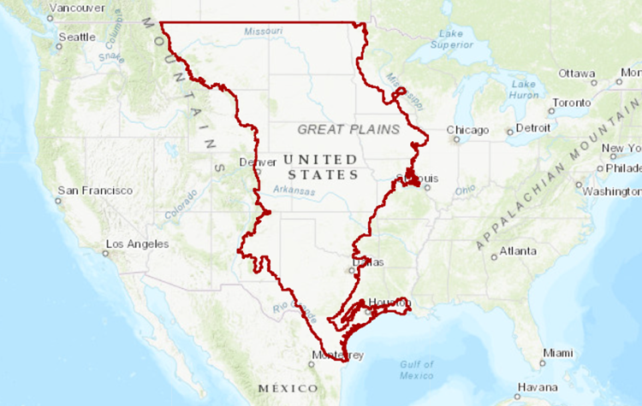
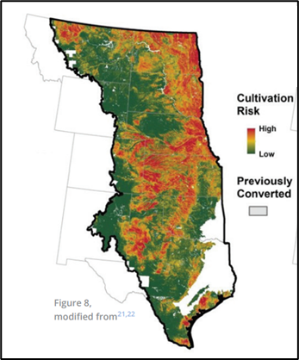
FY 2023 ACEP-ALE Prioritization
Notes:
This is the threat of grassland conversion from the WLFW Great Plains Grasslands Biome Framework. Those under the highest risk of conversion would be highest target areas for enrollment. EPD recognizes that there are pockets of grasslands in other areas in the US, but this allows for a concentrated effort for a national prioritization in FY2023.

Slide 9
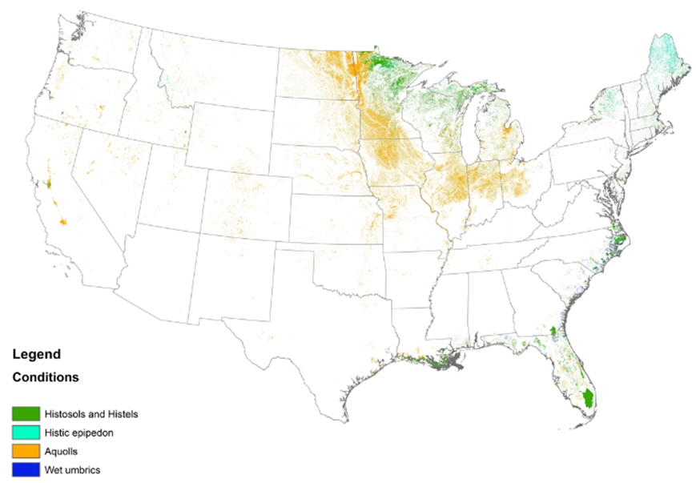
FY 2023 ACEP-WRE Prioritization
Notes:
The map shows the soils with the highest soil organic carbon storage for enrollment. Most areas are concentrated in the upper Midwest and coastal areas.

Slide 10
FY2023 IRA ACEP Ranking and Project Selection
National sign-up announcement and press release (applications were due 02/17/2023)
National Ranking Pools for IRA ACEP were published for WRE and ALE
All eligible and ranked applications will be compared nationally
IRA Financial Assistance (FA) funds will be allocated to States based on national selection of ranked applications

Slide 11
FY2024 IRA ACEP Strategy
$200 Million
  $130 Million Financial Assistance
  $70 Million Technical Assistance
National Sign-Up for new acquisition enrollments
  Establish threshold ranking scores for continuous funding selections based on FY 2023 ranking
State Resource Assessment for Stewardship Activities on existing easements
  Wetland enhancement practices to sequester carbon and reduce greenhouse gases
Expanded Geographic Area?

