Slide 1
NRCS
State Technical Advisory Committee
Partner Update - Risk Management Agency (RMA)
May 1, 2025
Notes:
GO TO VIEW > MASTER > SLIDE MASTER TO EDIT THE IMAGES ON THE TITLE AND DIVIDER SLIDES

Slide 2
Who are we?
USDA’s Risk Management Agency (RMA) regulates and supervises the Federal Crop Insurance Program
There are 10 Regional Offices in the U.S
AK
Spokane WA
Billings MT
St Paul MN
WA
ND
MN
Springfield IL
VT
ME
MT
WI
NY
NH
OR
ID
SD
CT
MA
WY
MI
PA
NJ
RI
IA
WV
MD
DE
Raleigh NC
NE
IL
IN
OH
VA
CO
NC
UT
KS
MO
NV
Topeka KS
KY
CA
Jackson MS
TN
Jackson, MS
AR
AZ
LA
MS
Davis CA
OK
SC
NM
AL
GA
Valdosta GA
TX
Oklahoma City OK
FL
HI
PR
Notes:
RMA’s vision is to secure the future of agriculture by providing world class risk management tools to rural America.

Slide 3
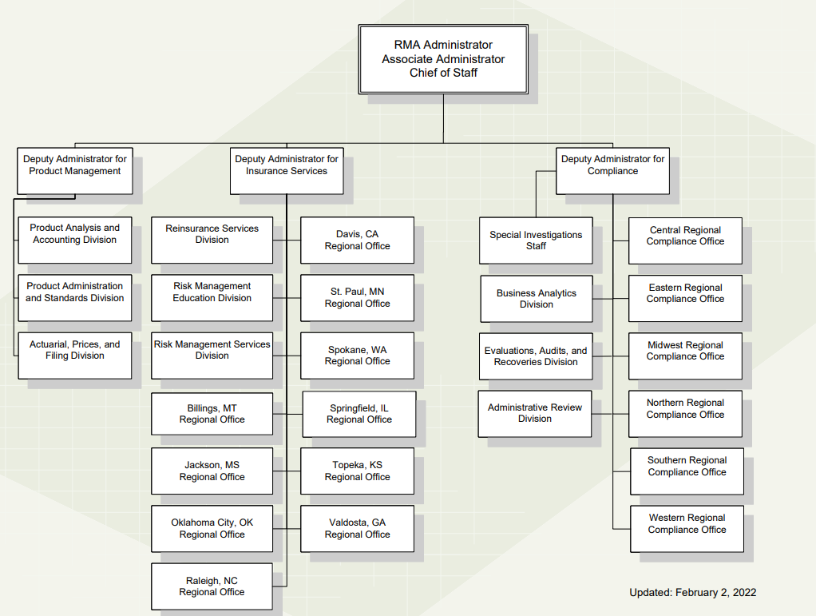
RMA Structure

Slide 4
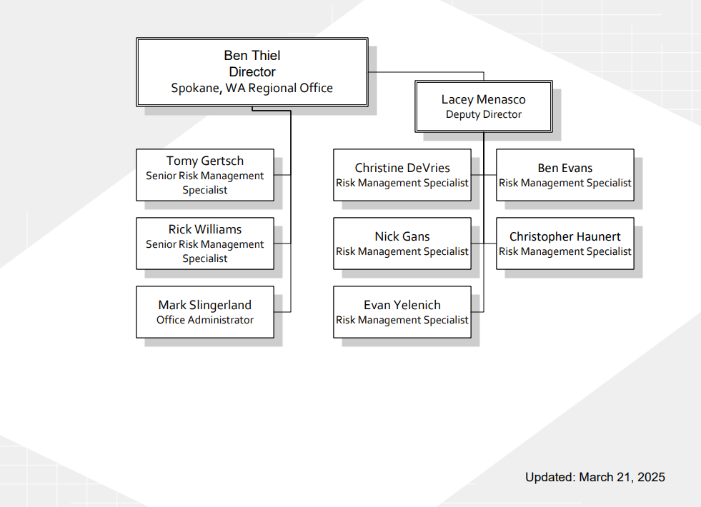
Spokane Regional Office

Slide 5
Risks in Agriculture
A farmer faces uncertainties inherent in weather, yields, prices, Government policies, global markets, and human capitol.
Production risk
Price or market risk
Financial risk
Institutional risk
Human or personal risk
Decline in yields from drought, excessive moisture, hail, wind, frost, hurricane, tornado, lightning, insects, wildlife, and disease.
Revenue loss due to decline in price.

Slide 6
Why Federal Crop Insurance?
Helps farmers and ranchers recover after severe weather or low production.
Affordable risk management with the government subsidized premium. (Subsidy of 38% to 80%)
Provides financial stability needed for beginning farmers and ranchers.
Improve access to credit.
Crop insurance could make the difference between staying in business or going out of business after a disaster.
Notes:
Why should you consider getting federal crop insurance for your farm or ranch? It may help you stay in business after a severe weather event, low production year, or low prices. It provides some financial stability and may improve access to credit.

Slide 7
How Does Crop Insurance Work?
Sold and serviced through Private Insurance Companies.
Premiums are set by RMA, so agents compete on service
A crop insurance agent can be found on the RMA website at https://www.rma.usda.gov/Information-Tools/Agent-Locator-Page

Slide 8
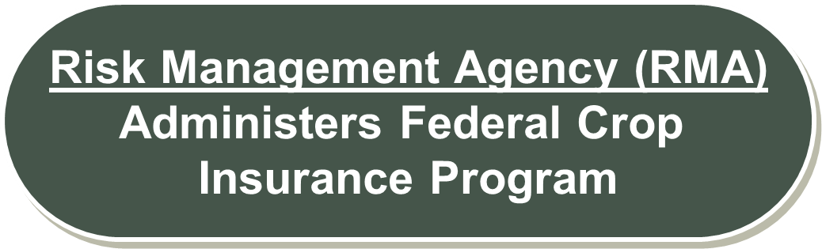
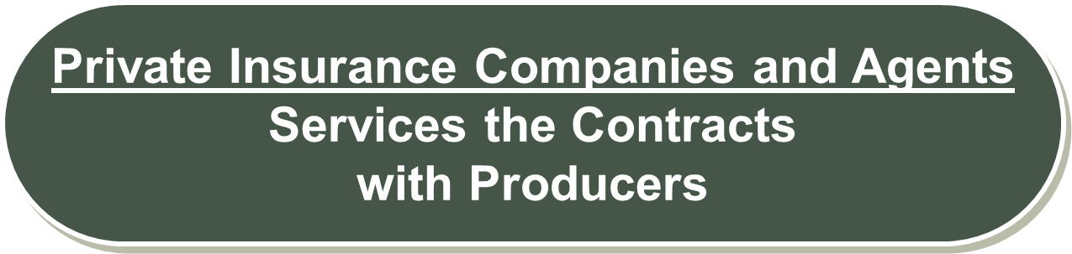
RMA / Private Insurance Partnership
Development & maintain programs
Integrity and compliance
Educate producers on risk management tools
Reinsure private insurance companies
Subsidizes program
Agents sell Federal crop insurance policies to farmers
Insurance companies service the contracts with farmers
Adjusts claims and pays indemnity to the farmer
Reports to RMA
Notes:
Crop insurance has a unique delivery system through a public private partnership.
The public side being the government through RMA is responsible for developing and maintaining federal crop insurance policies, this includes determining the rates, prices and yields for each crop at the county level every year. RMA is also in charge of compliance to prevent fraud or abuse.
Independent crop insurance agents sell the policies to farmers under approved insurance companies that underwrite the polices and settle the claims if there is a loss.
The federal government subsidizes the premiums to reduce the cost of crop insurance for farmers and reinsures the private insurance companies to share the cost of the claims. If multi-peril crop insurance was sold only in the private sector it would likely not be affordable.
Just a little background on the relationship between RMA and the private Insurance Companies and agents: RMA is responsible for developing and maintaining federal crop insurance policies, this includes determining the rates, prices and yields for each crop at the county level every year. RMA is also in charge of compliance to prevent fraud or abuse. Private insurance companies and agents are responsible for selling insurance policies to farmers and settling their claims. The federal government subsidizes the premiums to reduce the cost of crop insurance for farmers and reinsures the private insurance companies to share the cost of the claims.

Slide 9
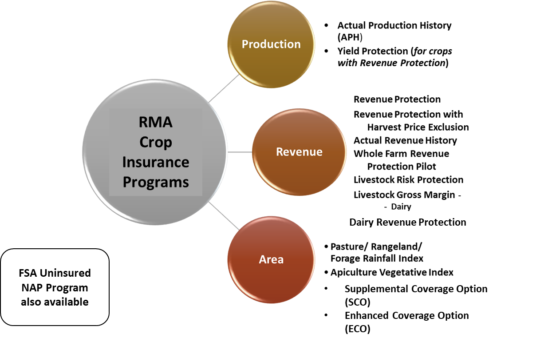

What is Crop Insurance
Private single peril:
Fire
Hail
Written Agreements

Slide 10
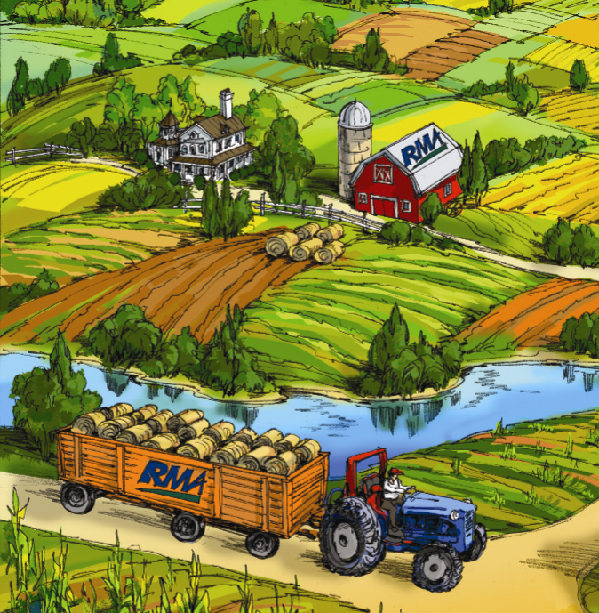
Insured Causes of Loss
Adverse weather conditions (hail, drought, freeze, etc.)
Fire (natural causes)
Insects & Plant disease, if proper application of pest and disease control measures
Wildlife
Earthquake
Volcanic eruption
Failure of irrigation water supply, if caused by an insured peril during the insurance period
Price changes for revenue policies
Insured Causes of Loss
Notes:
Production based policies insure against yield losses due to natural causes such as adverse weather, wildlife, insects, and disease. If the harvested (plus any appraised) production is less than the yield insured, the producer is paid an indemnity based on the difference.
Revenue policies provide protection against price decline or increase (or a combination of both) in addition to yield losses. Projected and Harvest Prices are used to establish your coverage and to determine whether you have a loss. There is additional premium cost for this added coverage.

Slide 11
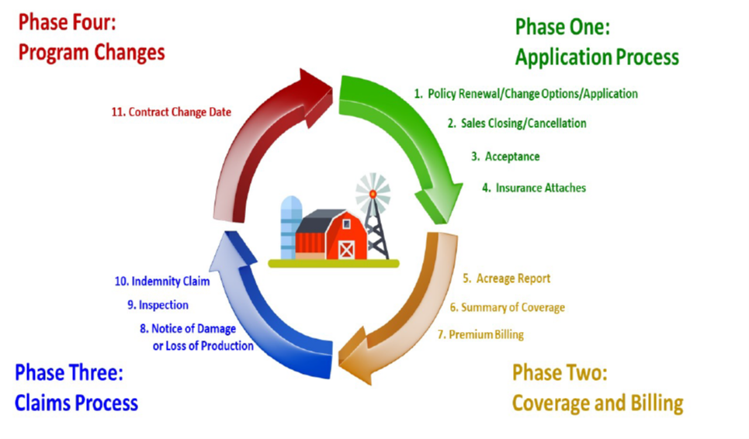
Crop Insurance Cycle

Slide 12
Thank you!!
Questions?
USDA Risk Management Agency
Spokane Regional Office
11707 E. Sprague Ave, Suite 304
Spokane Valley, WA 99206
509-228-6320
1-800-205-9953
www.rma.usda.gov
Benjamin.thiel@usda.gov

