Slide 1
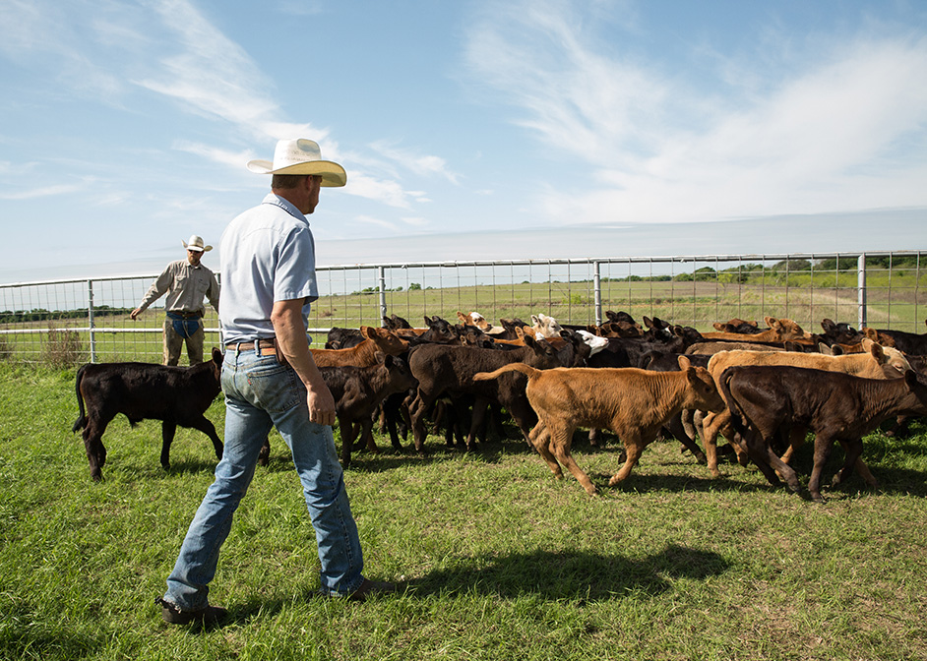
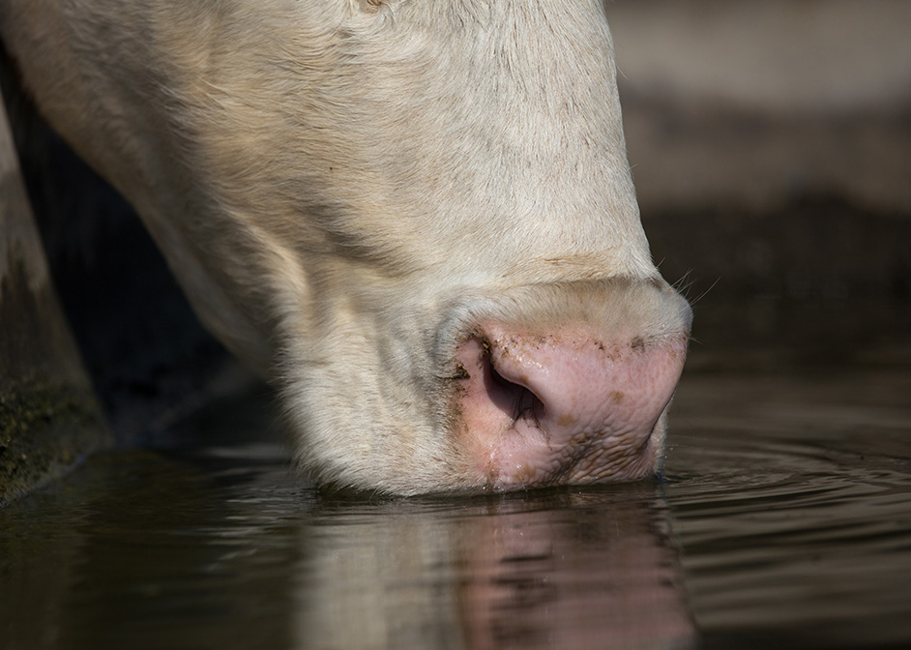
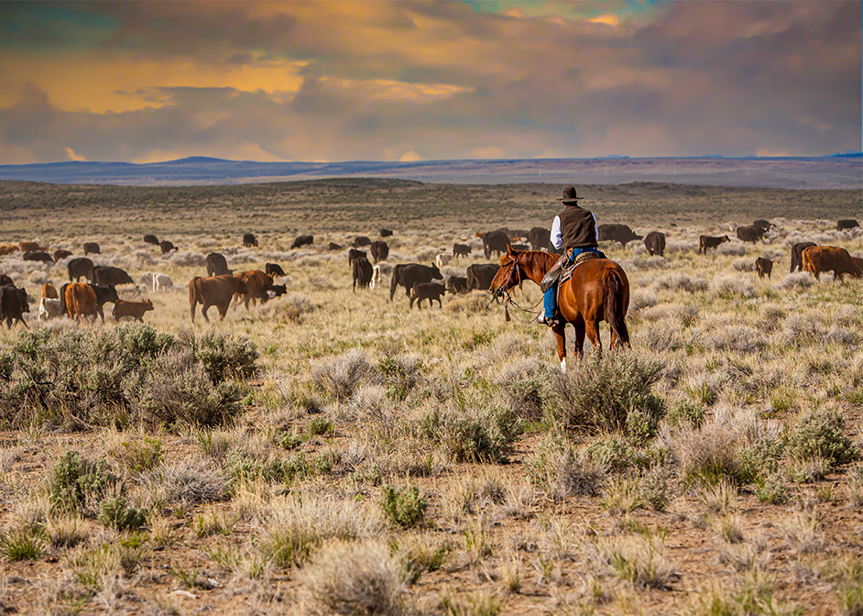

Source Water Protection Areas

Slide 2
Background
2018 Farm Bill directs us to identify source water priorities by identifying:
  Targeted geographic areas
  Targeted conservation practices – for water quality & quantity

Slide 3
Sidebars:
Limited to 20% of state’s acres
Provides increased financial assistance payment rates
States are expected to dedicate a minimum of 10% of program funding for these areas

Slide 4
Eligible Programs & Practices
All programs except for CRP
  Water Quality Degradation
  Insufficient Water
  Field Pesticide Loss
  Field Sediment/Nutrient/Pathogen loss
  Salt Losses to Water Source

Slide 5
Background
2020 – SWPAs established at county level
2022 – SWPAs established by 12-digit HUC
Focus on moderately high and high nitrate areas

Slide 6
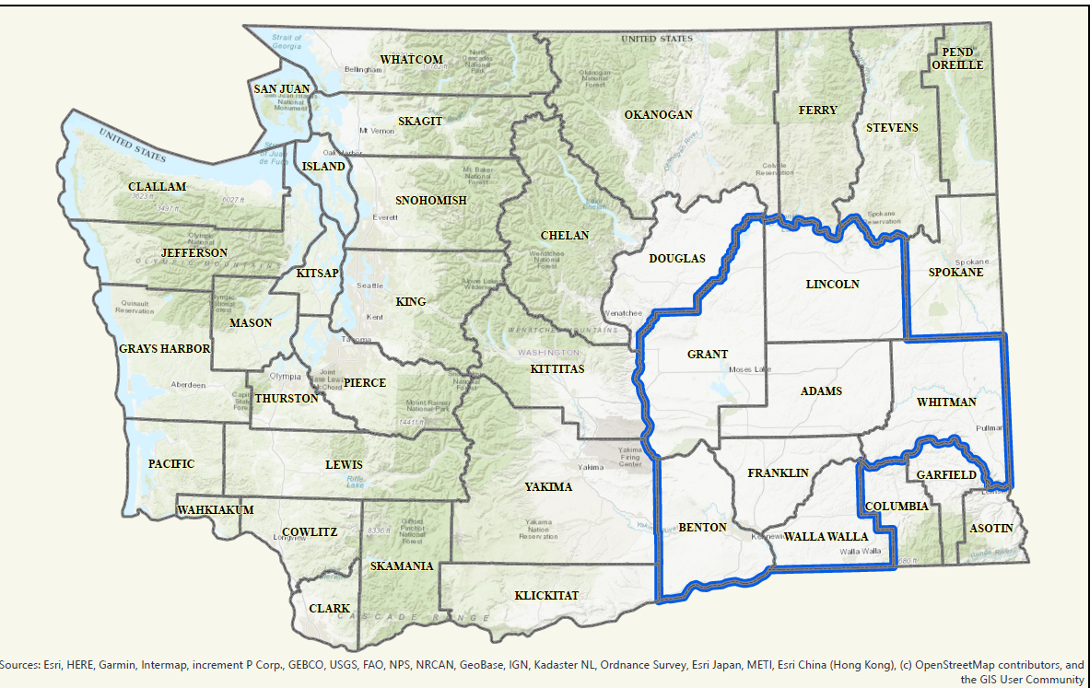
FY2020 SWPA

Slide 7
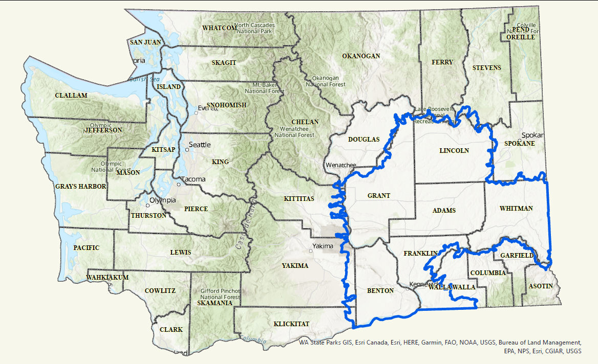
FY2022 SWPA

Slide 8
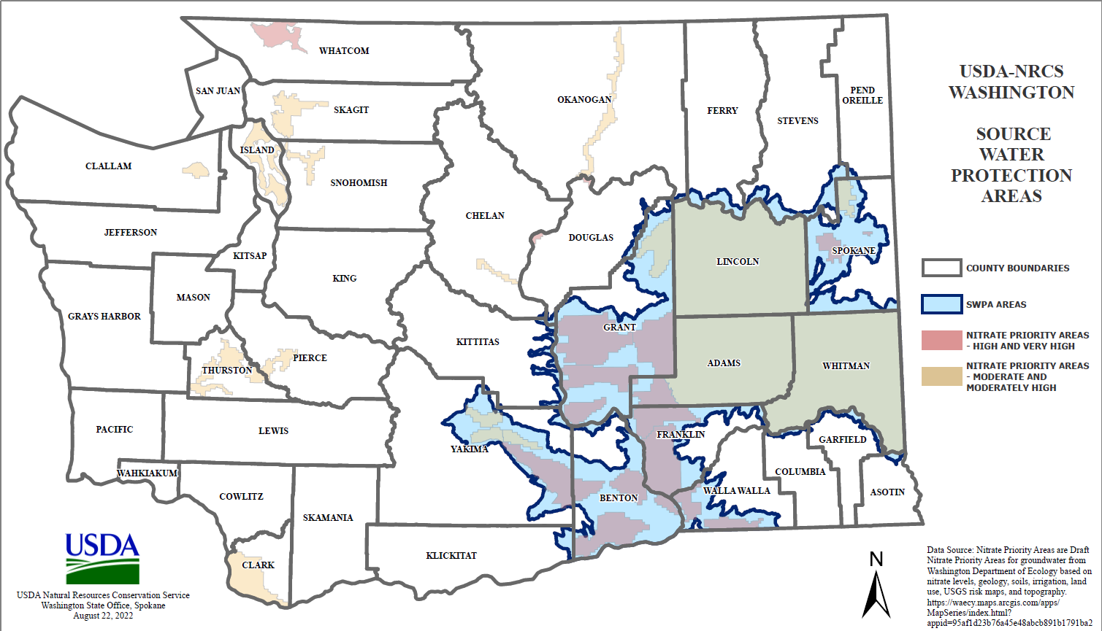
2023 SWPA

Slide 9
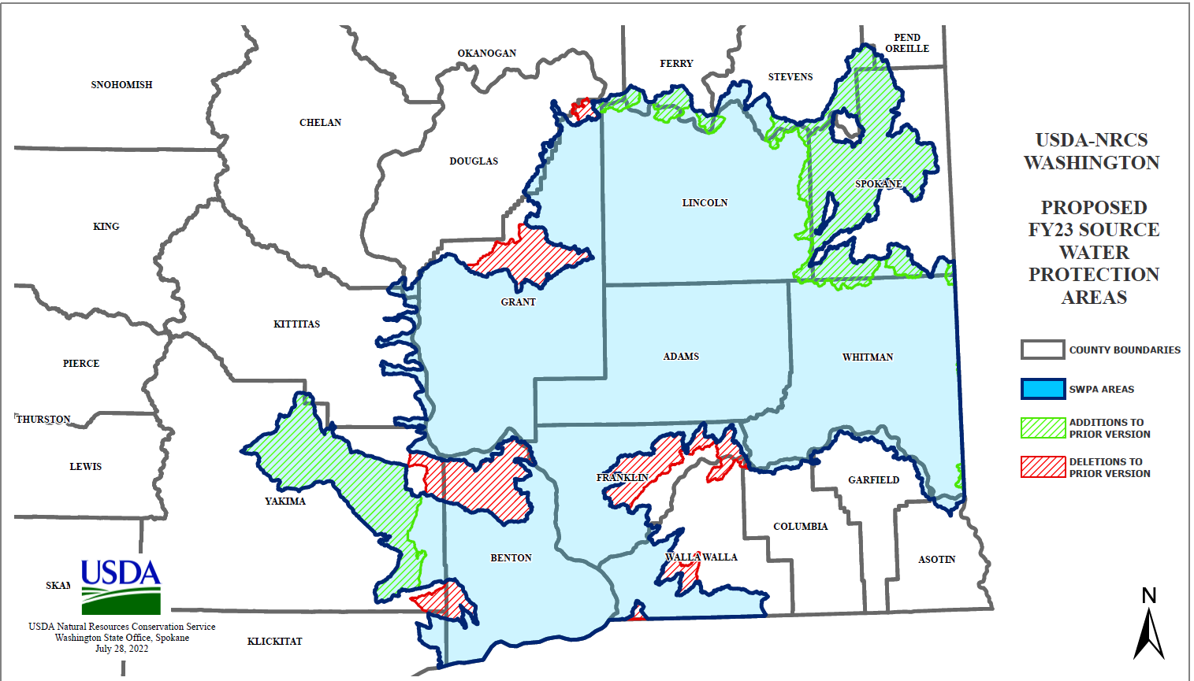
FY2023 SWPA Changes

Slide 10

Questions?

