Slide 1

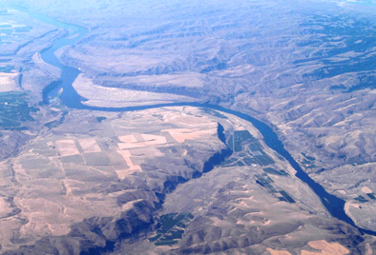
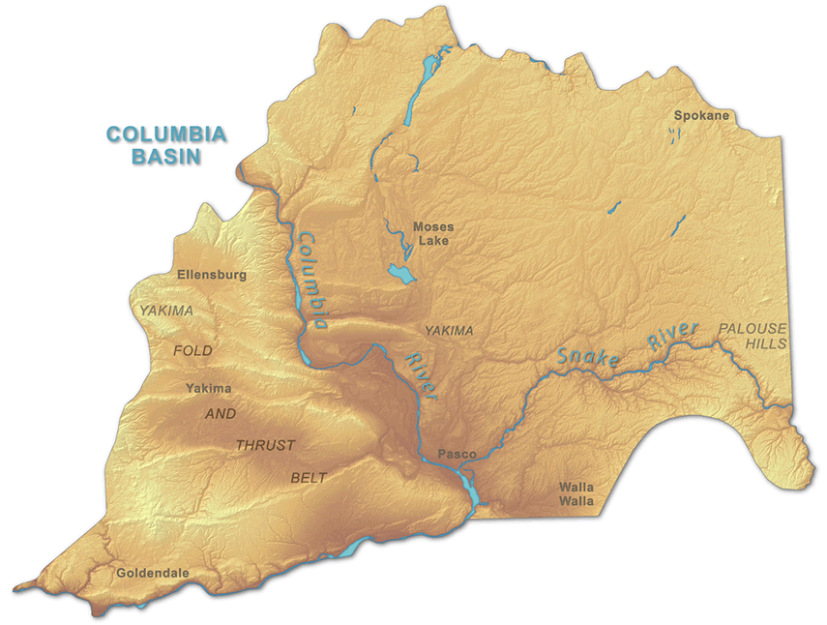

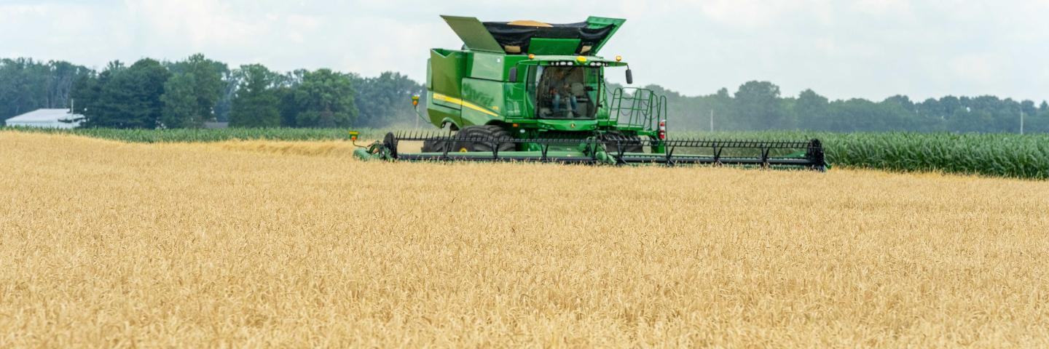
Soil Survey Project Proposal – Central Columbia Basin Andic Properties Investigation
Max Ross
State Resource Soil Scientist
NRCS Washington

Slide 2
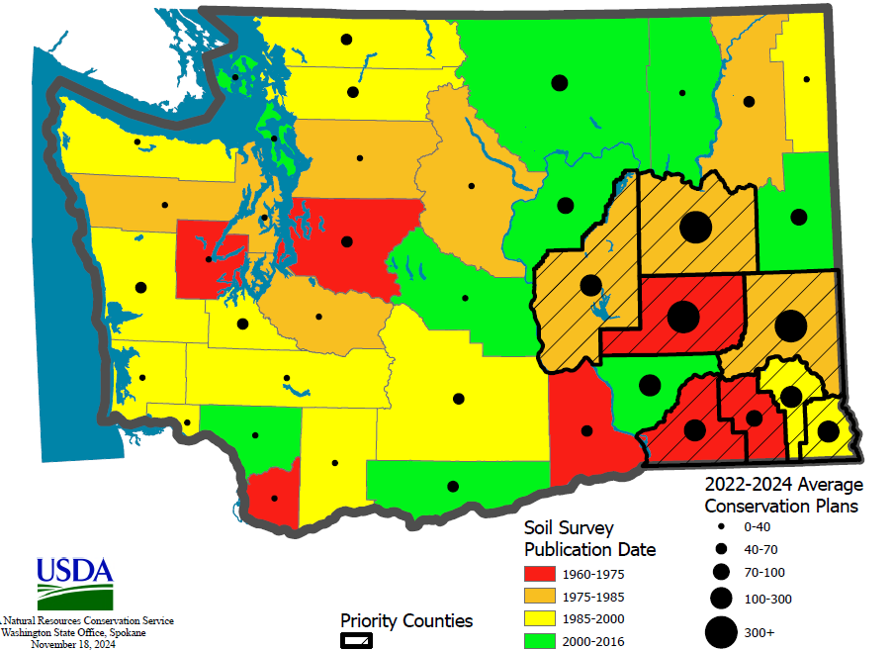
Background: Washington State Soil Survey Status
Analysis factoring age and use of existing soil surveys
Several counties in Central and Eastern WA flagged for further evaluation
Specifically, Adams County

Slide 3
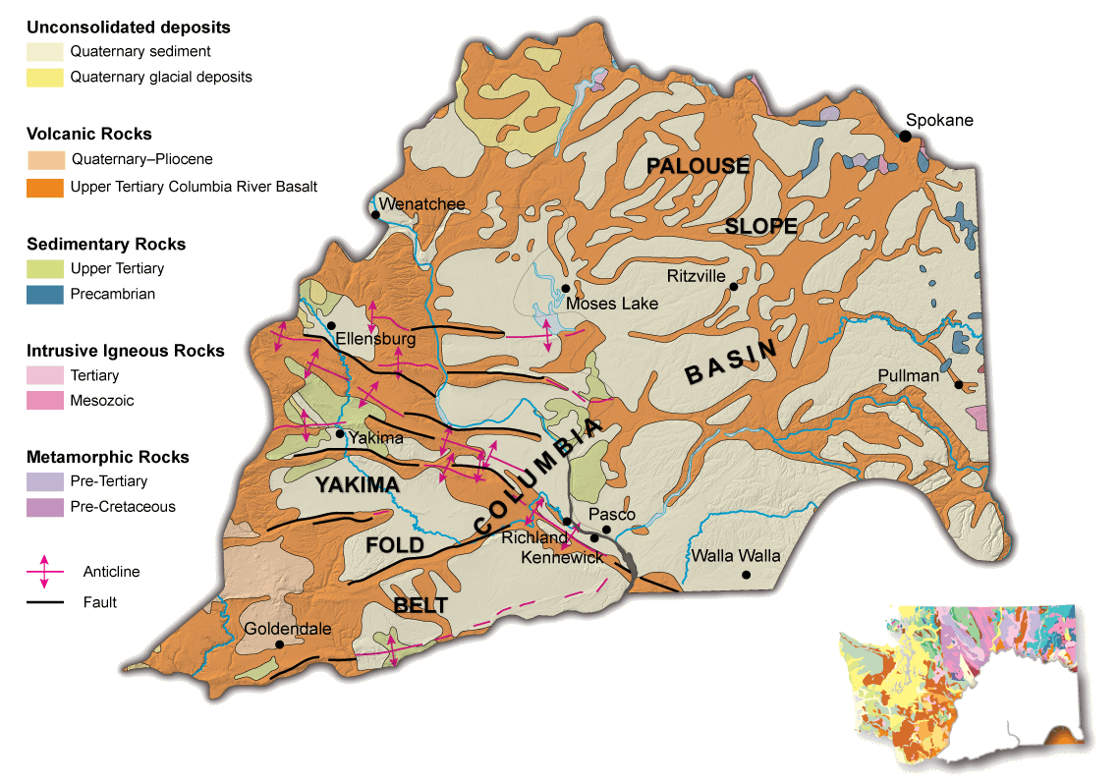
Background: Adams County Soil Survey Concerns
Adams County soil survey published in 1967
Soil survey is snapshot in time
Soils indicative of Central Columbia Basin Geology
Soils mapped are primarily Inceptisols with alluvial and residuum parent material

Slide 4

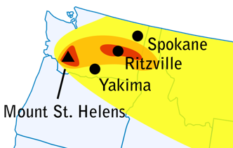
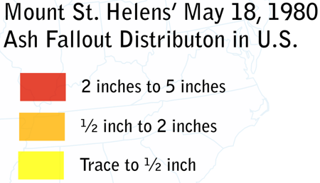
Background: Adams County Soil Survey Concerns
Eruption of Mount St. Helens in 1980
2-5 inches of ash deposited in Adams County
  Anecdotal reports of more
Concerns over reliability of soil survey data because MSH ash not accounted for

Slide 5
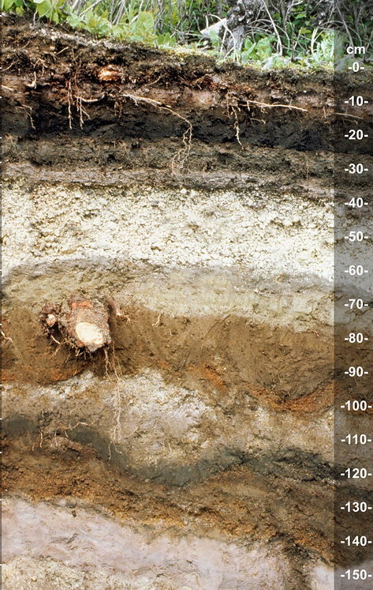
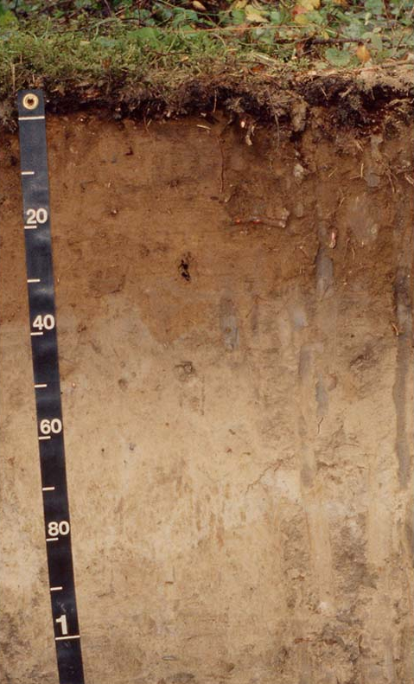
Volcanic Ash – Andic Soil Properties
Significance of Andic Soil Properties
Unique mineralogy – Allophane, imogolite, ferrihydrite
High water holding capacity
Low bulk density
High susceptibility to erosion and compaction
Low available phosphorous
High organic matter retention
Ultimately different management practices and implications

Slide 6
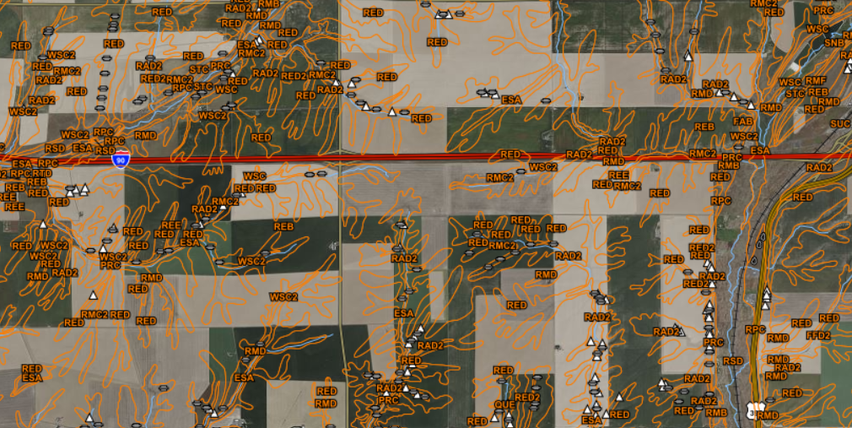
Options for Addressing Soil Survey Concerns
  Comprehensive update of soil survey for Central Columbia Basin
    Soil survey policy requires projects to align to geographic boundary, not political boundary
    Time, financial, and labor-intensive project
    Likely 5+ year timeline for completion
    Reactive, not investigative

Slide 7
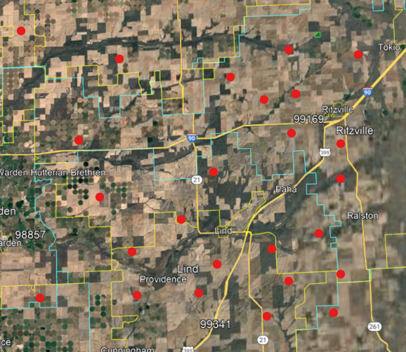
Options for Addressing Soil Survey Concerns
  Dynamic Soil Properties (DSP) Evaluation Project
    Targeted investigation to determine if Andic soil properties are present in project area
    Considers and tests competing hypotheses
      Ash is present and has significant impact on soil properties and interpretations
      Andic properties are not present - Ash has either been eroded away or incorporated into the soil and diluted
    Sample approximately 30-40 points in project area and analyze for Andic properties
      Bulk Density
      Texture
      Chemical properties
    Use results to inform future comprehensive update projects

Slide 8
Options for Addressing Soil Survey Concerns
  Take No Action
    Soil Survey resources are limited
    Other priorities?

Slide 9
Recommendation and Analysis
Recommend Option 2: Dynamic Soil Properties Evaluation Project
Pros:
  Address and validate soil survey concerns brought up by stakeholders and NRCS staff
  Targeted investigation with data collection used to inform future decisions
  Accurate soil survey data provides reliable information for planning and contracting
Cons:
  Soil survey staff is limited; this request would detract staff from other projects
  Additional financial cost to Soils

Slide 10
Next Steps
Decision Memo sent to STC
Present to STAC
Send letter to SPSD regional staff informing them of project request
Schedule technical team meeting to develop project details
  Scope and project boundary
  Methods and sampling strategy
  Timeline and deliverables
Initiate the project

Slide 11

Questions?
Max Ross
State Resource Soil Scientist
Washington State NRCS
360.480.6578
Max.ross@usda.gov

