Slide 1
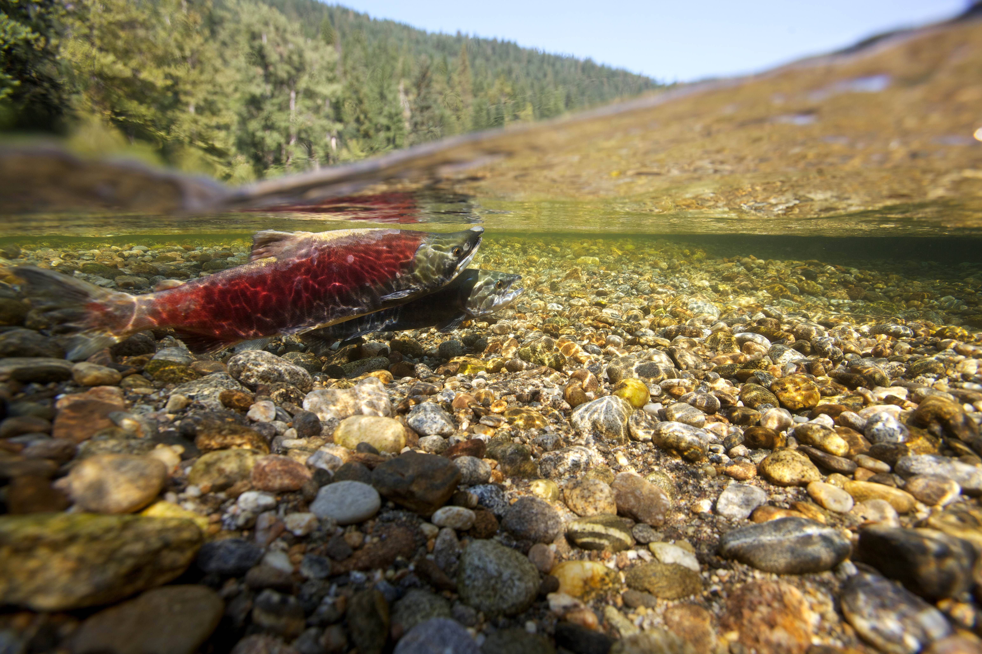
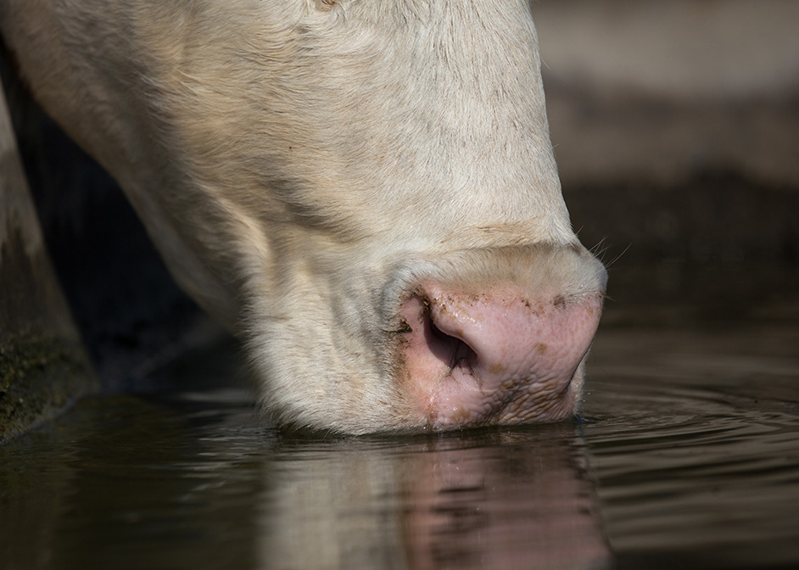
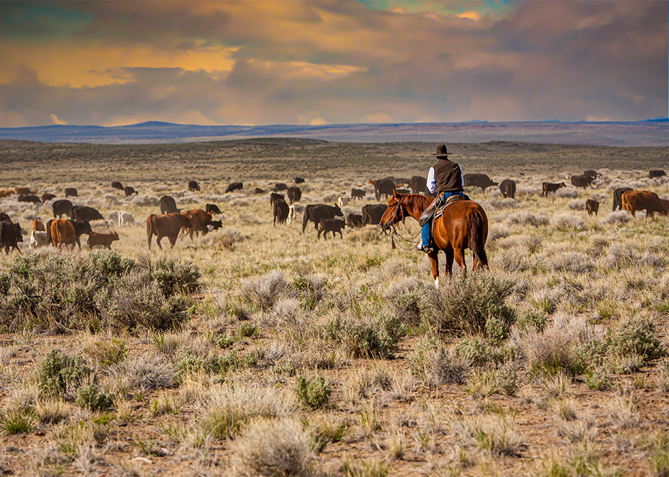

Ecological Sciences

Slide 2
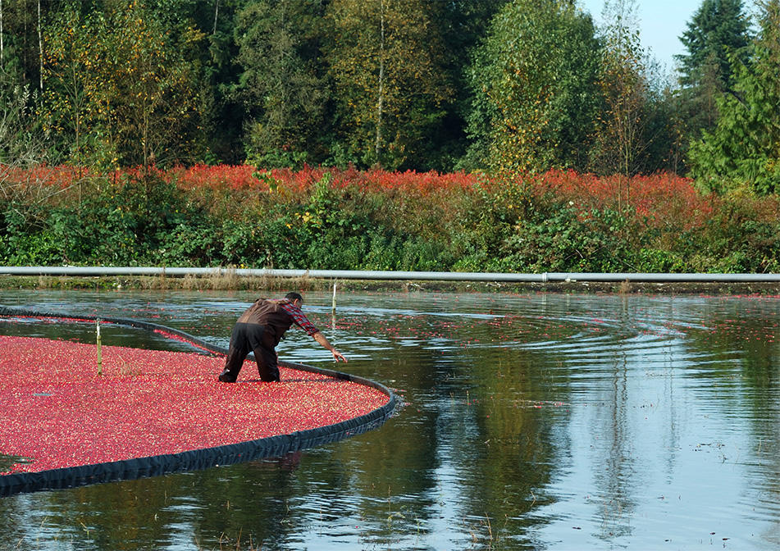
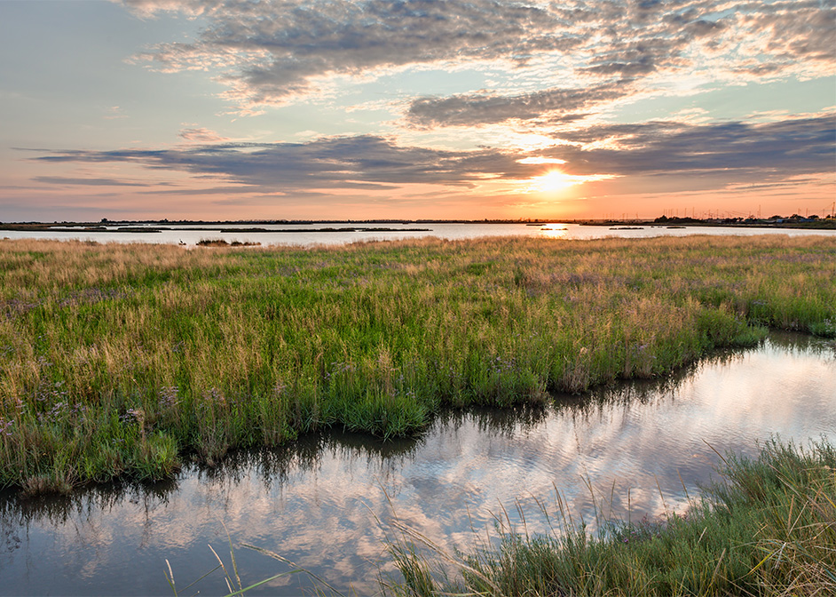

Practice Updates
Robert D. Evans, State Resource Conservationist

Slide 3

Public Comments on Practices
Policy: Title 450 General Manual Part 401
  States adopt nationally approved Conservation Practice Standards (CPS)
    States can be more restrictive, but not less.
  Public has opportunity to comment on CPS, prior to approval and release to states
    401.2 D: “…Ensure CPS are reviewed internally, by the public in Federal Register notices and issued by NHCP notices through the NRCS eDirectives System.”

Slide 4
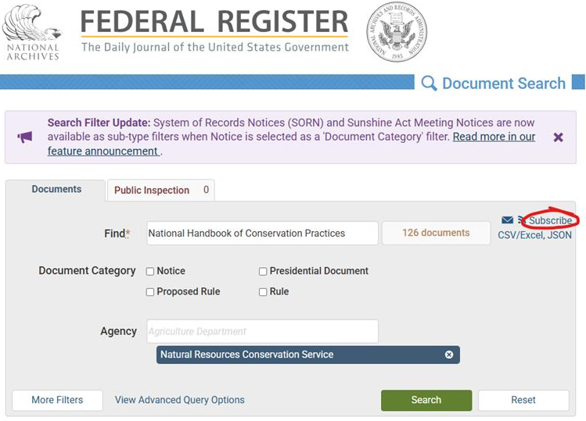
Quick Link

Slide 5

Field Office Technical Guide
New SharePoint based system
  Previous Quark system retired
New FOTG Content Manager: Josh Madison
Interim Practices (800 series)
  Unable to be uploaded to Section IV
  Will upload them to Section I temporarily
  Training for NRCS Technical Staff: May 12-15

Slide 6

Nat’l Handbook Conservation Practices
Notice 176 Released May, 2024
  Amending Soil Properties with Gypsum (333)
  Conservation Cover (327)
  Cover Crop (340)
  Woody Residue Treatment (384)
Notice 177 Released Nov, 2024
  Hedgerow Planting (422)
  Irrigation Pipeline (430)
  Seasonal Water Management for Wildlife (646)
  Wetland Restoration (657)

Slide 7
Ecological Sciences Division Updates
Practice Name | Practice Code | Standard | Implementation Requirement | Guidance Document
Conservation Cover | 327 | May 2025 | In progress | In progress
Cover Crop | 340 | May 2025 | Updated: Nov 2024 | Updated: Nov 2024
Fence | 382 | Up to date | Ready for upload | In progress
Woody Residue Treatment | 384 | Released soon | In progress | In progress
Riparian Forest Buffer | 391 | Adopting standard to be released with updates | Ready to Upload | SVAP & TN14 need updating
Prescribed Grazing | 528 | Up to date | Under revision | In progress
Nutrient Management | 590 | Needs update | In Progress | In progress
Pest Management | 595 | Needs update | In progress | In progress
Organic Management | 823 | Up to date | Ready for upload | Ready for upload
Culturally Significant Plantings for Soil Health | 825 | Up to date | Ready for upload | Ready for upload

Slide 8
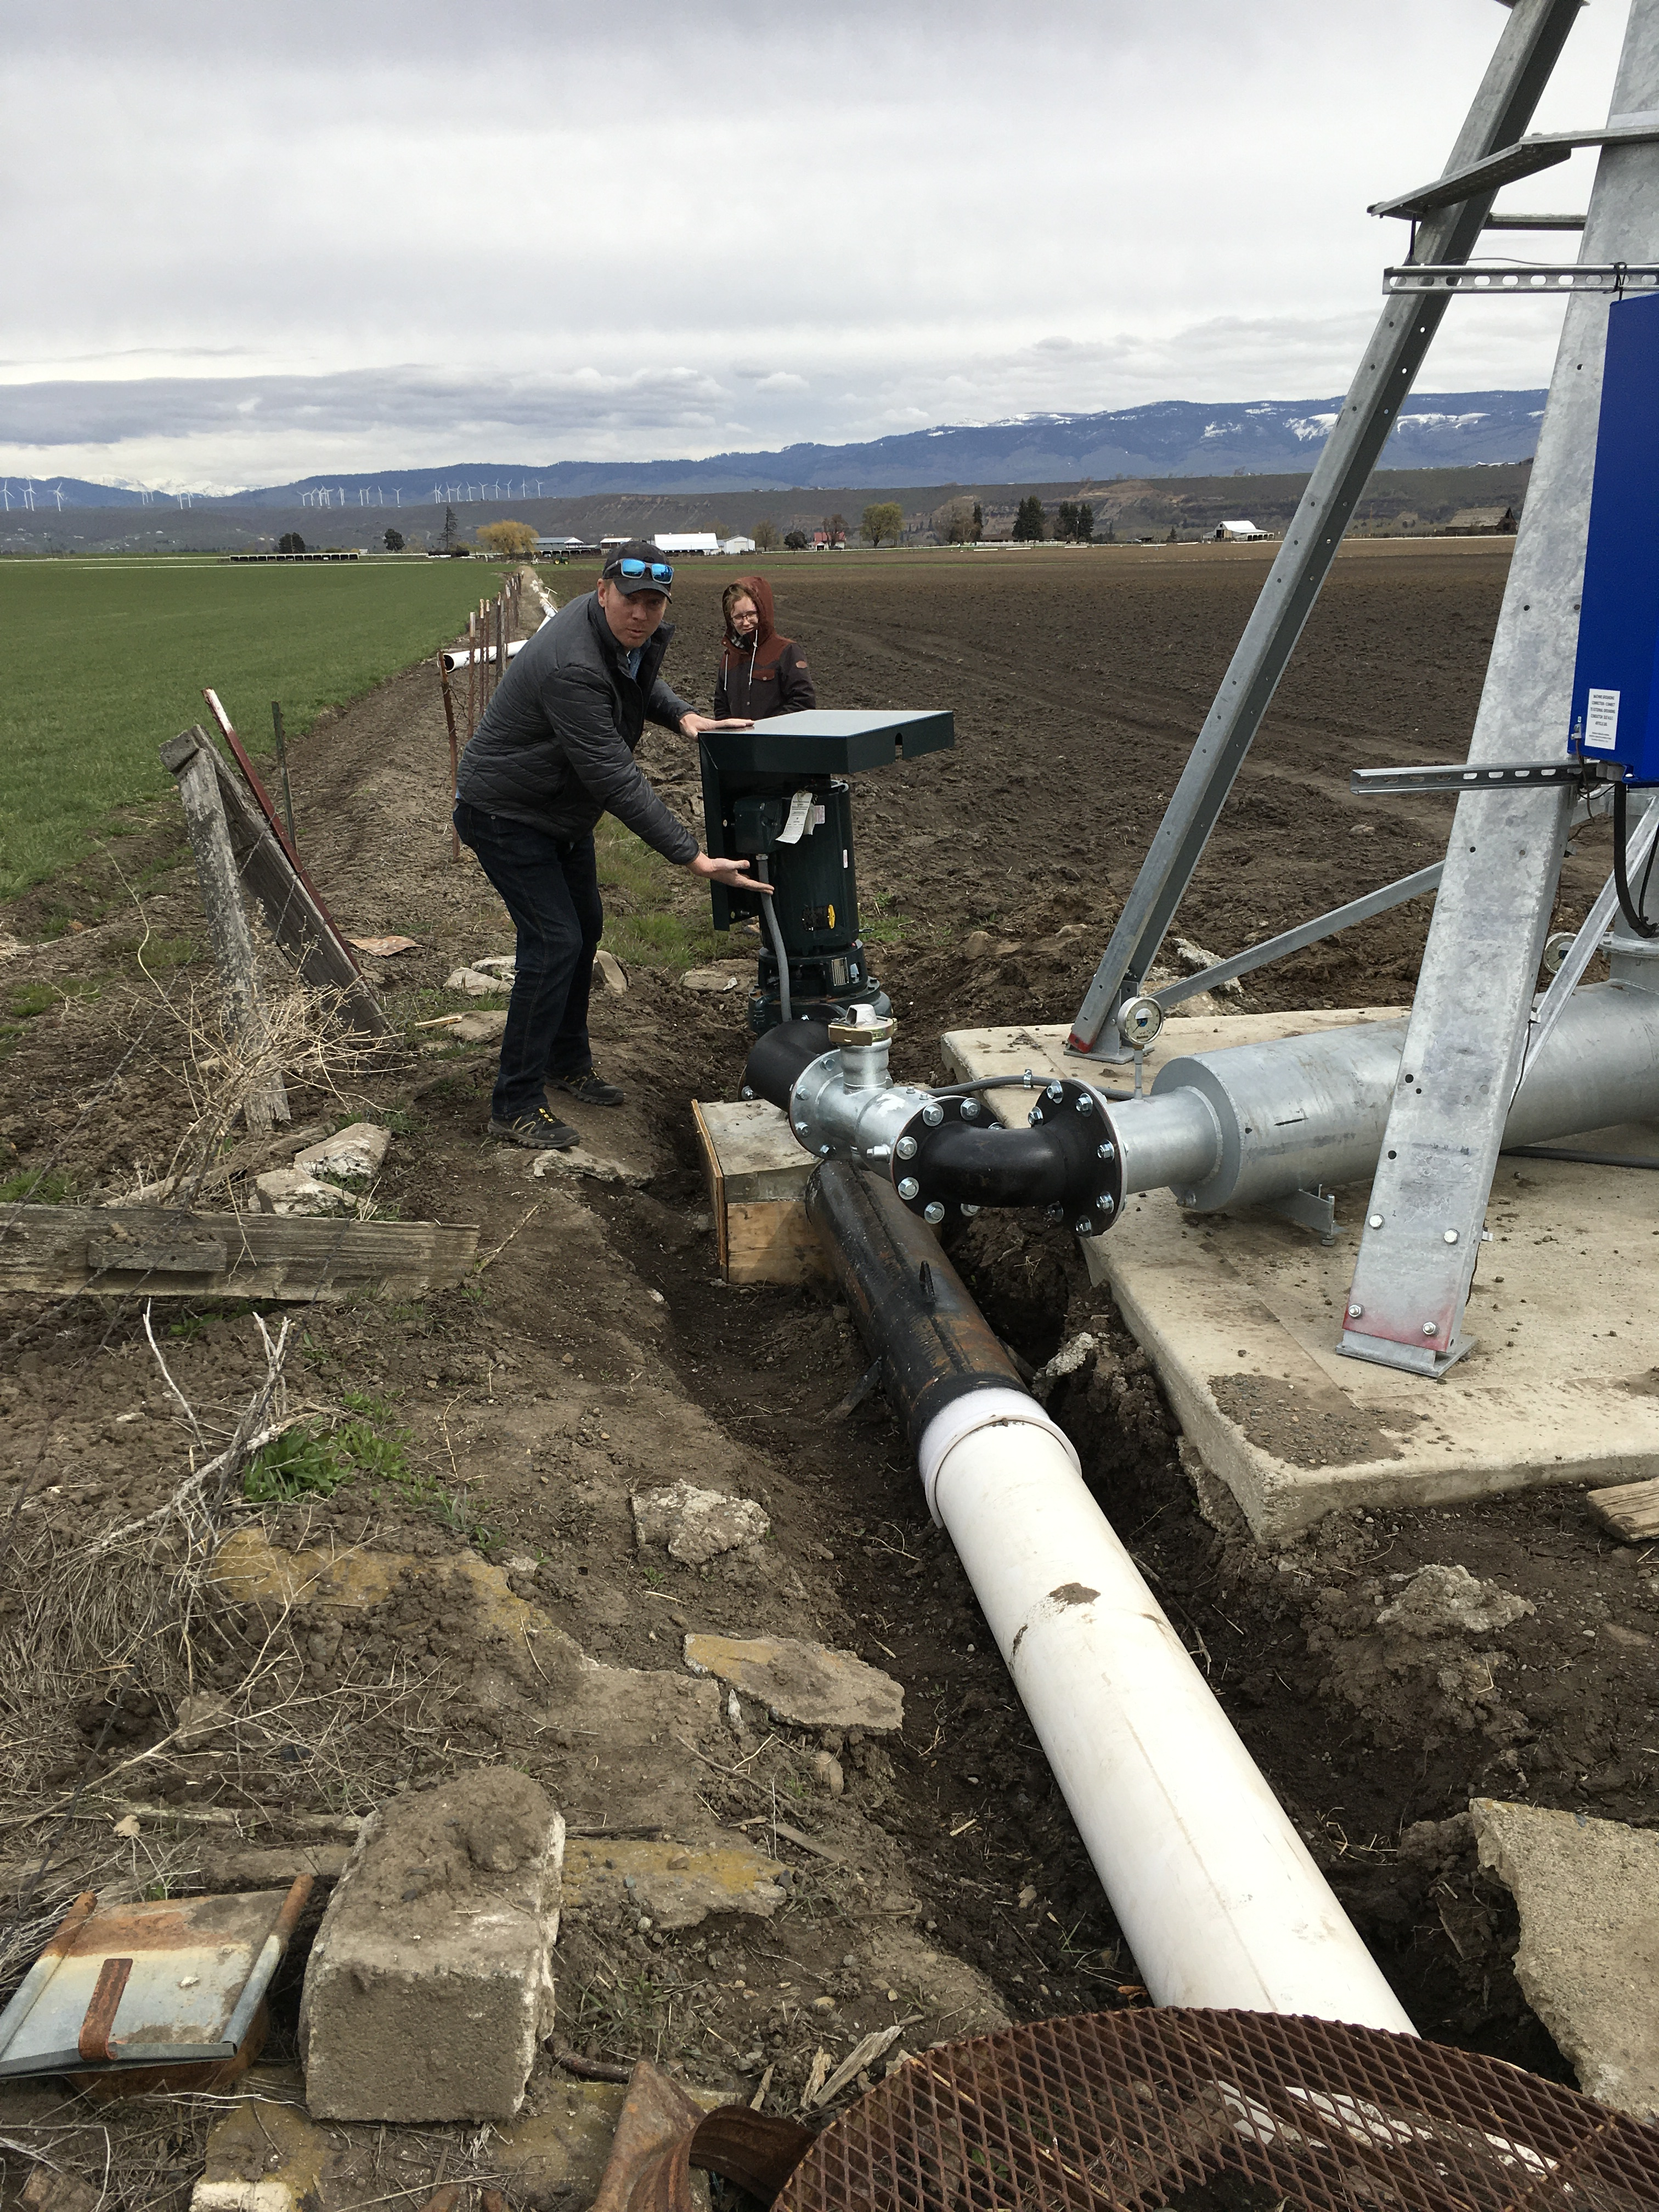
Engineering Practice Standard Updates 2025
New Practice Standard for Irrigation Pipeline (CPS 430)
  Allows more flexibility with air valve spacing & sizing with a detailed hydraulic analysis
    Removes criteria for 2,500 foot spacing of Air and Vacuum Relief (AVR) to “may be required”
    Provides additional design guidance on air valve sizing
New Implementation Requirement (IR) Related to Irrigation
  Irrigation Sprinkler IR that covers multiple practices typical with a sprinkler system
  Structure for Water Control IR for Fish Screens

Slide 9
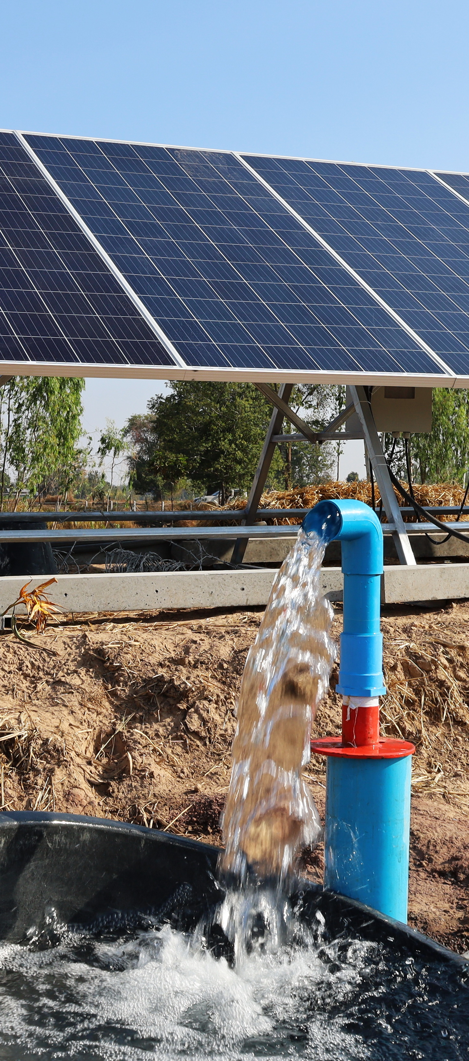
Engineering Practice Standard Updates 2025
New Practice Standard for Spring Development (CPS 574)
  Minimal changes to wording for clarifications
New Practice Standard for Water Well (CPS 642)
  A new emphasis on aquifer testing requirements in the practice standard
  New NRCS WA documents to support the CPS
    Practice Specification for aquifer testing
    Other Guidance document for water well performance

