Slide 1
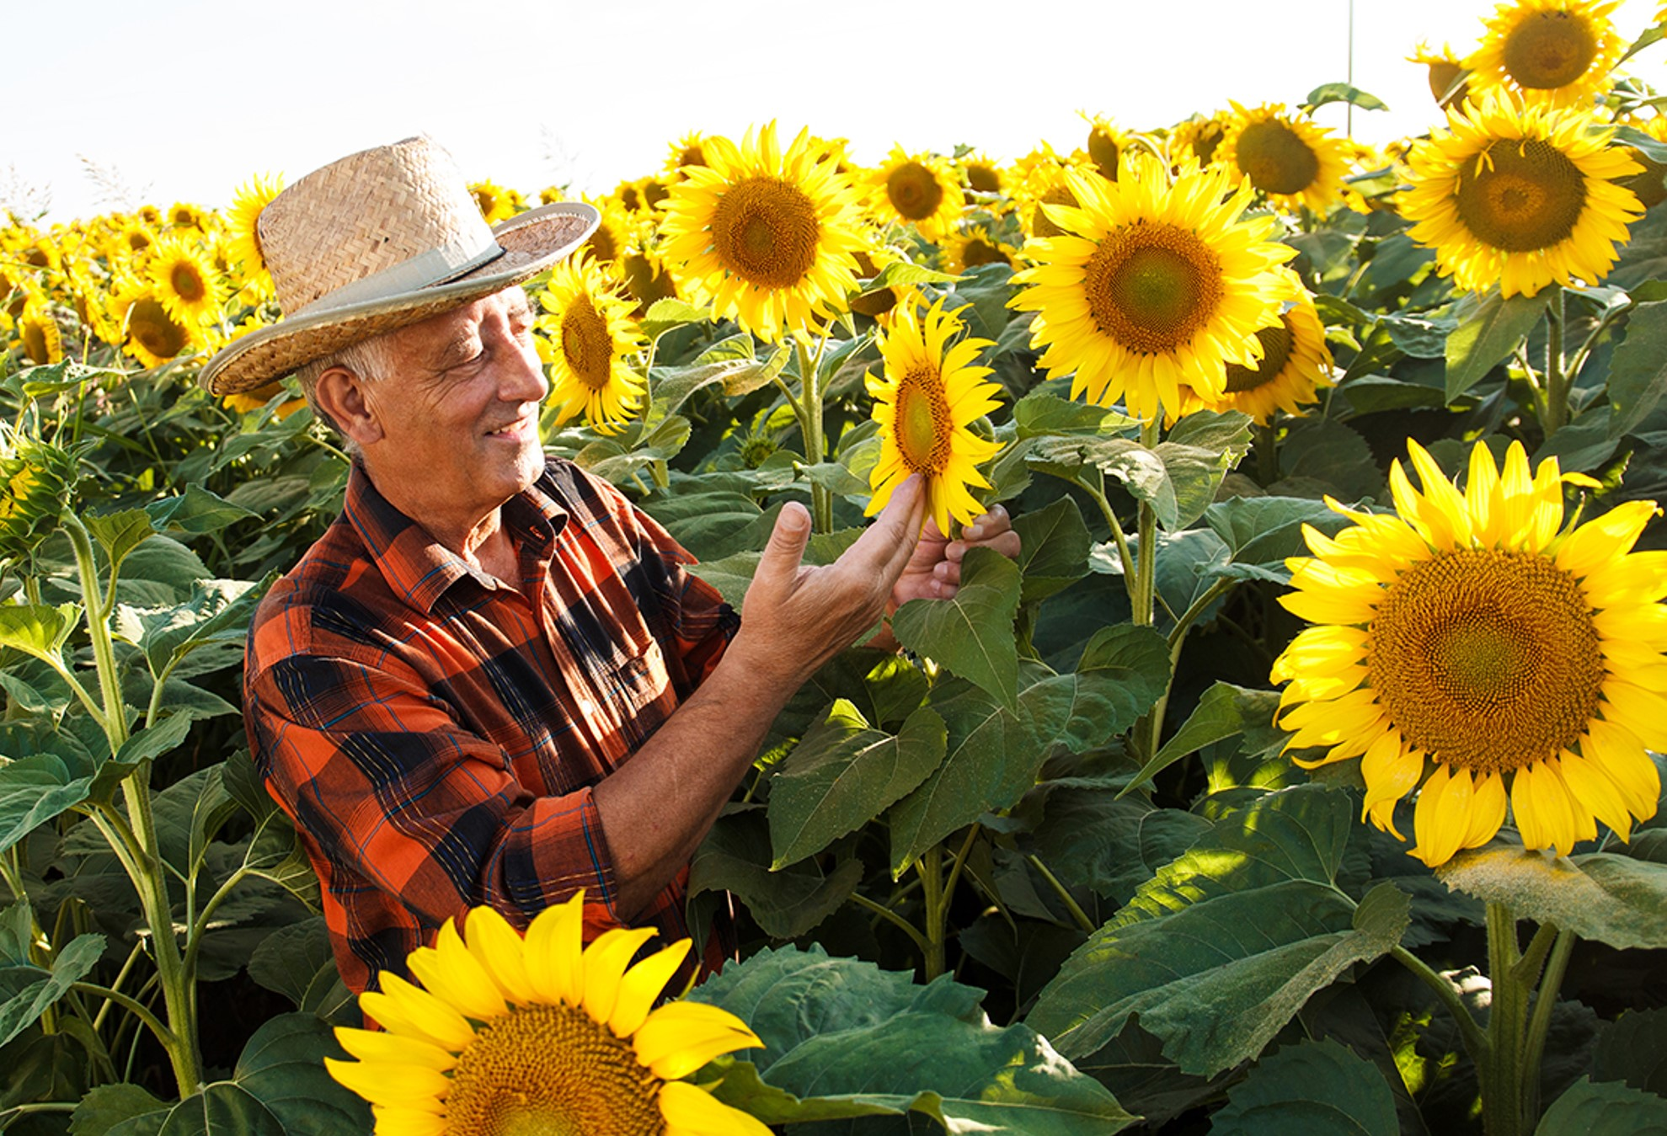
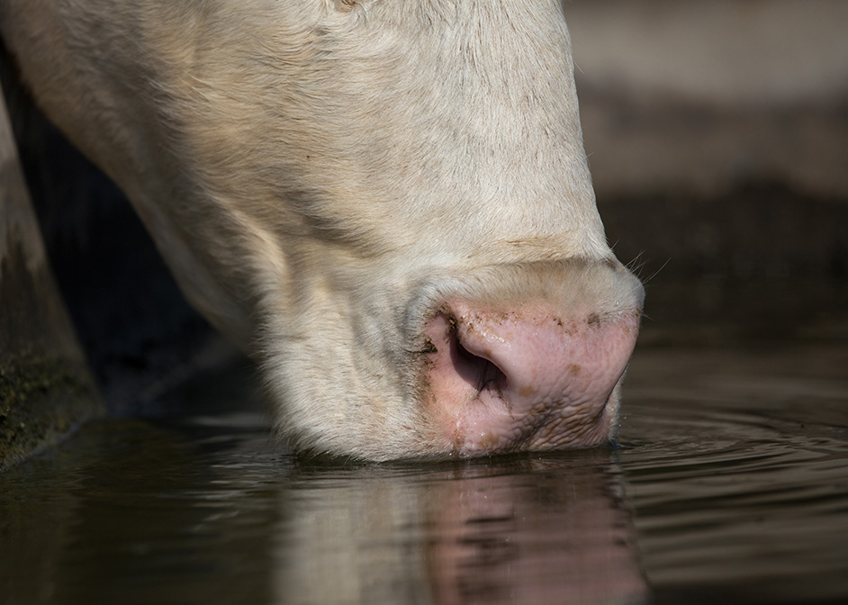
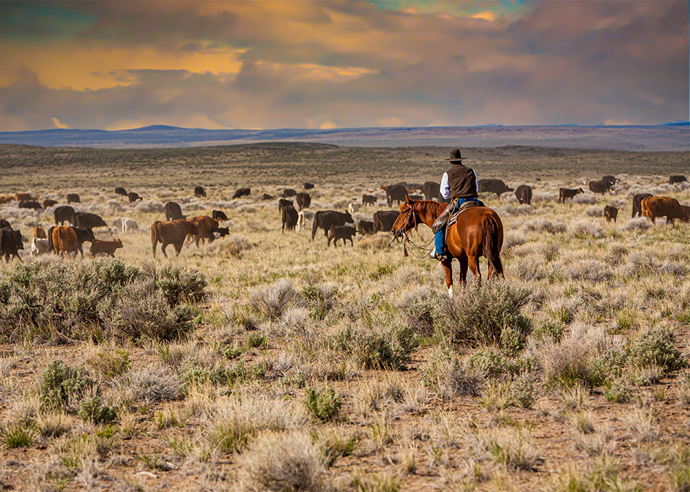

Conservation Harvest Management

Slide 2
Conservation Harvest Management
Definition
  Harvest or management techniques that optimize the amount, orientation, and distribution of plant residue left standing or laying on the ground.

Slide 3
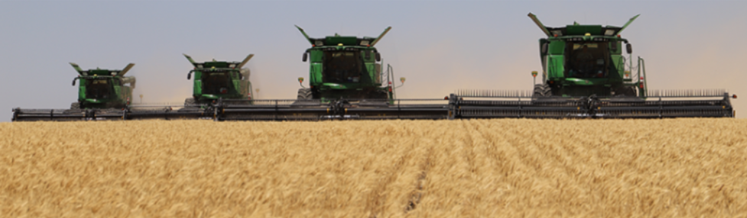
Conservation Harvest Management
Practice Purpose
  Improve natural available soil moisture and maximize precipitation retention.
  Enhance plant productivity and health
  Reduce erosion and uncontrolled runoff
  Enhance soil organic matter

Slide 4
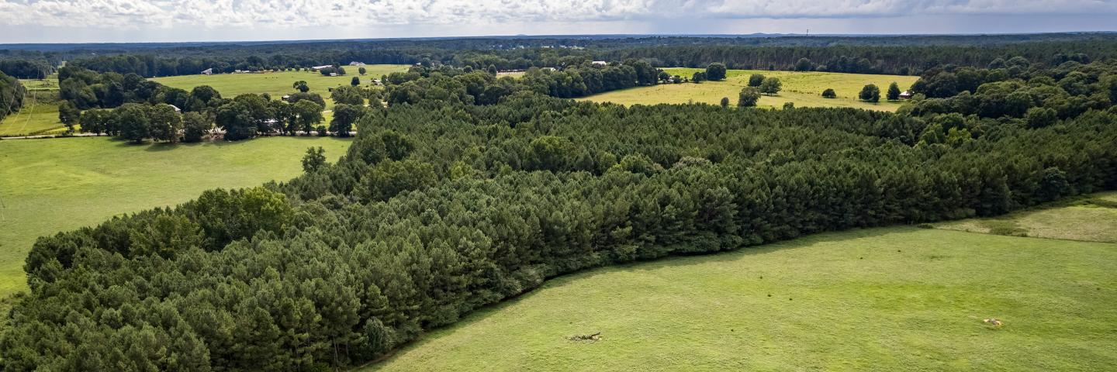
Conservation Harvest Management
Conditions where practice applies
  Any land use where harvest is managed or needed to improve soil or environmental conditions.

Slide 5
Conservation Harvest Management
General Criteria
  Harvest operations will remove:
    Cropland settings, harvest to retain maximum standing vertical residue. Minimize the amount of residue processed through harvesting machine.
    Forest and range settings, retain only the diameter and length of material, by species, as prescribed according to forest type or Ecological Site Descriptions and site inventory.
  Leave standing or distributed residue intact and onsite, undisturbed, for maximum time allowed by prevailing agriculture or land management systems.

Slide 6
Conservation Harvest Management
Additional Criteria—Naturally, Available Moisture
  On cropland, leave residue standing through periods of precipitation and snowfall.
  Minimum crop stubble height during winter months will be:
    10” or 80% of the plant stalk height for crops with row spacing of less than 15”
    15” or 80% of the plant stalk height for crops with row spacing of 15” or greater
    These heights shall be present over at least 80% of the field.

Slide 7
Conservation Harvest Management
Additional Criteria—Plant Productivity and Health
  On cropland, leave standing residue in place through the seeding and establishment of subsequent crop to provide increased soil moisture retention and protect against wind erosion.

Slide 8
Conservation Harvest Management
Additional Criteria—Reduce Erosion and Uncontrolled Runoff
  On cropland, leave standing residue in place through critical erosion period. Determine the amount of standing residue needed by using current wind erosion prediction technology.

Slide 9
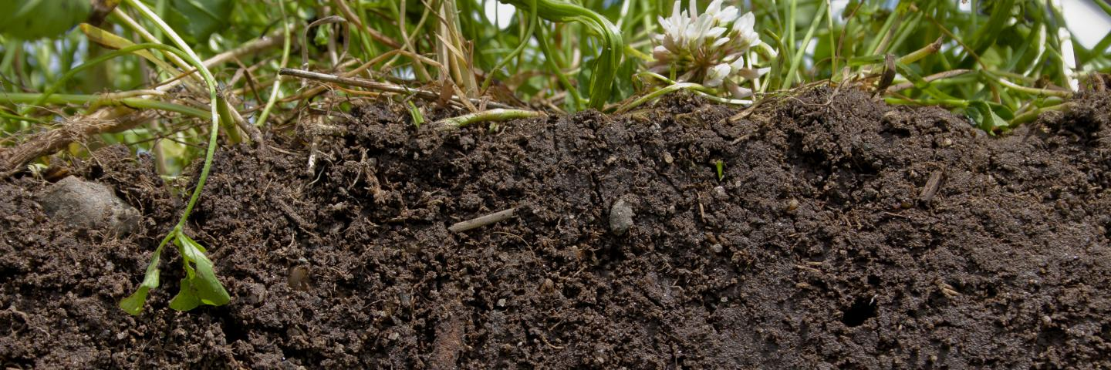
Conservation Harvest Management
Additional Criteria—Enhance Soil Organic Matter
  Ensure soil conditioning index and soil organic matter show a positive trend over the crop rotation.
  On forestland, fine (0-3”) woody material should be left on the site to enhance SOM

Slide 10
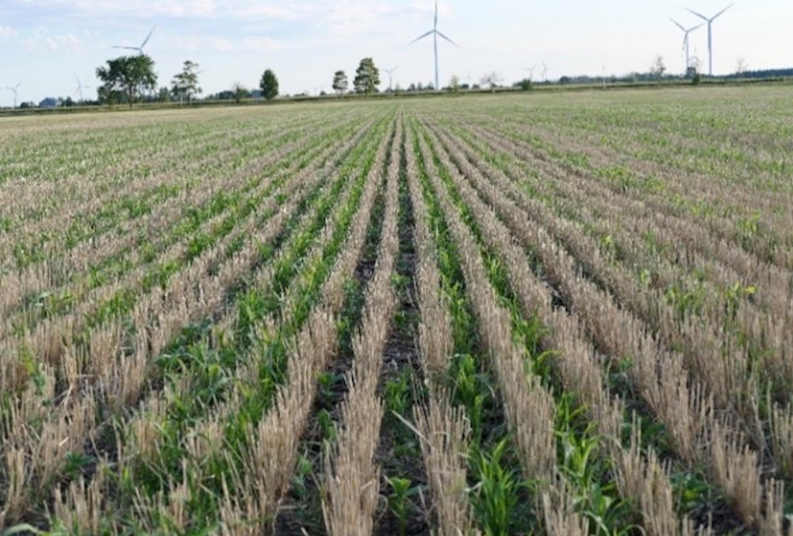
Conservation Harvest Management, ICPS 809
  Considerations
  Planting success is usually completed with a single disc or double disc drill.
  10-degree seeding offset from previous crop will assist in reducing hair pinning.
  Leaving stubble vertical reduces instances of hair pinning.

Slide 11
Conservation Harvest Management
Considerations
  Residue Management No till or Residue Management Reduced Till is strongly encouraged.
    Implementation of Conservation Harvest Management would be considered a change in operation dealing with a change in residue management, warranting implementing through NRCS programs where applicable.
  Other conservation practice that may change due to implementation of Conservation Harvest Management
    Cover Crop
    Nutrient Management
    Pest Management Conservation System
    Conservation Crop Rotation

Slide 12
What are the benefits?
Provides similar benefits as several of our Conservation Practices addressing soil health benefits, i.e. Cover Crop, Conservation Crop Rotation, Residue Management etc.
Increased nonfragile residue provides Soil Cover.
  Less material through combine
  Decrease wind speed at ground surface. (6mph at 2 leaf Vs 15+mph at top of canopy)
  Decrease soil temperature at seeding depth. (As much as 10+ degrees cooler than conventionally harvested wheat)
  Increased moisture and ideal temperatures increases bacteria and fungi activity increasing biodiversity.
  Provides wildlife habitat

Slide 13
Conservation Harvest Management
What are the benefits?
  Decrease soil disturbance
    Leaving more residue through critical erosion periods.
    Increasing Water infiltration.
    Increase precipitation retention, i.e., moisture efficiency.
    Increased residue height provides protection to growing crops to wind erosion.
  Increase Organic Matter increases biodiversity.
    Bacteria and Fungi feed on soil organic matter assisting in decomposition and providing nutrients released for future crop production.
    Increased biodiversity decreases disease and pest problems.

Slide 14
Interim Practice Standard
An interim conservation practice standard has a 3-year life span, at which time it is either requested to be come a practice or it does not become a practice. Special circumstances could extend to 5 years.
Currently two potential directions.
  Become a conservation practice under Soil Health.
  Covered under additional criteria/considerations to “Increase plant available moisture” in our residue management practices.
    Would probably require a conservation practice update for Residue Management Reduced till.

Slide 15
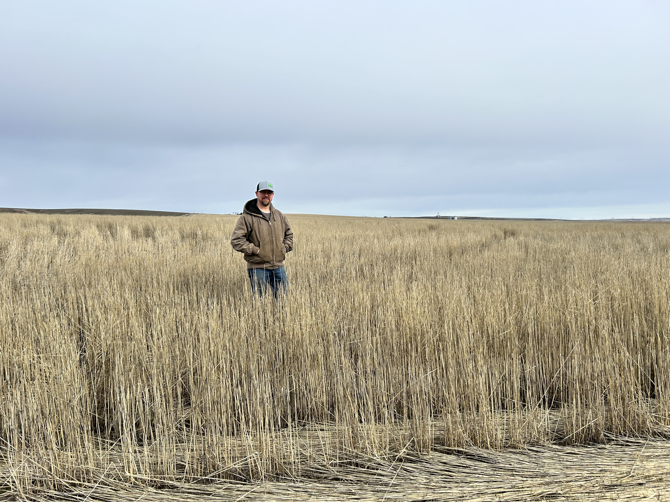
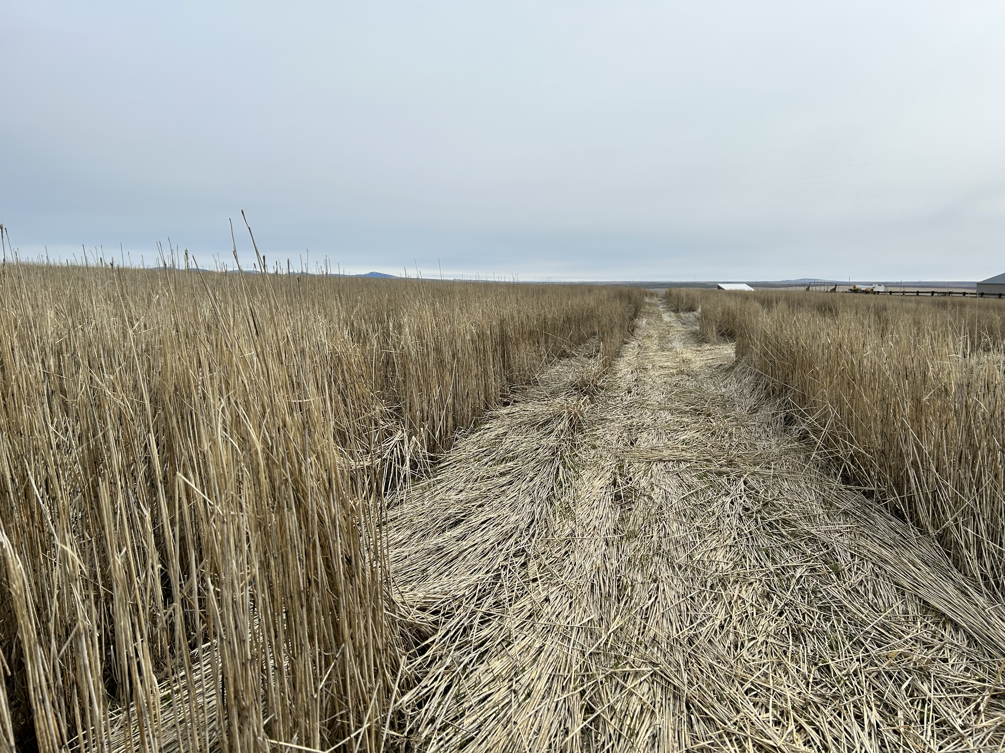
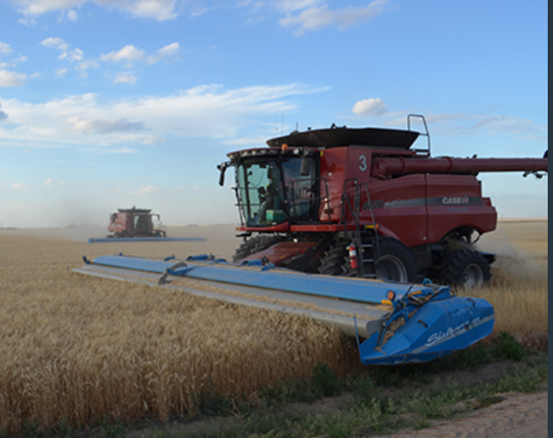
Jesse Brunner, Fifth Gen Farms

Slide 16
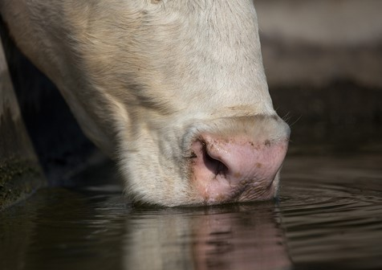


Questions?

Slide 17
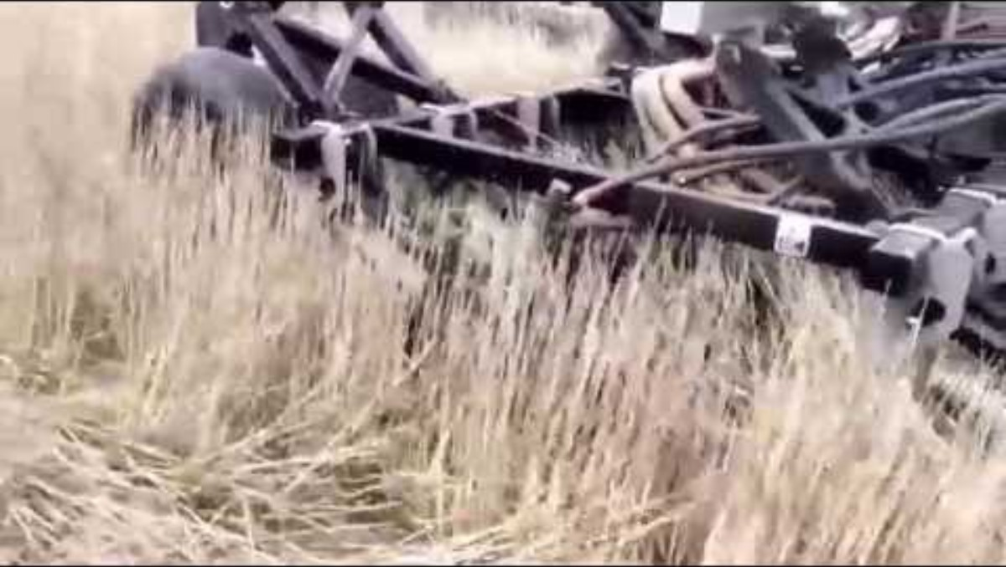
Conservation Harvest Management, Single disc drill

Slide 18
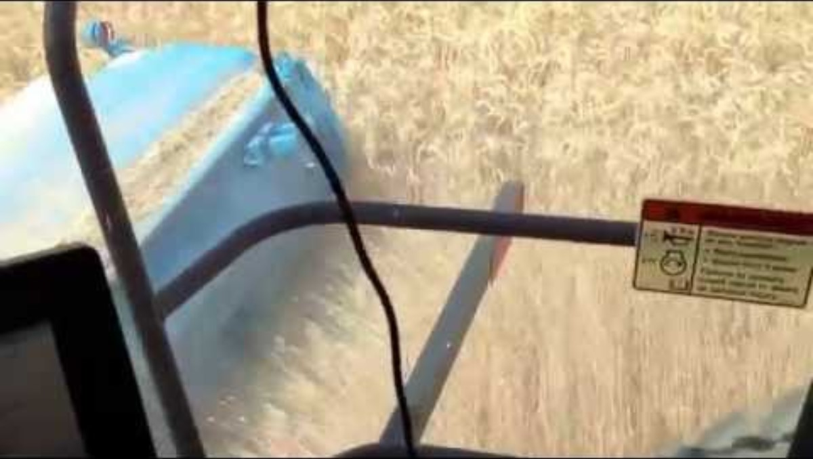
Conservation Harvest Management, Stripper Header

Slide 19
Additional Information
Washington
https://www.youtube.com/watch?v=4TwtvrtfY6s
https://pubs.extension.wsu.edu/stripper-header-and-direct-seeding-ron-and-andy-juris-farmer-to-farmer-case-study-series
Montana
https://www.youtube.com/watch?v=KMsBeZptlF4
https://www.nrcs.usda.gov/state-offices/montana/news/making-the-switch-adopting-a-stripper-header-and-disc-drill

