Slide 1
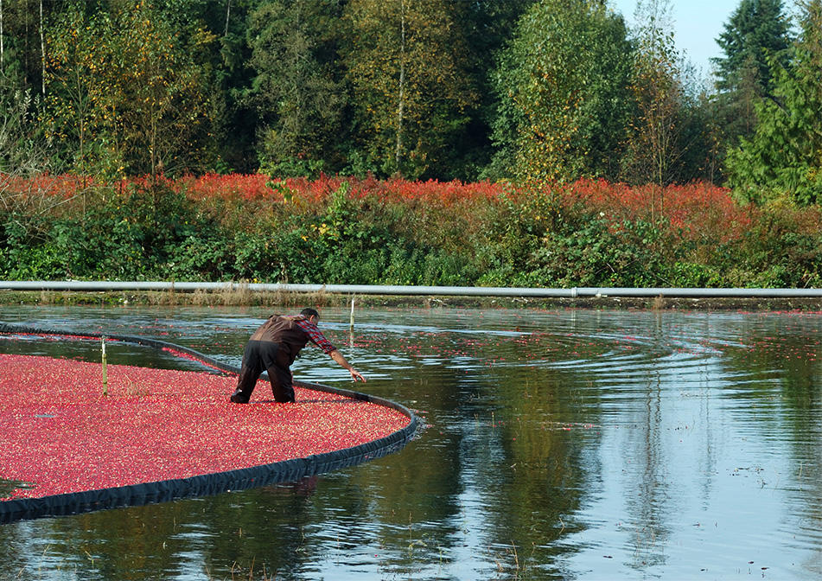
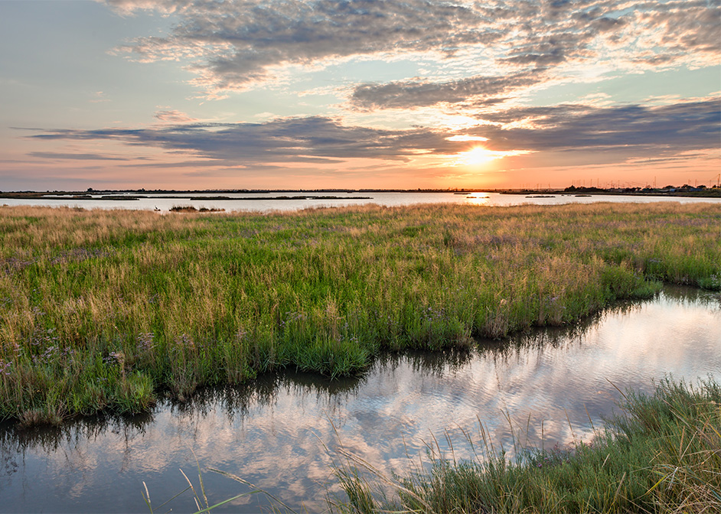

National Water Quality Initiative (NWQI)

Slide 2
NWQI: Purpose
Work w/Producers to implement voluntary conservation practices in an area wide effort
Incorporating multi year implementation plans in high priority areas
12 digit HUC Watersheds

Slide 3
NWQI: Goals
Water Quality in Surface Waters
  Sediment
  Pathogens
  Nutrients

Slide 4
NWQI: Partners
Local Work Groups
Tribes
Conservation Districts
Washington’s Department of Ecology
Environmental Protection Agency

Slide 5
Planning Phase
Partner develops a comprehensive watershed inventory/watershed plan
  Critical Treatment Acres
  Source of Impairments
  Producer Operations
  Partner Capabilities
  Watershed Climatic Characterizations

Slide 6
Implementation Phase
Dedicated multiyear EQIP Funding for watersheds
Incorporates Core & Supporting Conservation Practices

Slide 7
Partner Roles
Tribes & Local Work Groups
  Identify Watersheds for NWQI Consideration
Washington Department of Ecology
  Consults/Concurs on Watershed Selections and Removal
Tribes, Conservation Districts, & Others
  Serve as Watershed Champions
  Develop Planning Phase/Watershed Inventory
  Assists NRCS with Implementation, monitoring, outreach, etc.

Slide 8
NWQI History in Washington
2011: NWQI development began in Whatcom County Watersheds
  Wiser Lake – Nooksack River (2012-2024)
  Tenmile Creek (2012-2024)
  Fish trap Creek (2012-2023)
Spring Creek Union Flats – Whitman County (2023-2026)
Mill Creek – Walla Walla County (2023-present)
Crab Creek – Grant County (2024-present)

Slide 9
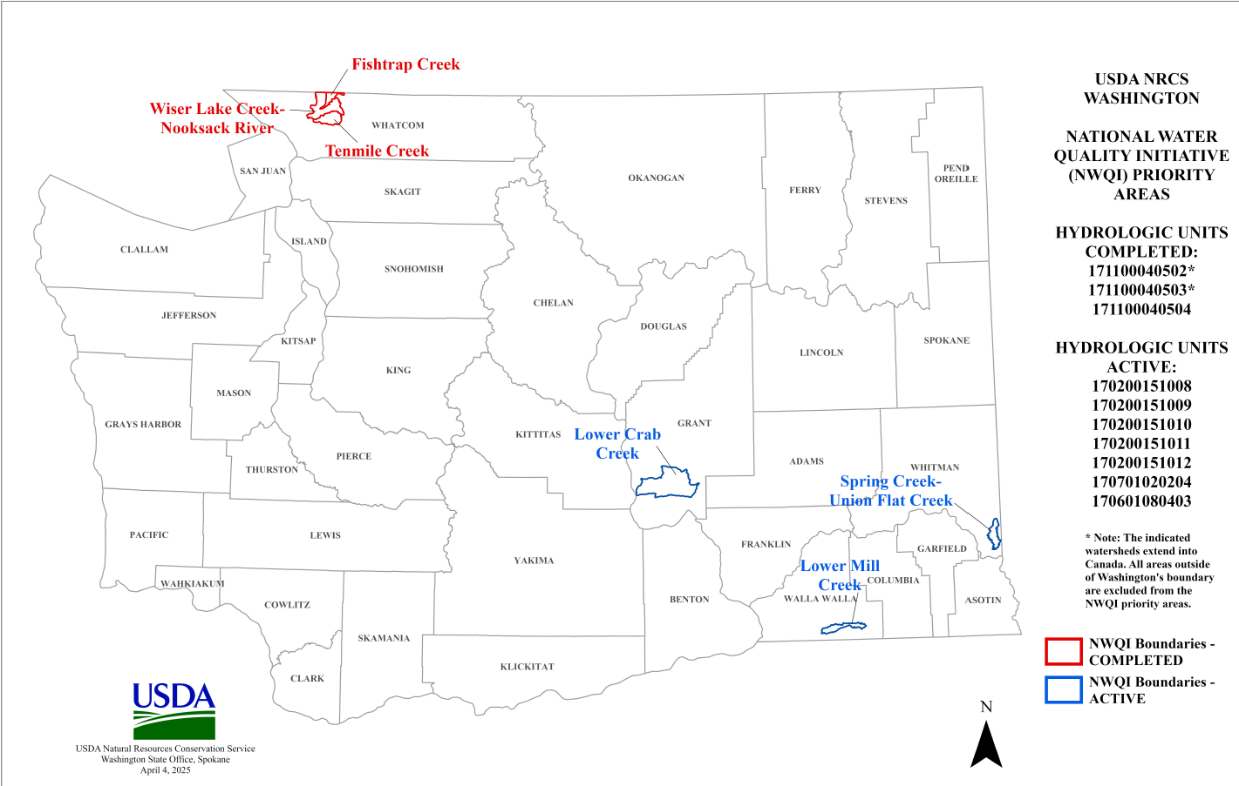
Current Status:

Slide 10
Next Steps…
Spring Creek/Union Flats – expected removal after 2026
Working with partners for new watershed identification for 2027
Identify partners to develop “planning phase assessments” for new watersheds

Slide 11

Questions?

