Slide 1

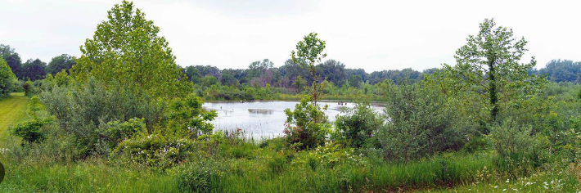

Expedited Minimal Effects
Wyoming STAC – February 20, 2025

Slide 2
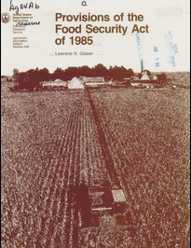
Background
Food Security Act of 1985
  …requires NRCS to delineate, determine, and certify wetlands located on land on a farm or ranch subject to wetland conservation (WC) provisions in order to establish a producer’s eligibility for certain USDA program benefits (16 U.S.C. Section 3822, 7 CFR Section 12.30).

Slide 3
Background
… a person shall be ineligible for all or a portion of USDA program benefits if…
  The person produces an agricultural commodity on a field in which highly erodible land is predominant, or designates such a field for conservation use;
  The person produces an agricultural commodity on wetland that was converted after December 23, 1985; or
  After November 28, 1990, the person converts a wetland by draining, dredging, filling, leveling, removing woody vegetation, or other means for the purpose, or to have the effect, of making the production of an agricultural commodity possible.

Slide 4
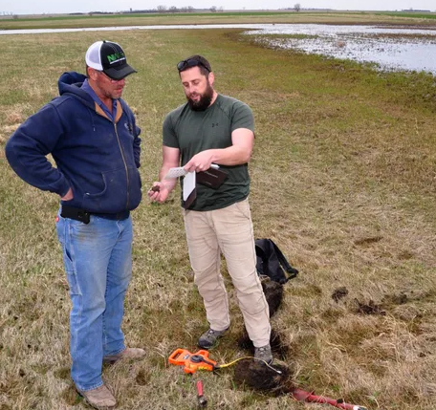
Minimal Effect Exemptions
…the conversion of a wetland and/or the production of an agricultural commodity on a converted wetland has a minimal effect on the functions and values of wetlands in the area.

Slide 5
Expedited Minimal Effects (EME)
…categories of conversion activities and conditions which are routinely determined by NRCS to have minimal effect on wetland functions and values…
11 EMEs available nationally
Wyoming NRCS proposing to adopt 3
  EME-3 Installing an Elevated Travelway
  EME-6 Removing Invasive Woody Vegetation
  EME-9 Removing Scattered Woody Vegetation

Slide 6
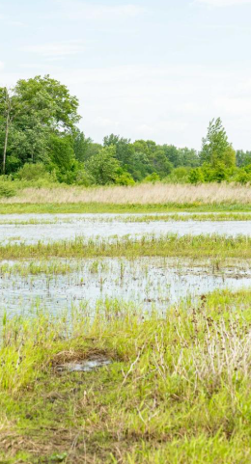
EME-3 Installing an Elevated Travelway
Examples: farm roads, elevated livestock walkways, and elevated irrigation track-wheel berms (pivot crossings).
Conditions:
  The travel-way will be no wider than necessary to meet the purpose.
  None of the travelway will be planted to an agriculture commodity, as defined in 7 CFR §12.2.
  An appropriately sized culvert as determined by NRCS will be installed at the lowest elevational point of the wetland which is immediately adjacent to the travelway.
  The culvert will be installed and maintained to allow free movement of water, such that the water level equalizes on both sides of the berm shortly after storm events and runoff.
  Can NOT be used in bogs, fens, or natural springs.

Slide 7
EME-6 Removing Invasive Woody Vegetation from Historically Herbaceous Wetlands
Invasive woody vegetation can impair habitat quality and ground water recharge.
Examples: Russian olive (Elaeagnus angustifolia) and saltcedar (Tamarix spp.)
Conditions:
As determined by NRCS, the project area was historically (pre-European settlement) an herbaceous wetland.
Woody vegetation removal will be limited to invasive species. Exception: As determined by NRCS, native woody species have also invaded the project area, and they represent less than 10-percent aerial cover of the wetland.
The removal activity will result in minimal soil movement.
Stump removal is permitted when necessary to achieve conservation benefits.
The project area will not be cropped, nor planted to a nonnative forage species. Rather, the project area will be managed as perennial, native herbaceous vegetation.
After removal of woody vegetation, the final elevation of the project area is not higher than the preconstruction elevation.
The hydrology of the project area wetland will not be altered.

Slide 8
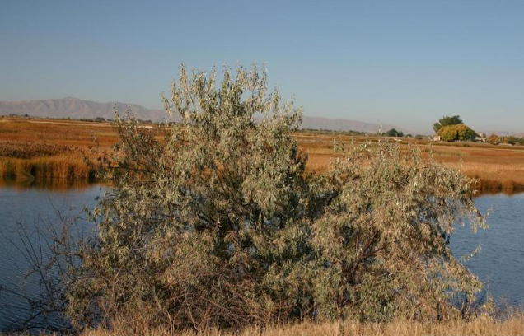
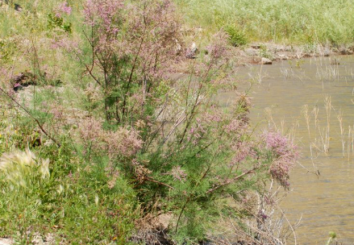
EME-6 Removing Invasive Woody Vegetation from Historically Herbaceous Wetlands
Russian olive (Elaeagnus angustifolia) and saltcedar (Tamarix spp.)

Slide 9
EME-9 Removing Scattered Woody Vegetation
In open agricultural settings, particularly managed pastures and hay fields, individual trees or very small groupings of woody vegetation can occur in wetlands. Isolated individual trees or very small groupings of trees contribute minimally to the functional capacity of wetlands in the area.
Conditions:
The individual trees and/or isolated small groupings are fully contained within an open agricultural field (e.g., crop, hay, and managed open pasture).
Unless provided by NRCS with an attached addendum to this document, total canopy of individual trees and/or small groupings represent ≤1% of the acres within the field. If the individual tree(s) or small grouping(s) are delineated by Farm Service Agency as a field, sub-field, or similar delineation, then the adjacent open field(s) is used to determine if the ≤1% threshold is met.
No individual small grouping of woody vegetation shall have a canopy size of larger than 0.1 acre.
Soil disturbance will be minimized.
Stumps retained at heights high enough to inhibit cropping.
No fill will be placed in the cleared areas.
No new drainage will be installed.
Removal of woody vegetation will occur outside of the nesting season.

Slide 10
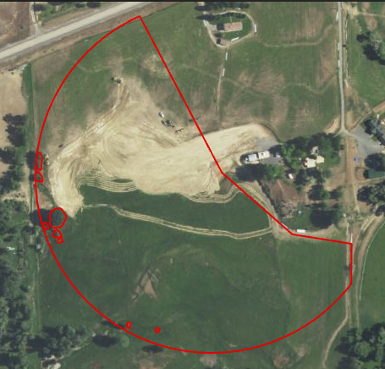
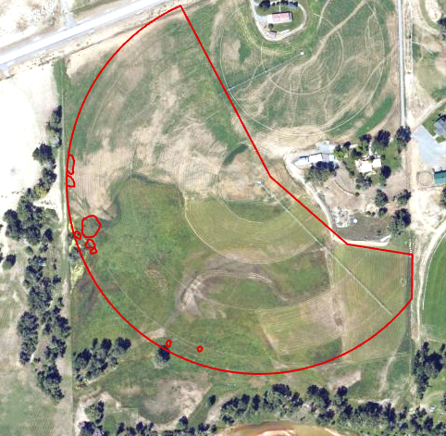
EME-9 Removing Scattered Woody Vegetation
0.89% canopy cover before and after

Slide 11
Questions?

