Slide 1

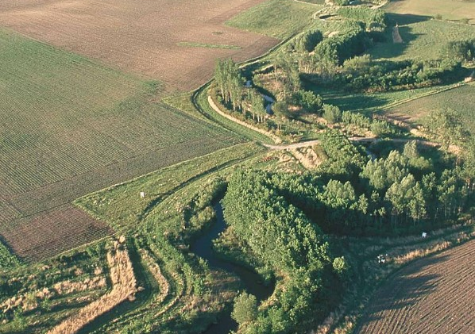


Washington State
Natural
Resources
Conservation
Service
EQIP Riparian Buffer – STAC Subcommittee
Nick Vira, NRCS State Partnership Liaison

Slide 2

Contributors
Walt Edelen | Water Resources Manager | Spokane CD
Cameron Stoflet | NRCS Liaison | Spokane Tribe
Tom O’Brien | Ecosystems Services Division Manager | WDFW
Emmett Wild | District Manager | Skagit CD
Ron Cummings | Ag & Water Quality Planner | WDOE – Ecology
Alan Warren | Senior Program Manager | Bonneville Environmental Foundation
Kaitlin Davies | State Outreach Coordinator | FSA
Keith Griswold | ASTC-P | NRCS
Nick Vira (Facilitator) | Partnership Liaison | NRCS
Steve Sprecher | Technical Specialist | NRCS
Mike Baden | Regional Manager | SCC

Slide 3
Objective
Increase adoption rates of NRCS Riparian Buffer and associated practices across the state. Identify opportunities to leverage partnerships.

Slide 4
Meeting Phases
Set the table
Understand purpose, background and process overview of subcommittee.
1
Understand
current state of NRCS EQIP program.
2
Compare
our programs to other programs; analyze.
3
Identify
where success is occurring both geographically and by program.
4
Identify
barriers to participation. Identify what is out of our control.
5
List
recommended program improvements.
6
Review
final recommendations.
7

Slide 5
Barriers
NRCS provides limited services | $$
  Does not provide installation, maintenance service, labor or equipment
  Does not provide rental payments
  Management practices limited to 3-year payment
Financial liability
  Out of pocket costs, reimbursement liability
Payment rate
  Single payment rate for 3 state area does not always reflect true costs
Understanding
  Programs not universally understood in community
Tree Stock Availability
Other
  Concerns of land use restrictions (spraying/mowing)

Slide 6
Recommendations – Partnership Coalition
Develop joint fact sheet outlying various available programs
Coalition to break project components out by task
  Site prep
  Financial assistance for establishment
  Maintenance
  Other
Targeted Approach
  Collaborate, identify priority areas, ranking incentives
Riparian Easement Buffer?
Tax Exempt Buffers?
Riparian RCPP?

Slide 7

Thank you!

