Slide 1

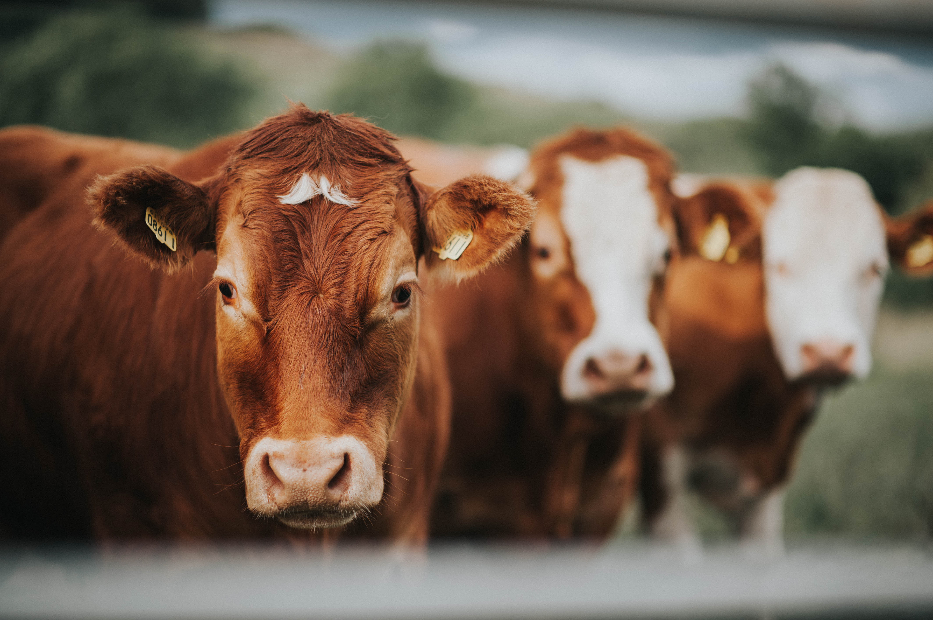
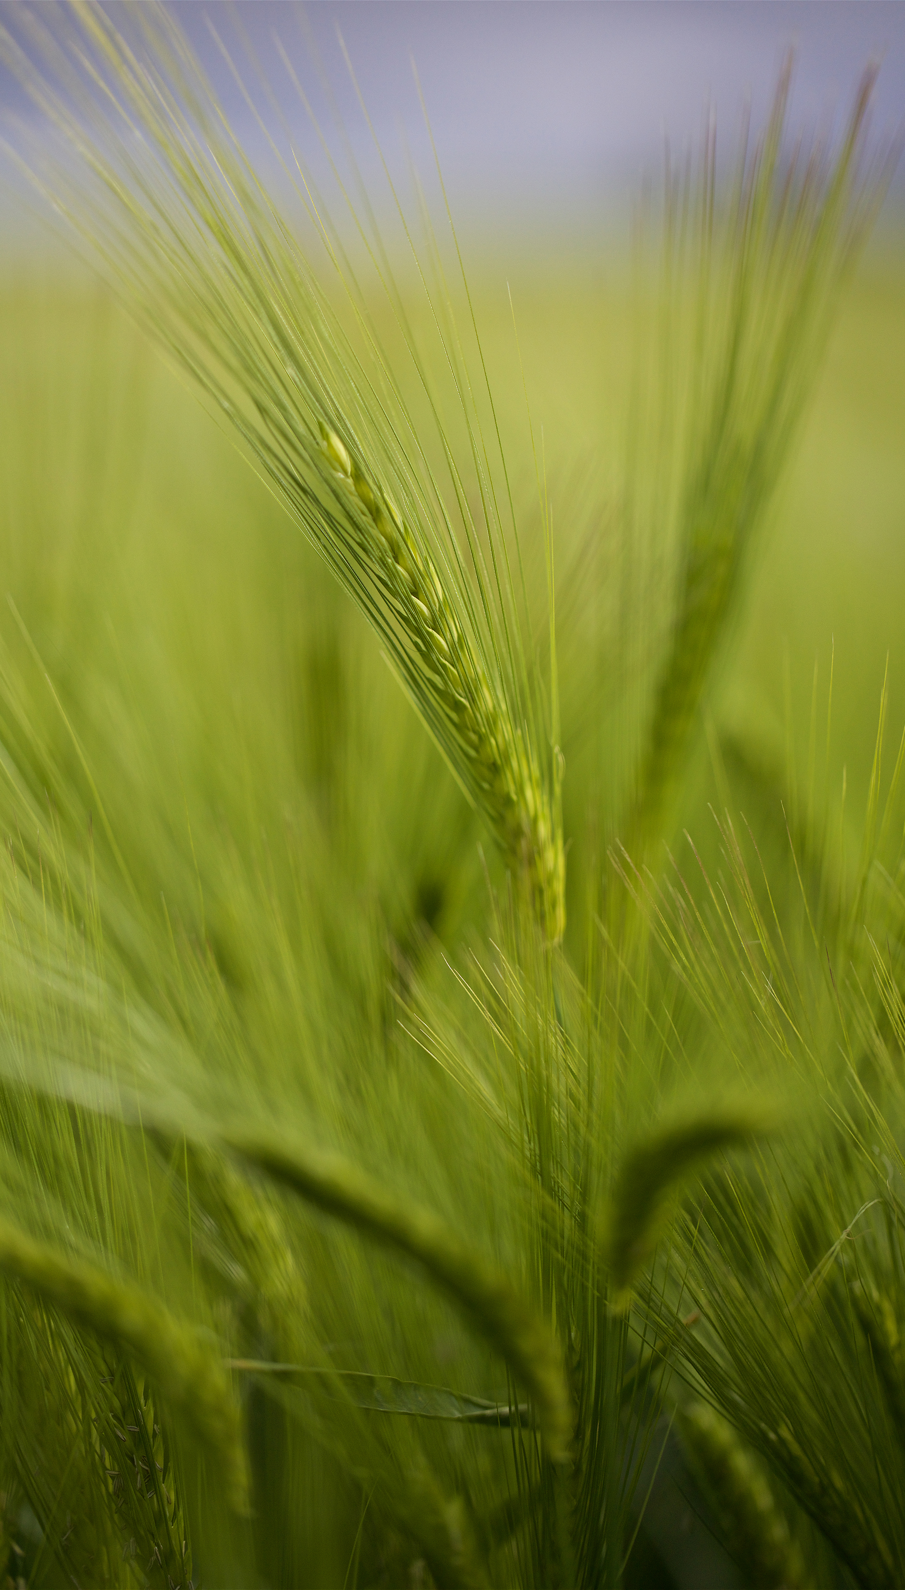

FY 25 Quarter 1: State Technical Advisory Committee Meeting
Katie Vaporis, Assistant State Conservationist - Programs

Slide 2
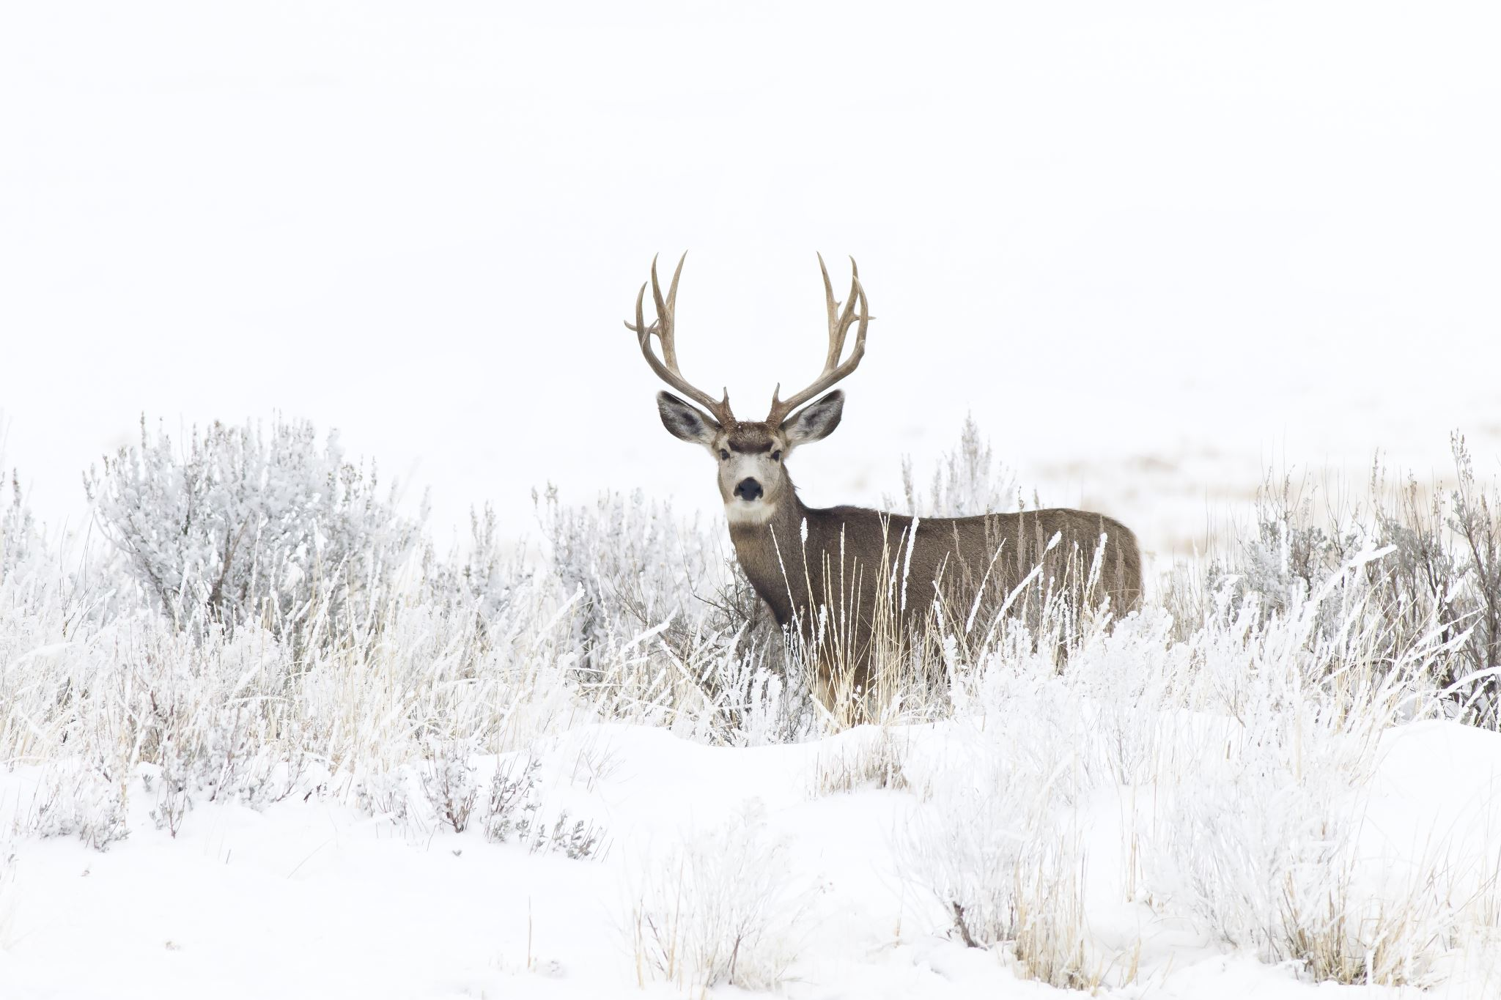

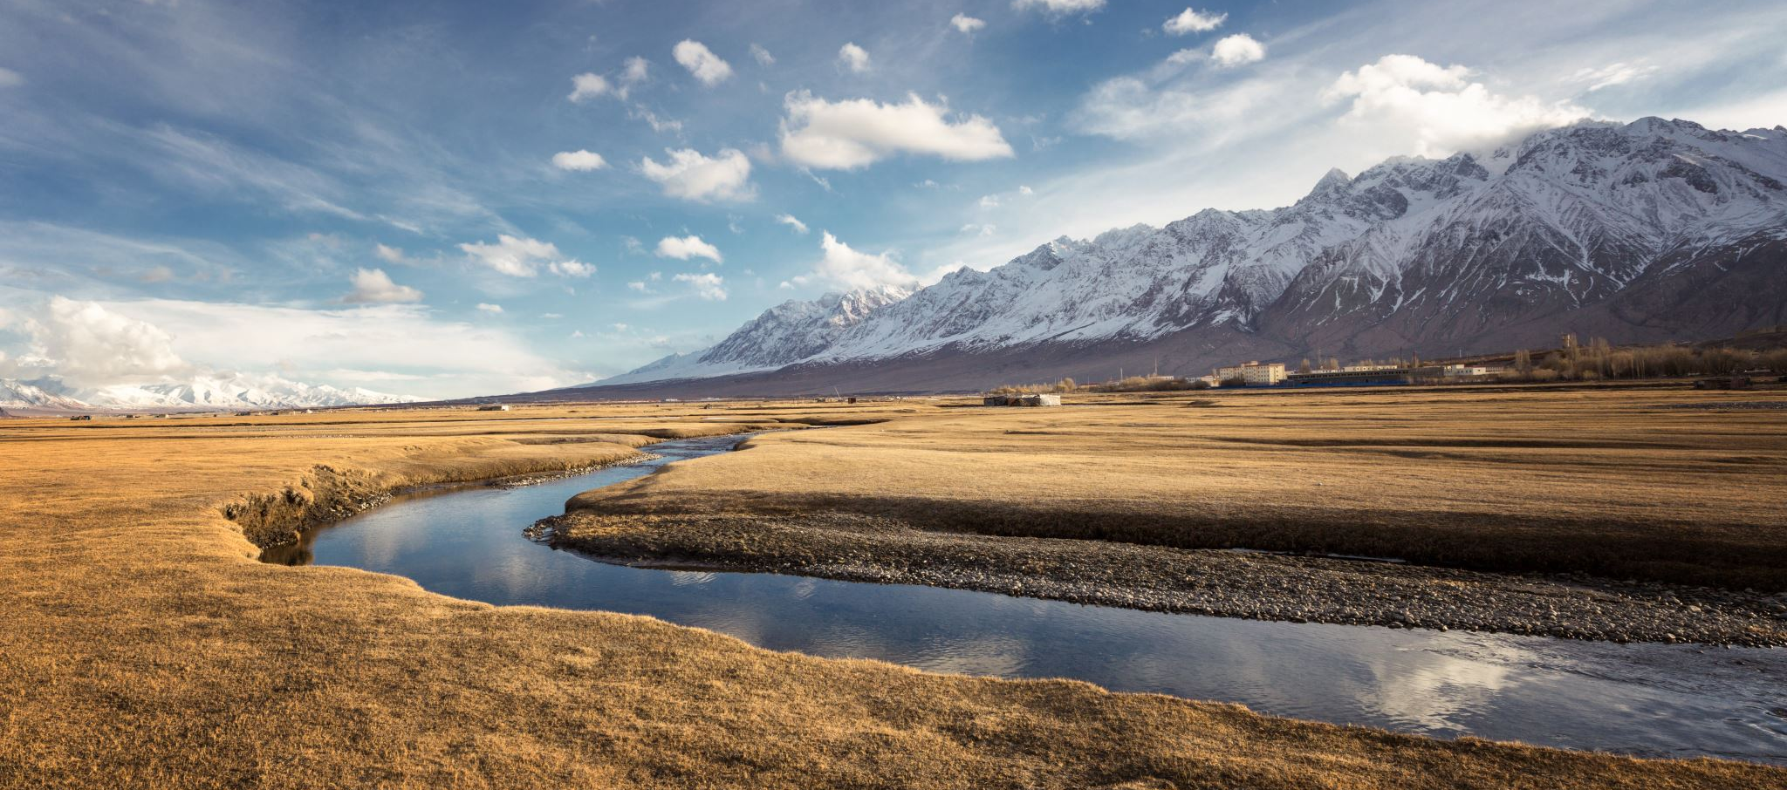
Our Mission: We deliver conservation solutions so agricultural producers can protect natural resources and feed a growing world.
Our Vision: A world of clean and abundant water, healthy soils, resilient landscapes, and thriving agricultural communities through voluntary conservation.
Our Motto: Helping People Help the Land

Slide 3
Welcome
State Conservationist: Jackie Byam

Slide 4
Introductions

Slide 5
FY 24 Overview

Slide 6
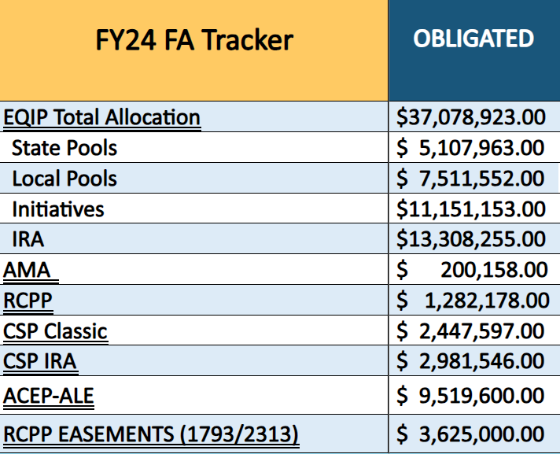
Total Obligations

Slide 7
Big Game Initiative
Wyoming Big Game Conservation FY 24 by County
Campbell | 5 Contracts | $684,191.00
Carbon | 5 Contracts | $389,534.00
Converse | 3 Contracts | $545,335.00
Crook | 1 Contract | $57,994.00
Fremont | 5 Contracts | $579,777.00
Hot Springs | 4 Contracts | $596,847.00
Johnson | 1 Contract | $11,032.00
Lincoln | 5 Contracts | $481,657.00
Park | 11 Contracts | $1,166,911.00
Sublette | 1 Contract | $25,722.00
Sweetwater | 3 Contracts | $43,622.00
Washakie | 5 Contracts | $1,093,578.00
 |  | $5,676,200.00

Slide 8
FY 25 Allocations & Subaccounts

Slide 9
 | ACEP: ALE & WRE |  |  | EQIP
 | ACP8: ALE (General) | $2,700,000 |  | EQP8: General | $8,833,695
 | ACP8: Migratory Big Game | $3,500,000 |  | EQP8: Migratory Big Game | $5,337,914
 | ACP8: WRE (General) | $472,030 |  | EQP8: Colorado River Basin Salinity Control Program | $440,000
 | ACP8: WRE: Stewardship | $75,000 |  | EQP8: National Water Quality Initiative | $471,516
 |  | $6,747,030 |  | EQP8: Sage Grouse Initiative | $1,334,478
 |  |  |  | EQP8: WaterSmart Initiative | $1,089,824
 | AMAP |  |  |  | $17,507,427
 | AMA | $92,000
 |  | $92,000 |  | IRA
 |  |  |  | IRAA: ACEP-IRA | $2,976,648
 | CSP |  |  | IRAA: EQIP-IRA | $18,064,700
 | CST8: Classic | $4,730,000 |  | IRAA: CSP-IRA | $5,592,000
 |  | $4,730,000 |  |  | $26,633,348

Slide 10
FY 25 Allocations

Slide 11
FY 25 Allocations

Slide 12
Comparison Throughout the Years

Slide 13
Local Work-group Updates/Comments

Slide 14
Geographic Area Rate Cap (GARC)

Slide 15
GARC – FY 26
Wetland Reserve Easement (WRE) through the Agricultural Conservation Easement Program (ACEP).
Wyoming NRCS has proposed to use appraisals for Wetland Reserve Easement (WRE) for the past 10 years. We would pay 85% of the Fair Market Value, not to exceed $5,000/acre of the easement.
  Comparable to other states with similar landscapes
Since 2014 WY has not received an eligible application that has been funded.

Slide 16
Conservation Innovation Grants (CIG) Discussion

Slide 17
CIG Discussion
Conservation Innovation Grants (CIG) is a competitive program that supports the development of new tools, approaches, practices, and technologies to further natural resource conservation on private lands.
Grants.gov
3 Types
  CIG Classic
  CIG On-Farm Trials
  State CIG Classic
Notes:
CIG Classic is better suited for projects that are focused on early-stage exploration of a new technology or practice.
CIG On-Farm is better suited for projects testing the technology or practices that have been explored.

Slide 18
CIG Discussion
CIG Classic
  National competition for projects that support the early-stage development and piloting of new tools, practices and technologies to further natural resource conservation on private lands.
CIG On-Farm Conservation Innovation Trials (On-Farm Trials)
  National competition for projects that support more widespread adoption and evaluation of innovative conservation approaches in partnership with agricultural producers. On-Farm Trials Awardees provide technical assistance and incentive payments to producers to help compensate for risks associated with implementation of new conservation practices, systems and approaches. Awardees also evaluate the environmental, financial and social (to the extent possible) impacts of implementing innovative approaches. The Soil Health Demo Trial is a priority within the On-Farm Trials competition which focuses exclusively on implementation of conservation practices and systems that improve soil health.
Notes:
CIG Classic is better suited for projects that are focused on early-stage exploration of a new technology or practice.
CIG On-Farm is better suited for projects testing the technology or practices that have been explored.

Slide 19
CIG Continued
State CIG Classic
  State-level competitions for projects that support early-stage development and piloting of new tools, practices and technologies to further natural resource conservation on private lands. While the overall goal and approach match those of CIG Classic, CIG state competitions fund projects that target state-identified conservation priorities. Each year, NRCS state offices may elect to administer their own CIG competitions. State CIG competitions are announced separately from national competitions.
Conservation Innovation Grants | Natural Resources Conservation Service

Slide 20
CIG National Competition
A CIG funding notice is announced each year.
1-3 years in length
50% Match
Projects may be:
  Watershed-based
  Regional
  Multi-state
  Nationwide in scope.
The natural resource concerns eligible for funding through CIG are identified in the funding announcement and may change annually to focus on new and emerging, high-priority natural resource concerns.
Notes:
23 approved last year $250,000 - $2M

Slide 21
CIG On-Farm Trials
A CIG funding notice is announced each year.
Projects may last up to 5 years (with supporting documentation)
Eligible Payments:
  Incentive payments to producers to implement innovative approaches.
  Technical assistance to help producers implement innovative approaches.
  Evaluation of conservation, economic, and social impacts of the On-Farm Trials.
Notes:
15-30 grants a year $800,000 – $5M

Slide 22
State CIG Classic
Historically Wyoming has not held a state signup
IRA funds can be used
Less competition but also less funds

Slide 23
Virtual Fence

Slide 24
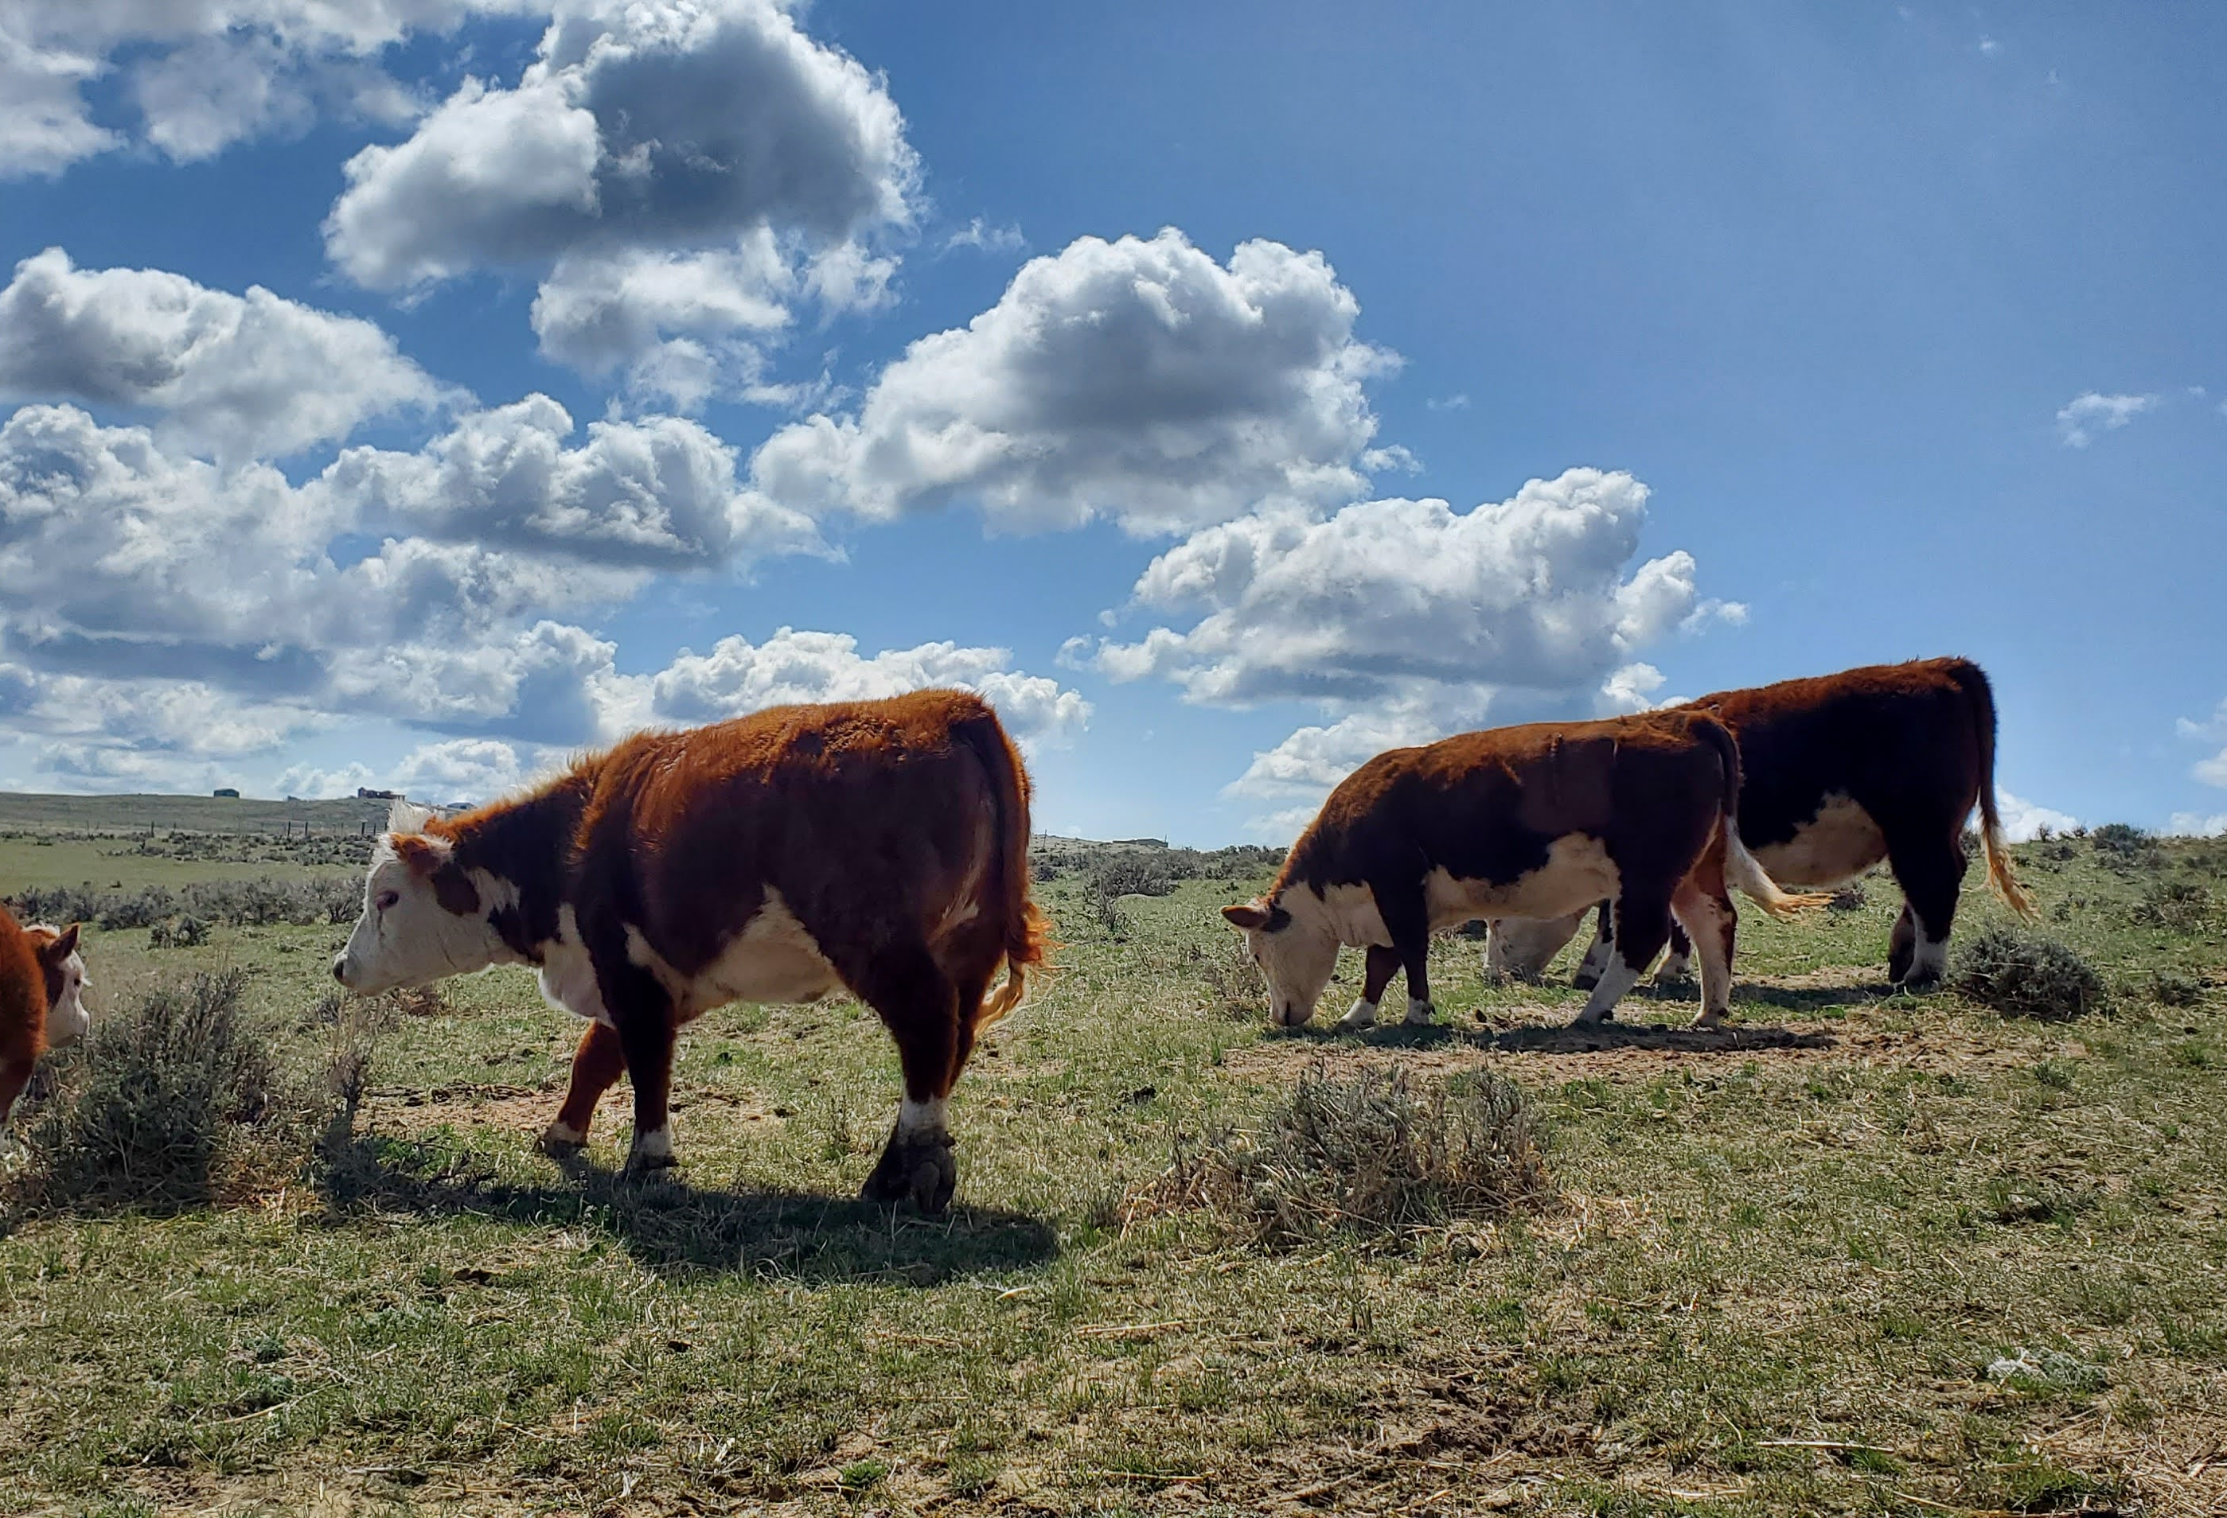
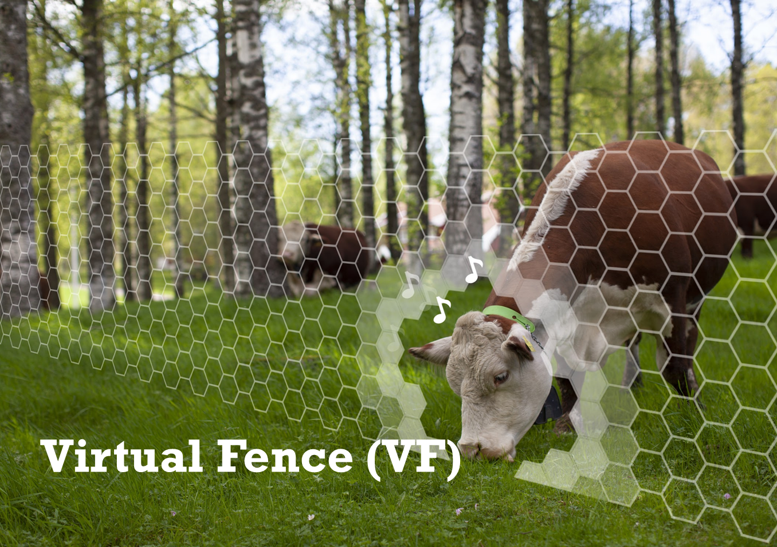
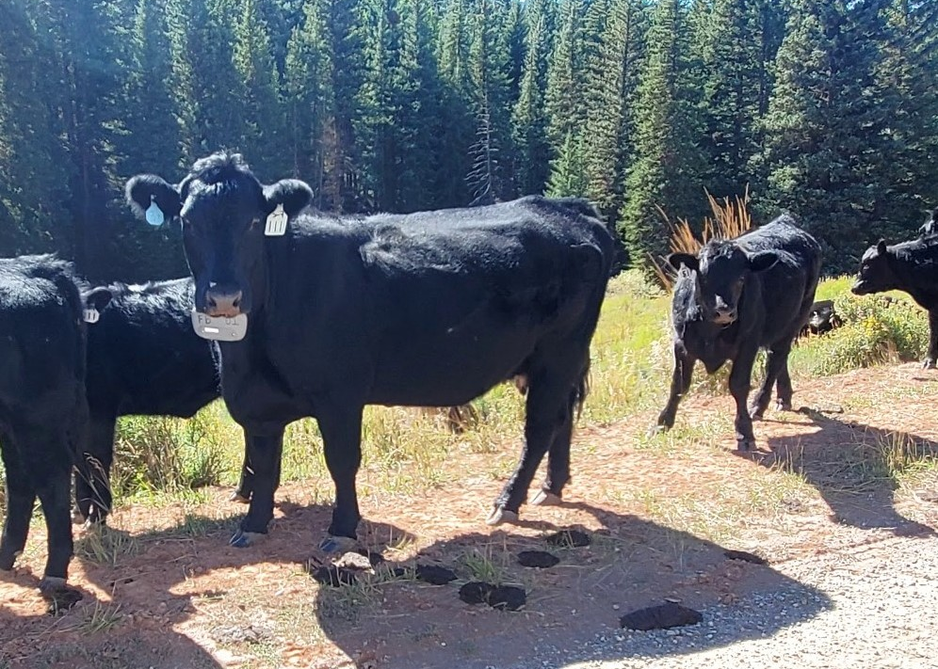

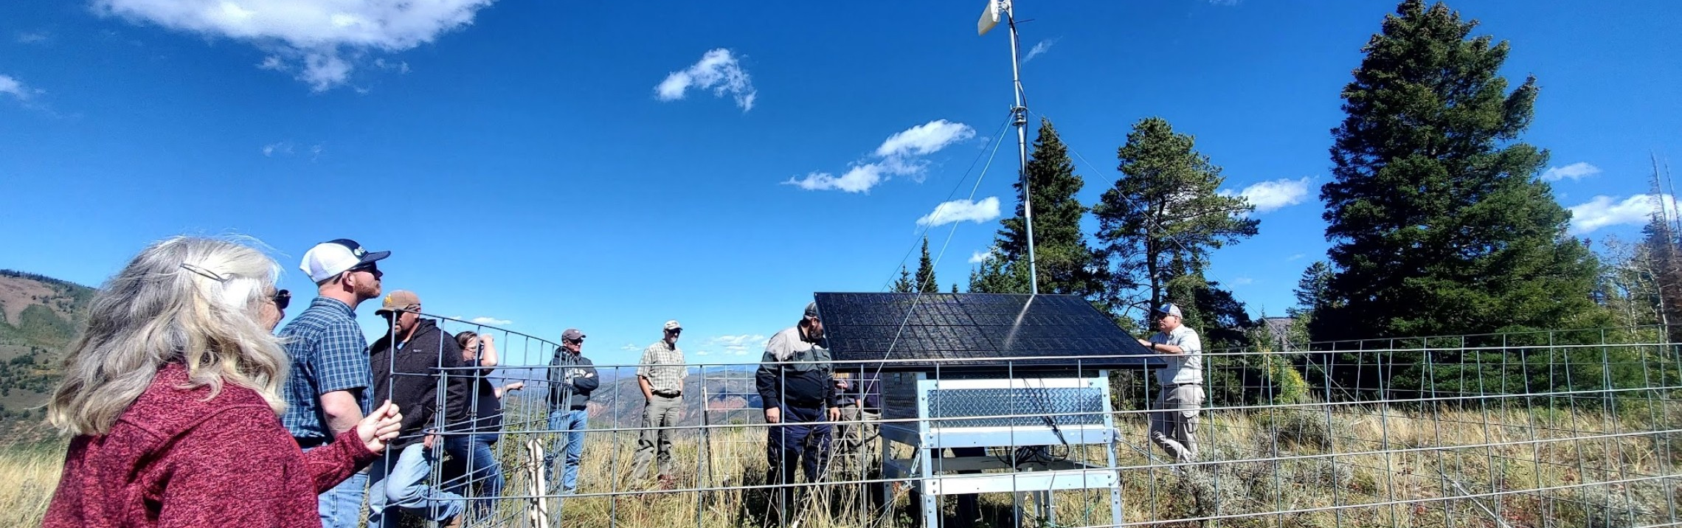

Virtual Fence (VF) - Wyoming

Slide 25
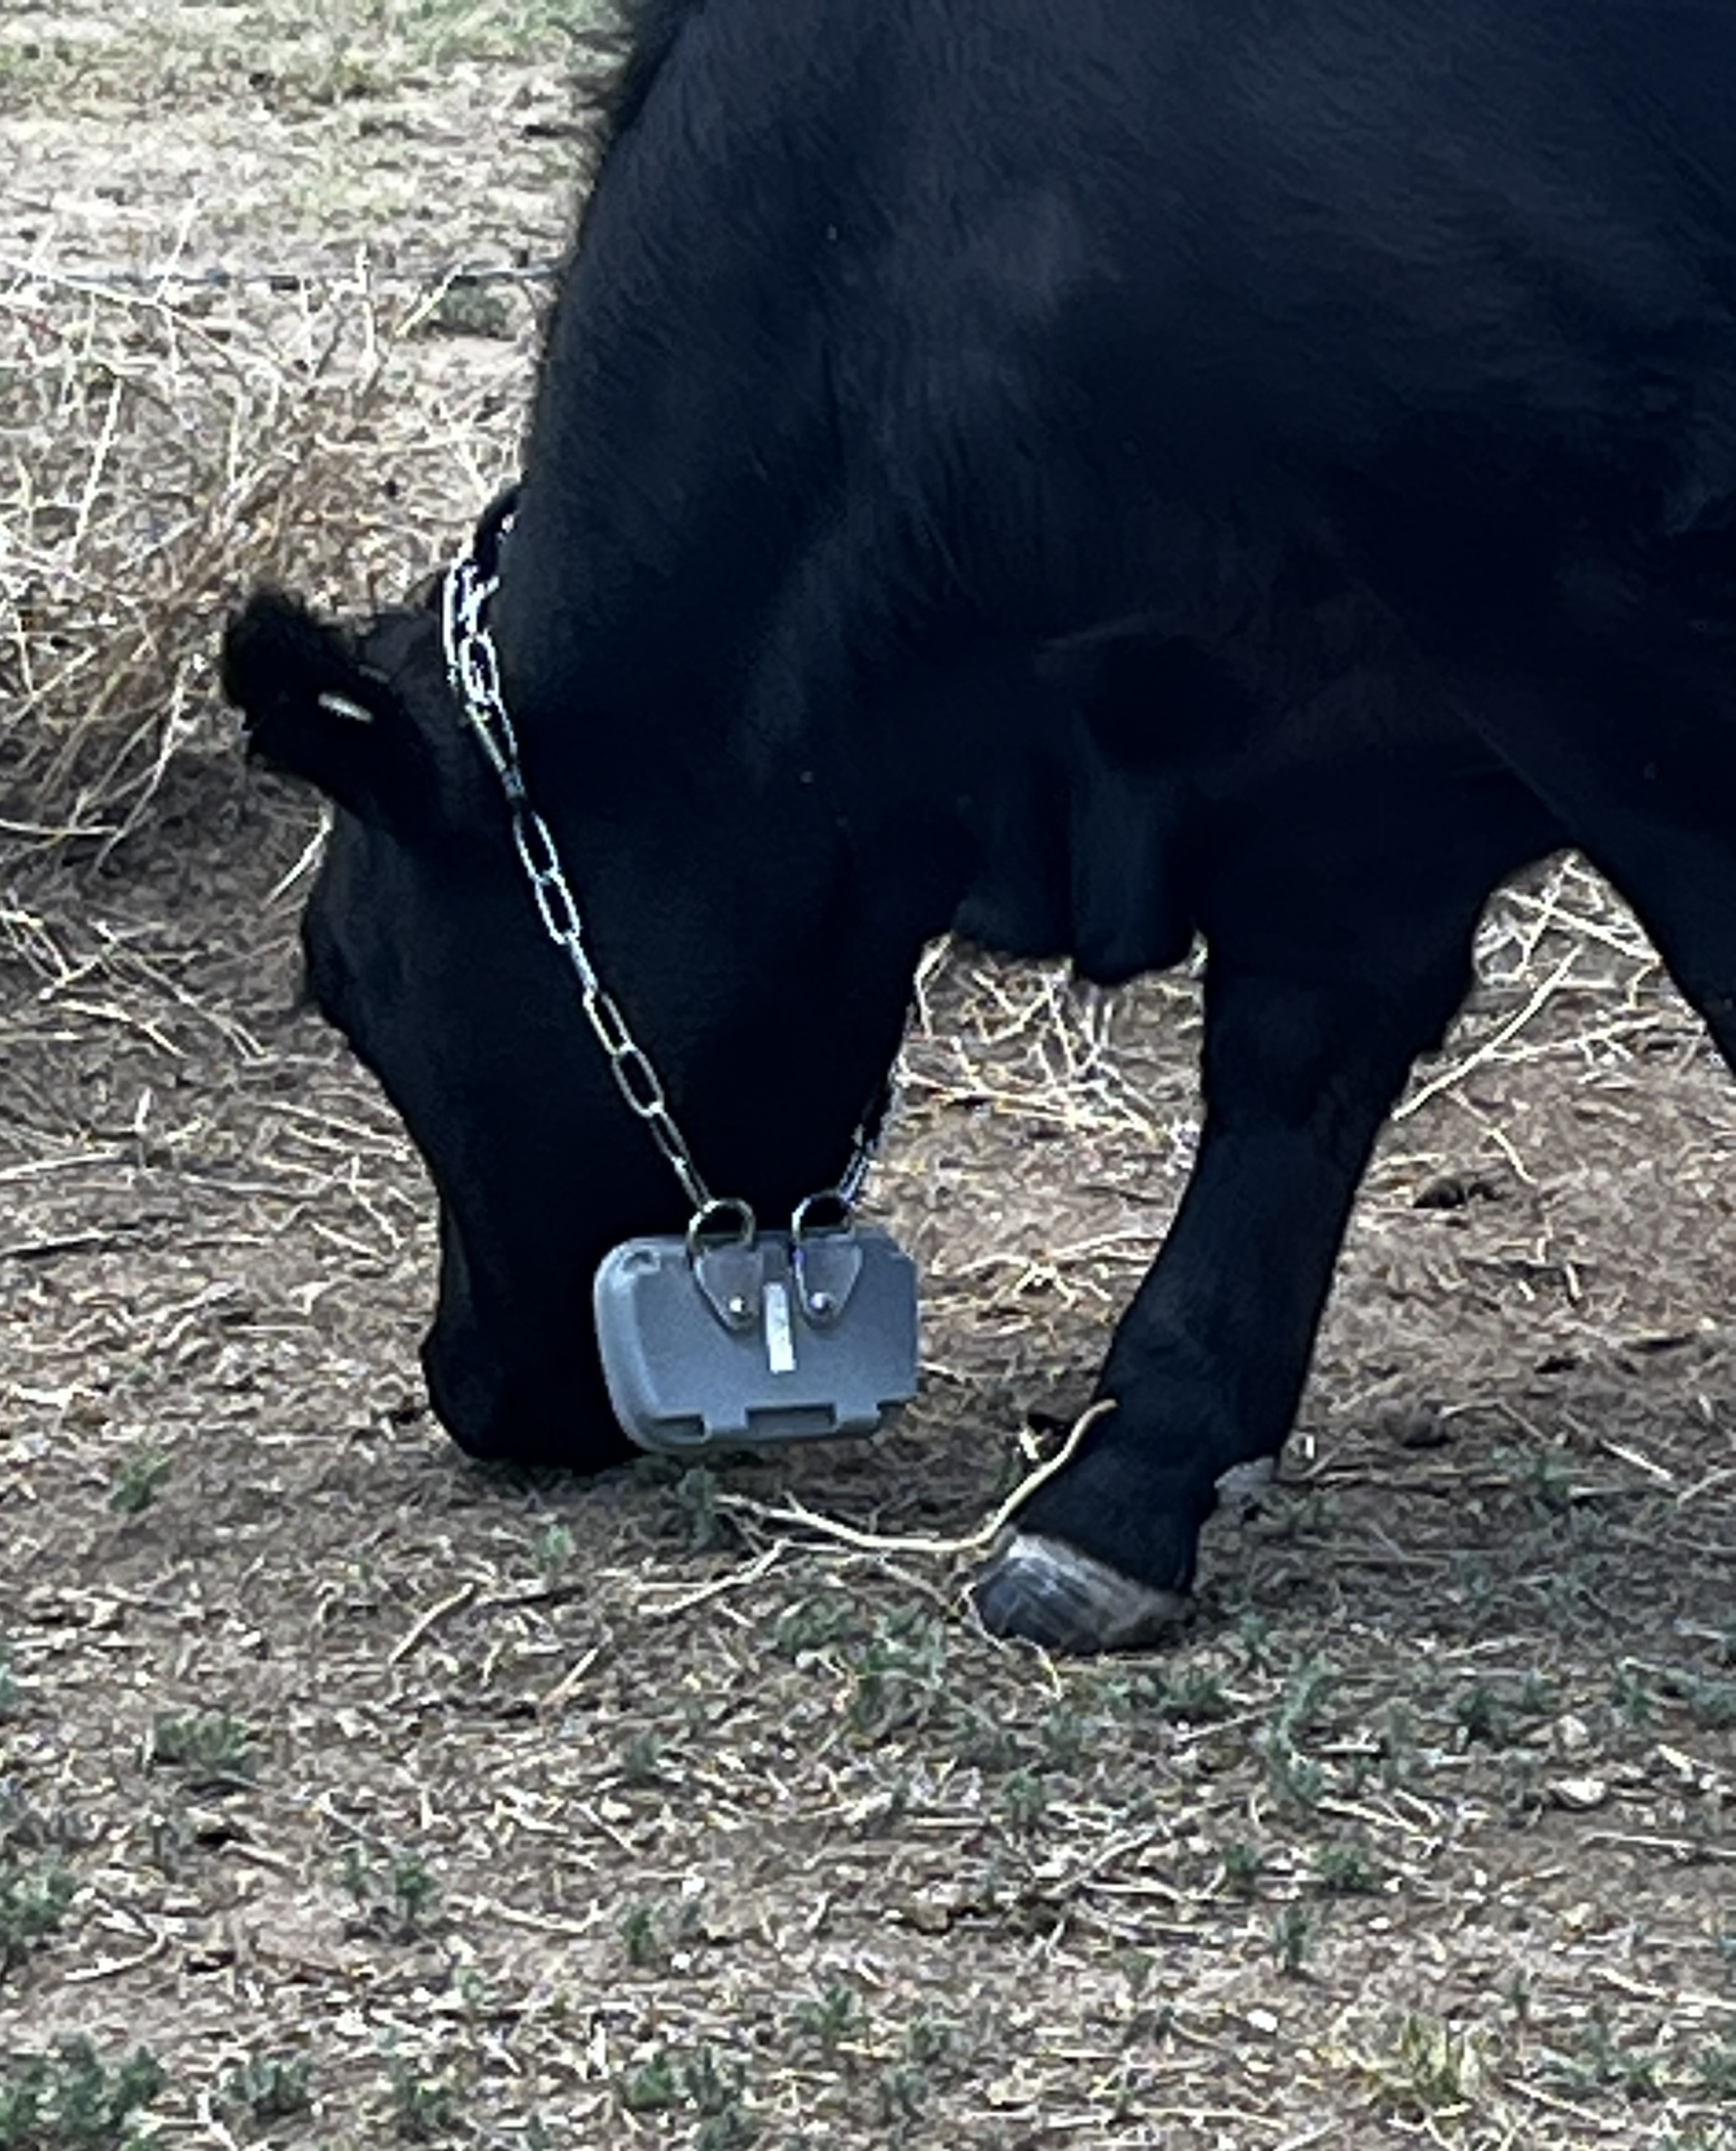
Virtual Fence (VF) - Wyoming
Topics:
1. What is Virtual Fence?
2. VF Companies in the Game
3. National Payment
Scenarios FY 2025
4. Moving Forward with VF and
Producers

Slide 26
Virtual Fence - Wyoming
What is Virtual Fence?
Virtual fencing, a relatively new technology, allows ranchers to control livestock distribution in rangeland landscapes without physical fences.
Livestock wear collars that communicate with GPS and reception towers to form a virtual fence set by the rancher or land manager.
When the livestock reach the limit of the virtual fence, auditory stimuli, including a series of loud beeps, emit from the collar.
If livestock continue their direction of travel beyond the boundaries of the virtual fence, they receive a benign shock.
Livestock (currently primarily cattle) demonstrate the ability to rapidly learn the audio and shock cues, eventually responding to the audio cue alone.
- USDA Climate Hubs – Virtual Fencing: A Climate Adaptation Strategy

Slide 27
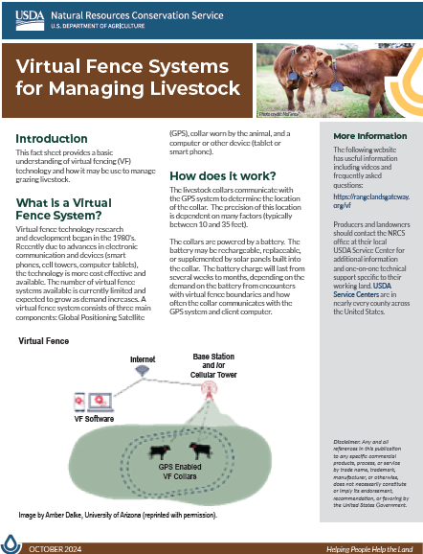
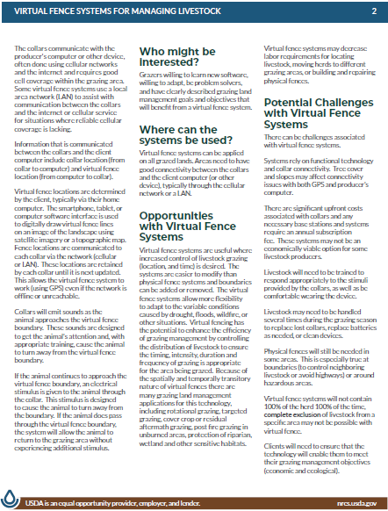
Virtual Fence – Fact Sheet

Slide 28
Virtual Fence – OSU Video
Virtual Fence on the Cow Cam! (youtube.com)

Slide 29
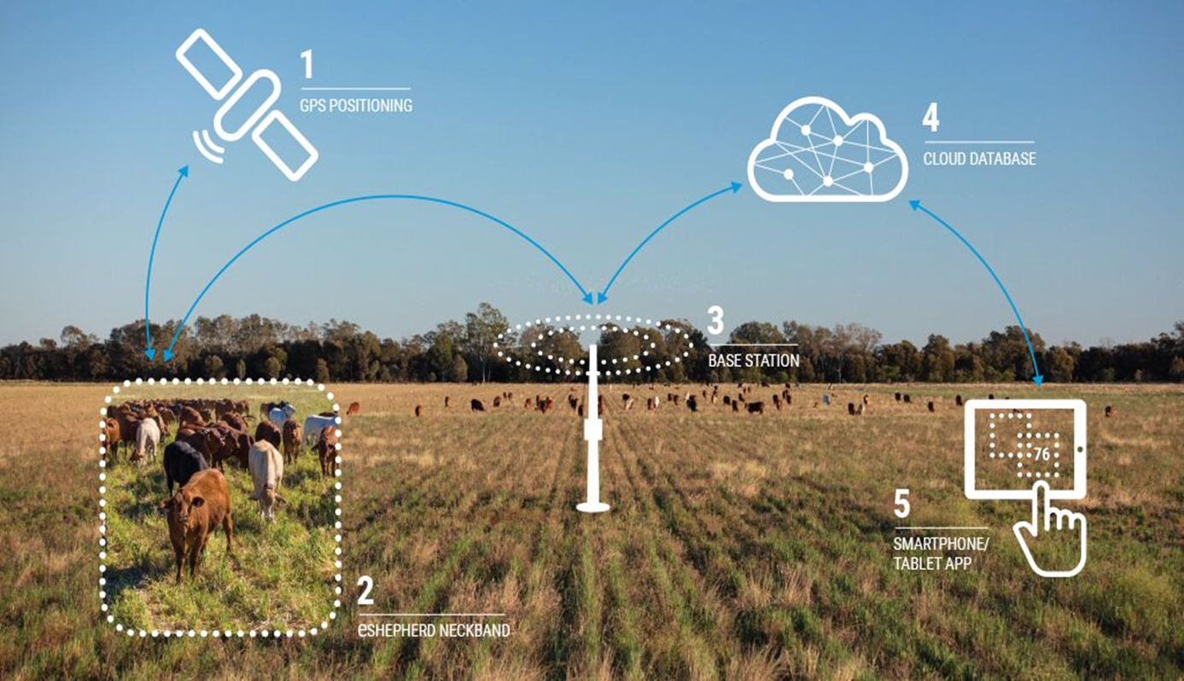
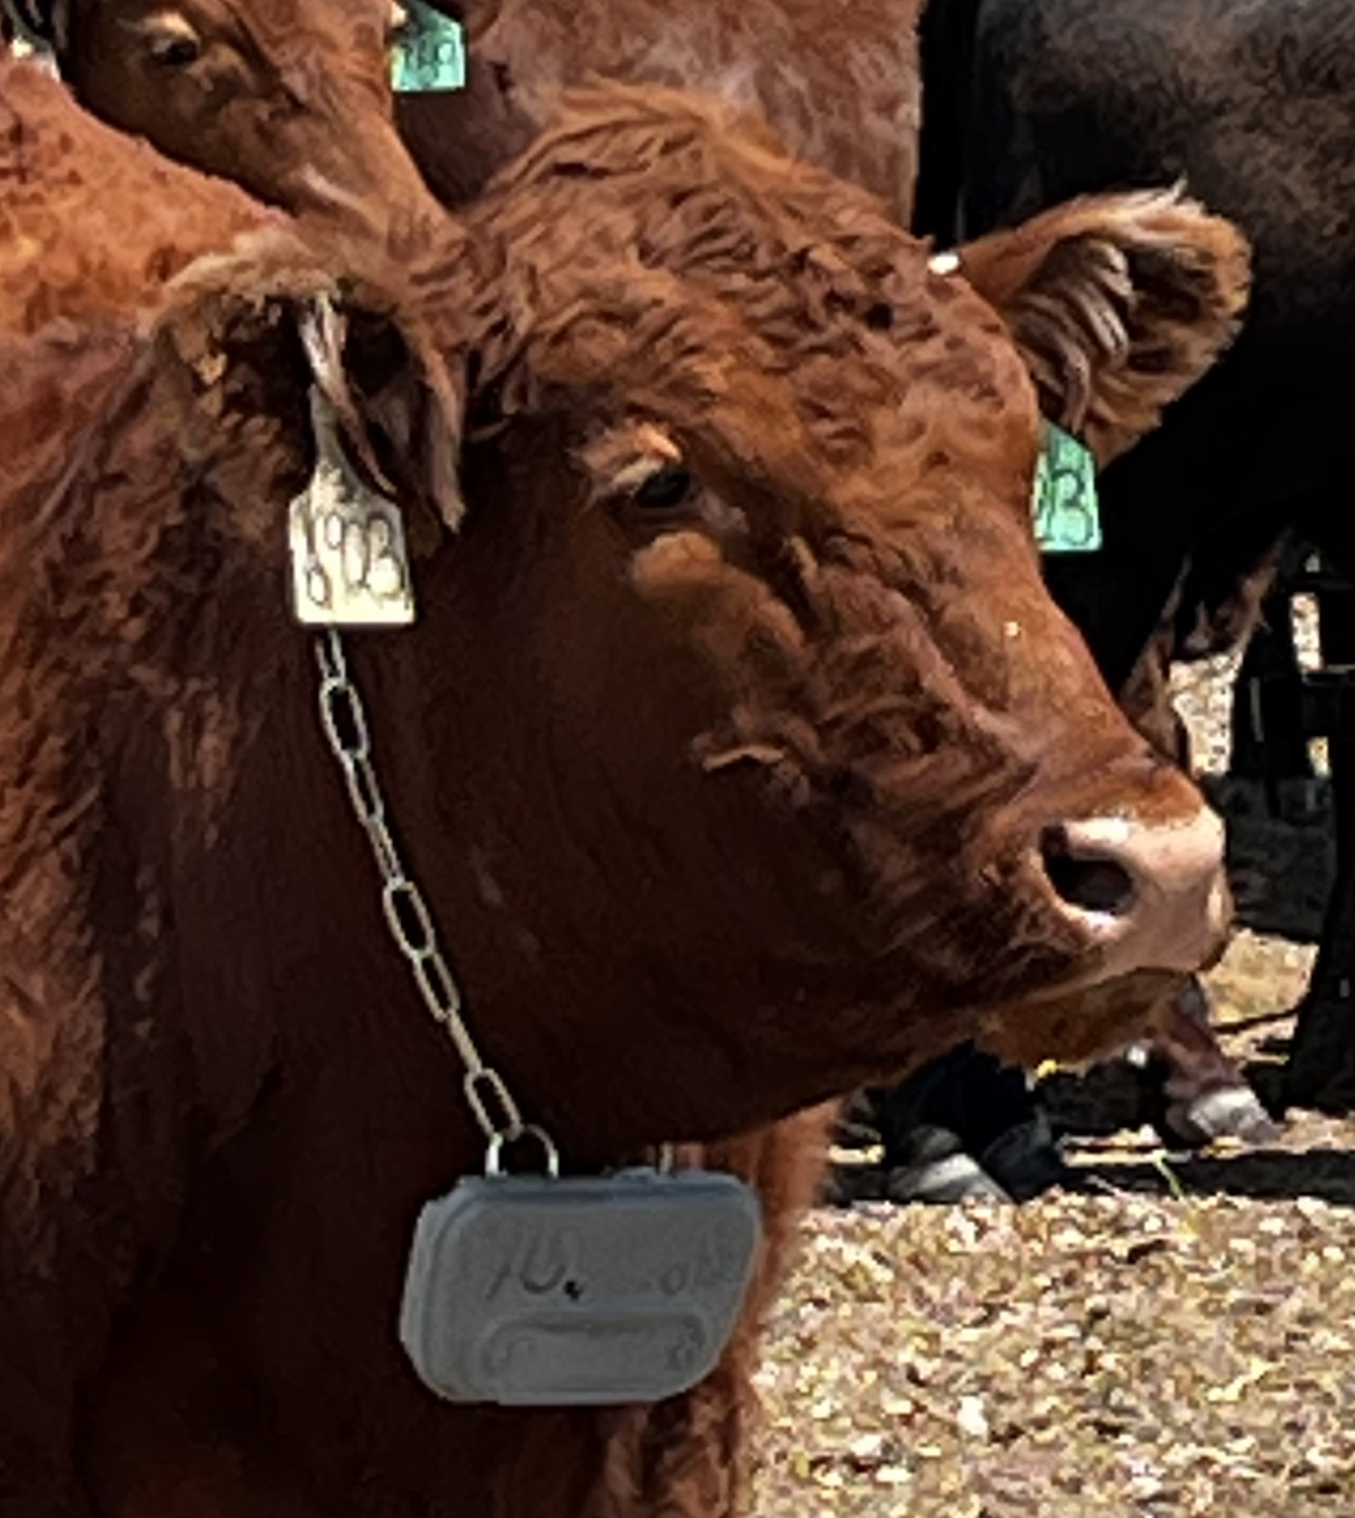
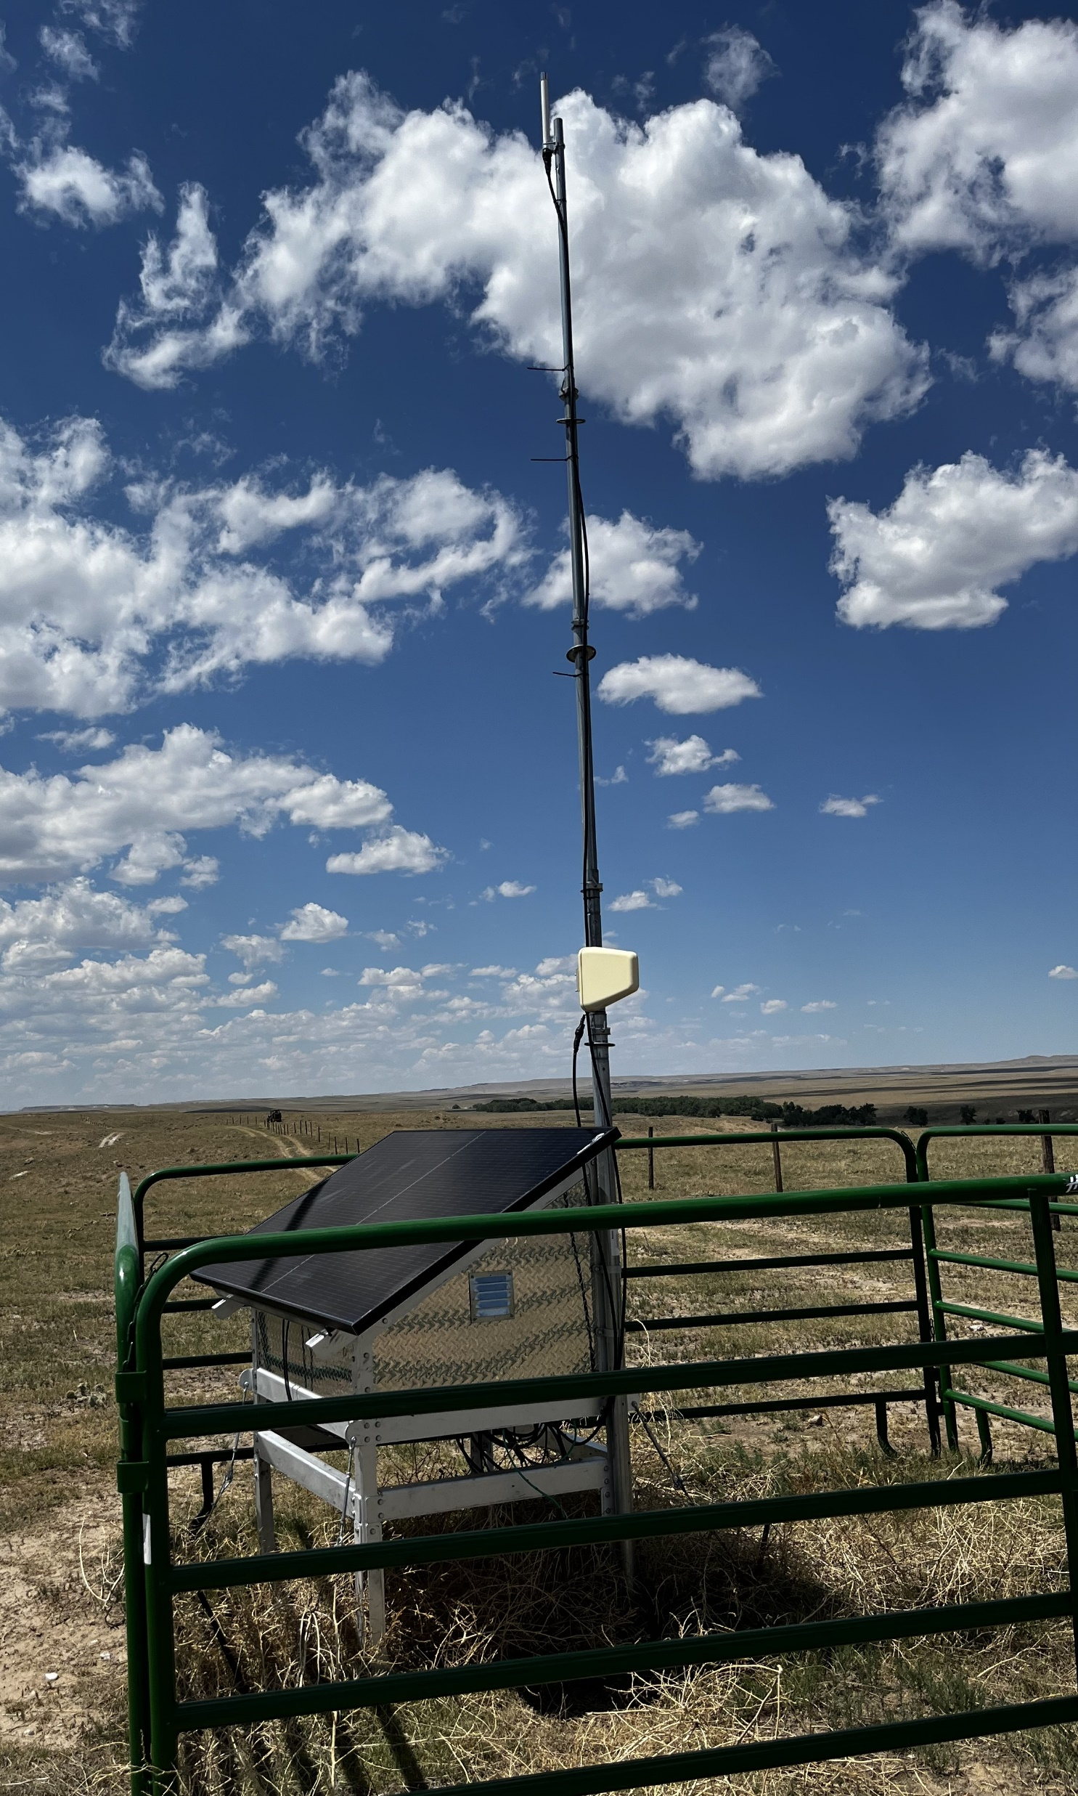
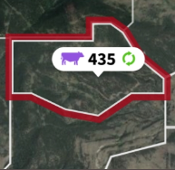
Virtual Fence - Communication

Slide 30
Virtual Fence - Benefits
Benefits:
Allows ranchers to change the locations of livestock grazing, both between and within years.
Allows ranchers to move livestock with reduced labor inputs.
Can be used in areas that are difficult to fence.
Eliminates wildlife conflicts with traditional wire fencing.
Can exclude cattle from areas of management.
Can limit undesired effects of grazing in riparian areas.

Slide 31
Virtual Fence - Challenges
Challenges:
Involves collar installation.
Relies on functional technology.
Has a high upfront cost of implementation.

Slide 32
Virtual Fence – Disclaimer of Endorsement
Any and all references in this presentation to any specific commercial products, process, or service by trade name, trademark, manufacturer, or otherwise, does not necessarily constitute or imply its endorsement, recommendation, or favoring by the United States Government. The views and opinions of the author expressed herein do not necessarily state or reflect those of the United States Government and shall not be used for advertising or product endorsement purposes.

Slide 33
Virtual Fence - Companies
No Fence
Gallagher – eShepard
Halter
Corral – Out of Business???
Vence
* All Companies work off cell service

Slide 34
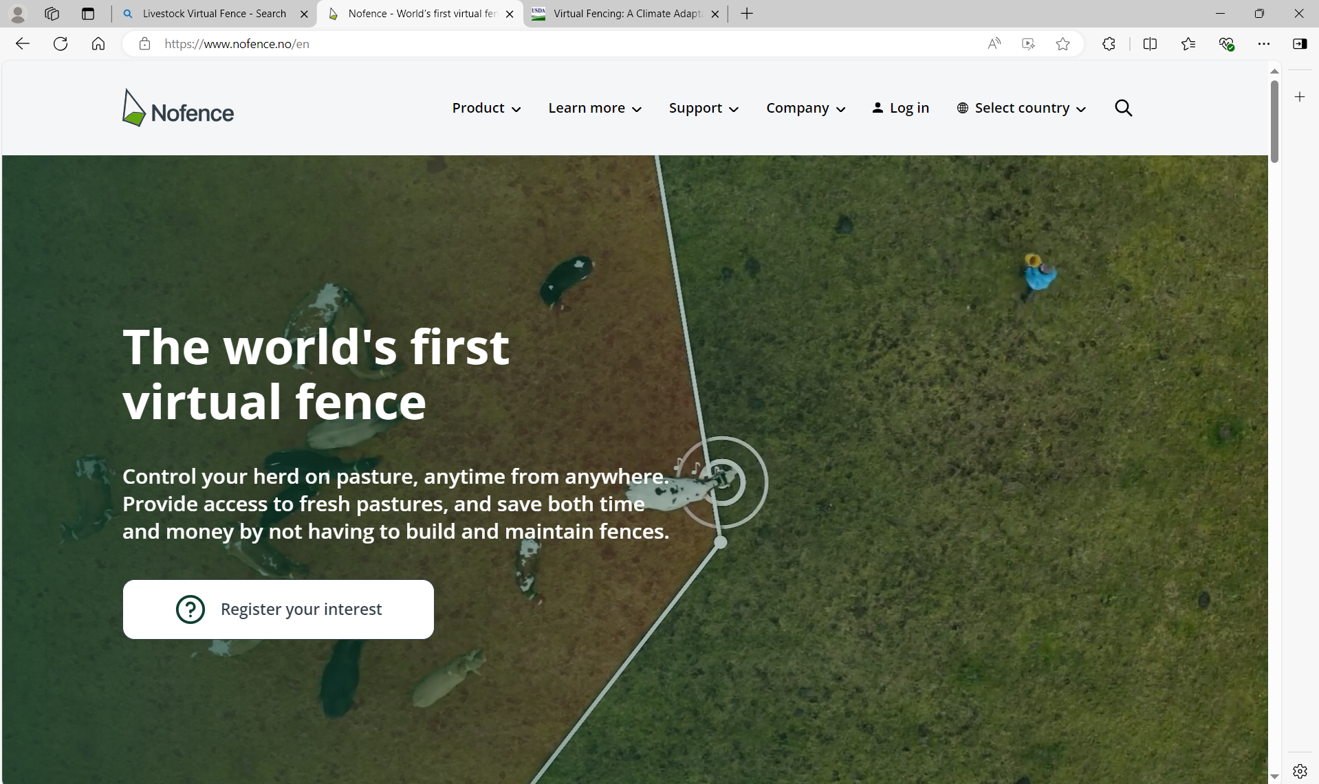
Nofence - Norway

Slide 35
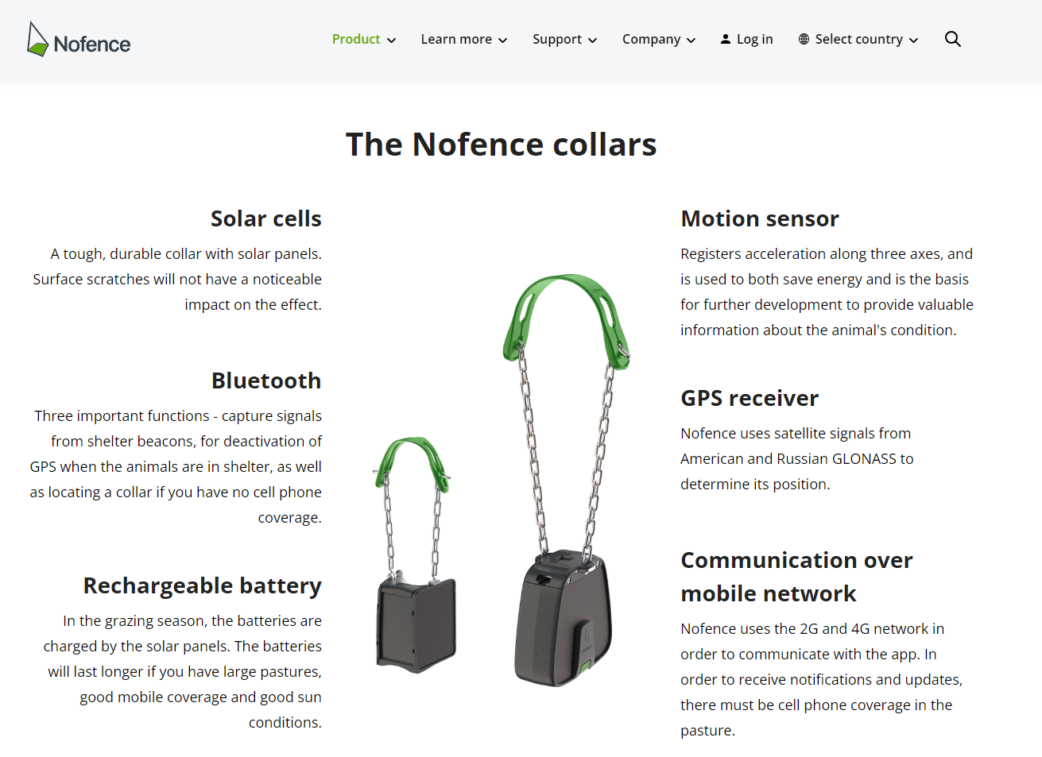
Nofence - Norway

Slide 36
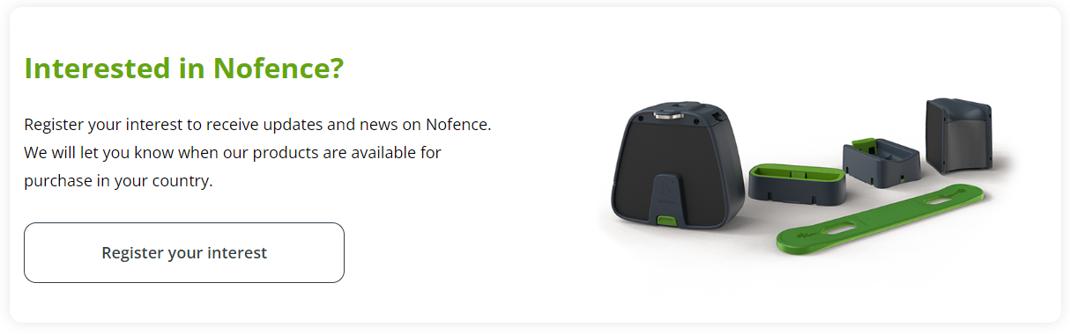
Nofence - Norway

Slide 37
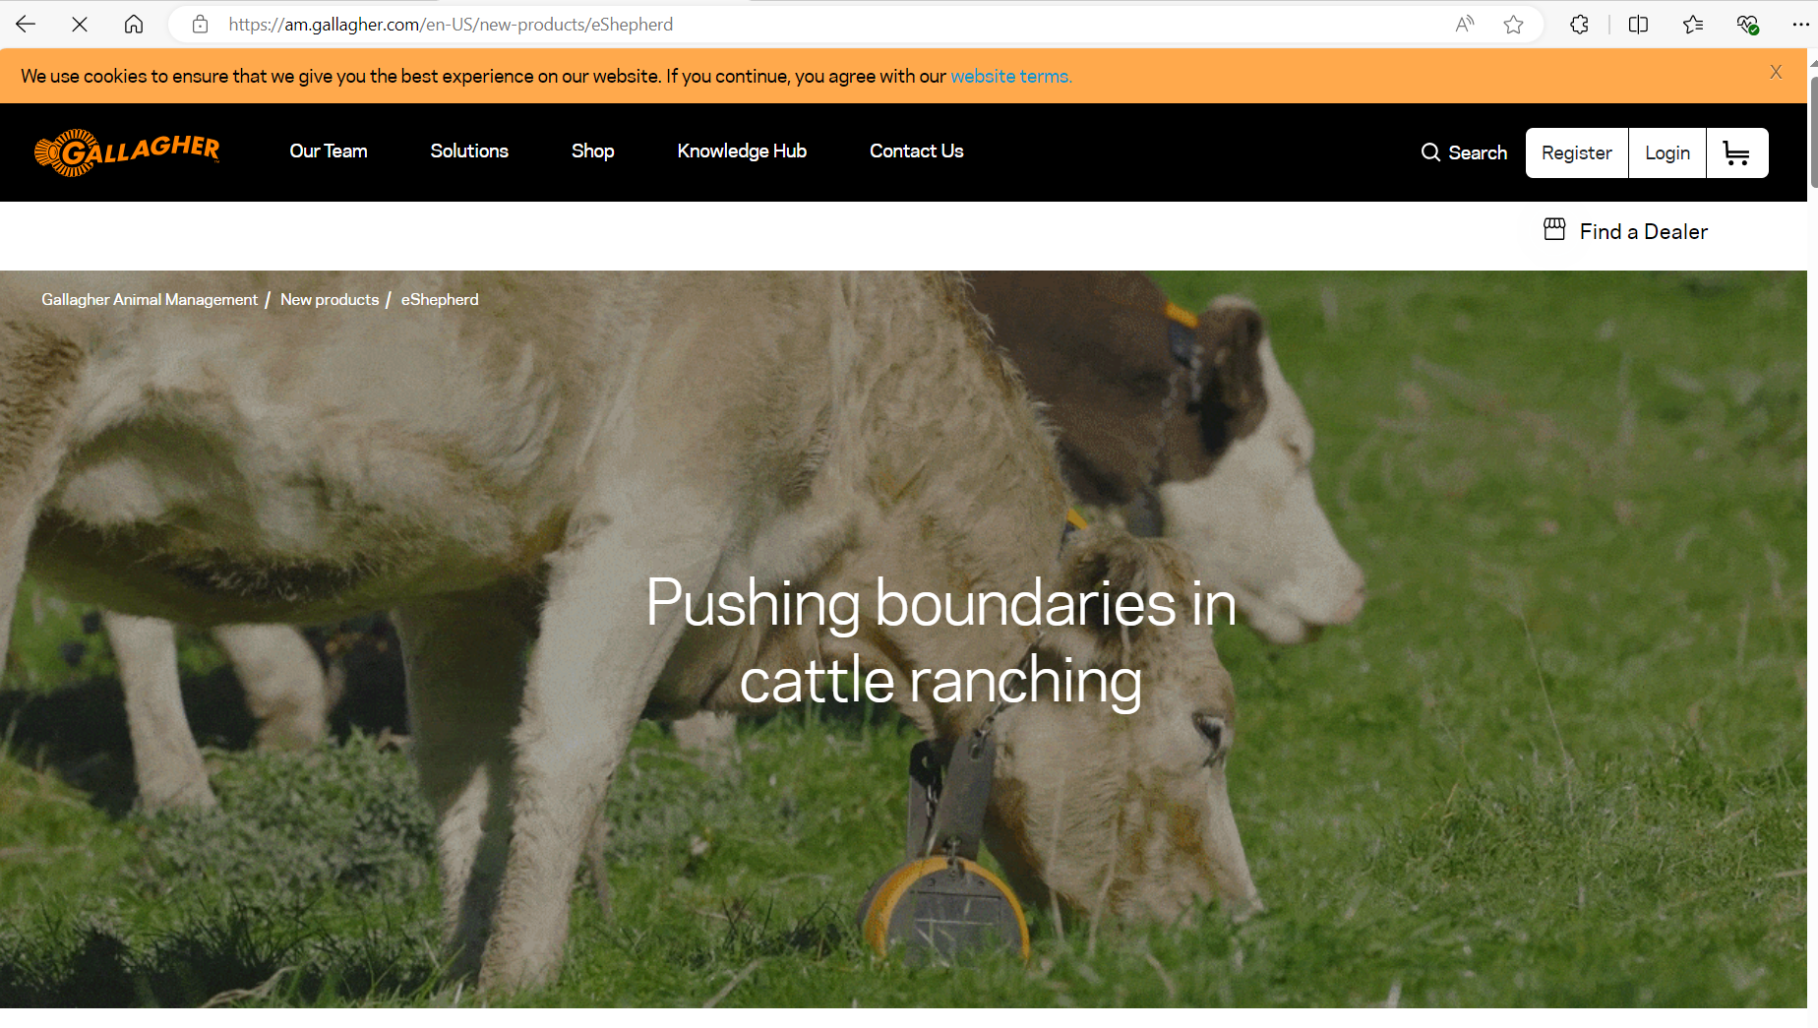
Gallagher – eShepard -
Australia

Slide 38
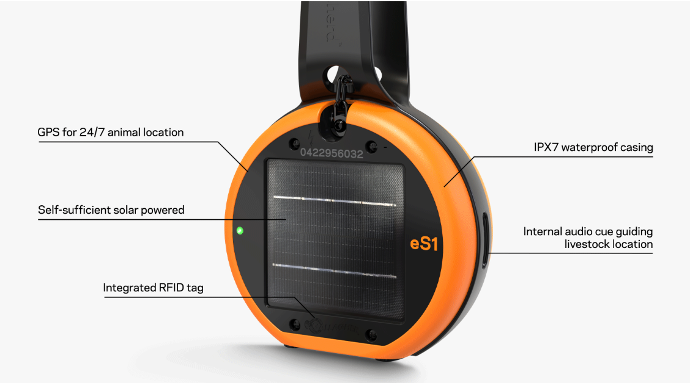
Gallagher – eShepard -
Australia

Slide 39
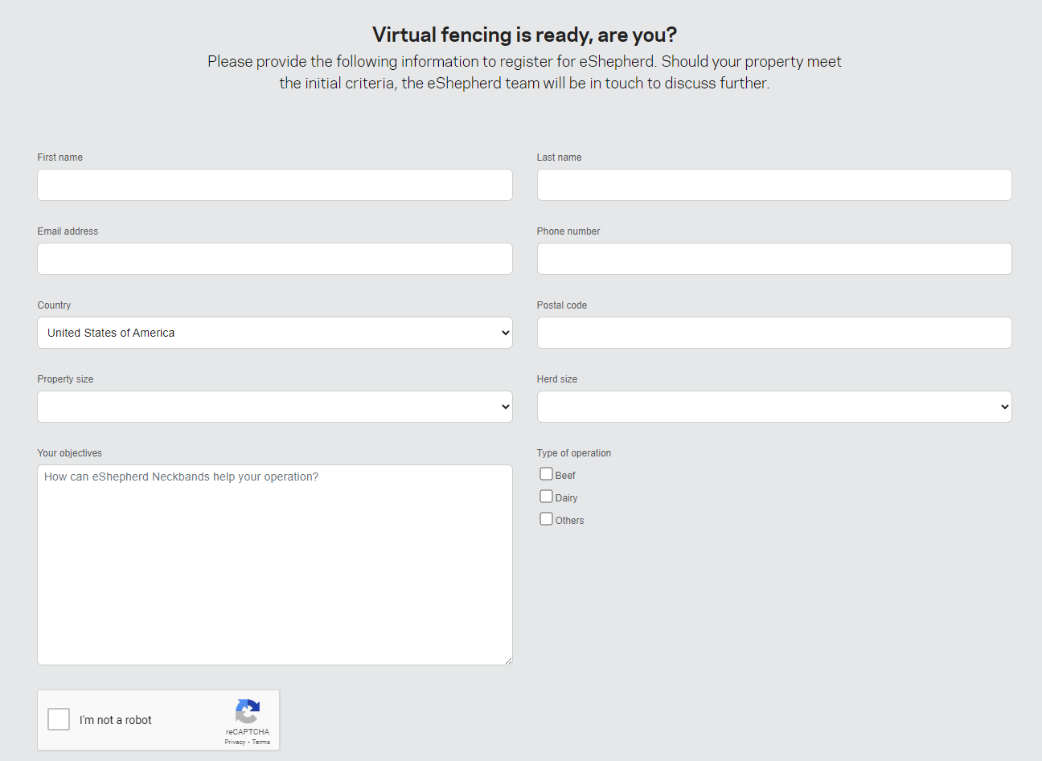
Gallagher – eShepard -
Australia

Slide 40
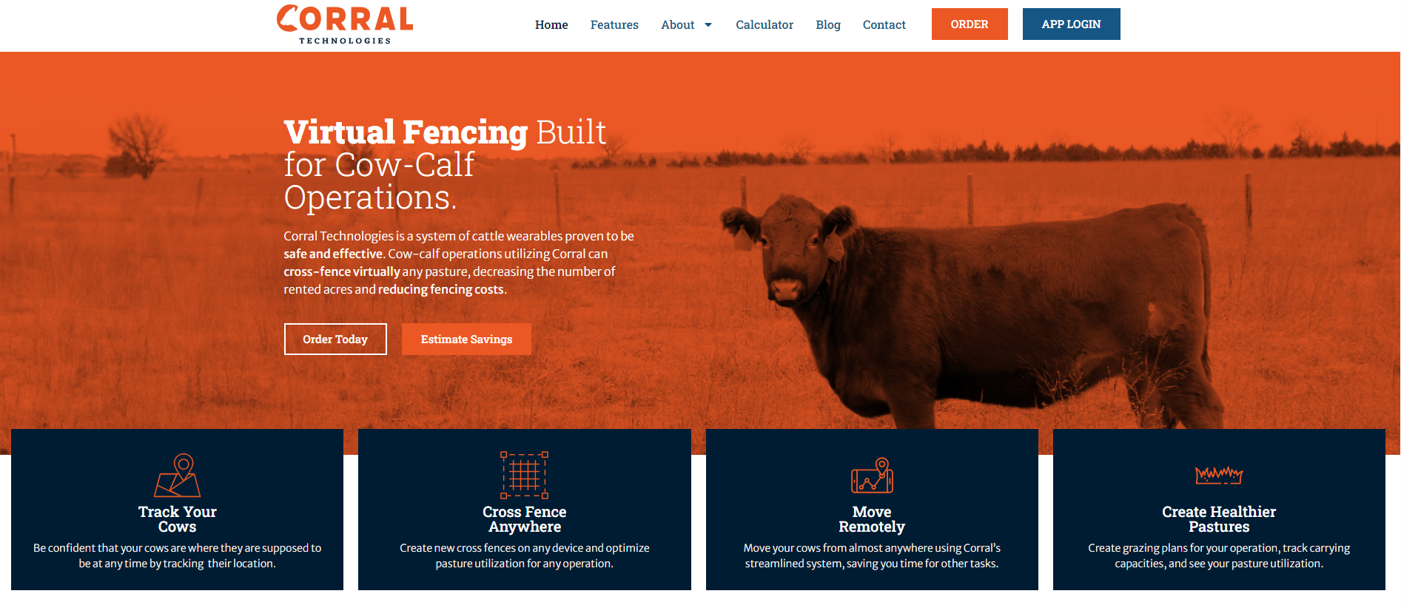
Corral Technologies - Nebraska
Went out of Business

Slide 41
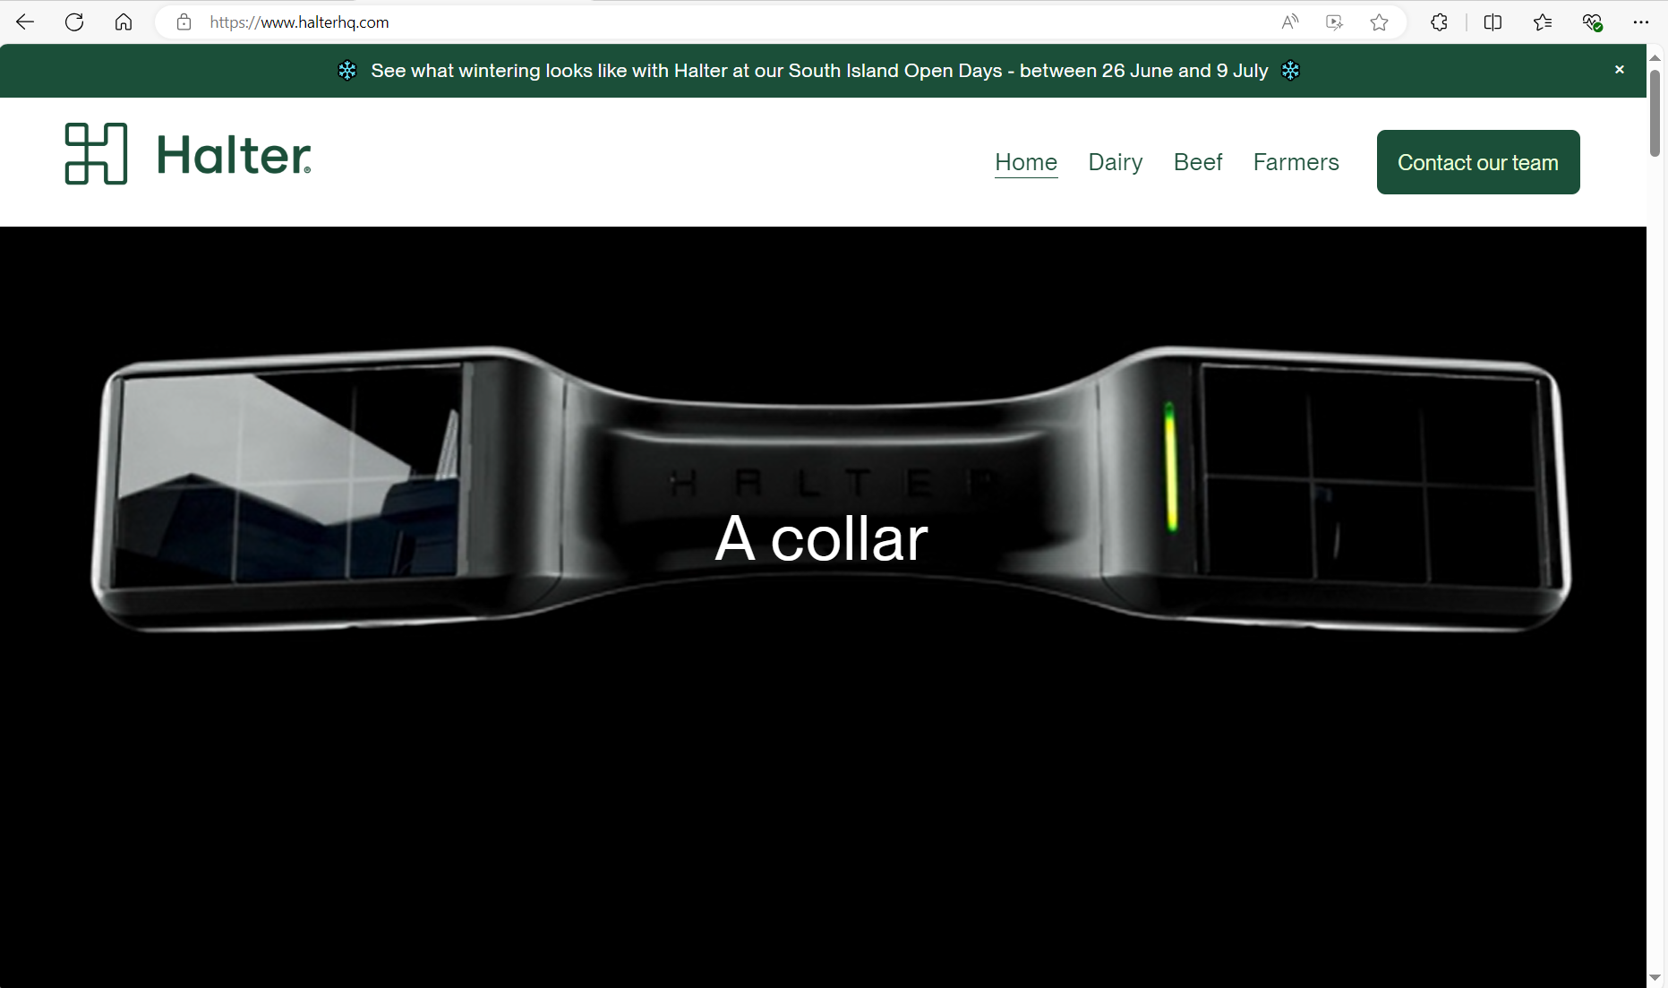
Halter – New Zealand
Corral Technologies and Halter have combined operations.

Slide 42
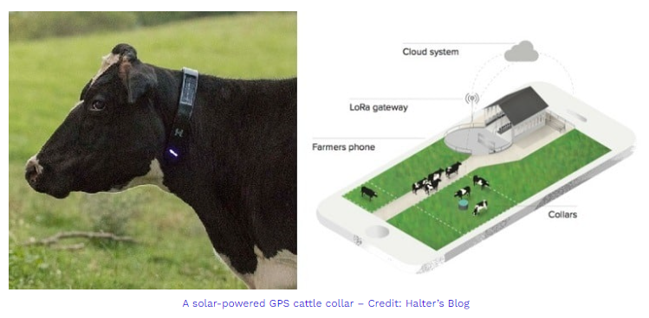
Halter – New Zealand
Planning U.S. Commercial Launch – Spring 2025 – Can Contact now by website
Regional Representative – Should be on website soon

Slide 43
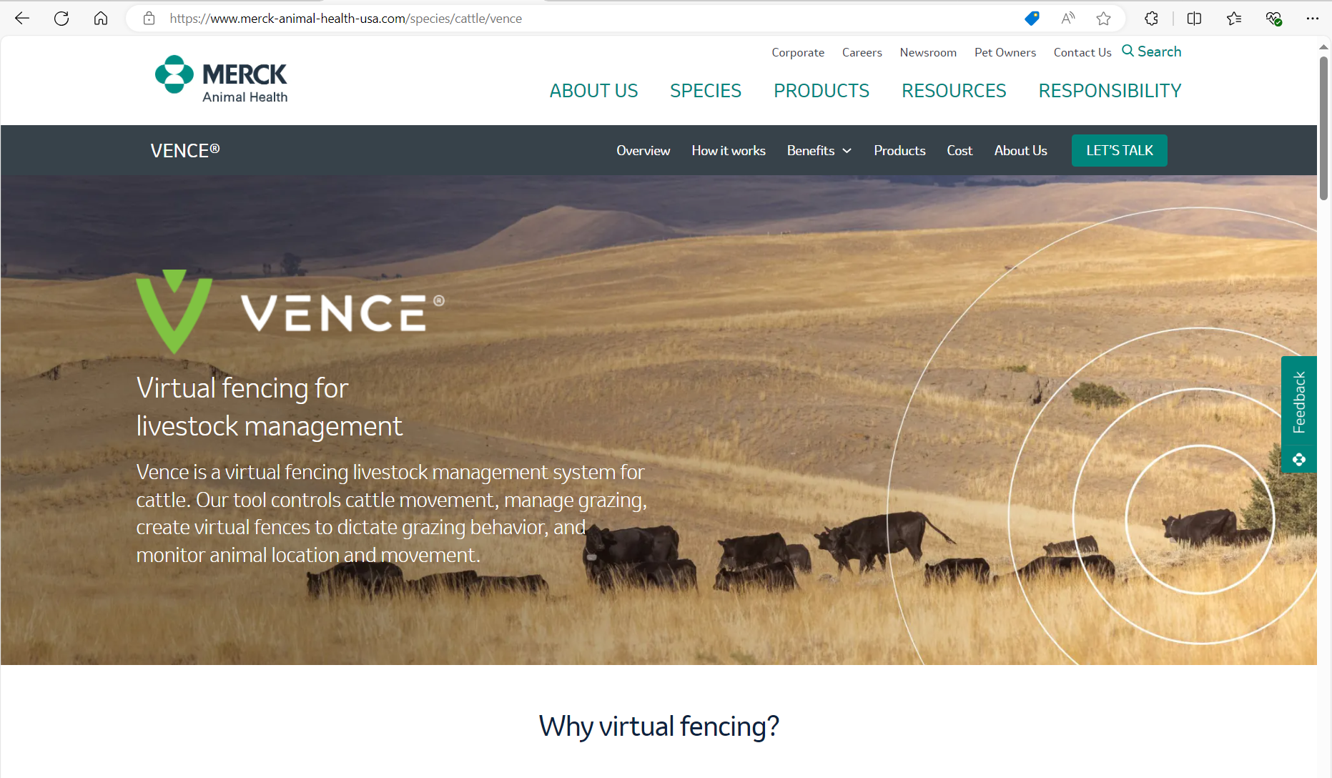
Vence – Merck Animal Health USA
New Jersey

Slide 44
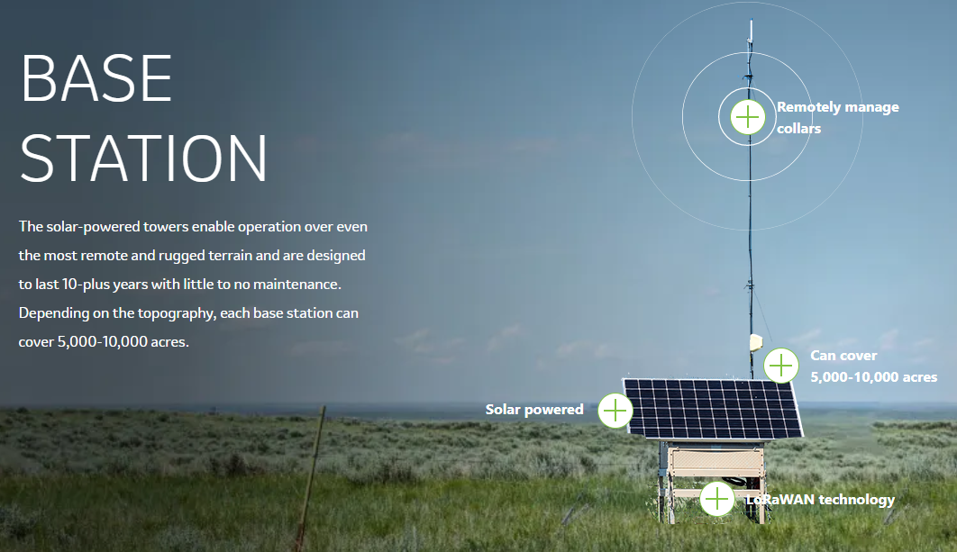
Vence – Merck Animal Health USA
New Jersey

Slide 45
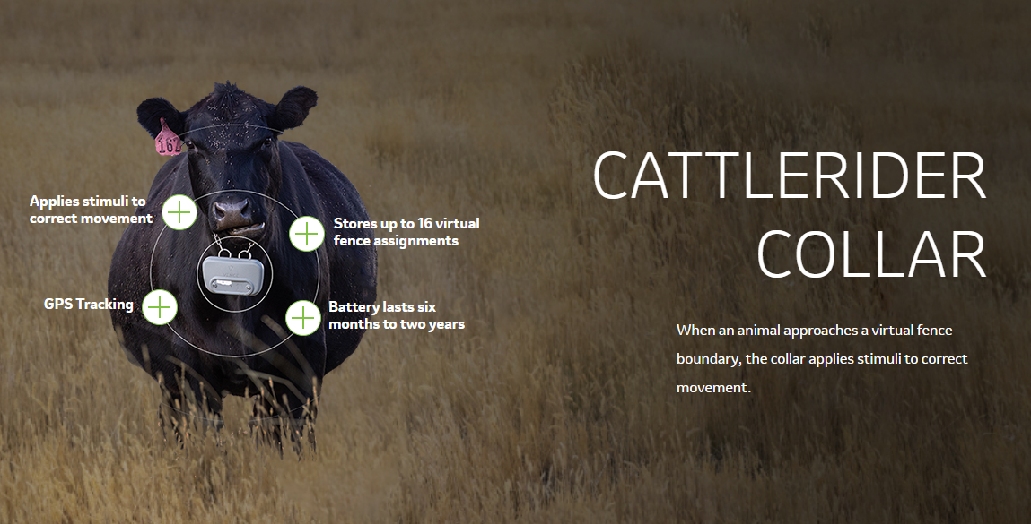
Vence – Merck Animal Health USA
New Jersey

Slide 46
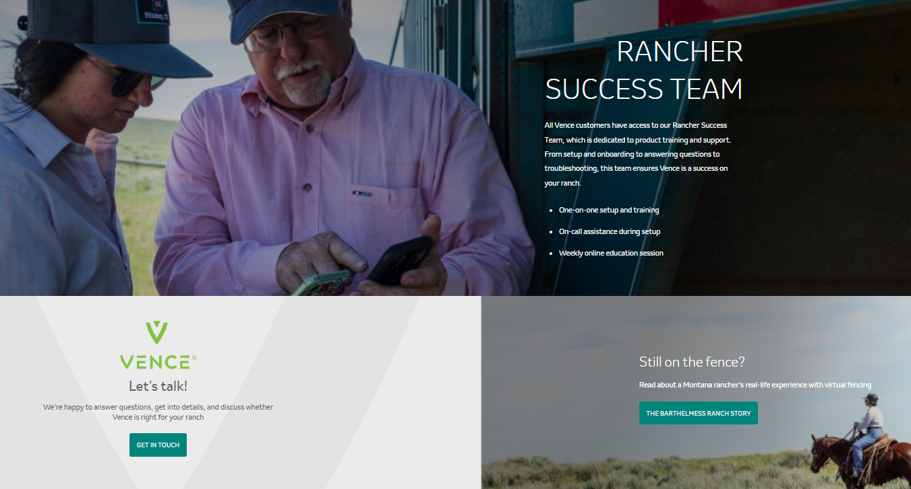
Vence – Merck Animal Health USA
New Jersey
Ty Roseberry – Wyoming Representative
(308) 293-6433

Slide 47
Virtual Fence – National Payment Scenarios - FY 2025
Fence (382) – 4 Scenarios – Year 1
Small Herd Startup – Cattle
Small Herd Startup – Sheep and Goats
Medium Herd Startup – Cattle
Large Herd Startup – Cattle
Prescribed Grazing (528) – 1 Scenario – Year 2-5
Virtual Fence Adaptive Management

Slide 48
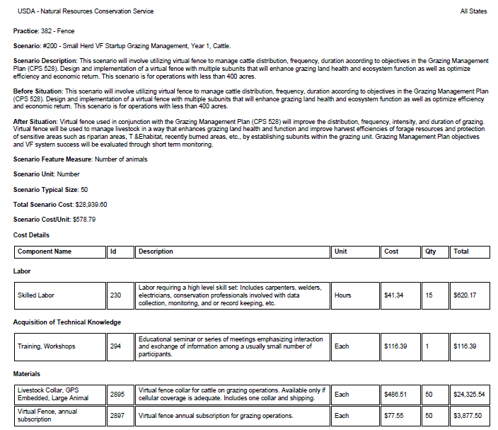
FENCE (382) National Payment Scenario
FY 2025
Scenario: #200 – Small Herd VF Startup Grazing Management,
Year 1, Cattle
Less than 400 Acres
50 Head

Slide 49
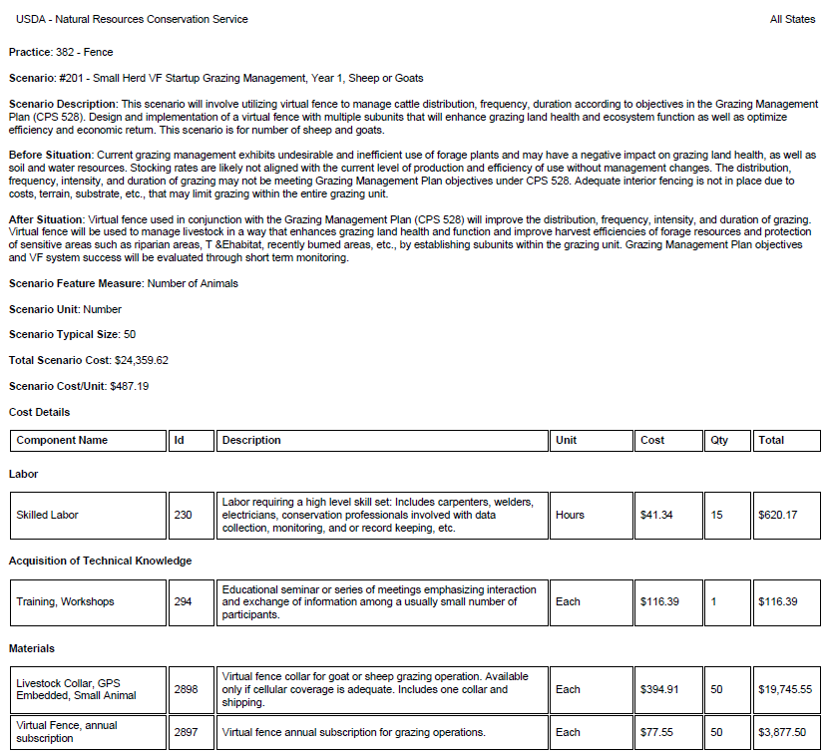
FENCE (382) National Payment Scenario
FY 2025
Scenario: #201 – Small Herd VF Startup Grazing Management,
Year 1, Sheep or Goats
50 Head

Slide 50
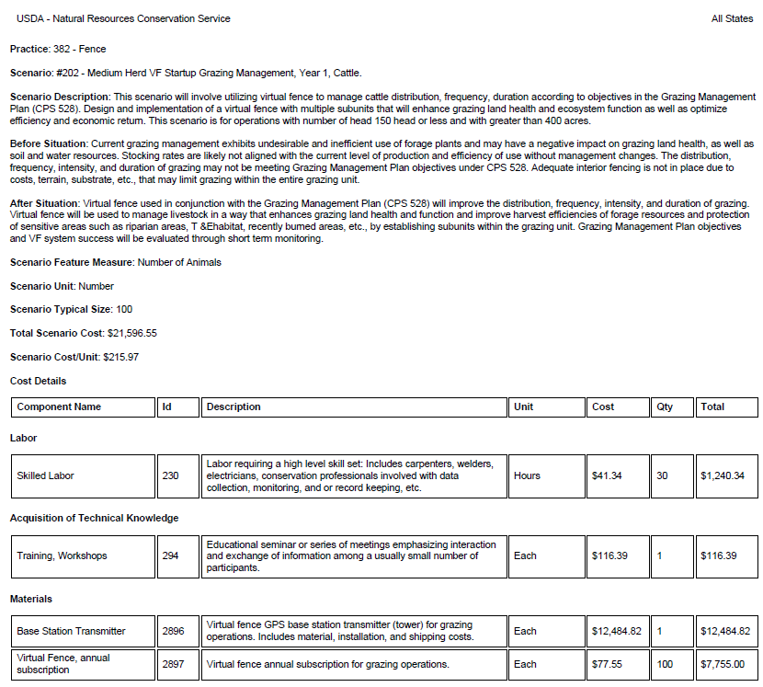
FENCE (382) National Payment Scenario
FY 2025
Scenario: #202 – Medium Herd VF Startup Grazing Management,
Year 1, Cattle
Greater than 400 Acres
150 Head or Less

Slide 51
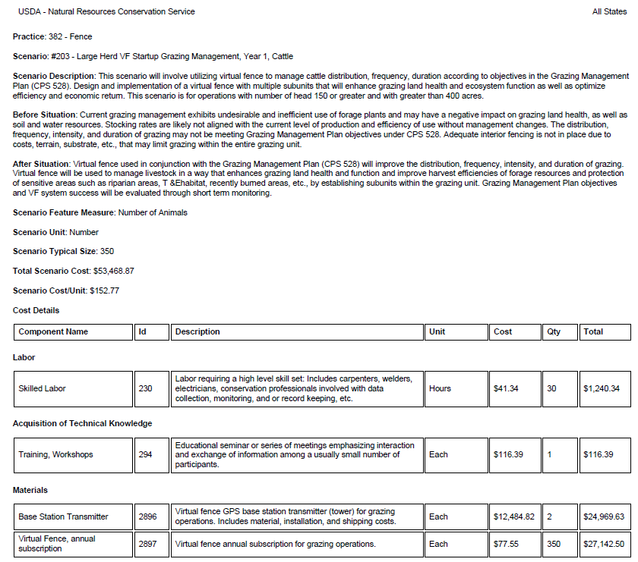
FENCE (382) National Payment Scenario
FY 2025
Scenario: #203 – Large Herd VF Startup Grazing Management,
Year 1, Cattle
Greater than 400 Acres
150 Head or Greater

Slide 52
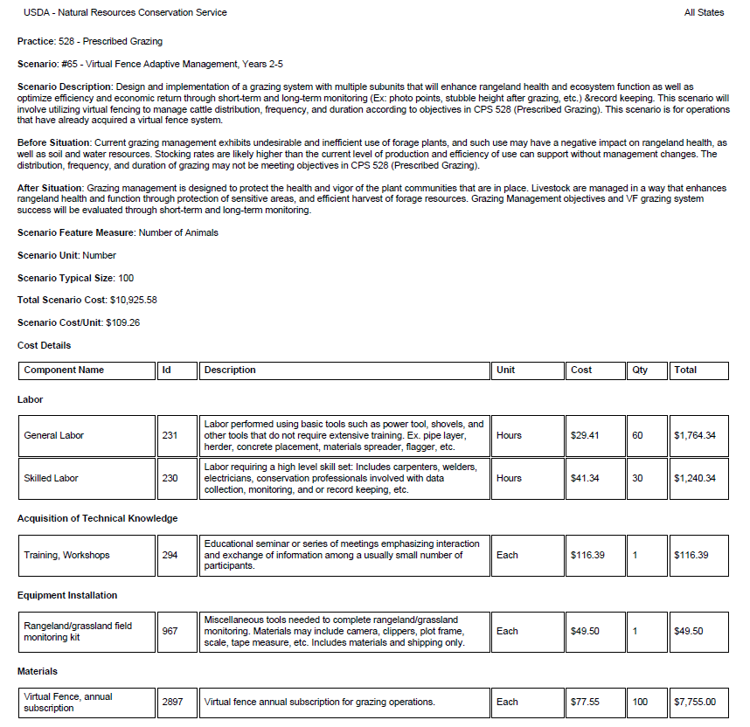
PRESCRIBED GRAZING (528) Payment Scenario
FY 2025
Scenario: #65 – Virtual Fence Adaptive Management, Years 2 - 5

Slide 53
Virtual Fence – National Payment Scenarios - FY 2025
Agency is working on a National variance for Virtual Fence
From 20-year lifespan to 7-year lifespan
Going through approval process
Currently working on Wyoming VF Implementation Requirements – Coming soon!

Slide 54
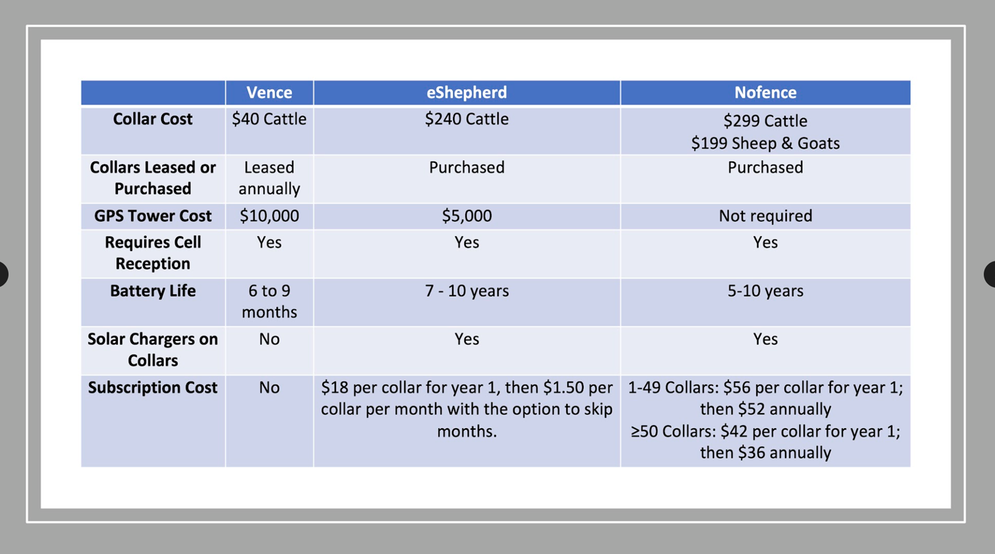
Company Costs

Slide 55
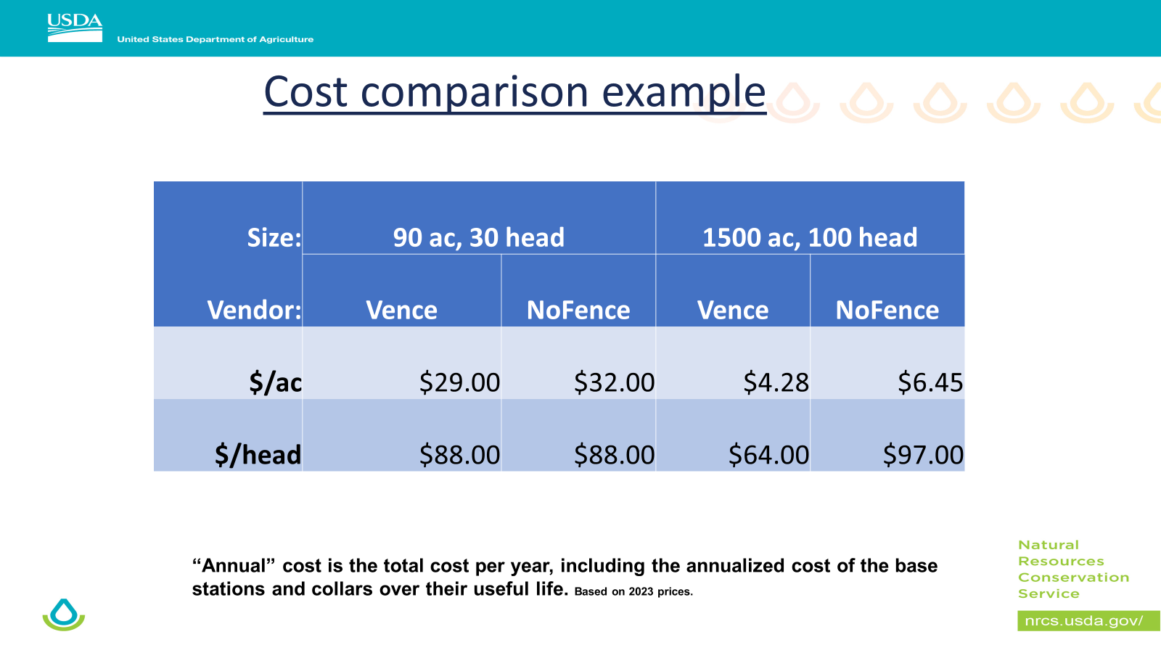

Slide 56
Moving Forward with VF and Producers
Be upfront – Need to do your homework on products.
- Product availability
- Product cost for start up and cost per year.
What happens after the contracting period?
- Conventional fence with a 20-year practice lifespan expectancy. Virtual Fence 7-year lifespan expectancy.
- Remember 300 cows x $40/collar = $12,000/year x 7
years = $84,000 = $3/ft for barbed = 28,000ft of fence
382 alone or 382 and 528 combined.
Currently working on updating Wyoming Fence (382) Standard and IR to include Virtual Fence.

Slide 57
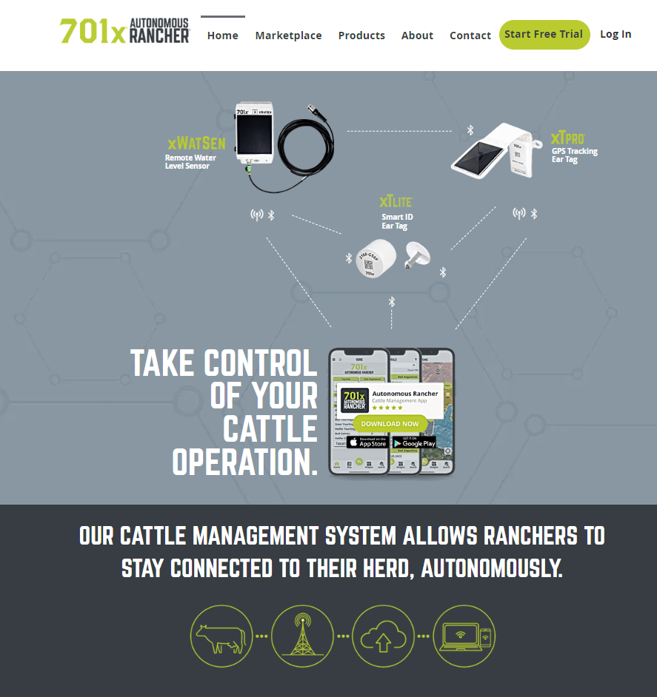
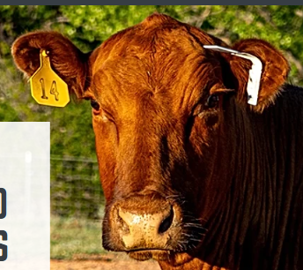
GPS Ear Tag

Slide 58
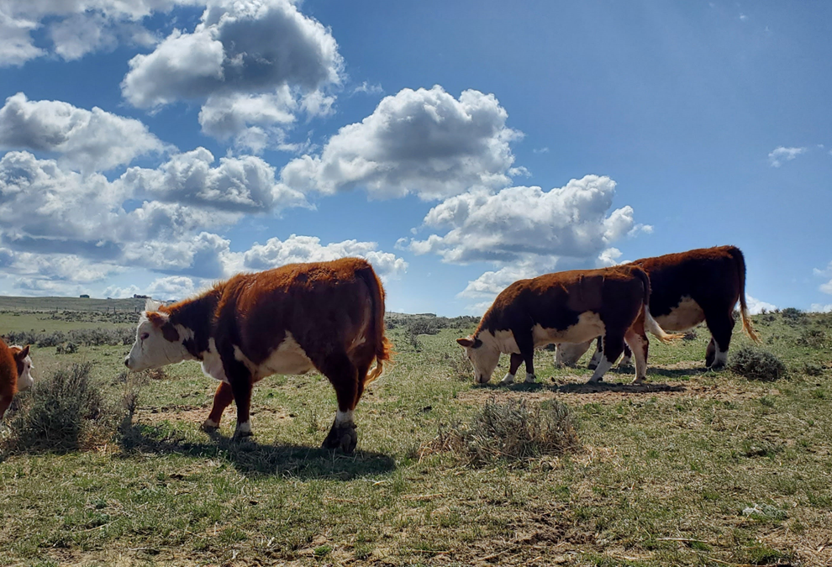
QUESTIONS?

Slide 59
Questions?

Slide 60
Partner Updates

Slide 61
Questions?
Thank you!

