Slide 1

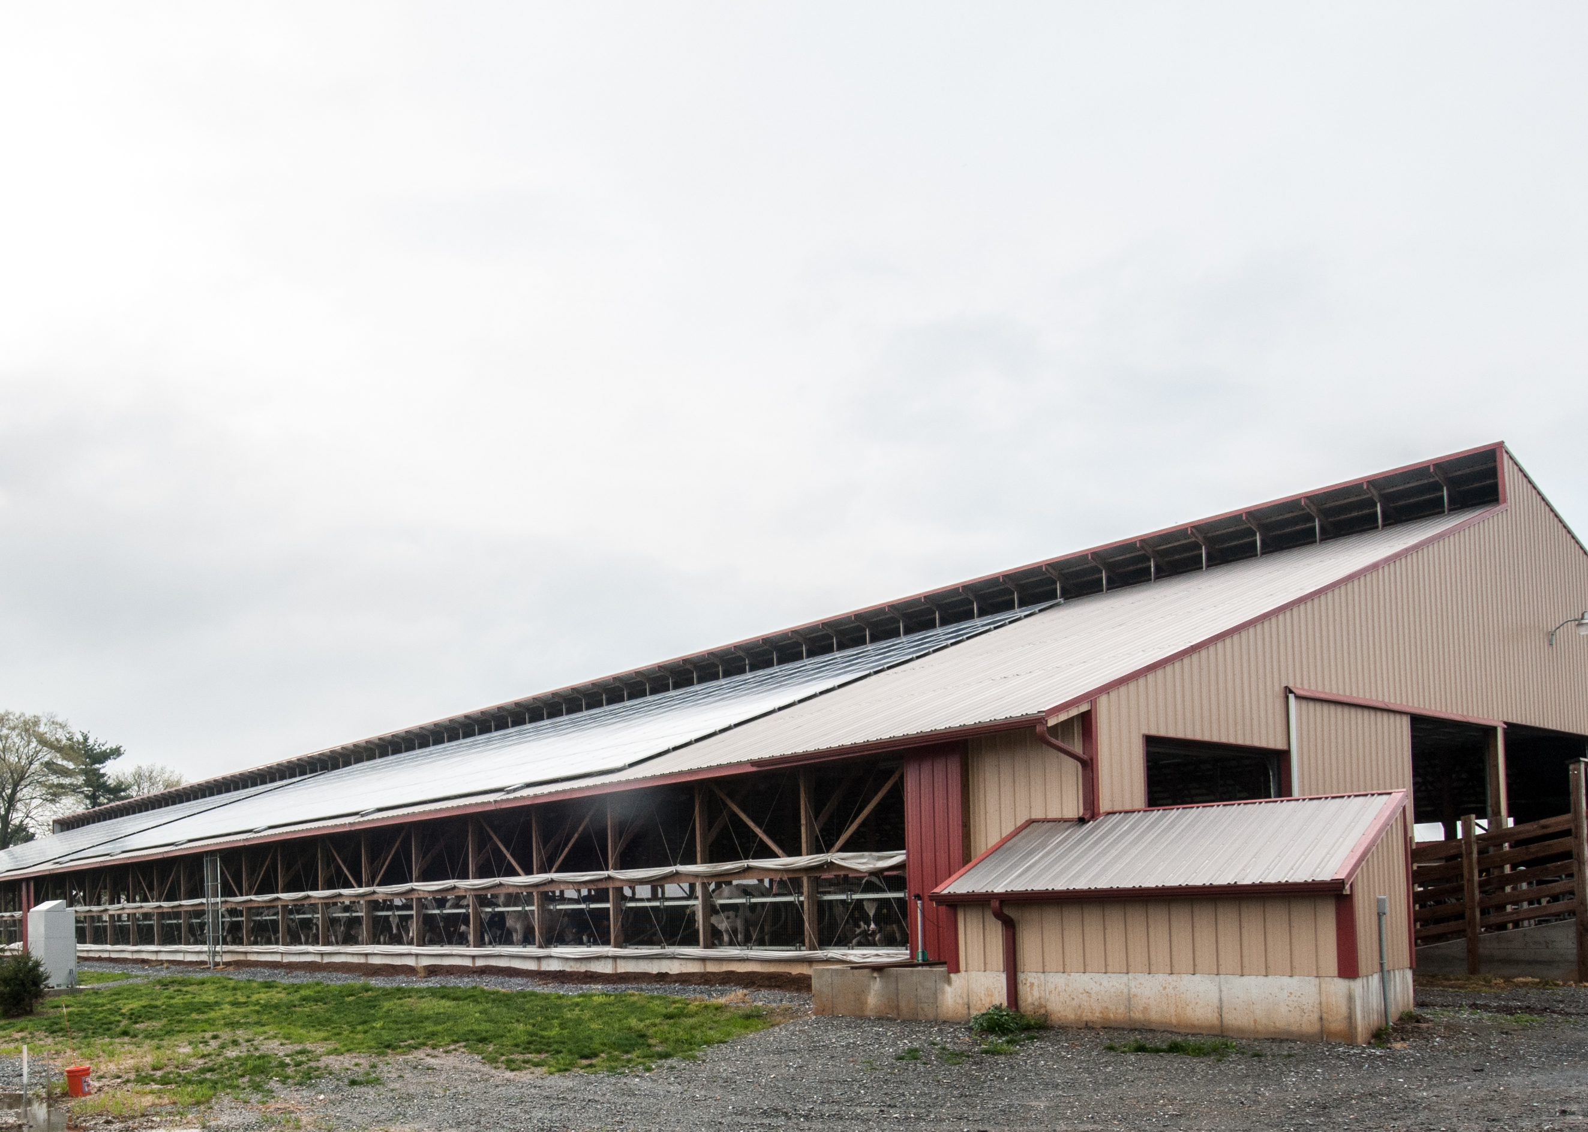
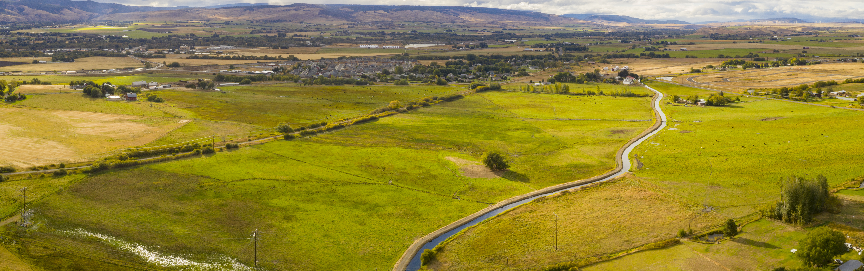
Ecological Sciences Updates

Slide 2
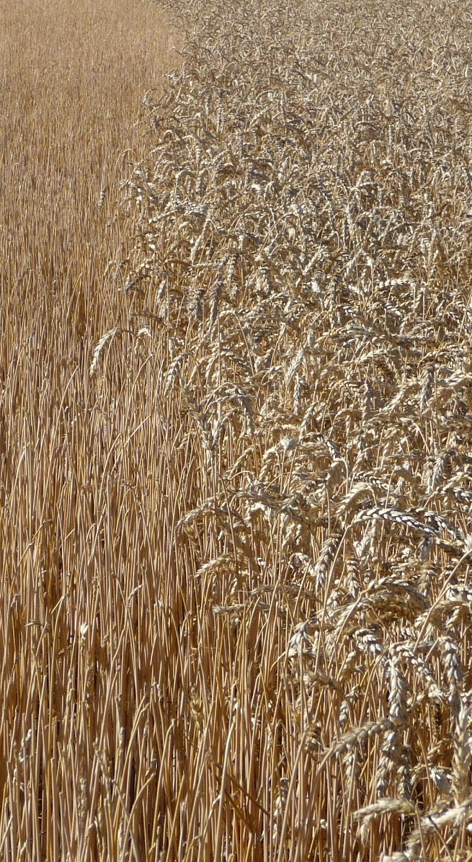
Field Office Technical Guide
Broken Links Fixed!
  Transition to new system changed commas in titles to plus signs, breaking the hyperlinks to these documents
  Reported to be resolved
Unable to upload new FOTG documents to Section IV
  Patch to be deployed at national level (near future)
  Will fix documents created outside of new system approved prior to transition to new system
Notes:
Picture on slide shows wheat harvested with a stripper headers, only removing the wheat head, leaving residue as tall as possible. Taller residue will help retain snow and moisture over winter. It helps push wind energy above soil surface greatly reducing evaporation.
Great practice, use to have purpose for increased stubble height in our residue mgt practice, which was removed at some point and time. This is a fantastic substitute.

Slide 3
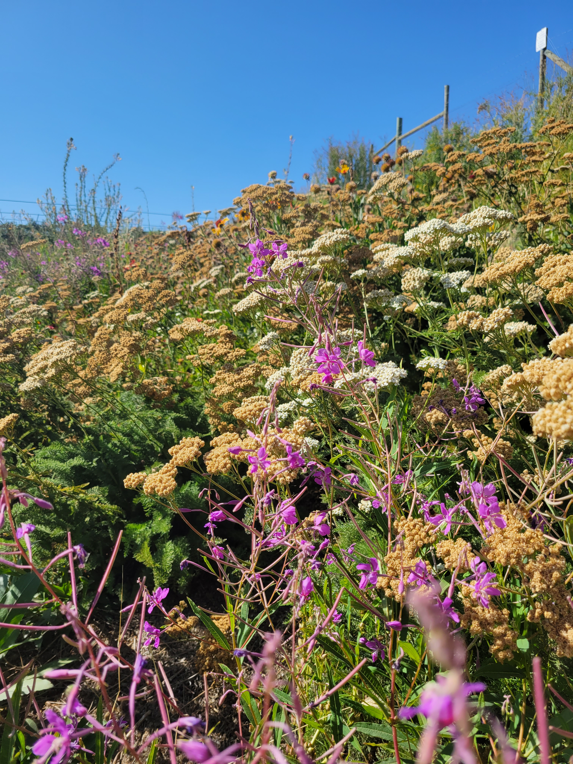
Conservation Reserve Program
CRP Continuous Process Improvement Underway
  Developing a strategy to manage workload & responsibilities
  Charter Developed
CRP Expiring Contracts:
    FY25: 342
    FY26: 1,269
    FY27: 528
  FY28: 129
  FY29: 176
Audit findings reported to FSA County Committees
Notes:
Picture on slide shows wheat harvested with a stripper headers, only removing the wheat head, leaving residue as tall as possible. Taller residue will help retain snow and moisture over winter. It helps push wind energy above soil surface greatly reducing evaporation.
Great practice, use to have purpose for increased stubble height in our residue mgt practice, which was removed at some point and time. This is a fantastic substitute.

Slide 4

Upcoming Technical Trainings
Training Name | Location | Date(s)
Advance Forest Insect & Disease and Management | Coeur d’Alene | May 19-23 or June 2-6 (IDF determining in March)
Agronomy (EcoSci Monthly Webinar) | Virtual | March 31, 2025
Assessment Tools: Basic Forest Inventory & Analysis | Wenatchee | May 5-9, 2025
Assessment Tools: Cropland | Pullman PMC | March 11-13
Assessment Tools: Stream Visual Assessment Protocol 2 (SVAP 2) | East Area | May 27, 2025
Assessment Tools: Stream Visual Assessment Protocol 2 (SVAP 2) | Central Area | May 28, 2025
Cultural Resources: Connected Actions (EcoSci Monthly Webinar) | Virtual | May 27, 2025
Endangered Species Act Short Course (EcoSci Monthly Webinar) | Virtual | Feb. 24, 2025
Into to Engineering | Virtual | May 20-21, 2025 (tentative)
Irrigation Water Management | Virtual | May 5-6, 2025
Nutrient Management | Yakima | Mar 31-Apr4, 2025
Organic 101 with Oregon Tilth (EcoSci Monthly Webinar) | Webinar | Feb. 24, 2025
Prescribed Grazing Management | Ephrata | May 28-30, 2025
Seeding in Western WA | Olympia | May 15, 2025
Virtual Grazing Training: Basics of Forage, Livestock, Grazing | Virtual | March 10-14, 2025
NRCS Wetland Compliance Process (EcoSci Monthly Webinar) | Virtual | April 28, 2025
Contact | joshua.m.madison@usda.gov
Notes:
Picture on slide shows wheat harvested with a stripper headers, only removing the wheat head, leaving residue as tall as possible. Taller residue will help retain snow and moisture over winter. It helps push wind energy above soil surface greatly reducing evaporation.
Great practice, use to have purpose for increased stubble height in our residue mgt practice, which was removed at some point and time. This is a fantastic substitute.

Slide 5
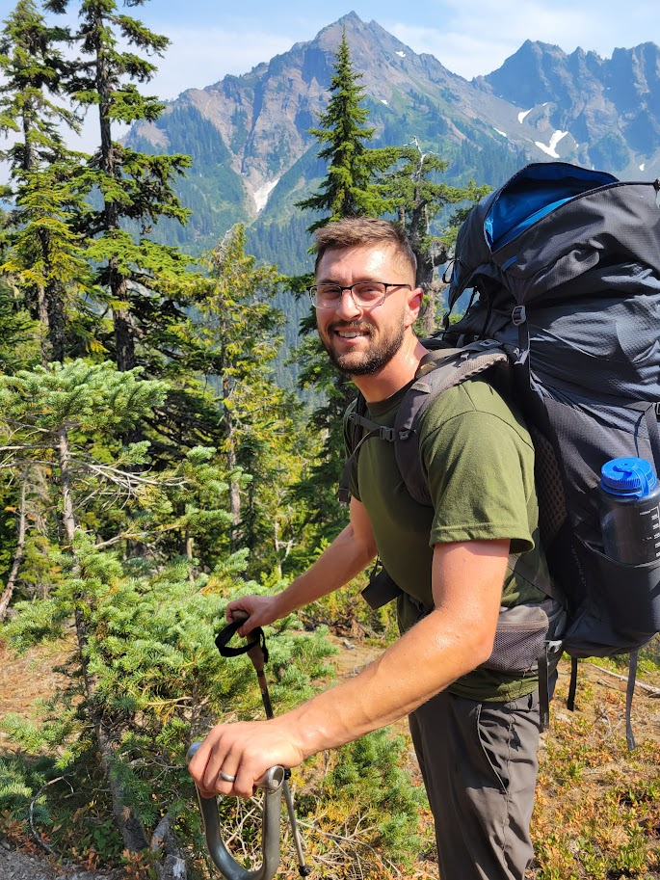
State Resource Soil Scientist - Introduction
Max Ross
  Duty Station | Olympia WA
  Start Date | September 2024
Formerly Soil Survey Project Leader
  Olympia Soil Survey Office
  Sept. 2016 - 2024

Slide 6
State Resource Soil Scientist – Position Overview
Wetland and Highly Erodible Lands Compliance
Training and Outreach
Soil Health Subject Matter Expert
Liaison to Soil and Plant Science Division of NRCS
Other Special Projects, Tasks, Initiatives
  Soil Carbon Monitoring Network State POC
  FPPA Exemption Requests
  Soil Survey Refresh
  Eligibility Inventory for Easements
  Technical Consultations; Utilization of Soil Survey Data

Slide 7
Wetland Compliance – Wetland Determinations
Updated State Instructions, FOTG, JAA Matrix
Actively Addressing Certified Wetland Determination Backlog
  Completed 12 of 17 CWD’s assigned in WC Tracker
Training Recently Hired West Area Wetland Specialist
  Developed training plan to attain Level II JAA in 6-8 months
  Regular OJT and “learn by doing” collaboration

Slide 8
Wetland Compliance – Goals and Objectives
Finish clearing 2024 CWD backlog and catch up with 2025 CWD requests
Achieve 30-60-day turnaround for CWD requests moving forward
Adopt off-site methods to expedite CWD’s
  Allowing neighboring states to set precedent
  Develop guidance for appropriate-use situations in WA
Deliver training to Field Staff and FSA
  Overview of WC Provisions, AD-1026, and CWD process
Split West Area CWD workload with West Area Wetland Specialist
  Once they attain Level II JAA

Slide 9
Training
Training | Lead Instructor or Cadre Member:
  Soil Health and Sustainability
  US Army Corps of Engineers Regulatory IV Wetland Inventory
Training | Supporting and Minor Roles:
  Riparian Planning Considerations – Web Soil Survey and Ground-Truthing the Soil Survey Modules
  OJT opportunities for field staff
  Others as requested!

Slide 10
Outreach and Technical Assistance
Outreach and Partner Engagement
  APWA Stormwater Management Committee
  Chehalis Basin Partnership
  WSU Forest Owner’s Winter School
  WSU Forest Stewardship Field Day
  Master Gardeners
  WSDOT – Hydric Soils Workshop
Technical consultations with federal, state, and local entities
  Accessing and interpreting soil survey data
  Problematic hydric soil and wetland situations
  Addressing soils-related resource concerns

Slide 11
Soil Health
WA State Subject Matter Expert and on POC distribution list for Soil Health Division
  Balancing responsibilities with Small Farms and Urban Ag Specialist - Rebecca Anderson Bellanca
  Lots of support from Laura Starr with Soil Health Division
Lead Instructor for Soil Health and Sustainability Training
Coordinate with Becca and Laura for CEMA Trainings
  CEMA 216 – Soil Health Testing
  CEMA 221 – Soil Organic Carbon Stock Monitoring
  Practice 336 – Soil Carbon Amendment
  Provide training to field staff to obtain QI status

Slide 12
Liaison to Soil and Plant Science Division
Advocating for updated soil survey products to support and inform planning in WA State
Coordinate with SLT, field staff, stakeholders to identify areas in need of soil survey updating
WA NRCS representative in Tech Team and Management Team meetings with Soil Survey staff
  Propose and prioritize soil survey update projects

Slide 13
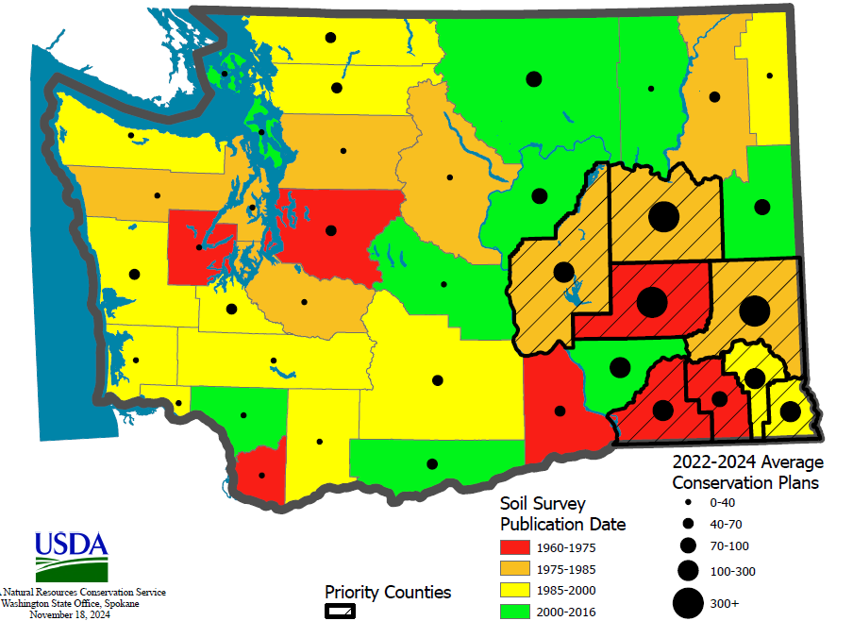
Soil Survey Status Evaluation and Update Priorities
Focus on Palouse and SE WA
  Older Surveys, lots of agriculture and planning activity
Interest in the distribution and effects of MSH ash
  Eruption event occurred after survey publication
Other ideas or priorities?
  Please bring to Max’s attention!

Slide 14
Other Special Projects, Tasks, Initiatives
  Soil Carbon Monitoring Network State POC
    IRA funded initiative; long term monitoring of soil carbon on agricultural lands
    Goal to sample 15 sites in WA in FY25
  Farmland Policy Protection Act Exemptions and Reporting
  Soil Survey Annual Refresh
  Eligibility Inventory for Easements
  Technical Consultations; Utilization of Soil Survey Data

Slide 15
NRCS-WA
Sage Grouse Initiative
(SGI) Priority Areas
Proposal for FY2026 update
Scott Scroggie, SGI Lead and
Peter McBride, State Wildlife Biologist

Slide 16

Sage Grouse Initiative (SGI)
NRCS-WA periodically updates areas to prioritize for Sage Grouse Initiative work.
NRCS-WA Sage Grouse Initiative Lead and State Wildlife Biologist developed a proposed update for FY26, and have worked with the STAC Wildlife subcommittee to finalize the proposal.
>>Note for reviewers: there is further explanatory information and background in the Notes field below slides.
Notes:
Background: In 2010 the potential for the Greater Sage Grouse becoming listed under the Endangered Species Act led to a proactive approach to conservation through strategies outlined in a joint USFWS/NRCS conference report as the vehicle for working lands conservation. NRCS received dedicated funding under the Sage Grouse Initiative to plan and implement various conservation practices in a focused geographic region centered around designated core and other priority areas. States were directed to develop eligibility/ranking maps with the help of their respective wildlife agencies with a goal of “defend the core, grow the core” by addressing state-specific threats in a focused manner.

Slide 17
SGI Priority Area Periodic Updates
Notes:
Since 2010 those eligibility Priority Areas maps have been updated semi-annually, based on program/state priorities as well as the most current relevant data. Above are the 2012 to 2015 SGI Priority Areas updates, for background and context.

Slide 18
SGI Priority Area
Periodic Updates
Notes:
Since 2010 those eligibility Priority Areas maps have been updated semi-annually, based on program/state priorities as well as the most current relevant data. Above are the 2016 to 2022 SGI Priority Areas updates, for background and context.

Slide 19
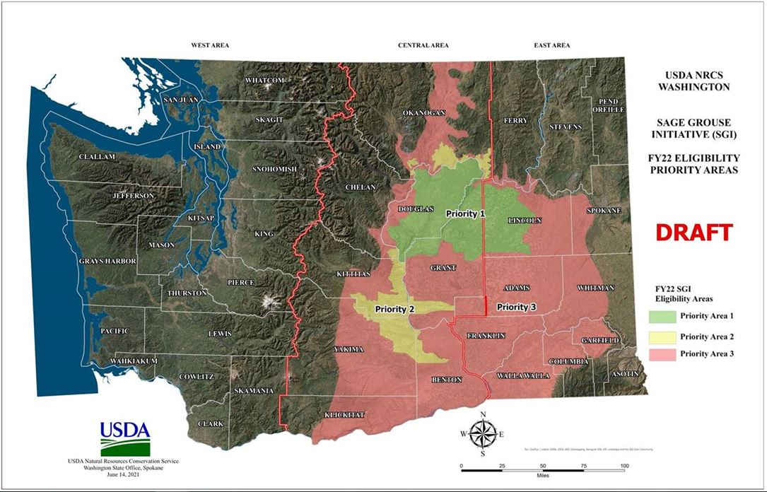
SGI Priority Area
Periodic Updates
Notes:
Since 2010 those eligibility Priority Areas maps have been updated semi-annually, based on program/state priorities as well as the most current relevant data. Above are the 2016 to 2022 SGI Priority Areas updates, for background and context.

Slide 20
WSRRI Mapping
WSRRI (the Washington Shrubsteppe Restoration and Resiliency Initiative) mapping and analysis, completed in 2024, provides an opportunity to update our SGI Priority Areas on the basis of most recent science.
Notes:
The Washington Shrubsteppe Restoration and Resiliency Initiative (WSRRI)’s recently-completed (2024) two-year multi-agency effort to re-map Washington’s sage-grouse and sagebrush habitats reflects the current status of shrubsteppe and guides where conservation efforts might best be targeted. (This mapping process was aided by bipartisan infrastructure law funding via USFWS, and supports WSRRI’s new 30-year conservation strategy. See: https://wdfw.wa.gov/species-habitats/habitat-recovery/shrubsteppe#mapping)
NRCS staff and many of our conservation partners and stakeholders recognized WSRRI mapping as a valuable opportunity and basis to update our SGI Priority Areas for FY2026.

Slide 21
WSRRI Mapping
We used the WSRRI Spatial Priorities for Sage-grouse mapping as the basis for our SGI Priority Areas update.
Having finalized the proposal following review and feedback by members of the STAC Wildlife subcommittee, we are now reporting to the STAC our proposed SGI Priority Areas update for FY2026.

Slide 22
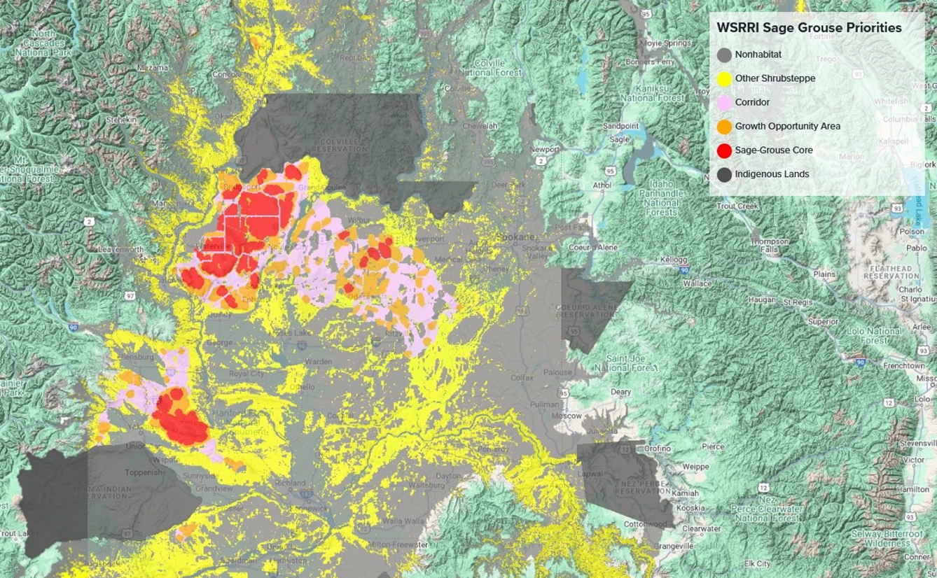
WSRRI Sage Grouse Priorities (2024) analysis and mapping (basis for current Priority Areas update):
Notes:
(WSRRI): Sage-grouse Core Areas may not be occupied now, but they contain abundant Sage-grouse habitat and correspond to the recent range of species. Sage-grouse Growth Opportunity Areas have less habitat and/or lower quality habitat and are therefore less likely to be occupied. However, many have seen occasional use and with additional restoration may help expand the occupied range.
We have two goals in using the WSRRI sage grouse priorities mapping to update our SGI Priority Areas: 1) to utilize this newer data and analysis (before/after the major central WA wildfires of 2020, and reflective of their impacts and ongoing challenges to sagebrush and sage-grouse conservation) to realign our Priority Areas on the basis of current sage-grouse habitat conditions and influences; and 2) to refresh and refocus our SGI conservation efforts around the areas presently or more recently occupied by sage-grouse, and ensure through updated mapping and ranking that our conservation resources prioritize these areas over historic areas long disused and converted from sage-grouse habitat.

Slide 23
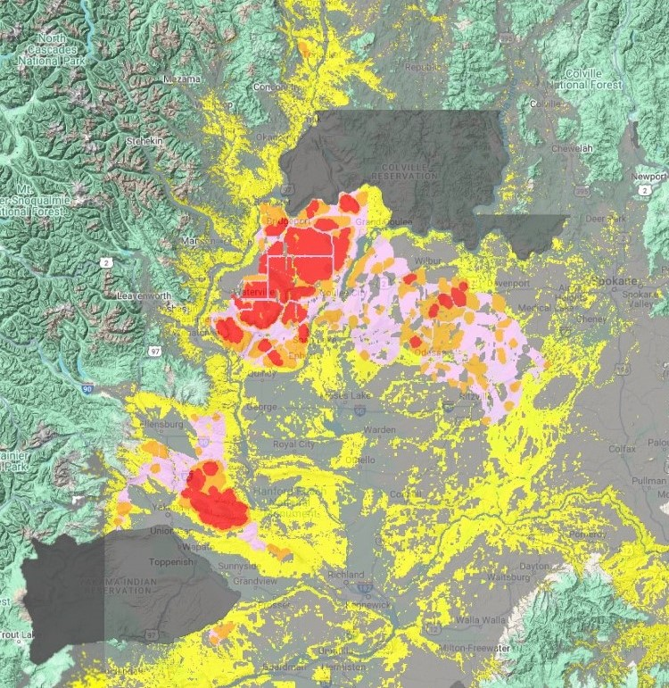
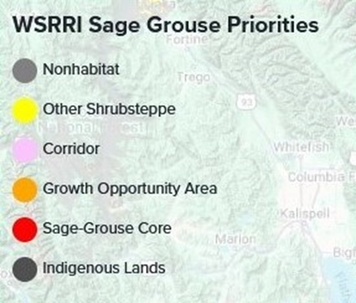
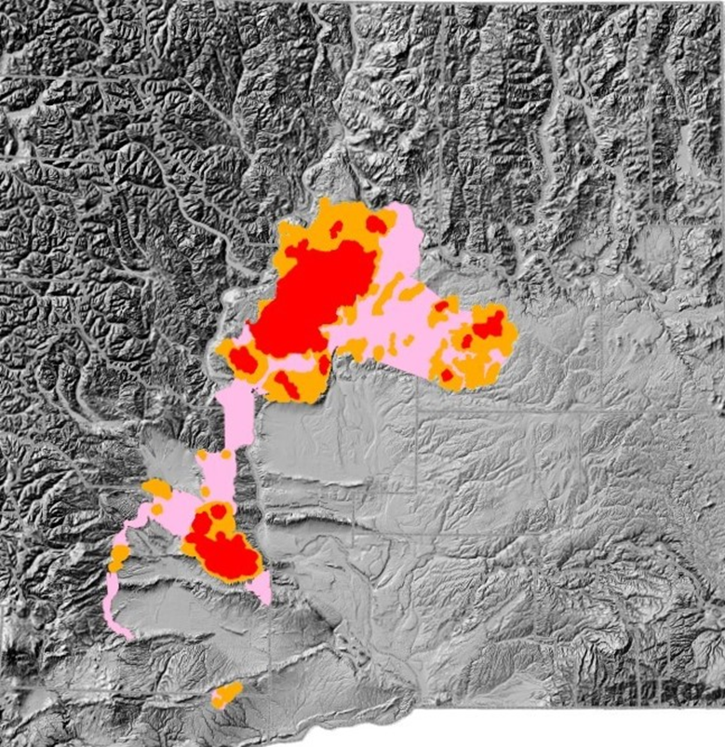
SGI Priority Areas – use of WSRRI Sage Grouse Priorities mapping as basis for current update
Notes:
LEFT: original WSRRI mapping (note that WSRRI’s Sage Grouse Priorities include core, growth-opportunity, and corridor areas, while the “other shrubsteppe” category are those areas not identified to be priorities for sage-grouse conservation). RIGHT: our proposal (aligned to our established three-tier Priority Areas) adjusts the WSRRI mapping by 1) primarily, dropping the fourth “other shrubsteppe” category, except for two small areas closely adjoining or spanning between the two currently-occupied Core areas, supporting potential corridor linkage between them; 2) to a much lesser extent, dropping a few distal and isolated areas of growth opportunity and corridor habitat that are further from the occupied sage-grouse core areas; and 3) “smoothing” or generalizing some small/narrow areas of lower-quality habitat into the surrounding higher-quality habitat areas (e.g., the linear traces of corridor habitat bisecting the extensive blocks of sage-grouse core areas in Douglas County).

Slide 24
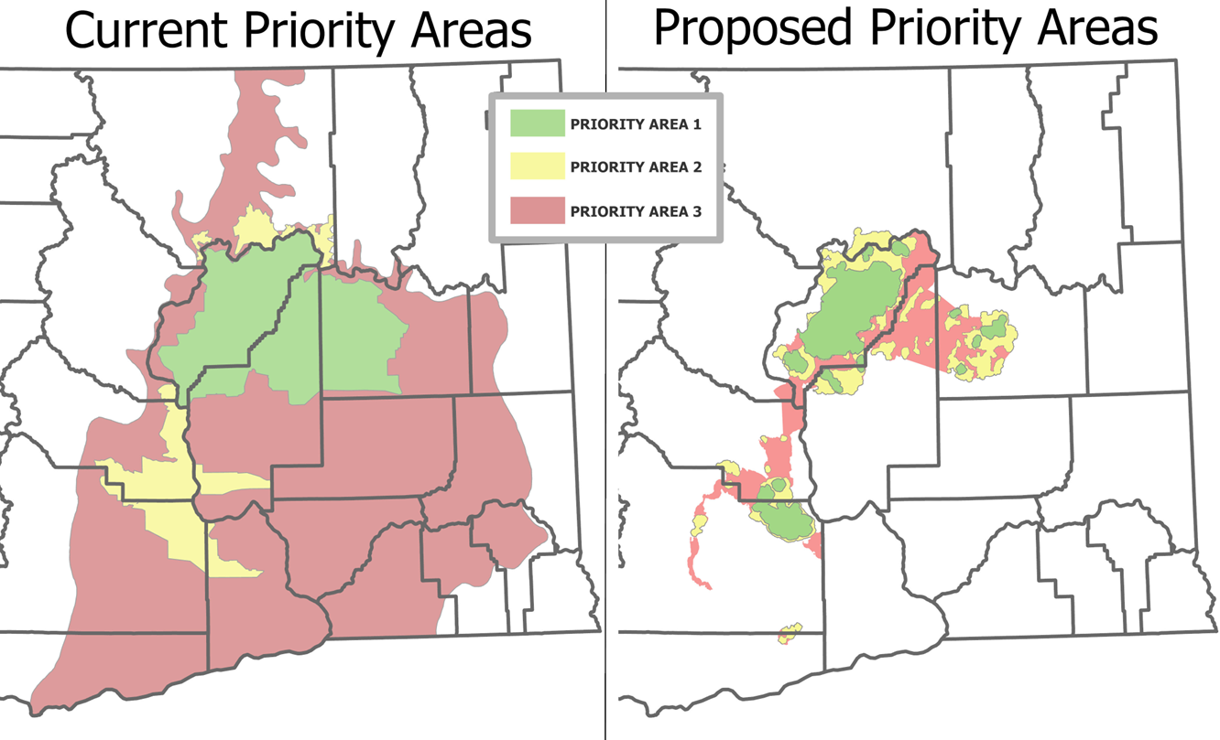
SGI Priority Areas – comparison of existing and proposed (WSRRI-based) Priority Areas:
Notes:
LEFT: The existing Priority Areas, last updated in 2021. RIGHT: Our proposed update, based on 2024 WSRRI Sage Grouse Priorities mapping. Note: these are the same areas (polygons) as prior slide, here colors have been changed for more direct/intuitive comparison with the existing Areas map. In addition to these updated highest-priority areas, this spring NRCS may consider including additional parts of the historic range (in other shrubsteppe/potential habitat zones) as a fourth, lower-priority area, that could allow broader participation while providing further support for these Priority Areas.
(NOTE that, in addition to refocusing more narrowly around the areas currently and recently occupied by sage-grouse, as already discussed, this updated mapping also elevates the prioritization of conservation efforts in certain areas, such as the core area occupied by the sage-grouse population in the Yakima Training Center area, near Kittitas-Yakima counties boundary.)

Slide 25
Update on recent listing proposals under the Endangered Species Act
Peter McBride, State Wildlife Biologist

Slide 26

Monarch Butterfly – proposed for listing as Threatened
Notes:
In Dec 12, 2024, the USFWS proposed to list the monarch butterfly under the ESA as Threatened rangewide, due primarily to loss and degradation of its habitat, exposure to insecticides, and effects of climate change. At the same time, the Service proposed to designate critical habitat – all in the monarch butterfly’s overwintering range in coastal California.

Slide 27

Monarch Butterfly – Conference Opinion
Notes:
On Dec 12, NRCS and USFWS signed a Conference Opinion, broadly covering implementation of activities under Farm Bill programs when conducted through the NRCS planning process and following conservation standards.

Slide 28

Monarch Butterfly – comment period open to March 12
Notes:
A 90-day comment period is open through March 12. The Service particularly seek comments concerning threats and conservation actions affecting the species, and whether they should include an exception for the use of pesticides and, if so, what measures are reasonable, feasible, and adequate to reduce or offset pesticide exposure for monarchs.
Information about how to submit comments can be found on regulations.gov by searching for docket number FWS-R3-ES-2024-0137.

Slide 29
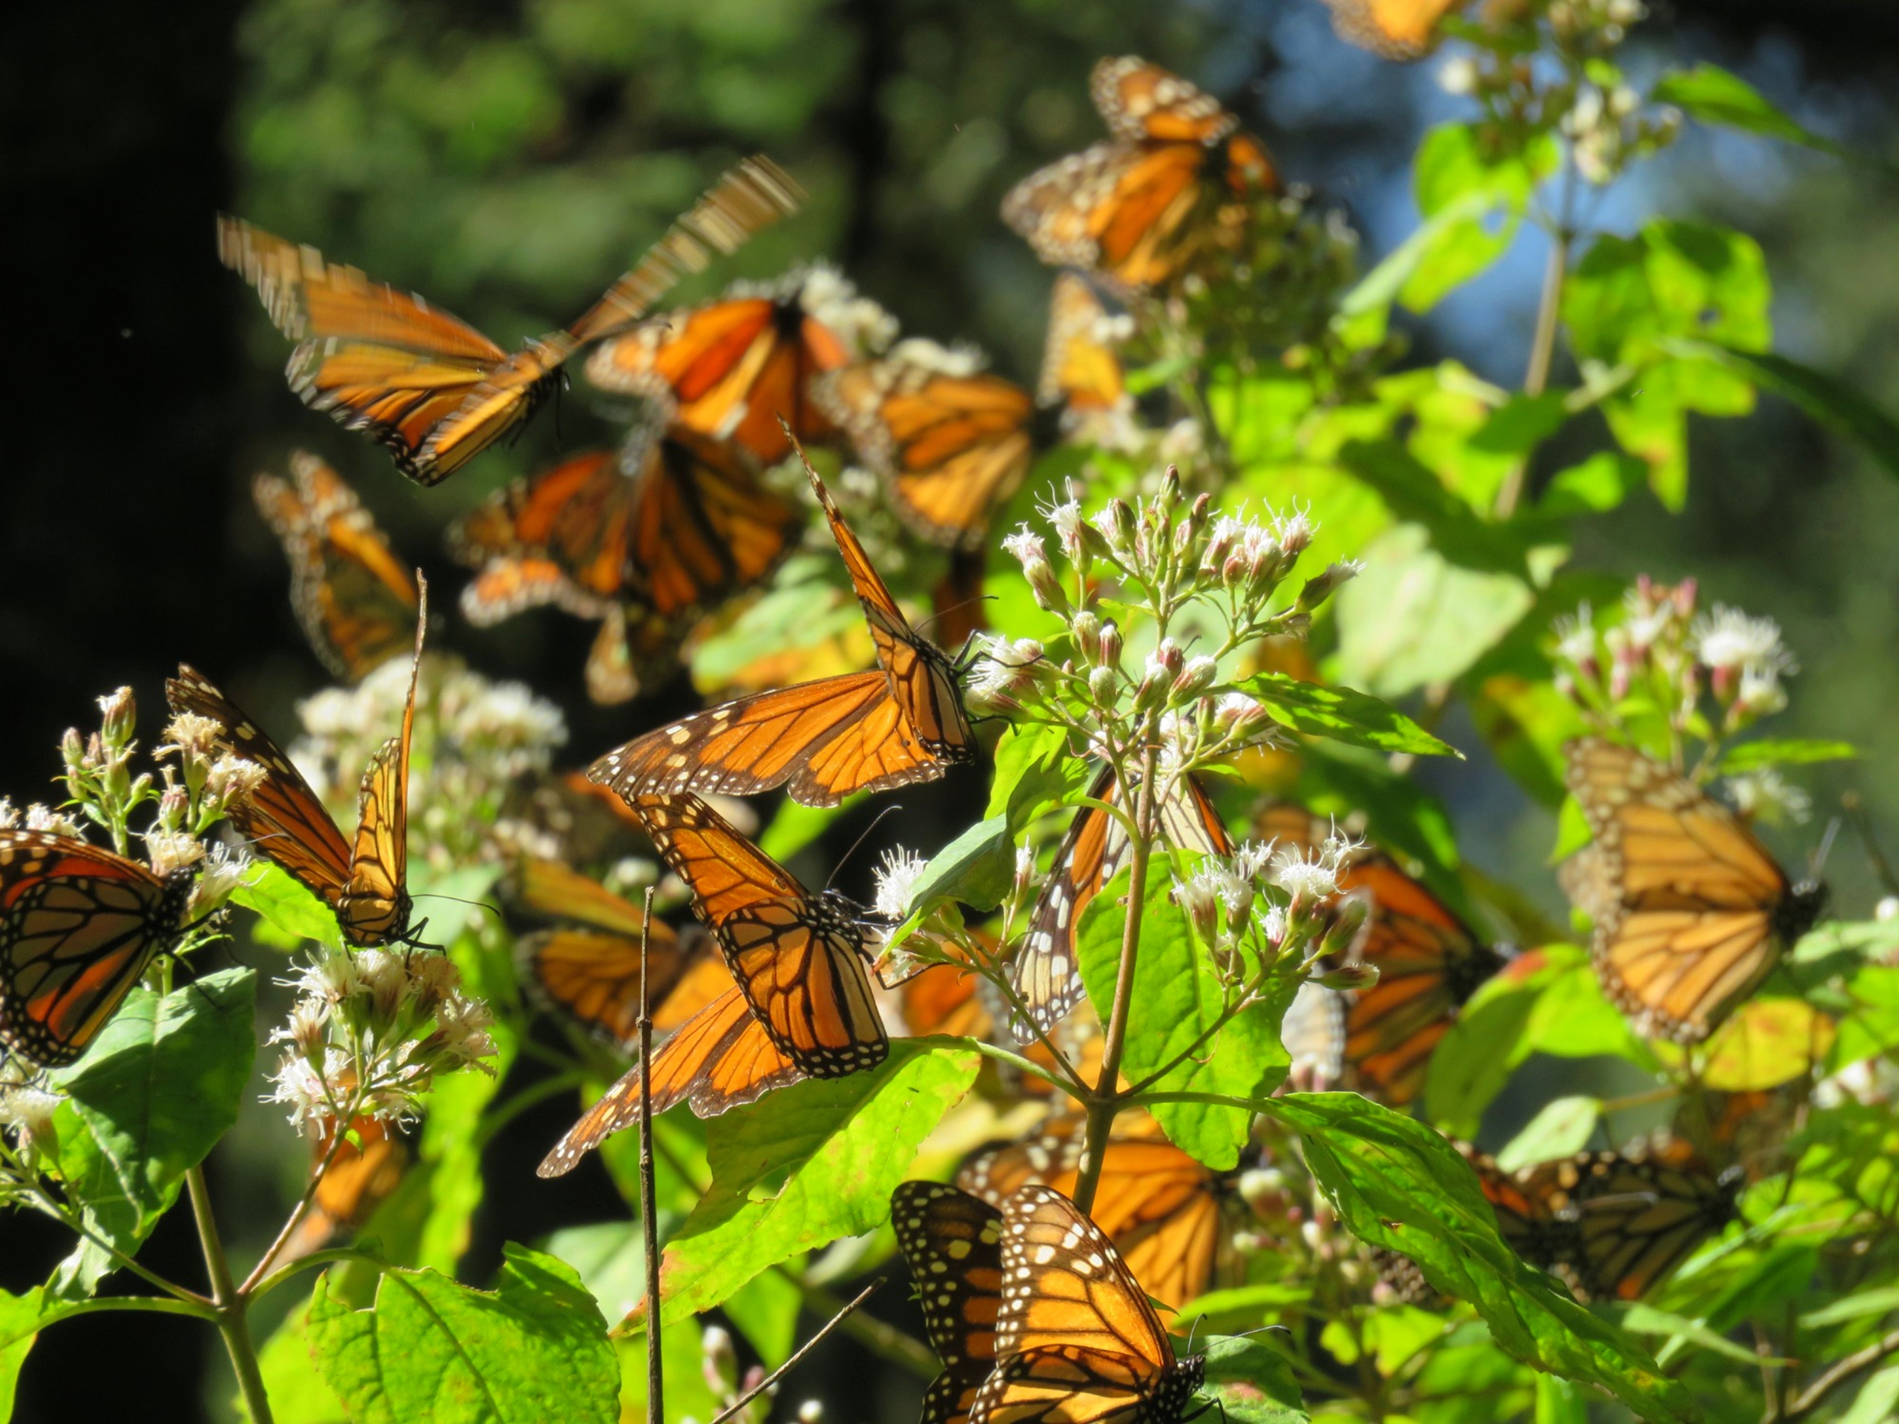
Monarch Butterfly – staff training and resources
Notes:
Xerces Society partner biologists have helped NRCS-WA prepare for monarch conservation work through training and technical guidance.
- Monarch habitat assessment and planning tools (Biology Tech Note 29)
- Over last four years 32 NRCS-WA and conservation district staff fully trained in monarch butterfly habitat evaluation and planning techniques.

Slide 30
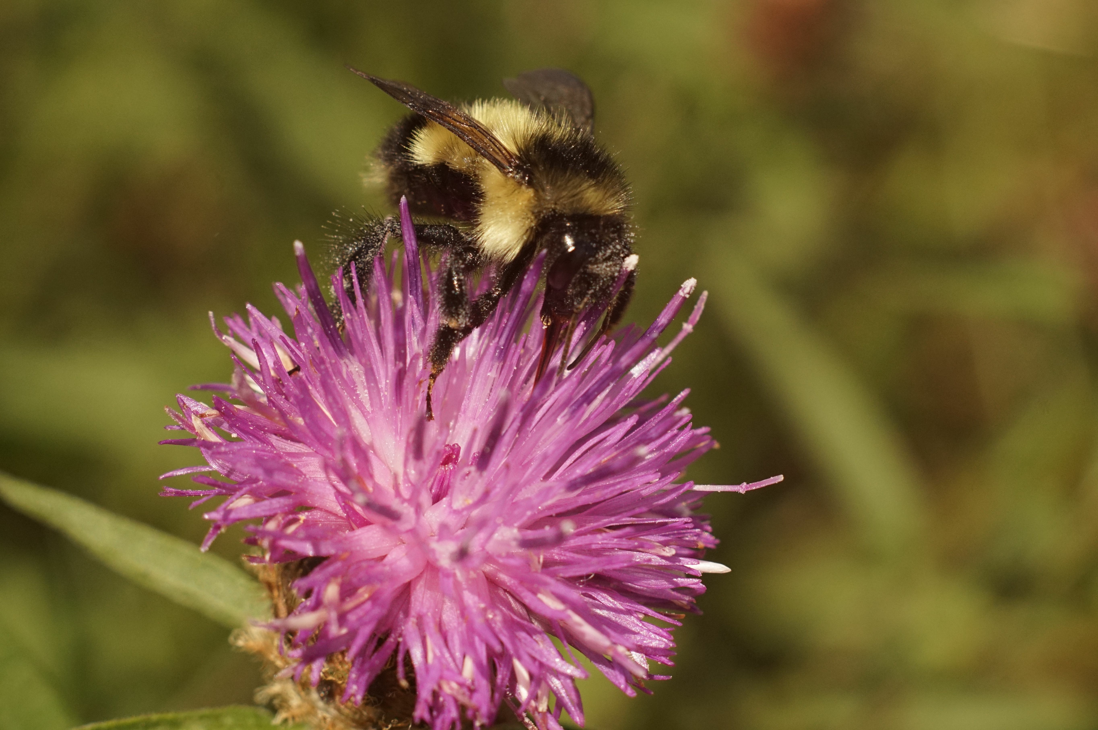
Suckley’s Cuckoo Bumble Bee – proposed for listing as Endangered
Notes:
On Dec 16 2024, the USFWS proposed to list the Suckley’s Cuckoo Bumble Bee as Endangered, due to habitat loss, pesticides, and climate change, but also due to ongoing declines of the host bumble bees upon which it depends.

Slide 31
Suckley’s Cuckoo Bumble Bee – comments until Feb 18
Notes:
On Dec 16 2024, the USFWS proposed to list the Suckley’s Cuckoo Bumble Bee as Endangered, due to habitat loss, pesticides, and climate change, but also due to ongoing declines of the host bumble bees upon which it depends.

Slide 32
Overview of nonlethal predator control practices
Peter McBride, State Wildlife Biologist

Slide 33
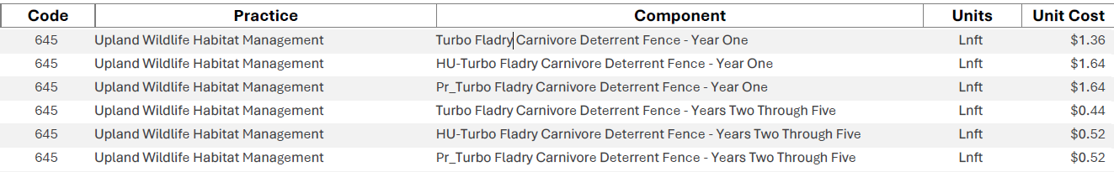
Practices available in Washington:
Turbo-fladry (Upland wildlife habitat mgmt.):
Carcass management (Obstruction removal):
Notes:
Turbo fladry: (new in Fy2025) – under CPS 645, scenario #374 (for year 1, purchase and install); and scenario #375 (for years 2-5, re-install and maintain); prior to contracting all coordination with Fish and Wildlife agencies/APHIS must be completed.
Carcass management, via Obstruction removal (CPS 500) – organic debris pile scenario

Slide 34
Other practices being used or evaluated in other states:
Range-riding (scenarios under 645 in MT)
Electrified mat (scenarios under CPS 649)
Electrified fence (scenarios under CPS 649)
Animal mortality management (Interim CPS 830)
Notes:
We are interested in potentially adopting some other nonlethal predator management tools being tested in projects such as the non-Lethal Conflict Reduction RCPP in five other western States. In Montana a Programmatic Biological Assessment is being developed in support of use of these practices.

Slide 35
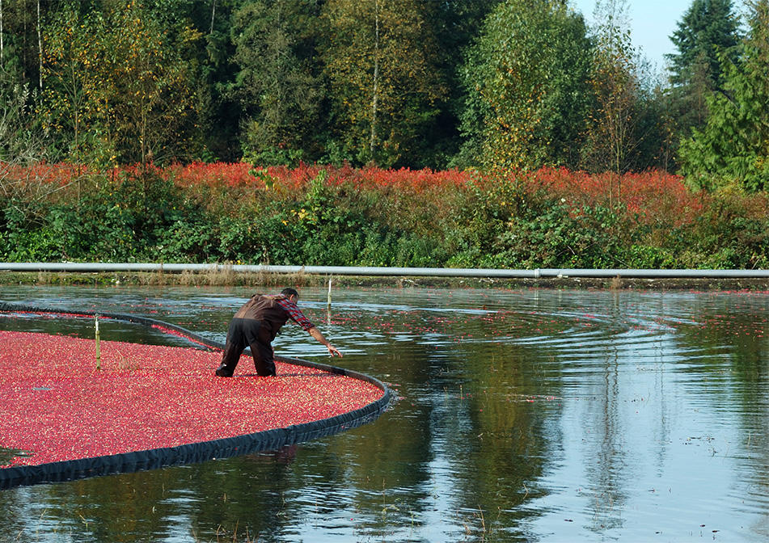


Questions?

