Slide 1
NRCS-WA
Sage Grouse Initiative
Priority Areas
update process

Slide 2
NRCS-WA staff (Sage Grouse Initiative Lead Scott Scroggie, and State Wildlife Biologist Peter McBride) are proposing a change to the current SGI Priority Areas map for FY2026 and beyond, to better align with the most current science as well as our various conservation partners/stakeholders priorities.
In 2010 the threat of the Greater Sage Grouse becoming listed led to a proactive approach to conservation by using a joint USFWS/NRCS conference report as the vehicle for working lands conservation. NRCS received dedicated funding under the Sage Grouse Initiative to plan and implement various conservation practices in a focused geographic region centered around designated core and other priority areas. States were directed to develop eligibility/ranking maps with the help of their respective wildlife agencies with a goal of “defend the core, grow the core” by addressing state-specific threats in a focused manner.

Slide 3
Since 2010 those eligibility Priority Areas maps have been updated on a semi-annual basis based on program/state priorities, as well as the most current relevant data, and we again are in the process of reviewing and proposing an update. The current proposed change is based on the recently-completed (spring 2024) two-year multi-agency effort to re-map sage grouse and sagebrush habitats across the state, reflecting the current status of shrubsteppe and where to focus conservation efforts. (This mapping process was aided by bipartisan infrastructure funding via USFWS and the Washington Shrubsteppe Restoration and Resiliency Initiative (WSRRI), and accompanies WSRRI’s new 30-year conservation strategy.)
We are proposing that NRCS use the WSRRI Spatial Priorities for Sage-grouse mapping to update our Priority Areas map, and are working through the details of what that final product would look like through feedback from the STAC wildlife sub-committee. After finalizing with the help of the subcommittee, we anticipate bringing the proposed SGI Priority Areas map update to the STAC for its support.

Slide 4
Priority Areas, periodic updates:
2012 2013 2015

Slide 5
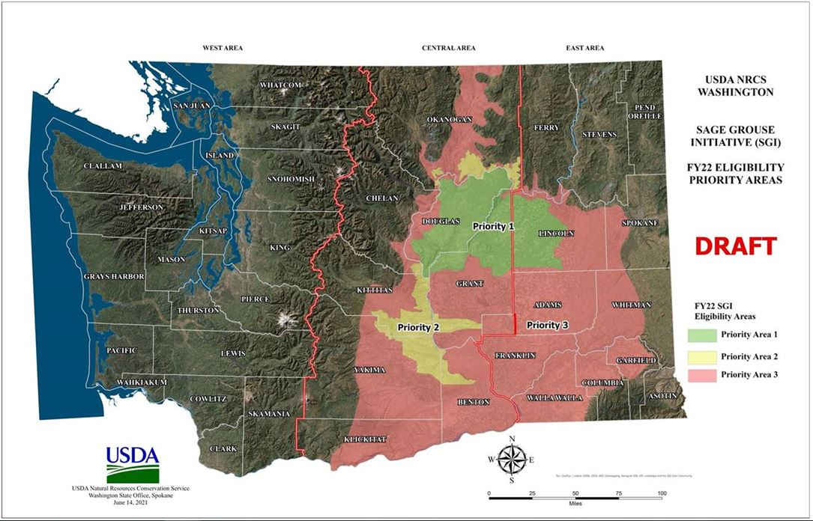
Priority Areas, periodic updates:
2016 2020 2022

Slide 6
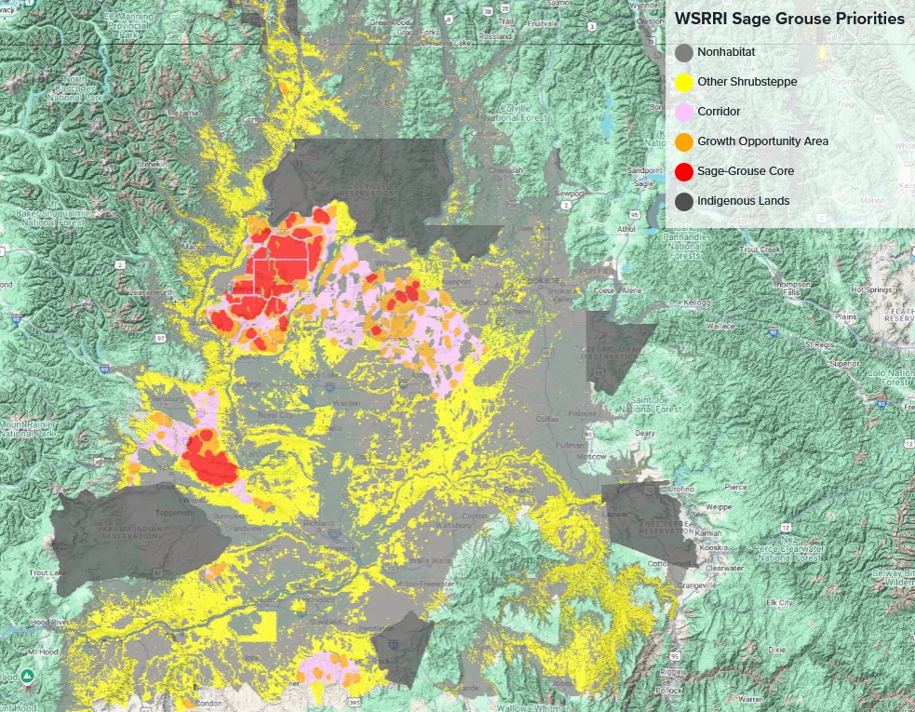
Priority Areas - basis for current update:

