Slide 1
Growing CSP in Washington
Keith Griswold, ASTC-P

Slide 2
Information
Fiscal Years (FY) 19-22, Farm Bill (FB) CSP provided average 38.2 % of NRCS WA mandatory TA funds each year.
For FY’s 25-27 NRCS WA is expected to receive increasing amounts of IRA-CSP FA each year in addition to FB-CSP funds. With each increasing funding year requires additional CSP applications.
Headquarters reviews CART and Protracts to determine the demand for CSP program FA and TA.

Slide 3
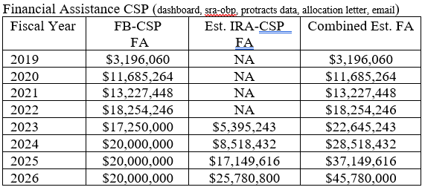
All eligible FY24 CSP applications were funded. There is no backlog of CSP applications for WA starting FY25.
FY25 CSP allocation---$27,484,000

Slide 4
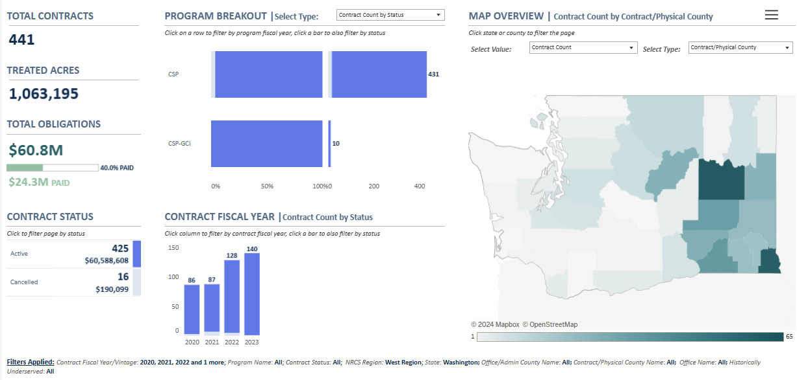
What are the existing CSP trends?
The biggest application and contracting demand is the East Area
441 active CSP contracts statewide FY20-23
318 (72%) of the FY20-23 active CSP contracts are in the East Area in three Teams

Slide 5
West Area Trends

Slide 6
Central Area Trends

Slide 7
East Area Trends

Slide 8
How do we increase our CSP applications in Areas not utilizing CSP?
CSP 101 training new staff less than 2 years of service is needed and should be required attendance.
CSP communications and outreach in TEAMS counties lacking CSP applications from July through October 2023 for FY24 program participation.
NHQ increased the minimum annual payment to $4000/yr
Set a goal for each NRCS team to have at least 15 eligible, assessed, ranked CSP applications per year

Slide 9
QUESTIONS

