Slide 1
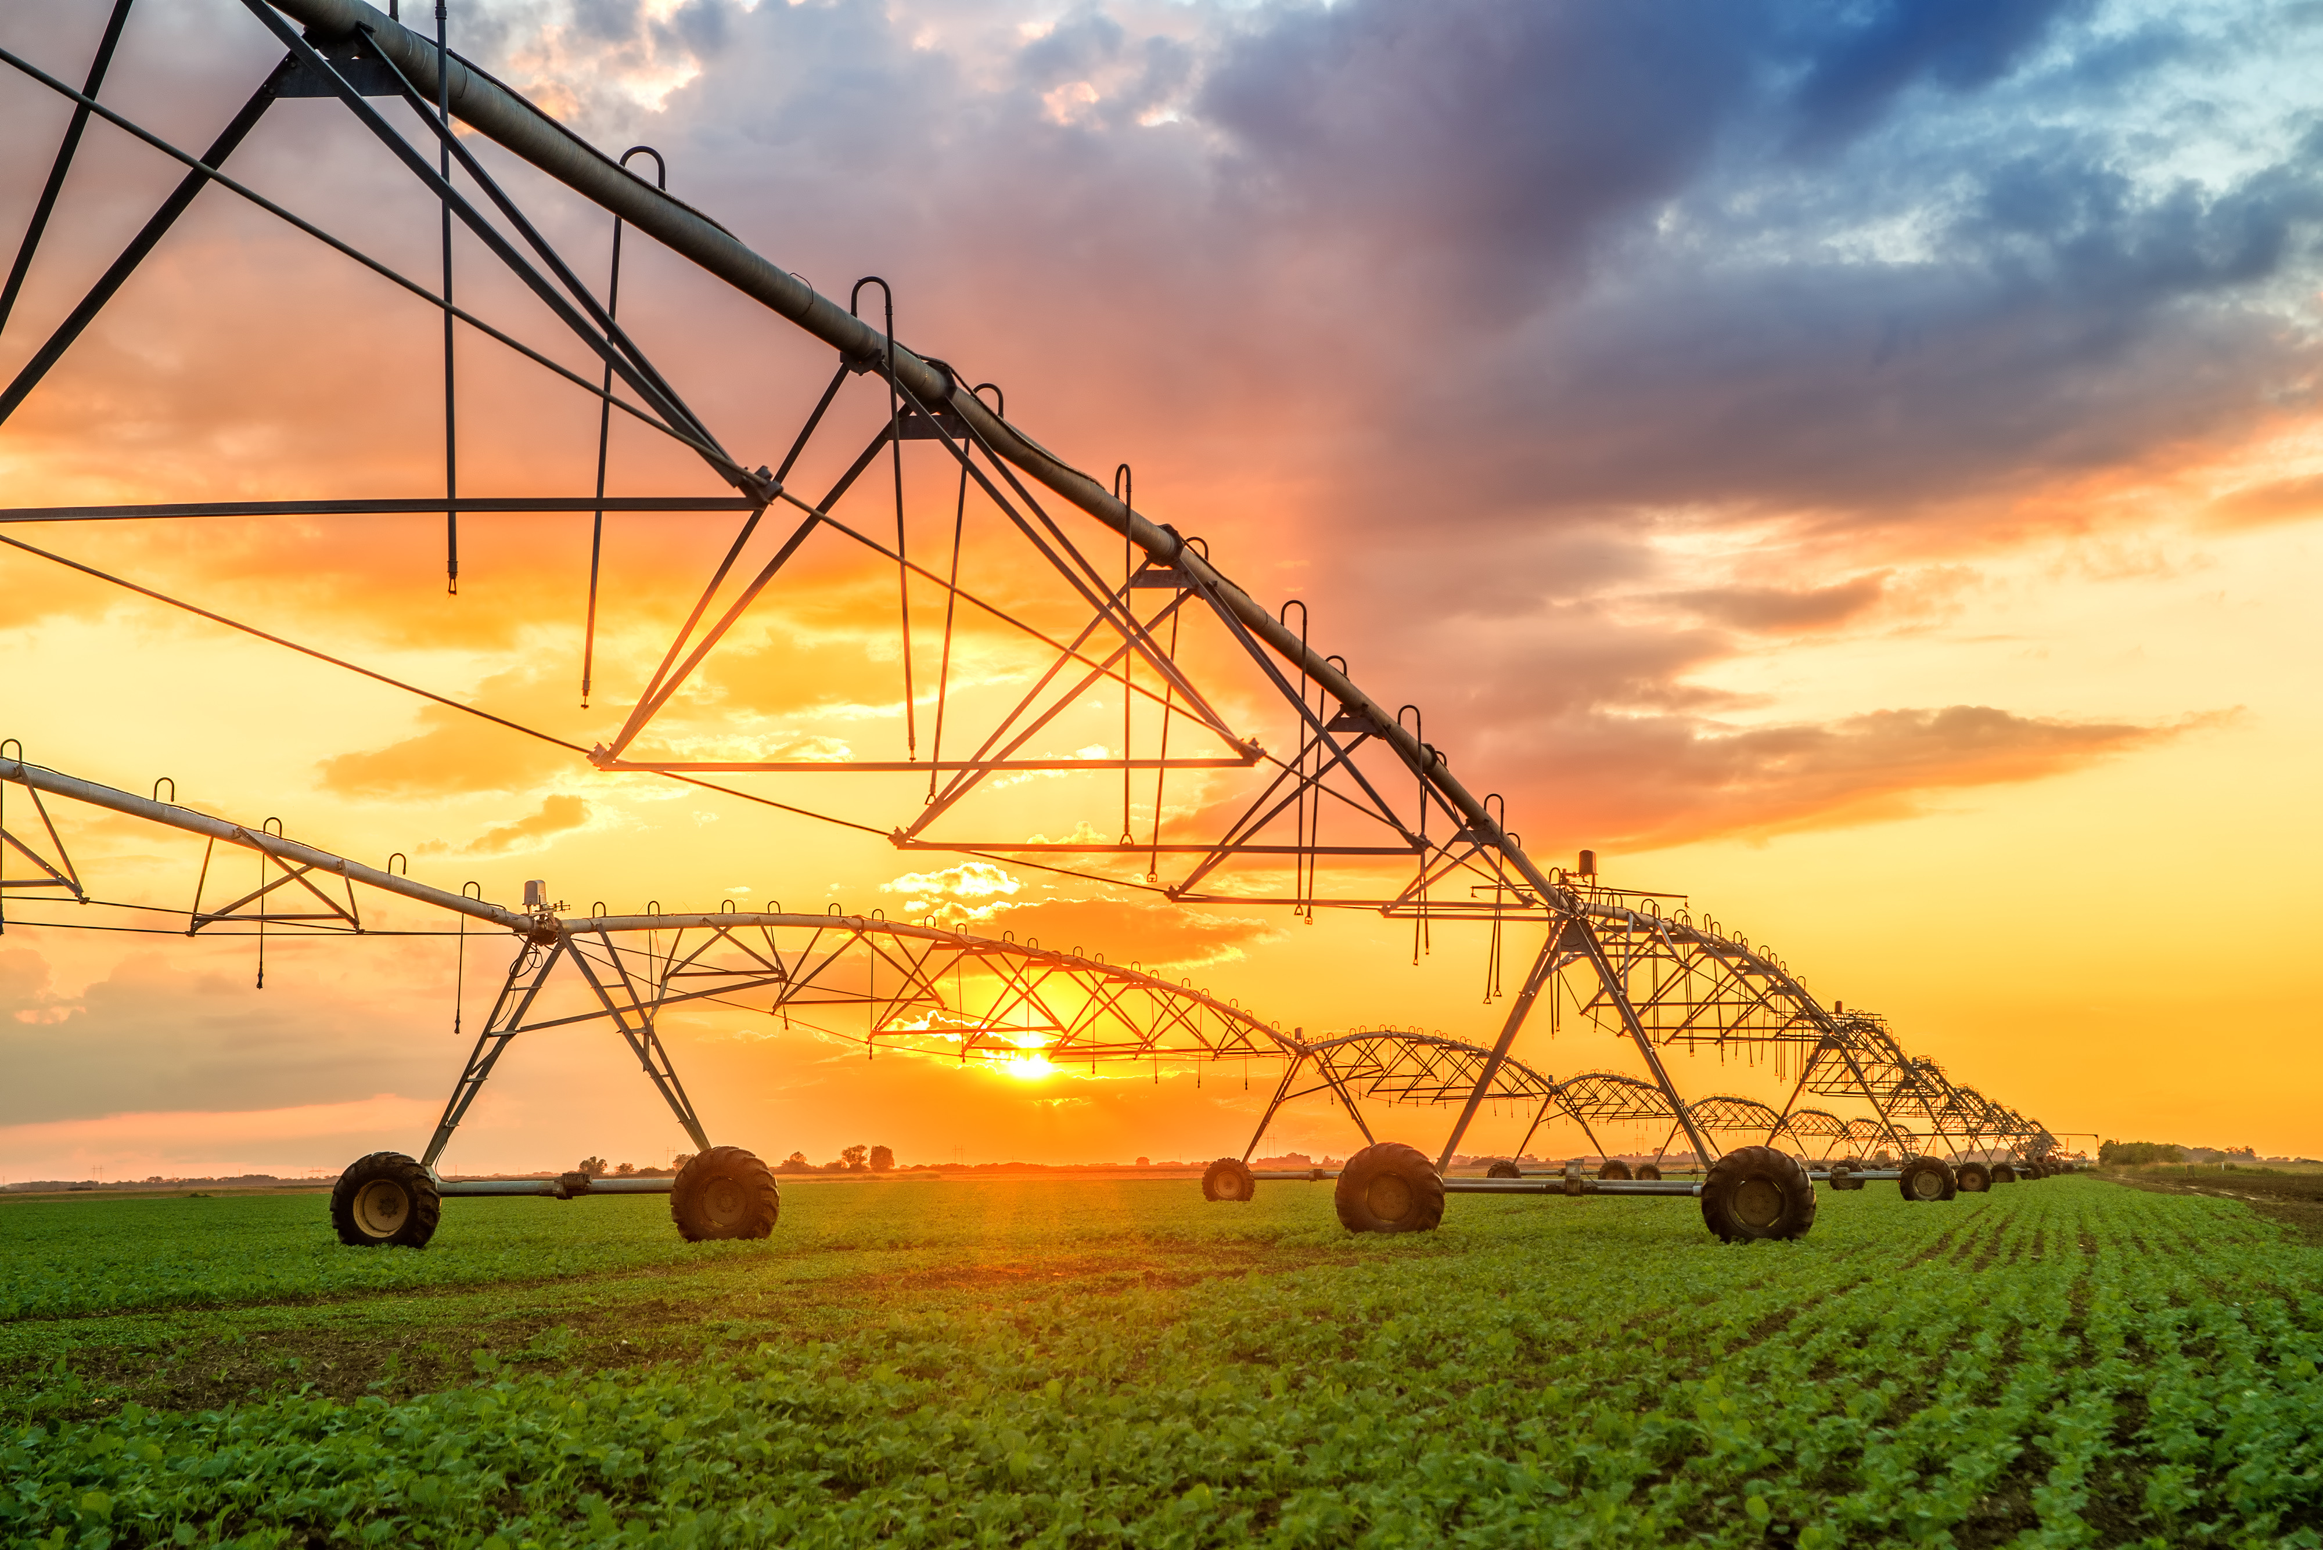
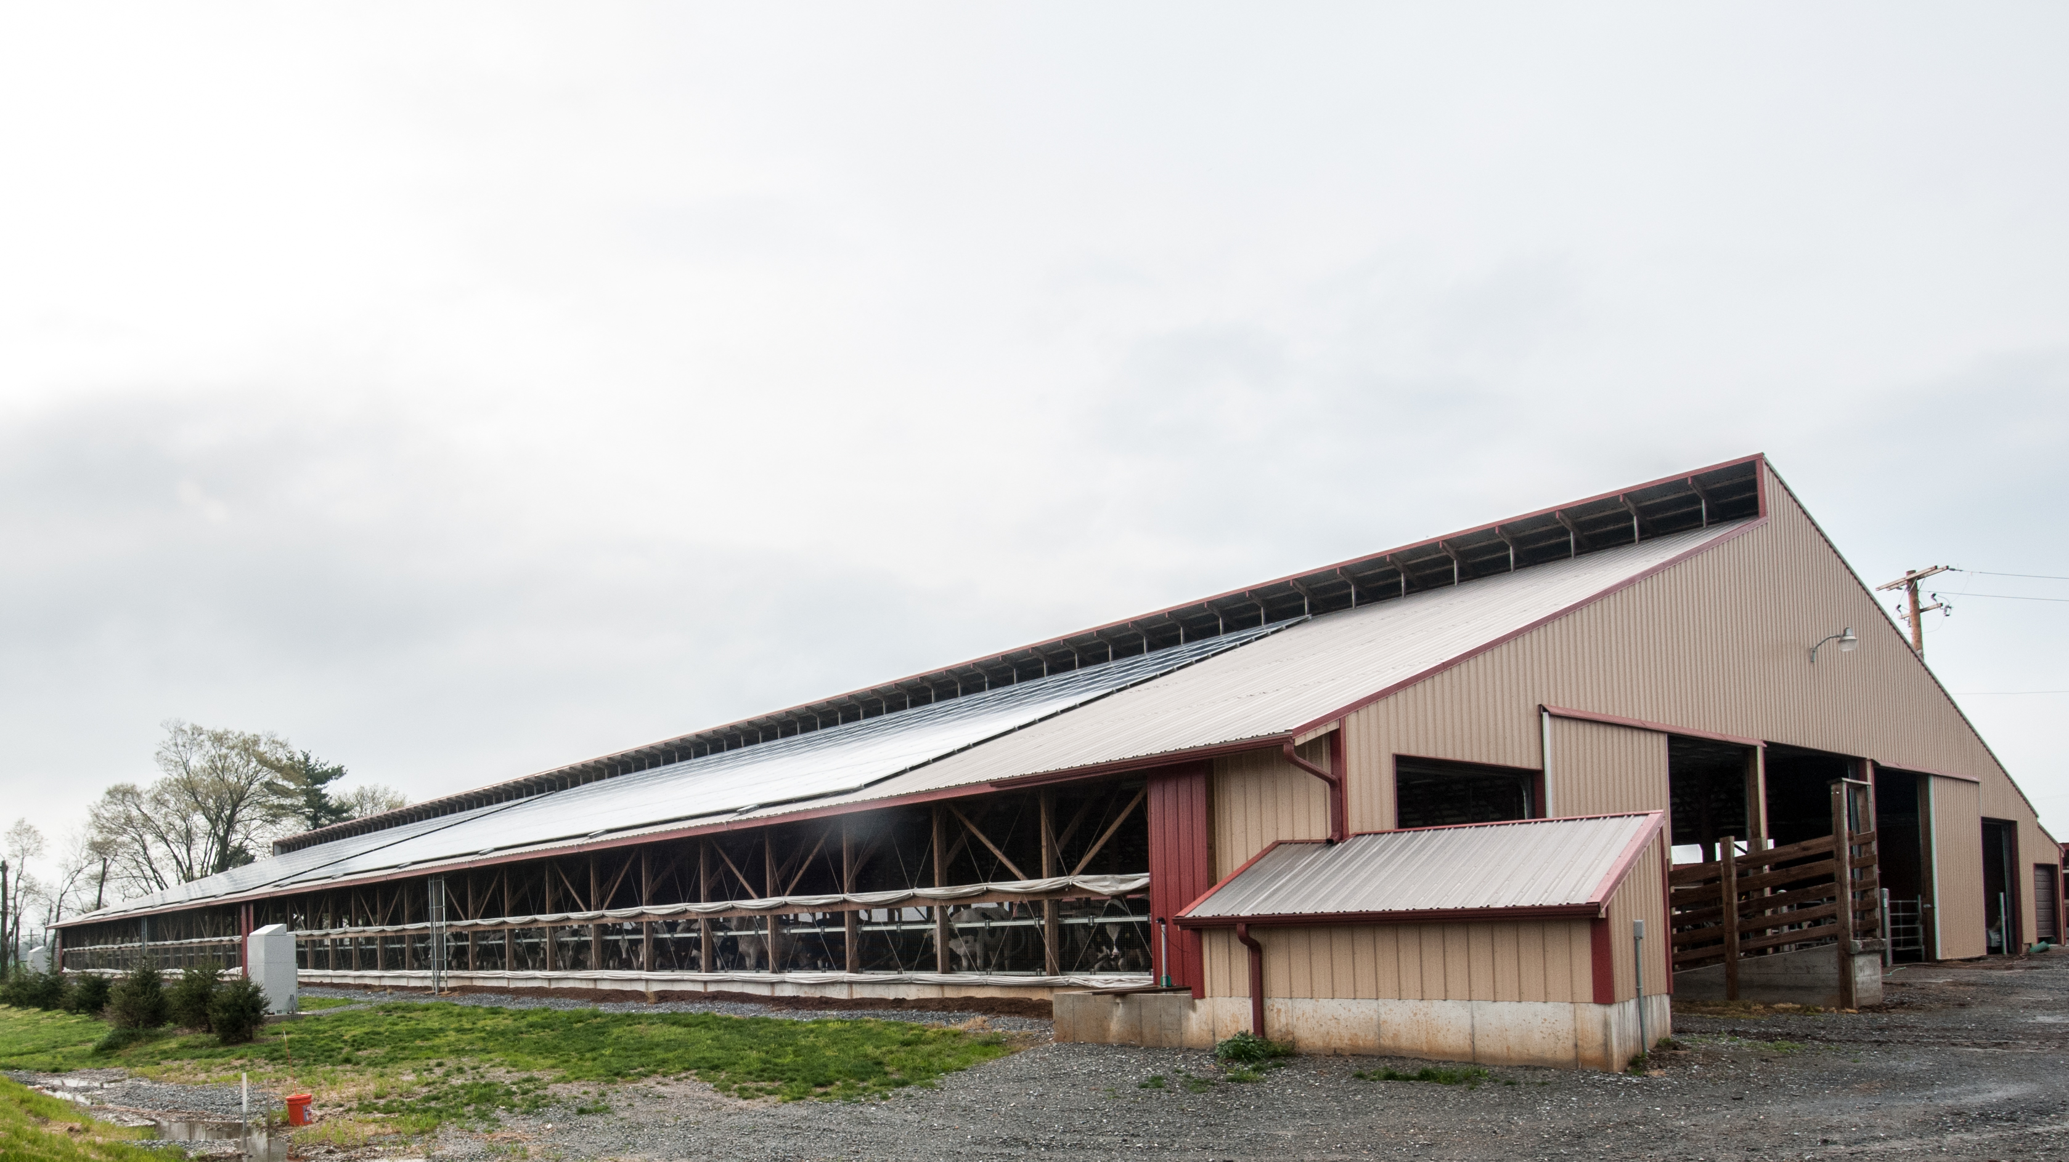

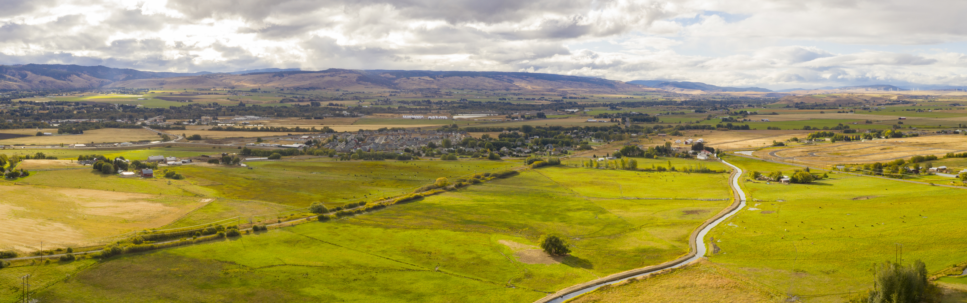
Ecological Sciences Enhancements & Upgrades

Slide 2
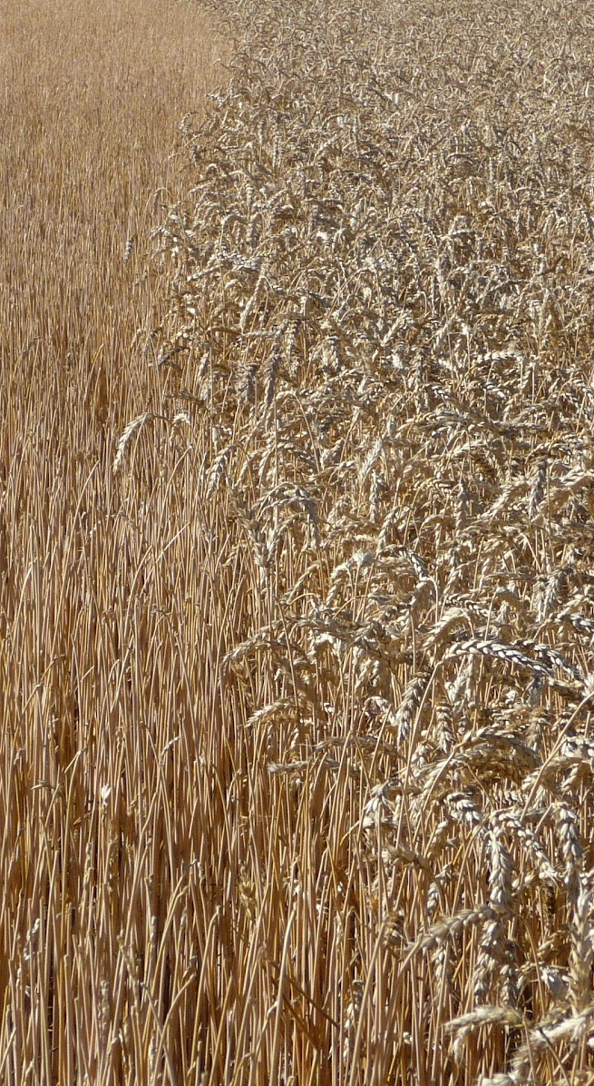
Conservation Practices
New Interim Practice Standard for Conservation Harvest Management; ICPS 809
  Harvest or management techniques that optimize the amount, orientation, and distribution of plant residue left standing or laying on the ground.
  Available for FY 2025 – Working on Implementation Req.
Payment Scenarios for ICSP 809
  Maximize residue height for snow capture
  Post-harvest woody residue retention
Notes:
Picture on slide shows wheat harvested with a stripper headers, only removing the wheat head, leaving residue as tall as possible. Taller residue will help retain snow and moisture over winter. It helps push wind energy above soil surface greatly reducing evaporation.
Great practice, use to have purpose for increased stubble height in our residue mgt practice, which was removed at some point and time. This is a fantastic substitute.

Slide 3
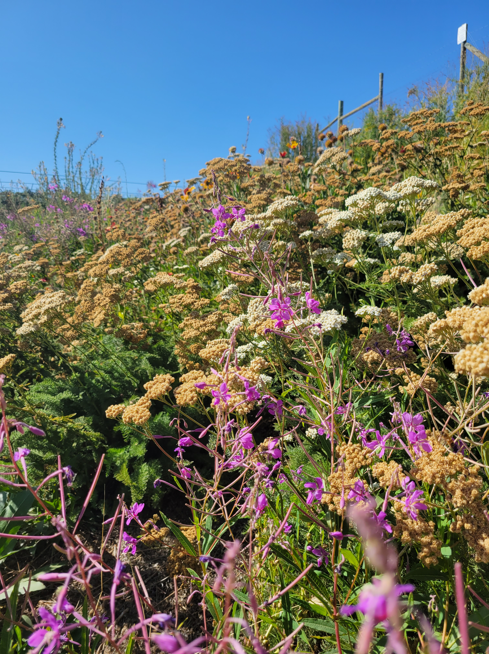
Conservation Practices
New Interim Practice Standard for Wildlife Habitat Site Preparation ICPS 828, coming soon (FY26).
  Provides means to achieve adequate site preparation to successfully establish perennial wildlife habitat plantings.
    Allows for multiple treatments, or more than one treatment method when needed.
    Enables treatment of sites where weed and invasive plant pressure is medium to high.
    Development of IR and payment scenarios coming soon.
    No available scenarios Q4 FY24 to bring into Q1 FY25
      Only 1 EQIP sign up planned per Programs
Notes:
Picture on slide shows wheat harvested with a stripper headers, only removing the wheat head, leaving residue as tall as possible. Taller residue will help retain snow and moisture over winter. It helps push wind energy above soil surface greatly reducing evaporation.
Great practice, use to have purpose for increased stubble height in our residue mgt practice, which was removed at some point and time. This is a fantastic substitute.

Slide 4
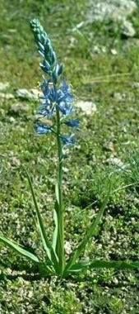
Conservation Practices
New Interim Practice Standard for Cultural Plantings for Soil Health, ICPS 825,
Available for FY25 – Working on Implementation Req.
Grow two or more culturally significant plants together, can plant into existing stand to constitute one of the two species.
All land uses
6 Available Scenarios:
Broadcast Herbaceous Plants into Stand of Woody Vegetation
Diversify Mixed Herbaceous and Woody Vegetation
Diversify Woody Vegetation
Establish Herbaceous Plants, Hand Planting with Harvest
Hand Seed Herbaceous Plants into Stand of Woody Vegetation
Overseed Annual Plants into Existing Herbaceous Perennial Vegetation
Notes:
Picture on slide shows wheat harvested with a stripper headers, only removing the wheat head, leaving residue as tall as possible. Taller residue will help retain snow and moisture over winter. It helps push wind energy above soil surface greatly reducing evaporation.
Great practice, use to have purpose for increased stubble height in our residue mgt practice, which was removed at some point and time. This is a fantastic substitute.

Slide 5
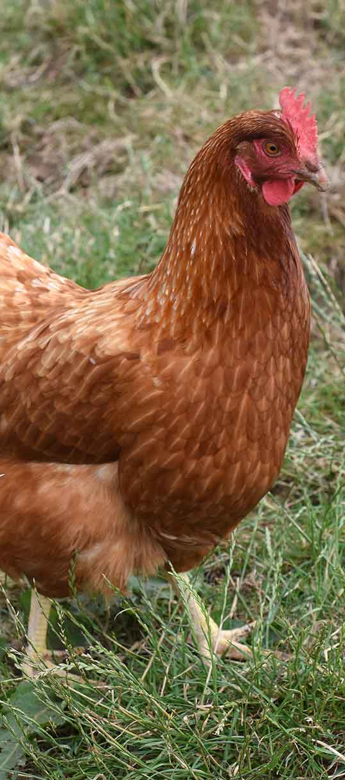
Conservation Practices
New Interim Practice Standard for Nonruminant Livestock Outdoor Management of Vegetative Cover, ICPS 822
Available for FY25 – Working on Implementation Requirement
Manage soil and vegetation with nonruminant livestock by managing livestock numbers, periods of use.
1 available scenario:
  Nonruminant Livestock Outdoor Management of Vegetative Cover
Notes:
Picture on slide shows wheat harvested with a stripper headers, only removing the wheat head, leaving residue as tall as possible. Taller residue will help retain snow and moisture over winter. It helps push wind energy above soil surface greatly reducing evaporation.
Great practice, use to have purpose for increased stubble height in our residue mgt practice, which was removed at some point and time. This is a fantastic substitute.

Slide 6
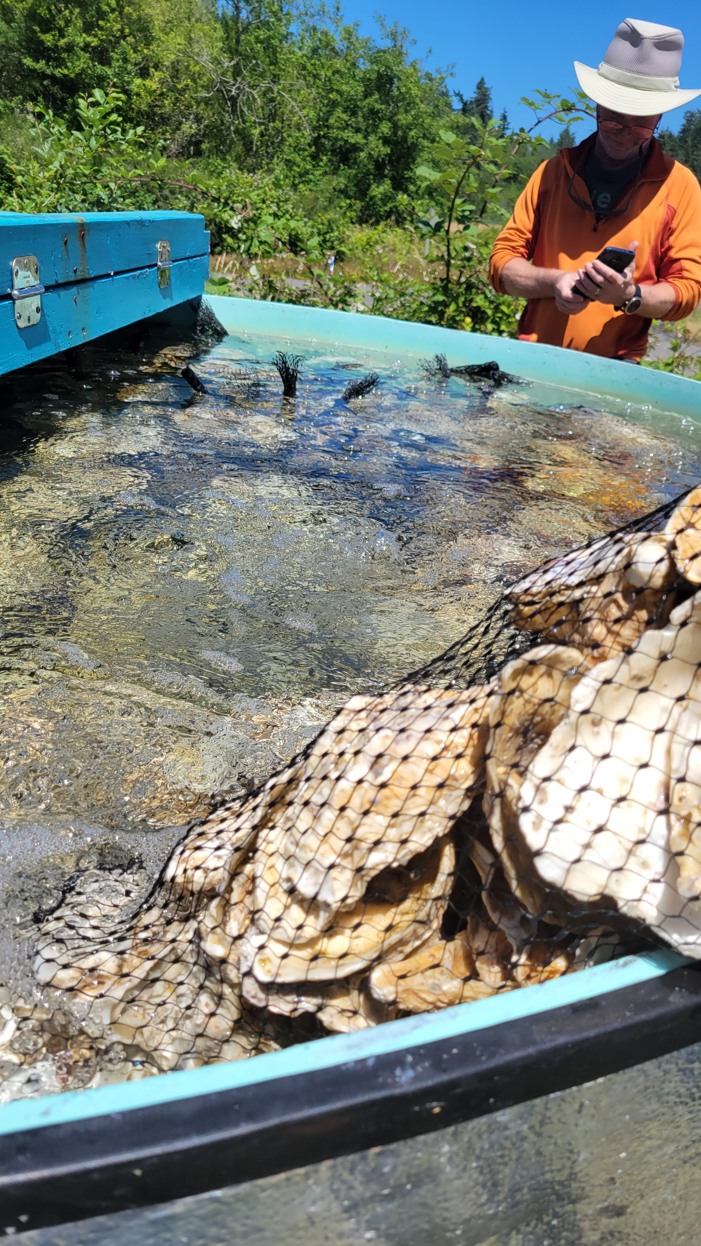
Conservation Practices
New payment scenarios available for Aquaculture
  PS 398 – Fish Raceway or Tank
    New to WA – #10 Single Raceway and #11 Parallel Raceway
    Rachel Maggi exploring opportunities to engage with Tribal Aquaculture in FY25 to prepare for future
  PS 400 – Bivalve Aquaculture Gear & Biofouling Control
    10 new National scenarios added to Pacific Region
    Still unclear if these are suitable for use in WA – more information coming this spring
Notes:
Picture on slide shows wheat harvested with a stripper headers, only removing the wheat head, leaving residue as tall as possible. Taller residue will help retain snow and moisture over winter. It helps push wind energy above soil surface greatly reducing evaporation.
Great practice, use to have purpose for increased stubble height in our residue mgt practice, which was removed at some point and time. This is a fantastic substitute.

Slide 7
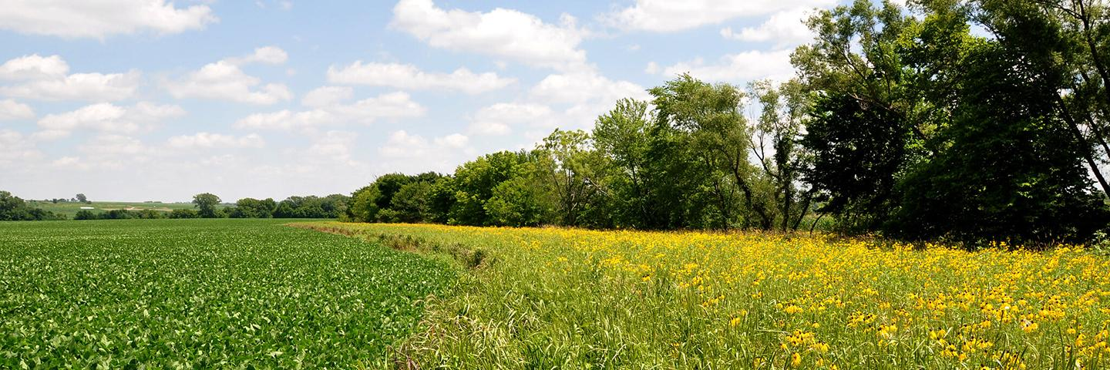
Conservation Stewardship Enhancement for Conservation Cover
E327C: Wildlife habitat for nesting and brooding on non-cropped areas.
  Grass and legumes provide refuge areas for nesting, brood rearing and winter survival of wildlife on non-cropped areas.
  Applicable to Associated Ag Ground and Farmsteads.
Notes:
Beneficial to CSP participants, as we have very few practices and or enhancements that are applicable to farmstead and associated ag land. Specifically, farmstead land use.

Slide 8
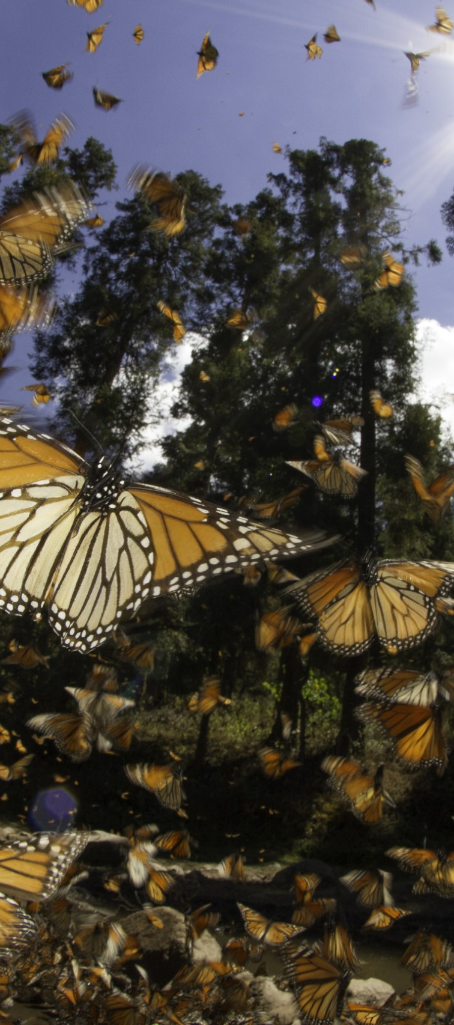
EcoSci Tools
Monarch butterfly WHEG (Bio TN 29) – new version, for eastern Oregon and Washington.

Slide 9
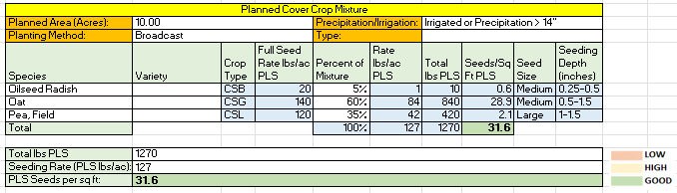
EcoSci Tools
Cover Crop Tool
  Tool to build out multispecies cover crop mixes
  Large-scale and small-scale
  For use in all counties
  To be released winter 2025

Slide 10
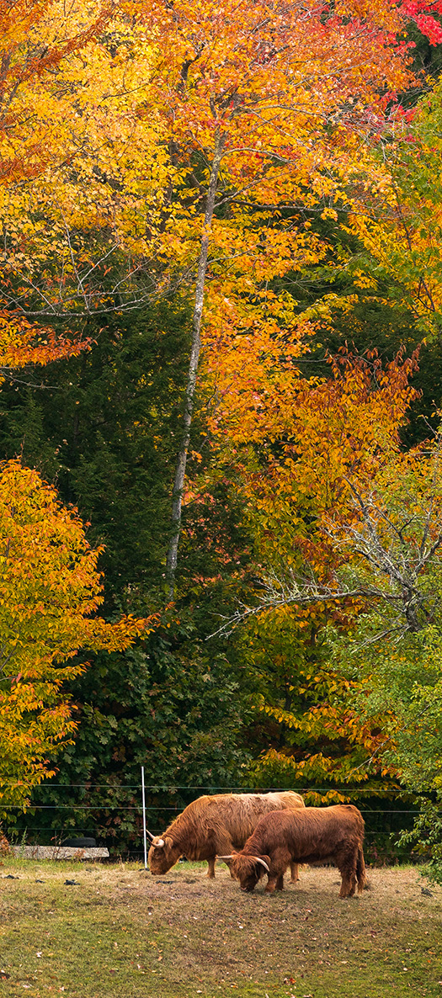
New Range/Grazing Payment Scenarios
New Virtual Fence (382) Scenarios
  First Year Virtual Fence Startup Scenarios .
    Small Herd VF Startup Grazing Management, Year 1, Sheep or Goats
    Small Herd VF Startup Grazing Management, Year 1, Cattle
      Operations with < 400 acres.
    Medium Herd VF Startup Grazing Management, Year 1, Cattle
      Operations with ≤ 150 head and > 400 acres
    Large Herd VF Startup Grazing Management, Year 1, Cattle
      Operations with ≥ 150 head and > 400 acres
  Prescribed Grazing (528) Scenario
    Virtual Fence Adaptive Management Years 2-5

Slide 11
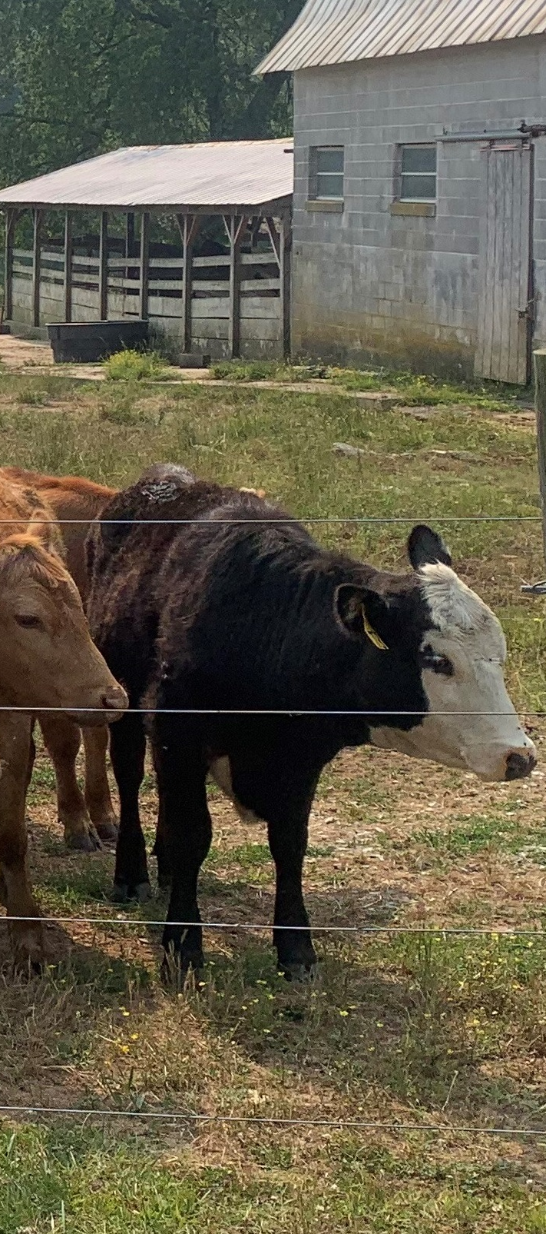
New/Updated Range Documents
Range/Grazing documents to be pending in FOTG
  382_WA_IR_Fence-Elec_2024.pdf
  382_WA_IR_Fence-Barbed_Smooth_2024.pdf
  382_WA_PS_Fence_Barbed_Smooth_2024.pdf
  382_WA_PS_Fence_Electric_2024.pdf
  382_WA_IR_Fence-Elec_Temp_2024.pdf
  382_WA_IR_Fence-Virtual_2024.pdf
  550_WA_IR_Range_Planting_2024

Slide 12
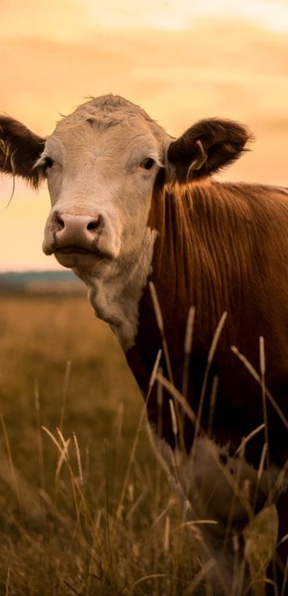
Range Riding*
“Range Riding” as herding livestock for the sole purpose of predator deconfliction it is only allowed in the 5 State RCPP area, under CPS 645. Washington is not part of the 5 state RCPP project area.
“Range Riding” as herding livestock to meet management objective under CPS 528 and employing a contingency plan to avoid predators while following a flexible management strategy (i.e. adaptive management) under 528, it is allowed using the existing scenarios under CPS 528
* Thomas Hilken, Range National Discipline Lead

Slide 13
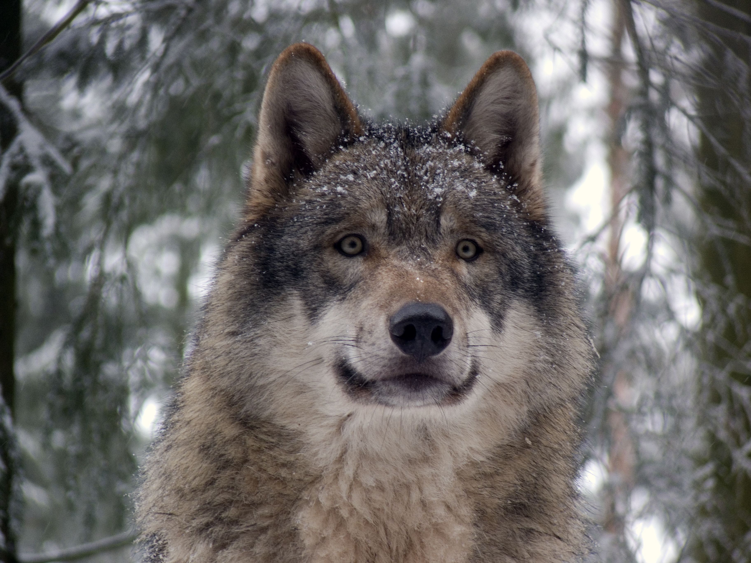
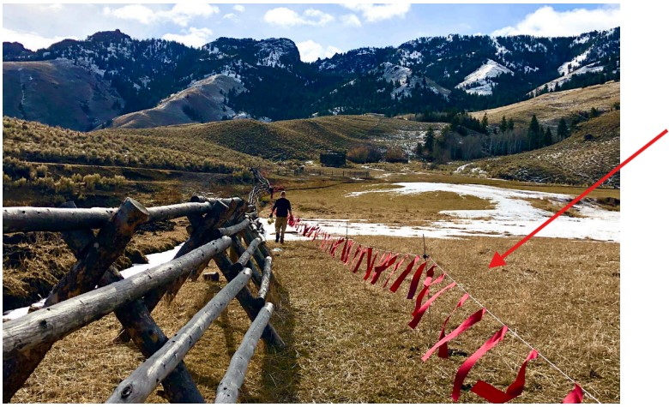
645 Turbo Fladry
New scenarios available in Pacific Region and WA
  #374 Turbo Fladry Carnivore Deterrent Fence – Year One
  #375 Turbo Fladry Carnivore Deterrent Fence – Years Two - Five
  Turbo fladry is a fencing tool designed to protect livestock from wolves.
  More guidance coming in next few months.
  ESA Consultation will be required where wolves are Federally listed. Looking at options that avoid single project consultations.
ThePhoto by PhotoAuthor is licensed under CCYYSA.

Slide 14
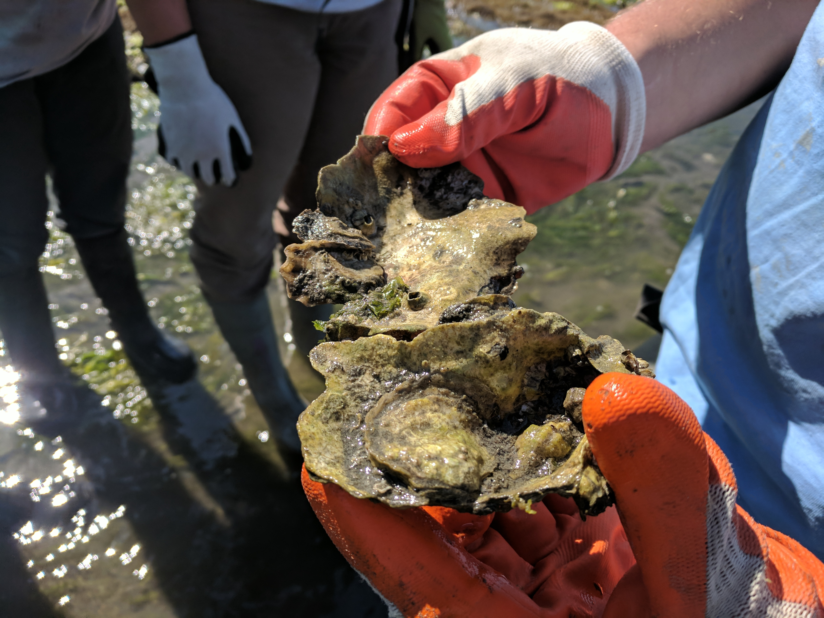
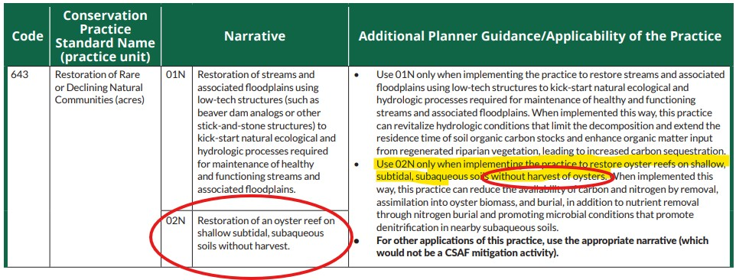
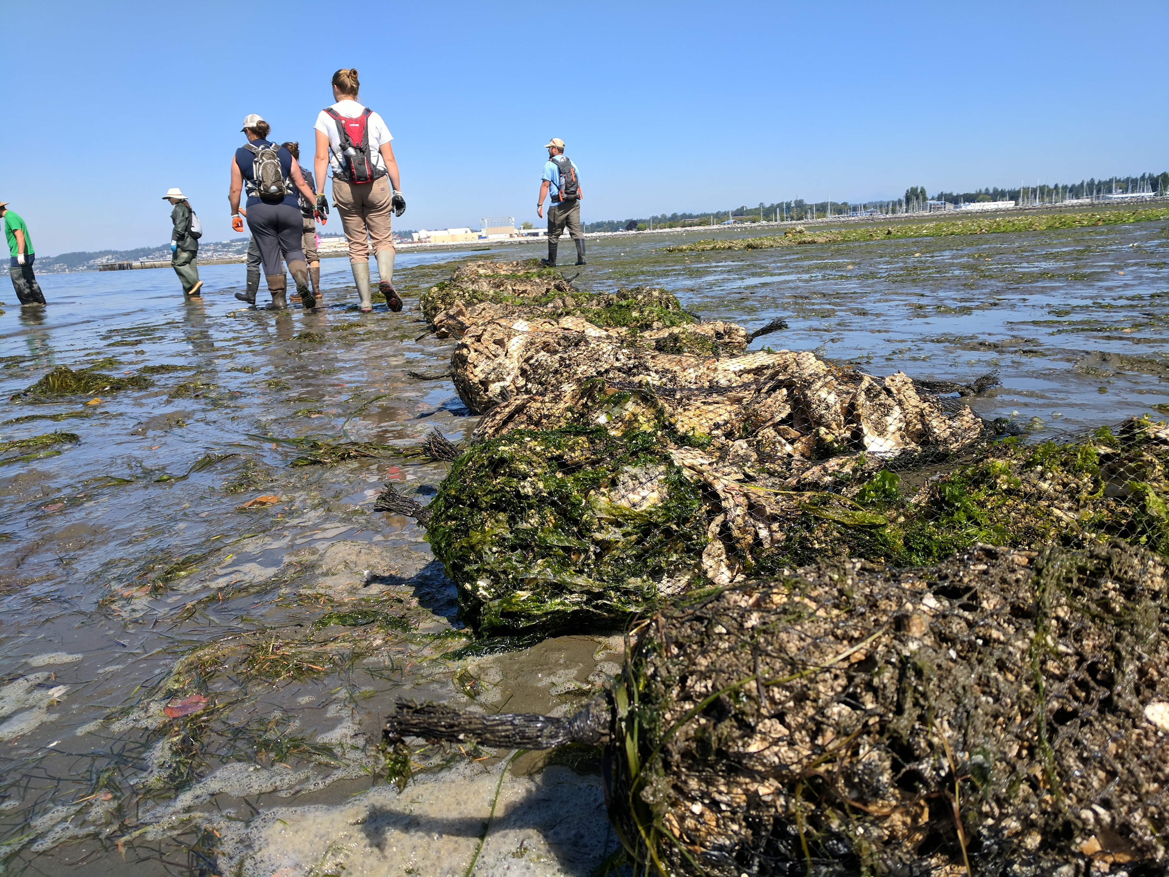
CSAF – NEW! 643 Oyster Reef

Slide 15
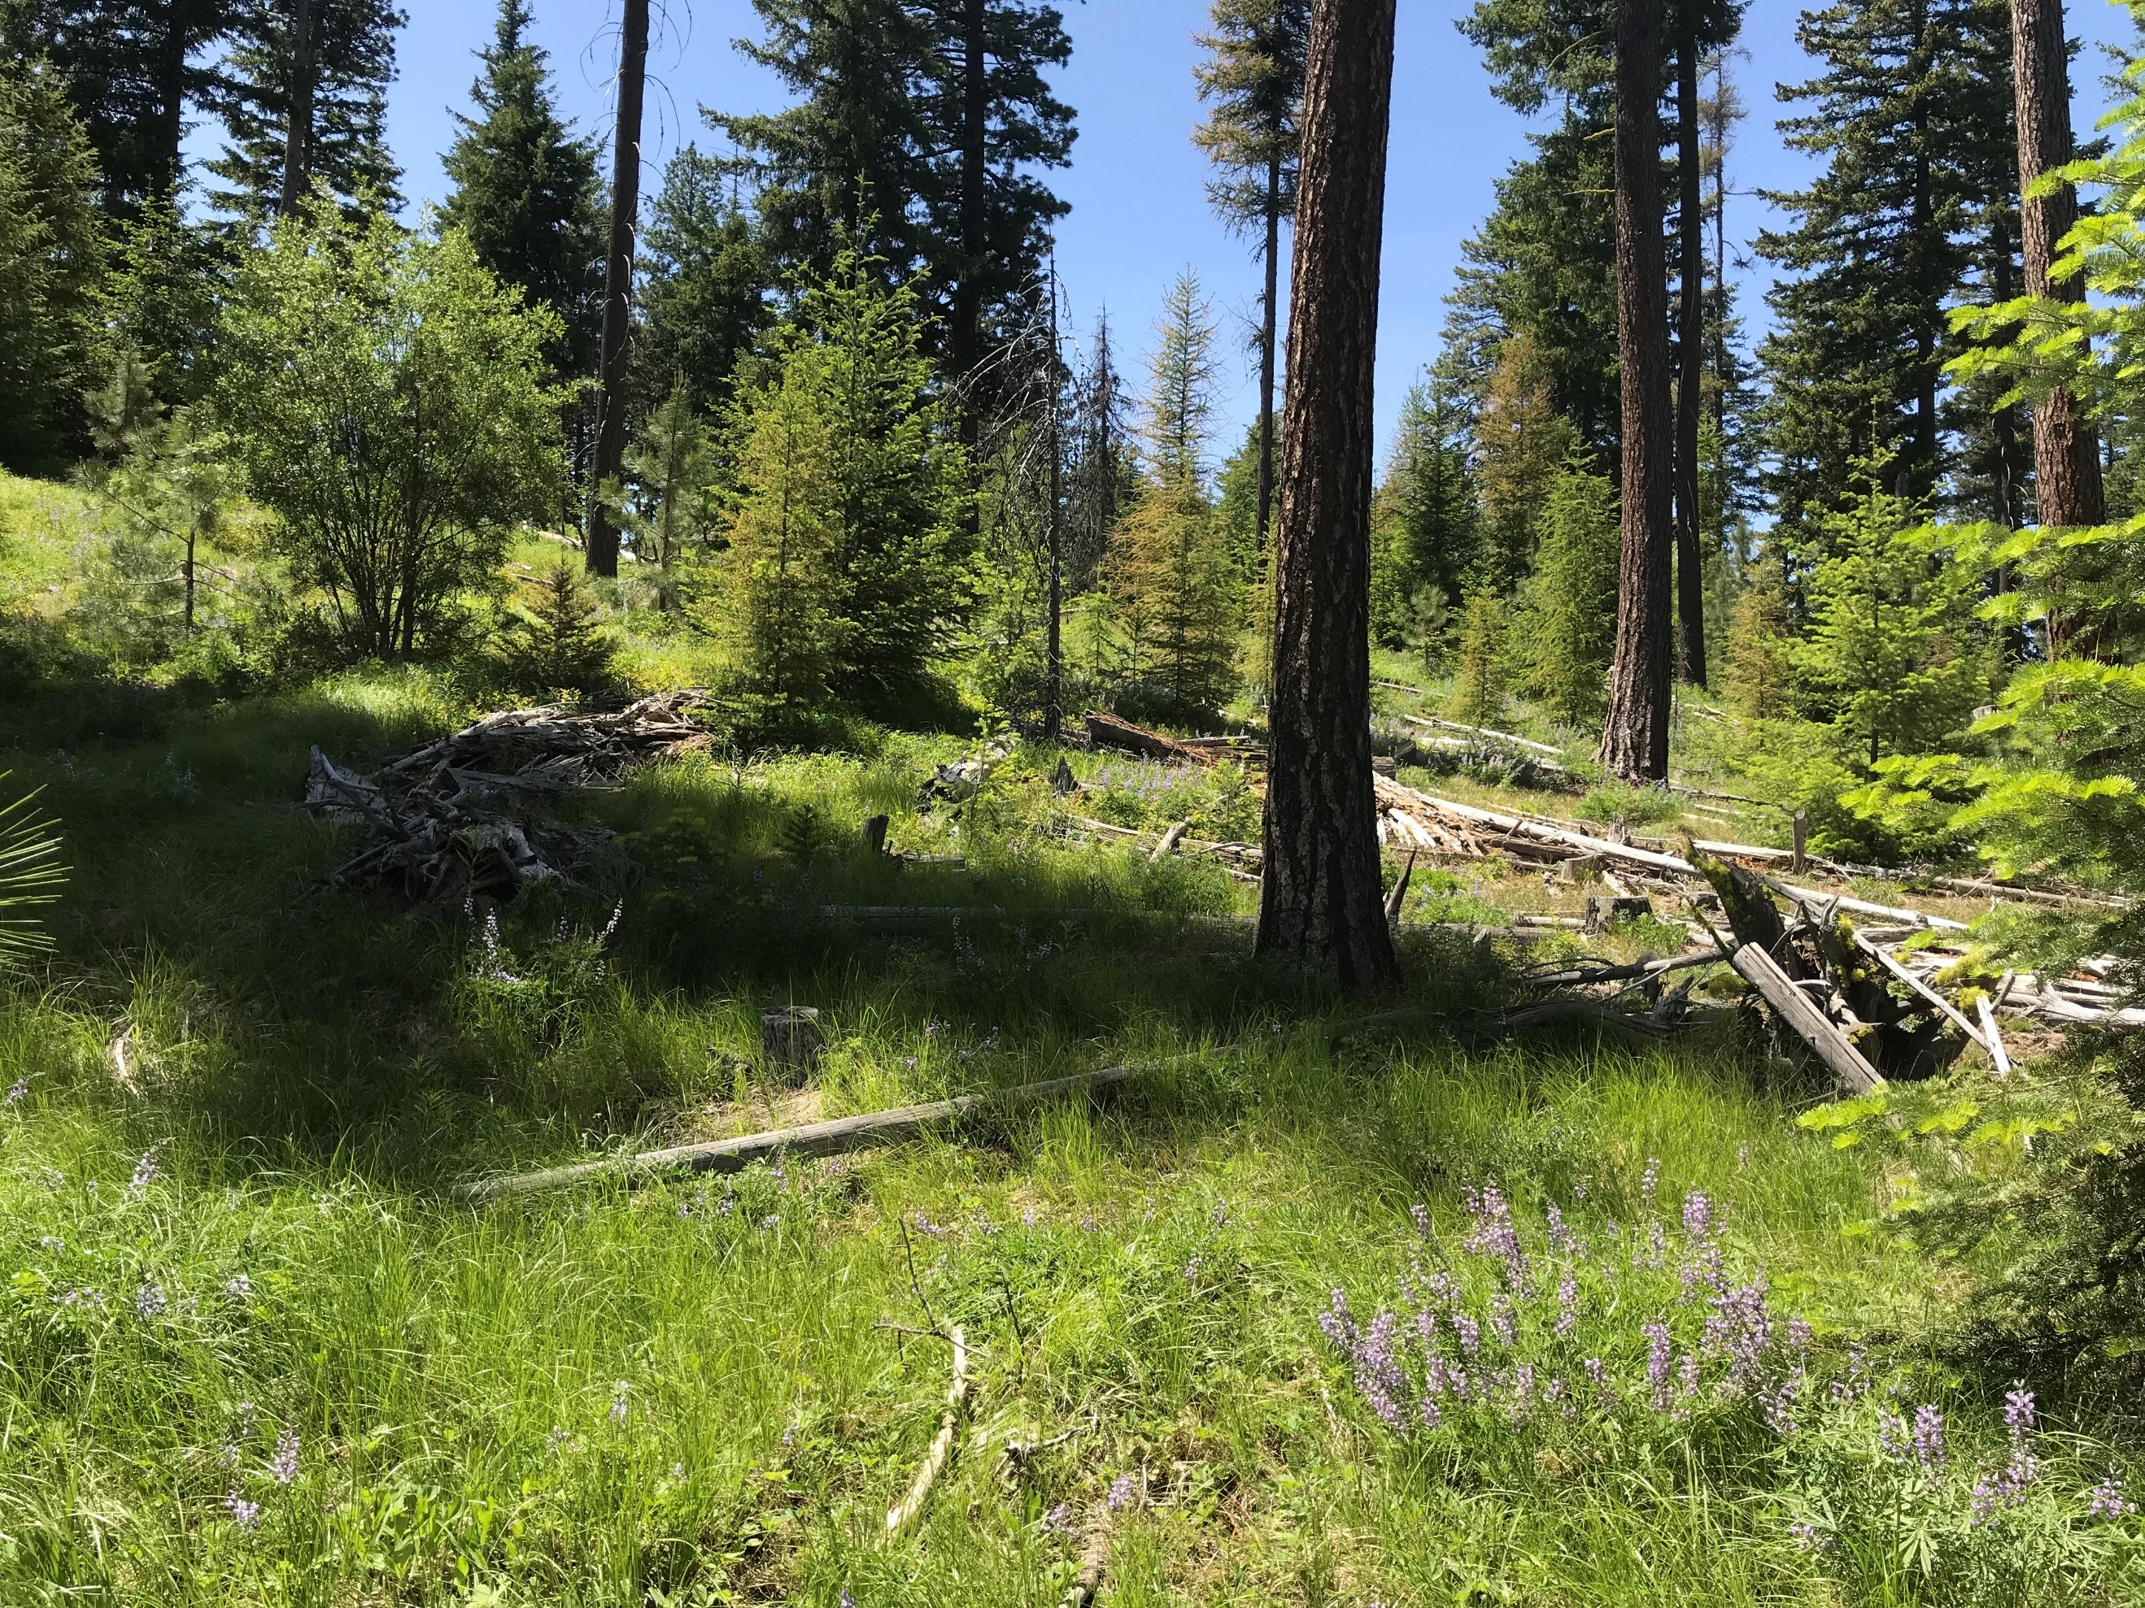
Forestry Updates
Forestland In-Field Soil Health Assessment and Guide Released
  Available and added to CART for FY25 use
Updating Fuel Break (383) guidance and IR
Enhancement E666J- Facilitating oak forest regeneration will include rangeland as an eligible land use

