Slide 1
Local Work Group Updates
Nick Vira

Slide 2
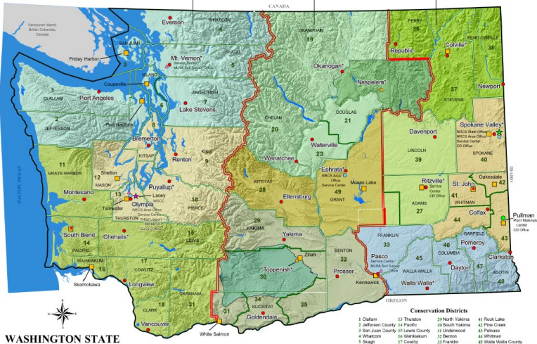
Washington Local Work Groups

Slide 3
2024 LWG Results
https://www.nrcs.usda.gov/conservation-basics/conservation-by-state/washington/washington-local-working-groups

Slide 4

LWG Webpage

Slide 5
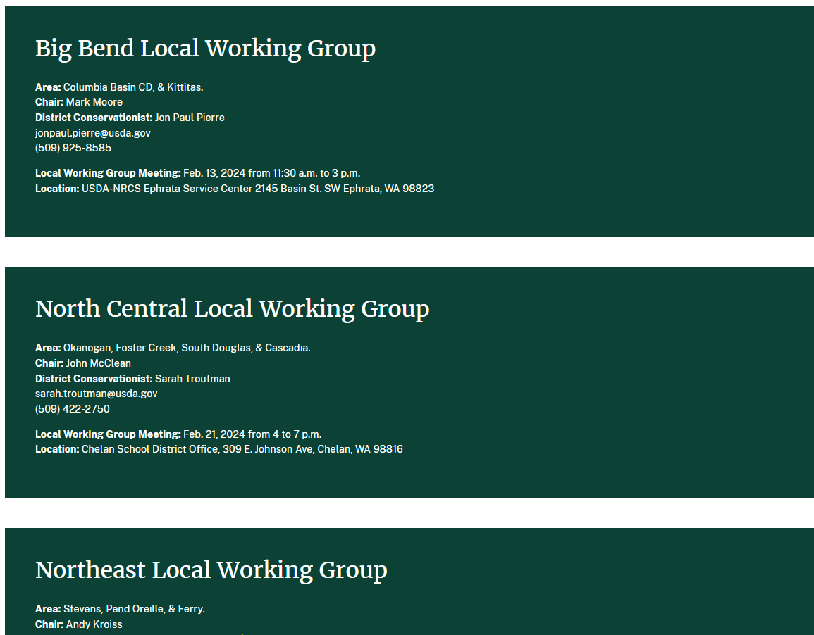
LWG Meeting Dates

Slide 6
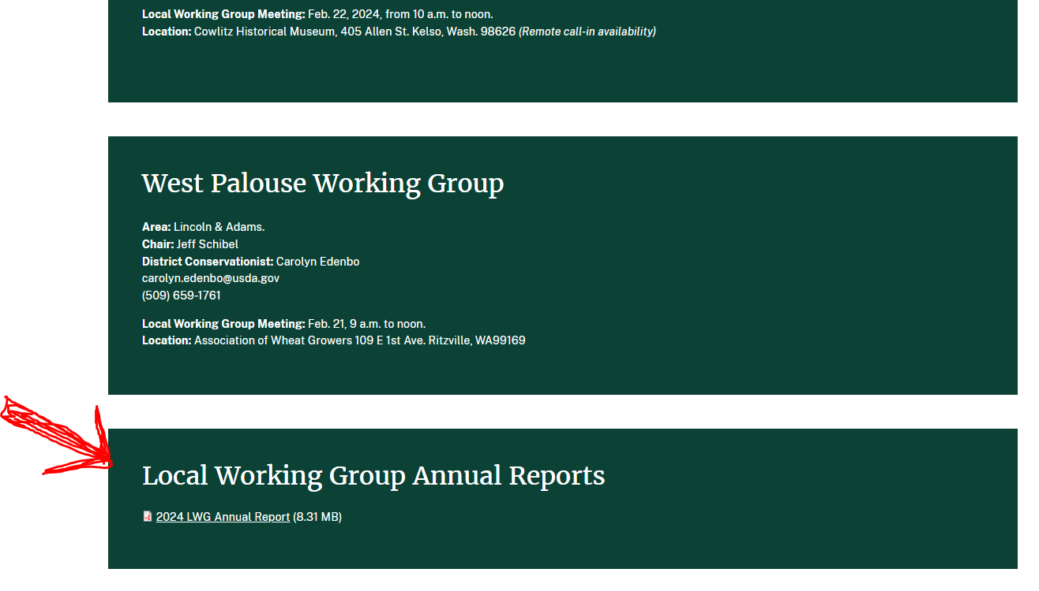
LWG Annual Report

Slide 7
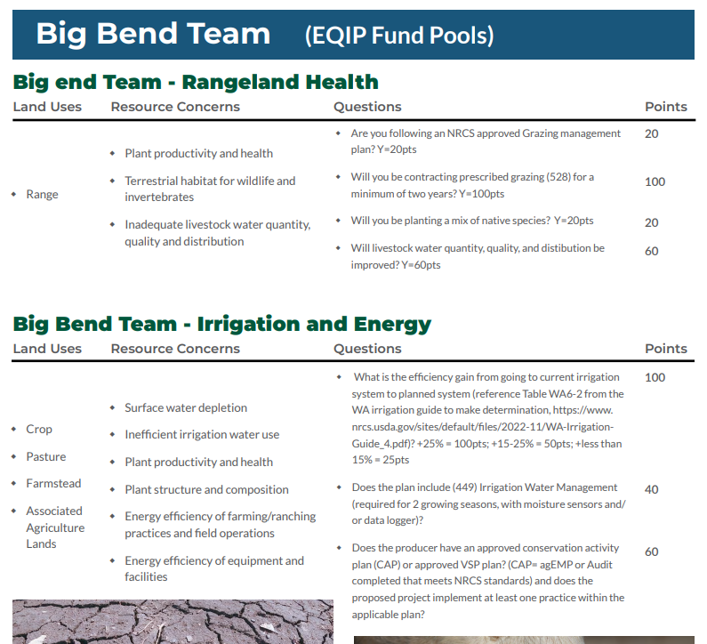
EQIP Fund Pools by Team

Slide 8
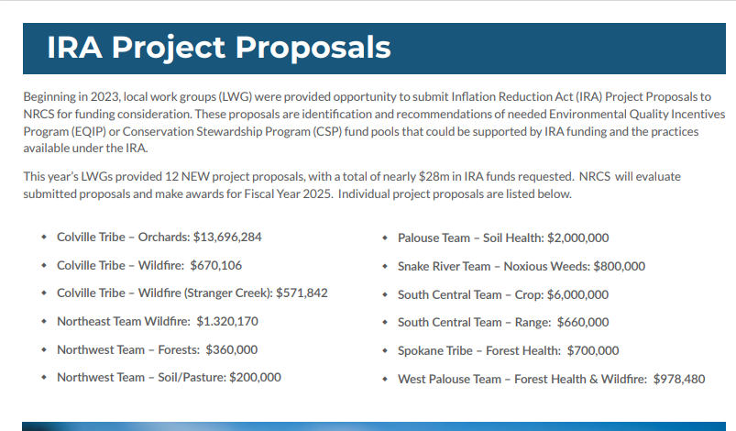
IRA Project Proposals

Slide 9
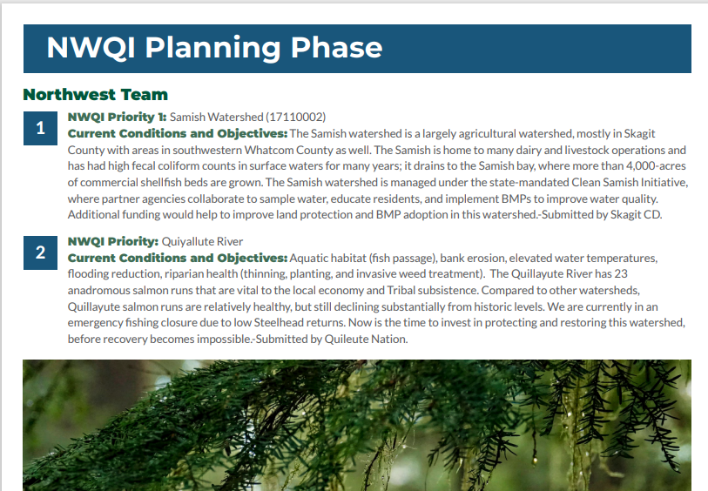
NWQI Planning Phase Watersheds

Slide 10
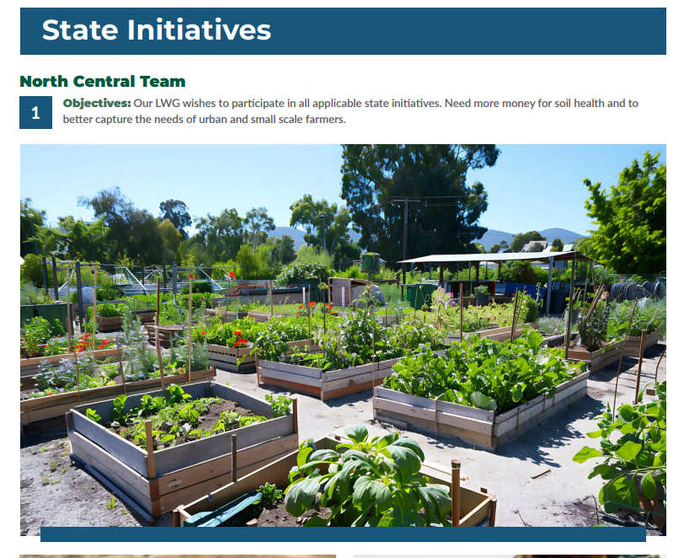
State Initiatives

Slide 11
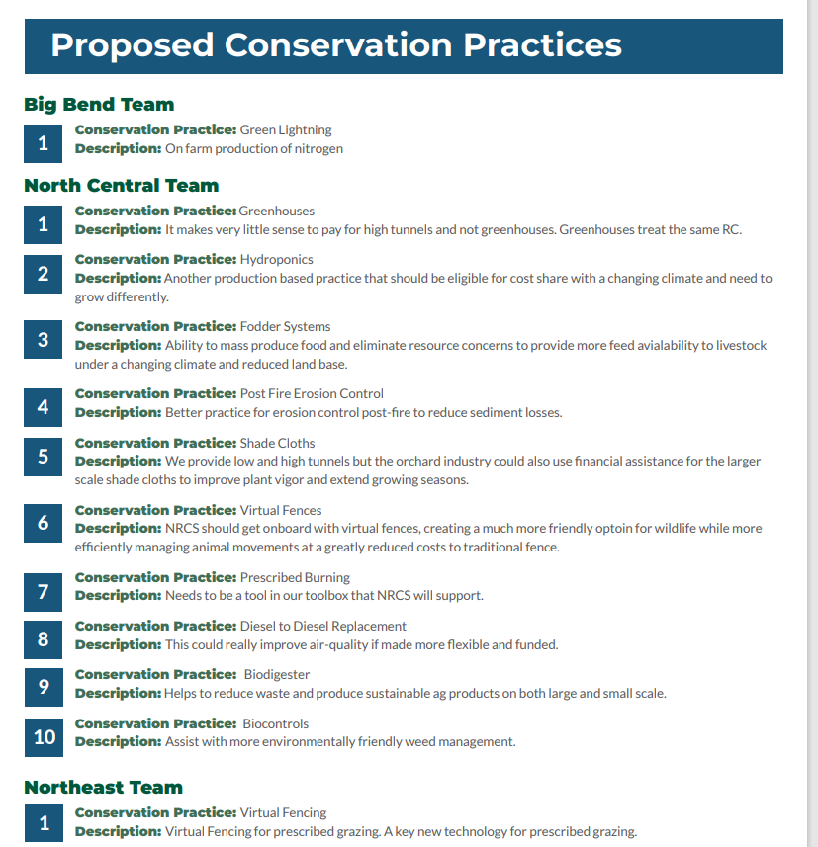
Conservation Practices

Slide 12
IRA 2025 Project Proposals

Slide 13
IRA Proposals
12 New Project Proposals Submitted
$28m in total new funds requested
Proposals range from $200k-$13.7m
Funded
  FY2025: 5 new projects - $5.94m
  FY2024: 9 renewed projects - $6.35m

Slide 14
IRA Projects Awards
Palouse LWG
  Project: Soil Health on Cropland
  Funds Awarded: $2m

Slide 15
IRA Projects Awards
Northeast LWG
  Project: Forest Health & Wildfire Resiliency
  Funds Awarded: $1.3m

Slide 16
IRA Projects Awards
South Central LWG
  Project: Rangeland Conservation
  Funds Awarded: $660k

Slide 17
IRA Projects Awards
South Central LWG
  Project: Soil Health on Cropland
  Funds Awarded: $1m

Slide 18
IRA Projects Awards
West Palouse LWG
  Project: Forest Health & Wildfire Resiliency
  Funds Awarded: $978k

Slide 19
Prior Year IRA Projects Awards – $6.35m Renewals
Puget Sound Team Forestry: $100k
Southwest Team Forestry: $750k
North Central Team Forestry: $150k
North Central Team Soil Health: $1.5m
North Central Team Grazing: $75k
North Central Team Non Conventional: $60k
Snake River Team Nutrients: $2m
Snake River Team Forestry: $1m
Colville Tribe: $1m

Slide 20
2025 Local Work Group Overview

Slide 21
Similar Process as Prior Year
EQIP Fund Pool (required)
NWQI Watershed
Conservation Practices
Special Initiatives

Slide 22
2025 LWG Key Dates
LWG Kickoff (remote meeting):
  November 5, 2024
Meeting Dates Set:
  Jan 15, 2025
Meetings Held By:
  May 16, 2025
Reports Due (by NRCS District Conservationist):
  May 30, 2025
IRA Project Proposals Due (by LWG Chair):
  May 30, 2025

Slide 23
IRA Project Proposals
EQIP and CSP $
Check list for submission
1 year projects only
Similar process as this year
IRA Project Proposals Due (by LWG Chair):
  May 30, 2025

Slide 24
Questions?
Notes:
GO TO VIEW > MASTER > SLIDE MASTER TO EDIT THE IMAGES ON THE TITLE AND DIVIDER SLIDES

Slide 25
Thank you!
Notes:
GO TO VIEW > MASTER > SLIDE MASTER TO EDIT THE IMAGES ON THE TITLE AND DIVIDER SLIDES

