Slide 1
Geographic Area Rate Cap (GARC)
Keith Griswold
Assistant State Conservationist - Programs
Notes:
Sept. 23, 2020

Slide 2
GARC Background
In accordance with the ACEP-WRE statute, regulations, and policy, NRCS must determine whether eligible lands may be enrolled in ACEP-WRE based on the likelihood of successful restoration of wetland functions and values, taking into considering the cost of acquiring the easement and the cost of the restoration, protection, enhancement, maintenance, and management.

Slide 3
GARC Policy
The basis for the compensation offer for an easement or 30-year contract enrollment will be the lowest of the following:
(i) The fair market value (FMV) of the land using either of the following: a Uniform Standards for Professional Appraisal Practices (USPAP) individual appraisal or an area wide market analysis (AWMA) or survey,
(ii) The geographic area rate cap (GARC), or
(iii) An amount voluntarily offered by the landowner.

Slide 4
GARC Policy - 440 CPM Part 528, Subpart M, Section 528.122
Each fiscal year the State Conservationist, in consultation with the State Technical Advisory Committee (STAC), must establish a process to determine easement and 30-year land use contract compensation values.

Slide 5
FY25 NRCS-WA GARC Proposal
1. The FY2025 ACEP-WRE GARC value for permanent easement offers will be 85% of the individually appraised fair market value of the subject property, not to exceed $5,000/acre, unless there are federal or state threatened and endangered (T&E) species present or if the site is considered essential habitat for species recovery.
2. In those cases that T&E species are present, there will be a hold down of $10,000/acre. (The $5,000/acre figure is the maximum set forth in policy, unless the state establishes a justification for a higher amount).
3. The FY2025 compensation for 30-yr easements, 30-yr tribal land use contracts and WRE-reserved grazing rights easements be set at 75% of the individually appraised fair market value of the subject property, not to exceed $5,000/acre, without any exceptions. Washington NRCS may allow the Reserved Grazing Right option on any new ACEP-WRE enrollments only if Threatened & Endangered (T&E) species are present, the T&E species identified is heavily dependent on early successional habitat wetland community and is concurred in writing for the official case file by the Washington NRCS Assistant State Conservationist for Programs (ASTC-P), State Resource Conservationist (SRC), and State Conservationist (STC). WRE-reserved grazing rights easement compensation on 30-year easements and 30-year tribal land use contracts will be 75% of the calculated 30-year compensation value, not to exceed $5,000/acre, without exceptions.

Slide 6
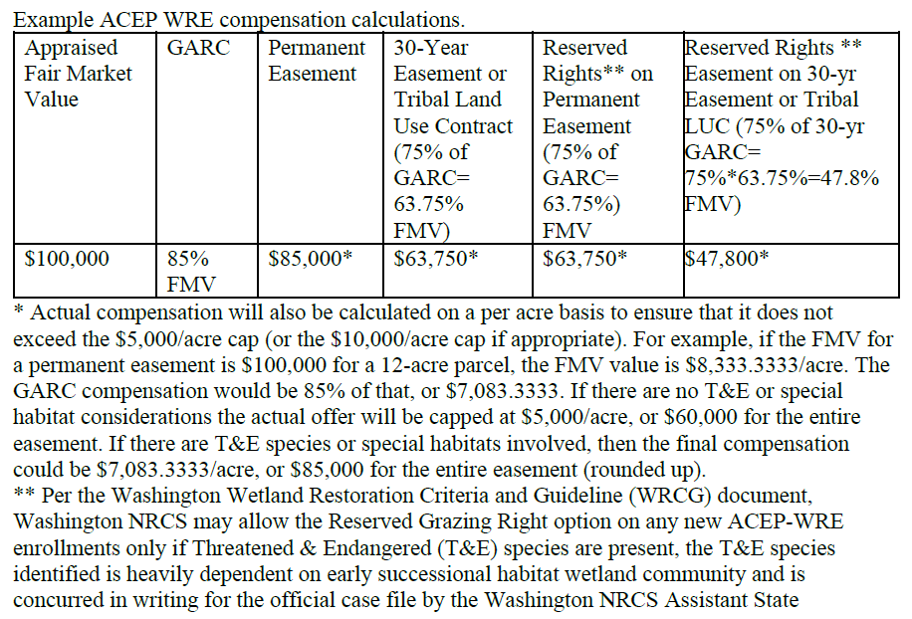
FY25 NRCS-WA GARC Example

Slide 7
Questions?
Notes:
Sept. 23, 2020

