Slide 1
Ecological Sciences
Presenter: Robert D. Evans (Bobby), State Resource Conservationist

Slide 2
NRCS Soil Health Opportunities

Slide 3
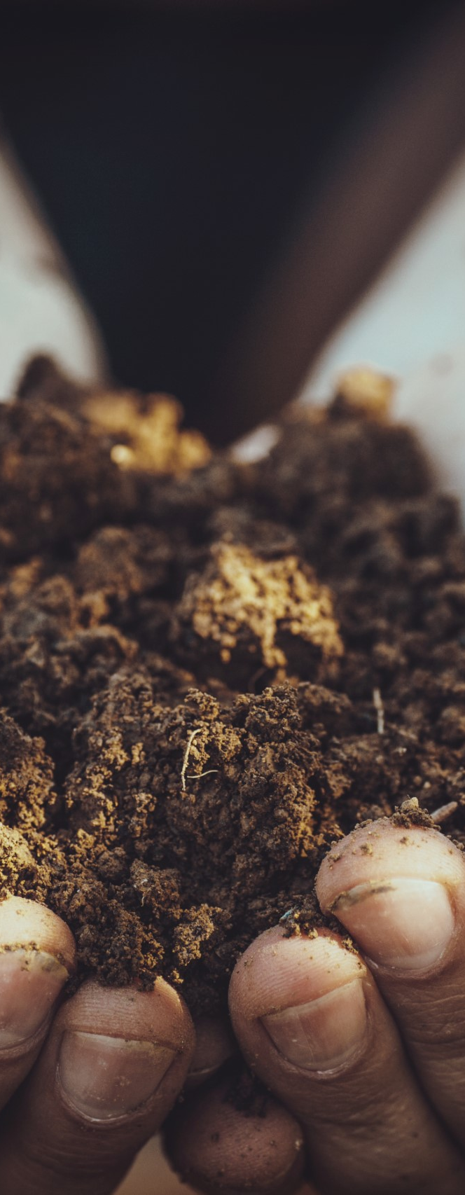
Fundpools
IRA Statewide Forestry & Soil Health
IRA Statewide Grazing & Soil Health
IRA Statewide Cropland & Soil Health’
IRA Soil Health on Cropland, Palouse LWG
IRA Soil Health on Cropland South Central LWG
IRA Soil Health North Central LWG
CSP

Slide 4
Field
Office Technical Guide (Updates)

Slide 5
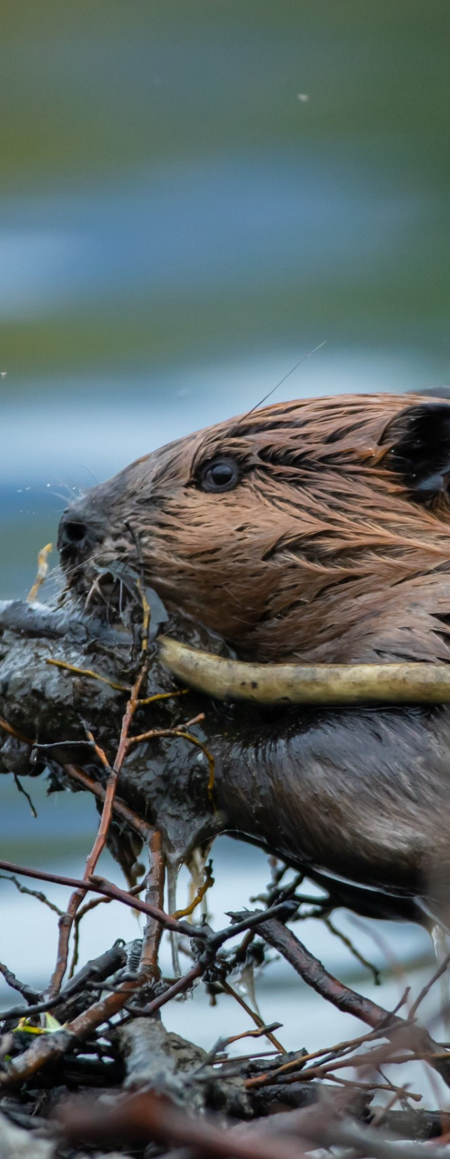
Biology Practice Updates
390 Riparian Herbaceous Cover
396 Aquatic Organism Passage
399 Fishpond Management
420 Wildlife Habitat Planting
578 Stream Crossing
644 Wetland Wildlife Habitat Management
645 Upland Wildlife Habitat Management
647 Early Successional Habitat Development/Mgmt
One or more documents updated

Slide 6
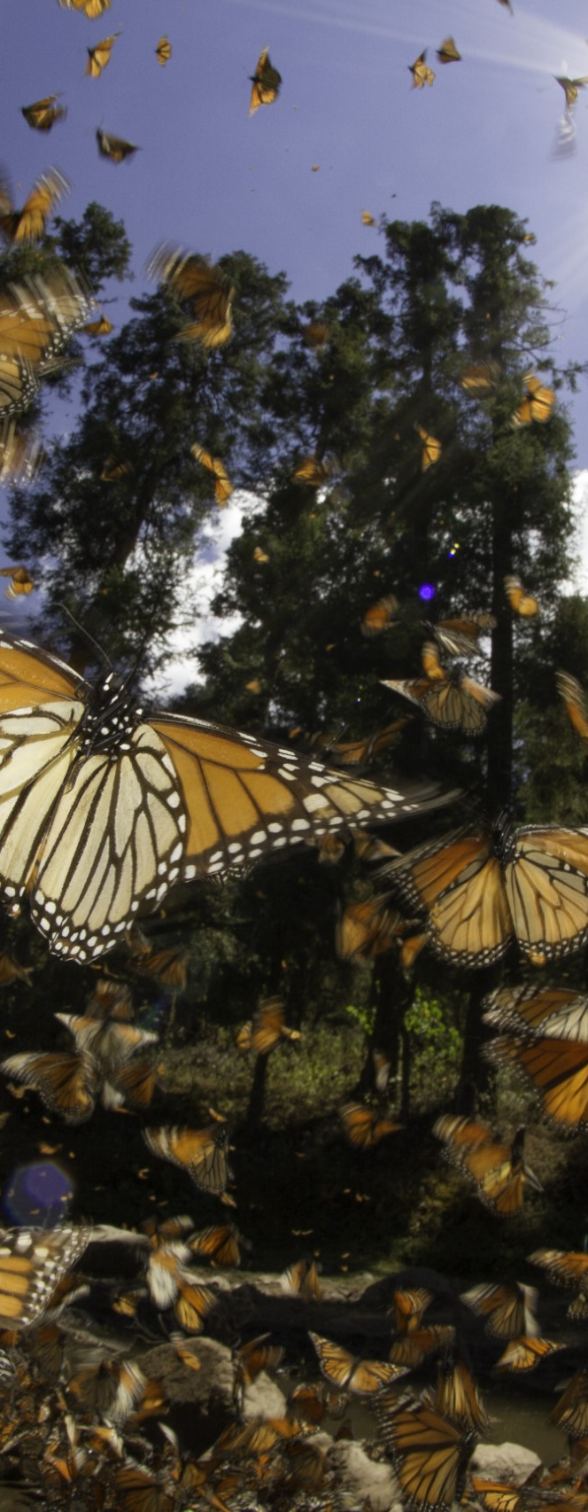
Updated Biology Technical Notes
Biology Technical Note 28 Habitat Planning for Beneficial Insects, guidelines for conservation biological control
Biology Technical Note 29 Eastern Washington Monarch Butterfly Wildlife Habitat Evaluation Guide (WHEG): Datasheet
Biology Technical Note 29 Eastern Washington Monarch Butterfly WHEG and Decision Support Tool: Instructions and Appendices
Biology Technical Note 30 Beneficial Insect Habitat Assessment Form and Guide, Farms and Agricultural Landscapes
Biology Technical Note 31 Pollinator Habitat Assessment Form and Guide, Farms and Agricultural Landscapes
Biology Technical Note 32 Pollinator Habitat Assessment Form and Guide, Natural Areas and Rangelands
Biology Technical Note 33 Native Plants for Pollinators and Beneficial Insects in the Maritime Northwest

Slide 7

Forestry Updates in Progress
Updating Implementation Requirements (IRs) to reduce redundancy & improve streamlining
384 Woody Residue Treatment
666 Forest Stand Improvement
660 Tree-Shrub Pruning
612 Tree/Shrub Establishment

Slide 8
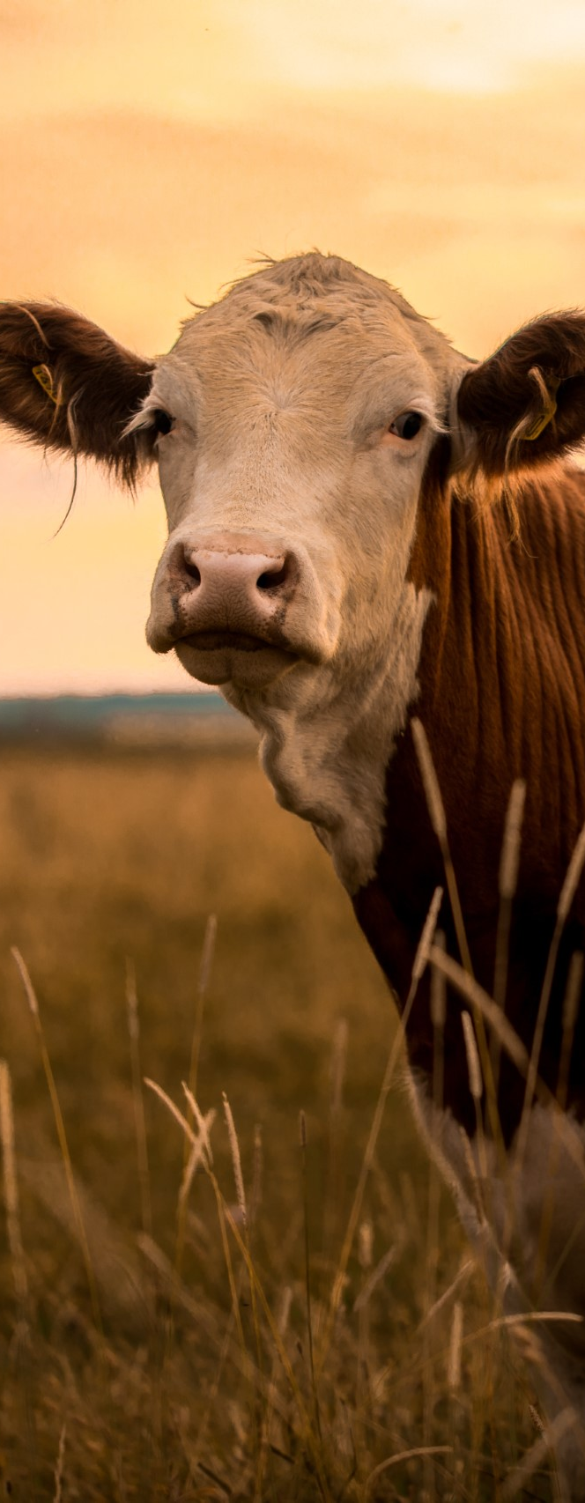
Grazing Updates
382 Fence Conservation Practice Standard
382 Fence SOW
382 Fence Practice Overview
382 Fence CPPE
512 Pasture and Hay Planting Conservation Practice Standard
512 Pasture and Hay Planting SOW
512 Pasture and Hay Planting IR
512 Pasture and Hay Planting Practice Overview

Slide 9
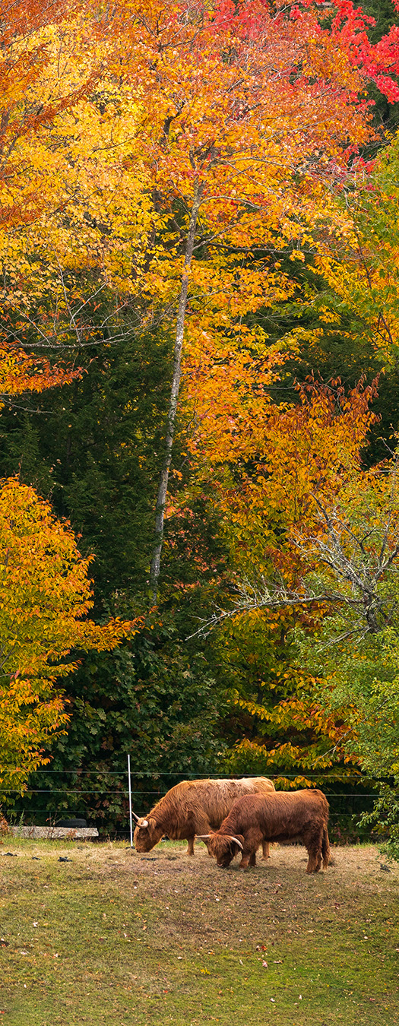
Small Farm & Urban Updates
328 Conservation Crop Rotation
  Implementation Requirement
  Records keeping doc
  Guidance Document
558 Roof Runoff Structure
  Guidance Document
  Checklist
821 Low Tunnel Systems
  Implementation Requirement
  Guidance Document
325 High Tunnel System
  Implementation Requirement
  Guidance Document
336 Soil Carbon Amendment
  Implementation Requirement
In progress
  340 Cover Crop
  Calculator (large and small scale)
  Implementation Requirements
  Guidance Document
  484 Mulching: Calculator (large and small scale)

