Slide 1
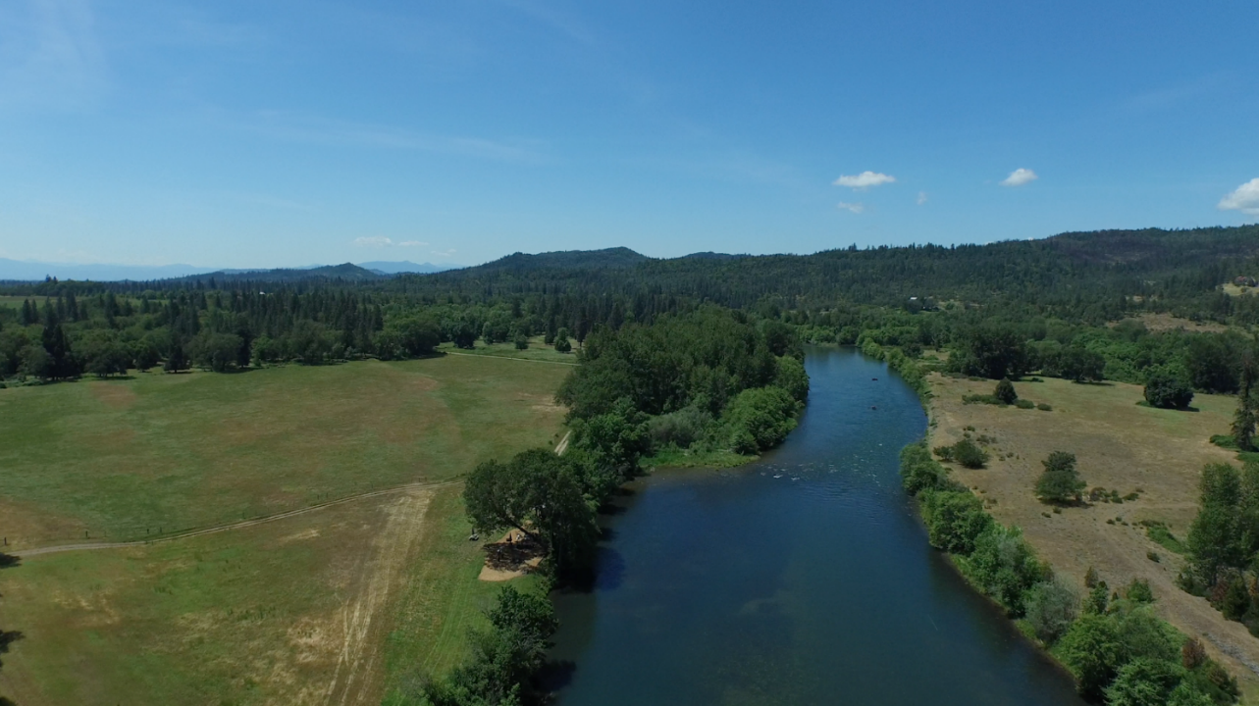
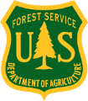
The Drinking Water Providers Partnership
Restoring watershed health for communities and Fish
International American fisheries society annual meeting
Reno, Nevada
September 30, 2019
James Capurso, PhD
Regional Fisheries Biologist
USDA Forest Service

Slide 2
Overview
Why source water protection and restoration?
Drinking water providers partnership: what is it and how did it form?
Accomplishments and lessons learned
Q&A

Slide 3
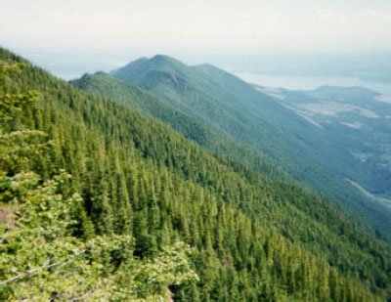
Importance of Forested Watersheds
            2/3 of the U.S. freshwater comes from forested watersheds
            60% of the water used in the American West originates on National Forest System land

Slide 4
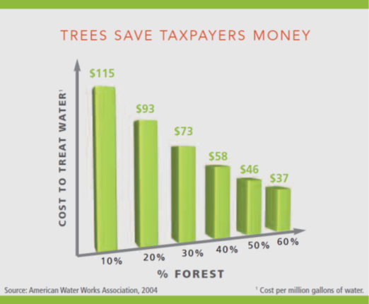
For every
10% in forest cover,
Water treatment costs 20%
Source: 2004 American Water Works Association
Notes:
Image and Text

Slide 5
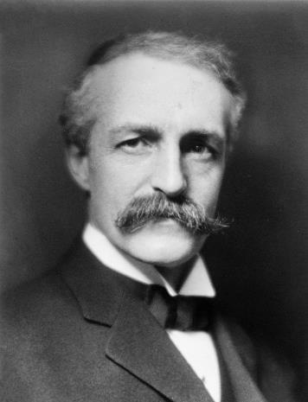
1897 USFS Organic Administration Act
Purpose of National Forests are to “secure favorable conditions of water flows and to furnish a continuous supply of timber for the use and necessities of citizens of the United States.”

Slide 6
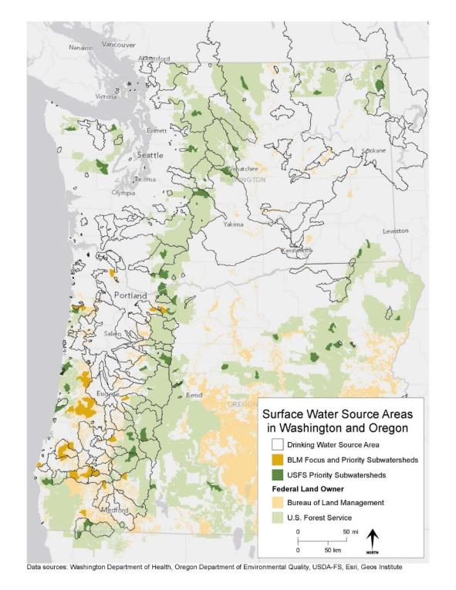

Slide 7
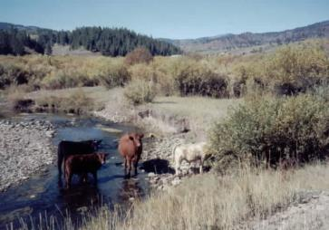
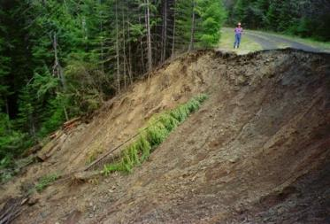
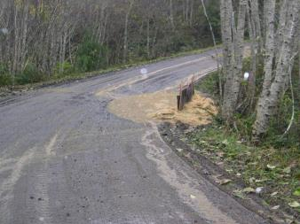
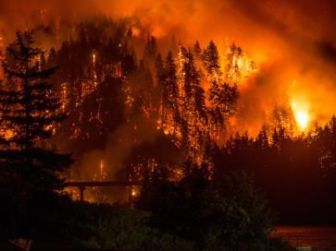
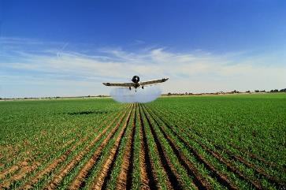
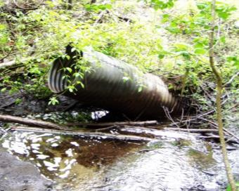
Risks to Drinking Water Quality and Watershed Health

Slide 8
Building the Drinking Water Providers Partnership

Slide 9
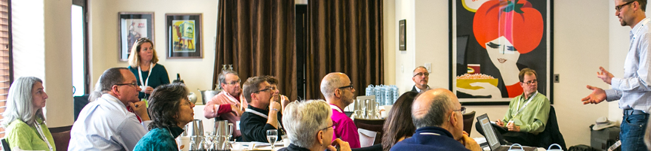
Making connections
USDa forest service and geos institute are cooperators in Carpe Diem west.
Carpe diem west is a nonprofit organization of diverse western water leaders developing innovative and sustainable responses to the western u.s. water crisis

Slide 10
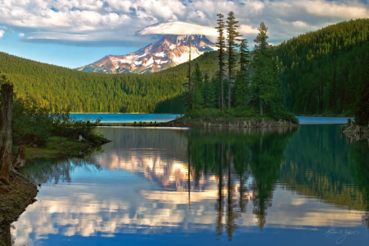
MAKING CONNECTIONS
Carpe Diem West, USFS and the GEOS Institute recognized challenges to protection and restoration in drinking water watersheds
  The Safe Drinking Water Act does not provide regulatory authority for communities to protect their drinking water
  Very few towns own their source watershed
  Only larger towns and cities have capacity to protect or restore source watersheds
Bull Run Lake

Slide 11
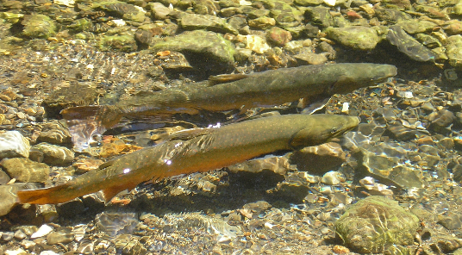
MAKING CONNECTIONS
The Forest Service and GEOS recognized working with water providers in municipal watersheds could result in:
  Improved water quality and security
  Lower treatment costs
  Improved aquatic/riparian habitat and watershed health

Slide 12
MAKING CONNECTIONS
The Forest Service and GEOS decided to establish a partnership bringing together:
  Water providers wanting to improve their source watersheds (but lacking resources or capacity)
  Restoration Practitioners having the expertise and capacity to protect and restore watersheds
  Land managers managing land within surface water watersheds
  Funding sources available to protect and restore drinking water source watersheds.
Clean,
Inexpensive
Drinking
Water
Municipal
Watershed
Restoration

Slide 13
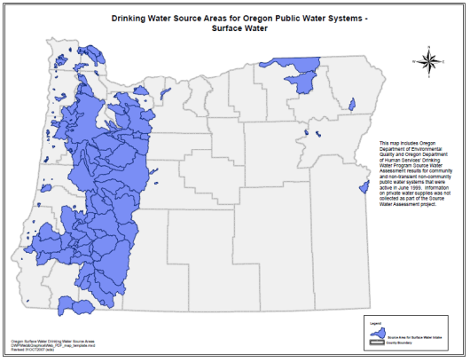
MAKING CONNECTIONS
FS and GEOS Summer Tour 2014
Visited Water Providers in the FS priority watersheds of the Cascade and Coast Ranges of Oregon to introduce the municipal watershed restoration concept
Met with great support everywhere
In most cases, we followed up the first meeting with an introduction between water providers and local restoration practitioners
We heard clearly from partners a source of funding was needed

Slide 14
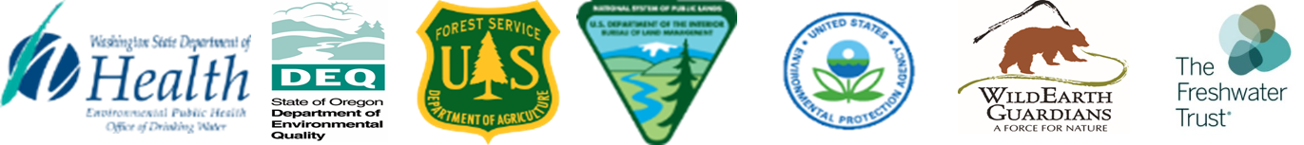
Regional partnership forms
In 2015, the regional partnership formed in response to grassroots partnerships’ demand for funding source
Oregon DEQ, WA DOH, EPA BLM, and Wild Earth Guardians joined in 2015
The Freshwater Trust joined in 2018

Slide 15
Drinking Water Providers
Partnership Goals
Restore and protect the health of watersheds which communities depend upon for drinking water while also benefiting aquatic and riparian ecosystems, including the native fish that inhabit them.
Support local partnerships between downstream drinking water providers and upstream landowners and restoration practitioners.

Slide 16
Eligible Applicants
Tribal, local, state, or federal governments, educational institutions, non-profit organizations, watershed councils, landowners, soil and water conservation districts, and others.
While the only applicants eligible to receive the state funding are public water systems, these $’s can go towards many activities.

Slide 17
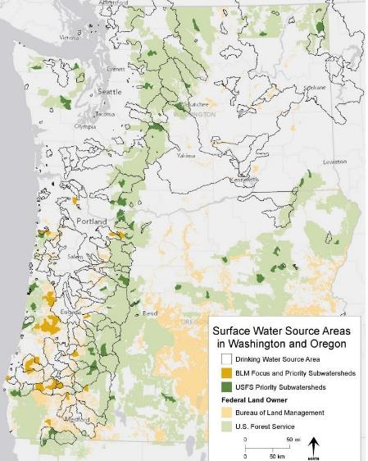
Geographic Eligibility
Projects located in a public drinking water watershed in Oregon or Washington.
To receive max # points, projects should:
  Be in or near a USFS priority watershed.
  Be in or near a BLM priority watershed.
  In Oregon, be in a sensitive area identified in an updated source water assessment delineation.

Slide 18
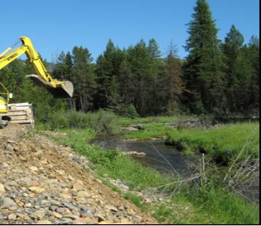
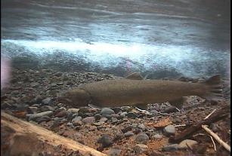
DWPP Project Types
Activities may include feasibility analyses, planning, design, outreach, education, and monitoring.
Work should address water quality or quantity issues within a public drinking water system and should benefit native fish and their habitat.
Proposed work should be identified in a recognized source water protection plan, restoration action plan, rare species recovery plan, or other publicly vetted prioritization document.

Slide 19
Examples of Eligible Projects
Culvert removal/replacement with streambed simulation or bridges
Road drainage improvements to route road runoff into vegetation instead of streams
Removal of dams or breaching/removal of levees and tide gates
Road decommissioning or modification/fine sediment prevention
Reestablishing river flow meanders and Restoring stream complexity and roughness.
Reducing pesticide application rates and loadings.
Reforestation or replanting in sensitive or riparian areas
Installation of fencing to protect sensitive areas
educational Outreach projects emphasizing watershed resource conservation, including flyers/brochures and signs
Planning for purchase of lands within the drinking water source area
Planning for the purchase of water for instream flow purposes

Slide 20
DWPP projects

Slide 21
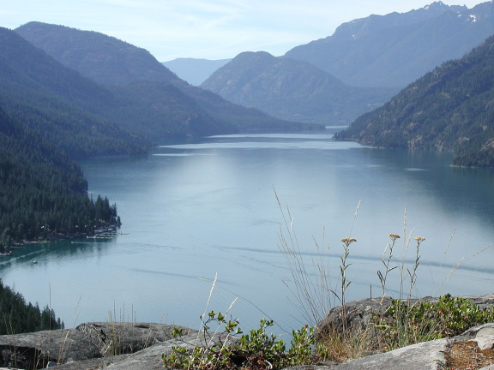
Increasing projects raise benefits
Steady increase of funded projects
  11 projects in 2016
  12 projects in 2017
  14 projects in 2018
These projects will benefit:
  Coho, chinook, steelhead, lamprey Bull trout, cutthroat trout, and other biota
  Water recreationists
  The 877,000 people relying on these streams and rivers for their drinking water
Lake Chelan, WA

Slide 22

2016 DWPP Funded Projects
DWPP partners developed a regional funding pool of $660,000 for its first year.
We received 20 project funding applications.
We were able to fund 11 of them in 11 different municipal watersheds in Oregon.
Geos Institute also received a Meyer Memorial Grant for monitoring projects

Slide 23
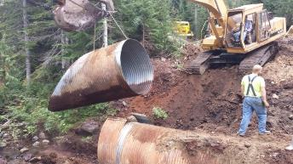
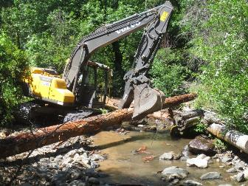
2016 Funded Project Types
Fencing to exclude livestock
Planting native vegetation and controlling weeds in riparian areas
Placing large wood in streams and floodplains
Replacing inadequate culverts and bridges
Inventorying/reconstructing roads
Decommissioning roads
Removing levees and restoring channel meander
Reducing road sedimentation with drainage improvements.

Slide 24
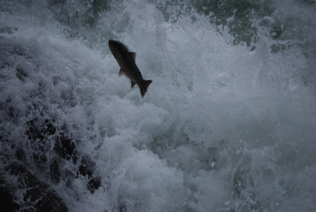
2017 DWPP Funded Projects
DWPP partners developed a regional funding pool of $688,000 for 2017.
We received 19 project funding applications.
We were able to fund 12 of them in 12 different municipal watersheds in Oregon and Washington.

Slide 25
2017 Funded Project Types
Fixing aquatic organism passage barriers
Restoring aquatic and riparian habitat through placement of wood, Increasing stream channel complexity and floodplain use, excluding livestock, eradicating invasive weeds, and revegetation.
Community planning
Public outreach

Slide 26
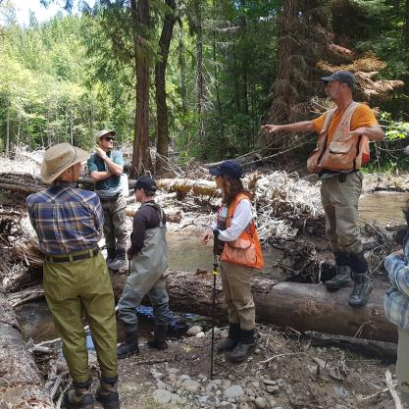
2018 DWPP Funded Projects
DWPP partners developed a regional funding pool of $519,000 for 2018.
We received 14 project funding applications.
We were able to fund 13 of them in 13 different municipal watersheds in Oregon and Washington.

Slide 27
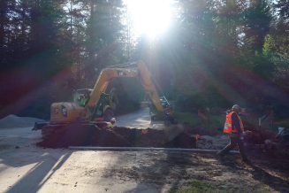
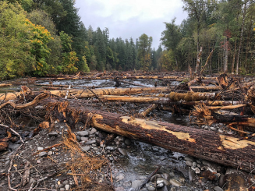
2018 Funded Project Types
Road removal and improvements
Fixing aquatic organism passage barriers, including diversion dam removal
Fish screen replacement
Restoring aquatic and riparian habitat through placement of wood, Increasing stream channel complexity, livestock fencing
Data collection on impacts of recreational use of municipal watershed
Public outreach including signage and watershed display.

Slide 28
Icicle Watershed Source Water Protection
Clear Creek Instream Flow
Lake Chelan: Keep it Blue
Domerie Creek Improvements
East Fork Mission Creek Restoration Coordination and Design
Bear Creek Road Drainage Repair
Clackamas Education/Outreach
Baker Municipal Watershed Fencing Project
Lower SF McKenzie phase II
Bend Municipal Watershed Outreach/Education
Upper South Umpqua Aquatic Habitat Improvement
Little Butte Creek Wetland Restoration
Dunn Creek Restoration Phase 3

Slide 29
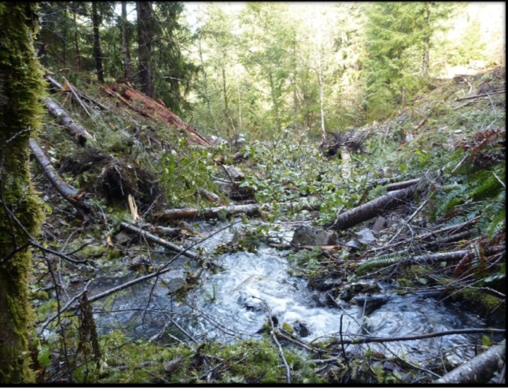
GLIDE, OR
Problem: High risk of sediment delivery to the North Umpqua River (drinking water source for Glide) due to deteriorating culverts on Forest Service roads.
Solution: Identify highest risk locations and restore roads to reduce hydrologic risk.
DWPP funds were used to remove 8 crossdrain pipes; remove 4 old culverts at stream crossings and 8,000 cubic yards of fill; pull back steep road fill; prevent erosion with native straw, seed and slash.

Slide 30
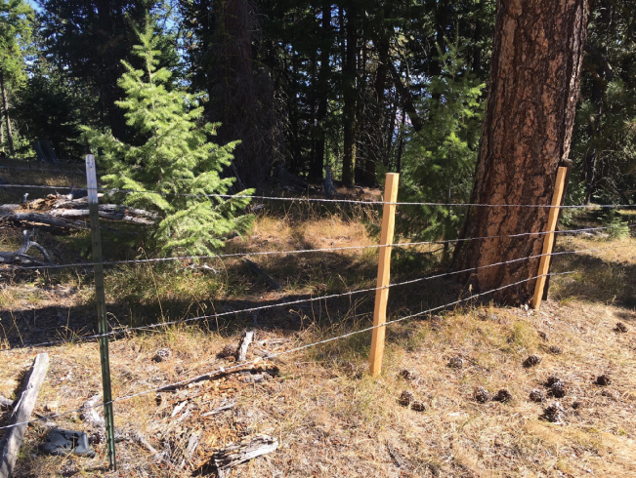
BAKER CITY, OR
Problem: Baker City experienced a cryptosporidium outbreak in 2013 and identified cattle as a probable source. City is one of only 3 unfiltered sources in Oregon.
Solution: Fix fencing in key areas.
DWPP funds were used to build fencing in the Elk Creek drainage in key location near grazing allotment. Wooden posts were built locally; barb less wire was used on the lower line for wildlife; city staff and contractors installed the fencing.

Slide 31
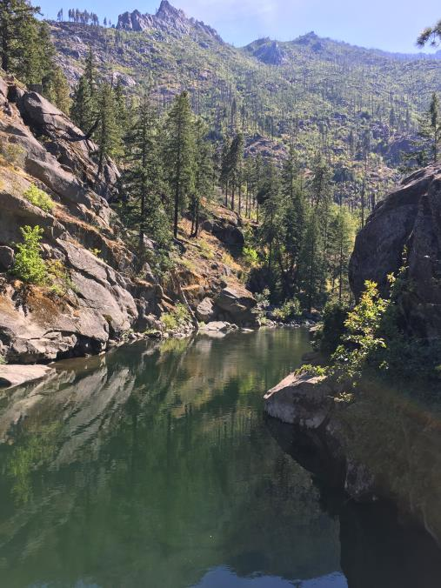
LEAVENWORTH, WA
Problem: Icicle Creek, town’s source water, is also an overly loved recreation destination impacting water quality. Creek also supports ESA listed Spring Chinook, steelhead and bulltrout.
Solution: Improve outreach to ensure visitors embrace protection of Icicle Creek.
DWPP funds were used to develop outreach materials and support outreach at trailheads, campgrounds and community events.

Slide 32
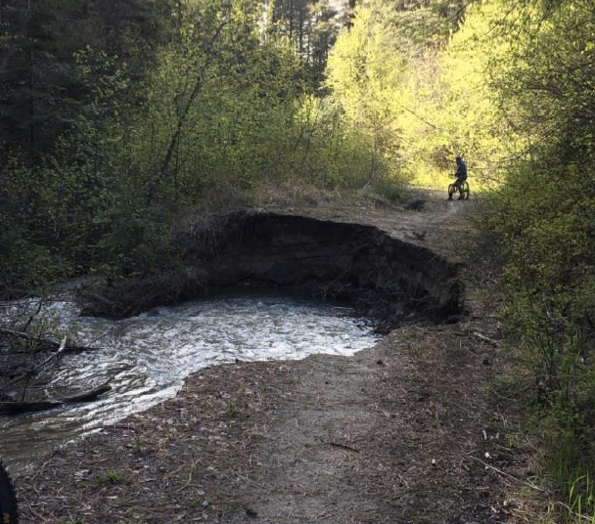
CASHMERE, WA
Problem: Mission Creek joins Wenatchee River, source water for Cashmere. Stream function is diminished due to incised and eroding/flood damaged road/trail in the floodplain.
Solution: Re-route trail, restore floodplain for ESA listed steelhead & spring Chinook, build partnerships.
DWPP funds will be used to develop alternatives for trail re-route, conceptual plan, baseline monitoring and community outreach.

Slide 33
medford, OR
Problem: Water providers and restoration interests in the Medford area wanted to develop a tool to better inform and prioritize their restoration approach to their municipal watershed, Little Butte Creek.
Solution: Under the leadership of The Freshwater Trust, they developed the Sediment Loss and Measurement Tool to prioritize actions.
DWPP funds were used to support a series of meetings of local stakeholders to develop and apply the tool.

Slide 34
Partnership Lessons Learned
Need to continue to accommodate diverse funding source limitations.
Maintain flexibility for timing of funding availability.
Remain cognizant of agency geographic restrictions.
Importance of Wyden Authority for BLM and USFS
Continue to market program to increase grant applicants and funding sources.

Slide 35
For More Information:
James Capurso, PhD, Regional Fisheries Biologist, PNW Region, USDA Forest Service, jcapurso@fs.fed.us
Teresa Kubo, Environmental Review and Sediment Management Unit, EPA Region 10 Forest Team, kubo.teresa@epa.gov
Scott Lightcap, Oregon Fisheries Lead, BLM, slightca@blm.gov
Julie Harvey, Drinking Water Protection Coordinator, Oregon Dept of Environmental Quality, Julie.Harvey@deq.state.or.us
Corina Hayes, Source Water Protection Manager, Washington Department of Health, Corina.Hayes@doh.wa.gov
Marlies Wierenga, PNW Conservation Manager, WildEarth Guardians, mwierenga@wildearthguardians.org
Mark McCollister, Habitat Restoration Director, The Freshwater Trust, Mark@thefreshwatertrust.org

