Slide 1

Locally Led Conservation Initiative
Dana Shuff
State Resource Conservationist
NRCS

Slide 2
Locally Led Conservation
Principle
Locally Led Conservation is based on the principle that community stakeholders are the best suited to deal with local resource problems.
Local Work Groups – submit priorities to the state office in March
State Technical Committee – Sets state priorities today

Slide 3
Locally Led Conservation
2023 Data Collection
Process for Collecting Resource Data
All NRCS offices were sent an Excel spreadsheet template to rank the resource concerns.
Each prioritized the resource concerns affecting their area and ranked them using a 10 point weighting process.
Any given resource concern can have a value as high as 10 or as few as 0 points, but the total for all resource concerns cannot exceed 10 points.

Slide 4
Locally Led Conservation
2023 Data Collection
Process for Collecting Resource Data (continued)
Each Parish spreadsheet was then combined, categorized, and tallied for each land use by resource concern.
Maps, charts, and graphs were then generated for all resource concerns.

Slide 5
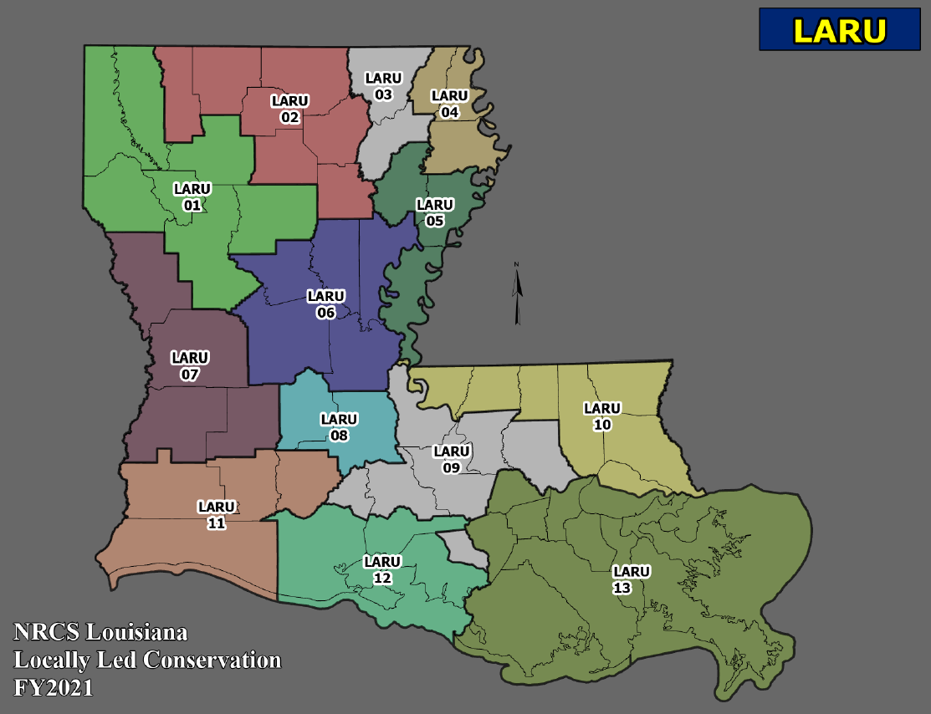


Slide 6
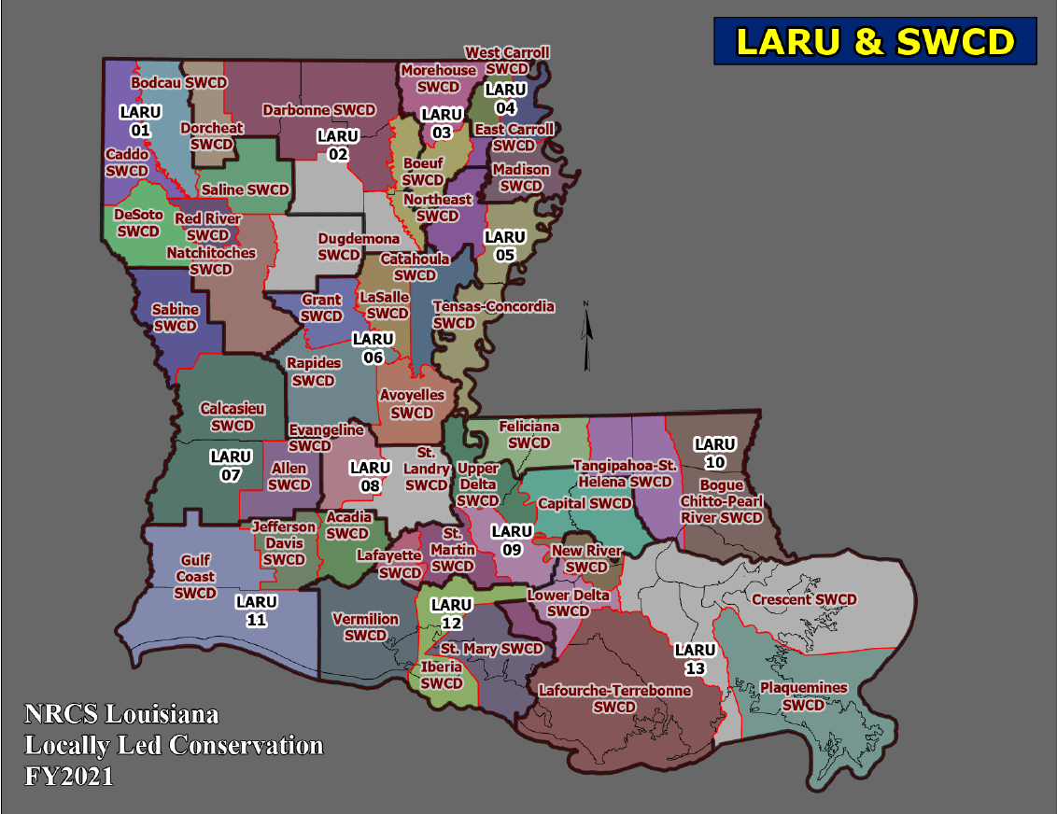

Slide 7
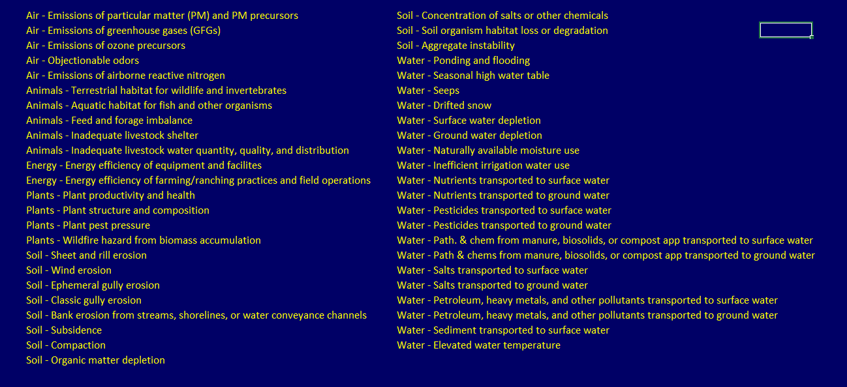
Locally Led Conservation
2023 Data Collection
2023 Resource Concerns

Slide 8
Locally Led Conservation
2023 Data Collection
Top 10 Resource Concerns

Slide 9

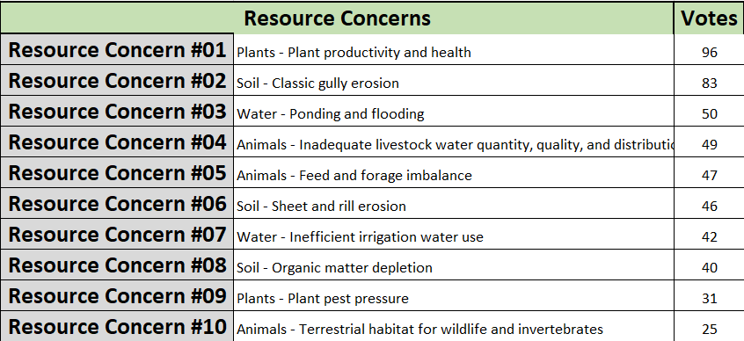
Locally Led Conservation
2023 Data Collection
Top Ten Resource Concerns
Resource Concern Factsheets (click)

Slide 10



The U.S. Department of Agriculture (USDA) prohibits discrimination in all its programs and activities on the basis of race, color, national origin, age, disability, and where applicable, sex, marital status, familial status, parental status, religion, sexual orientation, genetic information, political beliefs, reprisal, or because all or a part of an individual's income is derived from any public assistance program (not all prohibited bases apply to all programs). Persons with disabilities who require alternative means for communication of program information (Braille, large print, audiotape, etc.) should contact USDA's TARGET Center at (202) 720-2600 (voice and TDD). To file a complaint of discrimination write to USDA, Director, Office of Civil Rights, 1400 Independence Avenue, S.W., Washington, D.C. 20250-9410 or call (800) 795-3272 (voice) or (202) 720-6382 (TDD).
USDA is an equal opportunity provider and employer.

