Slide 1

Regional Conservation Partnership Program (RCPP) For Partners
RCPP Coordinator marissa.markus@usda.gov

Slide 2

RCPP History
Created within the 2014 Farm Bill
Became a stand-alone program in the 2018 Farm Bill
Vision to provide the opportunity for NRCS to work with partners that encourage innovation, high-performing solutions, accelerate conservation mission, and demonstrate the value of voluntary, private lands conservation
4 Pillars of RCPP
  Impact/Conservation Benefits
  Partner Contributions
  Innovation
  Partnerships and Management

Slide 3
NRCS Covered Programs and Program Activities
Environmental Quality Incentives Program (EQIP)- Land Management Activities (LMR)
Conservation Stewardship Program (CSP)- Land Management Activities (LMR)
Conservation Reserve Program (CRP) - Land Rental Activities (LMR)
Agricultural Conservation Easement Program(ACEP)-Easement Acquisitions(EHE,USHE,BPS)
Public Law 83-566 Watershed Program (PL566)- Watershed Project
Regional Conservation Partnership Program (RCPP)- Land Management Activities, Land Rental, Entity-held Easements, U.S. Held Easements (Classic only), Public Works and Watershed, or a Combination of Activities

Slide 4
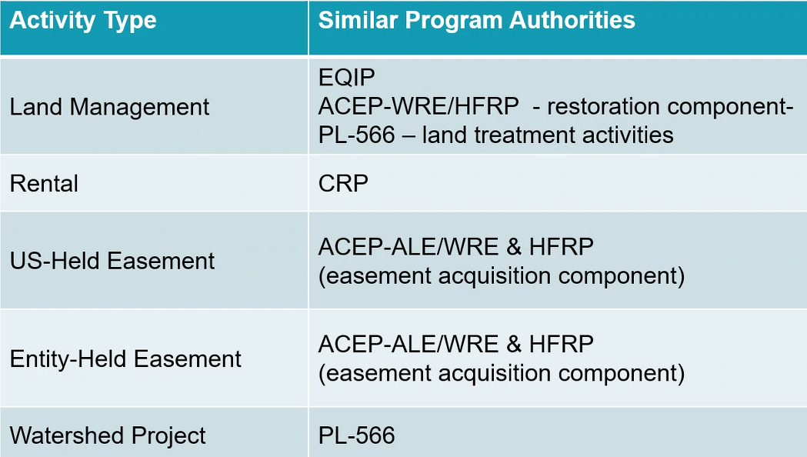
WHAT CAN RCPP DO?

Slide 5
Who Can Apply for RCPP?
From 7 CFR 1464.5 (b)
An agricultural or silvicultural producer association or other group of producers;
A State or unit of local government, including a conservation district;
An Indian Tribe;
A farmer cooperative;
An institution of higher education;
A water district, irrigation district, acequia, rural water district or association, or other organization with specific water delivery authority to producers on agricultural land;
A municipal water or wastewater treatment entity;
An organization or entity with an established history of working cooperatively with producers on agricultural land, as determined by the Secretary, to address -
  Local conservation priorities related to agricultural production, wildlife habitat development, and NIPF management; or
  Critical watershed-scale soil erosion, water quality, sediment reduction, or other natural resource concerns; or
An eligible entity as identified by NRCS pursuant to 7 CFR part 1468.

Slide 6
How can RCPP funding be used?
Financial Assistance
  These funds are used to implement eligible activities on eligible land.
  Typically, 75% of an RCPP Project
  Portal will allow between 75-82% FA for proposals
Technical Assistance
  Implementation TA (TA-I) are RCPP funds used to support FA. This may include planning, design, installation, and checkout.
  Enhancement TA (TA-E) are RCPP funds for project-wide support activities, such as outreach and outcomes assessment.
  NRCS TA are project-funds used by NRCS in support of producer contracts and easements.
Remember: RCPP funds pay for eligible activities, not people.

Slide 7

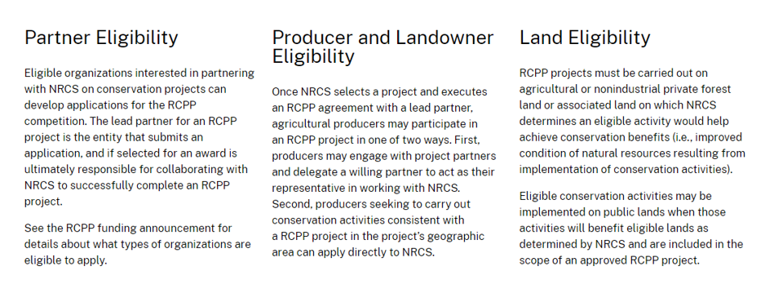
Where can RCPP Funding be used?

Slide 8
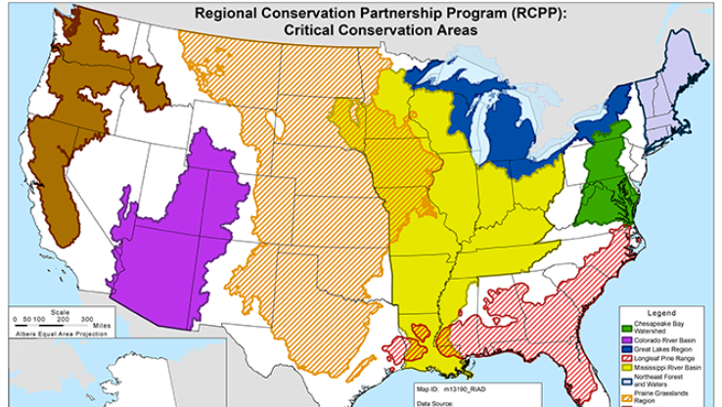
RCPP Funding Pools
State/Multi-State
  Can include any RCPP resource concern or conservation benefit.
Critical Conservation Areas (CCA)
  Project and producer contracts or easements under this project must address at least one CCA-specific priority resource concern.
  A single proposal cannot include multiple CCAs.
  See the RCPP website for more information.
Inflation Reduction Act (IRA)
  Project activities result in reductions in greenhouse gas emission or increases in carbon sequestration and include practices on the Climate-Smart Agriculture and Forestry Mitigation Activities List

Slide 9
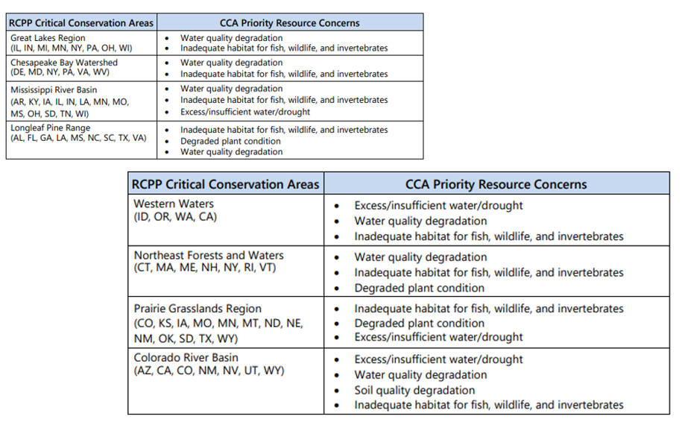


Critical Conservation Area Priority Resource Concerns

Slide 10
Does the partner want to implement
the conservation activities? Does the partner have the capacity to deliver a majority of the technical
assistance?
NO →Partner Inspired, Classic
OR YES → Partner Led, AFA
PROGRAM Structure
Planning?
Installation?
RCPP
Alternative Funding Arrangement (AFA)
Critical Conservation Area (CCA)
State/Multi-State
IRA
Classic
Critical Conservation Area (CCA)
State/Multi-State
IRA
Checkout?

Slide 11
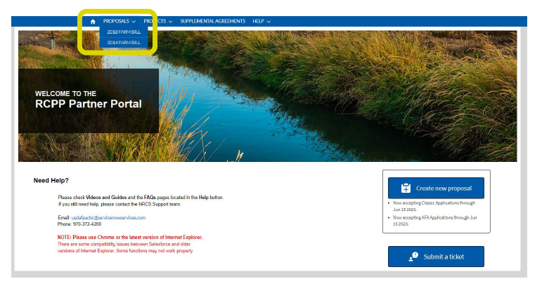
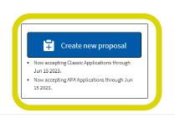
Workflow for RCPP Partner Proposal
Obtain eAuth Access
Obtain RCPP Portal Access
Develope RCPP Proposal
Submit RCPP Proposal
NRCS Review Process (State and NHQ)
NRCS Selects Proposals for Funding

Slide 12
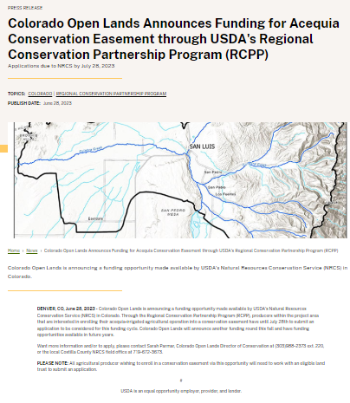
Workflow for RCPP Awarded Proposal
PPA Negotiations (Activities, Deliverables, Outcomes)
PPA Signatures
SA Negotiations
(Type I, II, III, IV- Deliverables)
SA Signatures
Project Kick-off
Announcements to Landowners

Slide 13

Workflow for RCPP-Classic, Active PPA
NRCS Announcements
Landowner Applications to NRCS Field Office
Eligibility, Ranking, Assessments, Producer Contracting, CPA52, and Cultural Resources
Active Producer Contract
Implementation

Slide 14
Workflow for RCPP-AFA, Active PPA
Partner Announcements
Landowner Applications to Lead Partner
NRCS Due Diligence Items
Implementation
Type 3 SA Reimbursement
Partner holds the Producer Contract and Provides Technical Assistance

Slide 15
Timeline
Pre-planning
  Identify project need
  Identify resources and technical capacities
Proposal Development
  Discussions with District Conservationists and local experts
  Discussion with RCPP Coordinator, State Technical Staff, and State Conservationist
NFO Announcement
  Portal Access
  Submit Proposal, Contributions Letters, and Map of Project Area
Proposal Reviews
  State Level Reviews (Classics 4 weeks)
  NHQ Review
  Award Announcements
PPA and SA negotiations (3-7 months)
  PPA negotiations
  SA Negotiations (Type 1 developed with PPA, 1+ month)
Active PPA/SA Implementation
  Announcements for producer contracts/parcel contracts
  All partner deliverables are met within the 5 years of the active agreement
  One year extension modification
  Renewals (90% of FA funds are expended)

Slide 16
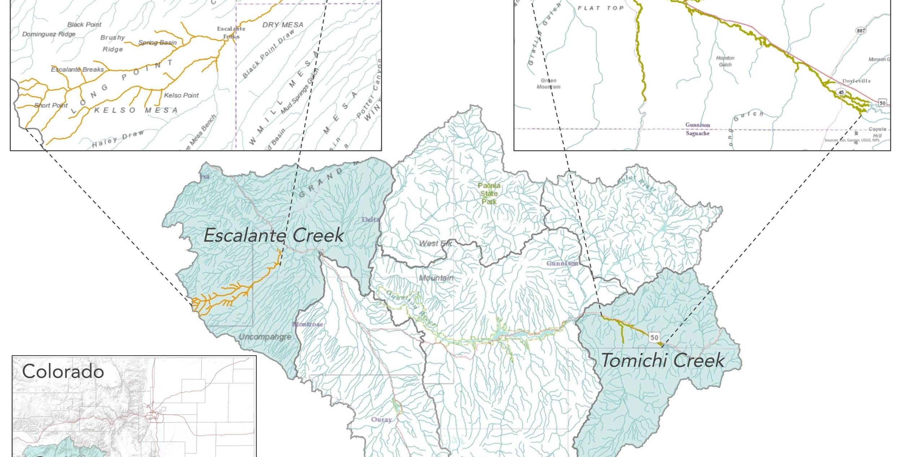
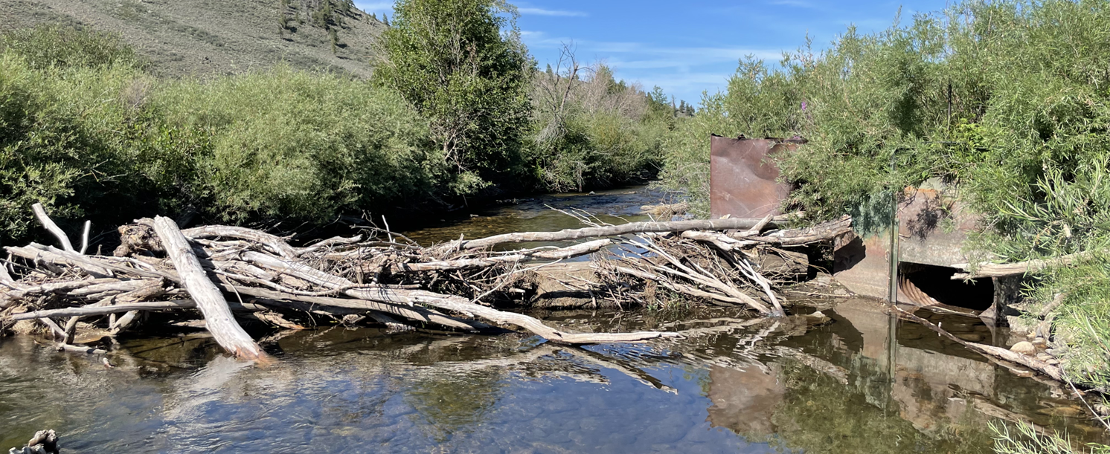
Project Example
Project Goal: Increase ecological and agricultural resiliency to drought by restoring wetlands and riparian areas while improving irrigation water management on at least five working ranches in three distinct tributaries
Project Type: AFA
Fund Pool: Colorado River Basin Critical Conservation Area
Primary Resource Concerns: Excess/insufficient water/drought
Additional Resource Concerns: Water quality degradation; Inadequate habitat for fish, wildlife, and invertebrates; Soil quality degradation
Activities: LM (supplemental agreement) (395- Instream Habitat Improvement, 587 Structure for Water Control)
Implementation: The lead partner provides the technical assistance on behalf of NRCS. NRCS still has due diligence responsibilities, but the partner holds the agreements with landowners.

Slide 17
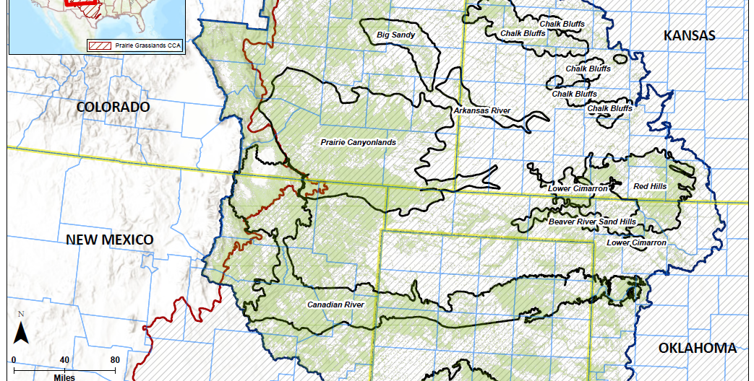
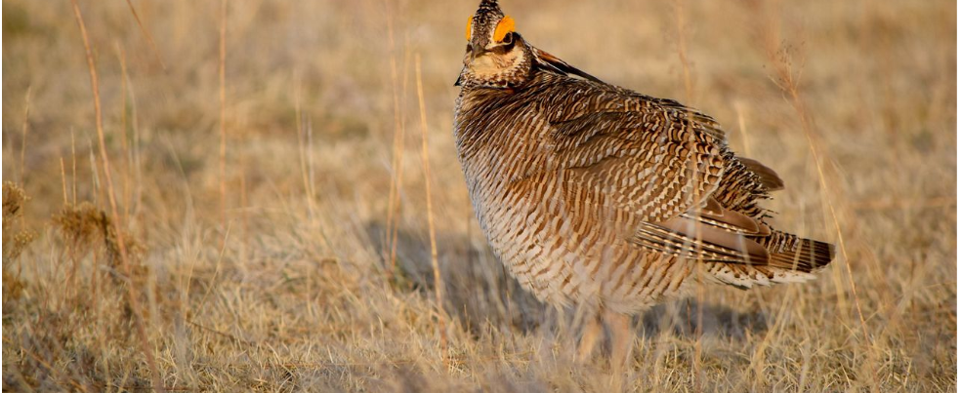
Project Example
Project Goal: asdfasdf
Project Type: Classic
Fund Pool: Prairie Grasslands Region Critical Conservation Area
Primary Resource Concern: Terrestrial Habitat
Additional Resource Concerns: Aquatic habitat; Degraded Plant Condition; Long term protection of land; Weather resilience
Activities: LMR, EHE (producer and parcel contracts)
Conservation Value Statement: Further the restoration, protection, enhancement, management, maintenance, and monitoring of ag use and future viability and related conservation values on the protected property.
Implementation: NRCS provides the technical assistance, so implementation looks similarly to our other programs.

Slide 18
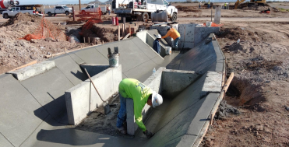
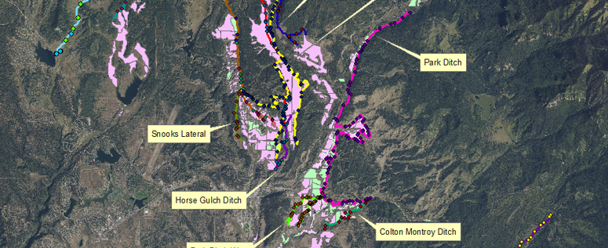
Other Project Examples
Land Management via Supplemental Agreement and Producer Contracts (Classic) - Delivery Ditch and On-Farm Activities
Land Management via Supplemental Agreements (AFA) - Delivery Ditch and On-Farm Activities
Watershed Project via Supplemental Agreement (Classic or AFA) – PL566-like activities, no producer contracts, canal lining and sublateral canal lining

Slide 19
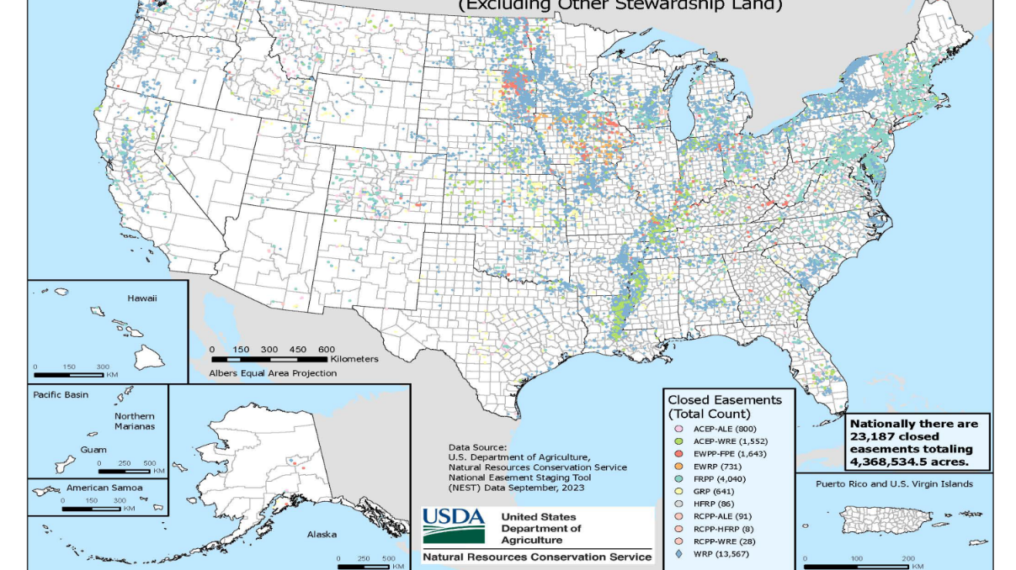
Other Project Examples
Entity Held Easements (EHE)
US Held Easements (USHE)
Buy-Protect Sell Easements (BPS)

Slide 20
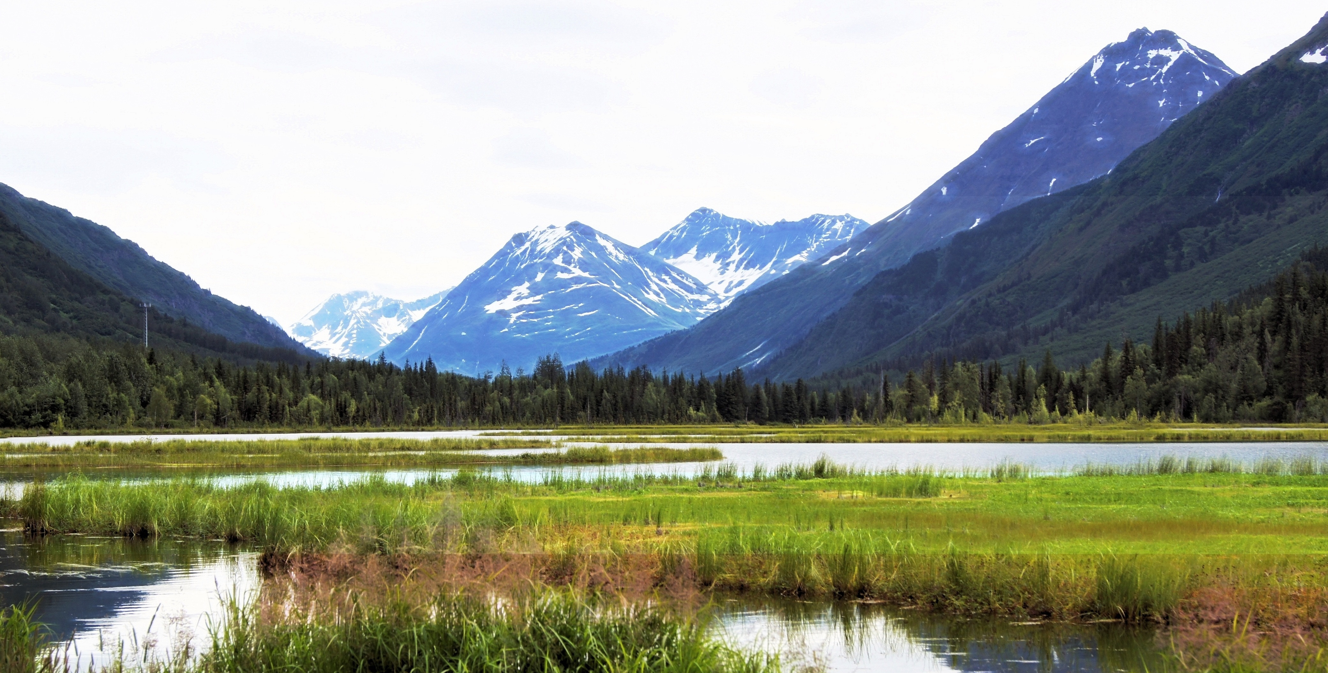
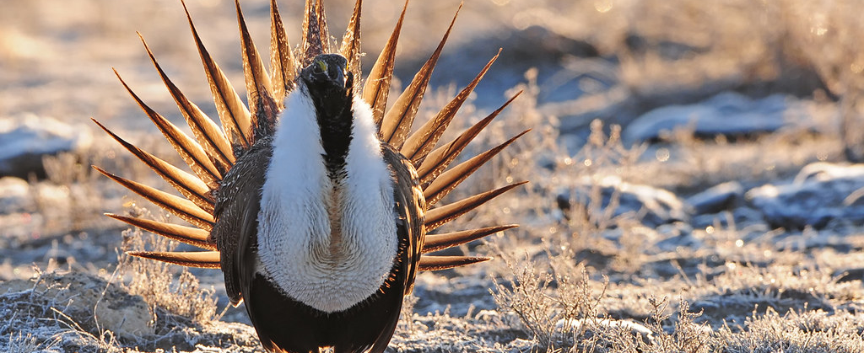
Other Project Examples- RCPP EHE, USHE, and BPS
Easement purposes aren’t limited to protecting agricultural and grazing uses
Easements address a conservation benefit and minimum deed terms
There are 6 versions of MDT
Federal Cost Share 25-50% (75% for HU)
RCPP Easement Plan (not required under minimally restrictive)
With US ROE | Without US ROE
Highly Restrictive | Highly Restrictive
Moderately Restrictive | Moderately Restrictive
Minimally Restrictive | Minimally Restrictive
This Photo by Unknown Author is licensed under CC BY-NC

Slide 21

Resources and Questions
How to Apply as a Partner
RCPP Agreements and Templates
Frequently asked Qs
Map of Active RCPP Projects

Slide 22

Thank you
Marissa.markus@usda.gov !!

