Slide 1

Brandi Baquera, Coordinator

Slide 2

What Is It?
32-hour professional development course offered to producers and crop consultants
Organized and designed by a farmer-led project advisory committee
Focuses on advanced conservation and irrigation management practices
Goal: To equip participants with knowledge and connections they can use to save water while maintaining/enhancing farm profitability.

Slide 3
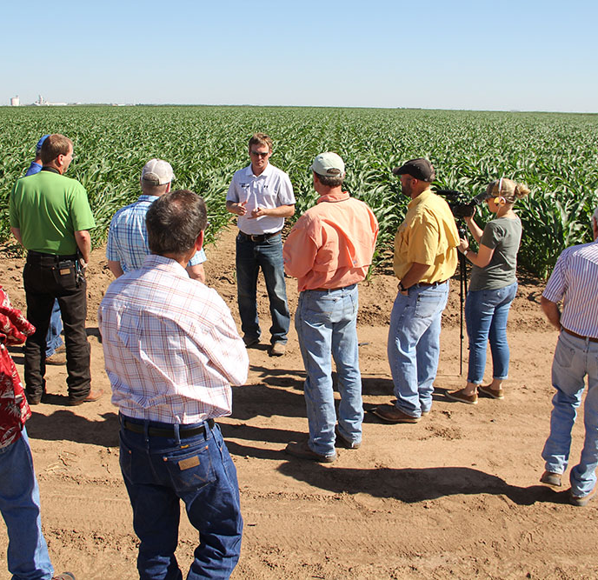


How Does It Work?
Modeled after a successful Master Irrigator Program run by North Plains Groundwater Conservation District in North Texas since 2016
25 seats offered to interested producers, crop-advisers, or agriculture-related industry representatives
Classes are held once a week for 4 consecutive weeks
Republican River Basin program moves host locations across the basin each year
Each session designed around a theme
  Economics included in every session
Presenters include representatives from state and federal agencies and universities as well as local businesses and producers
  Presentations limited to 30-45 minutes with emphasis on interactive discussions throughout

Slide 4
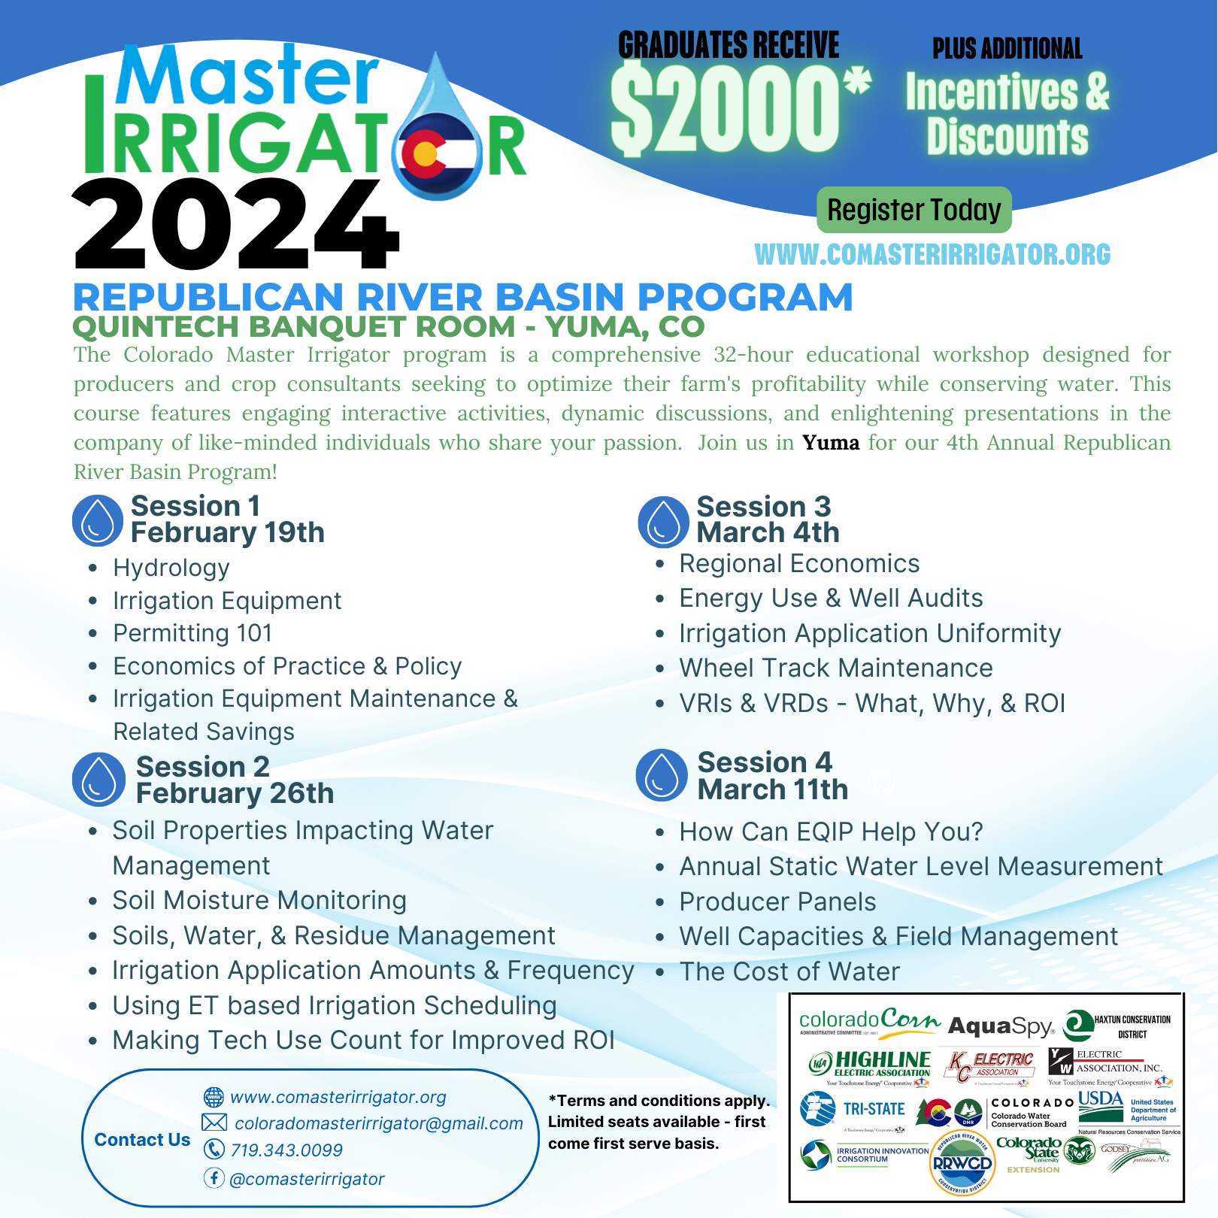
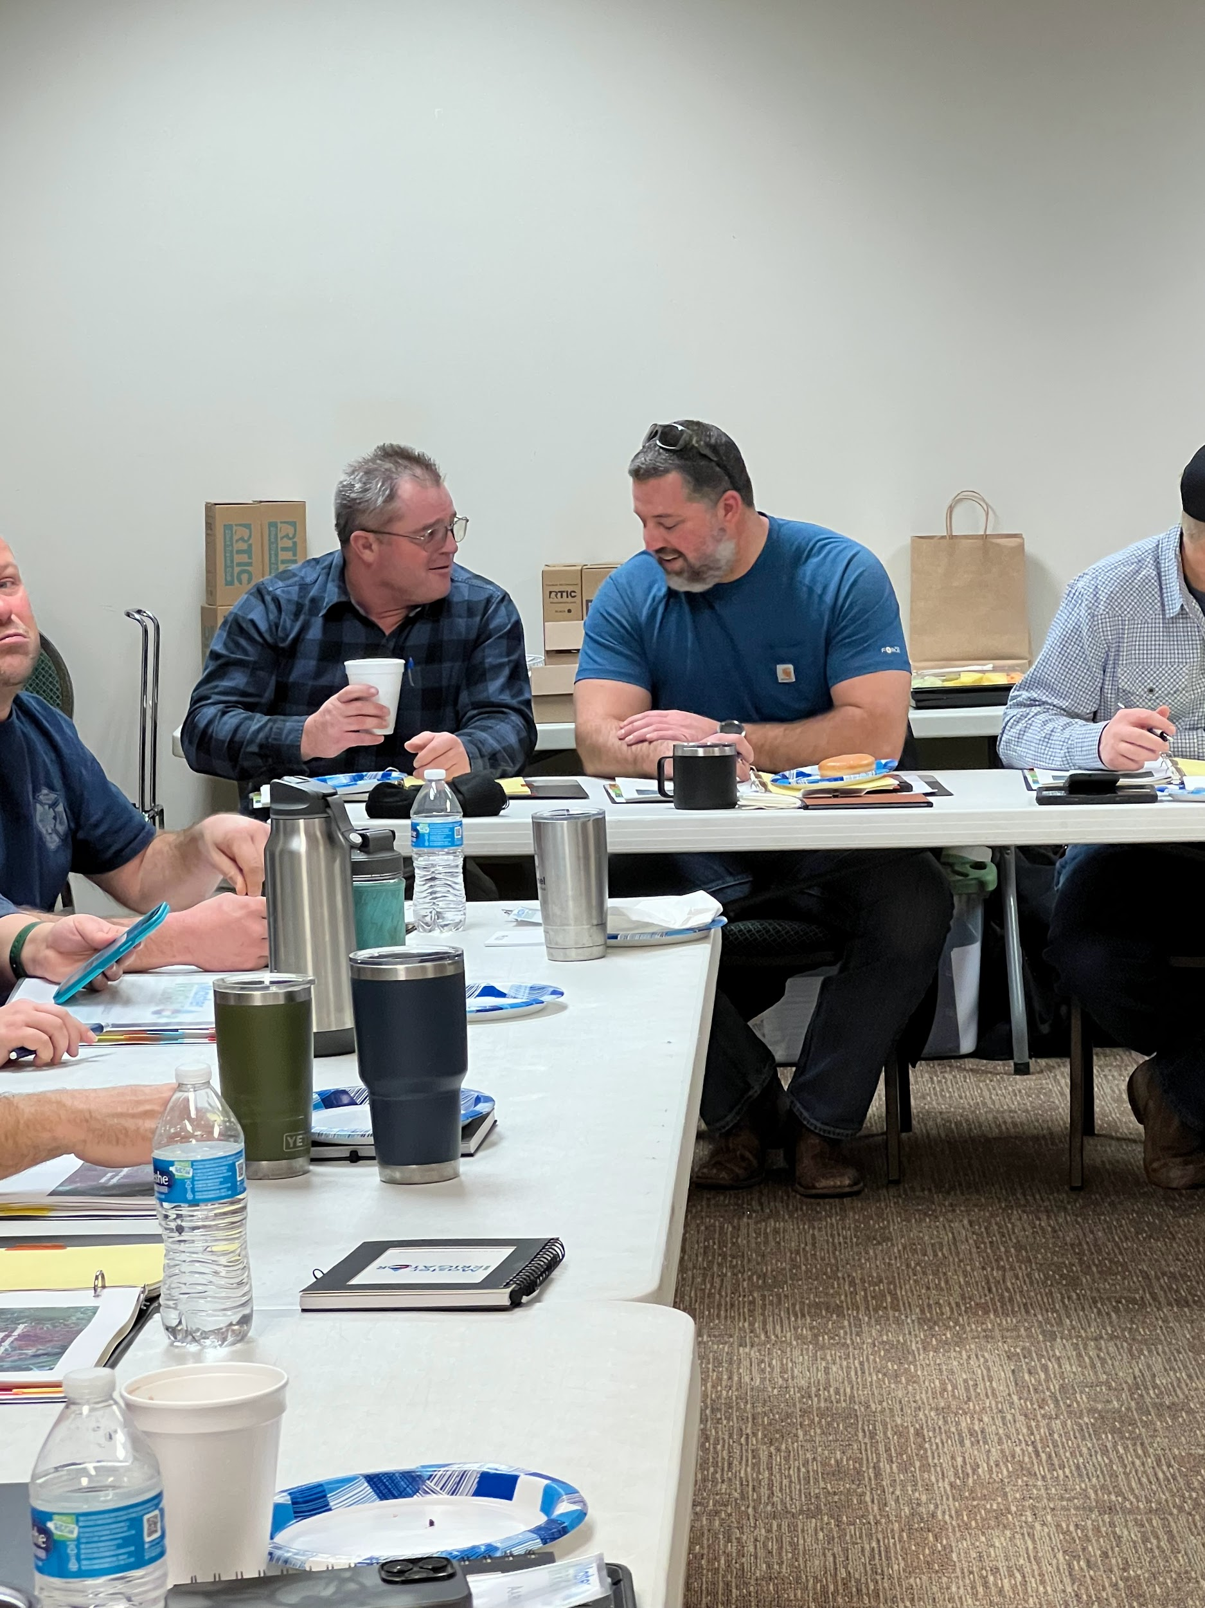
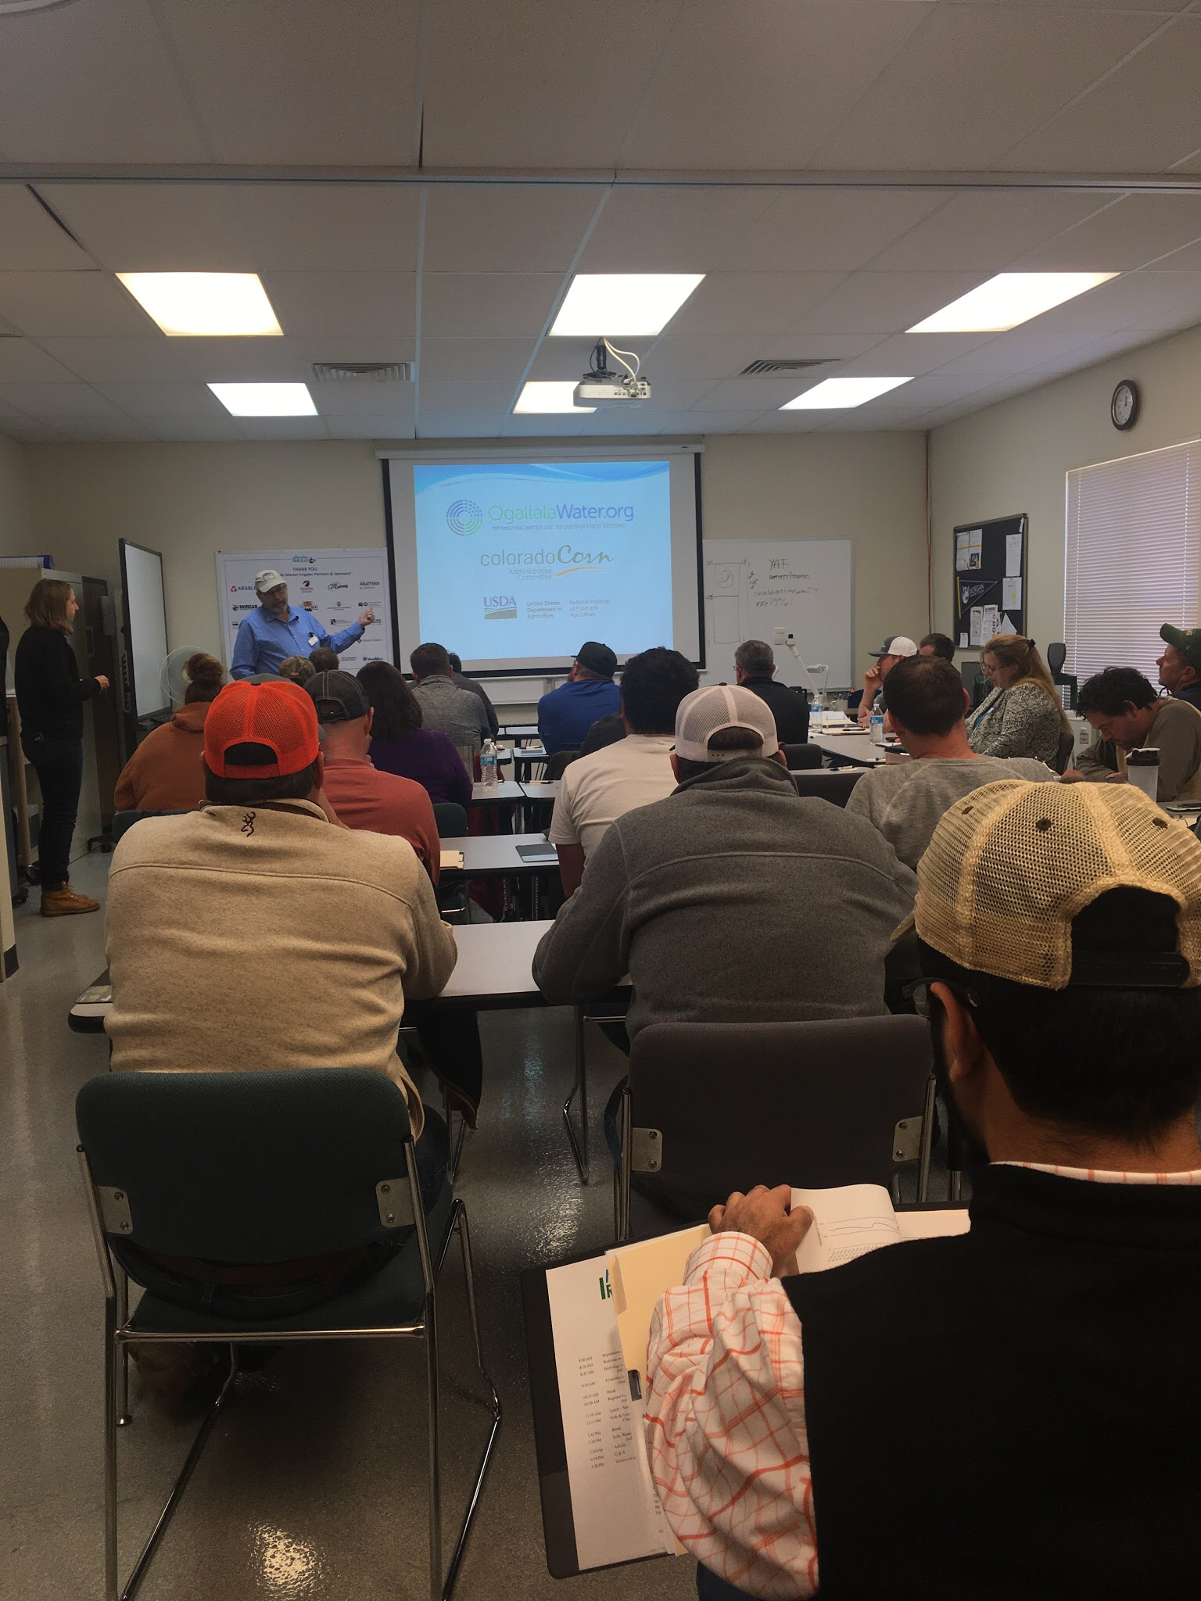
Agronomics, irrigation scheduling, tech, hydrology, incentives program, etc.
Tried and True practices and technologies available today

Slide 5
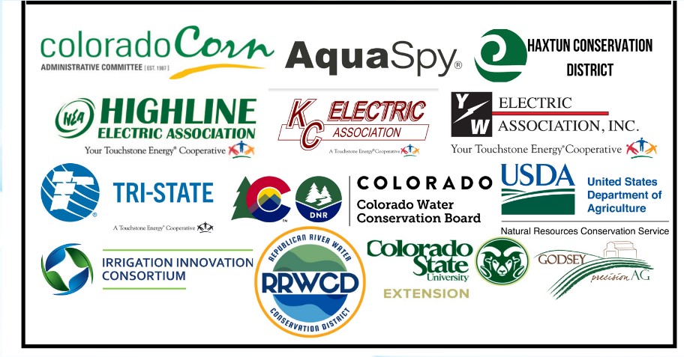
Incentives
$2000 Stipend
  $1250 paid upon graduation
  $250 each year for three years upon receipt of EOY survey
Special EQIP priority ranking points through NRCS
Energy Audits
Master Master Competition Award
  Up to $10,000 in reimbursements on conservation-oriented tools or practices
Partner discounts and products

Slide 6
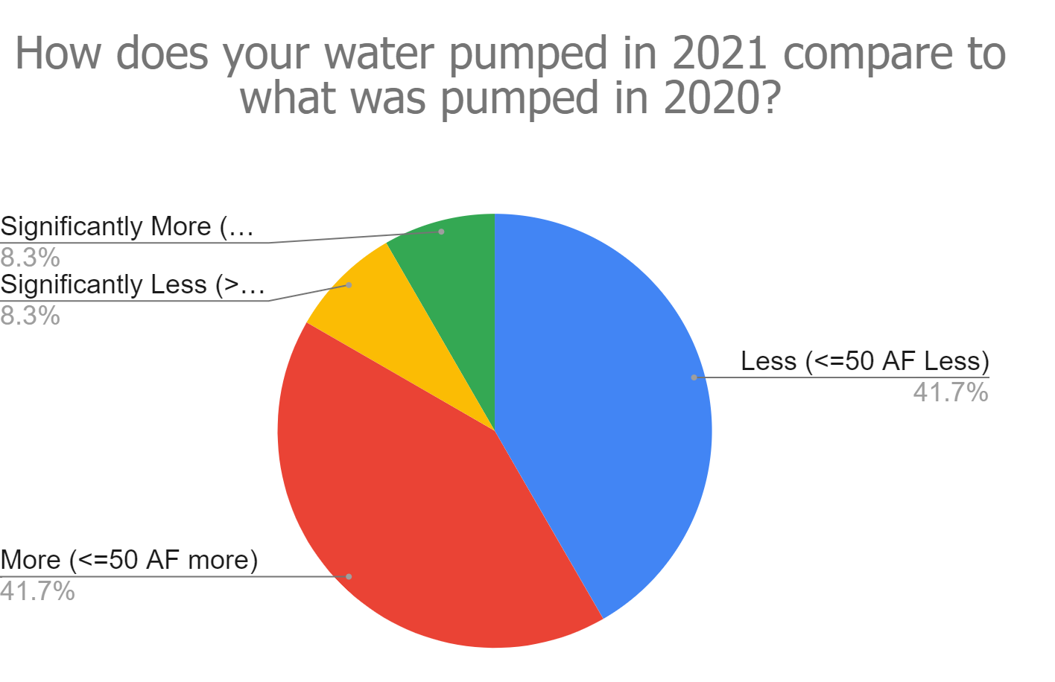
Potential Results
Increased water & energy use efficiency
Potential pros, cons & costs of many water management tools & strategies
  Assist producers with finding ways to make conservation profitable
Interstate Compact Discussions
Provide incentives, discounts, and other opportunities to graduates
Support a network of a younger generation (on average) of producers
(>50 AF)
(<50 AF)
Even in heavy drought, 50% of our 2020 graduates reported less water use than previous years.

Slide 7
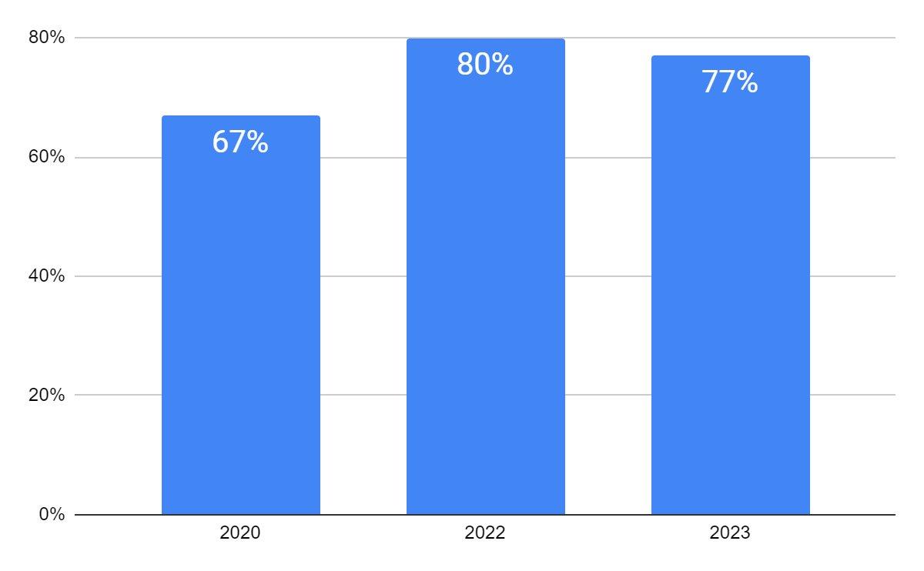
Actual Results
Did your perspective or approach to working on water conservation on your operation change in any way as a result of participating in Colorado Master Irrigator?
Mindset Change
>200,000 Irrigated Acres Represented
Multi-state Program Development
Relationship Building
Yes!

Slide 8
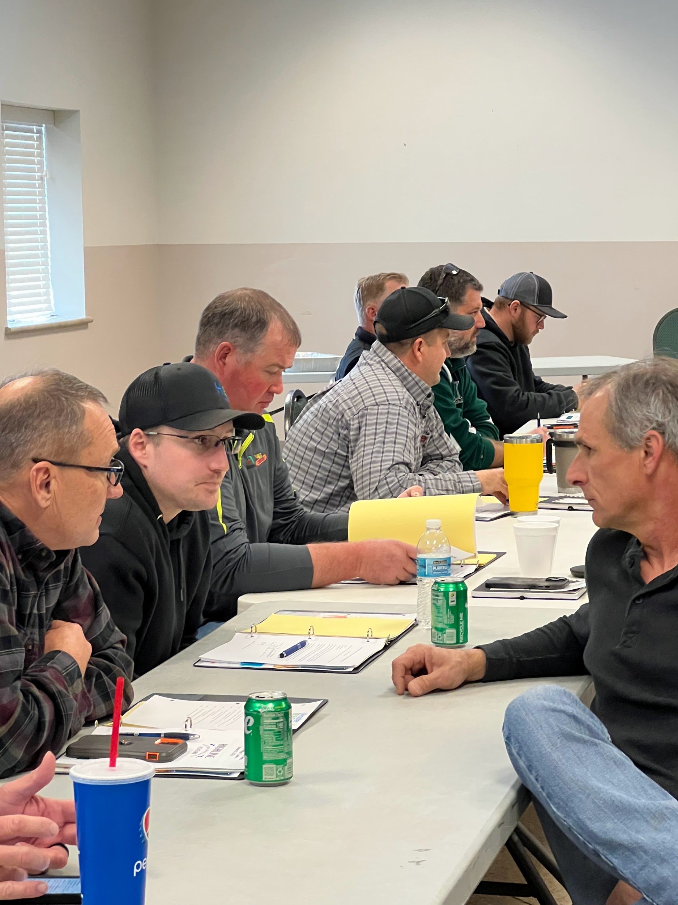
Graduate Feedback
“I really enjoyed the Producer Panels because you could see how the things we had talked about got applied in real life and the results.”
~2023 CO MI Graduate
“I enjoy the variety that is presented. The speakers are detailed and specific, but they are not presenting on such a narrow band of information that ideas are constantly repeated.”
~2023 CO MI Graduate
“The interaction & discussion between in-person students and presenters is my favorite thing about the class. One question typically turns into a very nice discussion about something that wasn't talked about or even a more in-depth answer than what was wanted.”
~2022 Graduate

Slide 9
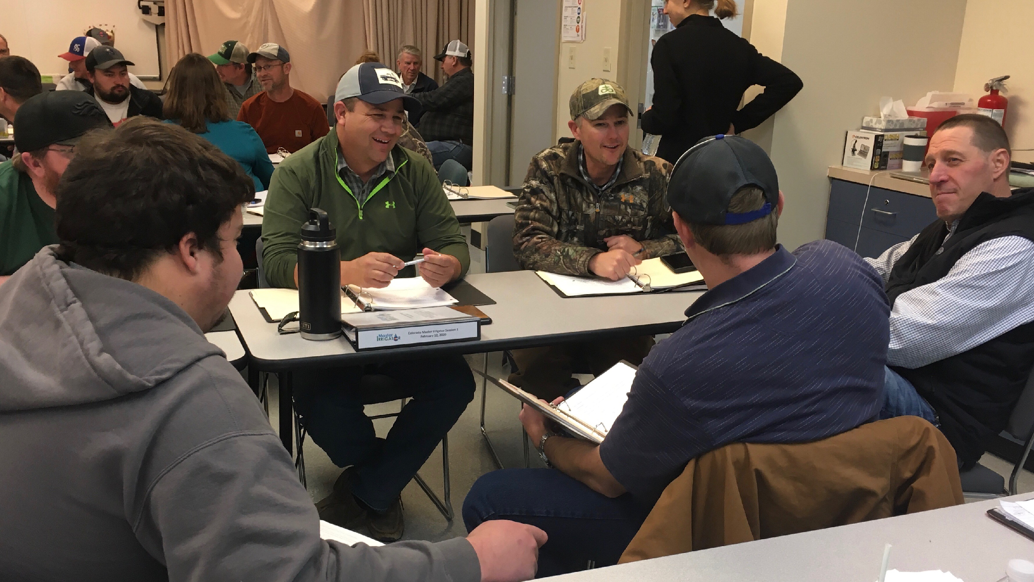
”I love the open discussion with the speakers and attendees. We can really discuss different ideas and see how they work in different environments.” ~2020 CO MI Graduate

Slide 10



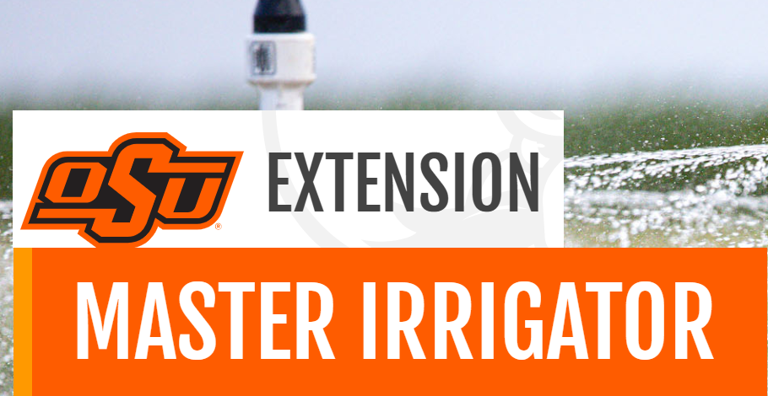
Questions?
Contact Us
Brandi Baquera, Program Coordinator
coloradomasterirrigator@gmail.com
@CoIrrigator Colorado Master Irrigator
Visit other Master Irrigator program sites:
https://northplainsgcd.org/conservationprograms/communityedu/master-irrigator/
https://extension.okstate.edu/programs/master-irrigator/

Slide 11
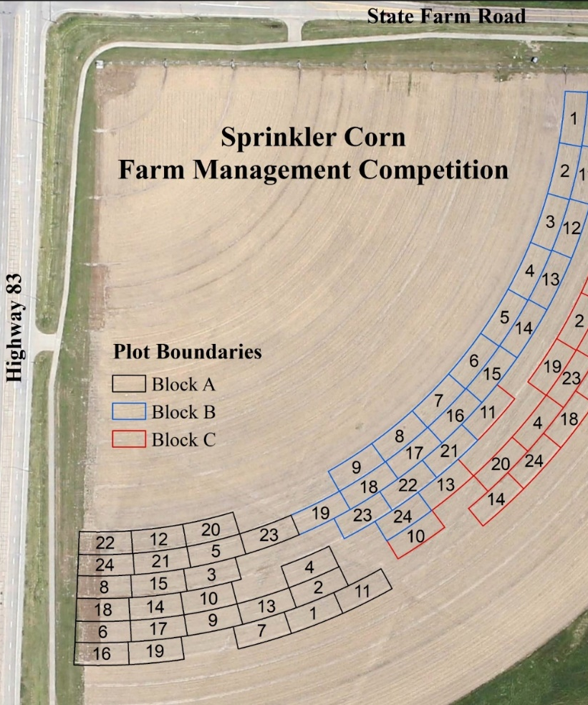
What is TAPS?
A farm management competition ​
designed to:
Build confidence in data-based management
Risk-free testing of technology and strategies
Focus on profitability & input use efficiency
Support research and demonstration
Encourage collaboration involving producers, researchers, industry and other ag sector partners
Recognize & celebrate producer management skill

Slide 12
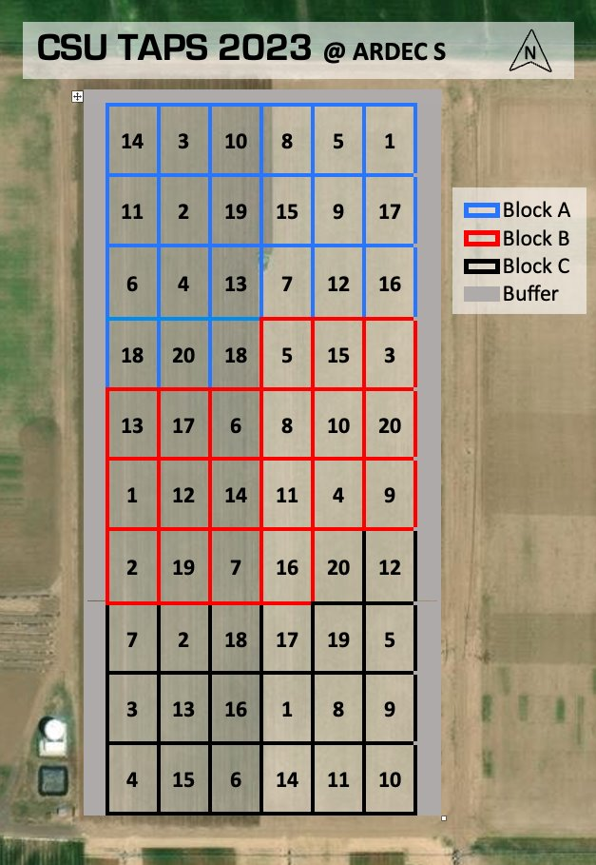
Competition Overview at CSU
Hosted at CSU ARDEC-South
18 teams + control and research
Simulated Farm Size: 1,000 ac
  Three randomized plots
6 management decision types
3 award categories:
  Most profitable
  Most input-use efficient
  (Highest Yield)

Slide 13
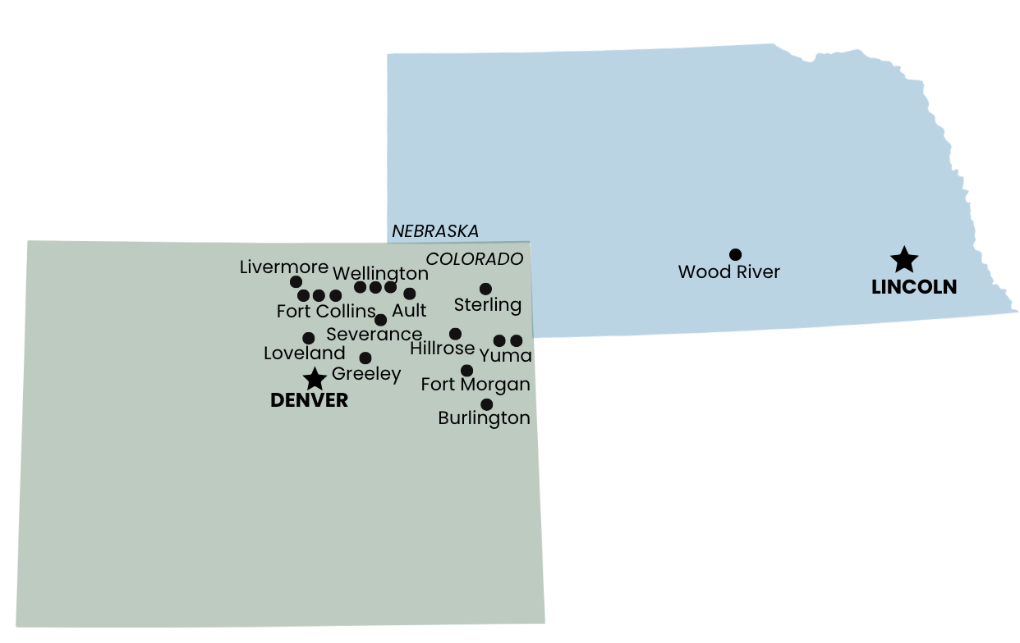
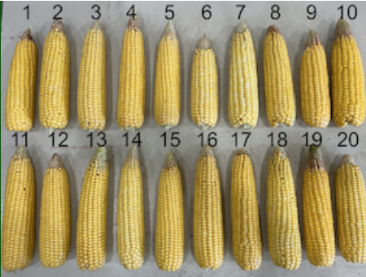
CSU-TAPS 2023
Participants
20 teams involving ~45 participants
Participating producers in 2023 split between Front Range, Eastern Plains
Included 1 Nebraska-based UNL-TAPS veteran team, competing “open book”
Some teams involve multiple family members or farm business associates
Input providers and/or seed dealers involved for some producer-led teams
Teams represent wide range of experience re: technology, precision irrigation strategies, grain marketing, etc.

Slide 14
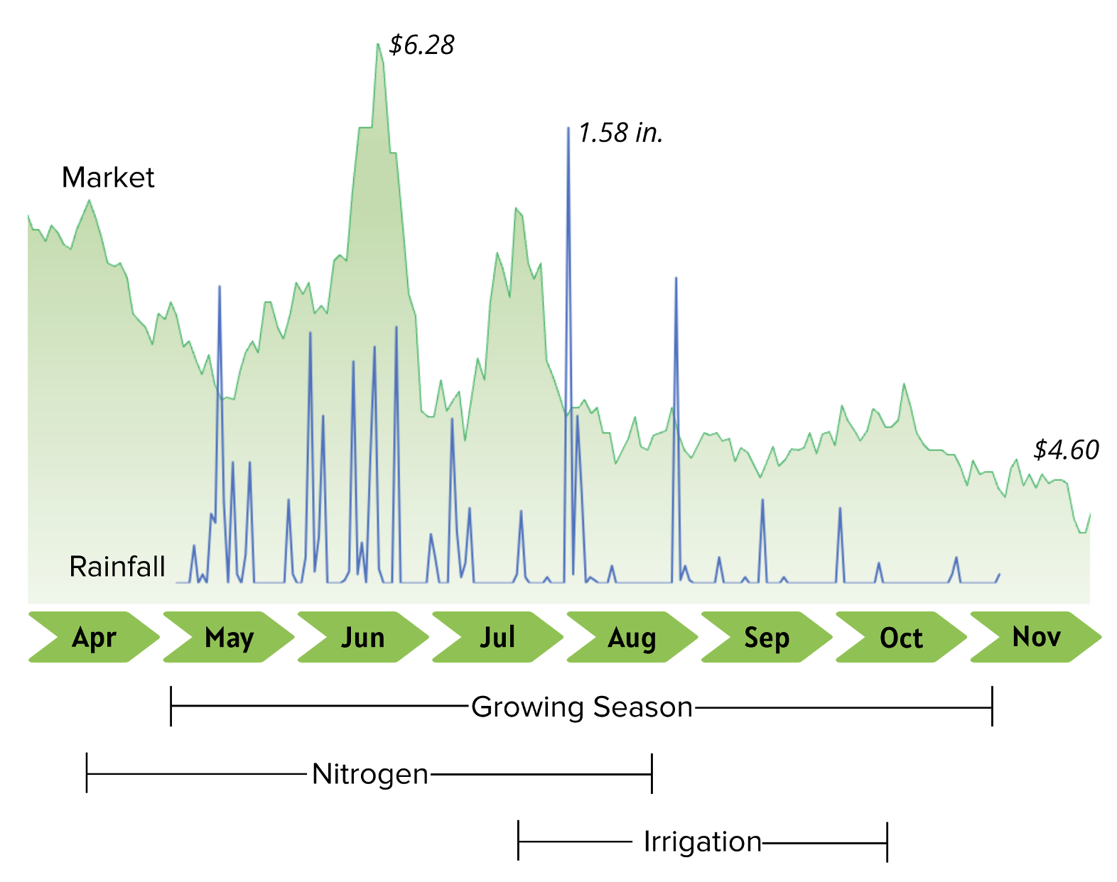
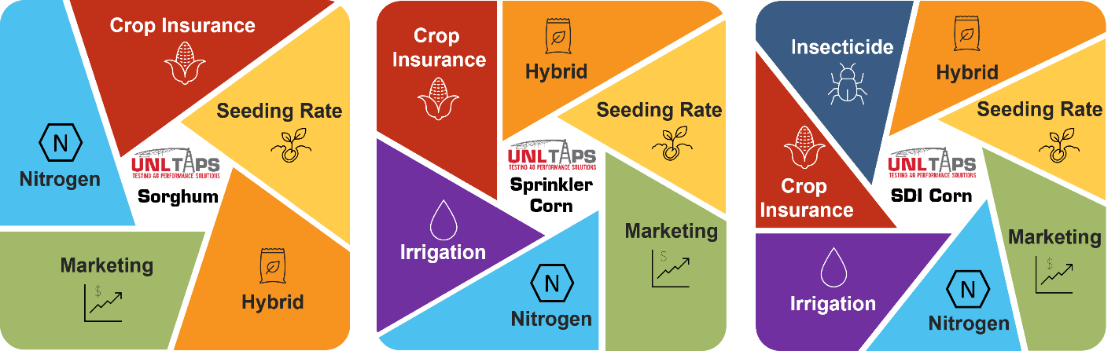
CSU TAPS 2023
Timeline
TAPS decisions:

Slide 15
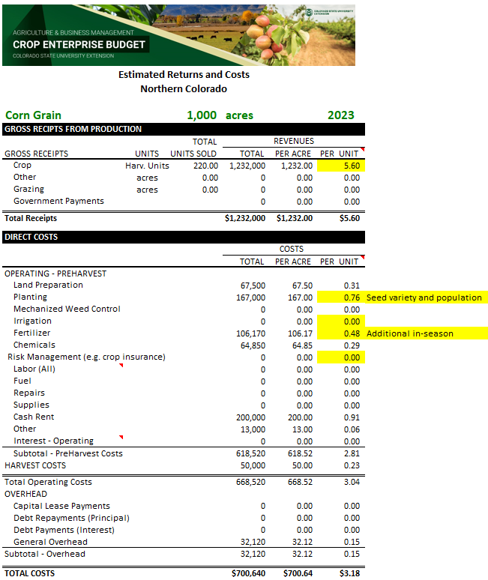
CSU-TAPS 2023
Farm Budgets
Simulated Acres:
1,000​
APH:
220 Bu/Ac
Bu to Market:
220,000

Slide 16
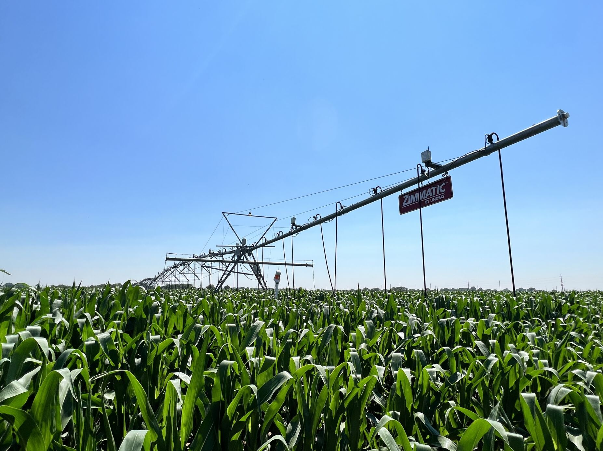
2023 CSU-TAPS
Management Decisions
Hybrids: 15, CRM of 92-104 days
Hybrid Cost: $94-$148
Planting Population: 28,000-36,000
Irrigation: 4.6-14.20 in.
Total Nitrogen: 110-350 lbs
  Pre-Plant: 60 lbs/acre
  Sidedress: 0 to 100
  Fertigation: 0 to 90
Insurance: $10-$50
Marketing: Closed December 12

Slide 17
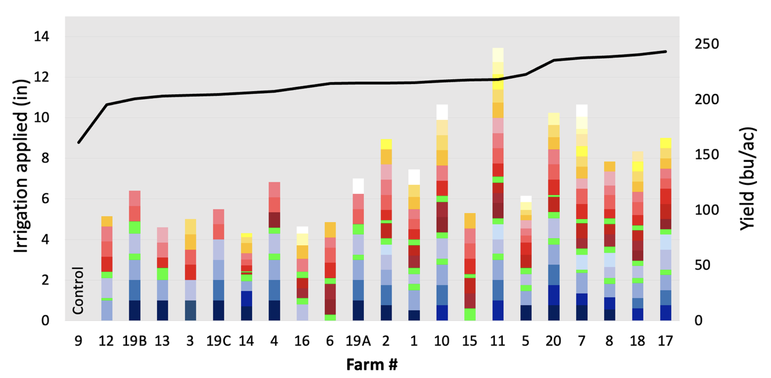

Slide 18
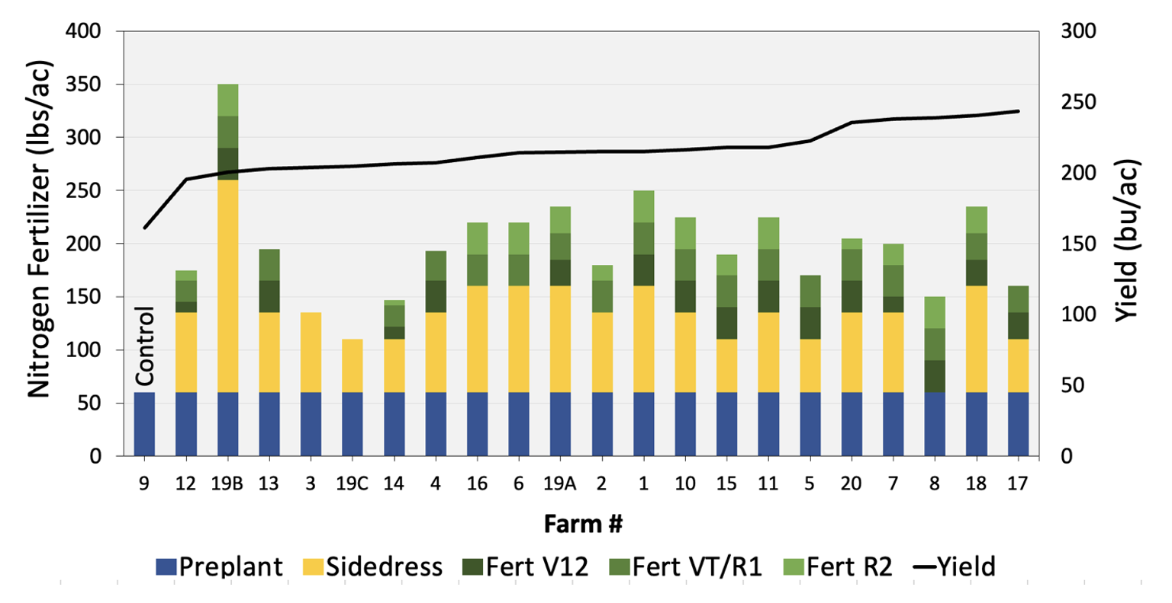

Slide 19
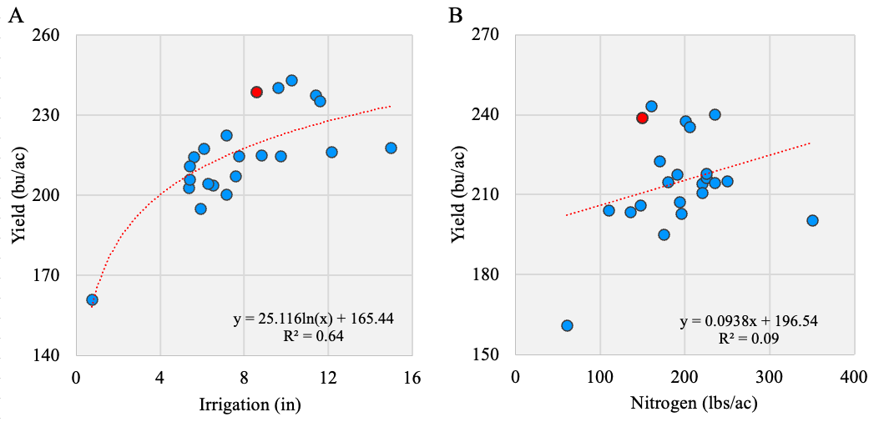
Corn grain yield response
to seasonal total irrigation (A, left) and nitrogen fertilizer (B, right)

Slide 20


Slide 21
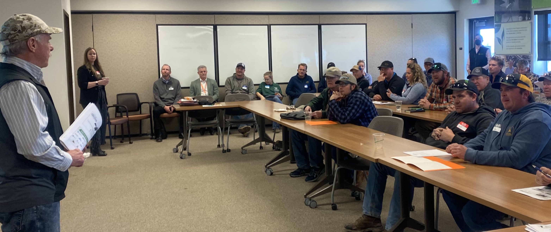
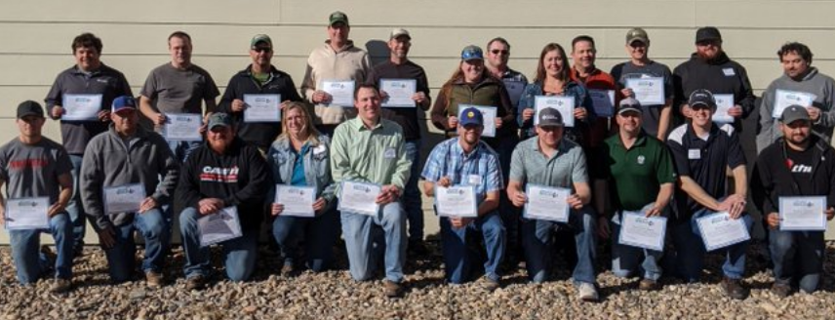
Common goals, complementary approaches:
Supporting low risk, high value learning
Building trust and community experience
Increasing precision management skill and knowledge
Expanding access to incentives, funding for system upgrades/updates
Encouraging profitable and input-use efficient management strategies

Slide 22
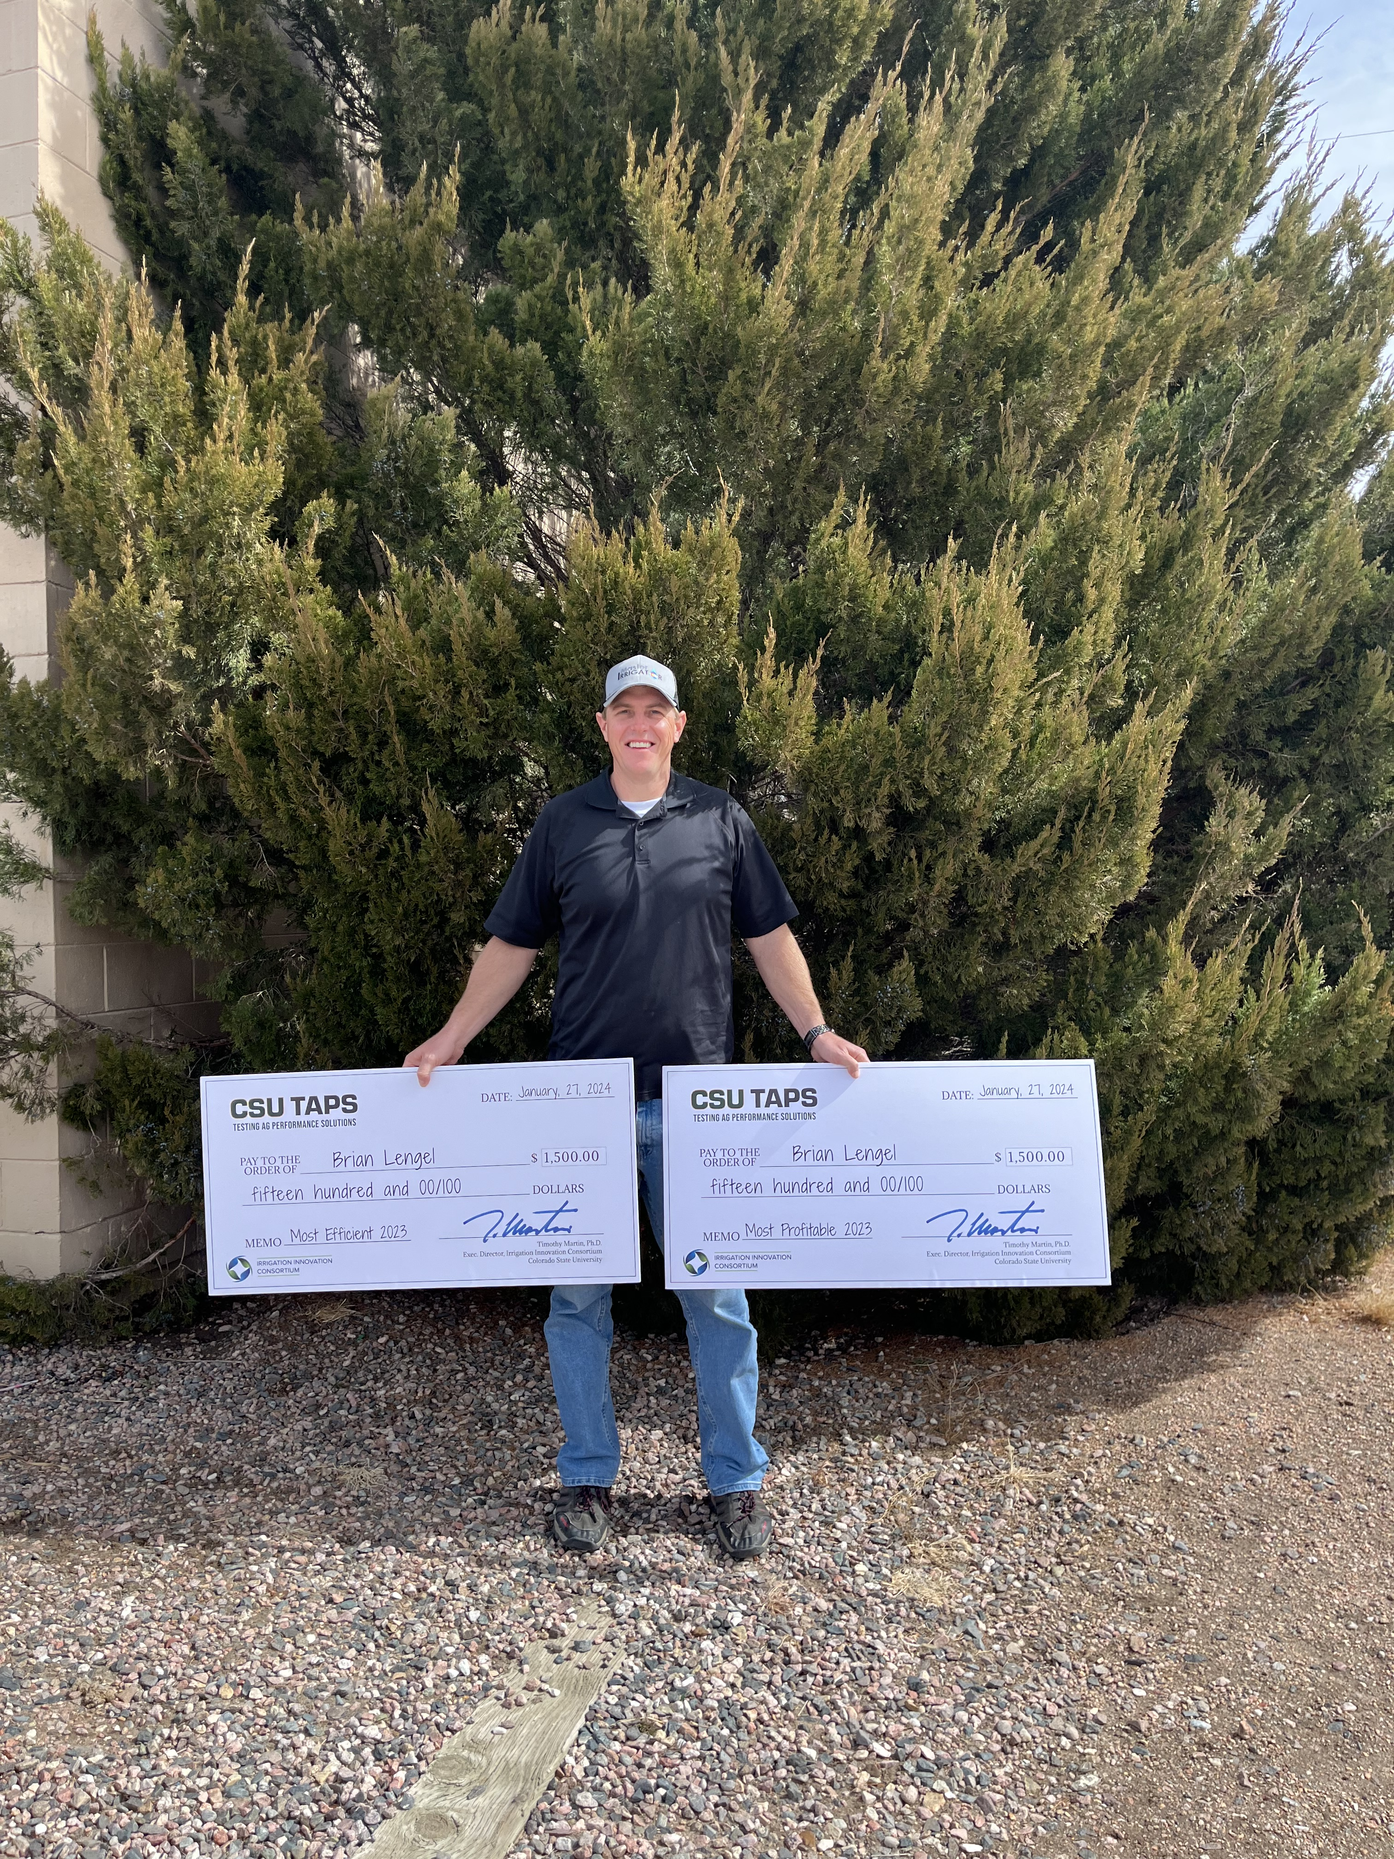
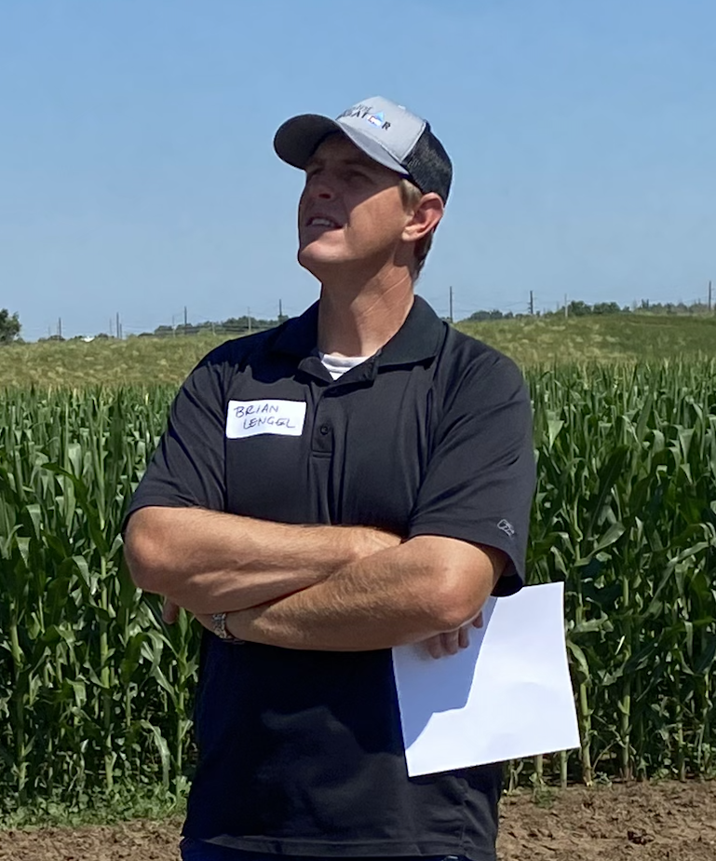
CSU-TAPS 2023
"Most Profitable" Award Winner
Profit/acre of $431
​Crop Ins: RP with EU at 65% coverage
3rd place yield: 239 bu/acre​
Hedge marketing strategy ​
Hybrid/rate Channel 199-60STXRIB
31,000 sds/ac​
150 lbs N/ac & 8.6 inches of water/ac ​
Awarded to Farm 8
Brian Lengel, of Idalia, CO

Slide 23

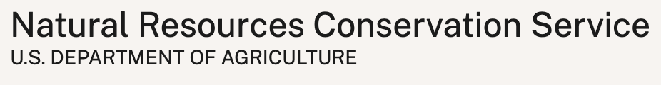




“Climate Smart Advances in Ag Performance”
Technical Agreement est’d Sept 2023
External Year 1 Match:

Slide 24
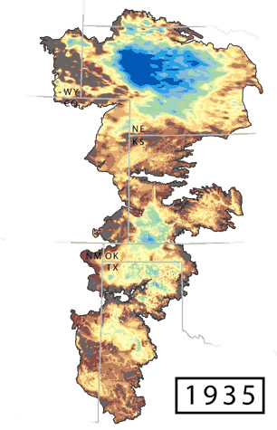






Coming soon:
KS Master Irrigator
Coming soon:
+ work with
Master Irrigator programs
beyond the High Plains!

Slide 25
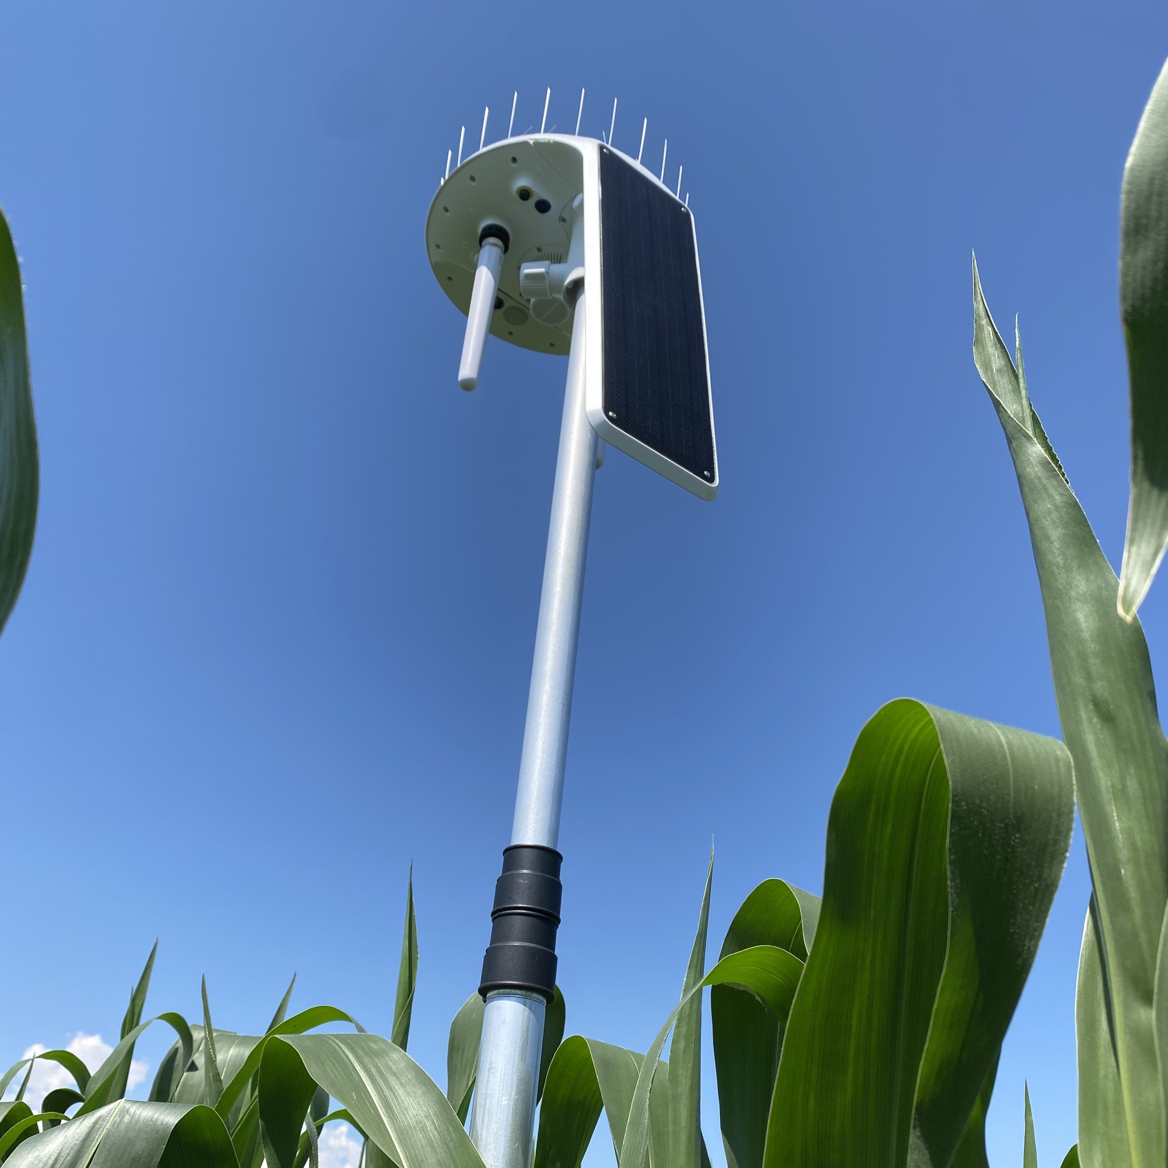
Multi-state efforts
Strengthen and expand Master Irrigator and TAPS
TAPS data portal
Program communications
GHG study & analysis
Strategic partnerships
Foundation for applied research
Develop common templates
Connect with beef/dairy sector
Build strong communities of practice
Improve access to support and incentives

Slide 26


Slide 27
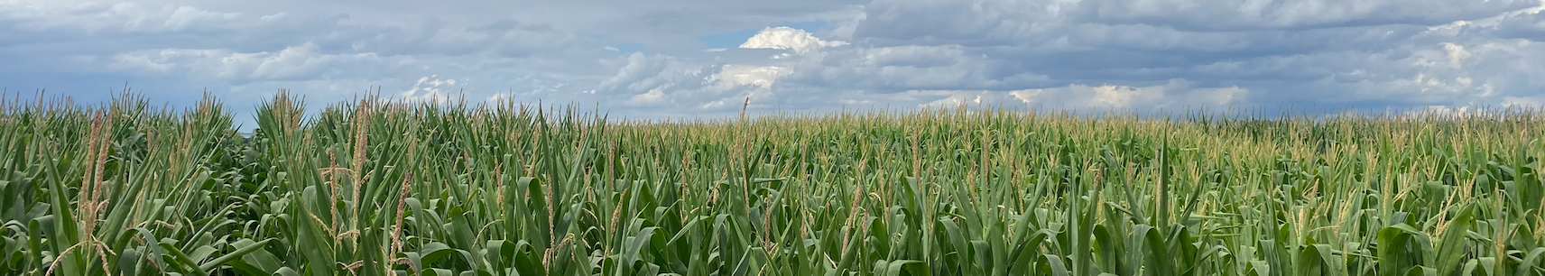


Thank you! Questions?
Colorado State Technical Advisory Committee
Testing Ag Performance Solutions & Master Irrigator
“Climate Smart Advances in Ag Performance” 5-state effort
March 13, 2024
Amy Kremen, IIC Associate Director
amy.kremen@colostate.edu
Brandi Baquera, CO MI Program Coordinator
coloradomasterirrigator@gmail.com

