Slide 1
FY2024 GARC
Recommendation from the prior STAC meeting, was just generally, to increase the GARC rate.
FY23 GARC – 80% EFMV of Individual appraisals, Not to Exceed $5,000/acre.
Recommendation from ACEP Subcommittee - FY24 propose rate of 95% EFMV of Individual appraisals, Not to Exceed $5000/acres
Notes:
Individual appraisals since 2014 due to low enrollment, wide variability of land uses and values across the state, and high cost of completing an Area-Wide Market Analysis (AWMA).
Colorado has only had one eligible WRE enrollment since 2013.
Colorado would like to continue this method.

Slide 2
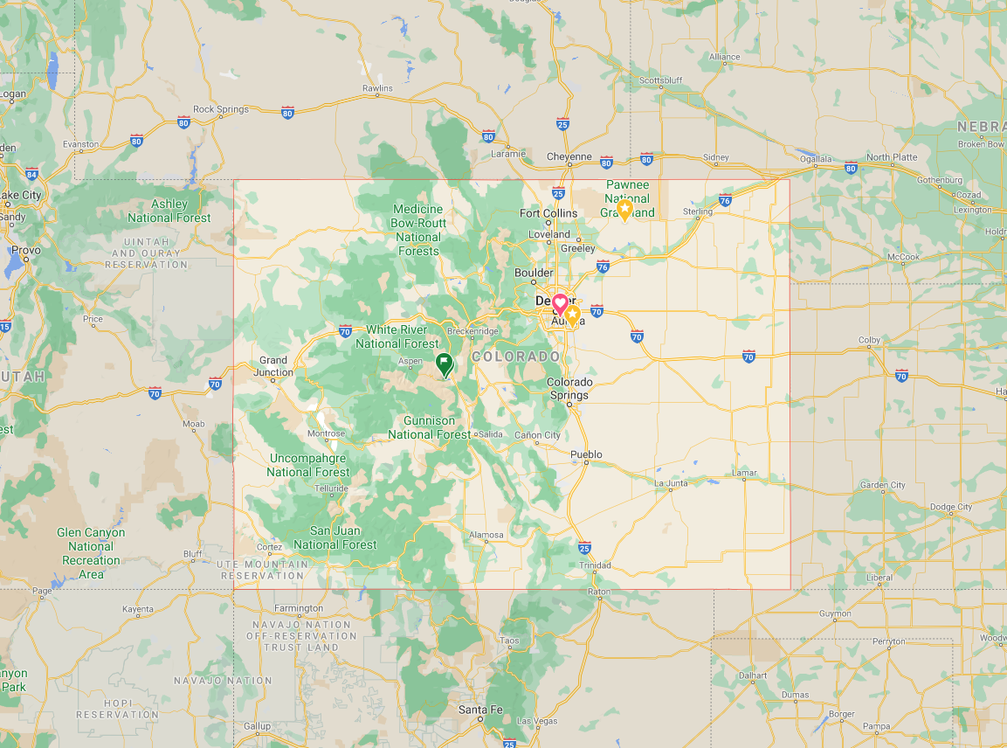
FY23 Geographic Area Rate Cap (GARC) -WRE
Wyoming:
85% EFMV of individual appraisals for all land uses statewide, NTE $5,000/ac
Nebraska:
90% EFMV of individual appraisals statewide
NTE $9,535/ac for irrigated cropland
NTE $5,000/ac for all other land uses
FY23 COLORADO:
80% EFMV of individual appraisal NTE $5,000/ac statewide and all land uses, no min/max acres
Kansas:
AWMA Region 1 $2,312/Ac (Min Ac 0 - Max Ac 400) >60% cropland
All other land use combos or >400 ac use individual appraisals
Utah:
85% EFMV of individual
appraisals statewide,
NTE $5,000/ac
Arizona:
Not provided.
New Mexico:
90% EFMV of individual appraisals statewide, NTE $5,000/ac
Oklahoma:
80% EFMV of individual appraisals statewide, NTE $2,000/ac
Notes:
EFMV – Estimated Fair Market Value
AWMA – Area Wide Market Analysis

Slide 3
FY24 GARCs - WRE
Wyoming:
85% EFMV of individual appraisals for all land uses statewide, NTE $5,000/ac
Nebraska:
90% EFMV of individual appraisals statewide,
NTE $12,970/ac for irrigated cropland
NTE $9,320/ac for all other land uses
FY24 COLORADO:
95% EFMV of individual appraisal NTE $5,000/ac statewide and all land uses, no min/max acres
(Proposed)
Kansas:
Region 1 – AWMA GARC 95% NTE $3,744/Ac (Min Ac 75 - Max Ac 940) all other variables use individual appraisals
Utah:
Not provided
New Mexico:
90% EFMV of individual appraisals statewide, NTE $13,000/ac
Oklahoma:
80% EFMV of individual appraisals statewide,
NTE $2,000/ac
Arizona:
Not provided
Notes:
EFMV – Estimated Fair Market Value
AWMA – Area Wide Market Analysis

Slide 4
Vote: Y/N
Recommend the proposed rate of 95% EFMV of Individual appraisals, Not to Exceed $5,000/ac.

