Slide 1
Overview of FY23 Program Delivery
Keith Griswold, Assistant State Conservationist for Programs

Slide 2
FY23 US Held Easement Successes
Increased monitoring performance
FY 22—43rd state in nation for completing US Held easement monitoring. Finished the last day NEST was open in September.
FY23---4th state nation for completing US Held easement monitoring. Completed August 14, 2023.

Slide 3
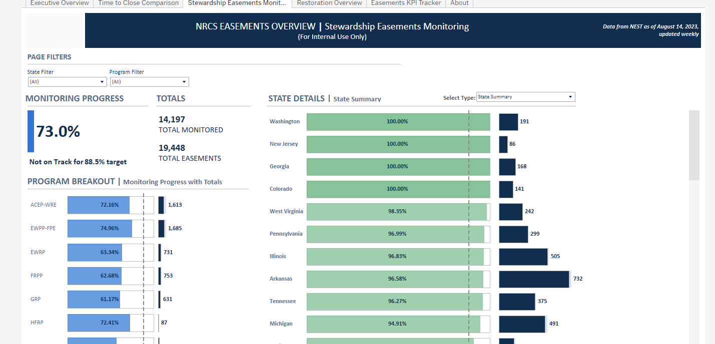
FY23 US Held Easement Successes

Slide 4
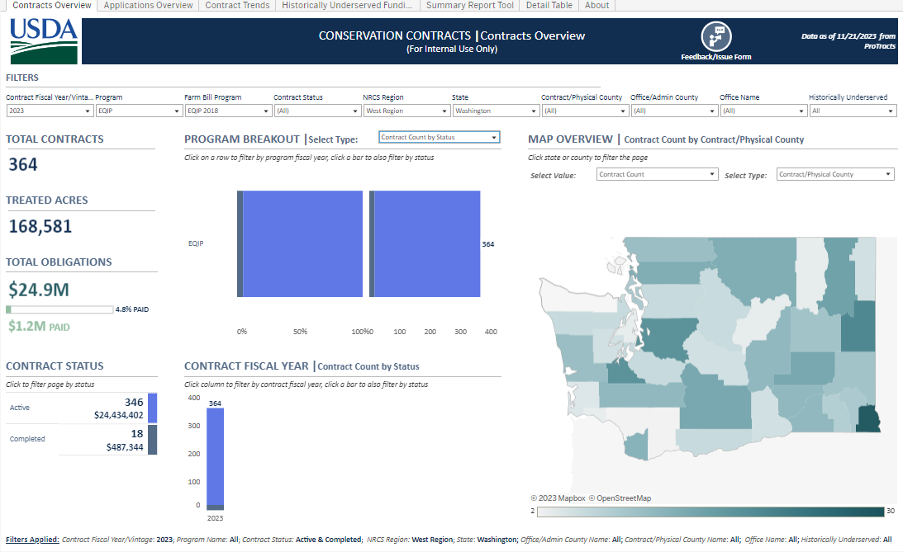
Environmental Quality Incentives Program (EQIP)

Slide 5
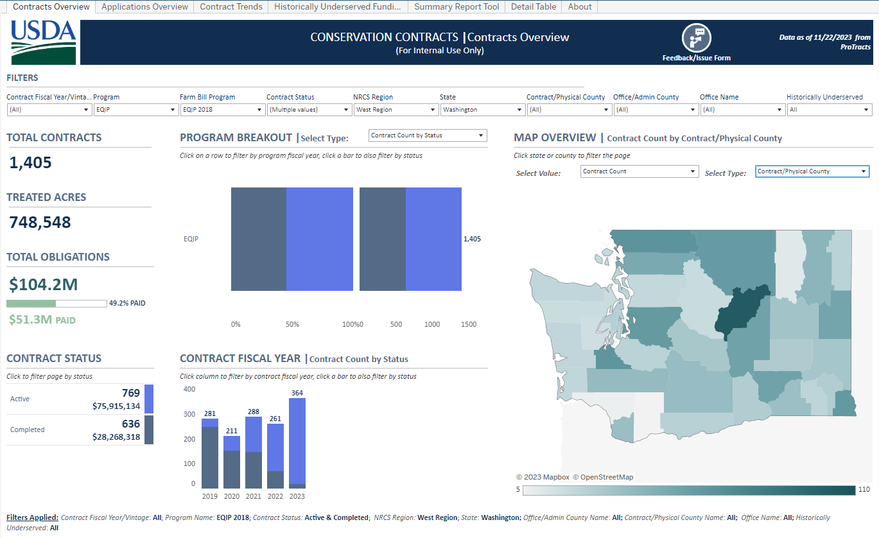
EQIP contracting trends

Slide 6
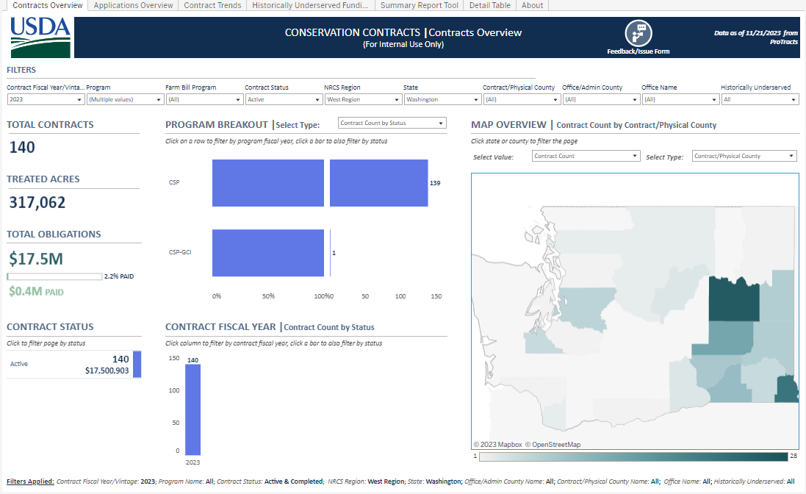
Conservation Stewardship Program (CSP)

Slide 7
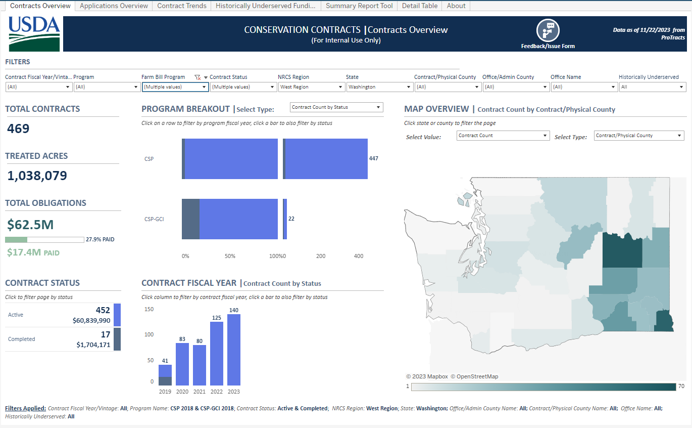
CSP contracting trends

Slide 8
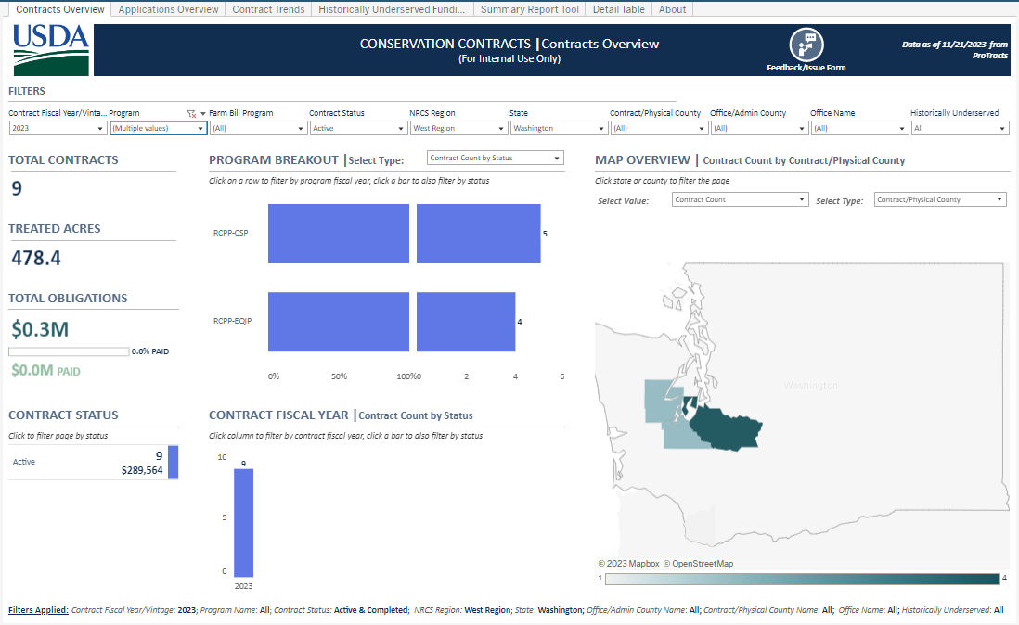
Regional Conservation Partnership Program (RCPP) Farm Bill 2014
This is the last year of FB2014 RCPP contracts to obligate

Slide 9
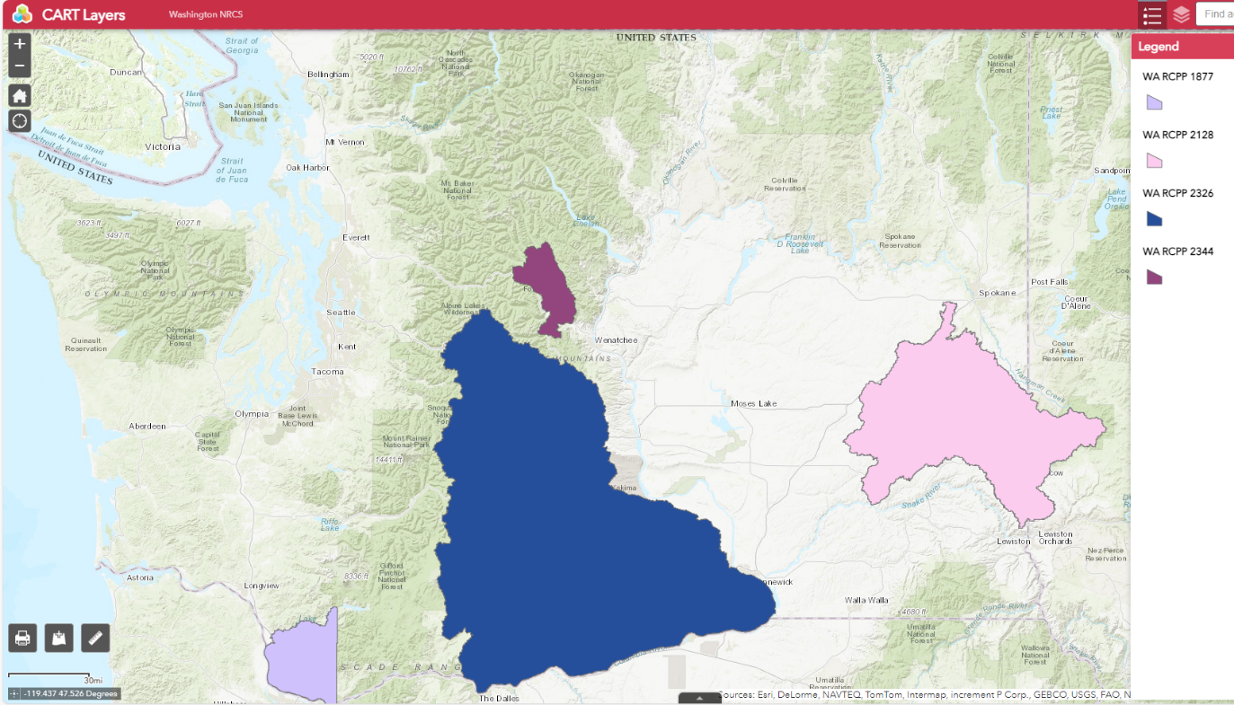
Regional Conservation Partnership Program (RCPP) Farm Bill 2018

Slide 10
Regional Conservation Partnership Program (RCPP) Farm Bill 2018
RCPP 1877 Land Management contract 3 contracts @ $ 286,182
RCPP 2128 Land Management contract 7 contracts @ $1,293,879
RCPP 2128 Easement Agreement 1 parcel @ $ 249,280
RCPP 2326 Land Management contract 4 contracts @ $1,455,024
RCPP 2344 Land Management contract 5 contracts @ $ 52,934
TOTALS 19 contracts @ $3,088,019
1 parcel @ $ 249,280

Slide 11
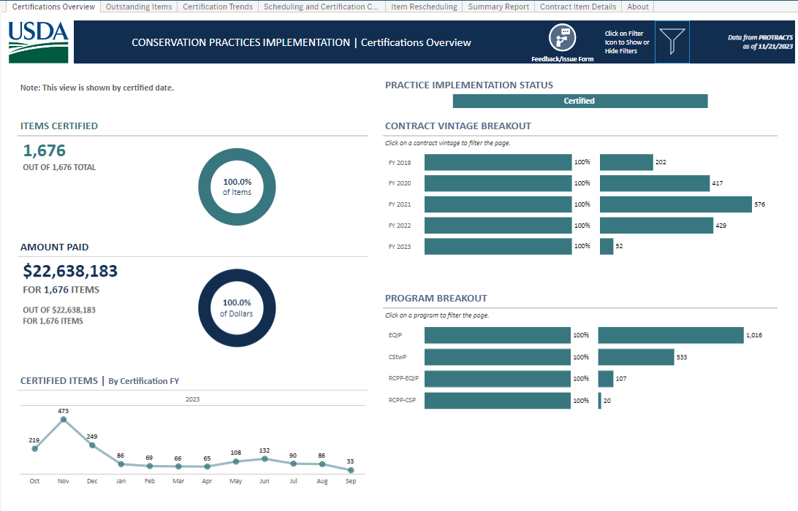
Practice Implementation FY23

Slide 12
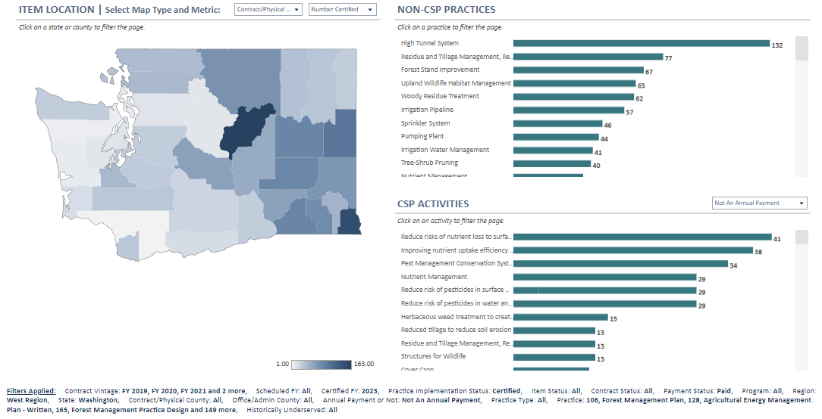
Practice Implementation cont…

Slide 13
QUESTIONS

