Slide 1
Local Work Groups
Nick Vira

Slide 2

LWG Basics
Chaired Conservation District
  Assisted by NRCS District Conservationist
  Facilitation Services Available
  Note Keepers are Helpful
Advisory Group

Slide 3
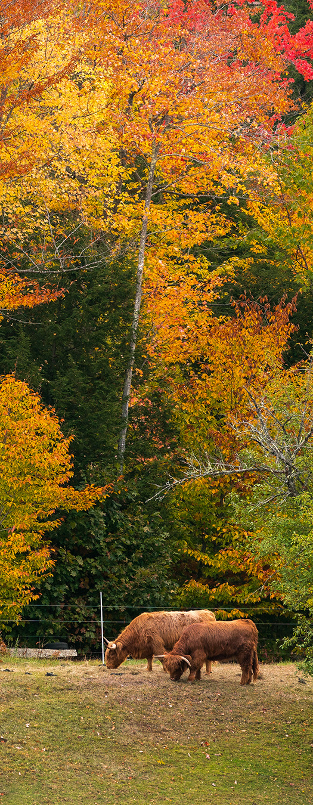
LWG Membership
Producers
Agriculture or Environmental Groups
Tribes
Units of Government
Conservation District Board Members
FSA County Committee and CED
Cooperative Extension
Local Elected Officials
Others with interest in conservation

Slide 4
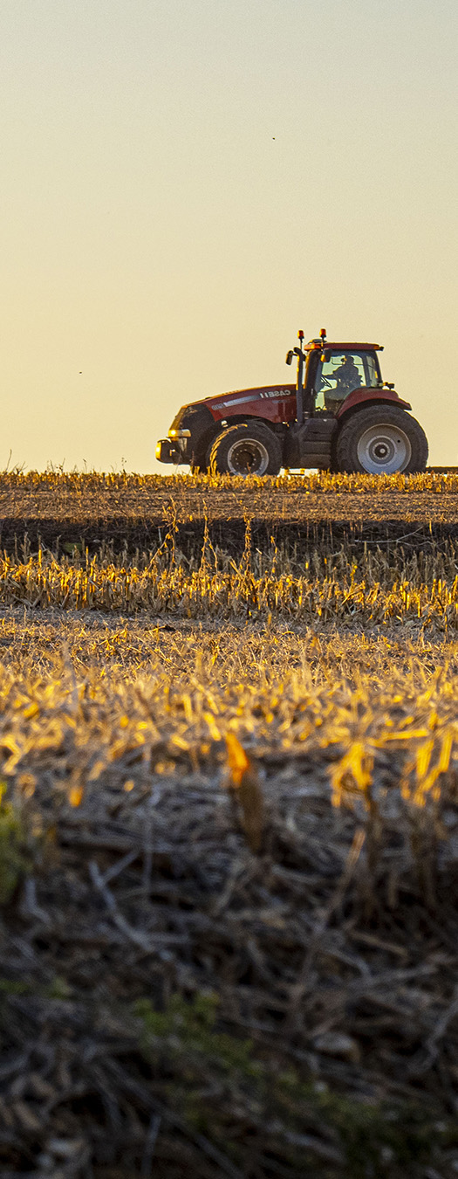
To Do
Set Meeting Date – by December 8th, 2023
Notify NRCS
Meeting Outreach
Conduct Meeting by May 10, 2024
  Submit EQIP Fund Pool and Meeting Attendance
  Determine if your LWG will submit:
    IRA Project Proposal
    NWQI Watersheds
    Conservation Practices
    State Initiatives

Slide 5
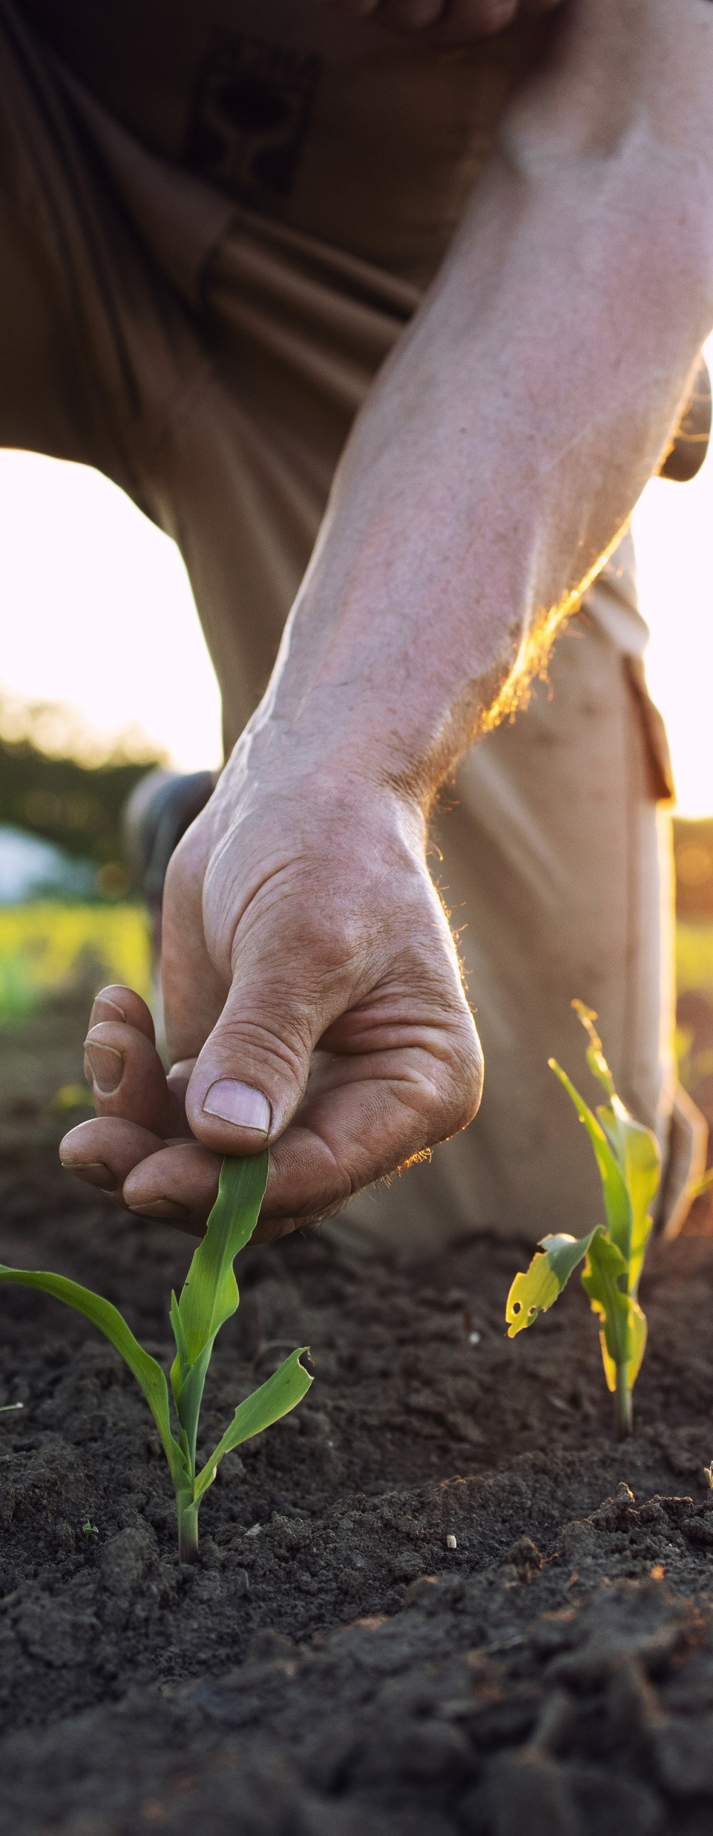
National Water Quality Initiative
Purpose: Sediment, Nutrient, and Pathogen Reduction w/in 12 digit HUC
Process:
Watersheds selected
Plan developed and approved
Watershed receives dedicated EQIP Funds

Slide 6
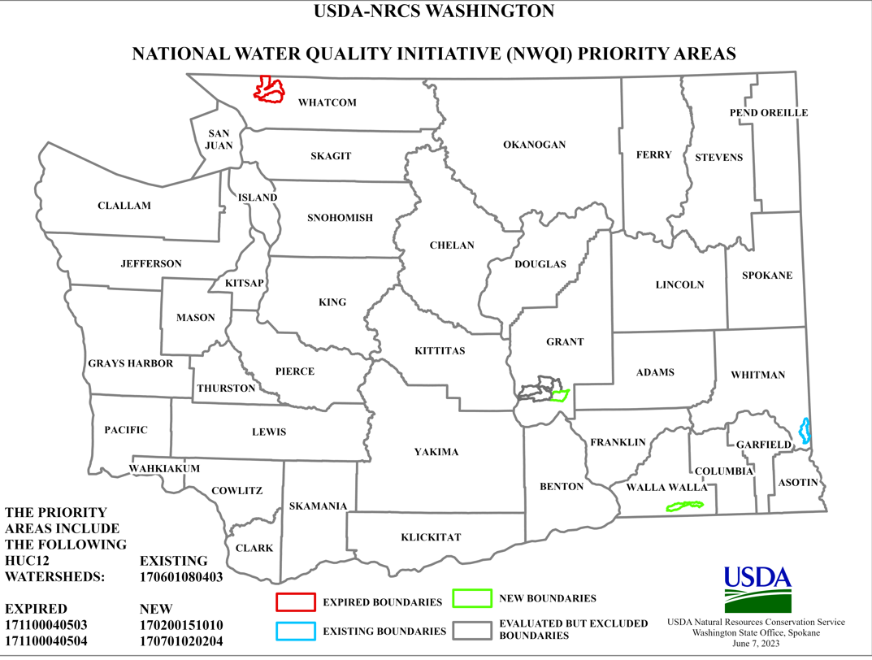
Current & Past NWQI Watersheds

Slide 7
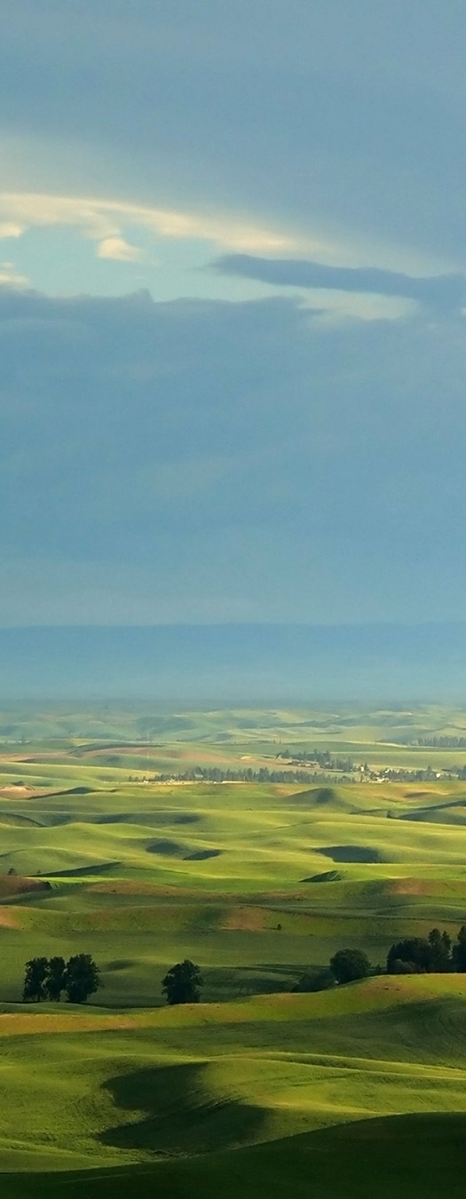
TO DO
Sign In (required)
EQIP Fund Pools (required)
NWQI Planning Phase (optional)
State Initiatives (optional)
Conservation Practices (optional)

Slide 8
IRA Project Proposals

Slide 9
LWG Project Proposals (IRA $)
Only 5 eligible categories:
Soil Health
Nitrogen Management
Livestock, Grazing, & Pasture
Energy, Combustion, & Electricity Efficiency
Agroforestry, Forestry, & Upland Wildlife Habitat

Slide 10
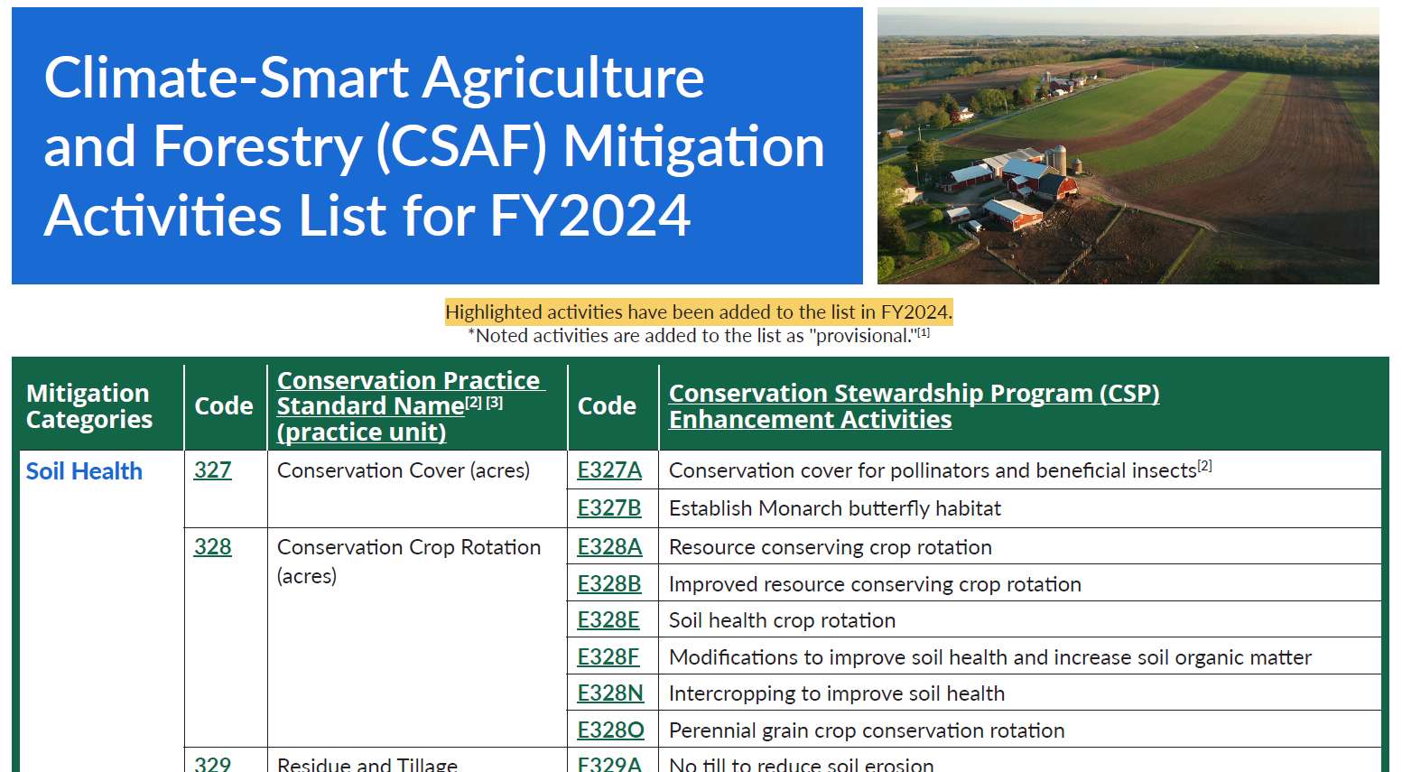
Eligible Practices

Slide 11
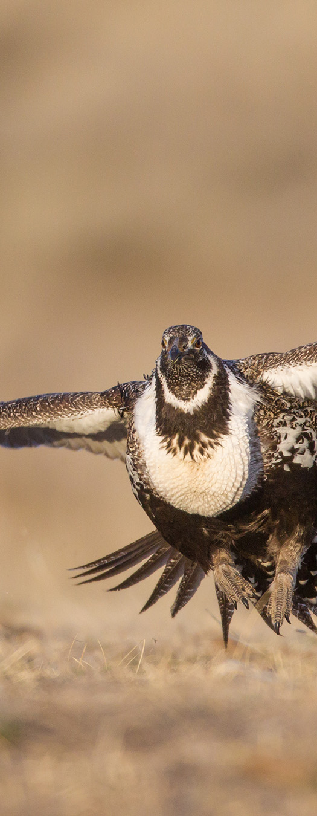
LWG Project Proposals (IRA $)
Proposals Due: May 24th, 2024
LWG Chairs submit to NICK.VIRA@usda.gov
Proposals MUST provide adequate background information to justify any financial request. Proposals lacking this info will not be considered.

Slide 12
2023 LWG IRA Proposals
11 proposals received for over $11.3 million (FY24 Only)
Awarded 10 proposals: $4,012,500
  SRT Forestry: $1,000,000
  SRT Nutrient: $500,000
  PST Forestry: $100,000
  SWT Forestry: $500,000
  NCT Soil: $500,000
  NCT Forestry: $150,000
  NCT Range: $75,000
  NCT Non Conventional: $37,500
  NCT Wildlife: $500,000
  Colville Tribal: $650,000

Slide 13
QUESTIONS?

