Slide 1

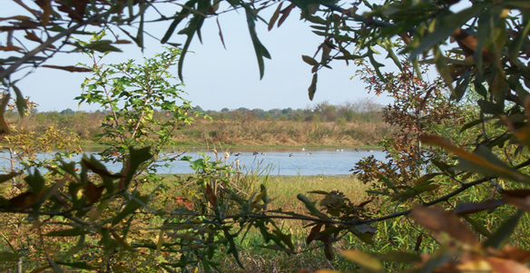
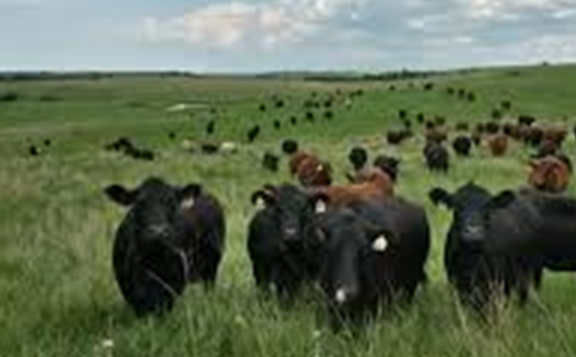
Darren Boudreaux
Program Liaison, Area 2

Slide 2
Locally Led Process –
Allows NRCS to include all stakeholders in the identification and evaluation of resource concerns at the local level.
Data collected through the locally led process, along with input from the State Technical Committee and Local Work Groups, is utilized when establishing Financial Assistance (FA) program priorities and application ranking criteria.

Slide 3
Locally Led Process Leading to Prioritized Financial Assistance
Locally Led Meetings
Producers provide resource concern information to NRCS and SWCD
Local Work Groups
NRCS and SWCDs prioritize the collected resource concern data and submit for local EQIP subaccount
Prioritized Local Funding
Top Resource Concerns are used to build local EQIP subaccounts, specific to the parish top priorities.
State Technical Committee
Locally Led Data is compiled across the state and is reviewed by the STC.
State Prioritized Funding
State Priority Resource Concerns are determined to use in State EQIP Subaccounts and to prioritize state funding.

Slide 4
Example Local and State Subaccount with Prioritized Resource Concerns
Acadia Parish Local EQIP Subaccount*
Inefficient Irrigation Water Use
Soil Organic Matter Depletion
Nutrients Transported to Surface Water
Classic Gully Erosion
*Example Data in no particular order
Statewide Master Farmer EQIP Subaccount*
Inefficient Irrigation Water Use
Inadequate Terrestrial Habitat for Wildlife
Soil Organic Matter Depletion
Plant Productivity and Health
Livestock Feed and Forage Imbalance
*Example Data in no particular order

Slide 5

Financial Assistance Program Updates

Slide 6
EQIP High Priority Practices
The 2018 Farm Bill authorize increased payments for up to 10 high priority practices through EQIP.
Selection of practices to receive higher payment should incentivize conservation practices that have high potential for conservation benefit but are underutilized.
A participant may receive an increased payment amount for a high priority practice:
  up to 90 percent of the incurred costs associated with materials, equipment for installation, labor, mobilization, or acquisition of technical knowledge;
  and up to 100 percent of the costs associated with income forgone.

Slide 7
FY23 EQIP High Priority Practices
  329 Residue and Tillage Management, No Till
  338 Prescribed Burning
  345 Residue and Tillage Management, Reduced Till
  384 Woody Residue Treatment
  386 Field Border
  393 Filter Strip
  420 Wildlife Habitat Planting
  430 Irrigation Pipeline*
  436 Irrigation Reservoir*
  533 Pumping Plant*
    *Practices are only HPP when used as part of a tail water recovery system.

Slide 8
What is a Source Water Protection Priority Practice?
The 2018 Farm Bill provides for increased incentives for practices that relate to water quality and quantity and protect drinking water sources while also benefitting producers.
A participant may receive an increased payment amount for a high priority practice:
up to 90 percent of the incurred costs associated with materials, equipment for installation, labor, mobilization, or acquisition of technical knowledge;
and up to 100 percent of the costs associated with income forgone.

Slide 9
Selecting SWP Priority Practices
A source water priority practice may be decided using the following criteria:
Have a significant impact on either water quality or water quantity (or both if applicable), based on the threats to drinking water in the local priority area(s).
Select practices that specifically address the source of the drinking water (ground vs. surface water systems).
With respect to irrigation practices and water quantity – consider whether water savings will actually be realized.

Slide 10
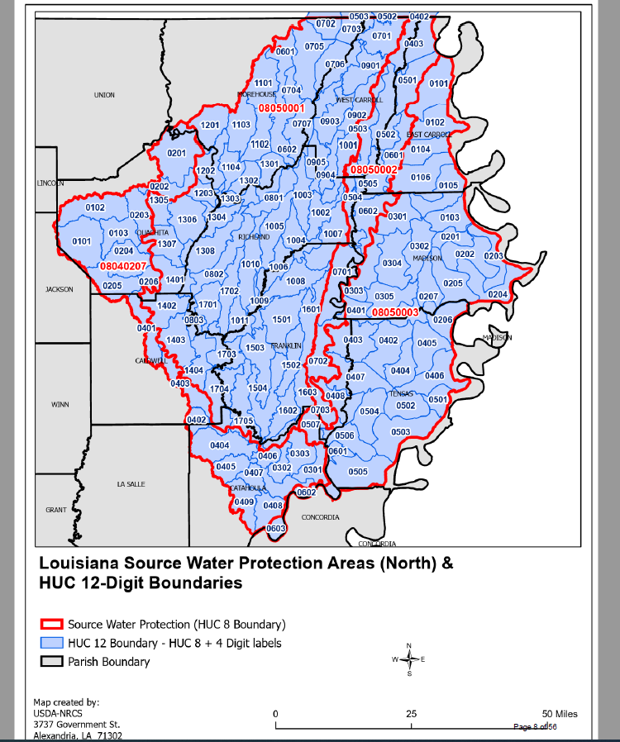
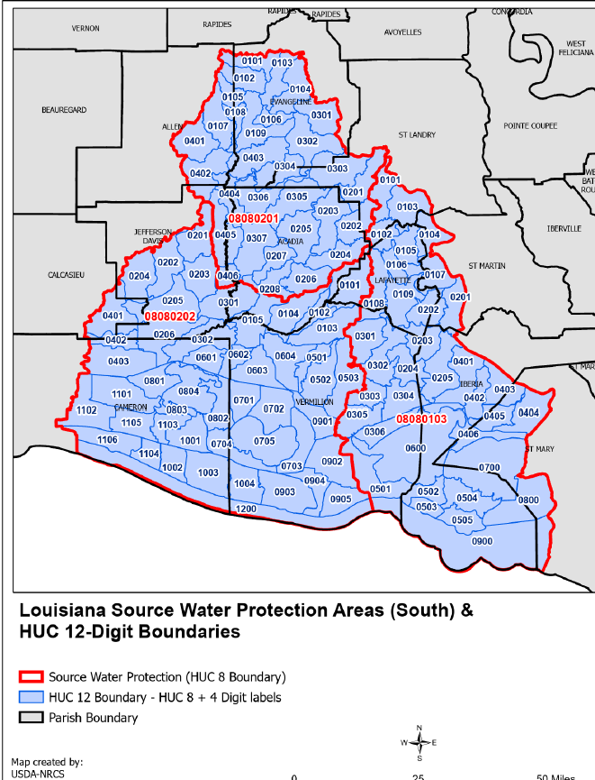
EQIP Source Water Protection
Source Water Protection are identified areas for the protection of drinking water by implementing practices where source waters can be protected or improved.
329 Residue and Tillage Management, No Till
345 Residue and Tillage Management, Reduced Till
351 Well Decommissioning
386 Field Border
393 Filter Strip
430 Irrigation Pipeline*
436 Irrigation Reservoir*
447 Irrigation and Drainage Tailwater Recovery*
533 Pumping Plant*
590 Nutrient Management

Slide 11
LA FY2023 EQIP Funding
Allocation Received: $21,169,342.00
Total FY23 Applications Received to date: 2,381
Expected to fund approximately 30% of applications received in FY23.
State and Local Funds | $17,769,000
Gopher Tortoise Initiative | $723,185
Long Leaf Pine Initiative | $1,090,160
Mississippi River Basin Healthy Watersheds | $1,336,997
National Water Quality Initiative | $250,000
Migratory Bird Resurgence Initiative (MBRI) | $800,000
EQIP Incentives (CIC) | $888,450

Slide 12
LA FY2023 CSP Classic Funding
Allocation Received: $12,200,000
Total FY23 Applications Received to date: 520
Expected to fund approximately 30% of applications received in FY23.
State and Local Funds | $11,800,000
Long Leaf Pine Initiative | $200,000
Organic | $200,000

Slide 13
LA FY2023 IRA Funding
Total IRA Allocation Received: $7,196,205
For EQIP-IRA and CSP-IRA, NRCS may only use IRA funds for contracts that include at least one core Climate Smart Agriculture and Forestry (CSAF) conservation practice or activity that directly improve soil carbon, reduce nitrogen losses, or reduce, capture, avoid, or sequester carbon dioxide, methane, or nitrous oxide emissions associated with agricultural production.
Facilitating practices or activities that are needed to implement the core practice may also be included.
IRA-EQIP | $2,327,738
IRA-CSP | $4,868,467

Slide 14
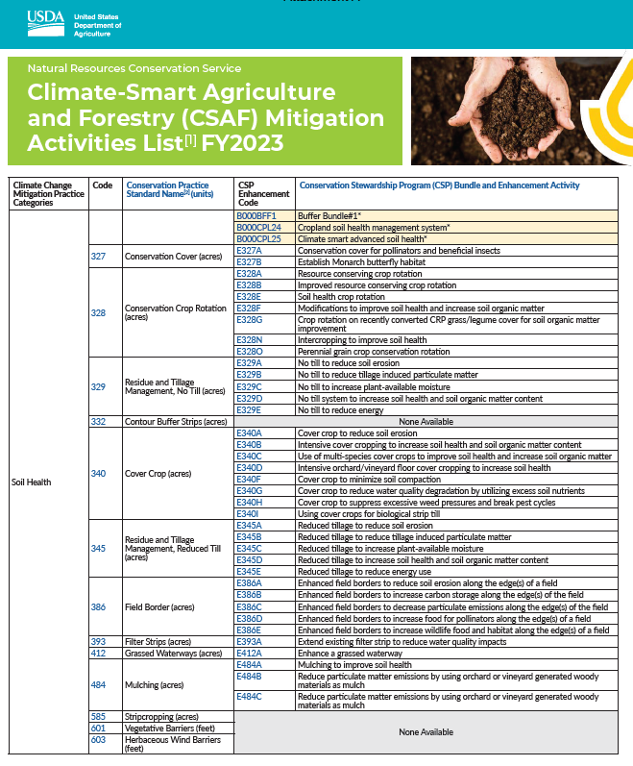
FY2023 IRA Core Practices and Enhancements

Slide 15
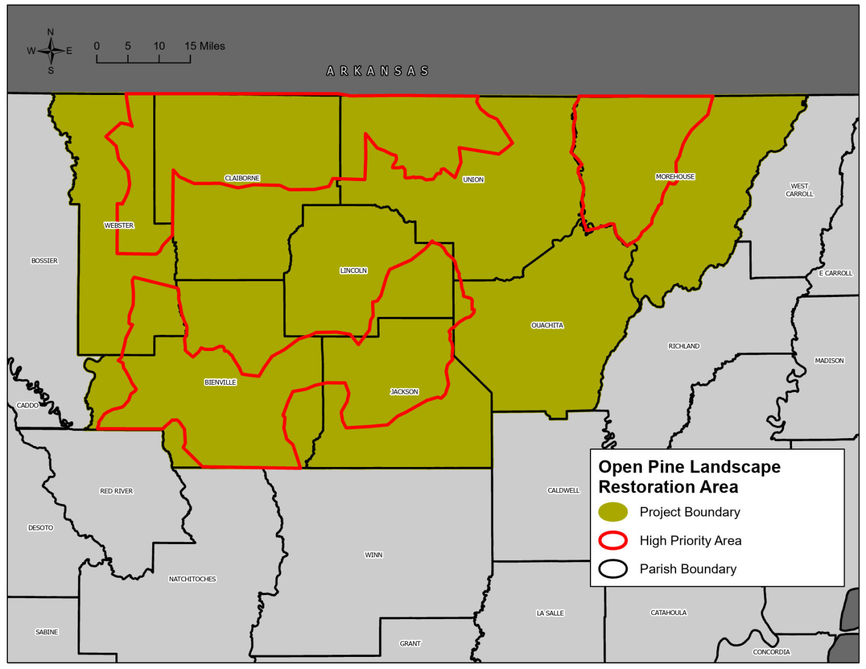
LA FY2023 RCPP Projects
Project: 2319 - Arkansas -Louisiana Conservation Delivery Network (CDN) Open Pine Landscape Restoration
Lead Partner: American Bird Conservancy
Allocation: $1,770,295
Project Summary: This project’s goal is to restore and improve Forest Health for Wildlife Resources addressing wildlife habitat, fire management and water quality. By implementing open pine forest will advance recovery of declining wildlife and plant species of terrestrial forest habitat in Arkansas and Louisiana.

Slide 16
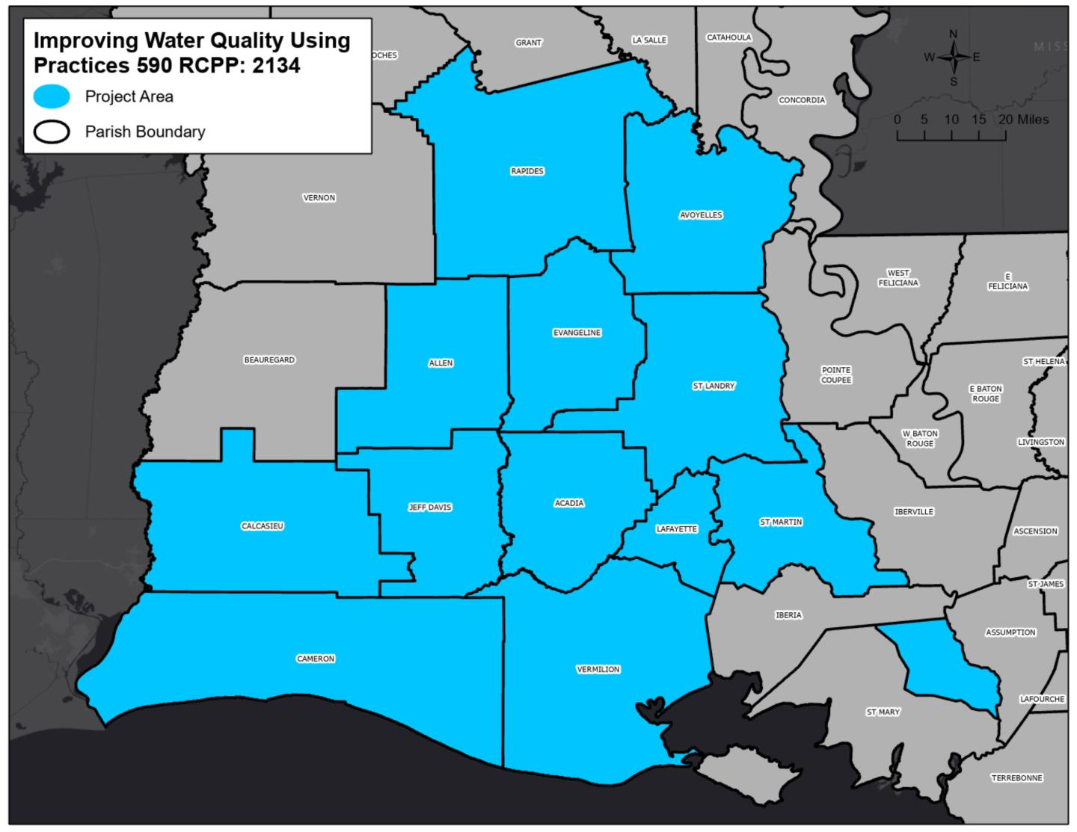
LA FY2023 RCPP Projects
Project: 2134 - RSP Improving Water Quality - Using 590
Lead Partner: Ducks Unlimited, Inc.
Allocation: $101,226
Project Summary: Nutrient loss from agriculture, particularly nitrogen and phosphorous contributes to over-enrichment of waterways, and loss of nutrients adding cost to producers. Using precision application of nutrients and a range of technology uses shows the benefits from grid soil sampling thus inspires future adoption the practice.

Slide 17
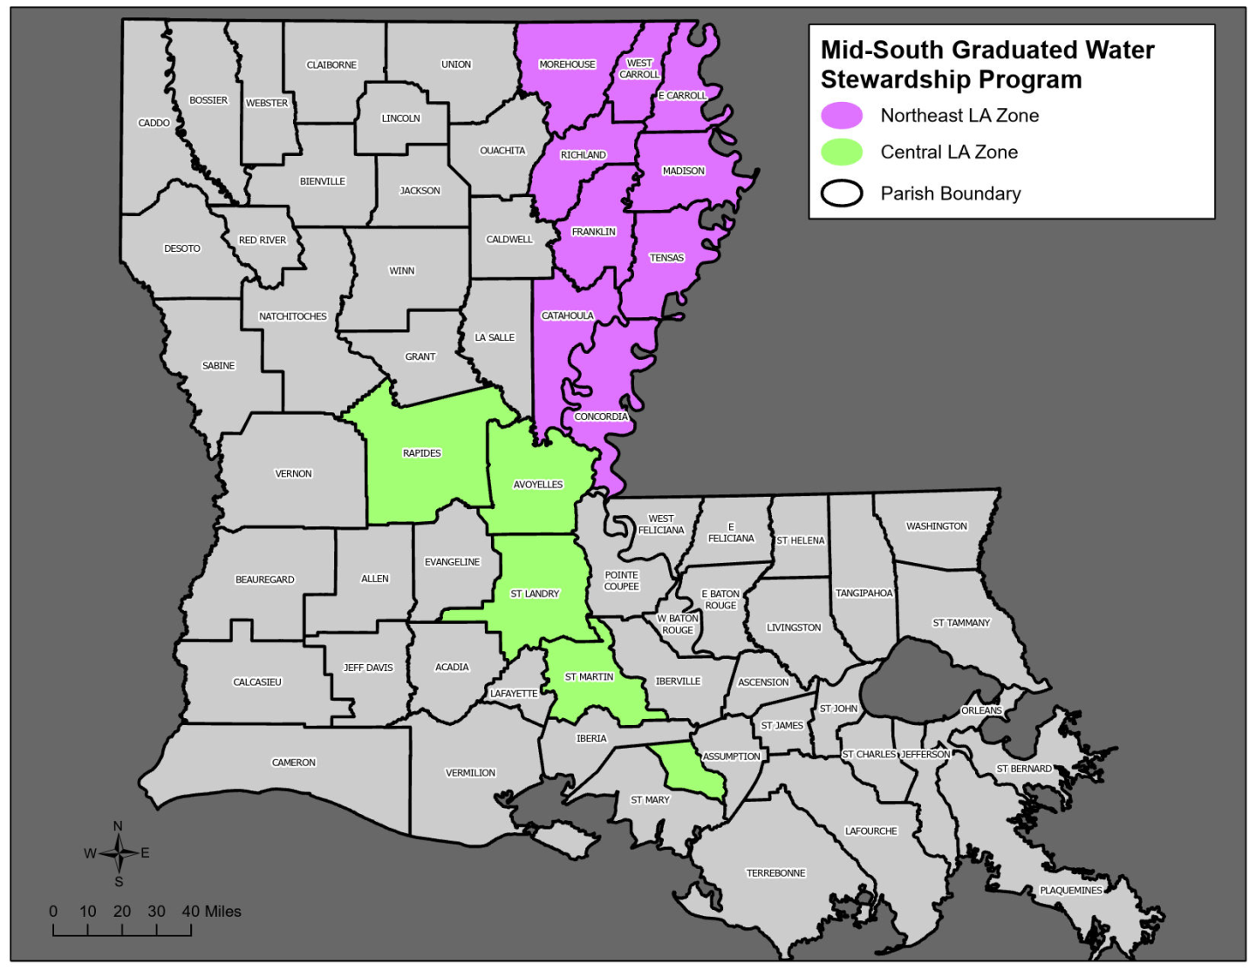
LA FY2023 RCPP Projects
Project: 2274 - Mid-South Graduated Water Stewardship Program
Lead Partner: USA Rice Federation
Allocation: $327,895
Pr
Project Summary: This project is to decrease the use of the Mississippi River Alluvial Aquifers as a main source of irrigation for rice crop farmers. This projects helps facilitate adoption of on-farm practices and technologies. This project is a multi-step stage program to advance irrigation management, water conservation and improve waterways and wildlife habitat.

Slide 18
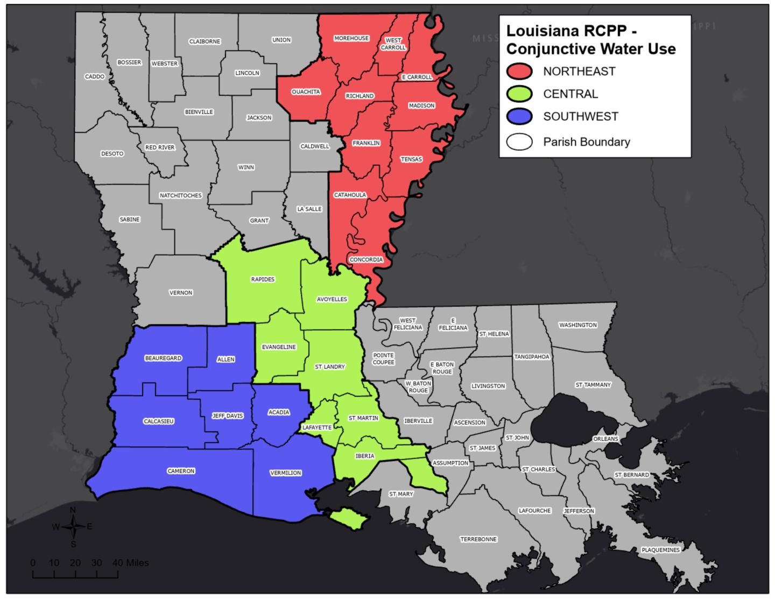
LA FY2023 RCPP Projects
Project: 2779 - Conjunctive Water Use Protects Mid-South Aquifers
Lead Partner: Ducks Unlimited, Inc.
Allocation: $2,400,000
Project Summary: Conjunctive water use is the coordinated use of ground and surface water resources. This project implements practices and systems to increase the availability use of surface water for irrigation. In addition, project is aimed to reduce the dependency on our Mid-South aquifers.

Slide 19
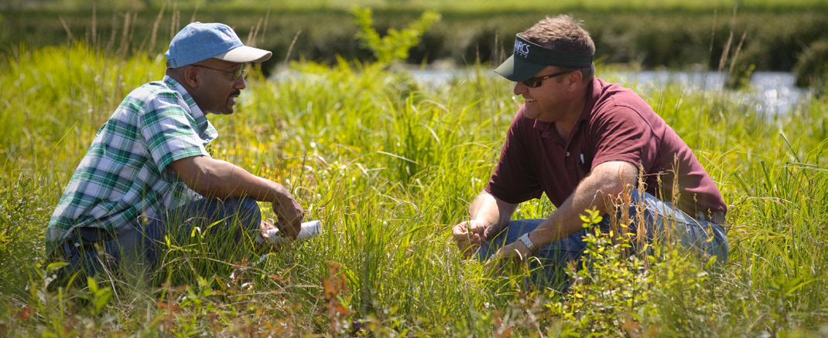

NRCS helps people make investments in their operations and local communities
Financial + Technical Assistance
USDA is an equal opportunity provider, employer, and lender.
www.nrcs.usda.gov
Notes:
Our support is threefold:
NRCS provides one-on-one, personalized advice on the best solutions to meet the unique conservation and business goals of those who grow our nation’s food and fiber.
NRCS helps people make investments in their operations and local communities to keep working lands working, boost rural economies, increase the competitiveness of American agriculture, and improve the health of our air, water, soil, and habitat.
NRCS generates, manages and shares the data, technology and standards that enable partners and policymakers to make decisions informed by objective, reliable science.

