Slide 1
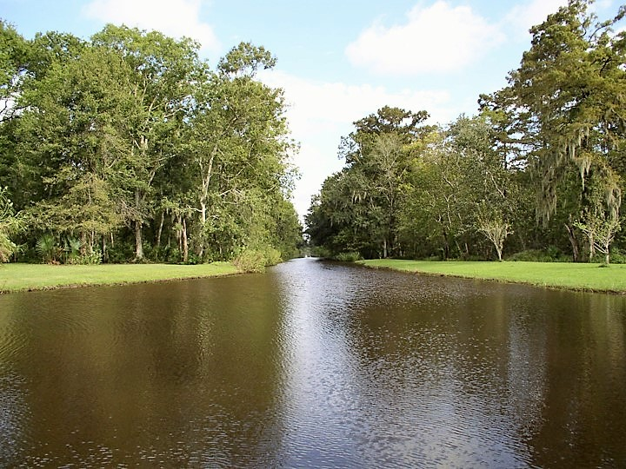
  Golden Meadow Plant Materials Center
  Galliano, Louisiana
Notes:
Enter you PMC name, city and state

Slide 2
Current Studies
Initial Evaluation of Sporobolus virginicus for Improved Vegetative and Seed Production, and Establishment for Coastal Restoration Along the Gulf Coast
  To accelerate wetland plant species’ production and establishment technology
  29 accessions collected from coastal Louisiana and Southeastern Texas coast
  To develop standards and specifications for establishing selected coastal wetland plant species used in critical area plantings – Conservation Practice Standard – 342
  To provide additional plant species for increased vegetative diversity for coastal vegetative planting projects used primarily by coastal planners and coastal NRCS technical staff
  Advanced Evaluation of Distichlis spicata for the Vegetative Production and Establishment for Coastal Restoration Along the Gulf Coast
  25 accessions collected from coastal Louisiana
  Observations and statistical analysis revealed that 10 of the 25 accessions exhibited superior performance and will further evaluate at 3 off-center locations
  To develop standards and specifications for establishing selected coastal wetland plant species used in critical area plantings – Conservation Practice Standard – 342
  To provide additional plant species for increased vegetative diversity for coastal vegetative planting projects used primarily by coastal planners and coastal NRCS technical staff
Notes:
1. List the title of the PMCs study 2. List objective or reason you did the study. 3. List the title of the final study report and the title of the Tech Note. 4. Describe how the product from the study was used to assist the field office.

Slide 3
Partnerships
Chitimacha Tribe of Louisiana and Coushatta Tribe of Louisiana for the Re-Establishment of Certain Culturally Significant Plants on Tribal Lands
  Memorandum of Understanding (MOU) was signed between the NRCS Louisiana and the Chitimacha Tribe of Louisiana to help in the preservation of natural and cultural resource conservation
  Consult with the Tribe regarding their cultural interest and desire for the re-establishment of certain culturally significant plants on tribal lands
  Assist the Tribe in developing a plan for the re-establishment of certain culturally significant plants on tribal lands
  Develop propagation techniques and select superior ecotypes from the assembly to meet the objective of the Tribe
  In consultation with the Tribe, identify appropriate sites on tribal land for the re-establishment of certain culturally significant plants
Nicholls State University - Farm
  Allow for additional plant testing of locally adapted plant species
  Offers suitable soil conditions for the evaluation of non-wetland plant species
Notes:
1. List the title of the PMCs study 2. List objective or reason you did the study. 3. List the title of the final study report and the title of the Tech Note. 4. Describe how the product from the study was used to assist the field office.

Slide 4
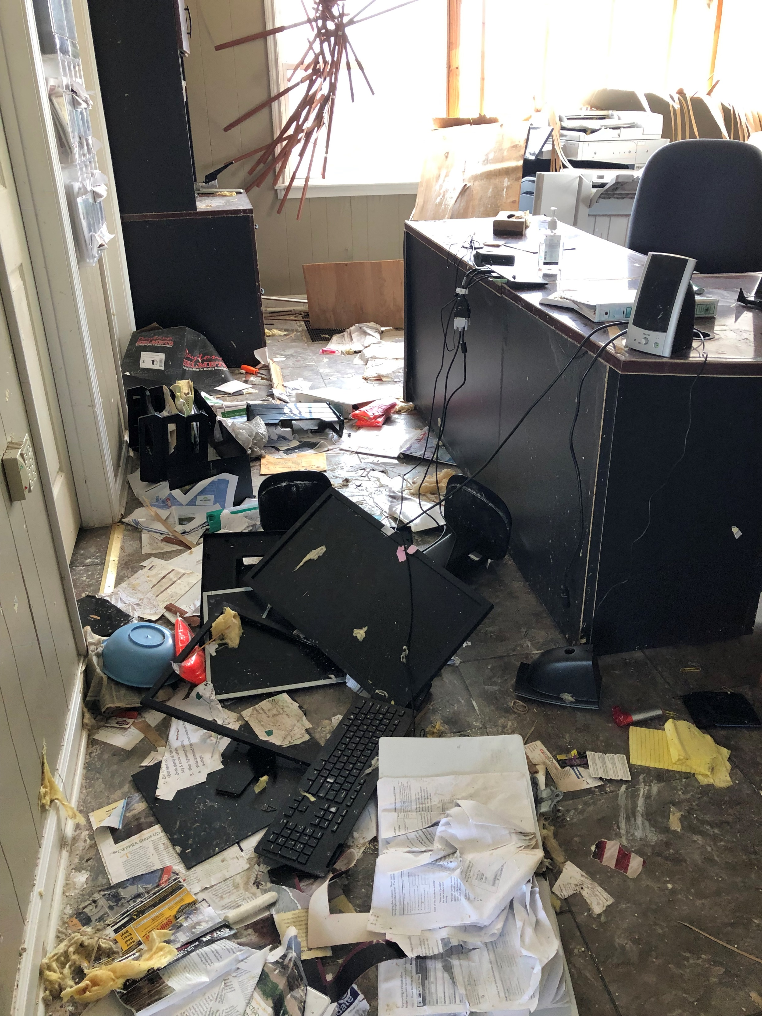
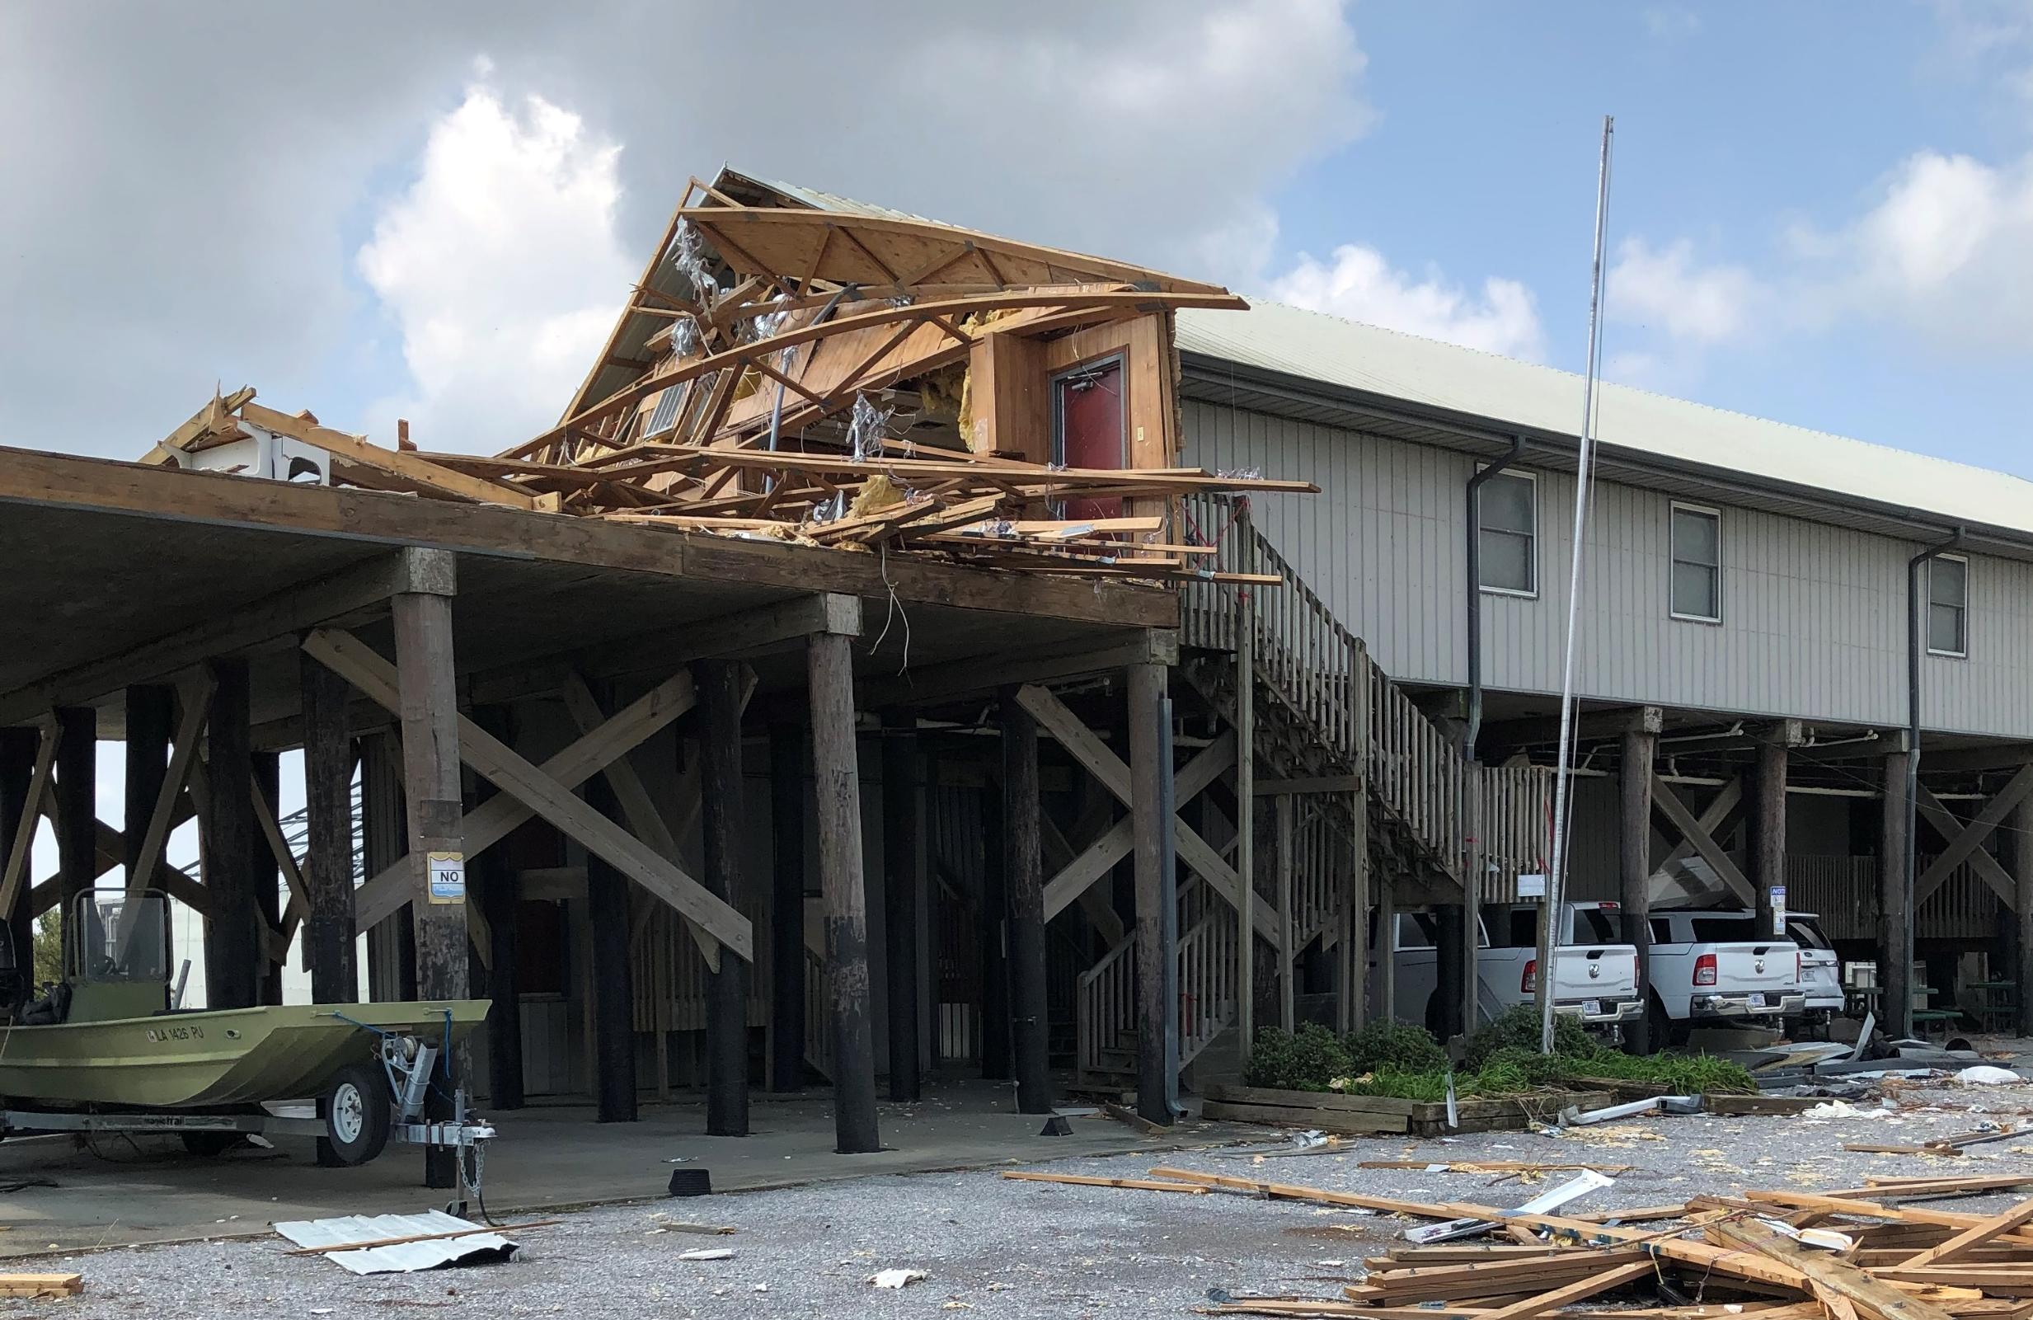
Updates
Field Office Technical Research & Plant Material Committee Meeting
Addressing State Plant Materials Needs Assessment
PMC Vacancies
Biological Science Technician - Advertised
Agronomist / Soil Conservationist - Vacant
PMC Hurricane Ida Damages and Progress
Temporary Mobile Office – Occupied
Facility Buildings - Repairs and Demo - Ongoing
Notes:
Provide a list of training or outreach the PMC has provided for NRCS staff or conservation partners, such as districts, that assists with conservation delivery.

Slide 5
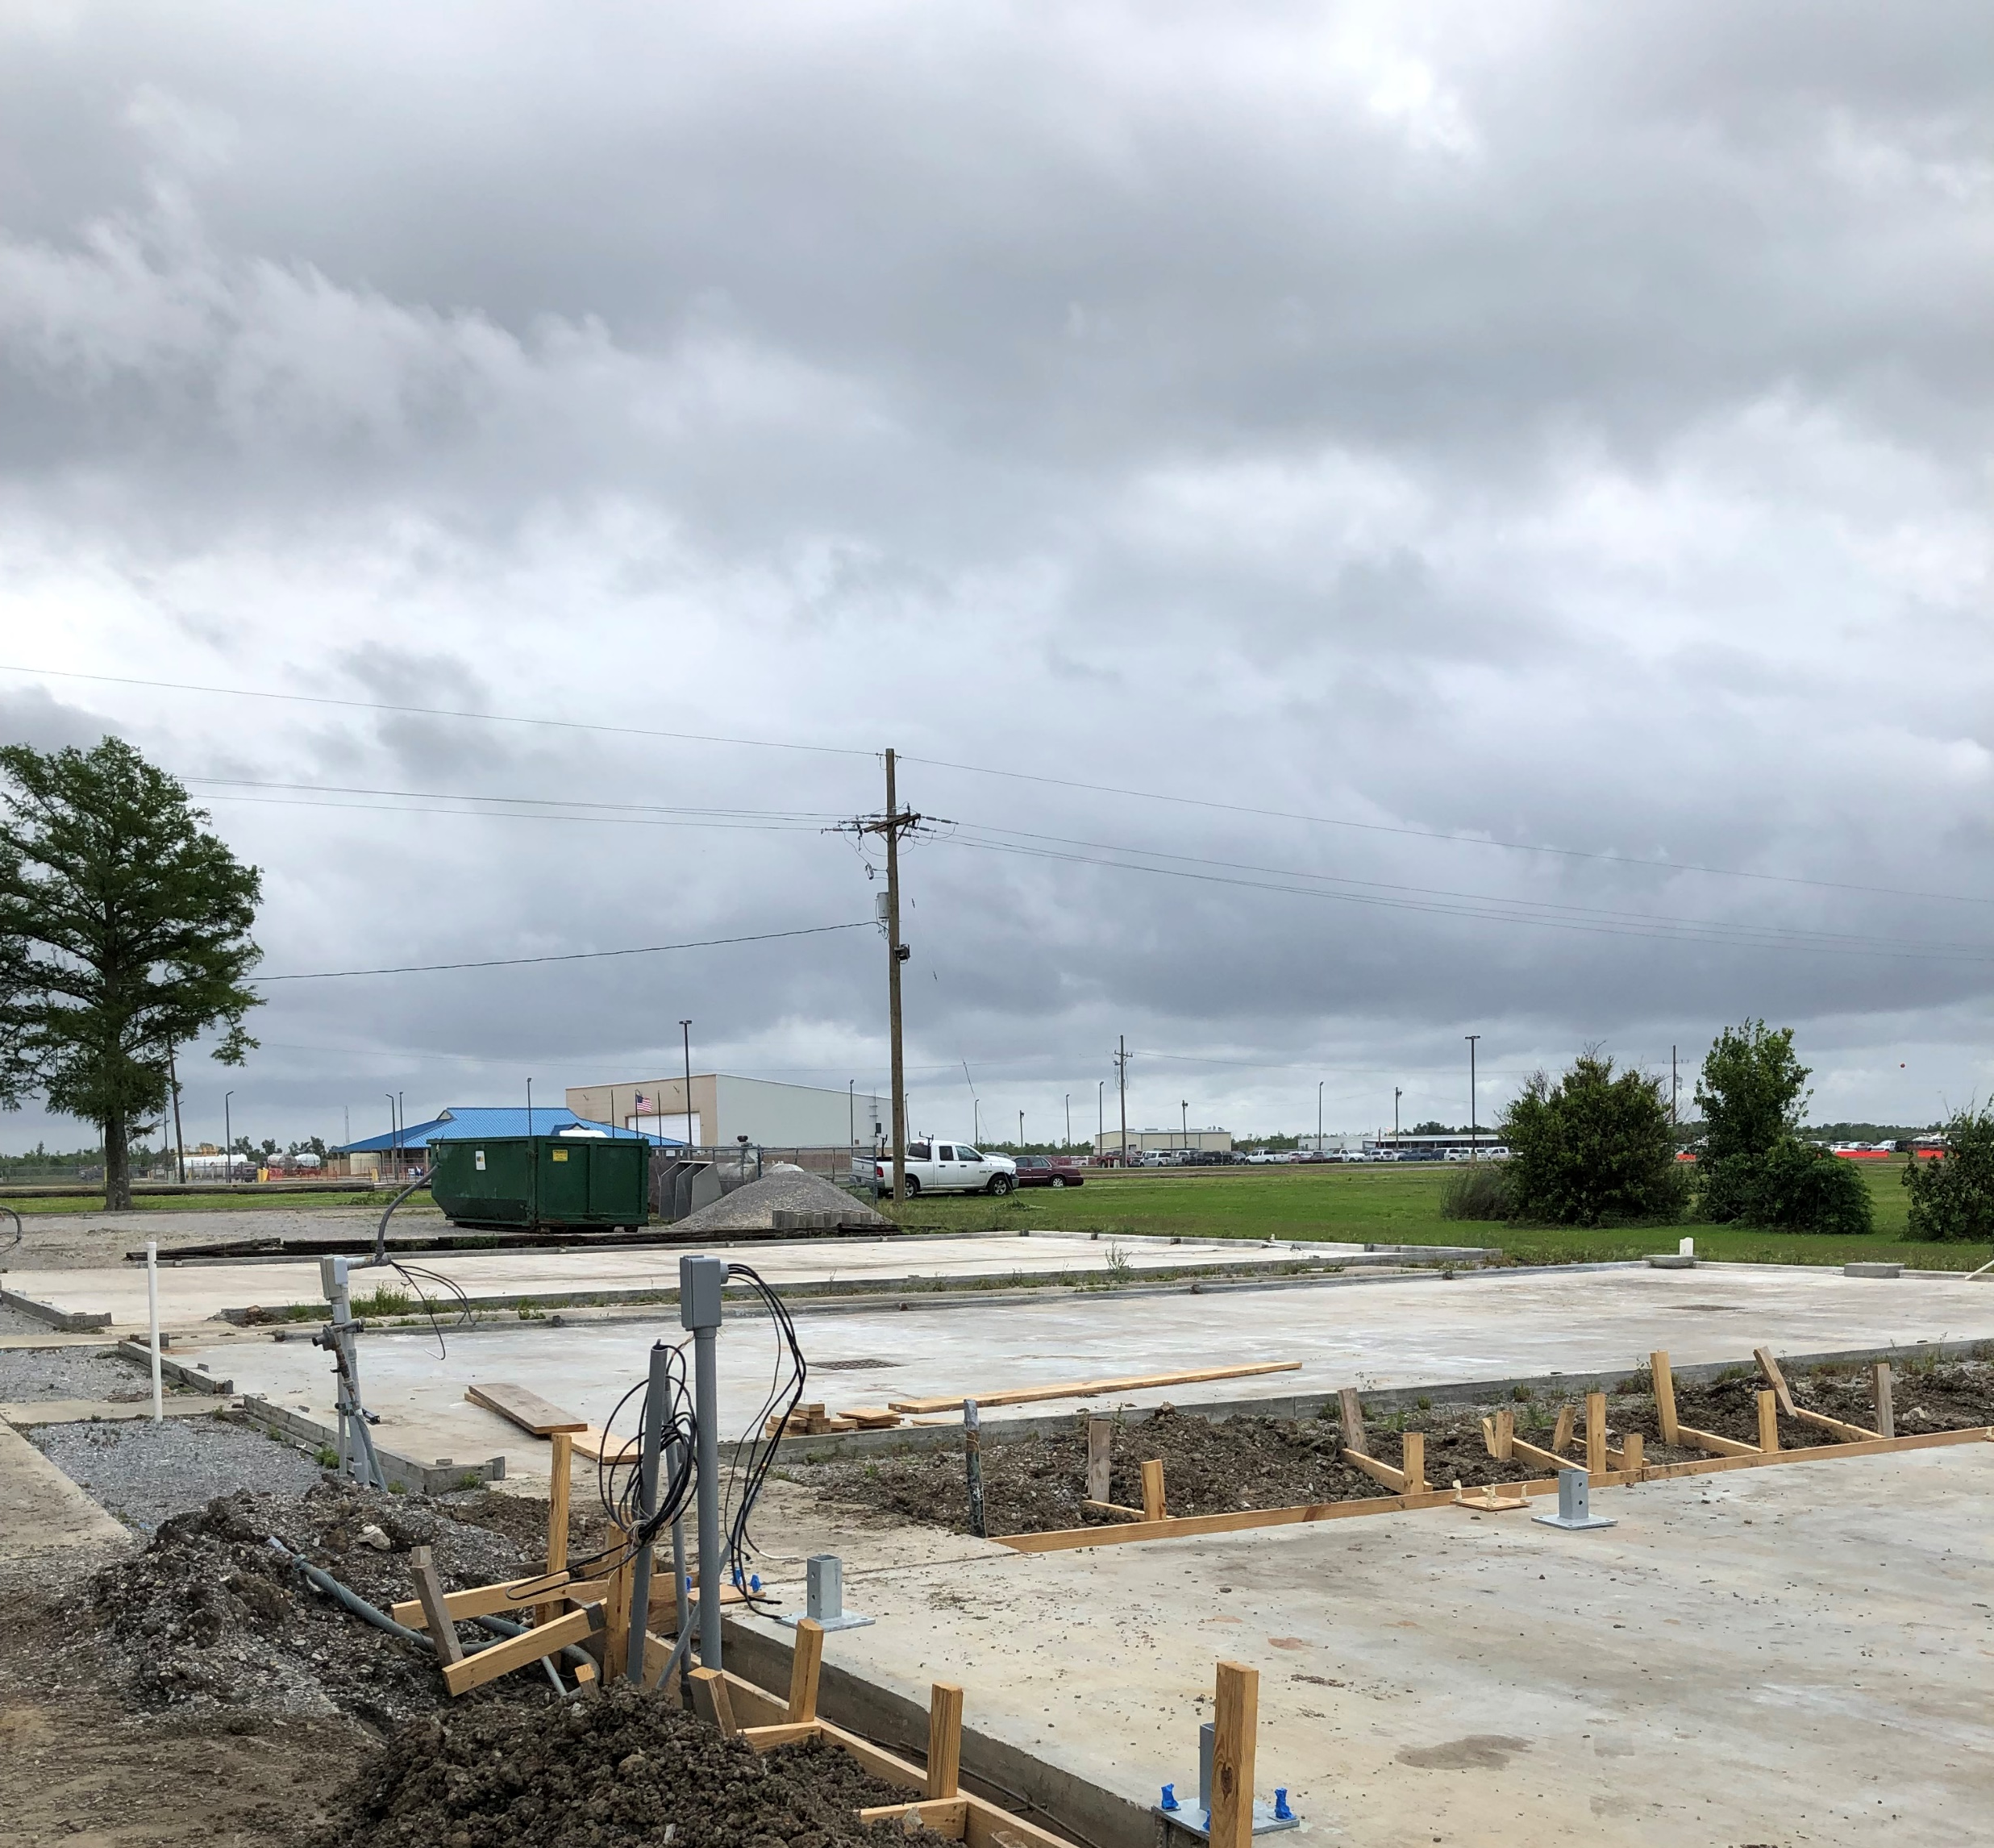
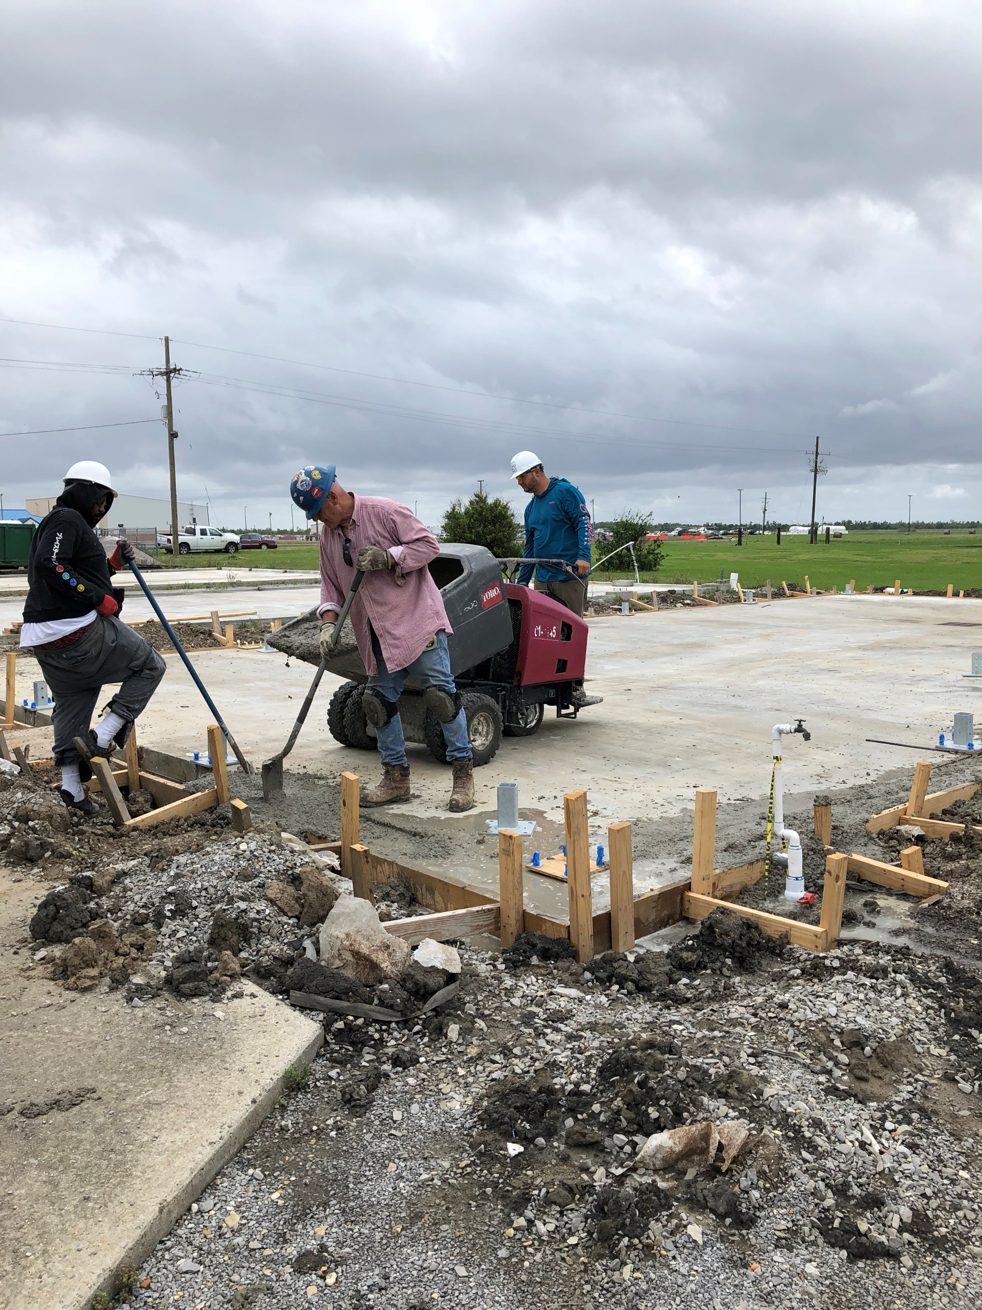
Updates
Propagation Greenhouses
All 3 damaged Greenhouses have been removed
One Greenhouse planned to be rebuilt
  New concrete footing complete 4/11/2023
  Greenhouse kit delivered on site for assembly 4/11/2023 and currently being constructed
PMC Main Building Demo
Site Showing held - 4/6/2023
Other PMC Repairs/Demo/Construction
Planning Stage
  Main Building
  Equipment Barn
Notes:
Provide a list of training or outreach the PMC has provided for NRCS staff or conservation partners, such as districts, that assists with conservation delivery.

