Slide 1
Urban and Small Acreage Agriculture in Idaho

Slide 2
Strategy and Guidance
Applies to any parcel of land that is:
  Inside city limits (or directly bordering city limits, including a complete residential subdivision of a community with a population of 2,500 or more OR
  Digitized as Urban Land on the Web Soil Survey OR
  In a community inside an Indian Reservation Boundary OR
  Is zoned as Urban Ag or is an Urban Ag District inside city limits OR
  Is a designated community garden OR
  Is a Community Supported Agriculture (CSA) program OR
  Is within a designated Food Desert Area with a Food insecurity Rate of 15% or greater, as according to Feeding America

Slide 3
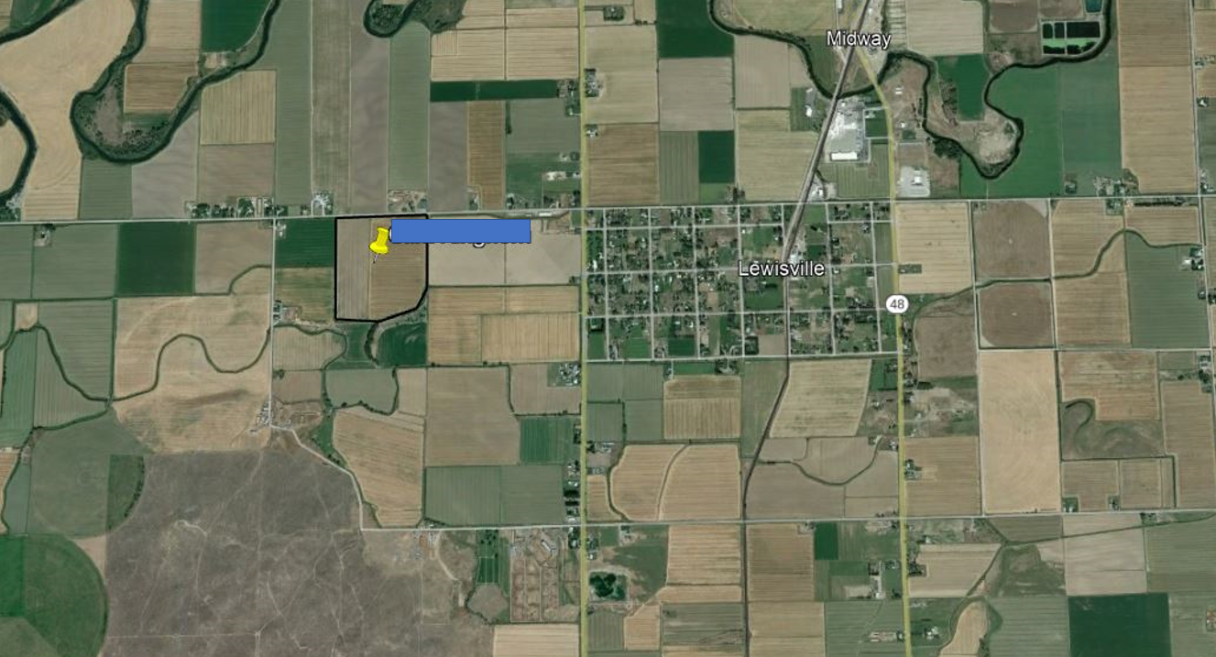

Slide 4
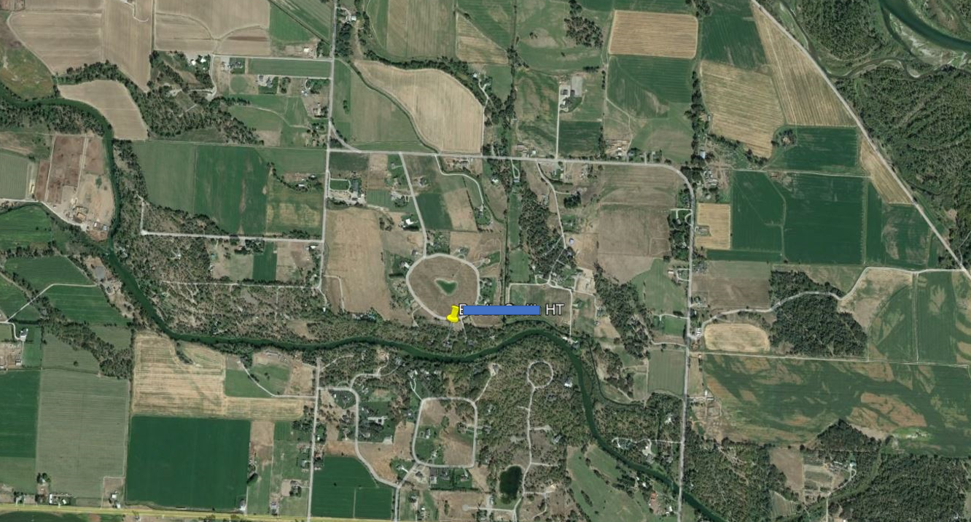

Slide 5
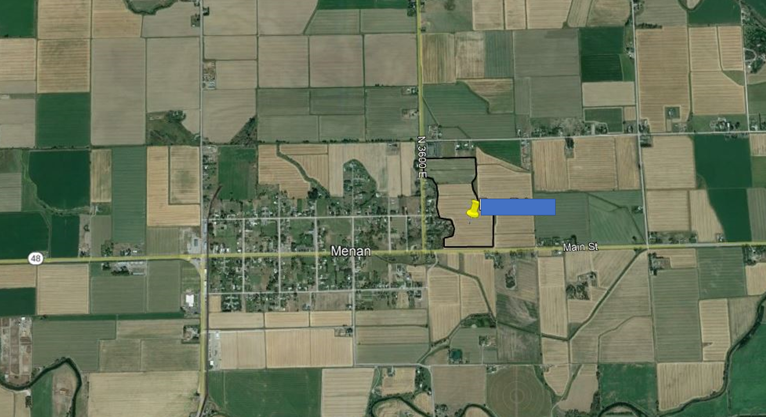

Slide 6
Why do we need Urban and Small Acreage Agriculture in Idaho?
Population growth
Supply better food for the population
Preserve the agricultural community
Reclaim agriculture that was lost due to growth

Slide 7
Current Priority Areas for Urban and Small Acreage Agriculture in Idaho
Pocatello
Boise (Ada and Canyon Counties)
Twin Falls
Idaho Falls
Rexburg
Coeur D’Alene
Rest of Idaho

Slide 8
Goals for Urban Agriculture Conservation
Preserve Agriculture in Idaho
Reclaim Agriculture in Idaho
Habitat

Slide 9
Current Projects
School garden with support of Power County Soil & Water District
City irrigation planning to allow better access for small acreage “ranchettes”
Pollinator gardens within cities
University of Idaho – Extension programs for youth and residents (4-H, etc.)
People’s Garden Initiative

Slide 10
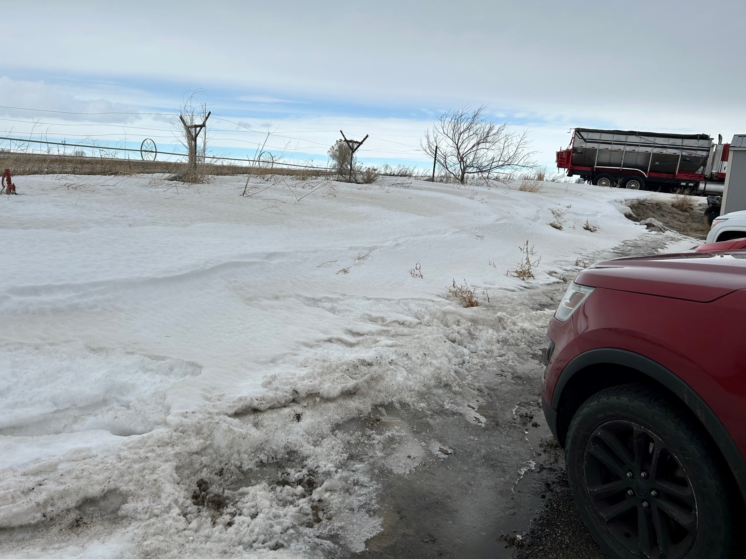
Future People’s Garden – American Falls Field Office

Slide 11
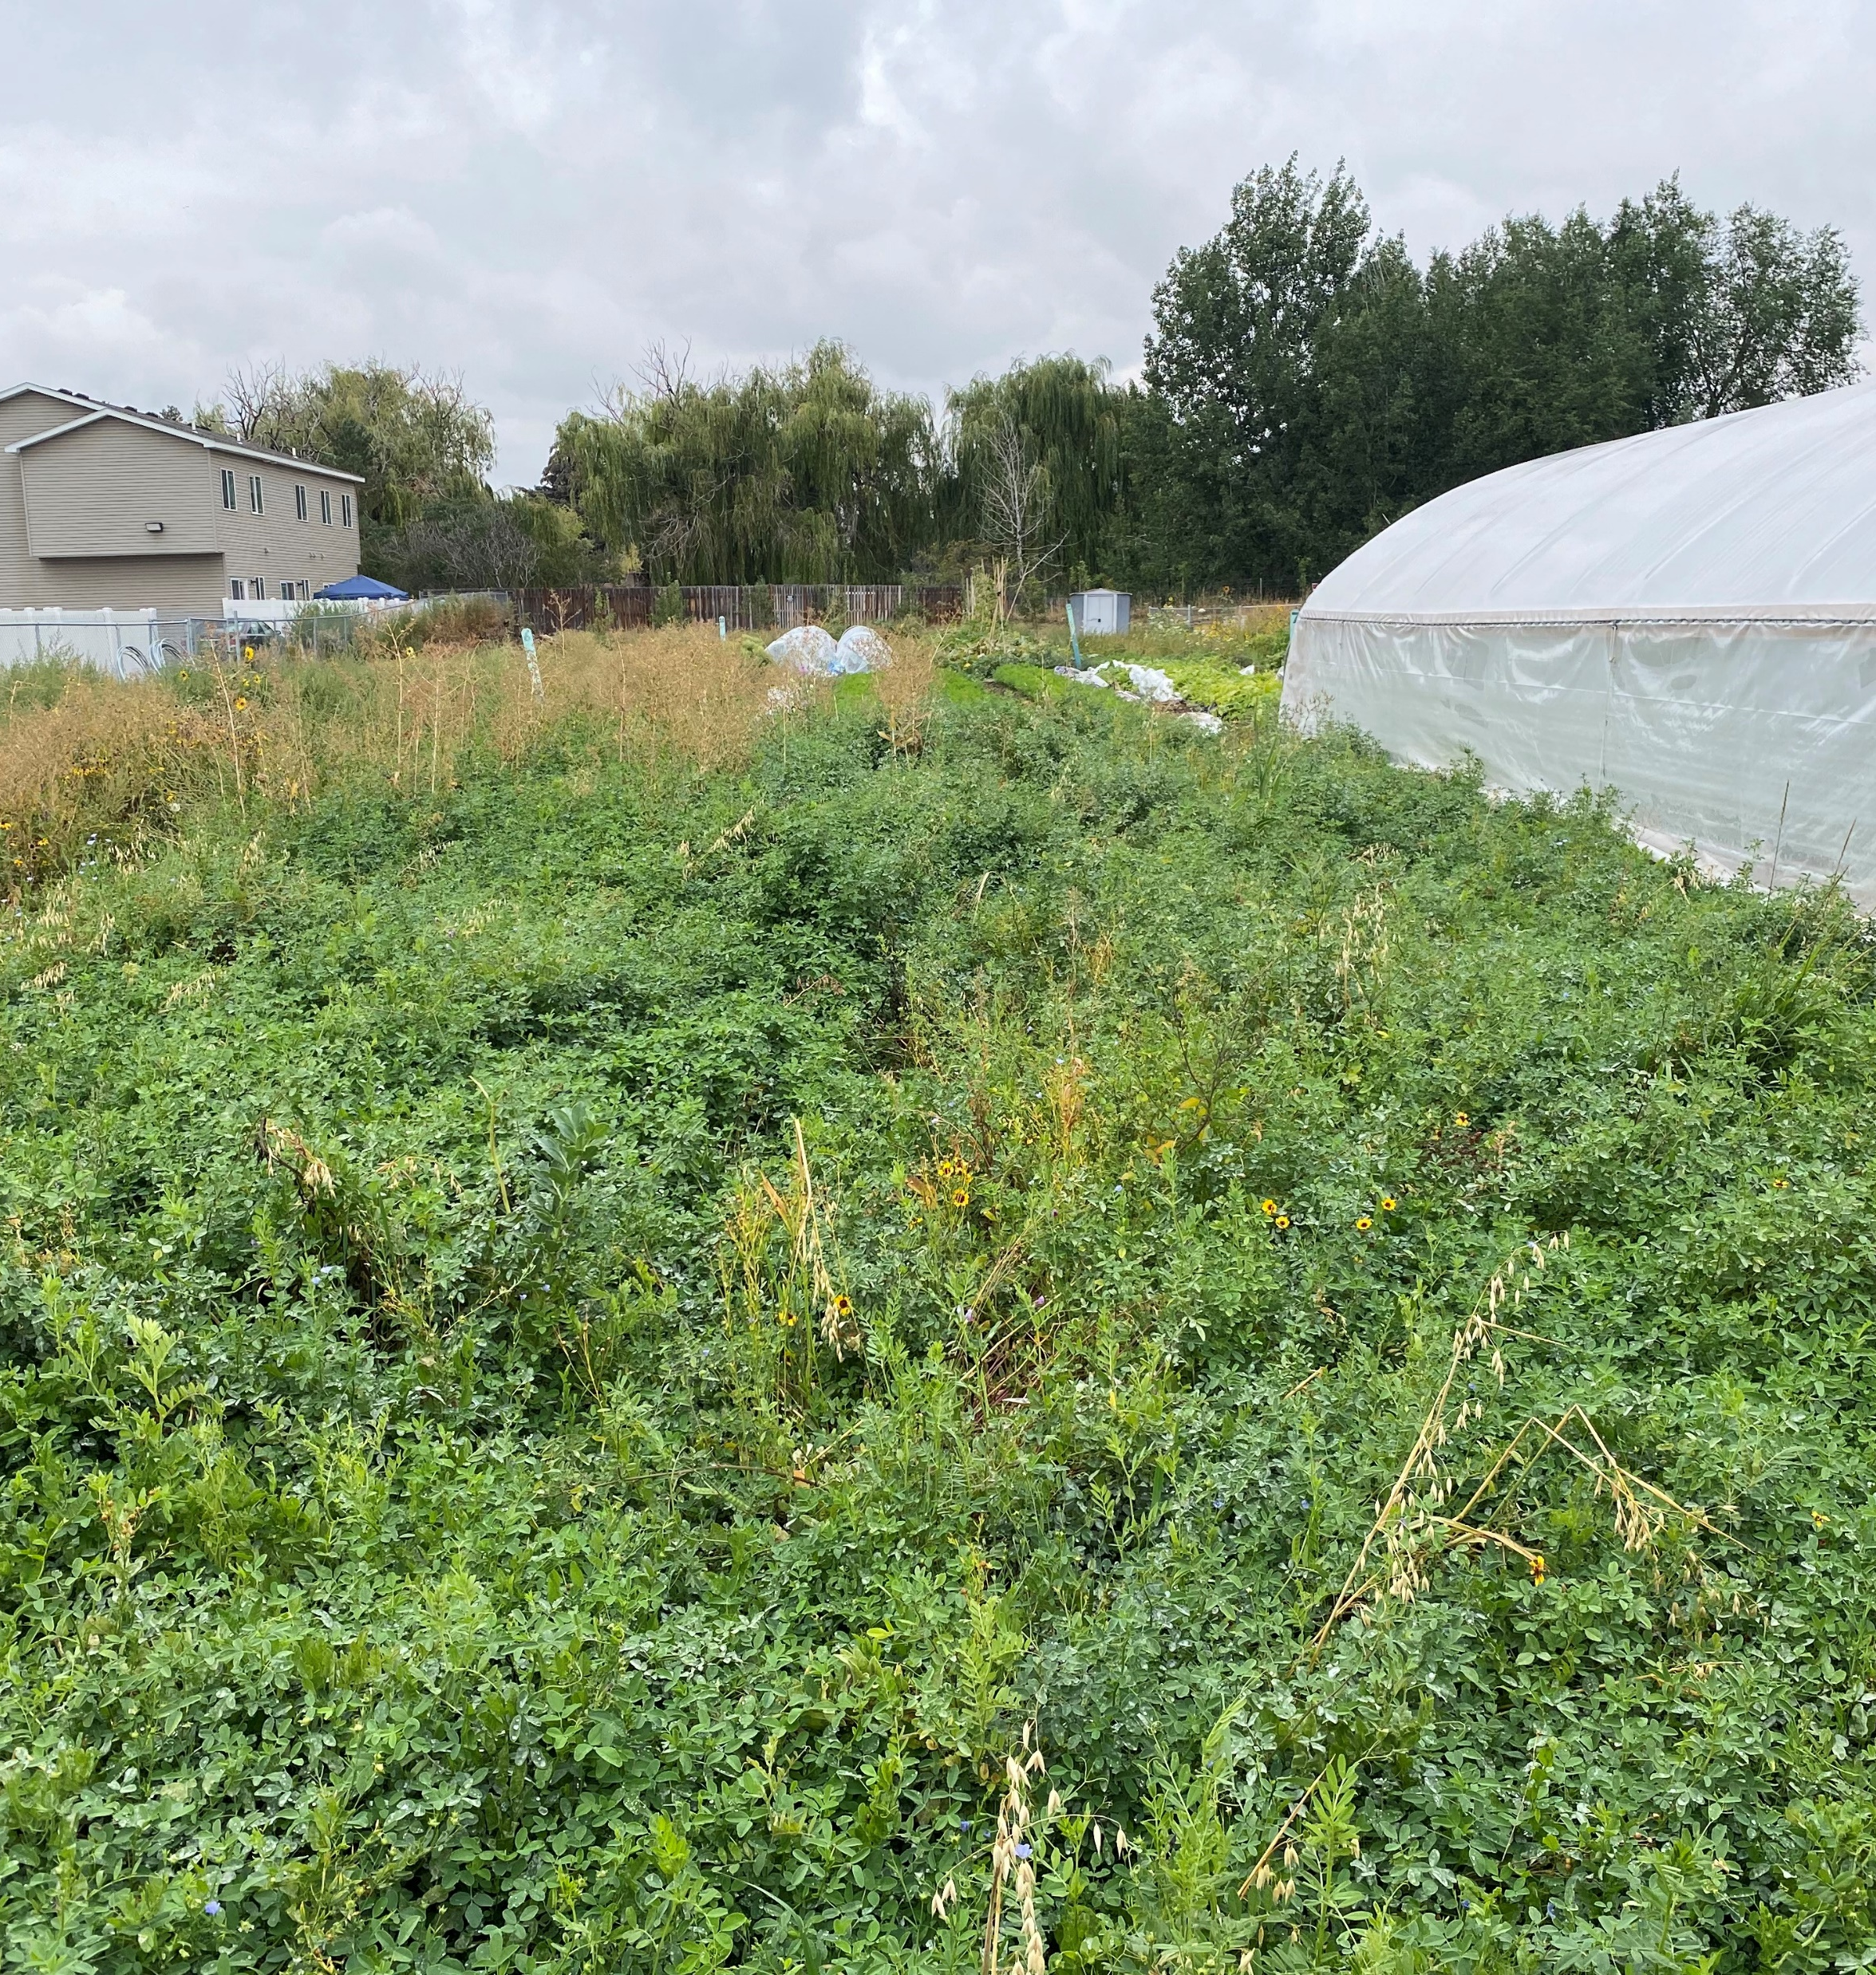
Food Basket High Tunnel
Cover cropping: Alfalfa*
On-site composting
Crop rotation
Pollinator plots
Entirely volunteer run
Youth programs
ADA Accessible
*Climate Smart practice

Slide 12
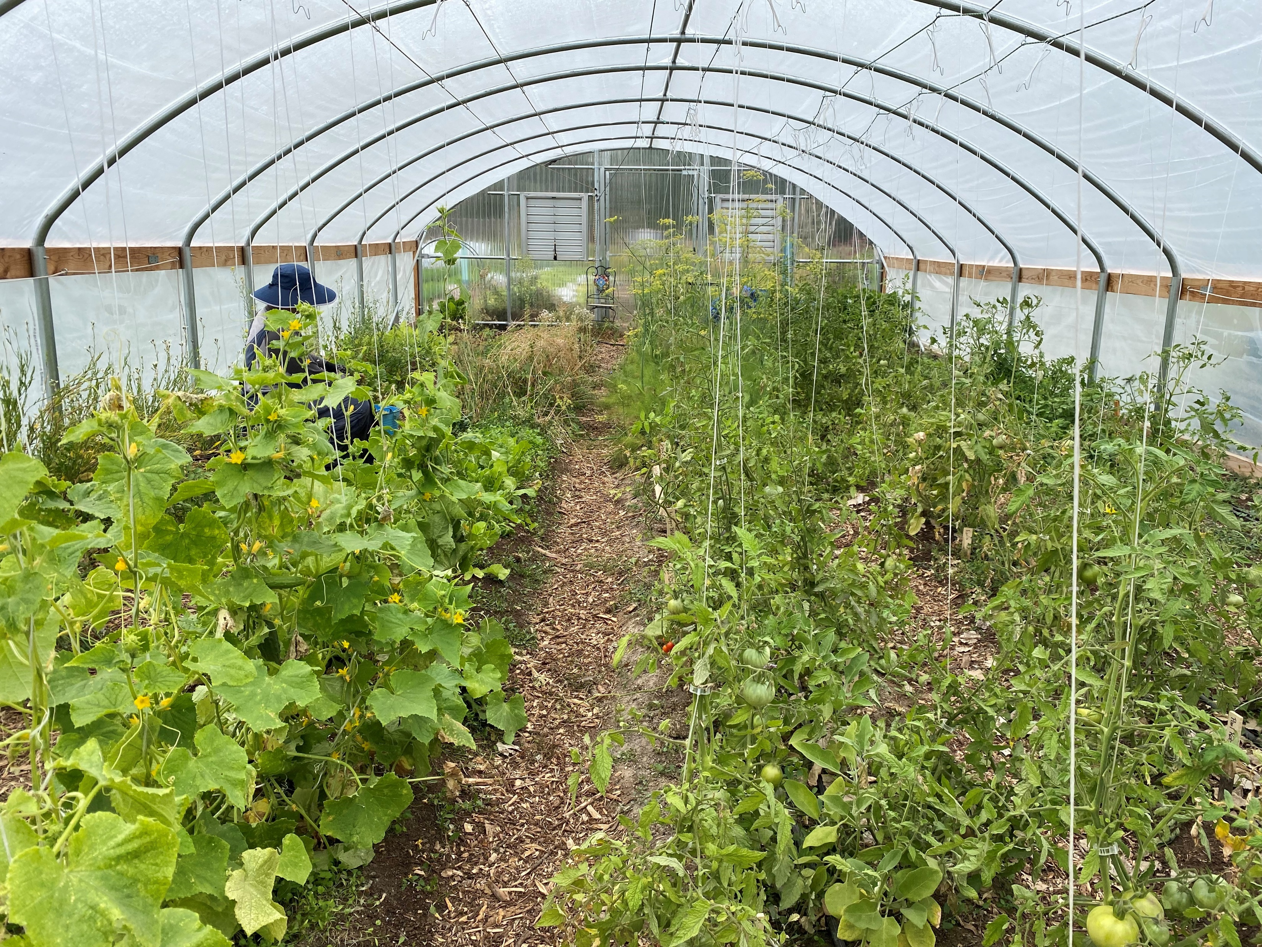
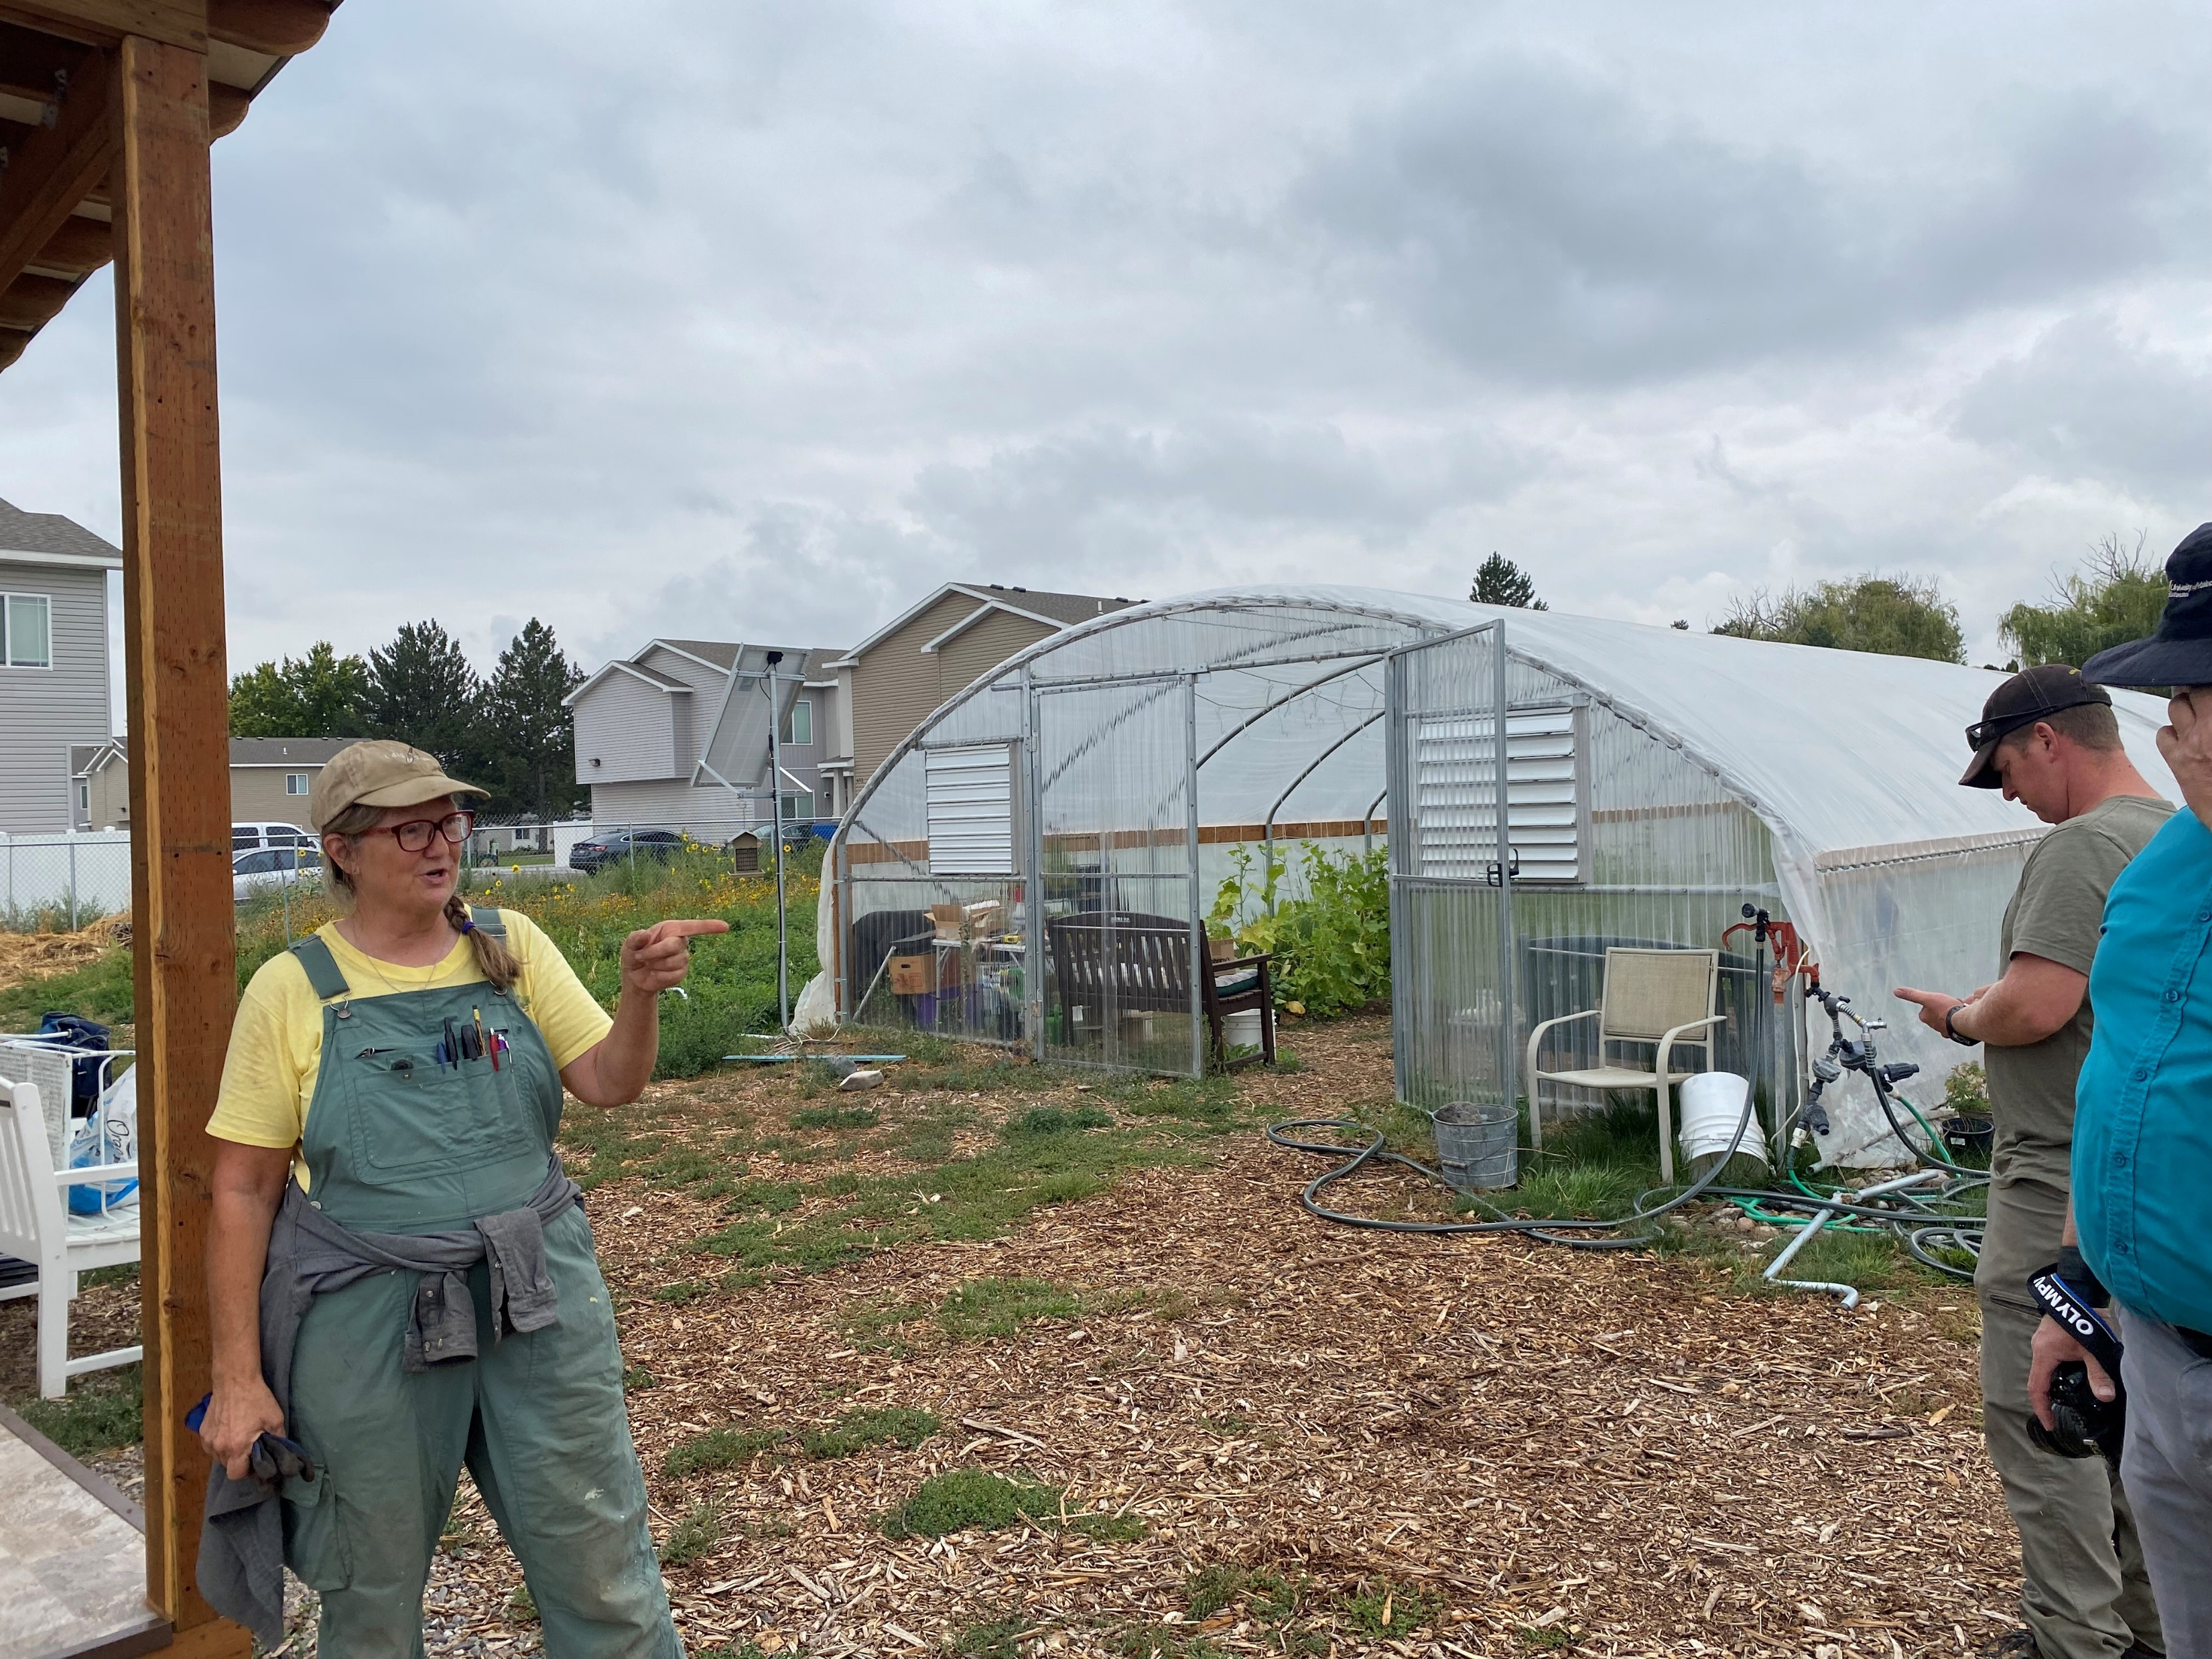
Food Basket High Tunnel

Slide 13
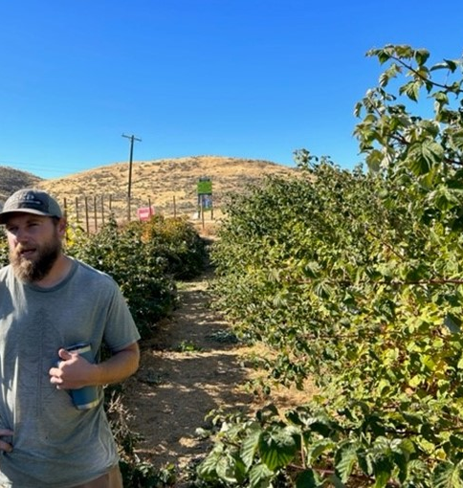
Urban Development Garden
Services a small acreage development of 90 homes within city limits
Has a volunteer base and a community “hero”
Temporary location
Support of the developer
Pollinator areas
Part of the development plan
Challenges

Slide 14
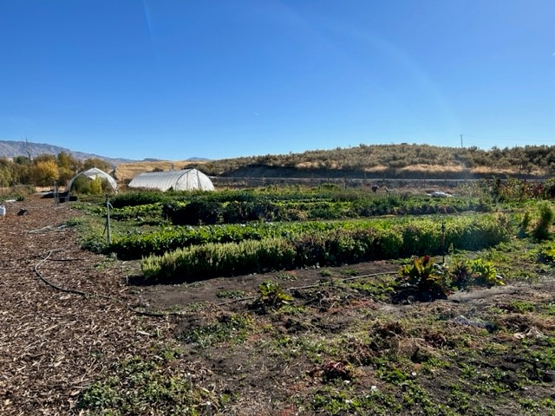
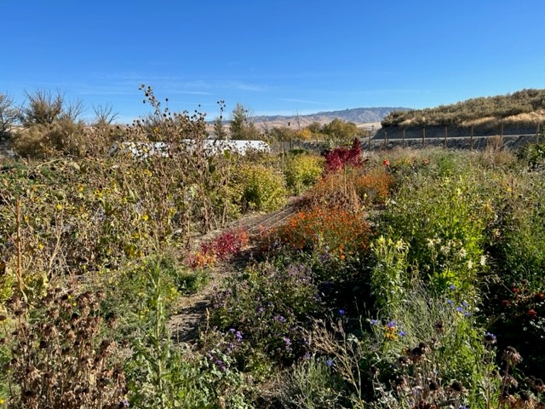
Urban Development Garden

Slide 15
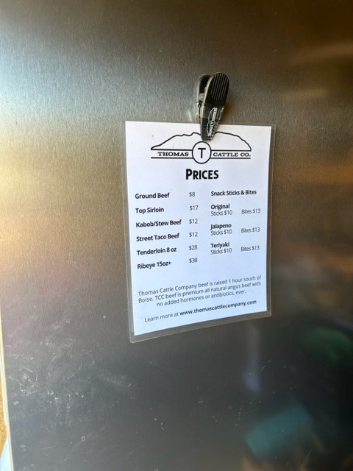
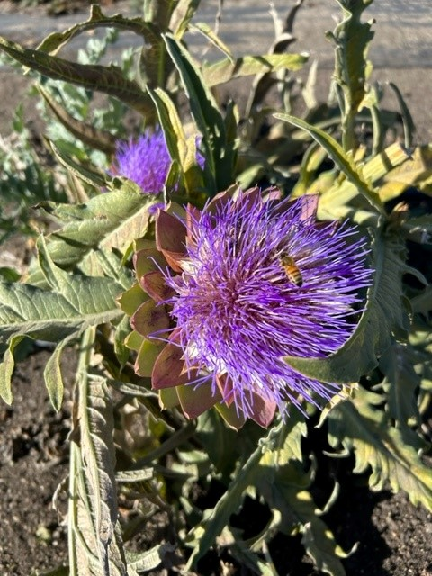
Urban Development Garden

Slide 16
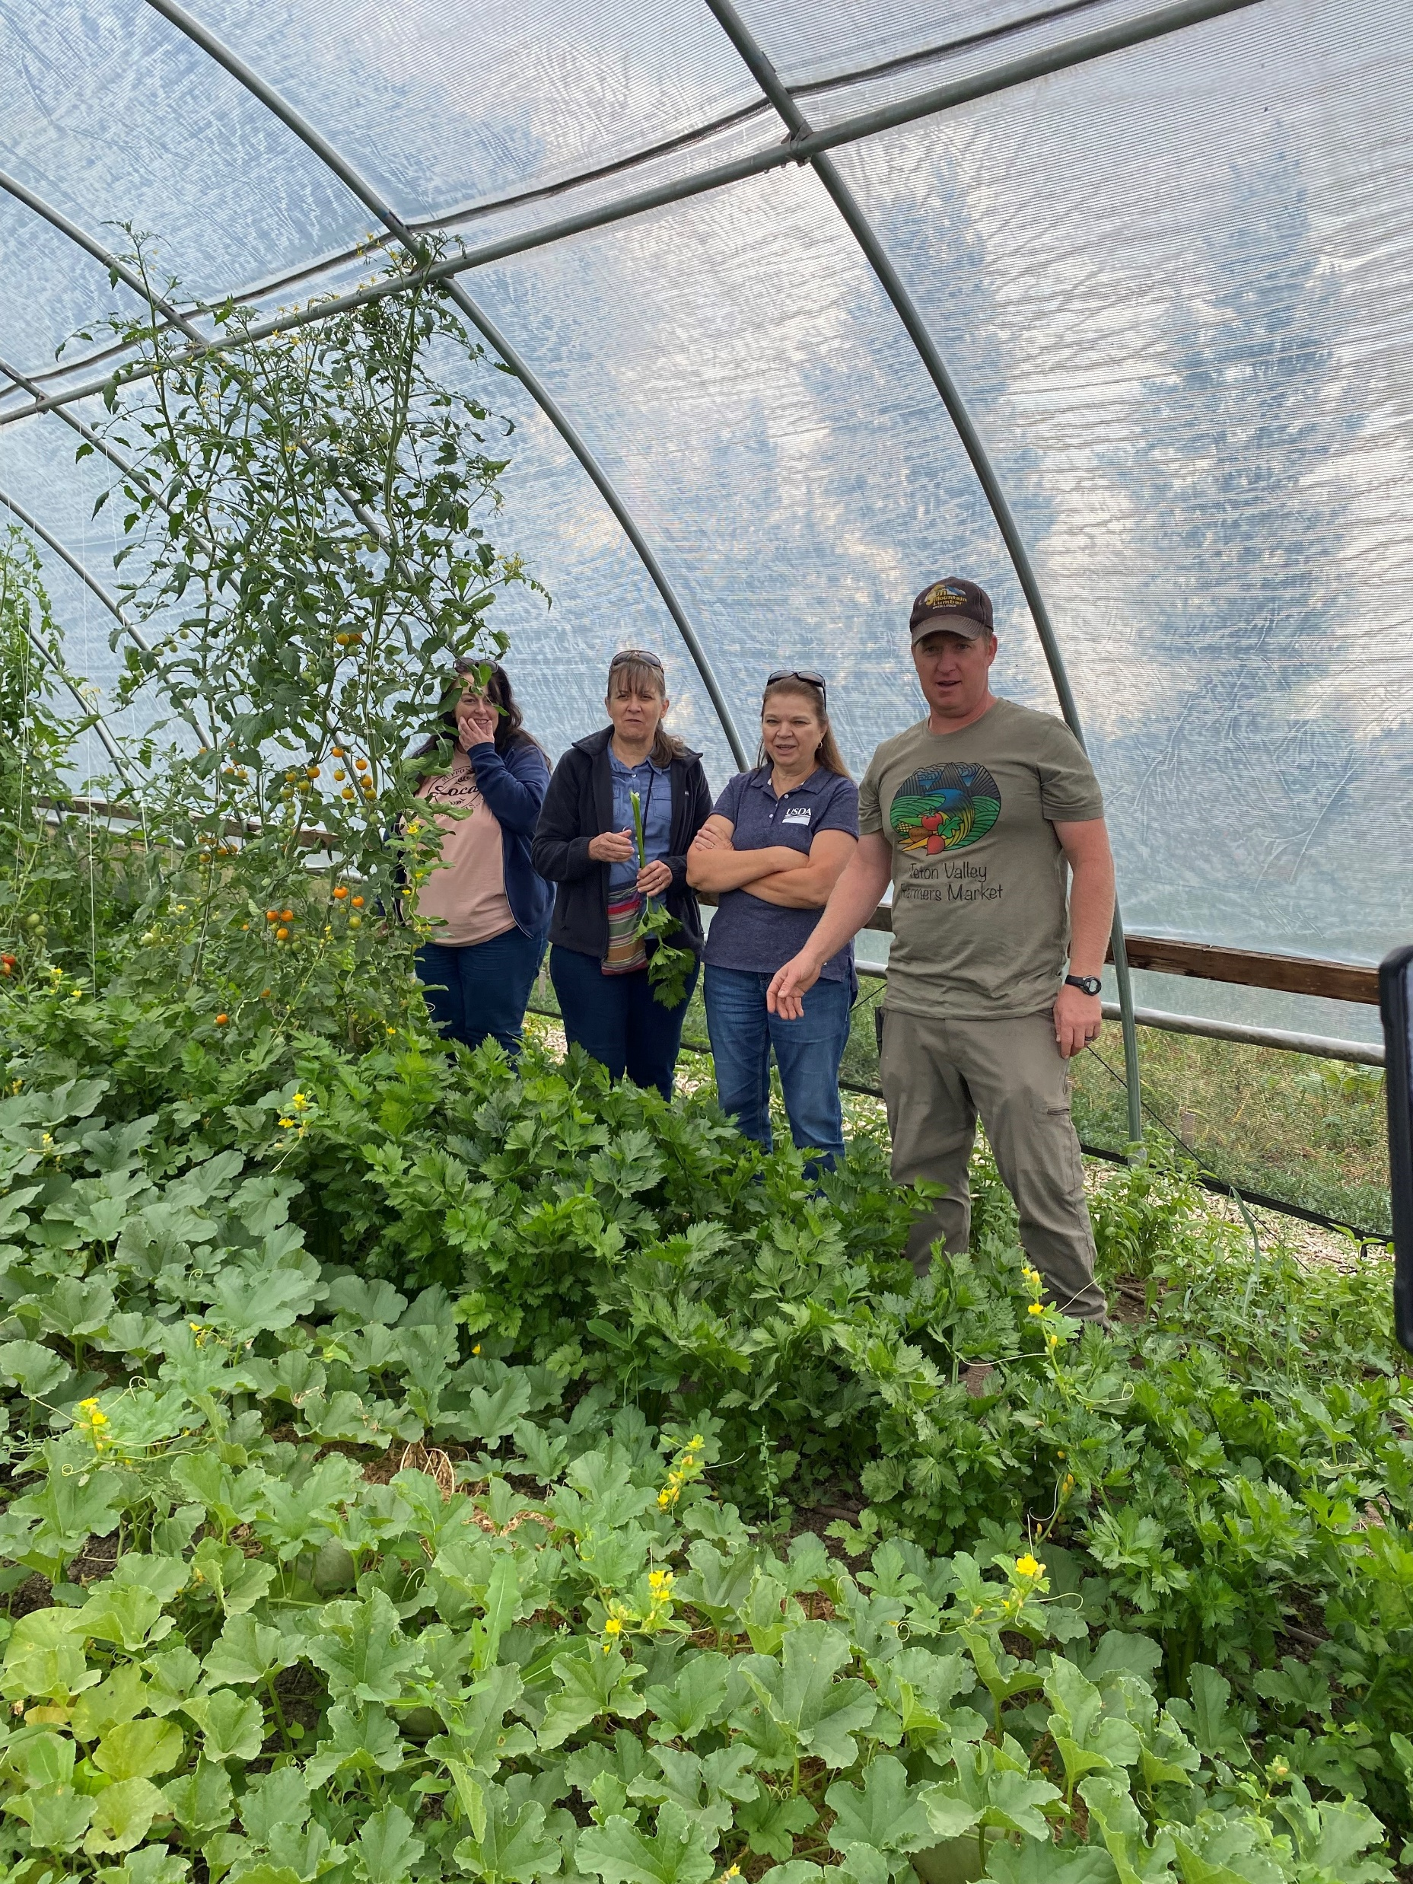
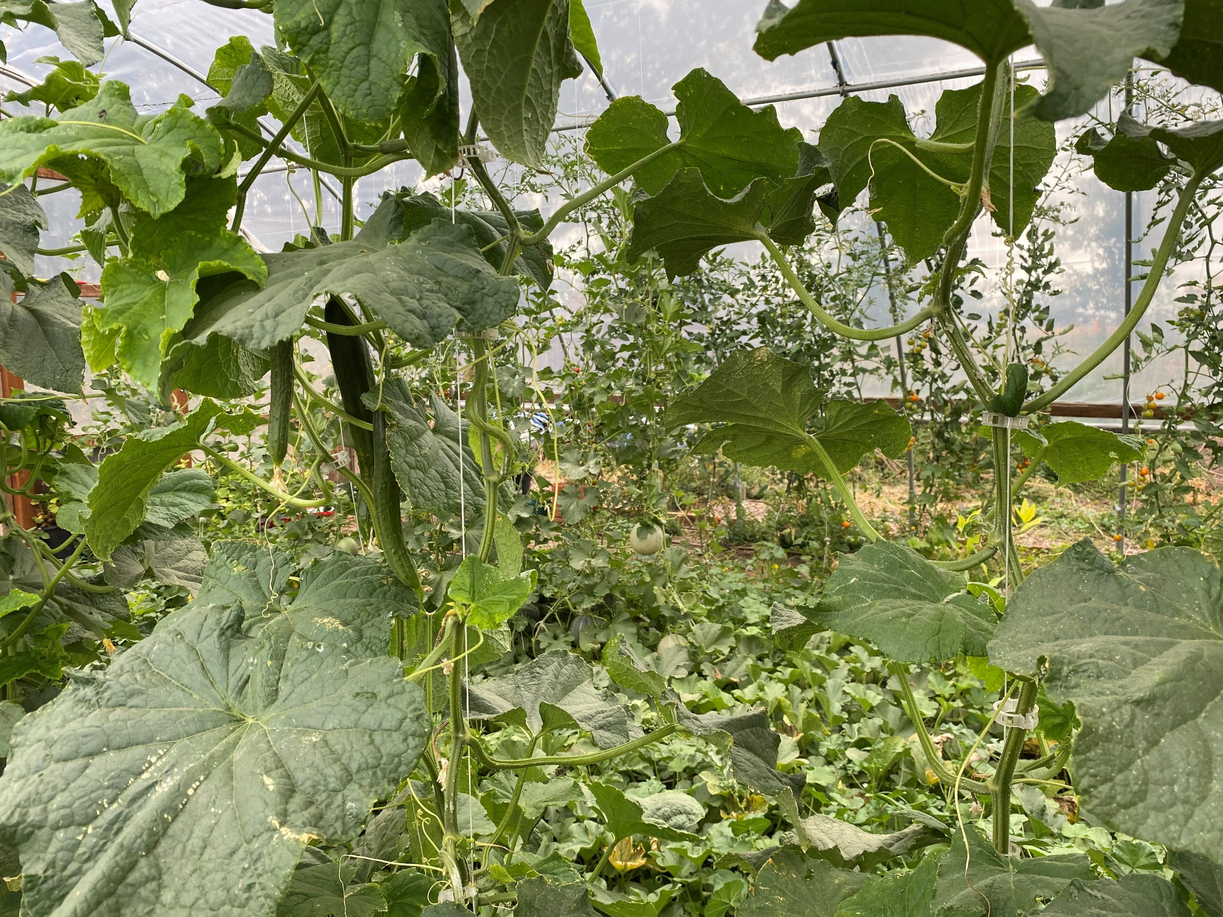
High Tunnel for Farmer’s Market

Slide 17
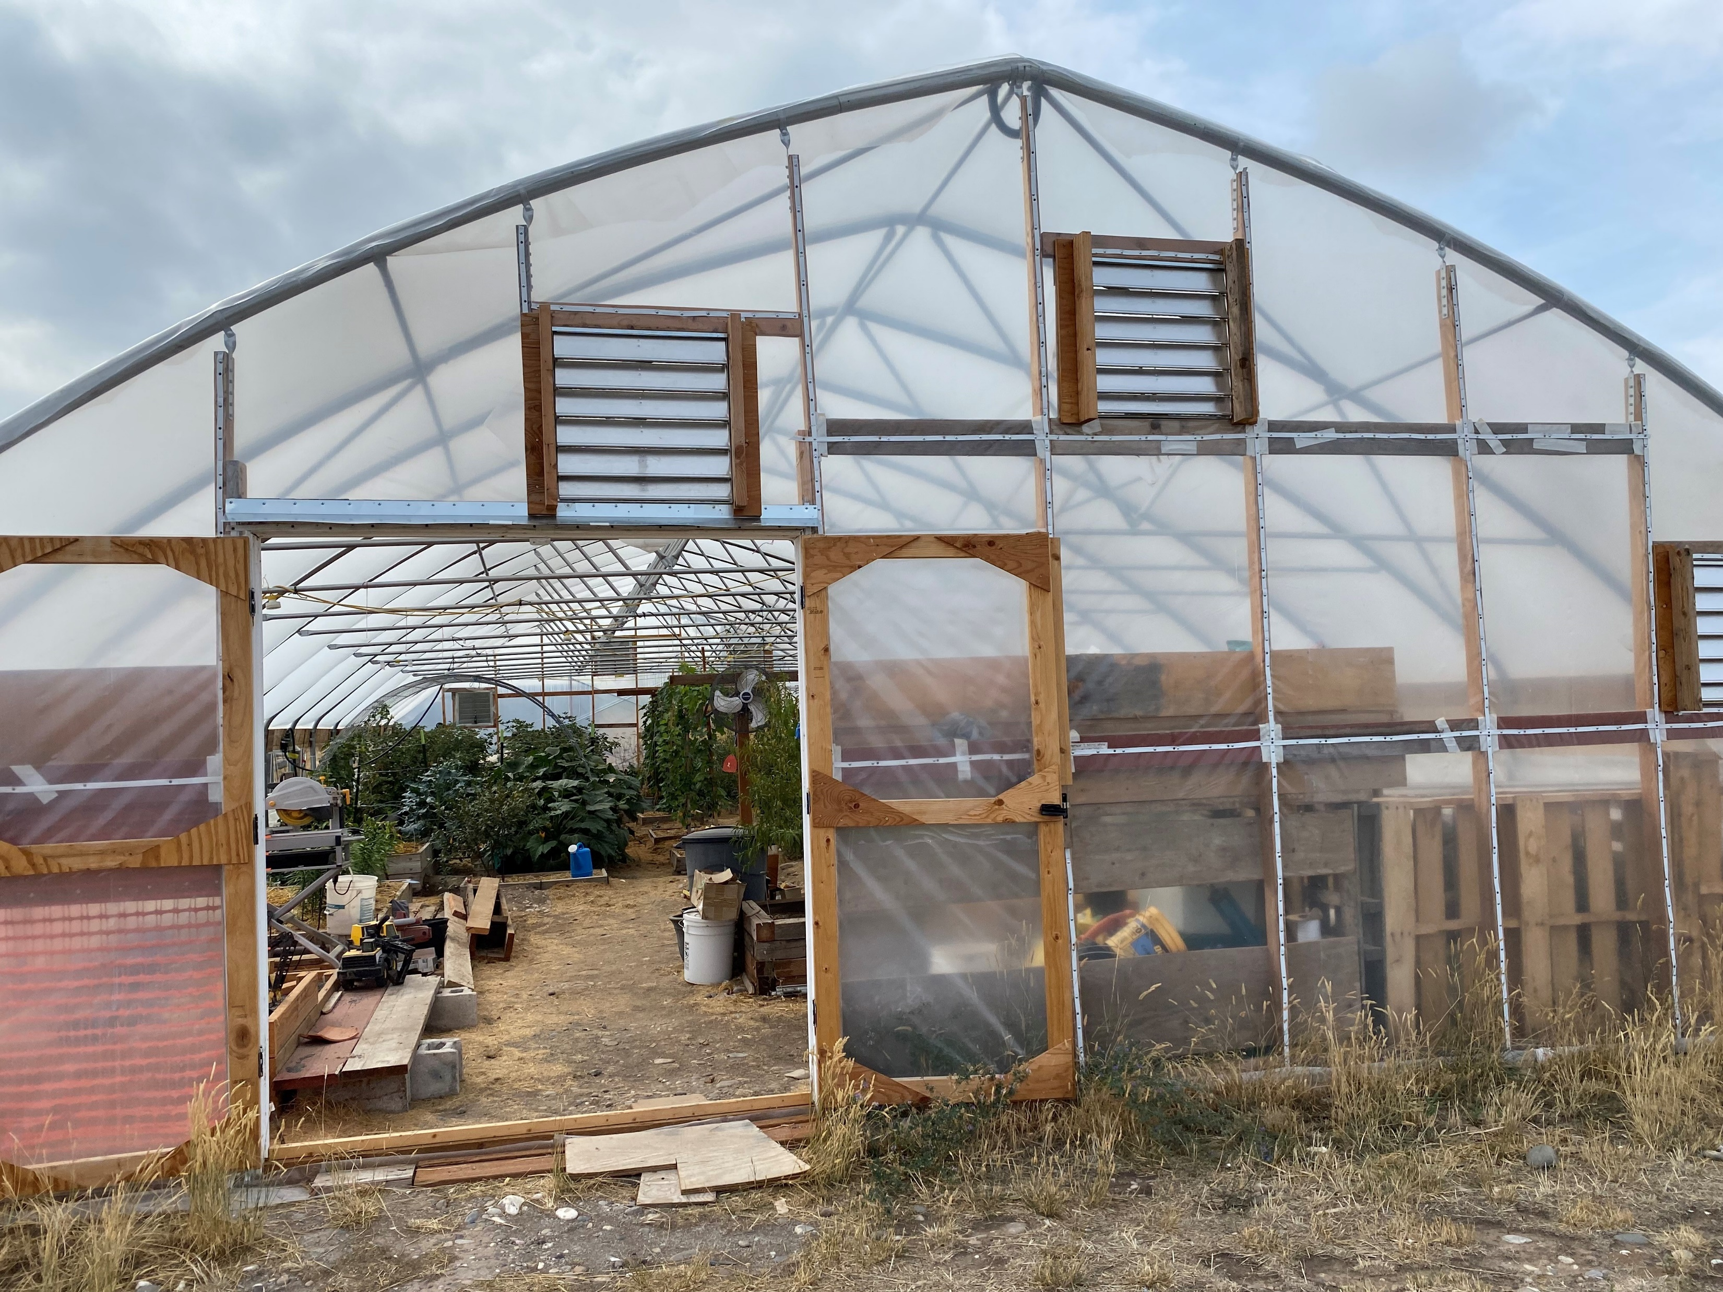
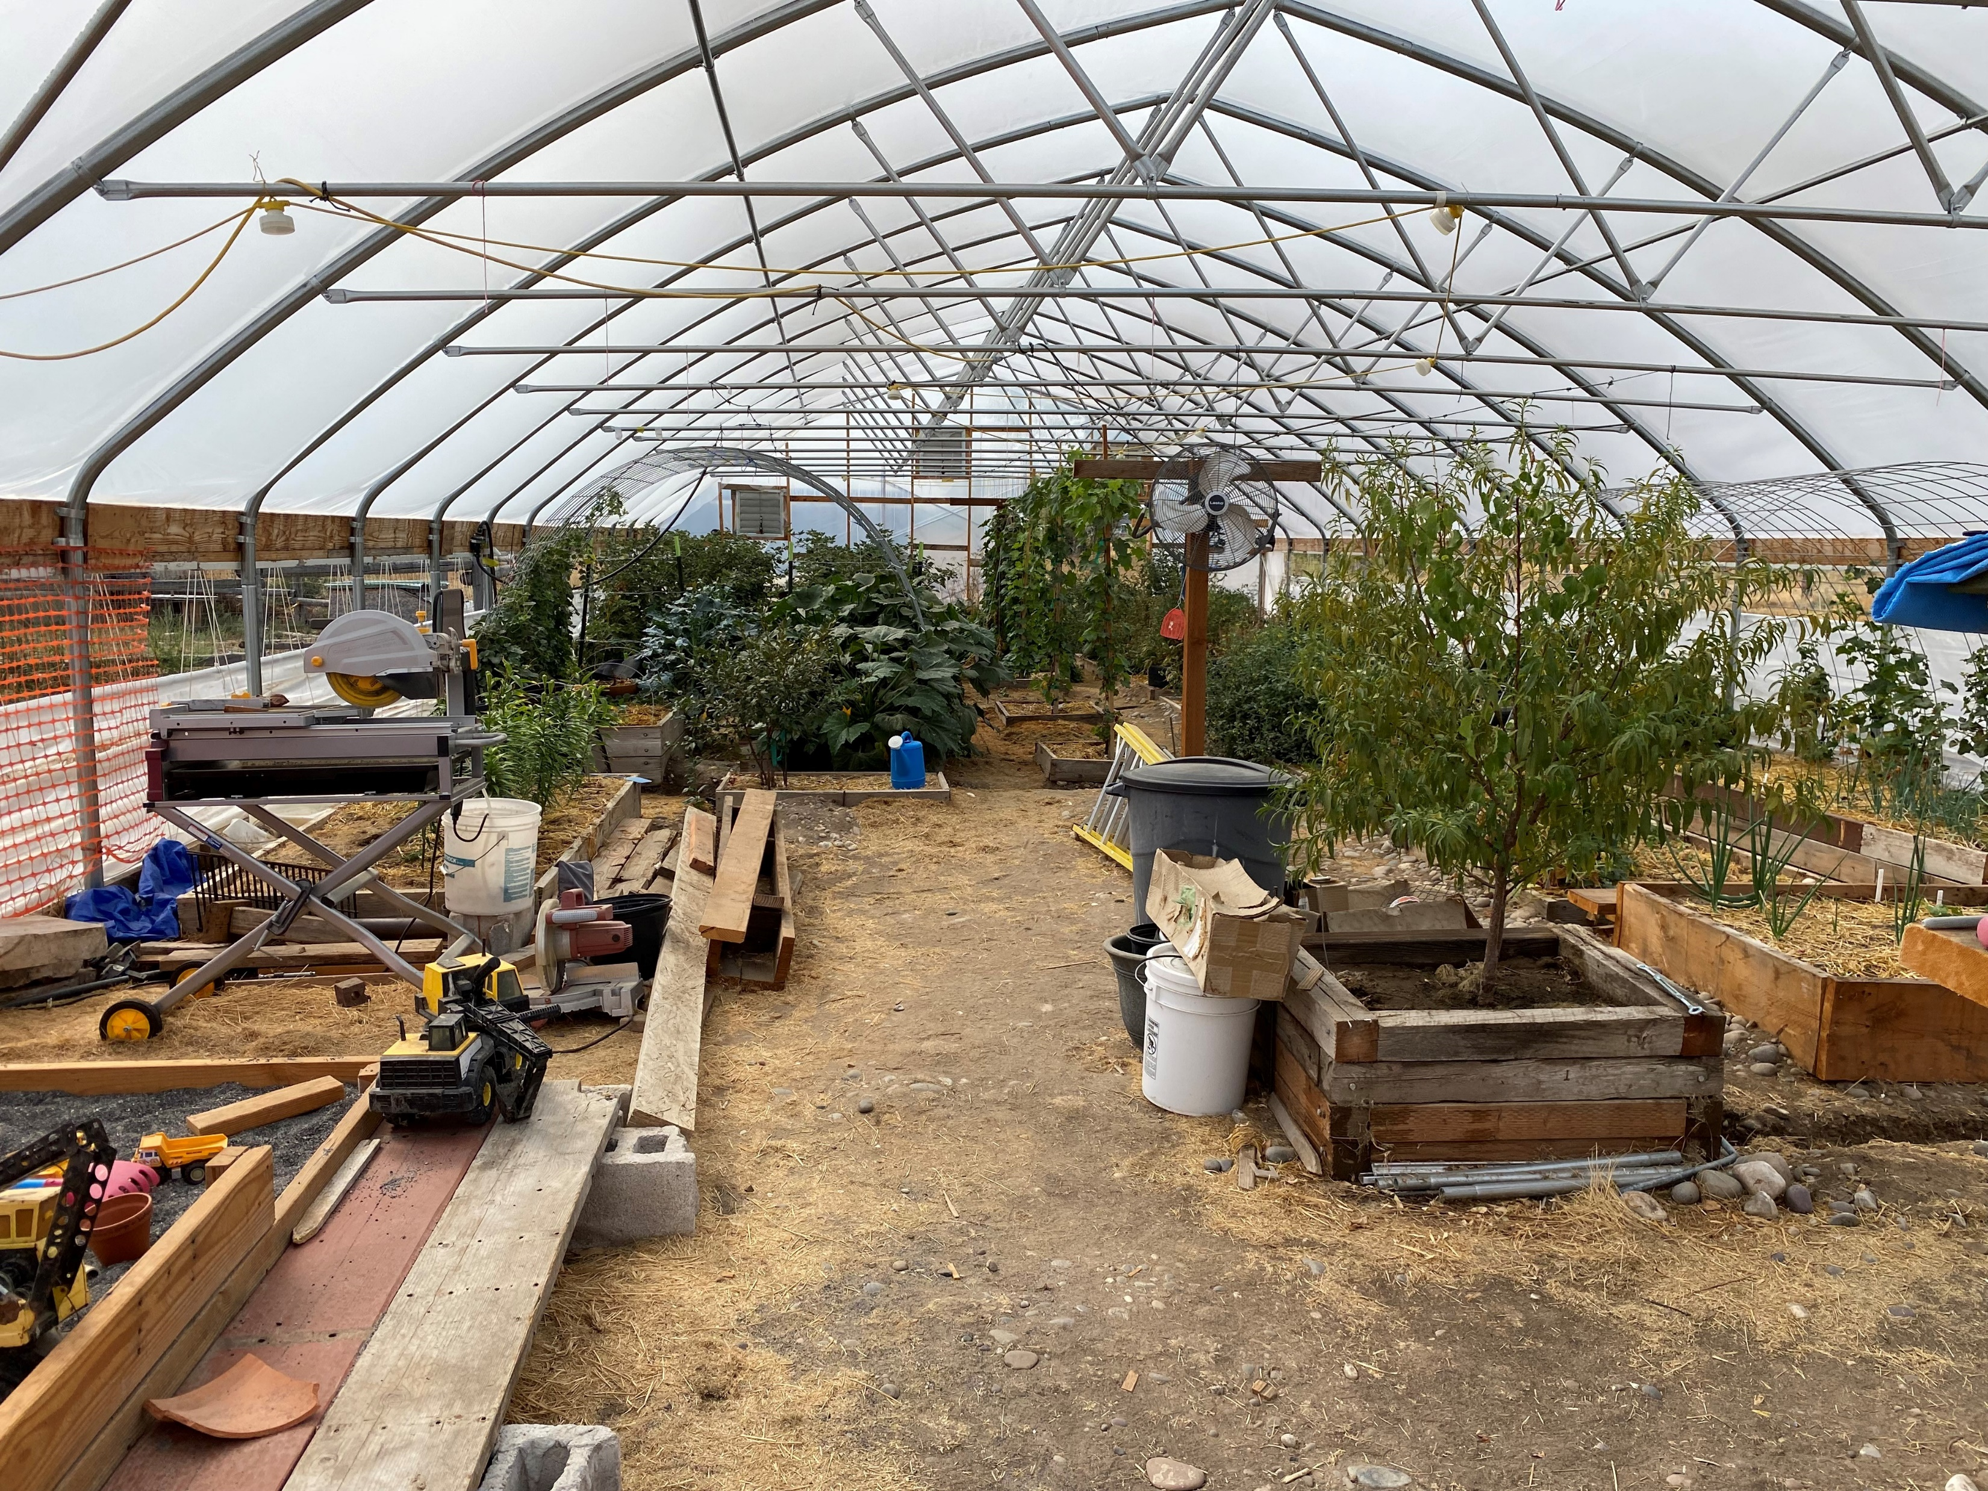
High Tunnel in an Urban Setting

Slide 18
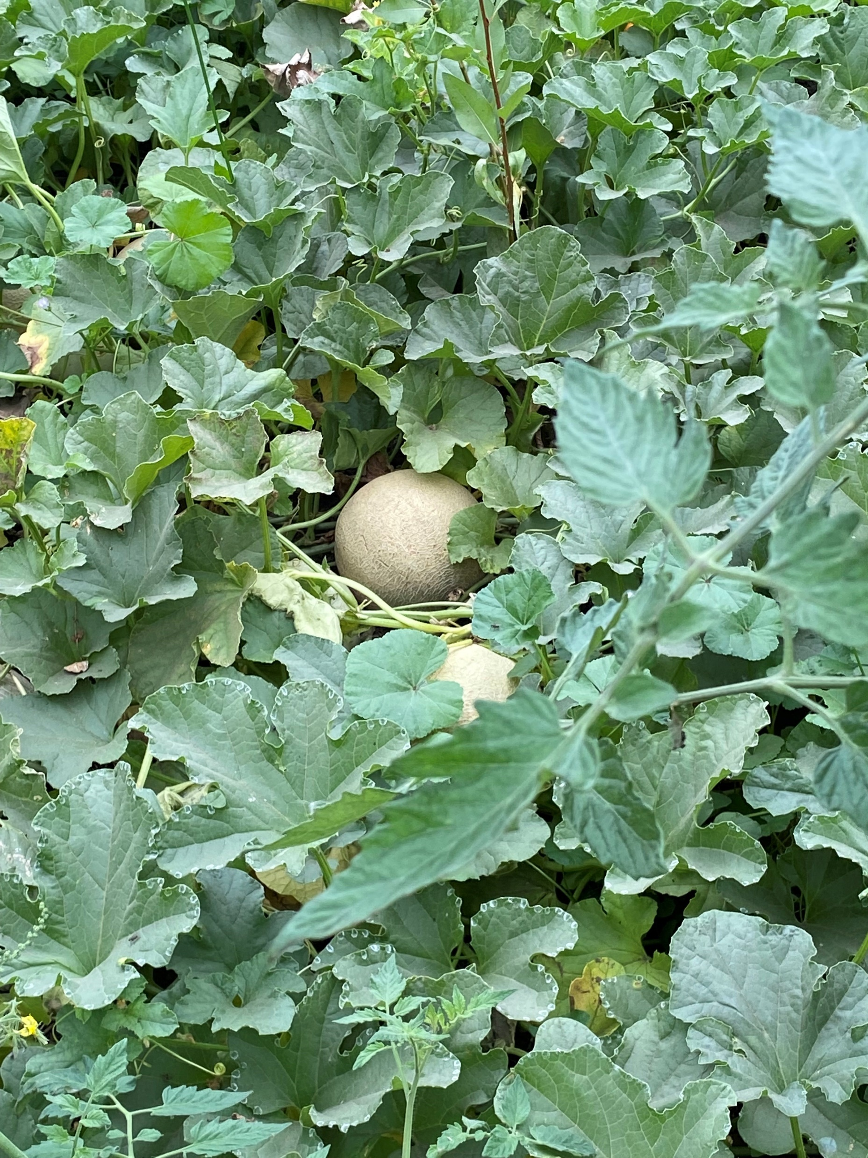
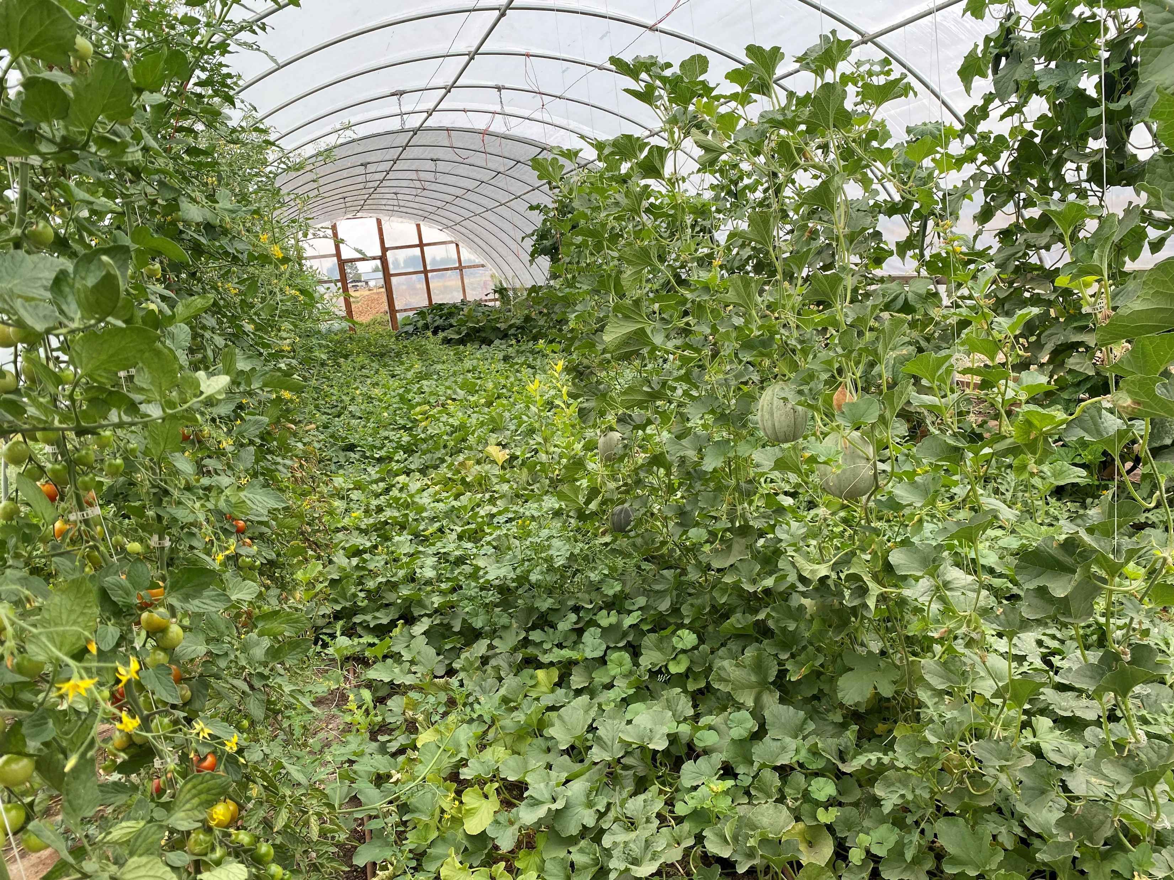
High Tunnel in an Urban Setting

Slide 19
Challenges
Policy in place may not be compatible with Urban/Small Acreage needs
Making contact with the right people at the right time
Reaching the population who needs assistance PRIOR to their purchase, or BEFORE they start their small acreage farm
Cities
Developers
Education, Targeting the Urban/Small Acreage Areas

Slide 20
Climate Smart Agriculture
Conservation Cover (Acres) 327
  Conservation cover for pollinators and beneficial insects (E327A)
  Establish Monarch butterfly habitat (E327B)
Conservation Crop Rotation (Acres) 328
  Resource Conserving Crop rotation (E328A)
  Improved resource conserving crop rotation (E328B)
  Soil health crop rotation (E328E)
  Modifications to improve soil health and increase soil organic matter (E328F)
  Crop rotation on recently converted CRP grass/legume cover for soil organic matter improvement (E328G)
  Intercropping to improve soil health (E328N)
Residue and Tillage Management, no till (Acres) 329
  No till to reduce tillage induced particulate matter (E329B)
  No till to increase plant-available moisture (E329C)
  No till system to increase soil health and soil organic matter content (E329D)
  No till to reduce energy (E329E)

Slide 21
Committees
Urban Agriculture and Small Acreage subcommittee (STAC)
  Work on statewide implementation
  Ideas
Cadre (NRCS Specific)
  Work within NRCS
  Made up of key specialists
  Possible producers
  Getting work done on the ground

Slide 22
Partners
University of Idaho – Extension
American Farmland Trust (AFT)
Farm Service Agency (FSA)
Local Working Groups
Master Gardeners/Grading clubs/Farmer’s Markets
Cities, planning and zoning, schools
Conservation Districts
And more!

Slide 23
Any questions?

