Slide 1
State and Transition Model on Cropland
Iowa
Jeff Matthias, State Grassland Specialist - Iowa
Notes:
GO TO VIEW > MASTER > SLIDE MASTER TO EDIT THE IMAGES ON THE TITLE AND DIVIDER SLIDES
RIGHT CLICK ON THE INDIVIDUAL IMAGES TO CHANGE THE IMAGE

Slide 2
MLRA107B
Wet Floodplain Prairie

Slide 3
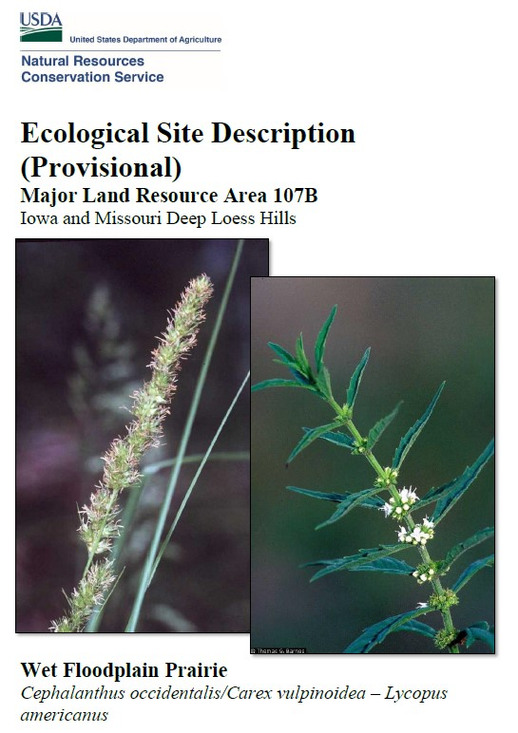
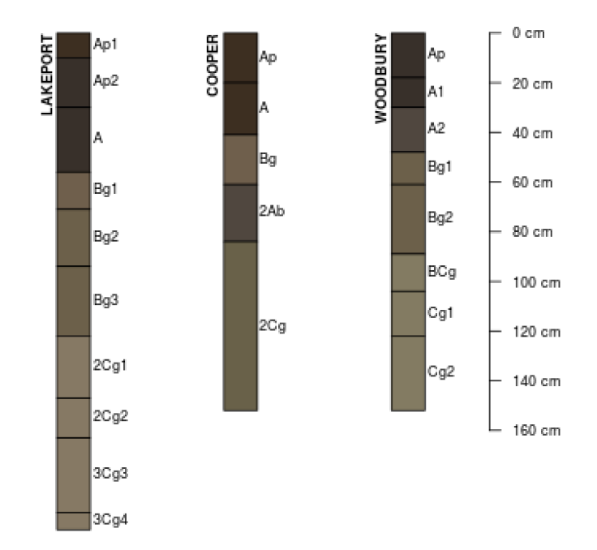
Completed in 2017
Notes:
This provisional ESD was originally completed in 2017. Typical profiles of prevalent soils of the ESD.

Slide 4
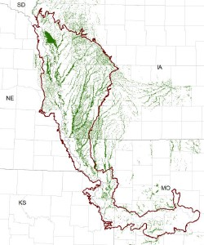
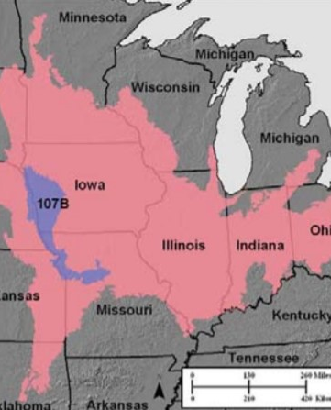
Location Map
Notes:
Location map shows 107B MLRA in Iowa, Nebraska, Kansas, and Missouri. The inset maps shows 107B in relation to the Central Feed Plains and Livestock Region of the Midwest

Slide 5
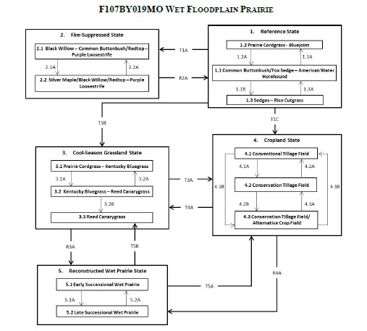
State and Transition Model
Notes:
Need to combine Transitions T1B and T1C into macro-scale drainage and then from it can be to pasture or cropland states.

Slide 6
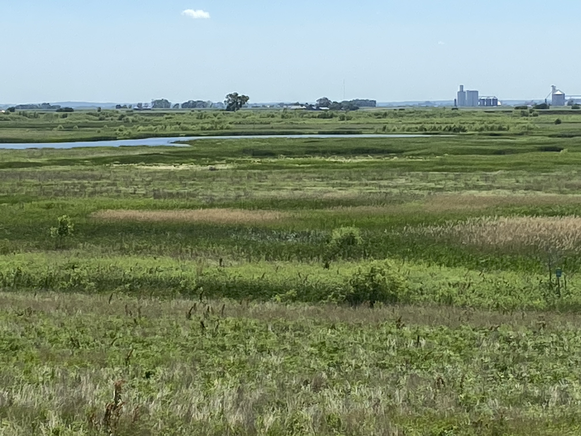
Location Map
Notes:
For field reviews, I concentrated on the area circled in red, which shows it to be a significant amount of the local landscape.

Slide 7
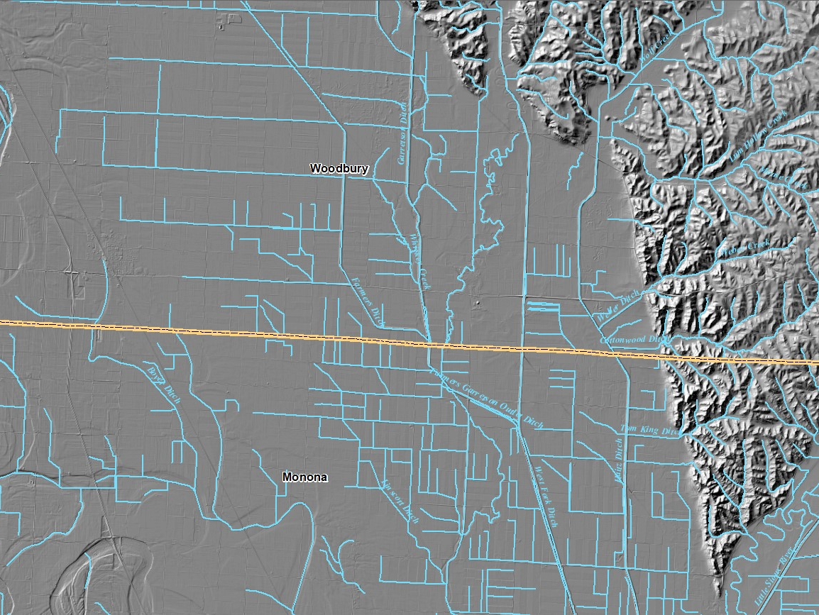
Notes:
This map shows “stream centerlines” in the area. Ditching projects have lowered water table and drained much of it. The old stream channel only flows during high-water and some is even farmed through currently. I found old records talking about digging the ditches and they were to be dug 13 feet deep.

Slide 8
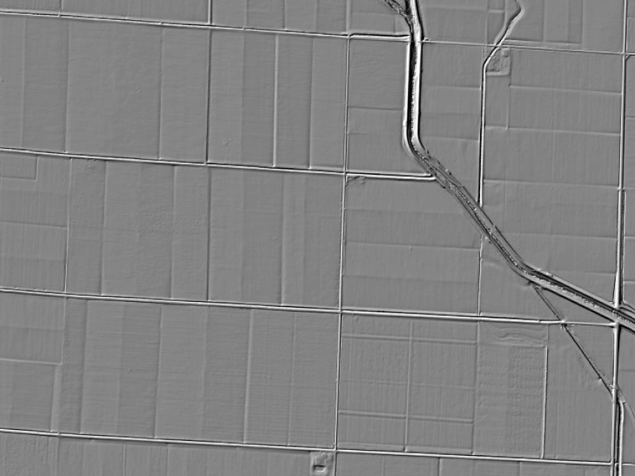
Notes:
This LiDAR hillshade map shows that much of this land also has land levelling completed on it.

Slide 9
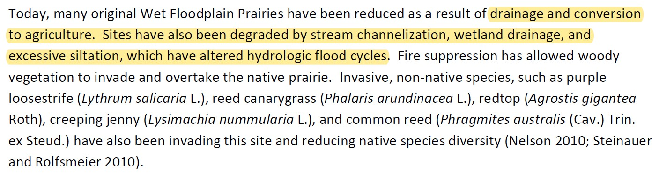
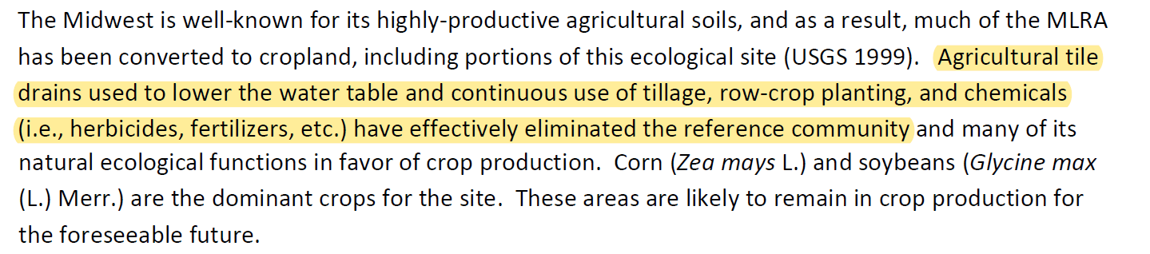
Notes:
Comments in Provisional ESD are lacking for manipulation that has been completed.

Slide 10
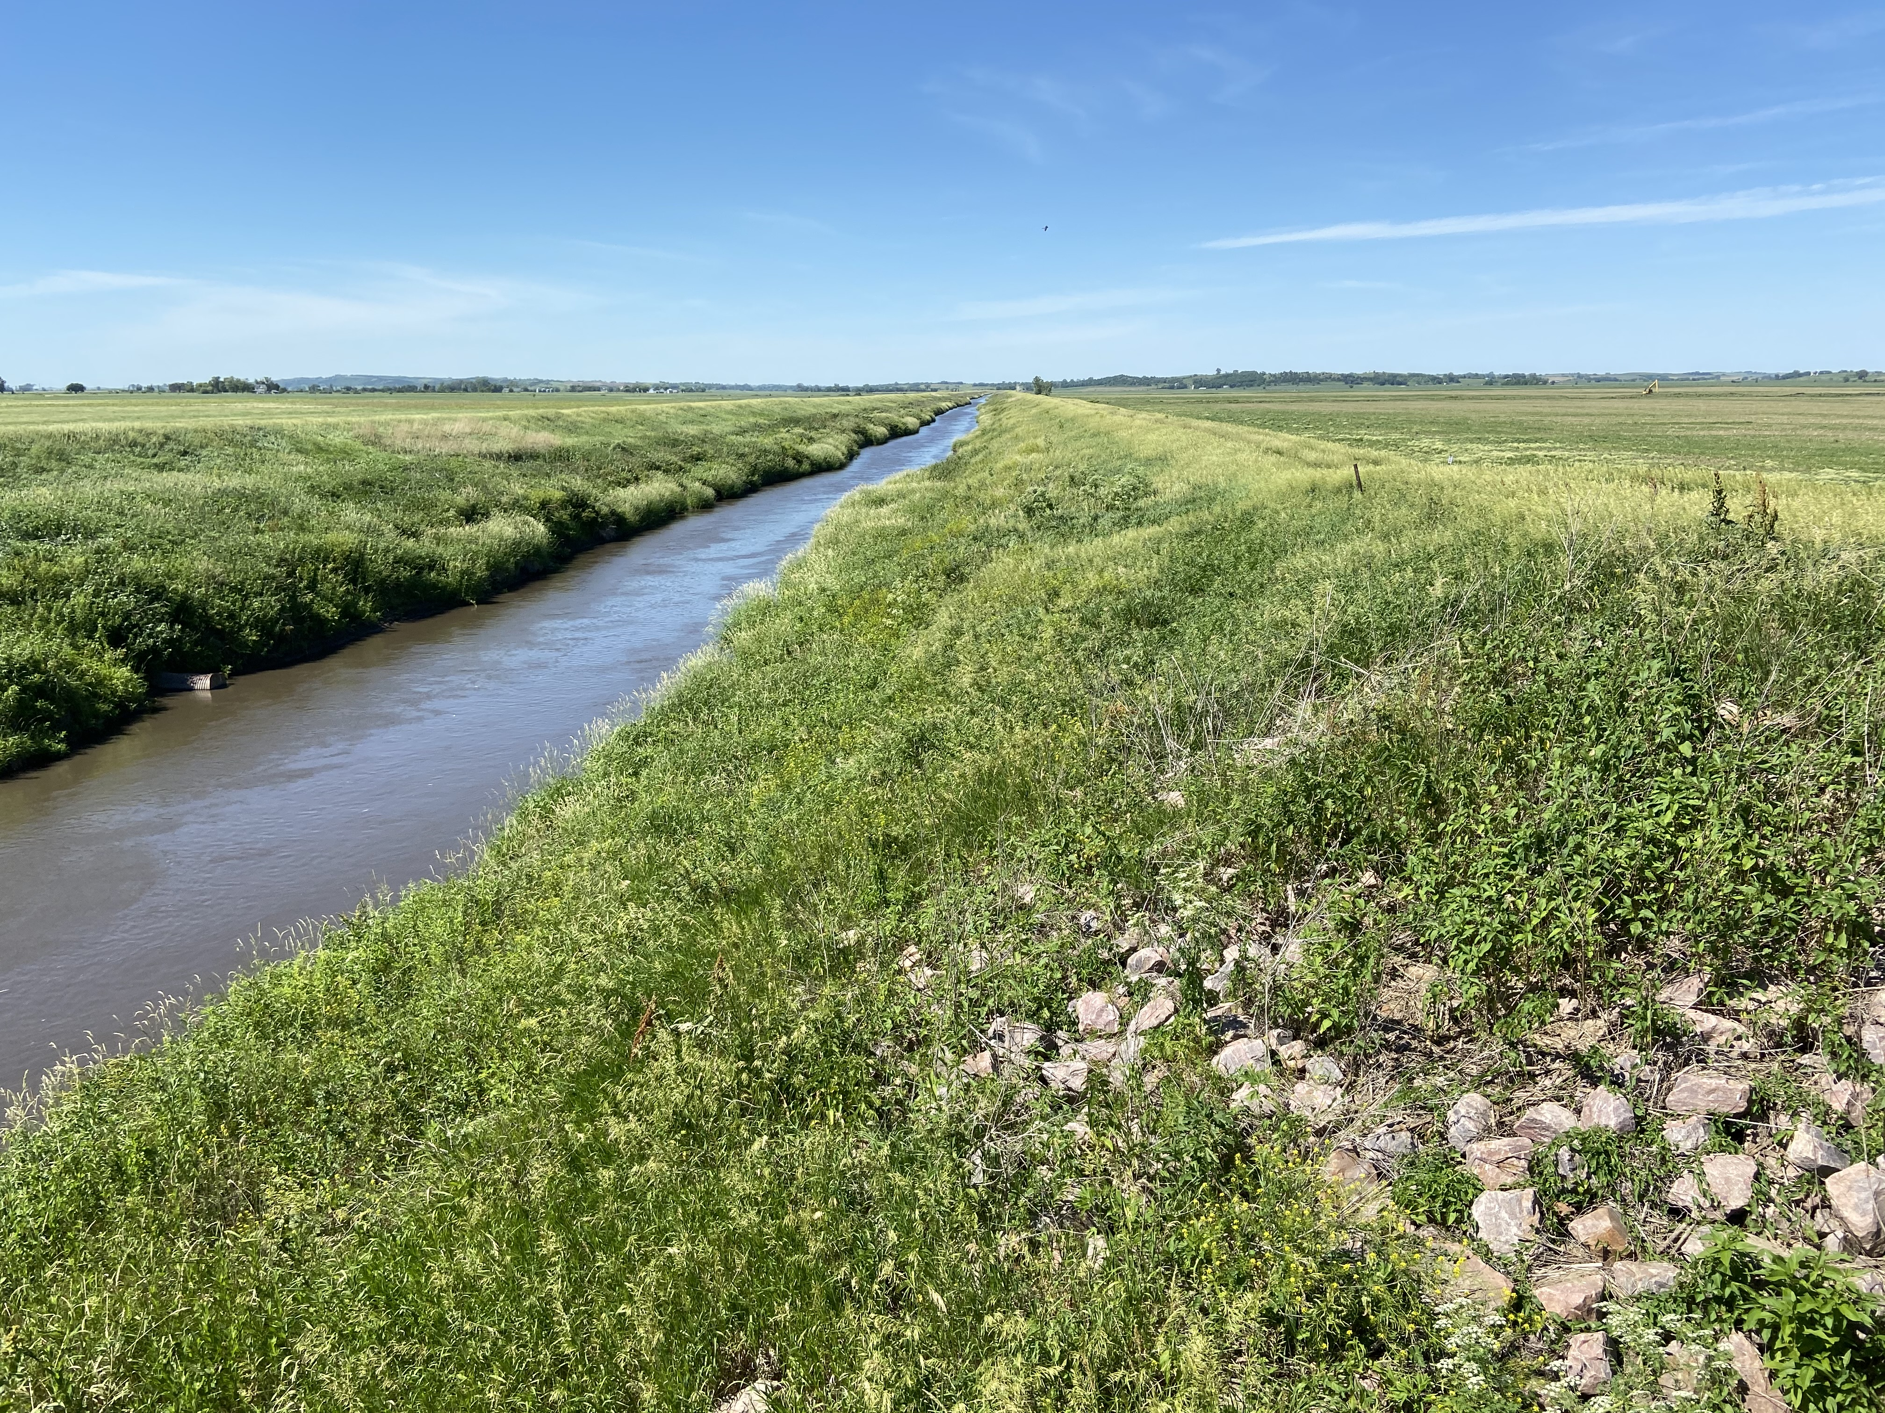
Drainage Manipulation
Notes:
Typical spring water level. Levees are about 16 feet and water level in the stream is about 5 feet below surface level of cropland.

Slide 11
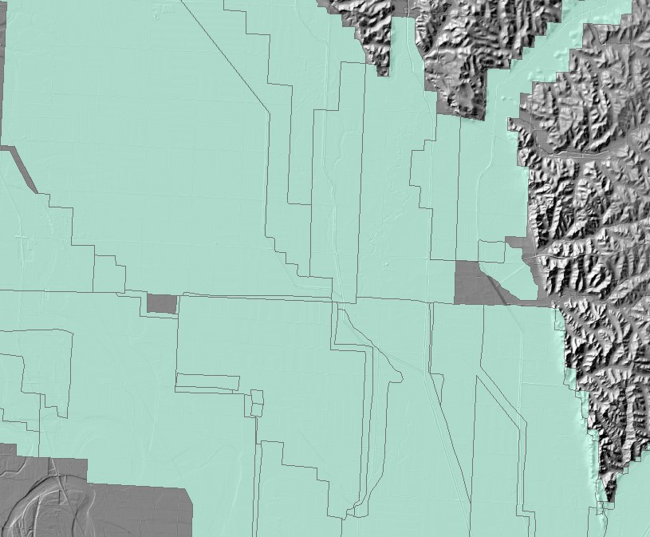

Slide 12
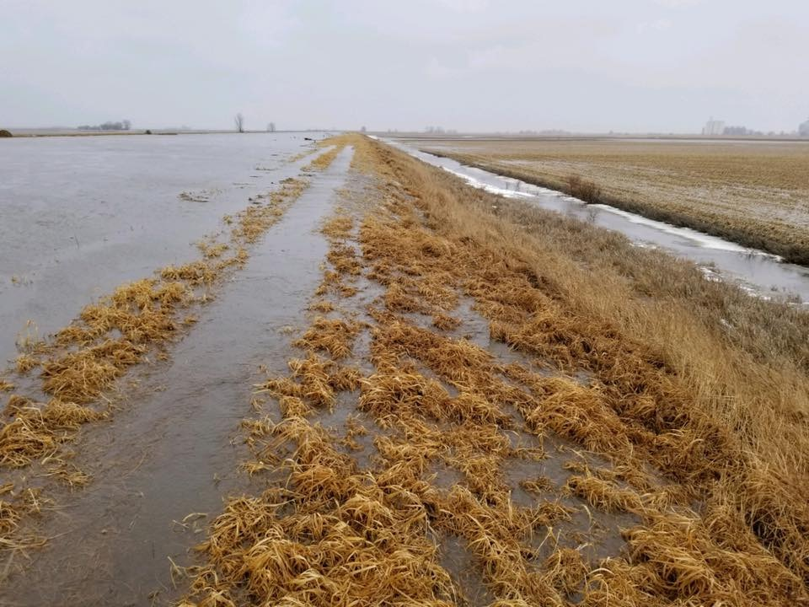
Drainage Manipulation
Notes:
Early stages of the “bomb cyclone” in the spring of 2019.

Slide 13
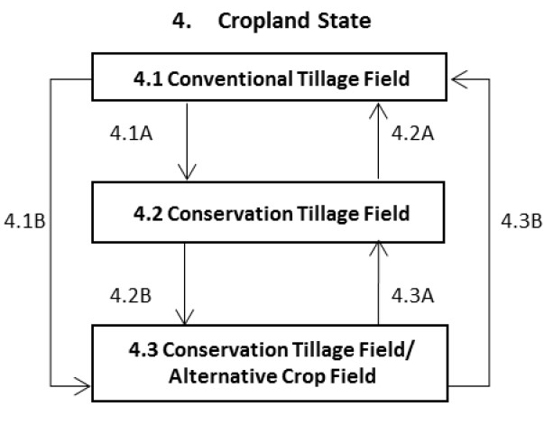
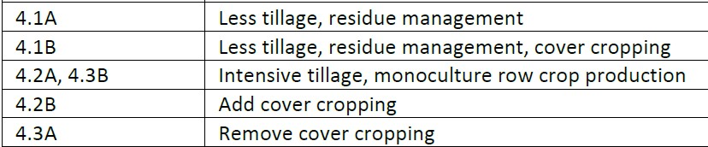
Cropland State
Notes:
Here is a simplified view of tiers within the cropland state. The problem with this model is community phases and phases can happen on a year basis, not allowing improved ecological services.

Slide 14
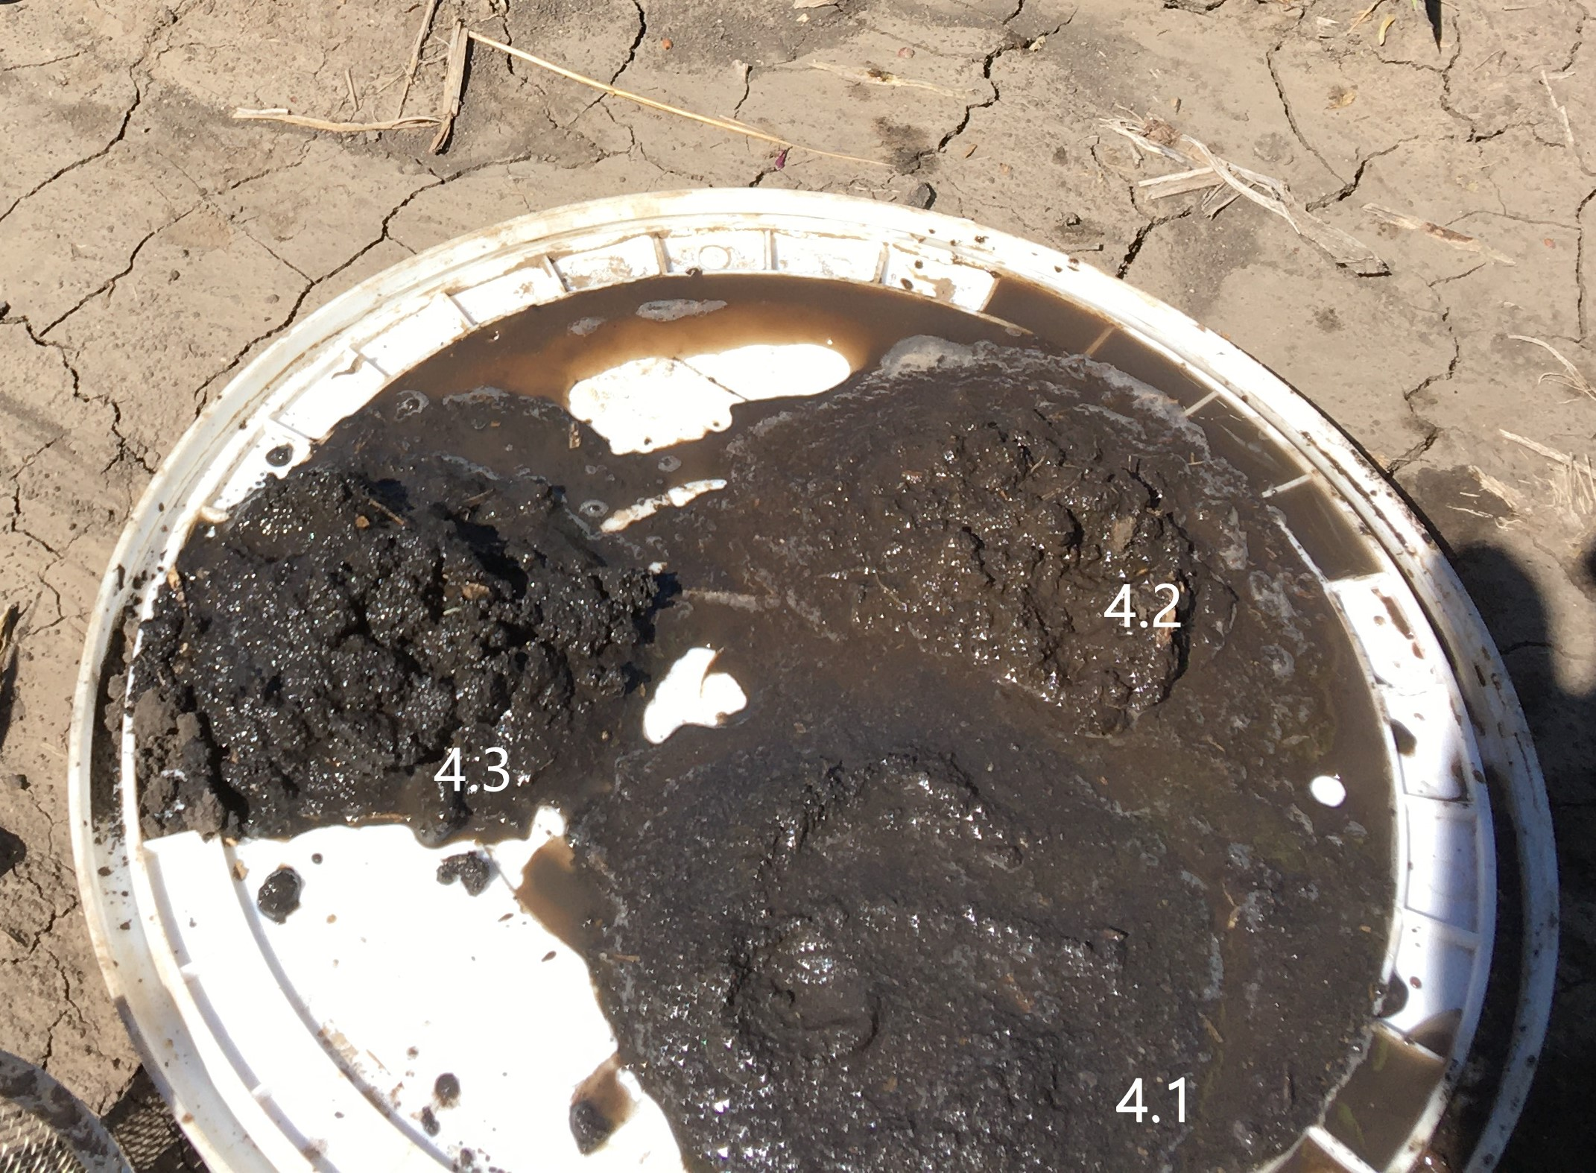
Soil Structure Comparison - Cropland
Notes:
Saturation soil test of the 3 phases of the cropland state. 4.3 is only in the second year due to tillage in 2019 after flooding.

