Slide 1
RCPP
State Technical Committee Meeting
August 26, 2021
Kris Graham Chavez
Notes:
GO TO VIEW > MASTER > SLIDE MASTER TO EDIT THE IMAGES ON THE TITLE AND DIVIDER SLIDES

Slide 2
Partner | RCPP # | Program | Expiration
Canadian River | 560 | 2015 - RCPP | Completed
Acequia | 89 | 2015 - RCPP | Completed
Restoration | 514 | 2015 - RCPP | Renewal
North Central | 287 | 2015 - RCPP | Renewal
Acequia | 1446 | 2016 - RCPP | Completed
North Central | 1525 | 2016 - RCPP | Completed
Soil Health | 1530 | 2017- RCPP | 9/30/2022
Chama | 1542 | 2017- RCPP | 2/28/2023
Canadian River | 1544 | 2017- RCPP | 9/30/2022
Acequia | 1614 | 2017- RCPP | 2/28/2023
North Central | 1615 | 2017- RCPP | 9/30/2022
NFWF | 1700 | 2018-RCPP | 8/31/2023
North Central | 1823 | 2018-RCPP | 8/31/2023

Slide 3
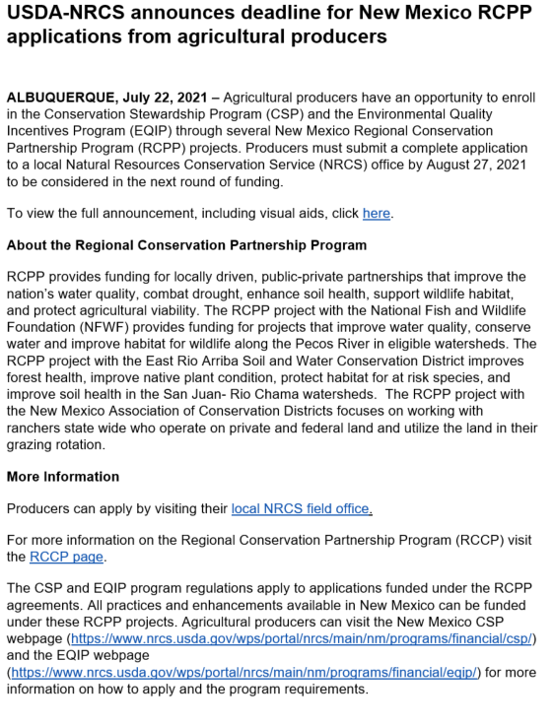

Slide 4
F/A - Funds Available
2017 Soil Health - NMACD
F/A funds $693,303.25 – EQIP - We will hold back $50,000
2017 Chama – East Rio Arriba SWCD
F/A Fund $1,289,389 - CSP
2018 Pecos Partnership - NFWF
F/A funds $417,250 - EQIP
F/A funds $1,064,970 – CSP

Slide 5
Project # | Project Title | Lead Partner | Funding Amount | Funding Pool | CCA | Summary
1893 A-0040 | San Juan Non-Native Phreatophyte Removal Program | San Juan SWCD | $1,042,208.00 | State | N/A | The San Juan Soil and Water Conservation District aims to protect reduce wildfire risk by removing non-native Russian olive and Salt Cedar infestations in identified high priority areas. The project will also undertake native plant and tree restoration activities to help restore riparian habitat and improve hydrology, involve the community in restoration and monitoring activities, and to encourage a renewed connection with the river.
1905 A-0056 | Eastern New Mexico Prairie Grassland Initiative | NMACD | $2,025,974.00 | CCA | Prairie Grassland | To increase suitable and occupied habitat to meet critical habitat needs of Lesser Prairie-chicken. Habitat improvements will occur through chemical and physical destruction of Mesquite patches across five priority areas identified using a mesquite density model and a study by scientists at New Mexico State University.
514 2127 A-0057 | 2015 NM Restoration Initiative for Rangeland, Forestland, and Wildlife on Ranches w Fed Lands | NMACD | $4,000,000.00 | State |  | The New Mexico Restoration Initiative will utilize EQIP contracts with ranchers whose operations include federal lands.
287 2137 A-0046 | 2015 North Central NM Watershed Restoration Project | Claunch Pinto SWCD | $2,313,359.00 | State |  | Claunch-Pinto SWCD and its partners have identified over 35,000 acres for forest restoration treatments on private, public, state and tribal lands that are located within both the upland ponderosa pine, pinon, and juniper watersheds, and in the lower elevation riparian ones. Claunch-Pinto SWCD and their partners are committed to successful restoration treatments aimed at improving watershed health and mitigating the extreme risk of wildfire.

Slide 6
Application Process
Once Supplemental Agreement has been signed and
Ranking Criteria finalized
Outreach
News Release Developed with deadlines
TSP and NRCS may promote program to producers
TSP’s - please send ALL applicants to FSA and NRCS
Ranking completed

Slide 7
Deadlines
Program/Initiative | Application Deadline | Ranking | 100% Obligation
RCPP- Rio Chama - (CSP only) | August 27 | October 29, 2021 | TBA
RCPP- Pecos Watershed (NFWF) EQIP | August 27 | October 29, 2021 | TBA
RCPP- Pecos Watershed (NFWF) CSP | August 27 | October 29, 2021 | TBA
RCPP- 2018 Soil Health EQIP | August 27 | October 29, 2021 | TBA
RCPP- San Juan Phreatophyte Removal | TBA
RCPP- Eastern NM Grasslands | TBA
RCPP- Restoration - Renewal | TBA
RCPP-North Central - Renewal | TBA

Slide 8
QUESTIONS?

