Slide 1
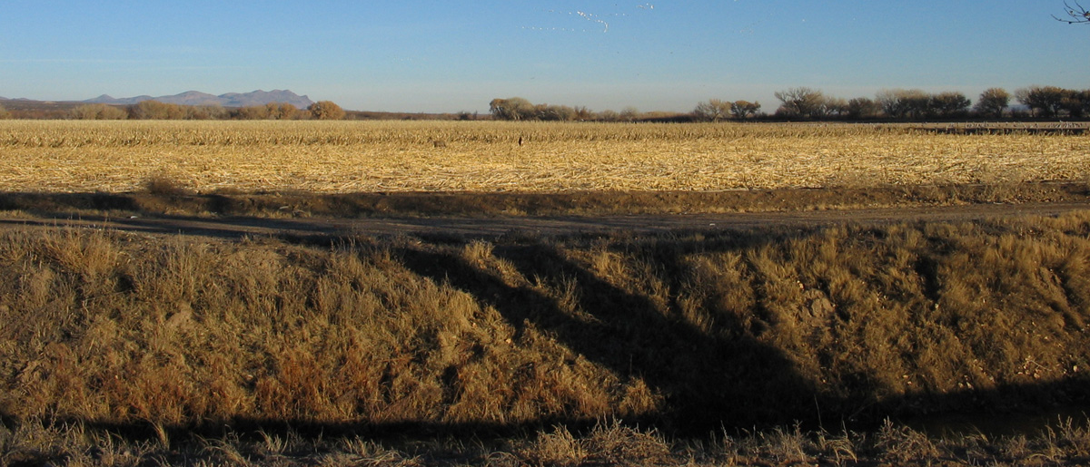

Locally Led Conservation
State Technical Committee Input
Notes:
State Technical Committee provides input and advice to guide locally led conservation priorities.

Slide 2
Local
Geographic area best suited to address the conservation needs.
Conservation
Driven by resource concerns, including social and economic.
Community
Led by a community effort where stakeholders are challenged to work together.
Notes:
Locally led is based on three principles. The term “local” can be a large or small area depending on the conservation issue.
Action is driven by the conservation needs based on resource concerns identified. Program funding is tool to help with action. Programs do not drive the process.
Community involvement is crucial. Key stakeholders must be involved in the process.

Slide 3
Annual review of program payment schedules for EQIP and CSP.
Payment rates and scenarios are posted to national webpage:
https://www.nrcs.usda.gov/wps/portal/nrcs/detailfull/national/programs/financial/?cid=nrcseprd1328426
Scenarios are developed for typical installation at the minimum level needed to meet the practice standard.
The scenarios list the equipment, materials, labor, training and foregone income needed for the typical size.
The typical size can make a large difference in the payment rate.
3
Notes:
Every year NRCS must conduct a review of payment rates and seek input from the State Technical Committee. FY2021 rates have not been published.

Slide 4



Irrigation Ditch Lining
2020 2021
$344.86
$413.84
Added more labor. Could evaluate again once more receipts and estimates of inputs are received.

Slide 5
Costs to evaluate for FY22
Typical costs for Prescribed Burning.
Well excavation- depth of casing.
Solar panels for well pumps
Low-cost, aerial Brush Management
Foregone income for cover crops
Small farm scenario for Irrigation Water Management
Change seed costs based on seeding rate and expensive seeds
Annual grasses, mostly introduced but may be native. Certified organic. | $68.58/ acre
Annual grasses, one or more species, mostly introduced but may be native. Not organic | $32.58
A mix of annual grasses, legumes and/or forbs, mostly introduced but may be native. | $47.95
A mix of annual legumes or forbs, may include grasses, includes introduced or native species that may be less available commercially. Species typically reseed and persist for multiple years. | $124.05

Slide 6
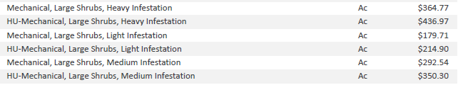
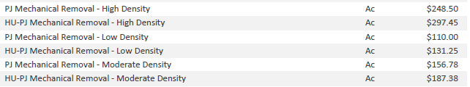
Brush Management
Mesquite vs Pinyon Juniper
Typical implementation: 120 acres
Typical implementation: 500 acres
Notes:
Need to collect information on size of equipment, hours and typical size to provide the justification to change the payment rate.

Slide 7
Soil Health Adaptive Management
Residue and Tillage Management, No-Till (329) $2,400 each
Residue and Tillage Management, Reduced Till (345) $2,925 each
Cover Crop (340) $1,609 each
Nutrient Management (590), $1,890 each
The producer is considering using the practice but is unsure how to manage on their operation or needs to change the management to be successful.
Evaluate one or more management strategies.
At least 4 small replicated plots.
Designed, laid out, managed and evaluated with the assistance of a knowledgeable consultant.
Repeated for 3 years.
Ideally, yields are collected and adjusted for moisture content.

Slide 8
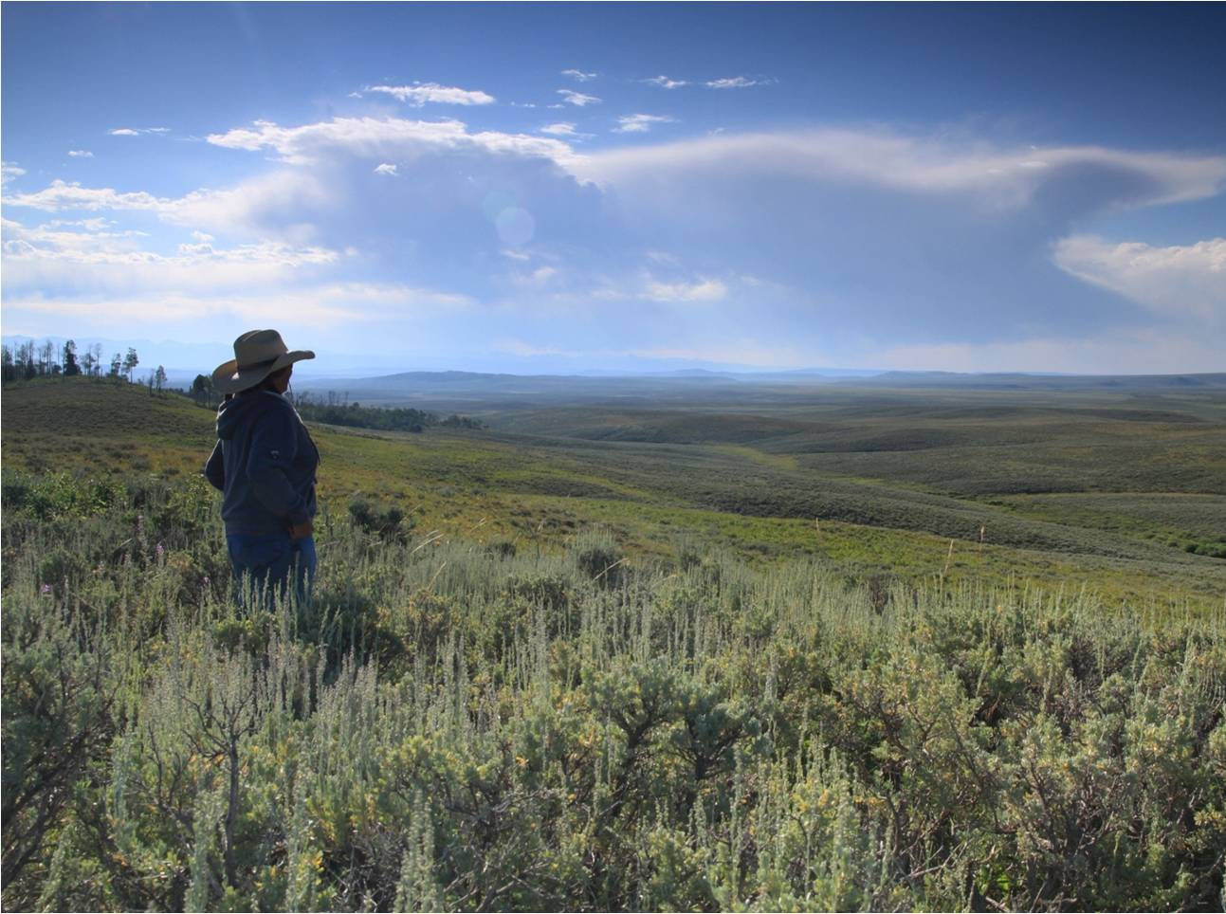
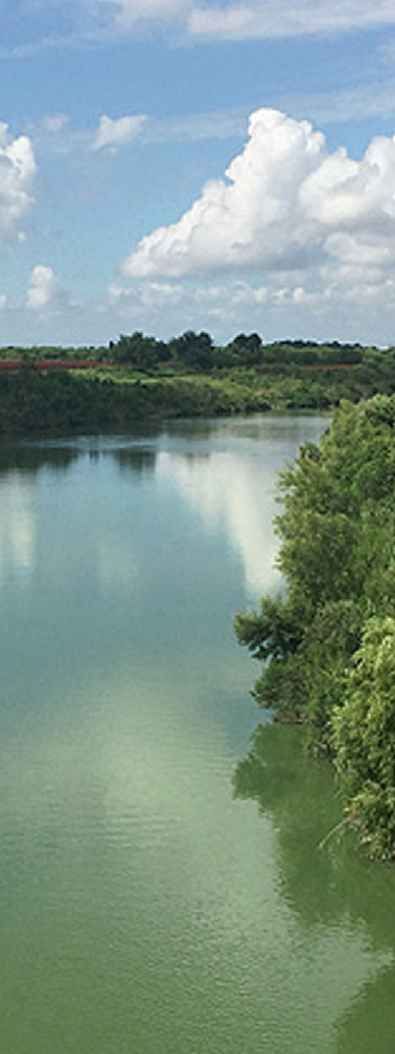
Agricultural Conservation Easements (ACEP)
Notes:
Kari- overview

Slide 9
Agricultural Land Easements (ALE)- Regular
Local
Valencia County, in Rio Grande floodplain
Conservation
Protect surface water rights.
Community
Stakeholders who contribute to purchase price and acquisition expenses.
Urbanized areas: Albuquerque, Las Cruces, Santa Fe, Farmington
Avoid loss of agricultural land.
Protect prime soils.
Stakeholders identify key properties.
Statewide ranking pool with priority for

Slide 10
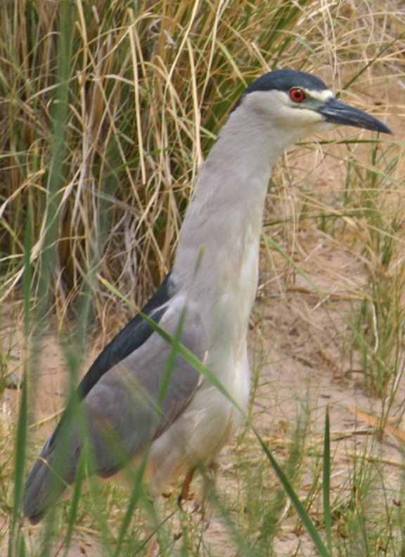
Input
Long-term viability of irrigation water – specify certain parts of the state where consistent irrigation water is not a concern?
Give negative points for areas with groundwater depletion?
Give ranking consideration to land with good soil health?
Minimum farm size in urban areas?
No prime soils mapped in Socorro county, make this an exception on the ranking question?
Higher ranking consideration for land next to already protected agricultural land?
Ranking consideration for wildlife benefits on dryland cropland, wetlands, riparian areas?

Slide 11
Agricultural Land Easements (ALE) - GSS
Local
Proximity to Rio Grande, Pecos, Gila or San Juan river.
Conservation
Avoids subdivision of large ranches.
Community
Stakeholders contribute to purchase price and acquisition expenses.
Stakeholders identify key properties.
Contains riparian or perennial water.
Provide wildlife habitat compatible with grazed land.

Slide 12
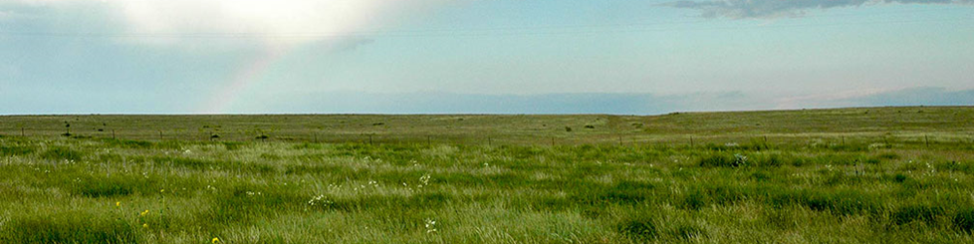
Input
Negative points for areas with encroachment of juniper, mesquite, cholla?
Higher ranking consideration for larger ranches?
Higher ranking consideration for land next to already protected agricultural land?
Wildlife considerations?
Higher ranking consideration for land converted from cropland?

Slide 13
Establishing Threshold Scores- streamlining
State Conservationists, with advice from State Tech Committee, may establish high threshold ranking score for ALE or WRE at a level high enough that an eligible application ranking above such threshold score would automatically warrant selection for funding
  Example, an eligible application scoring >90% of the state ranking points may be selected for funding at any time.
State Conservationists should establish low thresholds ranking scores below which applications will not be funded.
Return funds to NHQ for reallocation to other States rather than fund low-ranking applications that do not effectively meet
ACEP purposes
13

Slide 14
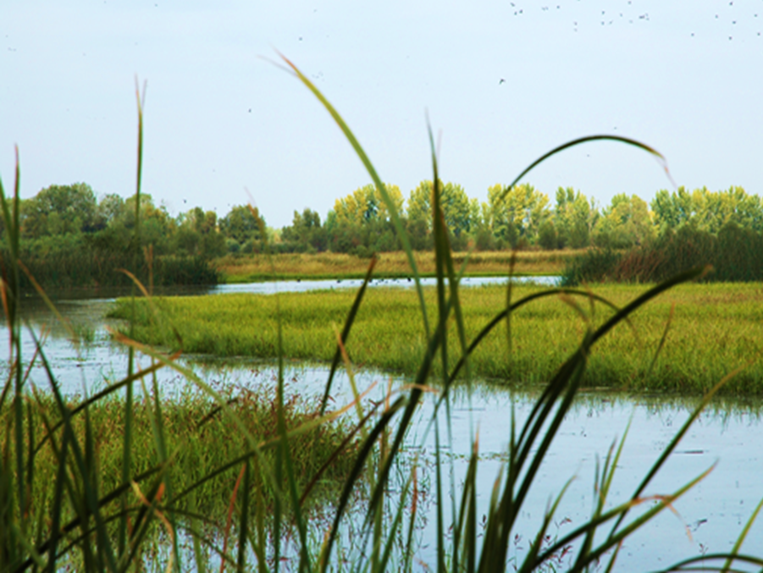
Wetland Reserve Easement (WRE) wetland restoration criteria and guidelines (WRCG)
Specific, clear expectations for restoration
For sites with phreatophytes, NRCS treatment will be for xx consecutive years, followed by landowner maintenance for xx years.
For riparian restoration in middle Rio Grande where ground water is at depths of 3 feet or less, would target establishment of woody species at density of xx plants per acre with a palette of: cottonwoods, willows, box elder, golden currant, etc.
For sites with flowing perennial water, would install beaver dam analogs if beavers are not currently on site.

Slide 15
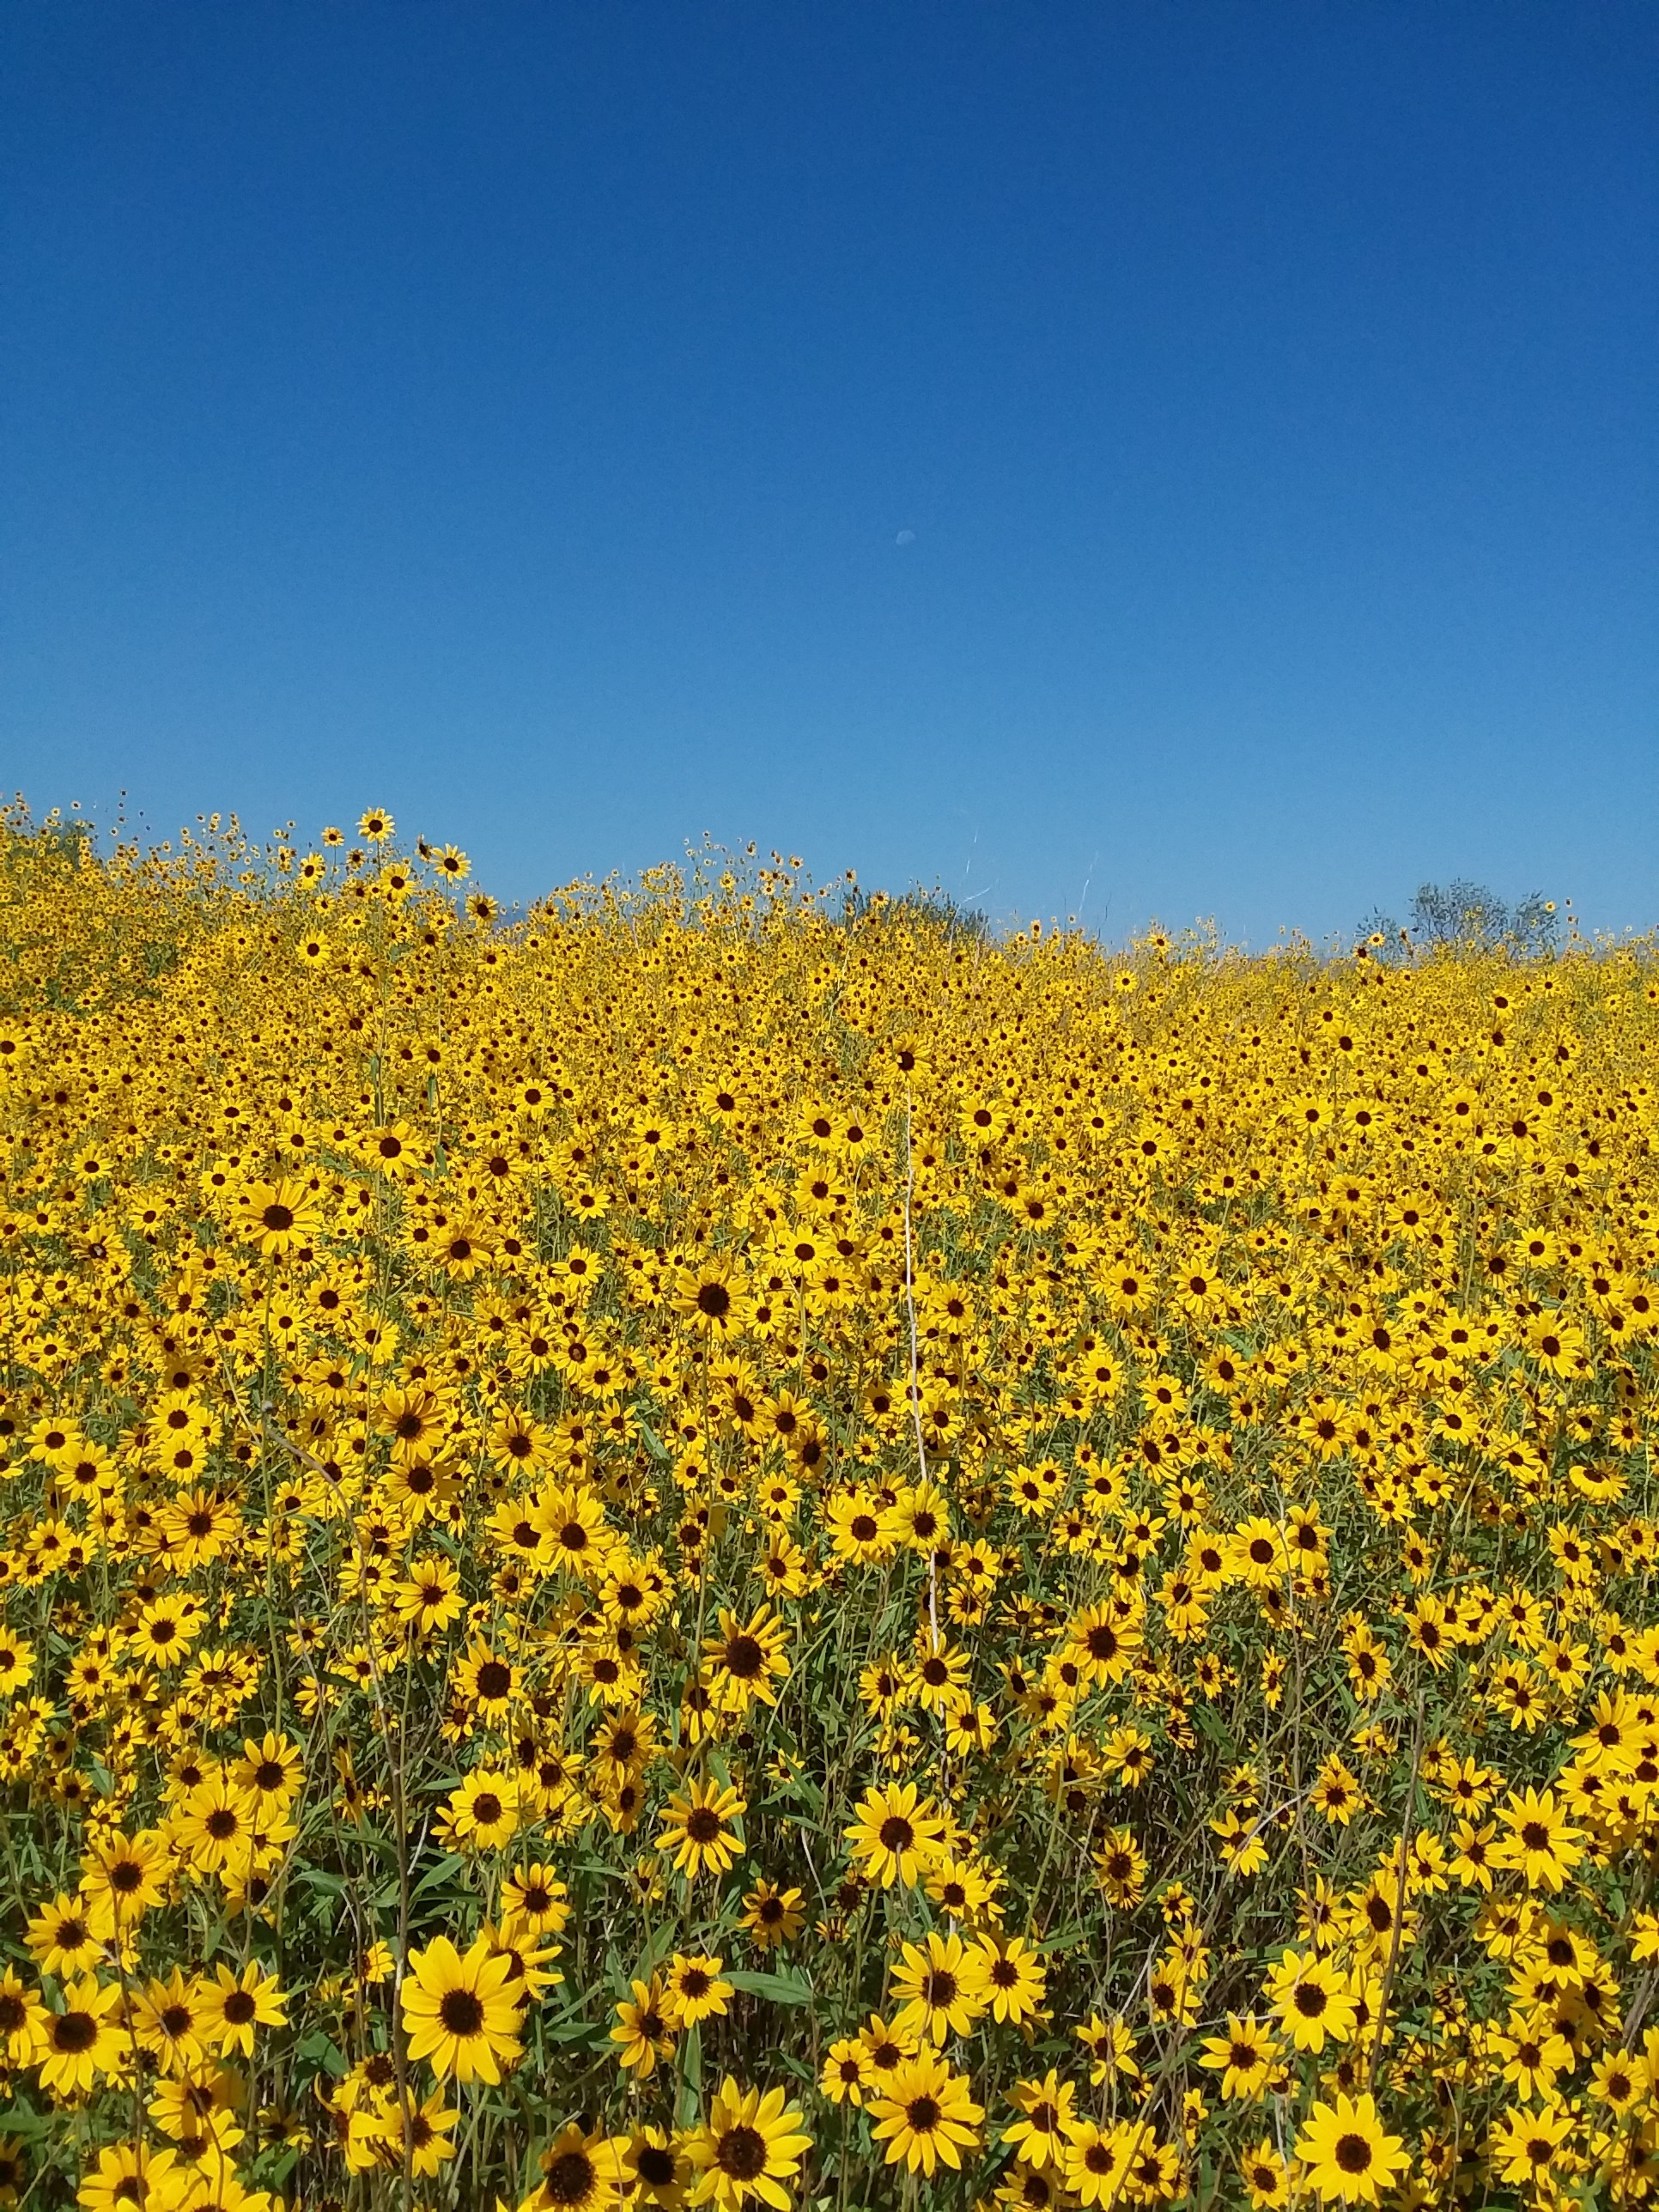
Grazing Rights Option
  Pecos sunflower: grazing reduces competition and increases germination
  Input on technical guidelines for grazing.
  Grazing must be necessary for restoration and management and consistent with long-term wetland goals.
15

Slide 16
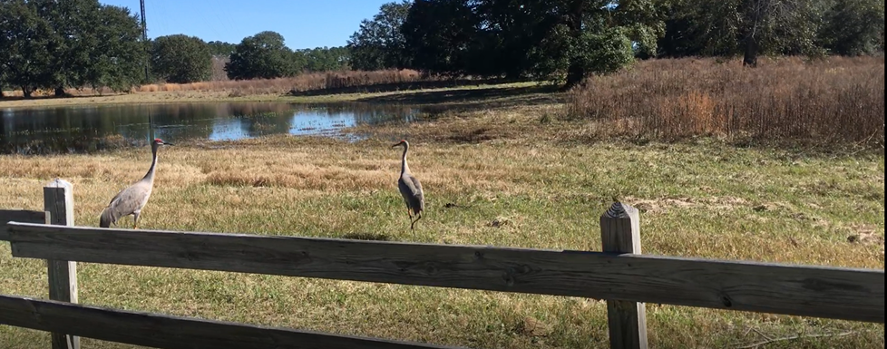
WRE- Geographic area rate cap (GARC)
Current GARC is 90% of market value.
Maximum easement payment is currently $5,000/acre. Exceptions can be granted.
Payment is the lower of GARC, $5,000 cap, or amount the landowner will accept.
With grazing rights option the payment is 75% of market value- a wildlife species must benefit from grazing.
Does State technical committee want to change the GARC for FY2022?

Slide 17
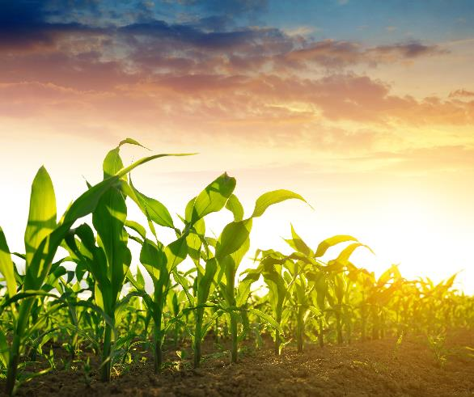
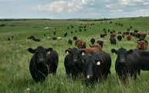
Conservation Stewardship Program

Slide 18
Conservation Stewardship Program (CSP)
Local
Statewide
Conservation
Protect plant diversity and condition with Prescribed Grazing practice.
Community
Sharing of best grazing practices- plant utilization and recovery.
Forested areas are separate from range, crop and pasture.
Improve habitat for wildlife.
Soil health with no-till, cover crops, crop rotation.
Contingency plan for market changes, drought, fire.
Corridors for wildlife
Priority for source water areas

Slide 19
Code of Federal Regulations Title 7 Part 1470.2
(d) To support locally led conservation, NRCS will solicit input from State technical committees, Tribal Conservation Advisory Councils, and local working groups to develop State-level technical, outreach, and program materials, including:
(1) Establishment of ranking pools appropriate for the conduct of CSP within the State to ensure program availability and better distribution of the funds. Ranking pools may be based on watersheds, geographic areas, or other appropriate regions within a State and may consider high-priority regional and State-level priority resource concern areas;
(2) Identification of not less than five priority resource concerns in particular geographic areas or other appropriate regions within a State;
(3) Identification of resource-conserving crops that will be part of resource-conserving crop rotations; and
(4) Identification of combinations of grazing conservation activities that will be part of an advanced grazing management system.

Slide 20
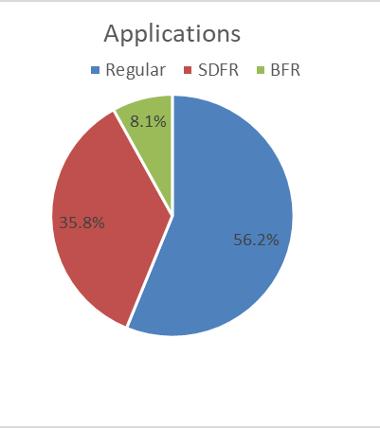
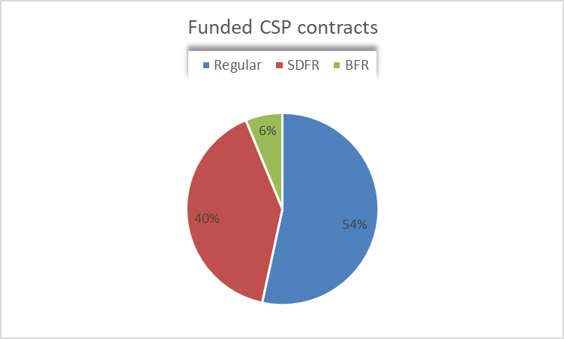
FY 2020 spending
$11.5 million
$33 million
BFR- Beginning farmer rancher
SDFR- Socially disadvantaged farmer rancher

Slide 21
FY 2020 CSP Ranking pools
Agland (range, crop and pasture)
Agland - Beginning Farmer/Rancher
Agland - Socially Disadvantaged Farmer/Rancher
Agland-Organic (not for renewals or NIPF)
Non-Industrial Private Forestland (NIPF)
NIPF - Beginning Farmer/Rancher
NIPF - Socially Disadvantaged Farmer/Rancher
Notes:
(1) Establishment of ranking pools appropriate for the conduct of CSP within the State to ensure program availability and better distribution of the funds. Ranking pools may be based on watersheds, geographic areas, or other appropriate regions within a State and may consider high-priority regional and State-level priority resource concern areas;

Slide 22
FY 2020 State Priority Resource Concerns
Agland | NIPF
Wind and water erosion | Concentrated erosion
Soil Quality limitations | Fire Management
Degraded Plant Condition | Degraded Plant Condition
Livestock production limitation | Livestock production limitation
Terrestrial Habitat | Terrestrial Habitat
Ranking considers the number of priority resource concerns met and addressed.
Renewal contract must meet two priority resource concerns to be eligible.
In FY2022 will change from 5 to 8.

Slide 23
Resource Conserving Crops
A perennial grass.
For NM: acceptable species include orchardgrass, ryegrass, smooth brome, and bermuda.
A legume grown for use as a cover crop, forage, seed for planting, or green manure.
For NM: acceptable species include alfalfa, sainfoin, perennial clovers, vetch, and peas.
A legume-grass or diverse grass-forb mixture comprised of species selected for climate, rainfall, soil, and other region-specific conditions.
For NM: Refer to the specification for conservation crop rotation
(4) A small grain or other resource-demanding crop grown in combination with a grass, legume, other forbs, or grass-forbs, or grass-forbs mixtures whether interseeded, relay planted into the resource demanding crop or planted in rotation.

Slide 24
Technical Materials
State Supplements for implementation of enhancements
E382A Wildlife friendly fence, NM Supplement
E382B Installing electrical fence offsets and wire for cross-fencing to improve grazing management, NM Supplement
E528 Prescribed Grazing, NM supplement
E528P Implementing Bale or Swath Grazing to increase organic matter and reduce nutrients in surface water, NM Supplement
E528Q Use of body condition scoring for livestock on a monthly basis to keep track of herd health, NM Supplement
In process of updating
NM Supplement for 340 Cover Crop Enhancements – April 2018
NM Supplement for 328 Conservation Crop Rotation Enhancements - 2018
https://www.nrcs.usda.gov/wps/portal/nrcs/main/nm/programs/financial/csp/

Slide 25
Ranking priorities
Adopt a practice for at least 3 years
Adopt a priority practice
  Prescribed Grazing
  Residue Management, No-Till
  Residue Management, Reduced Tillage
  Cover Crops
  Forage Harvest Management
Improve habitat for wildlife, not fence or trough
Establish pollinator habitat
Fence retrofits as key wildlife crossings
Escape ramps in existing troughs
Forest: reduce threat of wildfire, reduce pest damage

Slide 26
Input
If more funding, should there be geographic priority areas?
Specific wildlife improvements for ranking?
What outreach materials and efforts are needed to increase adoption of cover crops and conservation crop rotation?
How to better manage CSP to enhance soil health?
Technical requirements. For example, the State standard for Fence (382) requires 36” maximum top height for areas with elk and deer and wildlife friendly fence in key corridors must be at least 100 yards.

Slide 27
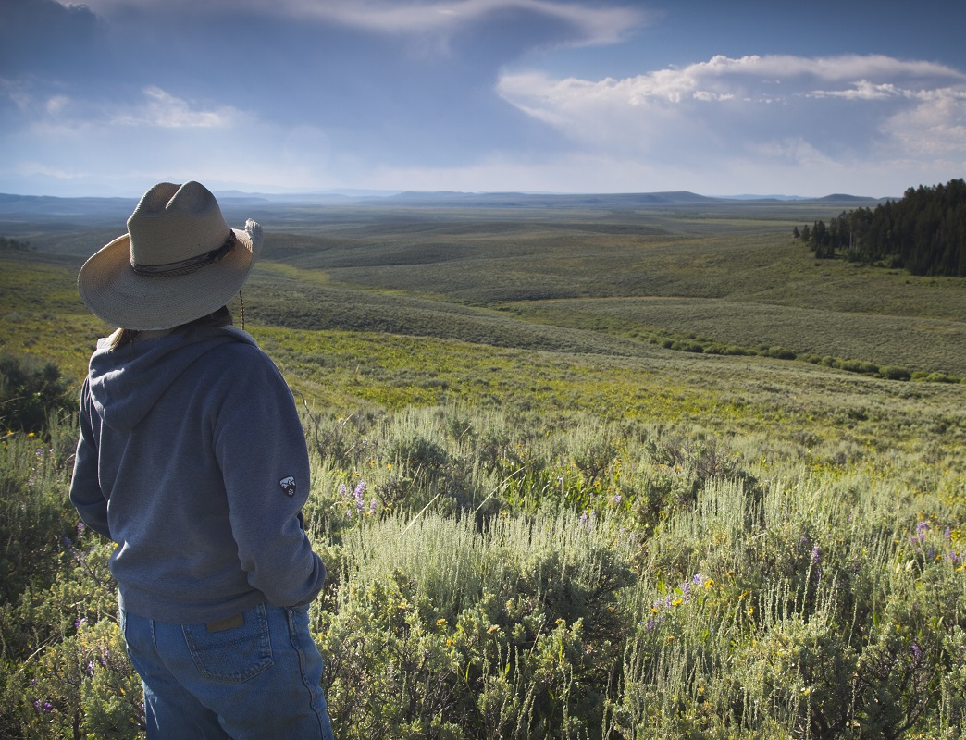

Conservation
Innovation Grants
Delivering Results for Agriculture and Conservation

Slide 28
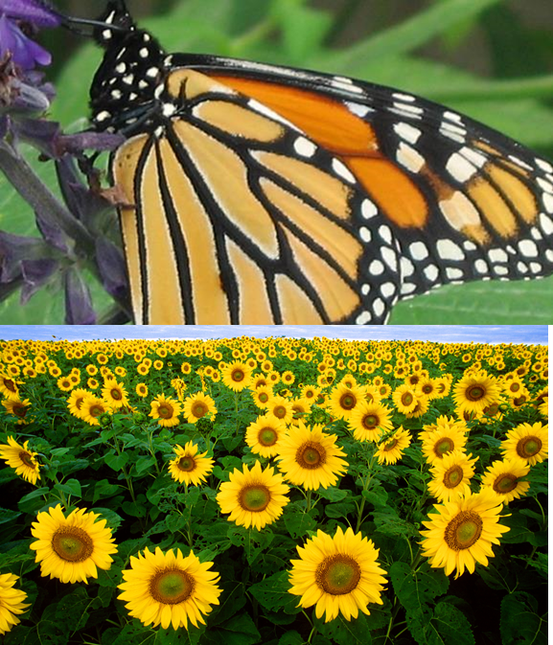
New Mexico State CIG funding
Currently have 5 active agreements
NMSU- grass buffer strips in irrigated circles
Playa Lakes Joint Venture- tool to assist with planning for groundwater recharge.
Center of Excellence- intensive grazing rotation
Quivira Coalition- soil health training to producers
Quivira Coalition- organic amendments on rangeland

Slide 29
Input on state priorities
Increased reliance on biodiversity to control pests. One priority: Develop, demonstrate and promote pest control strategies to control internal parasites and insect pests in livestock that do not include the use of avermectins or that reduce impacts to dung beetles on grazed lands. Proposals must inform livestock producers of the benefits of dung beetles on range ecosystems.
Support the adoption of soil health management systems. One priority: Develop, demonstrate and promote transitions to more diverse cropping rotations or the integration of livestock into existing cropping systems.
Water conservation. One priority: Development and demonstration of innovative approaches to transition from irrigated to non-irrigated systems by building soil health and that include consideration of soil sodicity, nutrient management, and weed control measures needed.
Fish and wildlife habitat. One priority: Demonstrate and promote strategies to increase wildlife habitat along ditches, edges of fields and noncropped areas associated with irrigated fields.

Slide 30
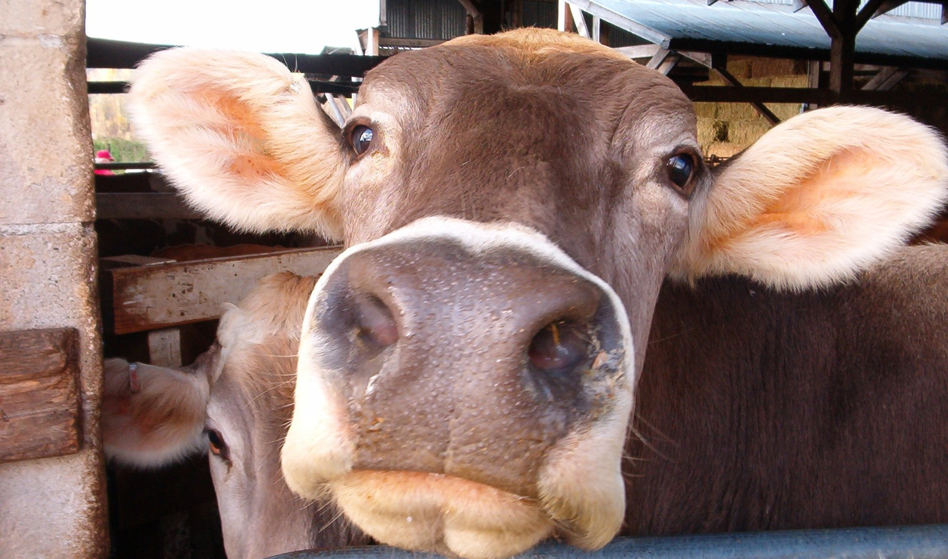
Thank you!
athena.cholas@usda.gov

