Slide 1
State Technical Committee
FY 2020-2021 EQIP
Aaron Reynolds
NRCS

Slide 2
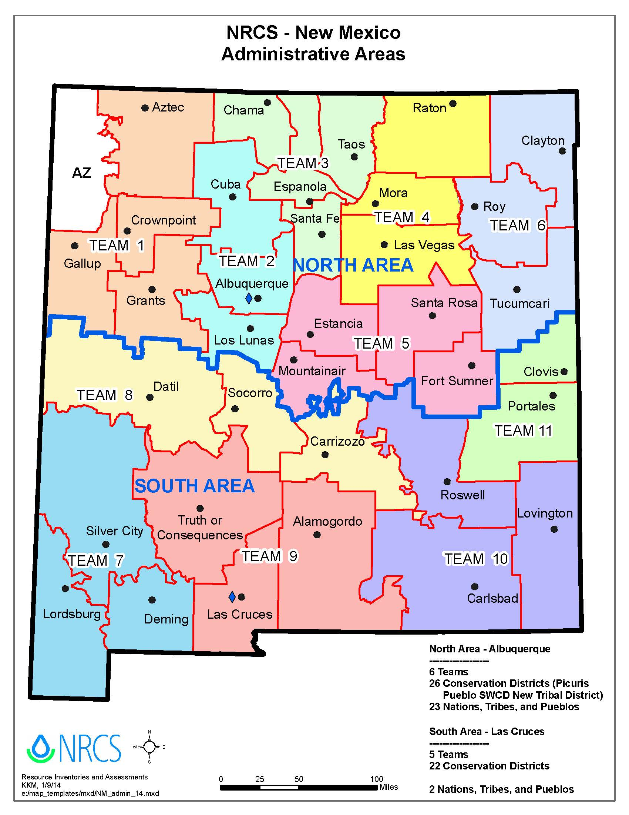

Slide 3
Team | Apps | Contract
1 | 140 | 25
2 | 112 | 34
3 | 120 | 31
4 | 224 | 41
5 | 143 | 23
6 | 156 | 26
7 | 77 | 22
8 | 116 | 32
9 | 75 | 32
10 | 96 | 20
11 | 141 | 18
Total | 1400 | 304
FY 2021 EQIP Applications and Contracts
Per Team

Slide 5
FY 21 Financial Assistance
NM Initiatives $24,000,000
Fund Code | Initial Allocation | Obligated
Organic** | $30,000 | $0
Organic-Trns** | $25,000 | $12,210
High Tunnel** | $90,000 | $87,076
BFR High Tunnel*,** | $90,000 | $89,673
Energy | $8000 | $0
CAP | $12,000 | $14,431
Tribal | $600,000 | $1,118,565
BFR- North* | $275,000 | $427,094
SD- North* | $185,000 | $57,154
WME | $800,000 | $934,450
Fund Code | Initial Allocation | Obligated
BFR- South* | $275,000 | $109,763
SD- South* | $185,000 | $294,801
Forestry* (BFR, SD) | $170,000 | $180,915
StrikeForce ** (Crop, Range, Forest) | $2,700,000 | $3,381,412.96
NM Wildlife* | $1,757,991 | $1,493,708
Source Water | 2,447,009 | 3,914,747
CIG | $50,000 | $50,000
State AFO | $150,000 | $0
Local *Mandated Funding | $10,000,000 | $13,091,093

Slide 6
FY 2021 Financial Assistance
National Initiatives- 6,000,000
Initiative | Allocation | Obligated
WLFW LPCI | $500,000 | $774,152.00
NWQI | $621,090 | $157,649
Joint Chiefs | $575,216 | $524,638*Sierra Blanca
WaterSMART | $3,970,000 | $4,119,081

Slide 7
Amended Polices
Control of Land
  Old Policy: Applicant/participant demonstrate control of land for the life of the contract at the time of enrollment
  New Policy: Verification of land control at the time of enrollment
  Applicant will need to establish control at the time of enrollment, NRCS will verify that the participant continues to maintain control during annual contract reviews and prior to approval of any Payment
Dependent Practices
  Pay when practice meet standards and specs regardless of whether the participant has fully implemented the entire system.

Slide 8
EQIP 2022 Updates
by Oct. 22
to
aaron.reynolds@usda.gov
Requests for STC Recommendations in Red

Slide 9
High Priority Practices
Each State, in consultation with the State technical committee established under section 1261(a) for the State, may designate not more than 10 practices to be eligible for increased payments under subparagraph (B), on the condition that the practice, as determined by the Secretary—
A high priority practice must meet one of the following criteria:
  Addresses specific causes of impairment relating to excessive nutrients in ground or surface water;
  Addresses the conservation of water, to advance drought mitigation and declining aquifers;
  Meets other environmental priorities and other priority resource concerns identified in habitat or other area restoration plans; or
  Is geographically targeted to address a natural resource concern in a specific watershed.

Slide 10
High Priority Conservation Practices
High Priority Practices in EQIP FY2021
1. Cover Crop- Multispecies Scenario only- 340
2. Diversion-All Scenarios-362
3. Grade Stabilization-All Scenarios-410
4. Residue and Tillage Management, No Till- All Scenarios-329
5. Residue and Tillage Management, Reduced or Mulch Till-All Scenarios- 345
6 .Structures for Wildlife-All Scenarios-649
7. Upland Wildlife Habitat Management-All Scenarios-645
8. Wildlife Habitat Planting-All Scenarios-420
Looking for recommendations on High Priority Practices

Slide 11
State Priorities
Conservation Assessment and Ranking Tool (CART)
  Weighted % for the 5 Ranking Criteria
  Identify Resource Concerns For Each Land use
  Requires Weighted Percentages for Resource Concerns
    FY 21 Same Weighted % for RC in State and National Initiatives
    Looking for recommendations on % of Ranking Criteria, Resource Concern per land use, and weighted % of Resource Concern for each land use.

Slide 12
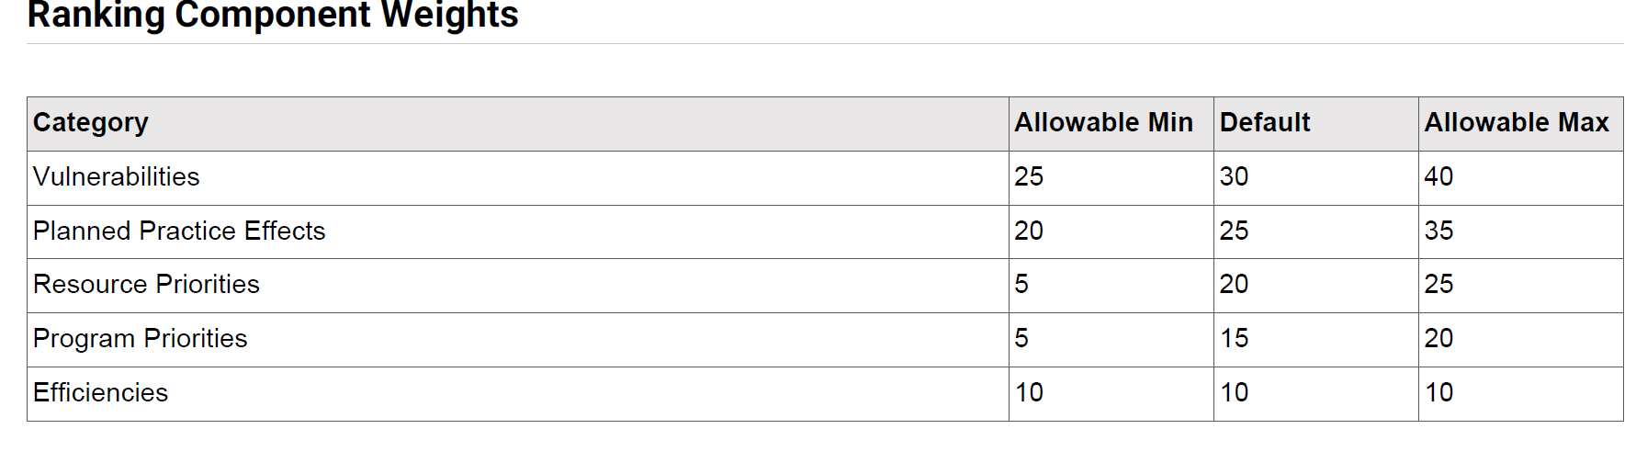
Ranking Weights
    Looking for recommendations on % of Ranking Criteria, Resource Concern per land use, and weighted % of Resource Concern for each land use.

Slide 13
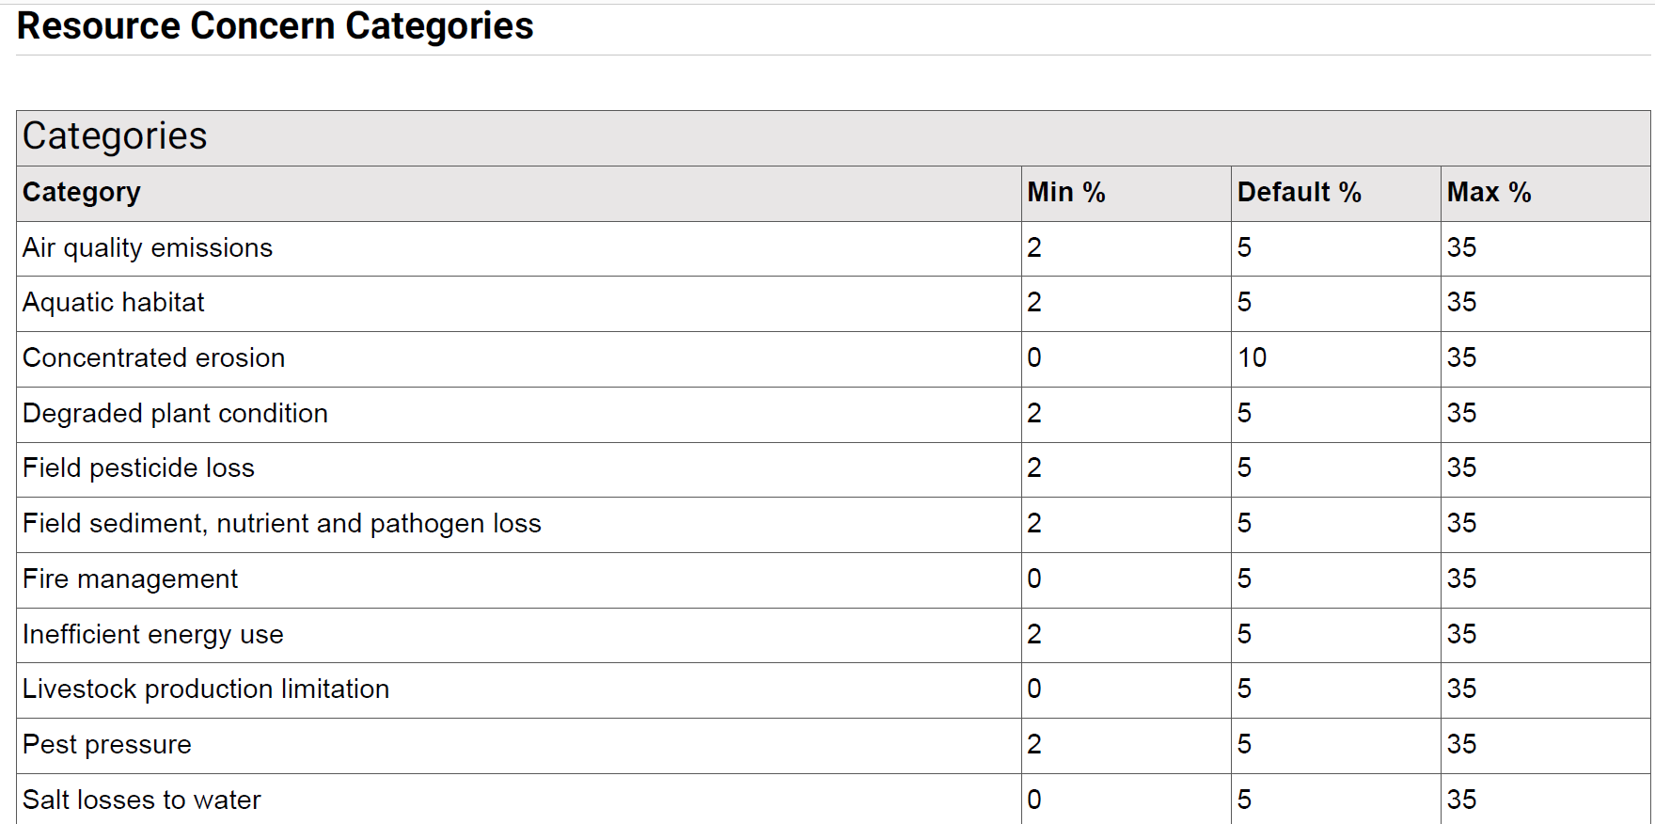
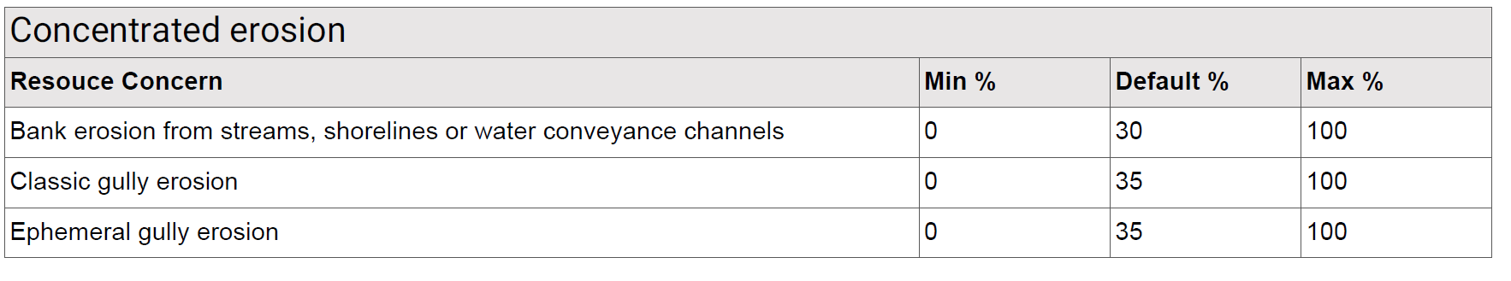
Ranking Weights
    Looking for recommendations on % of Ranking Criteria, Resource Concern per land use, and weighted % of Resource Concern for each land use.

Slide 14
EQIP 2021
Water- 50%
  Inefficient Irrigation Water Use
  Nutrients Transported to Surface Water*
  Nutrients Transported to Ground Water*
Soils- 50%
  Organic Matter Depletion
Cropland
Priority
Resource Concerns

Slide 15
EQIP 2021
Water- 33.3%
  Inefficient Irrigation Water Use
Plants- 33.3%
  Plant Productivity and Health
  Plant Structure and Composition
Soils- 33.3%
  Organic Matter Depletion
  Wind Erosion
Pasture
Priority
Resource Concerns

Slide 16
EQIP 2021
Plants- 25%
  Plant Productivity and Health
  Plant Structure and Composition
  Plant Pest Pressure
Animals- 25%
  Feed and Forage Imbalance
  Inadequate Livestock water quantity, quality and distribution
  Terrestrial habitat for wildlife and invertebrates*
Soils -25%
  Classic Gully Erosion
  Sheet and Rill Erosion
Energy- 25%
  Energy Efficiency of Equipment and Facilities
Rangeland
Priority
Resource Concerns

Slide 17
EQIP 2021
Plants- 25%
  Plant Productivity and Health
  Plant Structure and Composition
  Wildfire Hazard from Biomass Accumulation
Animals- 25%
  Inadequate Livestock water quantity, quality and distribution
  Terrestrial habitat for wildlife and invertebrates*
  Feed and Forage Imbalance
Soils- 25%
  Classic Gully Erosion
  Sheet and Rill Erosion
*Prior Resource Concern was Fish and Wildlife Inadequate Habitat
Forest
Priority
Resource Concerns

Slide 18
EQIP 2021
Water- 33.3%
  Nutrients Transported to Surface Water*
  Nutrients Transported to Ground Water*
  Sediment transported to Surface Water
  Pesticides transported to ground water
  Ponding and Flooding
Soils- 33.3%
  Sheet and Rill
  Wind
Air- 33.3%
  Emissions of particulate matter (PM) and PM precursors
AFO
Priority
Resource Concerns

Slide 19
Water Management Entities
Water Conservation or Irrigation Efficiency
Authorizes direct EQIP program assistance to irrigation districts, acequias, land grants and other entities, for purposes of water conservation or irrigation efficiency
States did not/will not receive additional funds for this assistance

Slide 20
Water Management Entities
FY 2022 Fund Codes
  Acequias
  Irrigation Districts
  Drought Mitigation (Range and Forest)Land Grants
FY 2021 Funds- $800K- Obligated- $934,450
  Acequia- 10 contracts

Slide 21
WaterSMART Initiative
Initiative with BOR where:
  BOR works with water and irrigation districts to improve operations of water delivery systems
  NRCS then works with producers within the delivery system area (who holds the BOR grant) to increase on-farm efficiencies and introduce conservation practices
General Criteria
  Participants and Land must meet normal EQIP Eligibility Criteria
  Participants receive irrigation water from Bureau of Reclamation source
  Irrigation water provider has an approved Bureau of Reclamation WaterSMART project for water conservation
FY 21 NM $3,970,000 Million Initial Allocation
  7 Areas in FY21
    ,
FY 22 Funding Changes
  Submit proposals to NHQ
  Funding is not guaranteed
  Only fund the areas approved
9 Proposals Submitted in NM
Review Team Recommend Funding Order
Carlsbad Irrigation District Area $500,000
Navajo Ag Products Industry Area $500,000 Arch Hurley Conservancy District Area $1,000,000
Guadalupe Soil and Water Conservation District Area $350,000
Elephant Butte Irrigation District Area $1,000,000
Animas Watershed Area $100,000
Middle Rio Grande Conservancy District Area $500,000
All funding is based on availability of funds * Fort Sumner & Bloomfield not selected

Slide 22
Source Water Protection
Purpose:
  Source Water Protection language in 2018 FB
  Encourage protection of drinking water sources through conservation programs
  Sources can be ground or surface water
  Address Water Quality and Quantity
  Dedicate at least 10 Percent of total funds available
General Criteria
  Participants and Land must meet normal EQIP Eligibility Criteria
  Land is located in a Source Water Protection Area (SWPA)
  Plan practices to address Water Quality/Quantity
Initial Task
  Identify SWPA’s with source water protection assessments where AG is identified as protentional source of degradation
  Select SWPA where 10% of funding can benefit source water protection (HUC 12 level)
  Local Support (Stakeholders, partners, producers)
  Identify priority practices
  Recommendation for future priority areas
  .
Priority Areas
Cannon AFB Curry
Town of Midway Curry\Roosevelt
120500020111 Curry
City of Clovis Curry
120500020110 Curry\Roosevelt
Blackwater Draw Curry\Roosevelt
Town of Ranchvale Curry
Pleasure Lake Curry
Cimarroncito Creek Colfax
Cimarroncito Creek Colfax
Burro Creek Harding\San Miguel
equesquite Creek Harding
Mule Creek Harding\San Miguel
Ladd Lake Harding
Black Lake Harding
Las Cuevas Canyon Harding
Smith Canyon McKinley
Upper Mitchell Draw McKinley
Shingle Canyon Grant

Slide 23
Source Water Protection
Source Water Protection Priority Practices – Recommendations needed
  All Practice that address Water Quality and Quantity are eligible
  Priority Practices paid at a higher payment rate
  Irrigation Water Management-449
  Residue and Tillage Management, No Till/Strip Till-329
  Riparian Forest Buffer-391
  Grade Stabilization-410
  Diversion-362
  Prescribed Grazing-528
  Cover Crop-340
  Filter Strips-393
  Field Border-386
  Forage Harvest Management-511
  Nutrient Management-590
  Pest Management Systems-595
  Hedgerow Planting-422
  Stream Habitat Improvement and Management-395

Slide 24
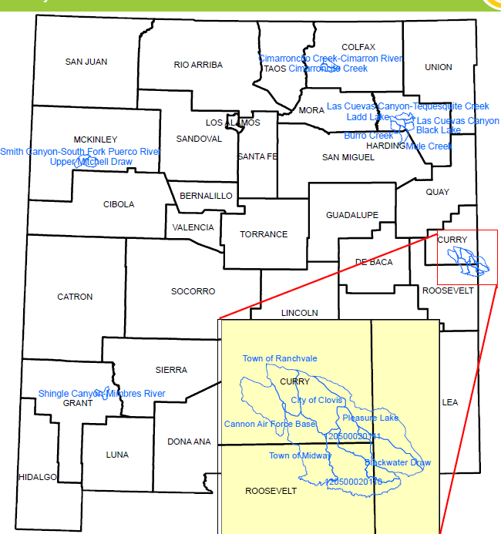

Slide 25
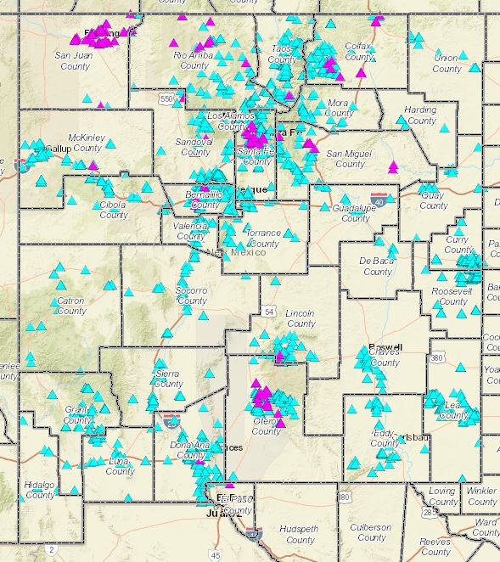

Slide 26
High priority areas
Priority resource concerns
Practices/Enhancements

Slide 27
EQIP CIC High Priority Areas (HPAs)
• States, in consultation with the State Technical Committee, will identify areas of high priority
• High Priority Areas:
• Represent areas of significant concern
• Must encompass every region within the State
• May encompass an entire State or overlap with other high priority areas
• Set of High Priority Areas must cover the whole state

Slide 28
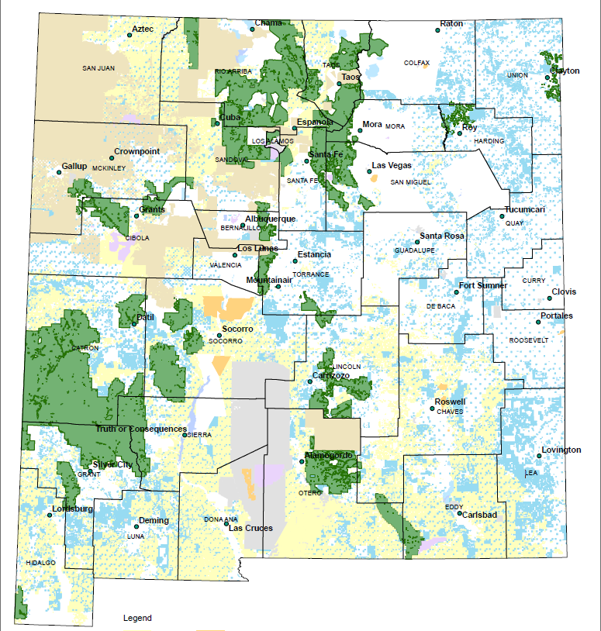
Example 1: Entire State is HPA

Slide 29
New Mexico FY2021 – Land Uses
Cropland/Pasture
Forest
In recent years Crop and Forest applications have been limited in CSP. Since CIC is a gateway from EQIP to CSP we are wanting to increase participation by crop and forest producers in CSP. We are hoping CIC will be a way for crop and forest landowners to try elements of CSP on portions of their operation which could lead to CSP applications.

Slide 30
EQIP CIC Priority Resource Concerns (PRCs)
• States, in consultation with the State Technical Committee, will
identify priority resource concerns
• Priority Resource Concern Criteria:
• States may identify up to 3 PRCs for each land use within a given high priority area
• Note: Not all land uses need to be included
• The same PRCs may be used for more than one land use within the same high priority area
• For each PRC, States will identify the incentive practices (practices and enhancements) that will be available
• Conservation plans must target at least one PRC

Slide 31
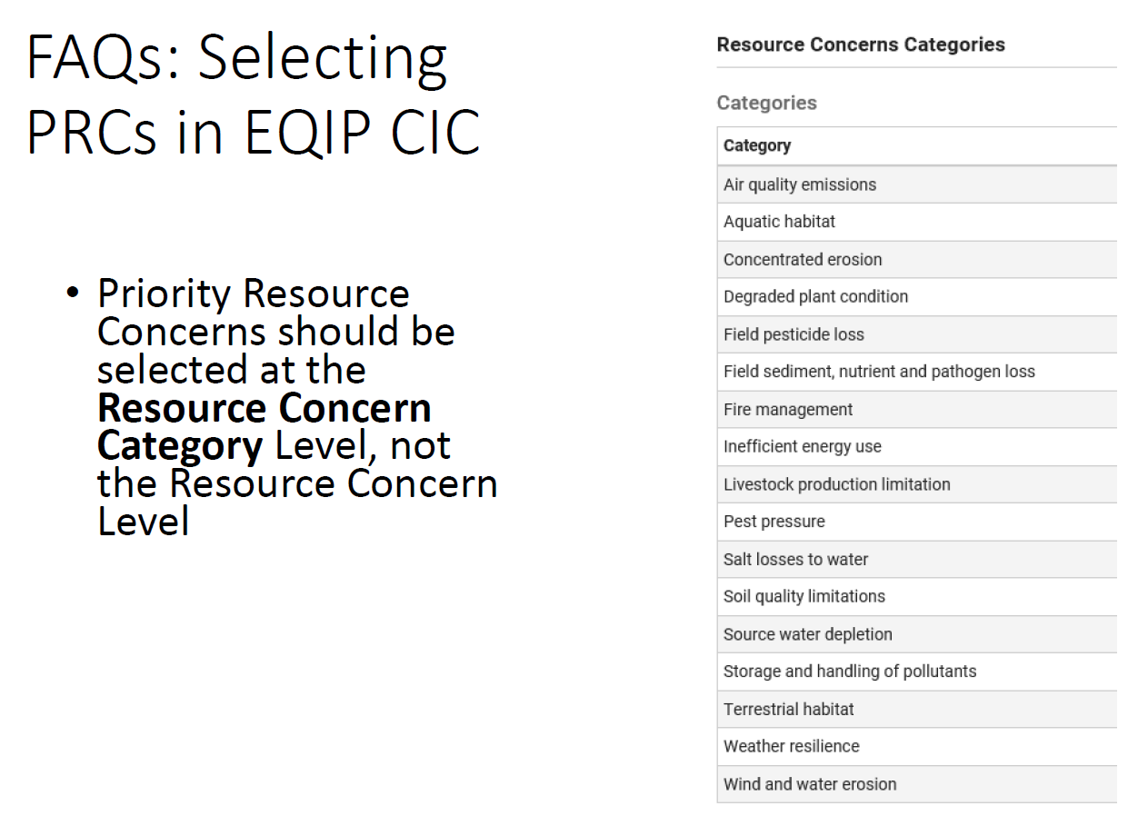

Slide 32
New Mexico FY2021 – PRC’s
Crop:
  Soil Quality Limitations
  Source Water Depletion
  Wind & Water Erosion
Forest:
  Fire Management
  Terrestrial Habitat
  Concentrated Erosion

Slide 33
New Mexico FY2021 – Cropland/Pasture
Practices
Practices:
327 – Conservation Cover
328 – Conservation Crop Rotation
329 – Residue and Tillage Management, No-Till
331 – Contour Orchard and Other Perennial Crops
340 – Cover Crop
345 – Residue and Tillage Management, Reduced Till
386 – Field Border
428 – Irrigation Ditch Lining
430 – Irrigation Pipeline
436 – Irrigation Reservoir
441 – Irrigation System, Microirrigation
442 – Sprinkler System
443 – Irrigation System, Surface and Subsurface
449 – Irrigation Water Management
464 – Irrigation Land Leveling
484 – Mulching
511 – Forage Harvest Management
512 – Pasture and Hay planting
533 – Pumping Plant
550 – Range Planting
587 – Structure for Water Control
590 – Nutrient Management
595 – Pest Management Conservation System
600 – Terrace

Slide 34
New Mexico FY2021 – Practices
Forestry
Practices:
314 – Brush Management
327 – Conservation Cover
338 – Prescribed Burning
381 – Silvopasture
382 – Fence
362 – Diversion
383 – Fuel Break
384 – Woody Residue Treatment
391 – Riparian Forest Buffer
394 – Firebreak
395 – Stream Habitat Improvement and Management
410 – Grade Stabilization Structure
420 – Wildlife Habitat Planting
472 – Access Control
516 – Livestock Pipeline
528 – Prescribed Grazing
533 – Pumping Plant
574 – Spring Development
614 – Water Facility
642 – Water Well
643 – Restoration of Rare or declining habitat
645 – Upland Wildlife Habitat Management
649 – Structures for Wildlife
666 – Forest Stand Improvement

Slide 35
New Mexico FY2021 – Cropland/Pasture
Enhancements
E328A Resource Conserving crop rotation
E328B Improved resource conserving vrop rotation
E328C Conservation crop rotation on recently converted CRP grass/legume cover
E328E Soil health crop rotation
E328F Modifications to improve soil health and increase soil organic matter
E328G Crop rotation on recently converted CRP grass/legume cover for soil organic matter improvement
E329A No till to reduce soil erosion
E329C No till to increase plant-available moisture
E329D No till system to increase soil health and soil organic matter content
E334A Controlled traffic farming to reduce compaction
E340A Cover crop to reduce soil erosion
E340B Intensive cover cropping to increase soil health and soil organic matter content
E340C Use of multi-species cover crops to improve soil health and increase soil organic matter

Slide 36
New Mexico FY2021 – Cropland/Pasture
Enhancements
E340D Intensive orchard/vineyard floor cover cropping to increase soil health
E340E Use of soil health assessment to assist with development of cover crop mix to improve soil health
E340F Cover crop to minimize soil compaction
E340I Using cover crops for biological strip till
E345A Reduced tillage to reduce soil erosion
E345C Reduced tillage to increase plant-available moisture
E345D Reduced tillage to increase soil health and soil organic matter content
E386A Enhanced field borders to reduce soil erosion along the edge(s) of a field
E386B Enhanced field borders to increase carbon storage along the edge(s) of the field
E449A Complete pumping plant evaluation for water savings
E449C Advanced Automated IWM - Year 2-5, soil moisture monitoring
E449D Advanced Automated IWM - Year 1, Equipment and soil moisture or water level monitoring
E449F Intermediate IWM- Year 1, Equipment with Soil or Water Level monitoring

Slide 37
New Mexico FY2021 – Cropland/Pasture
Enhancements
E449G Intermediate IWM- Years 2-5, Soil or Water Level monitoring
E449H Intermediate IWM— Years 2 -5, using soil moisture or water level monitoring
E449I IWM - Year 1, Retrofit Equipment with Speed Control on Sprinkler Irrigation System
E484A Mulching to improve soil health
E512A Cropland conversion to grass-based agriculture to reduce soil erosion
E512B Forage plantings that help increase organic matter in depleted soils
E512C Cropland conversion to grass for soil organic matter improvement
E512D Forage plantings that help increase organic matter in depleted soils
E533 Advanced Pumping Plant Automation
E550A Range planting for increasing/maintaining organic matter

Slide 38
New Mexico FY2021 – Enhancements
Forestry
E327A- Conservation cover for Pollinators and beneficial
E314A Brush Management to Improve Wildlife Habitat
E338A Strategically planned, path burning for grazing distribution and wildlife habitat.
E338B-Short-interval burns to promote a healthy herbaceous plant community
E338C Sequential patch burning
E381E Silvopasture to improve wildlife habitat
E382A- Incorporating "wildlife friendly" fencing for connectivity of wildlife food resources
E383A- Grazing-maintained fuel break to reduce the risk of fire
E391C- Increase riparian forest buffer width to enhance wildlife habitat
E395A - Stream habitat improvement through placement of woody biomass
E420A- Establish pollinator habitat
E528B Grazing management that improves monarch butterfly habitat
E528D Grazing management for improving quantity and quality of food or cover and shelter for wildlife
E528E Improved grazing management for enhanced plant structure and composition for wildlife

Slide 39
New Mexico FY2021 – Enhancements
Forestry
E643B Restoration and management of rare or declining habitat
E645B Manage existing shrub thickets to provide adequate
E645C Edge feathering for wildlife cover
E666D Forest management to enhance understory vegetation
E666E Reduce height of the forest understory to limit wildfire risk
E666F Reduce forest stand density to create open stand structure
E666G Reduce forest density and manage understory along roads to limit wildfire risk and improve habitat
E666K Creating structural diversity with patch openings
E666M Maintaining structural diversity in dry Western forests
E666N Creating structural diversity in dry Western forests
E666O Snags, den trees, and coarse woody debris for wildlife habitat
E666P- Summer roosting habitat for native forest-dwelling bat species

Slide 40
EQIP 2022 Updates
by Oct. 22
to
aaron.reynolds@usda.gov
Requests for STC Recommendations in Red

