Slide 1

Regional Conservation Partnership Program
Kris Graham Chavez 505-761-4404

Slide 2
Regional Conservation Partnership Program (RCPP)
Promotes coordination of NRCS conservation activities with partners that offer value-added contributions to expand our collective ability to address on-farm, watershed, and regional natural resource concerns.
NRCS seeks to co-invest with partners to implement projects that demonstrate innovative solutions to conservation challenges and provide measurable improvements and outcomes tied to the resource concerns they seek to address.

Slide 3
The New RCPP
RCPP is now a standalone program with its own funding--$300 million annually. Moving forward, landowners and ag producers will enter into RCPP contracts and RCPP easements.
Enhanced Alternative Funding Arrangement provision—NRCS may award up to 15 AFA projects, which are more grant-like and rely more on partner capacity to implement conservation activities.
Three funding pools reduced to two—the National pool was eliminated. Partners must apply to either the Critical Conservation Area (CCA) or State/Multistate funding pool.
Emphasis on project outcomes—all RCPP projects must now develop and report on their environmental outcomes.

Slide 4
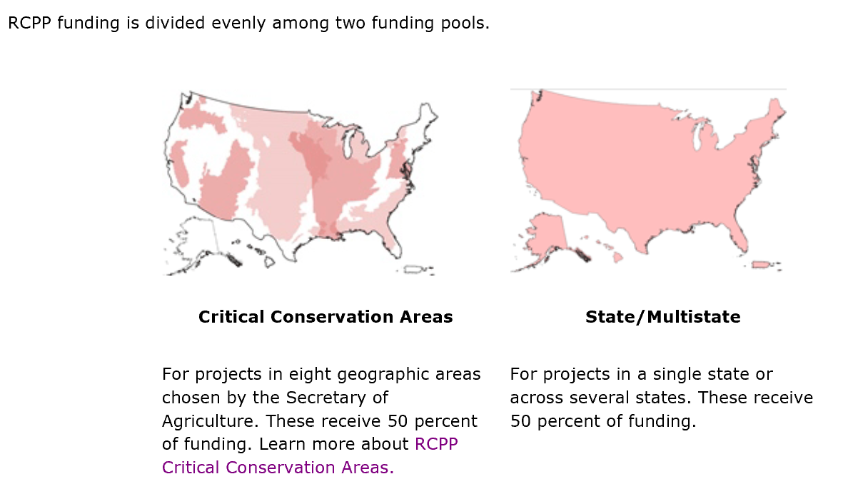
RCPP Funding

Slide 5
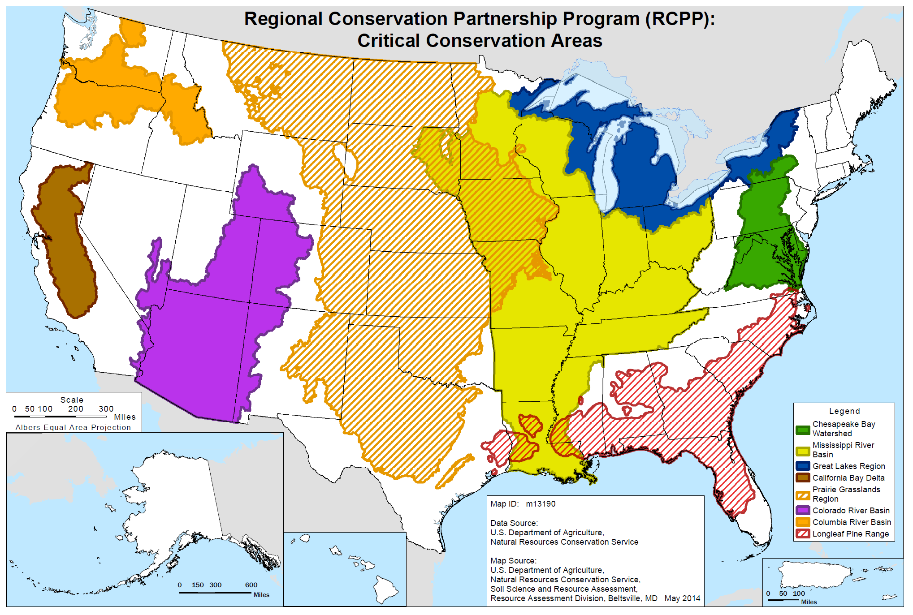
NM Submitted a proposal for the Rio Grande Valley to be added. Colorado and Texas supported the request.

Slide 6
2019 NM Selections
RCPP Project ID: 1905
Project Title: Eastern New Mexico Prairie Grassland Initiative
Lead Partner: New Mexico Association of Conservation Districts
Lead State: NM
Funding Amount: $ 2,025,974
Partner Contributions: $ 2,019,200
Funding Pool: Critical Conservation Areas (CCAs)
Critical Conservation Area (if applicable): Prairie Grasslands Region
Summary: The New Mexico Association of Conservation Districts aims to increase suitable and occupied habitat to meet critical habitat needs of Lesser Prairie-chicken. Habitat improvements will occur through chemical and physical destruction of Mesquite patches across five priority areas identified using a mesquite density model and a study by scientists at New Mexico State University.

Slide 7
2019 NM Selections (continued)
RCPP Project ID: 1893
Project Title: San Juan Non-Native Phreatophyte Removal Program
Lead Partner: San juan soil and water conservation district
Lead State: NM
Funding Amount: $ 1,042,208
Partner Contributions: $ 2,466,000
Funding Pool: State/Multi State
Critical Conservation Area (if applicable): N/A
Summary: The San Juan Soil and Water Conservation District aims to protect reduce wildfire risk by removing non-native Russian olive and Salt Cedar infestations in identified high priority areas. The project will also undertake native plant and tree restoration activities to help restore riparian habitat and improve hydrology, involve the community in restoration and monitoring activities, and to encourage a renewed connection with the river.

Slide 8
2015 Renewals
Projects Selected for Renewal Agreements
Project Title | Lead State | Lead Partner | Renewal Funding
New Mexico Restoration Initiative for Rangeland, Forestland and Wildlife on Ranches with Federal Lands | NM | New Mexico Association of Conservation Districts | $4,000,000
North Central New Mexico Watershed Restoration Project | NM | Claunch-Pinto SWCD | $2,313,359

Slide 9
Alternative Funding Arrangement
Announced March 17, 2020
$50,000,000
15 projects throughout the nations will be selected
Approved project partners can work directly with farmers, ranchers and private forest landowners to carry out RCPP projects, as opposed to implementing projects through NRCS producer contracts and landowner easements.
Deadline: May 11, 2020 May 29, 20202

Slide 10
RCPP April Schedule
April 9—notify States of RCPP Classic award selections
April 10—States notify new RCPP Classic awardees with embargoed info (unsuccessful applicants notified later)
April 16--RCPP Classic award announcement with U/S Northey
Week of April 20—send States negotiation templates
April 21—INTERNAL WEBINAR Programmatic Partnership Agreement and Land Management Exhibit Webinar (2 hours)
April 22—INTERNAL WEBINAR Technical Assistance in the Partnership Agreement, Exhibits and Supplementals (2 hours)

Slide 11
RCPP April Schedule
April 23—INTERNAL WEBINAR Outcomes and Privacy in the Partnership Agreement (2 hours)
Week of April 27—Projects Branch records Easements, Rentals and Watershed/Public Works exhibit webinars for later viewing
Week of April 27th—Release FY 2021 RCPP Renewals national bulletin
April 28th—PARTNER WEBINAR RCPP Classic Awardee Orientation (Projects Branch hosted)

Slide 12
RCPP Miscellanea
RCPP EQIP/CSP contracts cannot move forward in CD/SAT at this time. Working on a software fix.
Availability of new RCPP cost lists to incorporate high priority practices (e.g. source water) is coming soon.
States need to be cautious of increased funding in individual contracts degrading overall RCPP project deliverables.
RCPP AFA webinar posted on the How to Apply web page.

Slide 13
Information
NRCS Website:
https://www.nrcs.usda.gov/wps/portal/nrcs/main/national/programs/financial/rcpp/
Kris Graham Chavez
505-761-4404
Kristin.grahamchavez@usda.gov

