Slide 1
Joilynn R. Gray
August 26, 2021
New Mexico State Technical Committee Meeting
Notes:
Hello!

Slide 2
Topics
Conservation Reserve Program (CRP)
  Objective
  Changes to the Program
  Types
  Conservation Priority Areas (CPAs)

Slide 3
Program Objective
Assist owners and operators in conserving and improving the nation’s natural resource base.
Cost share is offered for eligible practices
Cost share rates include the cost of any factors necessary to perform the practice
Notes:
Its objective is to cost-effectively assist owners and operators in conserving and improving the nation’s natural resource base. Cost share is offered on eligible practices. Rates include the cost of any direct and significant factors necessary to perform the practice, such as:
• equipment
• new or used materials
• services
• labor
• sales tax

Slide 4

Changes in the CRP Program
Soil Rental Rates were adjusted
Inflationary Adjustment
Climate Smart Practice Incentive
  Woody Biomass – 10 Percent Incentive
  Grass and Legume – 5 Percent Incentive
  Grass – 3 Percent Incentive
Notes:
FSA adjusted the county rental rates to reflect an Soil Productivity Index range of 0.5-1.5 (50-150 percent of the county rental rate). SPI is used along with the NRCS National Commodity Crop Productivity Index to normalize the county rental rate by soil within each county.
FSA increased the county rental rate by a one-time 10 percent “inflationary” adjustment for the life of the contract. This inflationary adjustment will be set at contract start and be factored into the SRR. This incentive applies to cropland and marginal pastureland offers.
A new Climate-Smart Practice Incentive is available for CRP practices that increases carbon sequestration, reduces greenhouse gases emissions, and otherwise mitigates climate change. Practices include establishment of trees and permanent grasses, development of wildlife habitat, and wetland restoration. Climate-Smart Practice Incentive Percentage The incentive amount will be based on the estimated benefits of each practice type. Practices are broken into the following 3 cover types:
• Woody Biomass – 10 Percent Incentive
• Grass and Legume – 5 Percent Incentive
• Grass – 3 Percent Incentive.

Slide 5
CRP Programs
General CRP
Continuous CRP
  Grasslands CRP
  Highly Erodible Land Initiative (HELI) CRP
  State Acres for Wildlife Enhancement (SAFE) CRP
Notes:
CRP is a voluntary natural resource program that places emphasis on
protecting the nation’s soil, water, and wildlife resources
Improving and preserving water quality
Enhancing fish and wildlife habitat; as well as addresses issues raised by local, State, and national conservation initiatives.

Slide 6
CRP Programs
General
  Signup Period was from January 4 – July 23
  133 offers were submitted
    133 were ranked & accepted
County | Number of Offers
Curry | 116
Lea | 5
Roosevelt | 8
Torrance | 1
Union | 3
Notes:
The General program contracts with producers so that environmentally sensitive agricultural land is not farmed or ranched, but instead devoted to conservation benefits. CRP participants enter into a contract with a long-term objective to conserve plant species, establish grass or trees covers to control soil erosion, improve water quality and develop wildlife habitat. In return, FSA provides participants with annual rental payments and cost-share assistance. Contract duration is 10 years.
The signup period for General ended on July 23. Out of 133 offers submitted, 133 offers were accepted, Curry, Lea, Quay, Torrance, and Union. Participants are currently being notified. Contracts that are approved will become effective on October 1.

Slide 7
CRP Programs
Continuous
  HELI
  SAFE
  Grasslands
Notes:
Under Continuous CRP, environmentally sensitive land devoted to certain conservation practicesan be enrolled in CRP at any time. Offers are automatically accepted provided the land and producer eligibility requirements are met and the enrollment levels do not exceed the statutory cap. Unlike CRP enrollments under general or Grasslands, offers for continuous enrollment are not subject to competitive bidding during specific periods.
Under CRP Grasslands, landowners and operators can protect grassland, including rangeland and pastureland while maintaining the areas as grazing lands. The program emphasizes support for grazing operations, plant and animal biodiversity and grassland and land containing shrubs and forbs under the greatest threat of conversion. Participants receive annual payments and cost-share assistance. Contract duration is either 10 or 15 years.

Slide 8
CRP Programs
Continuous
  HELI
    Signup Period January 4 – August 6
County | Number of Offers
Curry | 56
Harding | 3
Lea | 1
Roosevelt | 101
Notes:
HELI offers a continuous signup to establish long-term cover on highly erodible cropland that has a weighted EI greater than or equal to 20 that will reduce:
• erosion to below the soil loss tolerance level that will assist in maintaining the long-term productivity of the land
• off-site adverse impacts to water quality
• adverse impacts to hydrology by changing the land use, including reducing potential adverse flood impacts associated with severe storm events
• adverse impacts commonly associated with wind borne soil, including impacts to human health and property damage associated with severe dust storms.

Slide 9
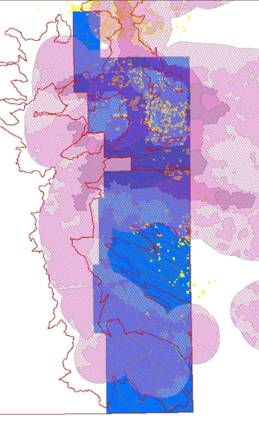
CRP Programs
Continuous
  SAFE
    Lea (2007)
    Lea &Roosevelt (2021)
      No offers were submitted
      during this year’s signup period
Notes:
SAFE projects are established by a cooperative conservation effort which is based on locally developed conservation proposals that addresses a State’s highest priority wildlife objectives before the practice may be implemented. The purpose of SAFE is to address local wildlife conservation needs by allowing producers to install practices that benefit high priority State wildlife conservation objectives by using targeted restoration of vital habitat. The priority of the two projects in New Mexico are the Lesser Prairie Chicken habitat.

Slide 10
CRP Programs
Continuous
  Grasslands
County | Number of Offers |  | County | Number of Offers
Catron | 1 |  | Quay | 102
Chaves | 2 |  | Roosevelt | 44
Colfax | 8 |  | San Miguel | 2
Curry | 93 |  | Santa Fe | 1
De Baca | 11 |  | Torrance | 23
Harding | 20 |  | Union | 17
Lea | 2
326 offers were submitted for ranking on August 20
Notes:
Under CRP Grasslands, landowners and operators can protect grassland, including rangeland and pastureland while maintaining the areas as grazing lands. The program emphasizes support for grazing operations, plant and animal biodiversity and grassland and land containing shrubs and forbs under the greatest threat of conversion. Participants receive annual payments and cost-share assistance. Contract duration is either 10 or 15 years.

Slide 11
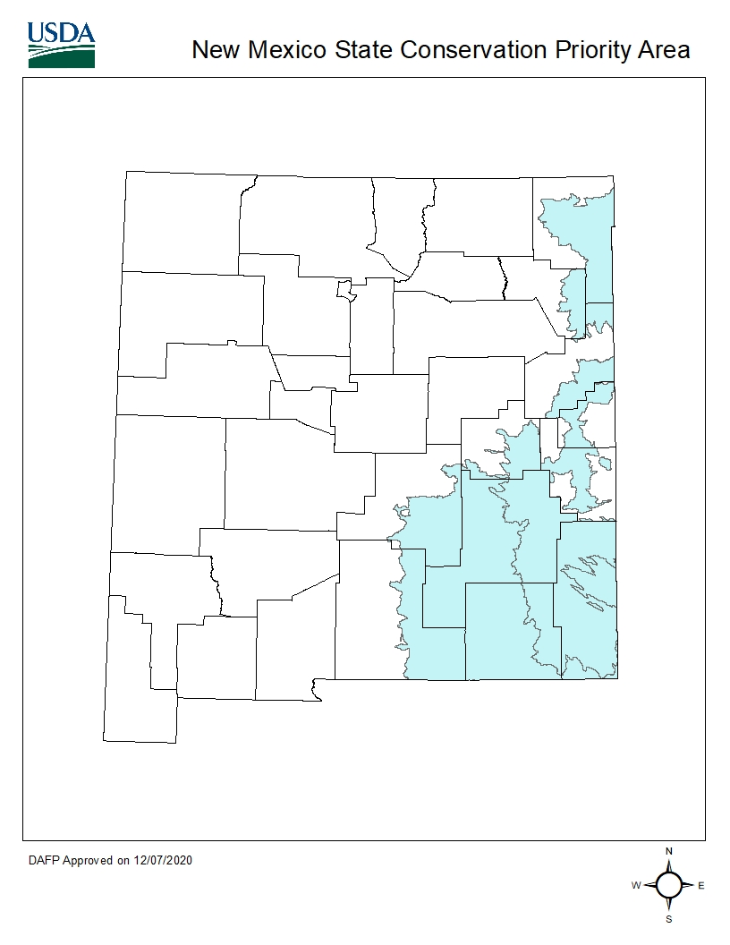
Conservation Priority Areas (CPAs)
National CPA
State CPA
Notes:
Conservation Priority Area Conservation priority area means an area designated with adverse water quality, wildlife habitat, air quality, or other natural resource impacts related to agricultural production activities or to assist agricultural producer to comply with Federal and State environmental laws or to meet other conservation needs, such as for air quality.
New Mexico does not fall within the National Priority Areas:
Chesapeake Bay CRP; Great Lakes CRP, Long Island Sound, Longleaf Pine CRP, and Prairie Pothole
State CPA’s allow a State to address important environmental issues within the designated area in a planned and coordinated manner. A State CPA is defined as an area that has been prioritized by STC, State Technical Committee, and State agencies that highlights a specific wildlife, water quality, or air quality concern. A State CPA must clearly define the conservation and environmental objectives and provide an analysis of how CRP can cost-effectively address those objectives.
Cropland physically located within a National or an approved State Conservation Priority Area (CPA) is one of the eligibility criteria that otherwise eligible cropland must meet to be eligible for enrollment through general CRP signup according to 2-CRP, subparagraph 151 B. See 2-CRP, Exhibit 18, for maps of National CPA’s. Under general CRP signup, cropland physically located in an approved wildlife, water quality, or air quality zone may be awarded points within the Environmental Benefits Index (EBI) according to 2-CRP, Exhibit 26

Slide 12
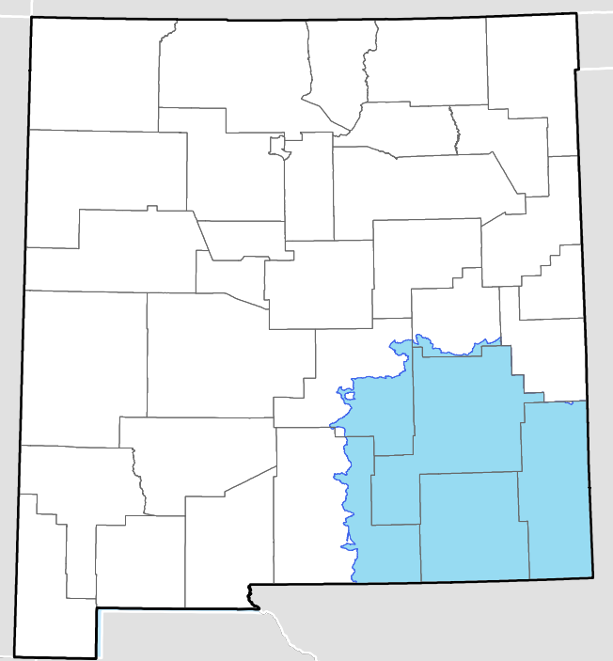
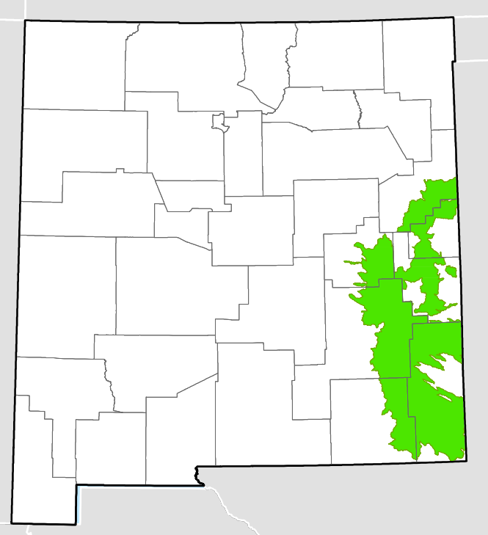
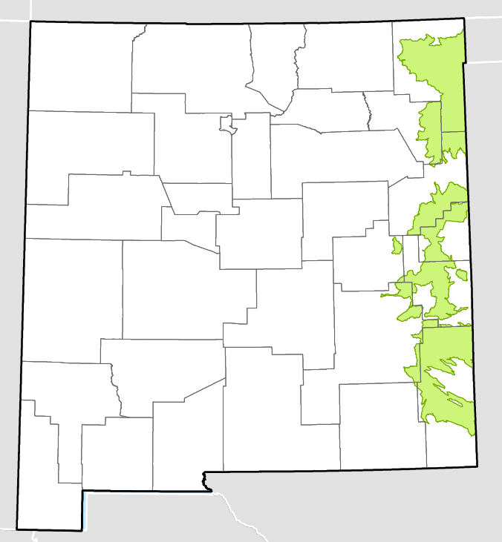
Conservation Priority Areas (CPAs)
State CPAs
Air Quality (AQ) CPA
Water Quality (WQ) CPA
Wildlife (WL) CPA

Slide 13
Thank you!
Joilynn R. Gray
joilynn.gray@usda.gov
(505) 761-4911
Farm Service Agency
New Mexico

