Slide 1
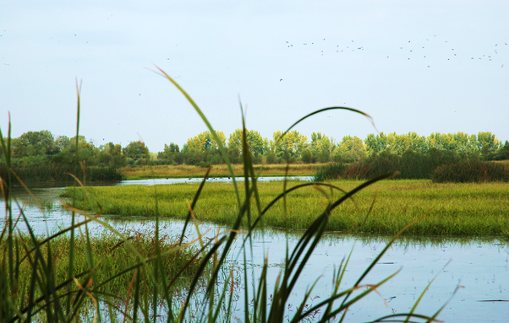
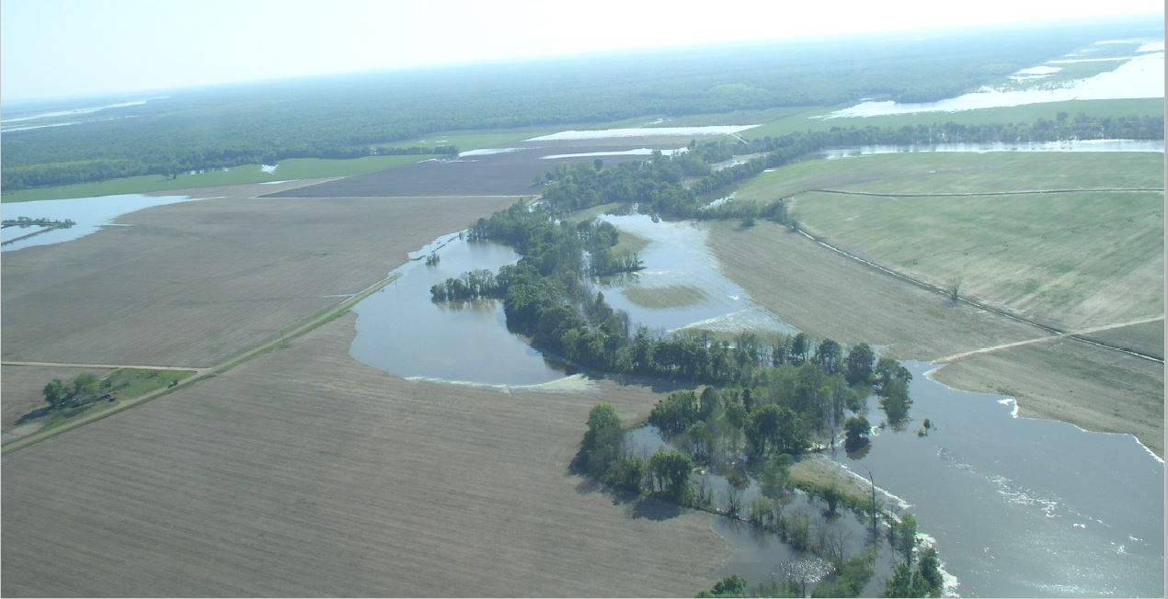
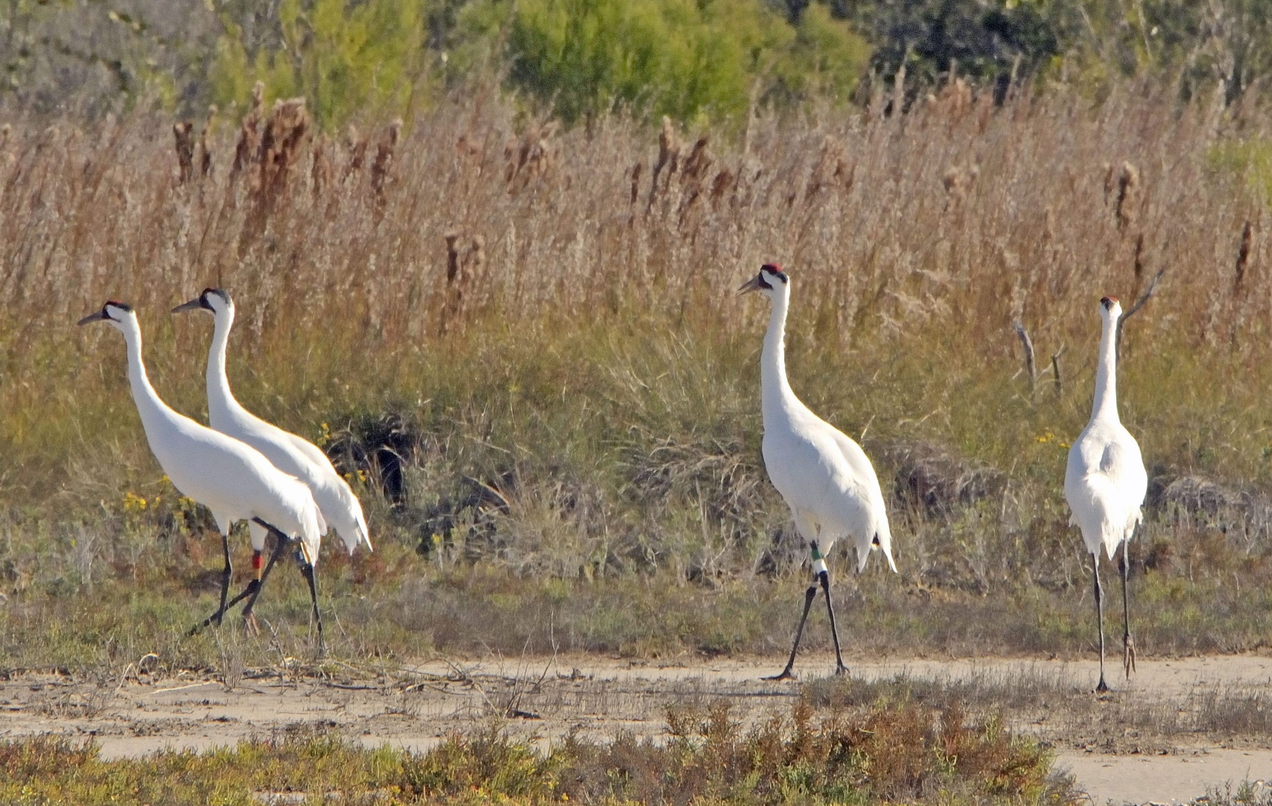
Agricultural Conservation Easement Program ACEP

Slide 2
Current NRCS Easement Programs
Healthy Forests Reserve Program (HFRP)
Agricultural Conservation Easement Program
Agricultural Land Easement (ACEP-ALE)
Wetland Reserve Easement (ACEP-WRE)
Emergency Watershed Protection Program – Floodplain Easements (EWPP-FPE)
Regional Conservation Partnership Program (RCPP) – Easement Authorities

Slide 3
Floodplain Easements (EWP-FPE)
This applies on floodplain lands that have been
impaired or impacted within the last 12 months,
have flooded at least twice during the past ten years,
would be inundated or adversely impacted as a result of a dam breach,
or have been damaged by a specific natural disaster for which Congress appropriated disaster funding.
Under FPE, a landowner voluntarily sells a perpetual conservation easement to NRCS that provides the Agency the full authority to restore and enhance the floodplain’s natural functions and values.
Can accept an application anytime.
Need to be able to react quickly in event of a flood.

Slide 4
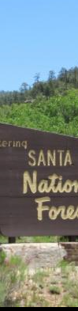
Healthy Forest Reserve Program (HFRP)
HFRP must contribute to the restoration or enhancement of the habitat or otherwise measurably increase the likelihood of recovery for a selected species listed under section 4 of the ESA, or a candidate for such listing, or a selected State-listed species, or is a species identified by the Chief for special consideration for funding.
To receive HFRP funding New Mexico NRCS would need to submit a proposal to the national office identifying the species, target areas, demonstrated interest and proven restoration techniques.
Up to 50% of restoration cost for 10-year restoration contracts
Up to 75% for 30-year easement or 30-year contract
Up to 100% for permanent easements

Slide 5
Agricultural Conservation Easement Program (ACEP)
Agricultural Land Easements (ACEP-ALE)
Combines the purposes and functions of FRPP and GRP. Now has special category for grasslands of special significance.
Wetland Reserve Easements (ACEP-WRE)
Same purposes and functions as WRP
NRCS purchases easements directly from private and Tribal landowners through a reserved interest deed in eligible land to restore, protect, and enhance wetlands and associated lands.
Eligible Entity holds the easement
US holds the easement
US obtains a 3rd party right of enforcement
Eligible Entity responsible for monitoring, management, and enforcement
NRCS responsible for monitoring, management, and enforcement
NRCS provides funds to eligible entities for the purchase of agricultural land easements.

Slide 6
Changes in policy
528.11 - OTHER AGENCY INVOLVEMENT
USFWS (528.11 D)
  Provide recommendations and input on:
    Ranking priorities and considerations
    Development of State-specific Wetland Restoration Criteria and Guidelines (WRCG) document
  No longer requires USFWS concurrence in land eligibility determinations

Slide 7

ACEP-ALE – Eligible Entity Contribution Requirements
NRCS provides up to 50% of easement FMV for non-GSS and up to 75% of easement FMV for GSS
The non-Federal share may be comprised of:
  Eligible entity’s cash contribution toward easement payment to landowner
    No longer a minimum required amount
  Landowner’s donation or charitable contribution reducing easement price
  Procured costs paid by eligible entity for certain easement acquisition-related expenses, or
  Eligible entity’s costs for monitoring and stewardship (up to 2% of FMV of the easement)

Slide 8
528.12 – ROLE OF STATE TECHNICAL COMMITTEE
State Technical Committee
  ACEP-ALE and WRE: Input on ranking factors
  ACEP-ALE: Input on considering non-grasslands as grasslands of special significance
  ACEP-WRE: (new) wetland restoration criteria and guidelines (WRCG) document
  ACEP- WRE: grazing rights option
  ACEP- WRE: Evaluating unique wetland complexes within the State to determine if they are consistent with ACEP-WRE national eligibility criteria. Examples of unique wetland complexes include but are not limited to pocosins, prairie potholes, playas, vernal pools, fens, bogs, or ridge, and swale floodplain complexes.
Can be discussed in subcommittees and brought to the main committee for review.

Slide 9
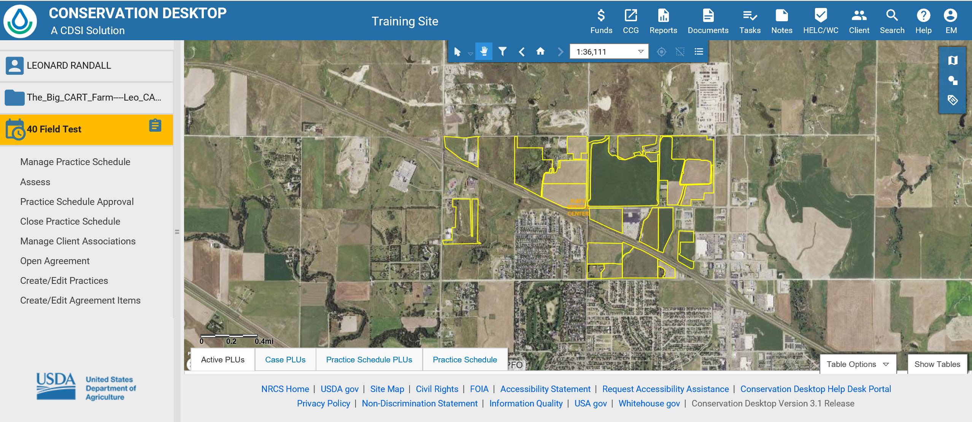
Conservation Desktop
Create Schedule
Identify or create case
Create practice schedule
Add PLUs
keep the PLUs matching the FSA CLU boundaries as closely as possible.

Slide 10
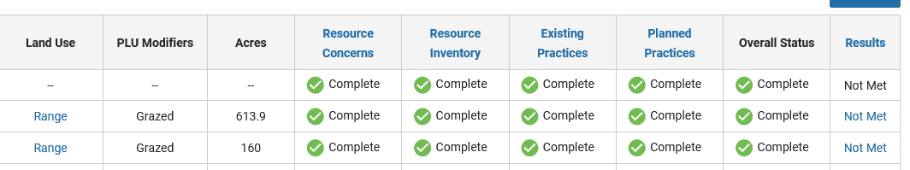
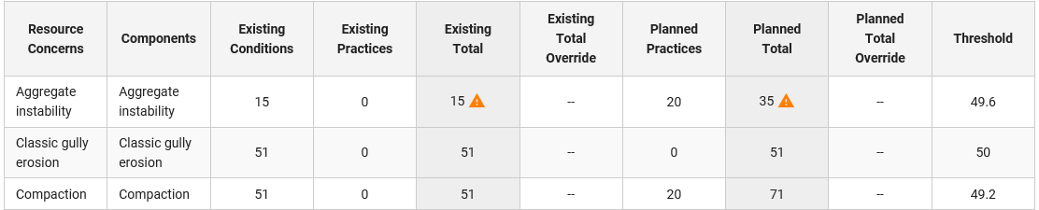
Conservation Assessment and Ranking Tool (CART)

Slide 11
ACEP – Establishing Threshold Scores- streamlining
State Conservationists, with advice from State Tech Committee, may establish high threshold ranking score for ALE or WRE at a level high enough that an eligible application ranking above such threshold score would automatically warrant selection for funding
  Example, an eligible application scoring >95% of the available ranking points may be selected for funding at any time.
State Conservationists should establish low thresholds ranking scores below which applications will not be funded
  Return funds to NHQ for reallocation to other States rather than fund low-ranking applications that do not effectively meet ACEP purposes

Slide 12
National Criteria in ALE ranking pools
Percent of prime, unique, important farmland soils.
Percent of non-developed land in the parcel.
Ratio of parcel to average county farm size.
Decrease in farm and ranch acres in county.
Decrease in rangeland, pasture and permanent grassland acres in county.
Population growth since 2010 Census.
Population density.
Presence of farm or ranch succession plan.
Distance from other protected land.
Distance from other agricultural land and infrastructure.
Land is enrolled in CRP.
Percent of entity cash contribution.
Grassland of special significance.

Slide 13
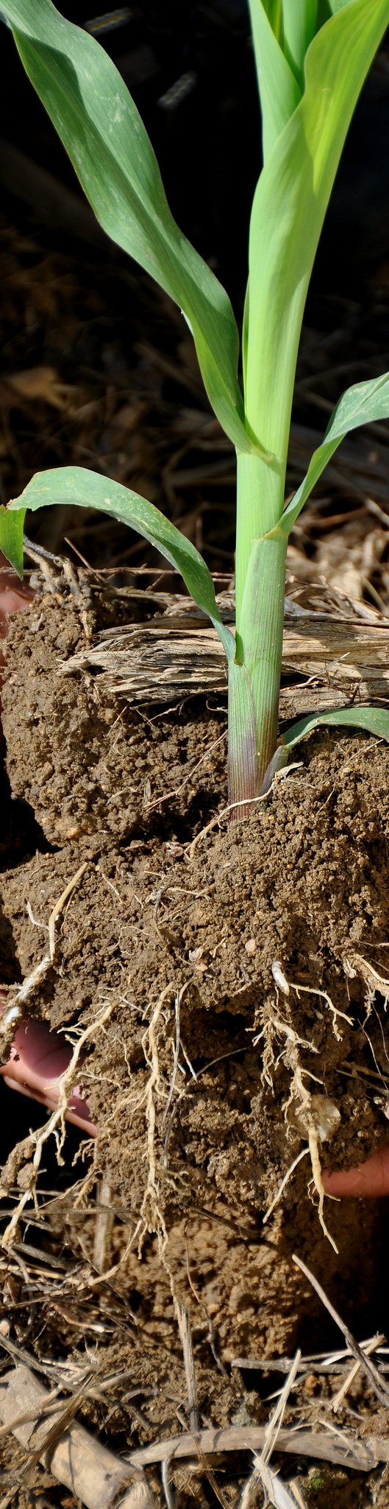
State Criteria- ALE “regular”
Landowners are historically underserved, limited resource landowner, new, veteran or beginning farmer/rancher.
Parcel contains riparian or perennial streams.
Parcel is in Rio Grande floodplain and within one mile of riparian habitat designated as WLFW for southwestern willow flycatcher.
Located in proximity to Rio Grande River, Pecos River, Gila River or San Juan River.
Contains surface water rights for irrigation.
Located in an urbanized area or urban cluster.
Located in Valencia county.

Slide 14
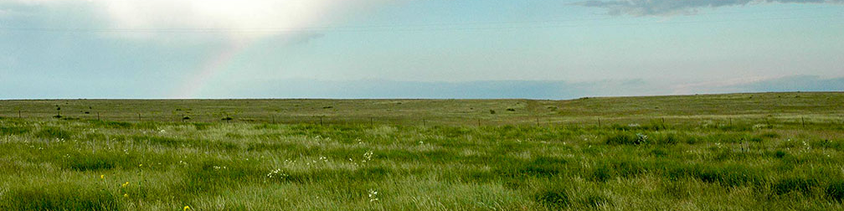
State Criteria- ALE Grasslands of special significance
Landowners are historically underserved, limited resource landowner, new, veteran or beginning farmer/rancher.
Parcel contains riparian or perennial streams.
Parcel is in close proximity to the Rio Grande, Pecos, Gila or San Juan river.

Slide 15
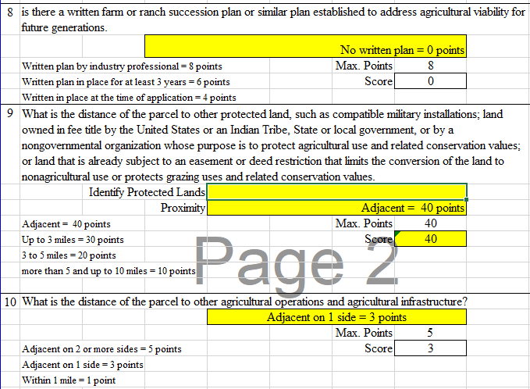
ALE- criteria in Excel

Slide 16

ACEP-WRE Ranking Criteria
Ecological Considerations: benefits to species, reduction in flooding, percent of area returned to native vegetation
Hydrology Restoration: percent of area with hydrology restored, availability of water for restoration
Economic Considerations: cost of restoration, cost of maintenance, contributions from partners, landowner share
Priority Geographic Regions.—The State conservationist, with advice from the STC, may give priority to certain geographic regions of the State where restoration of wetlands may better achieve State and regional objectives. Additionally, an easement offer in a priority geographic region may be accepted before other individual easement offers that rank higher but are outside the priority region. This policy provides an opportunity for the State conservationist, with advice from the STC, to begin an ACEP-WRE initiative in an area that has been determined important for ACEP-WRE involvement.

Slide 17
WRE- Geographic area rate cap (GARC)
Current GARC is 90% of market value.
Maximum easement payment is currently $5,000/acre. Exceptions can be granted.
Payment is the lower of GARC, $5,000 cap, or amount the landowner will accept.
With grazing rights option the payment is 75% of market value- a wildlife species must benefit from grazing.
Does State technical committee want to change the GARC for FY2021?

Slide 18
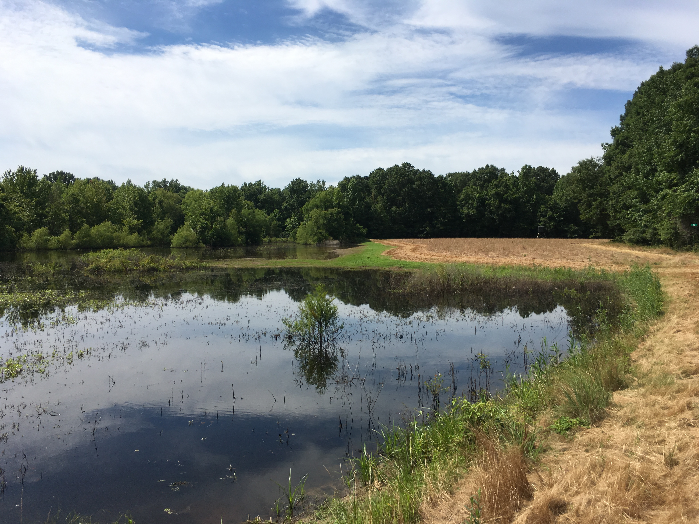
ACEP-WRE - Restoration
State-specific Criteria and Guidelines for wetland restoration (WRCG) (528.130 B)
Documents technical considerations, rationale, and parameters used in implementation of ACEP-WRE activities
    Land eligibility determinations
    Priorities
    Evaluation and Ranking
    Planning and Implementation
    Restoration and Enhancement
    Management and CUAs

Slide 19
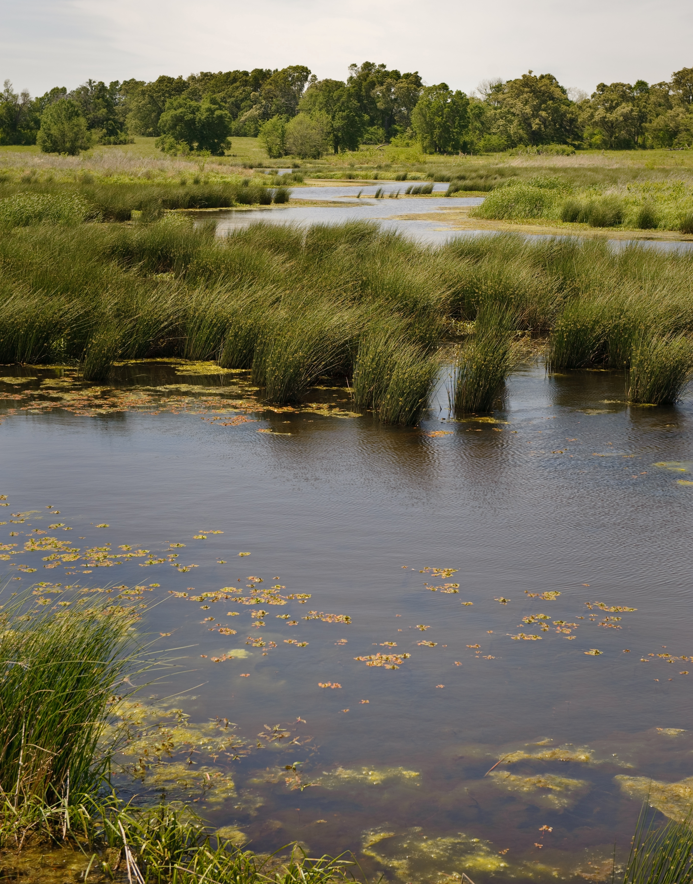
Input on adjacent land
Adjacent Lands (528.105 I)
The State conservationist, with input from the State technical committee and FWS, must include in the wetland restoration criteria and guidelines (WRCG) the State-specific technical considerations and parameters used to make determinations about the inclusion of adjacent lands
State Conservationist can only allow a maximum of 5:1 (adjacent to eligible)

Slide 20
Special Enrollment Options
Grazing Reserved Rights
Grazing must be necessary for restoration and management and consistent with long-term wetland goals- can be species specific, eg. Pecos sunflower.
States offering this option must document geographic areas, wetland types, role of grazing, and other criteria
  Recommend documenting in WRCG

Slide 21
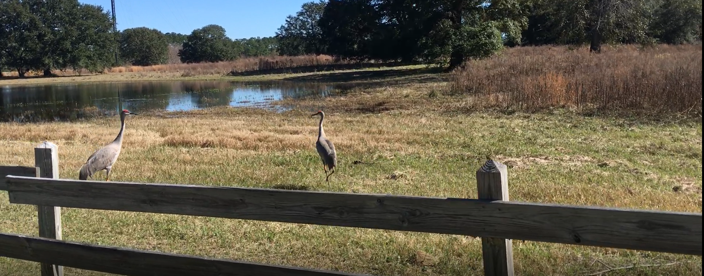
Special Enrollment Options
Grazing Reserved Rights
“Grazing management plan” for ACEP-WRE:
  Site-specific plan developed as a component of the WRPO for grazing reserved rights easements
  Provides for grazing that accomplishes the wetland functions and values of the ACEP-WRE
  Must be reviewed every 5 years and updated as needed

Slide 22

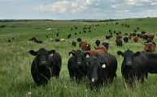
Conservation Stewardship Program

Slide 23
CSP Highlights
Public land can be enrolled. NRCS plans to work with participants to develop a CRMP to inform Federal agencies of activities contracted on Federal land.
Requires funding for organic and transitioning to organic.
Cover crops will get no less than 125% of estimated cost.
Advanced grazing management is a new supplemental payment that is paid no less than 150% of estimated costs.
Comprehensive conservation plans receive one-time payment based on the number of resource concerns addressed and types of land uses included in the plan.
Agency must do more to promote soil health.

Slide 24

CSP Funds Management
NEW
Funding Targets and Ranking Pools
  States will receive a separate allocation for organic and transitioning to organic producers (§1470.4(b))
  States must establish separate ranking pools for
    organic and transitioning to organic producers (§1470.20(d)(2))
    CSP renewals
    Non-industrial private forest land
  Veteran Farmers and Ranchers—
    will no longer be automatically set at high priority
    will receive additional ranking points when competing in the BFR or SDFR ranking pools
Notes:
This section covers two topic areas:
Funding Targets and Ranking Pools
CSP Preparation activities
States must continue to target 5% each of available funds to BFR and SDFR. This includes establishing a separate ranking pool (and spending plan) for each category. In addition to a BFR and SDFR ranking pool, States must also establish separate ranking pools for:
Organic and transitioning to organic - NEW
CSP renewals - NEW
Agricultural land – crop, pasture, and rangeland
Non-industrial private forest land
States will receive a separate allocation for organic and transitioning to organic producers.
Veteran farmers and ranchers who compete in the BFR or SDFR ranking pools will no longer automatically receive “high” priority, but they will receive additional ranking points.

Slide 25
FY 2020 State Priority Resource Concerns
Agland | NIPF
Wind and water erosion | Concentrated erosion
Soil Quality limitations | Fire Management
Degraded Plant Condition | Degraded Plant Condition
Livestock production limitation | Livestock production limitation
Terrestrial Habitat | Terrestrial Habitat
Ranking considers the number of priority resource concerns met and addressed.
Renewal contract must meet two priority resource concerns to be eligible.

Slide 26
FY 2020 Ranking pools
Agland
Agland Beginning Farmer/Rancher
Agland Socially Disadvantaged Farmer/Rancher
Agland-Organic
Non-Industrial Private Forestland (NIPF)
NIPF Beginning Farmer/Rancher
NIPF Socially Disadvantaged Farmer/Rancher

Slide 27
Ranking points- questions in all fund accounts
What percent of the operation will have an activity scheduled with this application? a. 75% or more b. 50- 74% c. 25- 49% d. 10- 24% (or less) | a. 100 b. 75 c. 50 d. 25
Will an activity be contracted in a source water priority area? | If yes, 80 points
Does the applicant meet the NRCS definition of a veteran farmer or rancher (VFR)? For beginning farmer and socially disadvantaged fund accounts | If yes, 20 points

Slide 28
All Ranking Pools- range, crop, pasture, associated ag land and farmstead
At the time of application, how many State priority resource concerns categories are met? For Agland on the land use with the least amount of resource concerns met. For NIPF on forestland. a. At least 4 State priority resource concerns are met on the least performing land use (exclude Farmstead and Associated Ag Land) b. 2-3 State priority resource concerns are met on the least performing land use (exclude Farmstead and Associated Ag Land) c. One(1) State priority resource concerns are met on the least performing land use (exclude Farmstead and Associated Ag Land)- or zero | a. 25 b. 20 c. 15
By the end of the contract, how many State priority resource concerns will be met? For Agland on the least performing land use (excluding Farmstead and Associated Ag Land). For NIPF, on forestland. A. At least 4 State priority resource concerns will be met with conservation activities on the least performing land use (exclude Farmstead and Associated Ag Land) b. 2-3 State priority resource concerns will be met with conservation activities on the least performing land use (exclude Farmstead and Associated Ag Land) c. One (1) State priority resource concerns will be met with conservation activities on the least performing land use (exclude Farmstead and Associated Ag Land)- or zero | a. 25 b. 20 c. 15

Slide 29
Agland Pools- range, crop, pasture, associated ag land and farmstead
What is the number of years a priority activity listed below is scheduled? The answer is based on the land use with the most years scheduled. The priority activity for rangeland is Prescribed Grazing (528), cropland is Cover Crop (340), No-till (329), Reduced tillage (345); and pasture is Prescribed Grazing (528) if grazed and Forage Harvest Management (511) if not grazed. a. For 3 or more years b. For 2 years c. One year. Or zero | a. 75 b. 50 c. 25
Will habitat for wildlife, not for beneficial insects/pollinators, be improved with an activity that specifically addresses wildlife habitat (such as prescribed grazing for wildlife refuge area)? | If yes, 50 points
Will pollinator habitat be improved with an activity that establishes pollinator plants or that specifically addresses pollinator habitat (such as prescribed grazing for monarch butterflies)? | If yes, 25 points

Slide 30
NIPF Ranking Pools- forestland, associated ag land and farmstead
Will a contracted activity improve habitat for wildlife or reduce the risk of pest damage to trees? | If yes, 50 points
Will activities reduce erosion from concentrated runoff, such as diversions on dirt roads or grade stabilization structures? | If yes, 50 points
Will the threat of wildfire be reduced with a contracted activity (Fuel break, fire break, forest stand improvement, woody residue treatment, etc.)? | If yes, 50 points

Slide 31
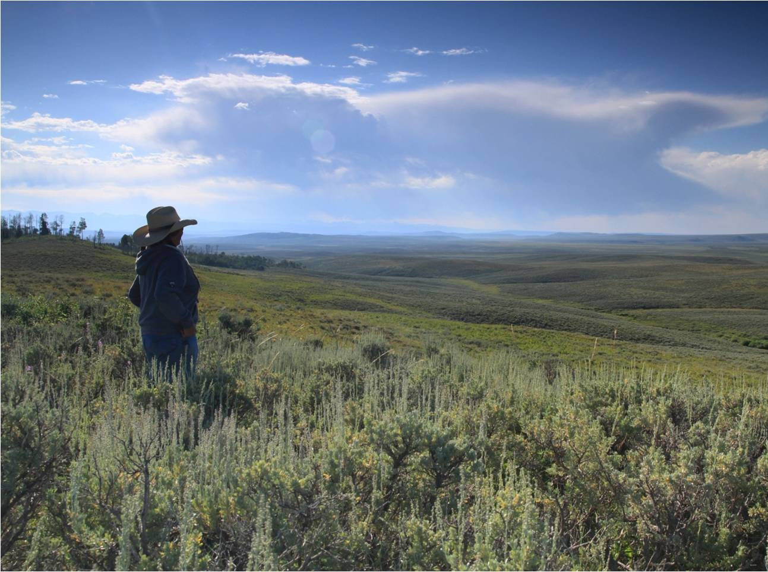

Voluntary Public Access and Habitat Incentive Program (VPA-HIP)
Notes:
Kari- overview

Slide 32
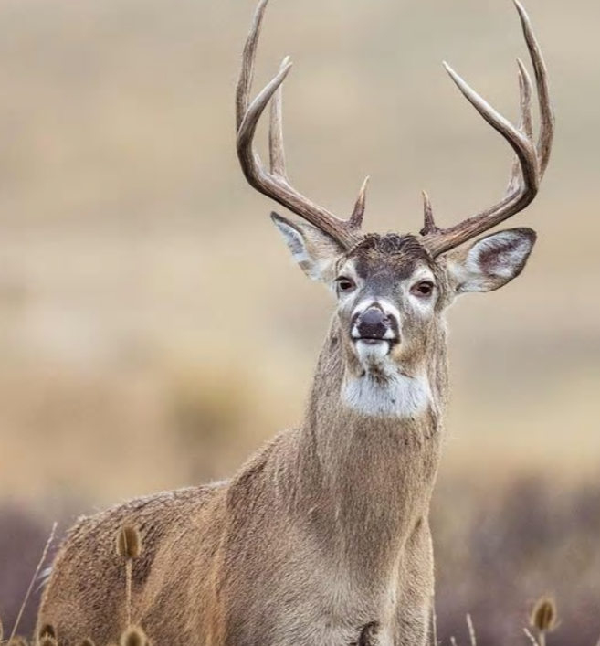
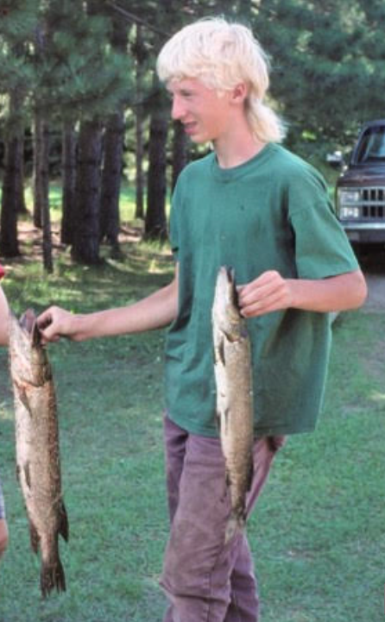
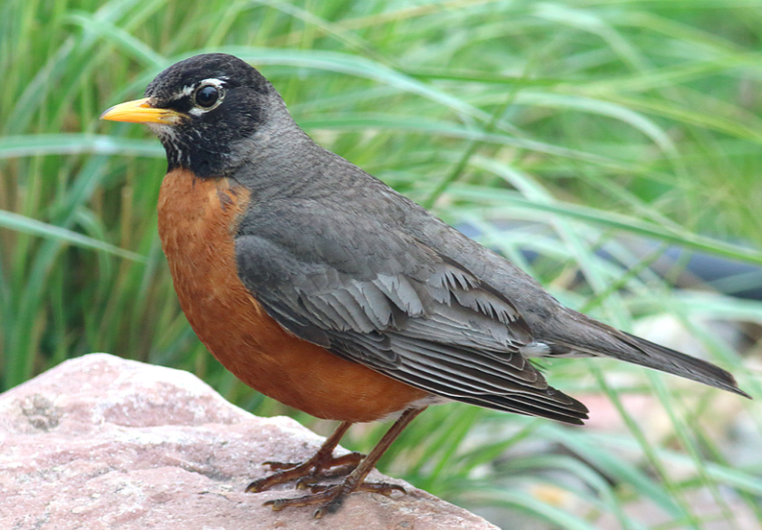
Program Purpose
VPA-HIP provides funding to State and Tribal Governments to create or enhance public access programs that encourage private landowners to make their land available for public access for wildlife-dependent recreation.

Slide 33
VPA-HIP Overview
Open to State and Tribal Governments
Only one application allowed per State or Tribal Government
Up to $50 million available
$3 million maximum award
Up to 3 year project duration
Application period closed November 27, 2019
Notes:
50 million – all at once
3 million max – 100k min
3 year duration – option for NCE

Slide 34
VPA-HIP Overview
Allowable VPA-HIP Budget Costs
Public access incentives to landowners
Public access infrastructure (e.g., kiosks, signage, gates)
Technical assistance (up to 10%)
Wildlife habitat improvement incentives (up to 25%)
Direct administrative costs (e.g., travel, supplies)
Indirect costs
Notes:
Public access –focus
TA 10% - all personnel

Slide 35
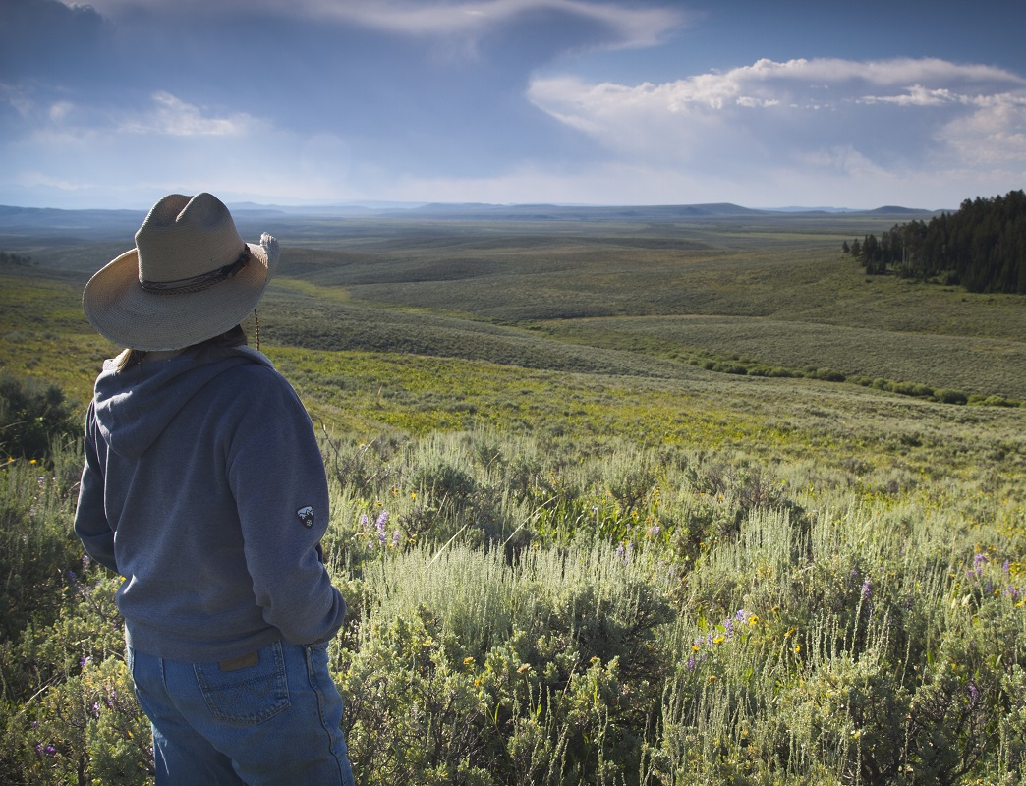

Conservation
Innovation Grants
Delivering Results for Agriculture and Conservation
Notes:
Kari Cohen
72nd Soil and Water Conservation Society conference (SWCS)
July 31, 2017, Madison, WI

Slide 36
CIG Classic
Funds the development of promising approaches and technologies—which may or may not be successful!
Funding rarely provided directly to producers
Projects often include small-scale pilots or demonstrations
National notice of funding will be posted soon at grants.gov.

Slide 38
CIG On-Farm Trials
Funds the implementation and evaluation of innovative approaches, systems and practices that we know provide a conservation benefit.
Funding must be provided directly to producers to offset implementation risk.
Partners must complete both conservation and economic evaluations.
Soil Health Demo Trial awardees must agree to use consistent assessment methods.
Application deadline is May 29, 2020.

Slide 39
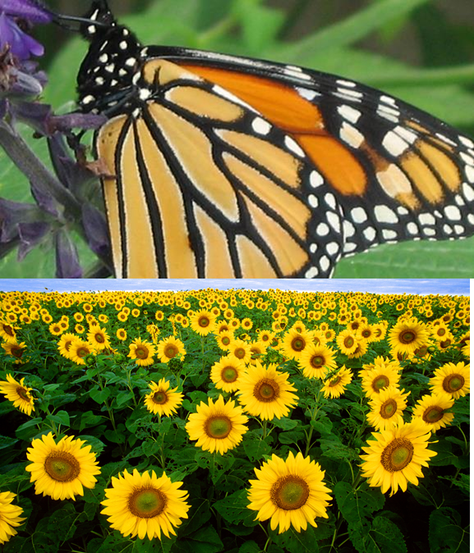
New Mexico State CIG funding
State is allocating $75,000 for FY2020.
Application deadline is May 23, 2020.
Notice of funding is found at grants.gov
Same state priorities as 2019:
Increased reliance on biodiversity to control pests.
Support the adoption of soil health management systems.
Water conservation.
Fish and wildlife habitat.

