Slide 1
State Technical Committee
FY 2020-2021 EQIP
Kenneth J. Branch
NRCS

Slide 2
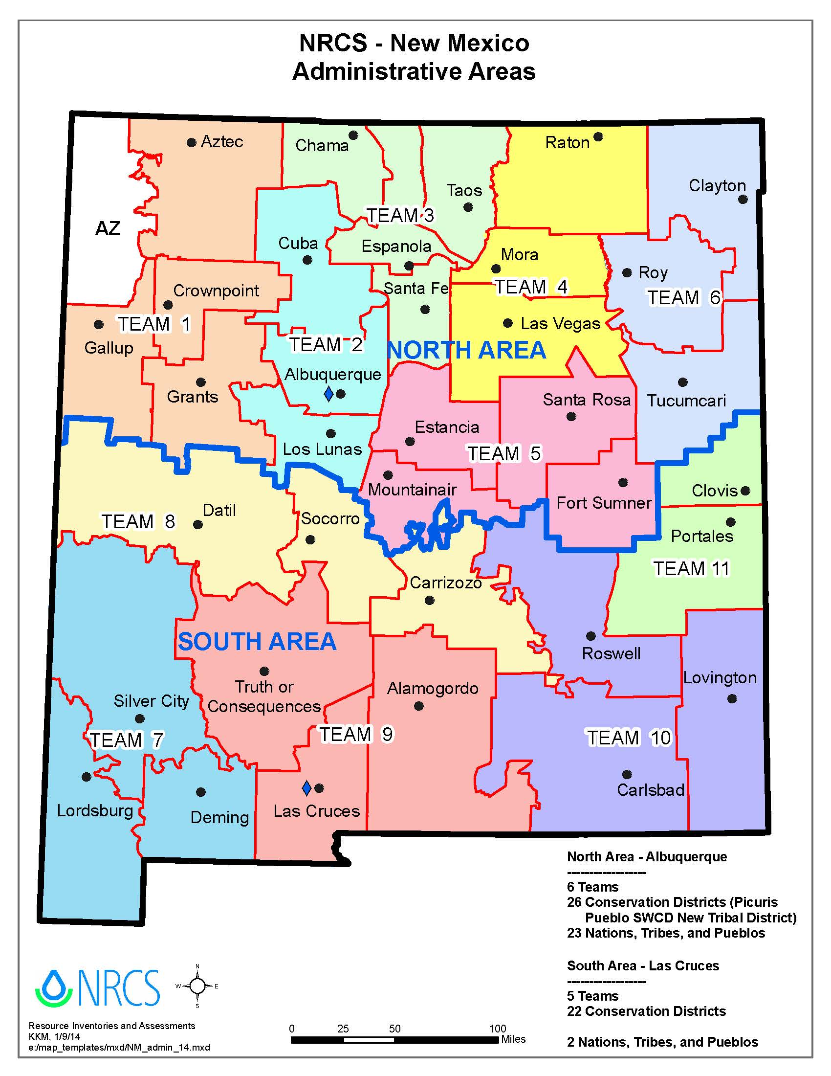

Slide 3
FY 2020 EQIP Recap
And FY 2021 Spending Plan
Provide feedback by October 30, 2020
To
Kenneth.branch@usda.gov

Slide 4
Team | Apps | Contracts
1 | 153 | 21
2 | 121 | 29
3 | 129 | 30
4 | 180 | 18
5 | 133 | 29
6 | 170 | 25
7 | 94 | 29
8 | 105 | 23
9 | 72 | 22
10 | 102 | 19
11 | 170 | 44
Total | 1429 | 289
FY 2020 EQIP Applications and Contracts
Per Team

Slide 6
FY 2020 Financial Assistance
NM Initiatives $20,703,000
Fund Code | Initial Allocation | Obligated
Organic** | $35,000 | $8,666
Organic-Trns** | $30,000 | $86,614
High Tunnel** | $100,000 | $94,112
BFR HT*,** | $100,000 | $91,771
Energy* | $10,000 | $0
CAP* | $25,000 | $9,783
Tribal | $650,000 | $677,893
BFR- North* | $300,000 | $187,963
SD- North* | $200,000 | $190,154
Strike Force** Crop, range, forest | $800,000 | $1,285,071
Fund Code | Initial Allocation | Obligated
BFR- South* | $300,000 | $612,442
SD- South* | $200,000 | $216,264
Forestry* (BFR, SD) | $0 (Funded in SF Forest) | $0 (Funded in SF Forest)
Source Water* | $2,463,133 | $2,180,406
NM Wildlife* | $1,888,133 | $1,771,983
WME | $900,000 | $823,776
CIG | $75,000 | $75,000
State AFO | $200,000 | $200,000
Local | $11,000,000 | $11,955,785
*Mandated Funding | **national Initiative funded with state funds

Slide 7
FY 2020 Financial Assistance
National Initiatives
Initiative | Allocation | Obligated
StrikeForce* (Crop, Range, Forest) | 0 | 0
WLFW LPCI | $575,000 | $534,820
NWQI** | $703,331 | $989,346
Joint Chiefs | $487,104 | $367,867
WaterSMART | $2,500,000 | $2,677,310
* Did not receive separate allocation in FY 21, funded from State Allocation
** Beginning in FY 21 the watersheds in LC will need a watershed assessment
and will not be eligible for FA until the assessment is written

Slide 8
Amended Polices
Control of Land
  Old Policy: Applicant/participant demonstrate control of land for the life of the contract at the time of enrollment
  New Policy: Verification of land control at the time of enrollment
  Applicant will need to establish control at the time of enrollment, NRCS will verify that the participant continues to maintain control during annual contract reviews and prior to approval of any Payment
Dependent Practices
  Pay when practice meet standards and specs regardless of whether the participant has fully implemented the entire system.
Payments when a Participant has Died
  Must verify personal representative (PR)
  According to OGC: NM State Law (NMSA 1978, § 45-3-103) states PR must be appointed by a court and issued form 4B-303 or 4B-902

Slide 9
Agriculture Improvement Act of 2018
Implemented in FY 19
Organic Payments
  May not exceed $140,000 during 2019-2023
  Removed $20,000 annual payment limit
New Veteran Farmer/Rancher Definition
  Veteran that was discharged under conditions other than dishonorable AND
  has not operated a farm or ranch/has operated a farm or ranch for not more than 10 years” (Meet BFR) OR
  who first obtained status as a veteran “during the most recent 10-year period” (FY 20: Discharge between 10/1/2009-09/30/2020)
Requires Notification of Advance Payment Eligibility
  Eligible producers must be asked by NRCS if they wish to receive AP

Slide 10
EQIP 2021
Please provide feedback by October 30, 2020
To
Kenneth.branch@usda.gov

Slide 11
High Priority Practices
The 2018 Farm Bill and the EQIP interim rule (published December 17, 2019) authorized increased payment for up to 10 high priority practices
A high priority practice must meet one of the following criteria:
  Addresses specific causes of impairment relating to excessive nutrients in ground or surface water;
  Addresses the conservation of water, to advance drought mitigation and declining aquifers;
  Meets other environmental priorities and other priority resource concerns identified in habitat or other area restoration plans; or
  Is geographically targeted to address a natural resource concern in a specific watershed.

Slide 12
High Priority Conservation Practices
High Priority Practices in EQIP FY2020
1. Cover Crop- Multispecies Scenario only- 340
2. Diversion-All Scenarios-362
3. Grade Stabilization-All Scenarios-410
4. Residue and Tillage Management, No Till- All Scenarios-329
5. Residue and Tillage Management, Reduced or Mulch Till-All Scenarios- 345
6 .Structures for Wildlife-All Scenarios-649
7. Upland Wildlife Habitat Management-All Scenarios-645
8. Wildlife Habitat Planting-All Scenarios-420
Consider adding Range Planting (550) as NM received variance for a 10-year lifespan

Slide 13
State Priority Resource Concerns
Conservation Assessment and Ranking Tool (CART)
  Identify Resource Concerns For Each Fund Code/Land use
  Requires Weighted Percentages for Resource Concerns
    FY 20 Same Weighted % for RC in State and National Initiatives
    FY 21- Recommendations to be discussed during the CD/CART presentation

Slide 14
EQIP 2021
Water- 50%
  Inefficient Irrigation Water Use
  Nutrients Transported to Surface Water*
  Nutrients Transported to Ground Water*
Soils- 50%
  Organic Matter Depletion
*Prior Resource Concern was Excess Nutrients in Surface and Groundwater
Cropland
Priority
Resource Concerns

Slide 15
EQIP 2021
Water- 33.3%
  Nutrients Transported to Surface Water*
  Nutrients Transported to Ground Water*
  Sediment transported to Surface Water
  Pesticides transported to ground water
  Ponding and Flooding
Soils- 33.3%
  Sheet and Rill
  Wind
Air- 33.3%
  Emissions of particulate matter (PM) and PM precursors
*Prior Resource Concern name was Excess Nutrients in Surface and Groundwater
AFO
Priority
Resource Concerns

Slide 16
EQIP 2021
Water- 33.3%
  Inefficient Irrigation Water Use
Plants- 33.3%
  Plant Productivity and Health
  Plant Structure and Composition
Soils- 33.3%
  Organic Matter Depletion
  Wind Erosion
*Prior Resource Concern was Excess Nutrients in Surface and Groundwater
Pasture
Priority
Resource Concerns

Slide 17
EQIP 2021
Plants- 25%
  Plant Productivity and Health
  Plant Structure and Composition
  Plant Pest Pressure
Animals- 25%
  Feed and Forage Imbalance
  Inadequate Livestock water quantity, quality and distribution
  Terrestrial habitat for wildlife and invertebrates*
Soils -25%
  Classic Gully Erosion
  Sheet and Rill Erosion
Energy- 25%
  Energy Efficiency of Equipment and Facilities
*Prior Resource Concern was Fish and Wildlife Inadequate Habitat
Rangeland
Priority
Resource Concerns

Slide 18
EQIP 2021
Plants- 25%
  Plant Productivity and Health
  Plant Structure and Composition
  Wildfire Hazard from Biomass Accumulation
Animals- 25%
  Inadequate Livestock water quantity, quality and distribution
  Terrestrial habitat for wildlife and invertebrates*
  Feed and Forage Imbalance
Soils- 25%
  Classic Gully Erosion
  Sheet and Rill Erosion
*Prior Resource Concern was Fish and Wildlife Inadequate Habitat
Forest
Priority
Resource Concerns

Slide 19
Water Management Entities
Water Conservation or Irrigation Efficiency
Authorizes direct EQIP program assistance to irrigation districts, acequias, land grants and other entities, for purposes of water conservation or irrigation efficiency
States did not/will not receive additional funds for this assistance

Slide 20
Water Management Entities
FY 2021 Fund Codes
  Acequias
  Irrigation Districts
  Drought Mitigation (Range and Forest)
FY 2020 Funds- $900K
  Acequia- 5 contracts
  Irrigation Districts- 2 contracts
  Drought Mitigation- 1 contract (funded all)

Slide 21
WaterSMART Initiative
Initiative with BOR where:
  BOR works with water and irrigation districts to improve operations of water delivery systems
  NRCS then works with producers within the delivery system area (who holds the BOR grant) to increase on-farm efficiencies and introduce conservation practices
General Criteria
  Participants and Land must meet normal EQIP Eligibility Criteria
  Participants receive irrigation water from Bureau of Reclamation source
  Irrigation water provider has an approved Bureau of Reclamation WaterSMART project for water conservation
FY 20 NM $2.5 Million Initial Allocation
  9 Areas in FY20
    3 Areas in 2016
    6 Areas in 2017
    8 Areas in 2018 and 2019
FY 21 Funding Changes
  Submit proposals to NHQ
  Funding is not guaranteed
  Only fund the areas approved
9 Proposals Submitted in NM
Review Team Recommend Funding Order
Carlsbad Irrigation District (CID)
NAPI
Arch Hurley Conservancy District
Guadalupe SWCD
Elephant Butte Irrigation District (EBID)
Animas Watershed
Middle Rio Grande Irrigation District (MRGCD)
Bloomfield Irrigation District
Fort Sumner Irrigation District
All funding is based on availability of funds

Slide 22
Source Water Protection
Purpose:
  Source Water Protection language in 2018 FB
  Encourage protection of drinking water sources through conservation programs
  Sources can be ground or surface water
  Address Water Quality and Quantity
  Dedicate at least 10 Percent of total funds available
General Criteria
  Participants and Land must meet normal EQIP Eligibility Criteria
  Land is located in a Source Water Protection Area (SWPA)
  Plan practices to address Water Quality/Quantity
Initial Task
  Identify SWPA’s with source water protection assessments where AG is identified as protentional source of degradation
  Select SWPA where 10% of funding can benefit source water protection (HUC 12 level)
  Local Support (Stakeholders, partners, producers)
  Identify priority practices
Priority Areas
Cannon AFB Curry
Town of Midway Curry\Roosevelt
120500020111 Curry
City of Clovis Curry
120500020110 Curry\Roosevelt
Blackwater Draw Curry\Roosevelt
Town of Ranchvale Curry
Pleasure Lake Curry
Cimarroncito Creek Colfax
Cimarroncito Creek Colfax
Burro Creek Harding\San Miguel
equesquite Creek Harding
Mule Creek Harding\San Miguel
Ladd Lake Harding
Black Lake Harding
Las Cuevas Canyon Harding
Smith Canyon McKinley
Upper Mitchell Draw McKinley
Shingle Canyon Grant

Slide 23
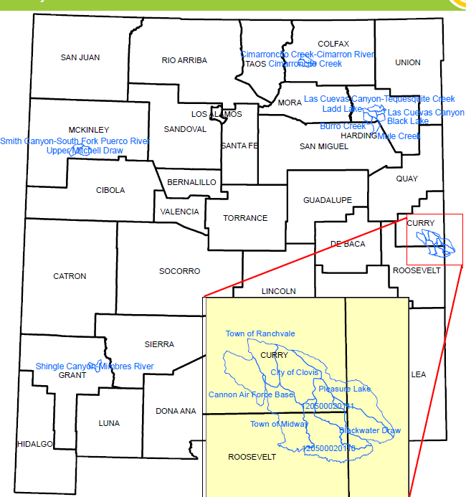

Slide 24
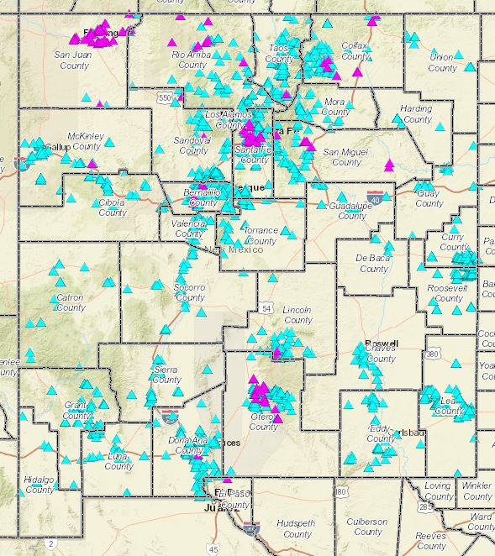

Slide 25
Source Water Protection
Source Water Protection Priority Practices
  All Practice that address Water Quality and Quantity are eligible
  Priority Practices paid at a higher payment rate
  Irrigation Water Management-449
  Residue and Tillage Management, No Till/Strip Till-329
  Riparian Forest Buffer-391
  Grade Stabilization-410
  Diversion-362
  Prescribed Grazing-528
  Cover Crop-340
  Filter Strips-393
  Field Border-386
  Forage Harvest Management-511
  Nutrient Management-590
  Pest Management Systems-595
  Hedgerow Planting-422
  Stream Habitat Improvement and Management-395

Slide 26
EQIP Incentive
EQIP Incentive Contract:
  Provide incentive practice payments for adopting practices
  Annual payments for managing, maintaining, and improving the incentive practices
  5-10 Year contracts
Details are being workout but implementation to begin FY 21

Slide 27
EQIP Incentive
State Determines:
  High Priority Areas that encompass every region of the state
  Up to three priority resource concerns for each land use within a given priority area
    Participants must address at least one priority resource concern
  Incentive practices that will be available for payment
    Discussed the practices that will have the highest Conservation Practice Physical Effect (CPPE) value

Slide 28
EQIP Incentive
High Priority Areas: Previous Watersheds Identified by LWG
  Team 1- Zuni Mtns or Cebollita Mesa
  Team 2- TBA
  Team 3- Upper Chama
  Team 4- TBA
  Team 5- Arroyo de Anil Yeso Creek
  Team 6- Union County Irrigated Crop
  Team 7- San Francisco
  Team 8- Lower Rio Grande/Central Jornada
  Team 9- TBA
  Team 10- LPC Habitat Improvement
  Team 11- Tierra Blanca/Running Water/Taiban

Slide 29
EQIP Incentive
Priority Resource Concerns:
  Crop
    Insufficient Use of Irrigation Water- Source Water Depletion
    Organic Matter Depletion- Soil Quality Limitations
    Wind Erosion-Wind and Water Erosion
  Range
    Inadequate Livestock Water quantity, quality and distribution- Livestock production limitation
    Plant Structure and Composition- Degraded Plant Condition
    Classic Gully Erosion-Concentrated Erosion
  Forest
    Wildlife hazard from biomass accumulation- Fire Management
    Plant Structure and Composition- Degraded plant condition
    Terrestrial Habitat for wildlife and invertebrates- Terrestrial habitat
  Pasture
    Compaction- Soil Quality Limitations
    Inefficient irrigation water use-Source Water Depletion
    Plant Structure and Composition- Degraded plant condition

Slide 30
EQIP Disaster
Designed for EQIP Funds to assist with disaster events
Recommend that States reserve a portion of allocations
  1:1 Match Request (NHQ to State)
Practices that provide immediate assistance to address natural resources impacted by the disaster event
Practices that will be installed and payment made in a short time frame
  6 to 9 Months Implementation
  Management practices should be carefully considered, most do not address an immediate disaster relief. These practices can be included

Slide 31
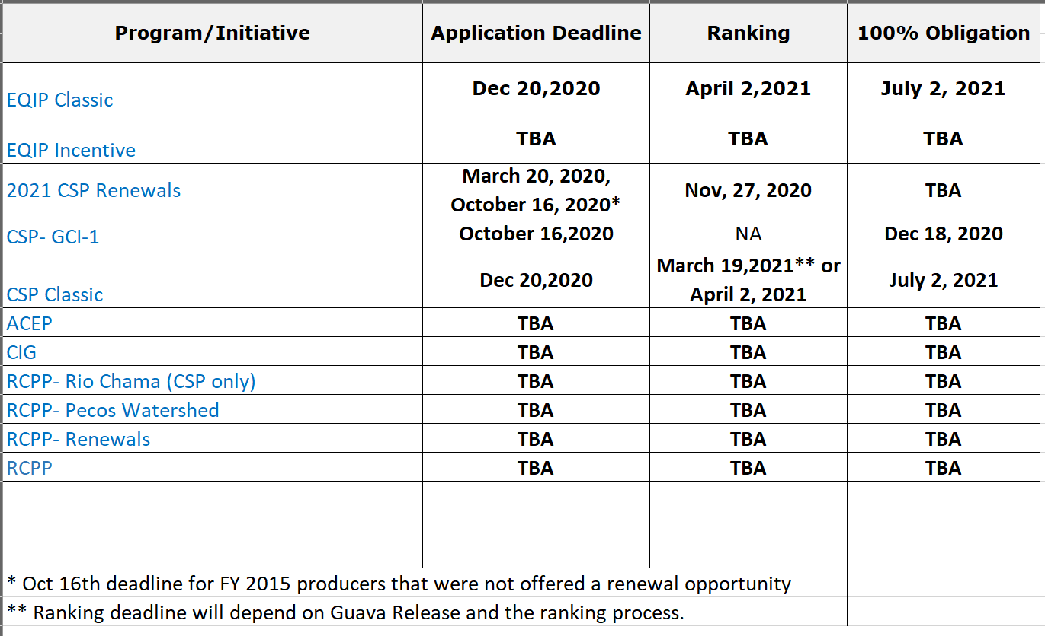
Proposed Deadlines

Slide 32
Questions?
Please Provide Feedback by October 30,2020
Email to Kenneth.branch@usda.gov

